Slide 1
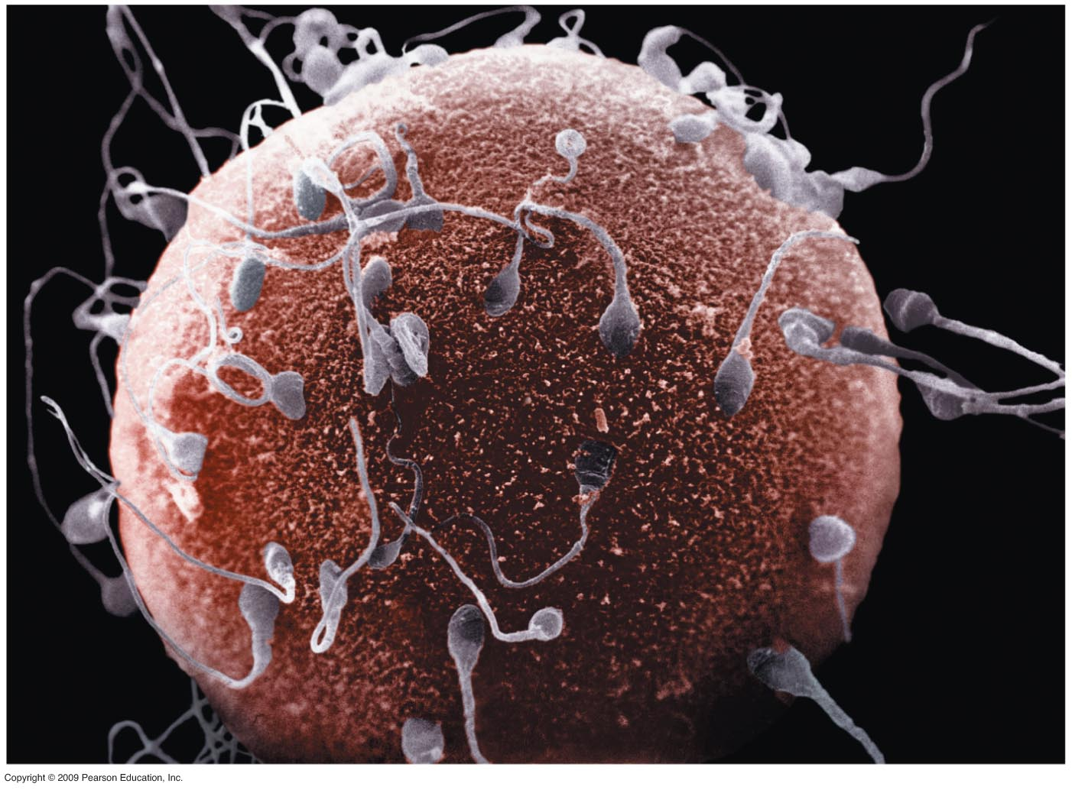
Fertilization
Fertilization – Union of 2 parent cells.
Sperm and egg cells called gametes.
Product of egg ₊ sperm = fertilized egg = zygote.
Embryo = early stages of an organism’s development; from first cell division to end of 8th gestational week,
Fetus = Starts with 9th gestational week to birth of baby.

Slide 2
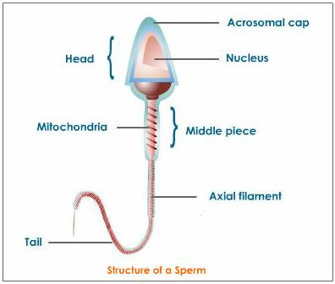
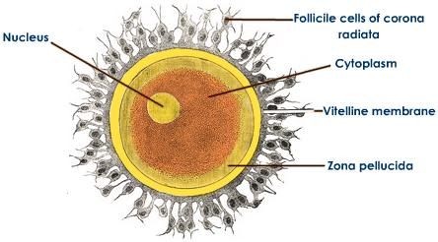
Gametes
Sperm – small cell with flagellum; nucleus & mitochondria; ½ chromosomes.
Ovum – larger cell; cytoplasm contains yolk (lipids &proteins); many ribosomes, mitochondria; ½ chromosomes.

Slide 3
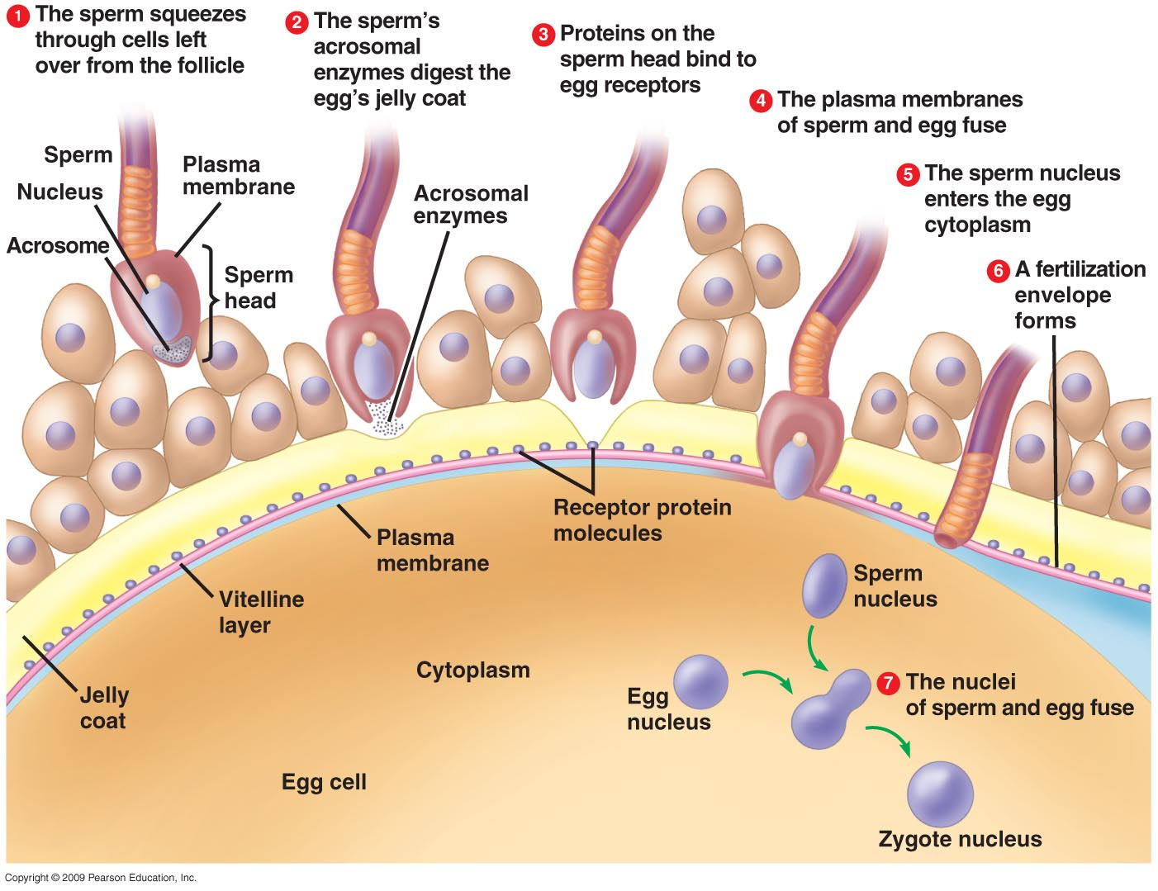
Fertilization-Activation
Fertilization – Union of two cells.
Sperm passes through follicular cells.
Sperm passes through jelly coat of ova by releasing acrosomal enzymes.
Proteins on sperm bind to ova receptor proteins; ensures single species fertilization.
Sperm/egg plasma membrane fuse; membrane now impenetrable by other sperm.
Sperm nucleus enters cytoplasm.

Slide 4
Fertilization/Activation
Fertilization envelope forms; space between outer membrane and veteline layer fills with water; further ensures no fertilization by other sperm.
Nuclei fusion activates metabolic activity; cell respiration, new proteins etc.
Sperm and egg nuclei fuse into zygotes.
http://bcs.whfreeman.com/thelifewire/content/chp43/4301s.swf

Slide 5
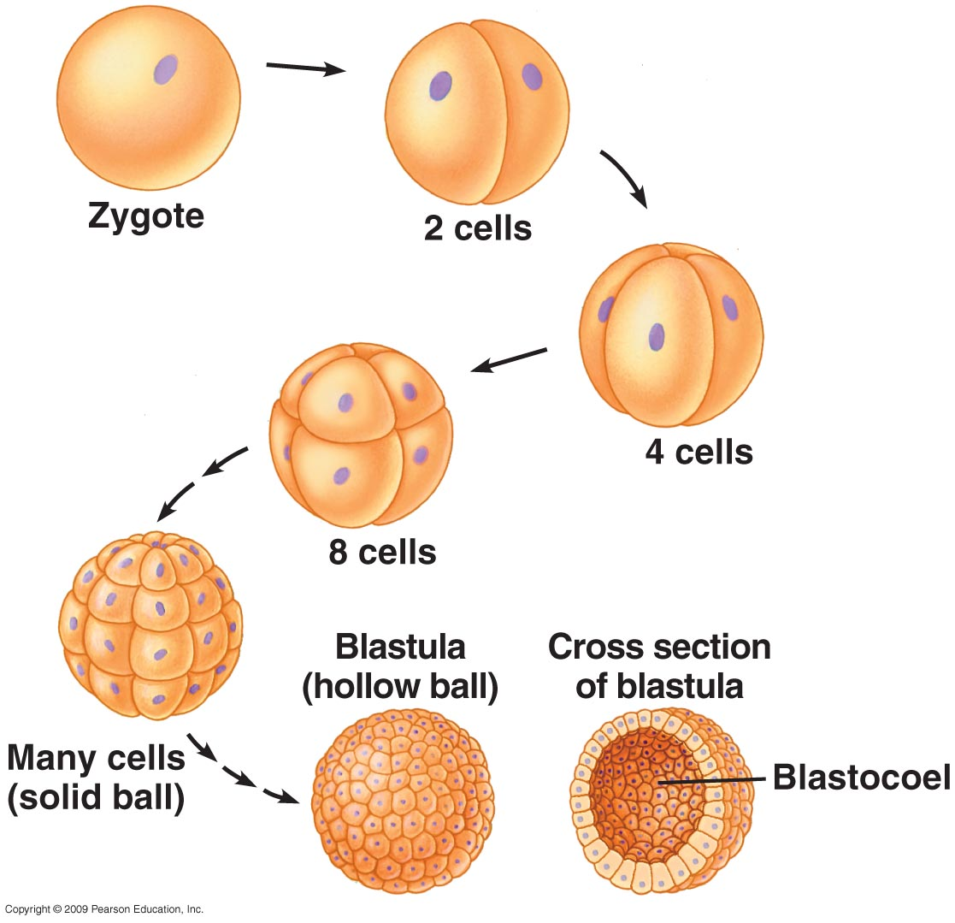
Cleavage – Cell Growth
Rapid succession of cell divisions.
Produces multicellular ball of cells from zygote.
Mitosis produces may small cells; many nuclei; cytoplasm partitioned; size of embryo does not change much.
Multicellular ball = blastula.
Cleavage partitions cells into developmental regions.

Slide 6
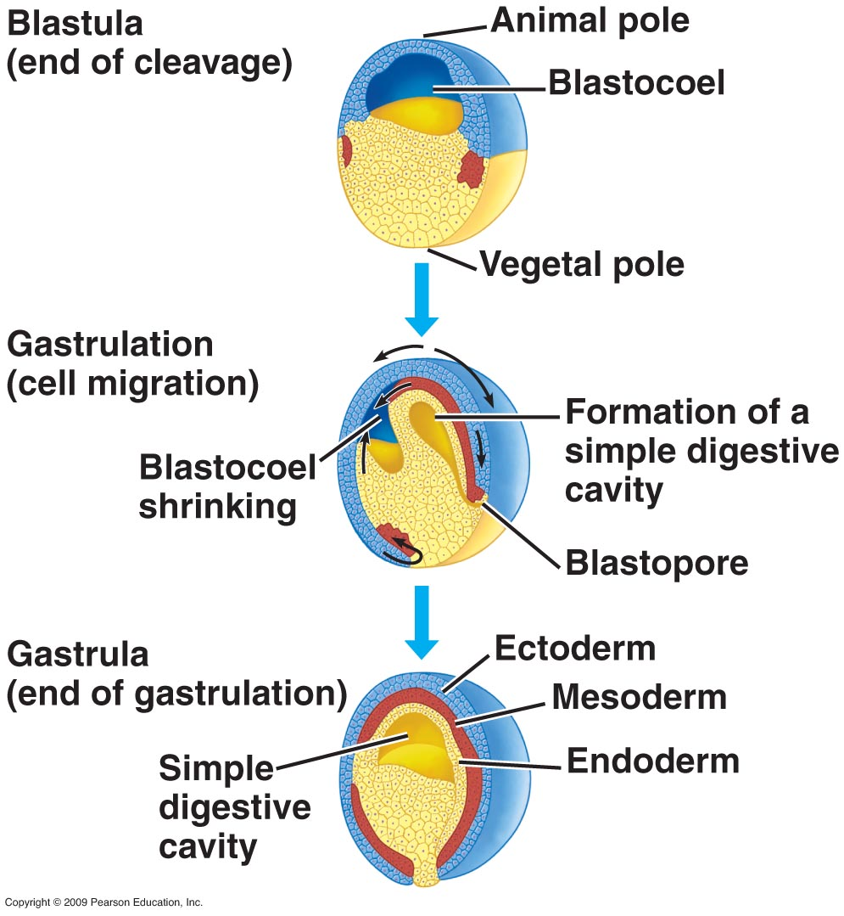
Gastrulation - Differentiation
Cells take up new locations that later allow for formation of organs& tissues.
Cells migrate and form 3 layers.
1. Ectoderm
2. Endoderm
3. Mesoderm
Gastrulation beginning of differentiation ( cells become different from each other); ends when 3 tissue layers are formed.
http://bcs.whfreeman.com/thelifewire/content/chp20/2002001.html

Slide 7
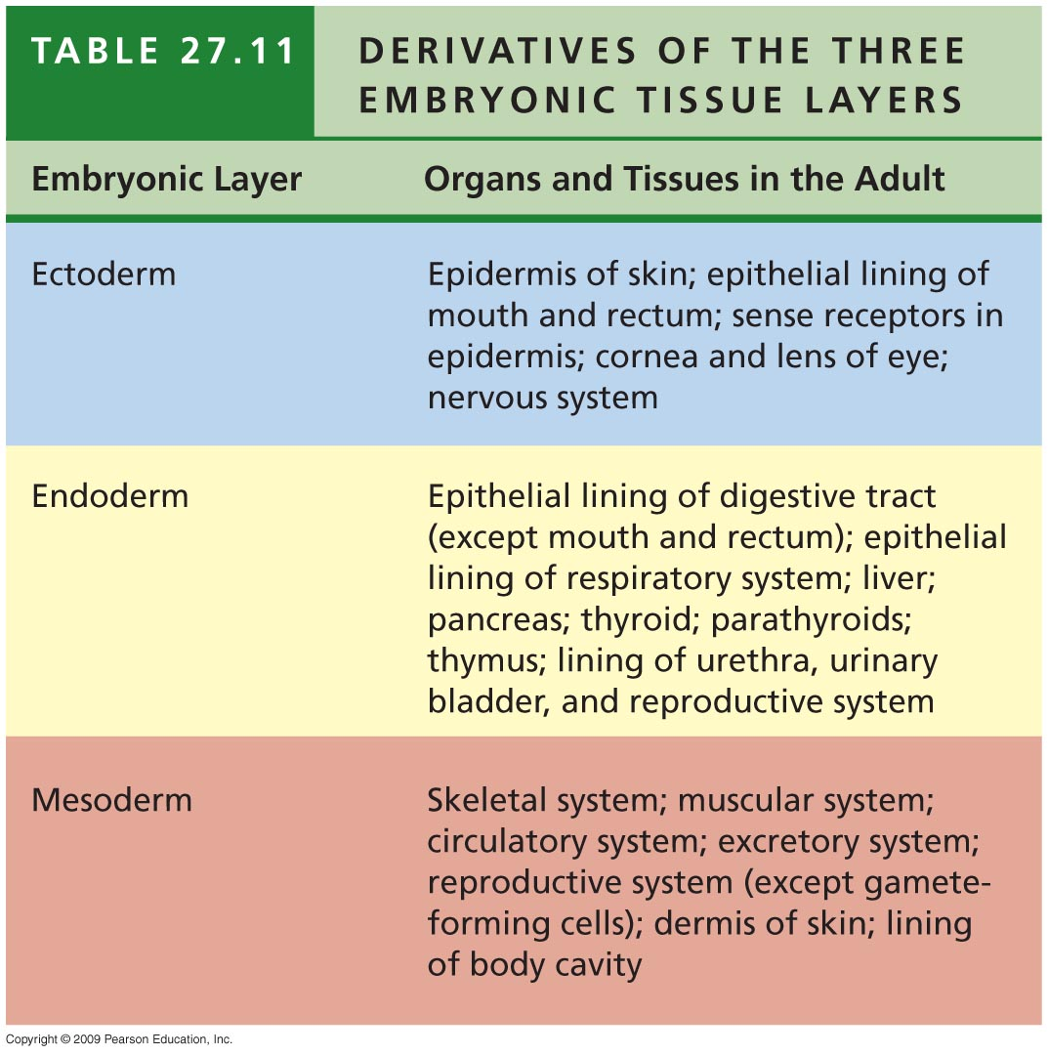
Embryonic tissue layers

Slide 8
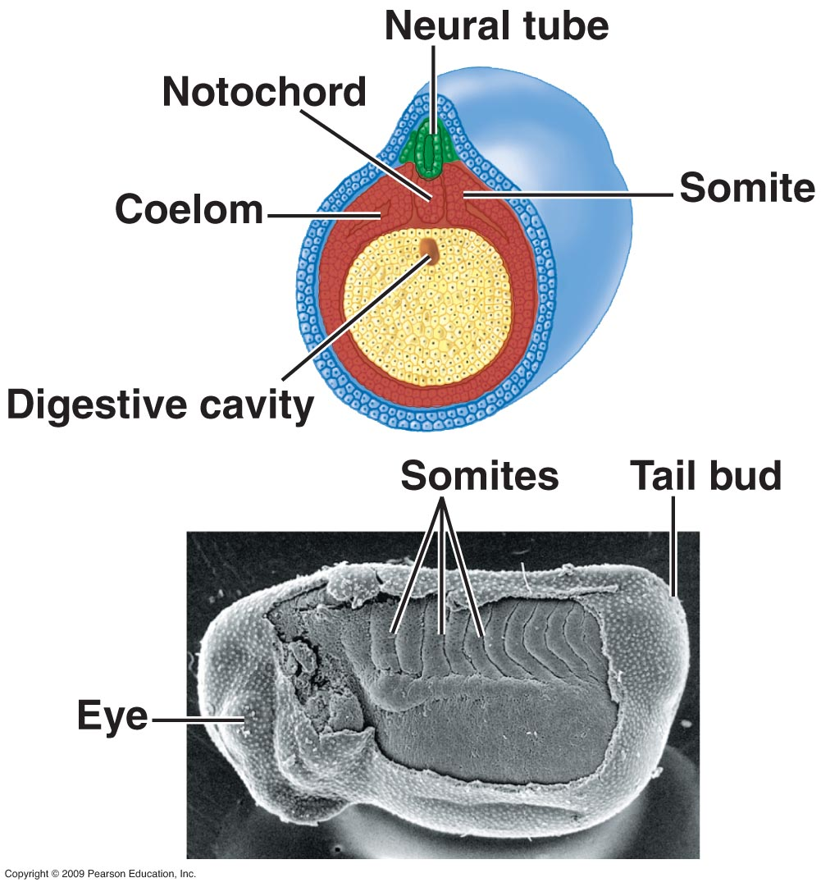
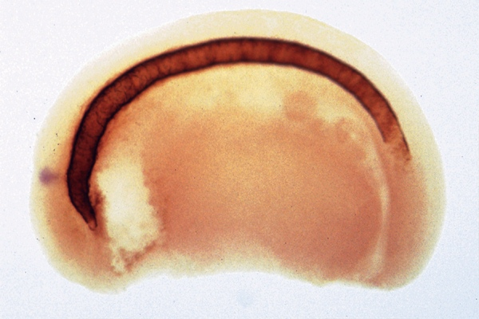
Organs form after gastrulation- Morphogenesis
Morphogenesis- formation tissues/organs.
Two structures appear soon after gastrulation.
1. Notochord - Arises from mesoderm; establishes anterior/posterior axis (body plan); later becomes backbone.
Frog Notochord
2. Neural Tube- Arises from ectoderm; becomes brain, spinal cord and nerves.

Slide 9
Review- form teams of 4
1. What is fertilization
2. Describe how a sperm is specialized for its function.
3. What occurs to assure an egg can be fertilized by one sperm.
4. What is a gamete
5. Describe how an ovum is specialized for its function.
6. Describe why fertilization occurs within a single species.
7. What is a fertilized egg called.
8. Rapid succession of cell divisions in an embryo is called what.
9. What stage of embryo development is the beginning of differentiation.
10. What is the multicellular ball that is formed during cleavage called?
11. What type of cell reproduction forms the blastula?
12. What is an embryo
13. What are the 3 tissue layers formed during gastrulation.
14. Define differentiation.
15. Which tissue layer forms the skin – ectoderm
16. Which tissue layer forms the circulatory system – mesoderm
17. What is a fetus
18. Define morphogenesis
19. Into what structure does a notochord develop?
20. Into what structues do the neural tube develop?
21. Which tissue layer forms the reproductive system - endoderm

Slide 10
Checkpoint
Discuss the definitions of fertilization, cell growth (cleavage), differentiation (gastrulation), and morphogenesis.
How are these activities related and can they occur independently?

Slide 11
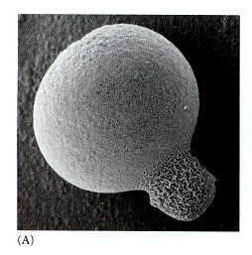
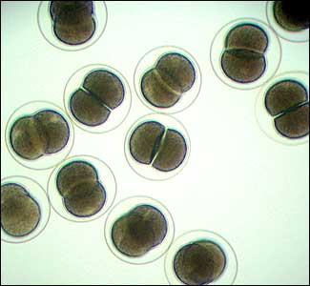
Basic developmental pattern
←Two cell stage in snail; large cell produces mesoderm and endoderm; small cell produces ectoderm. Neither cell alone can produce a complete individual.
Two cell stage in sea star; cells identical and both will produce all tissue types & develop into complete individual.
→
Embryonic similarities reflect relatedness; more similarities in embryo development = closer evolutionary relationship

Slide 12
Question
Why do all animals have their head in the anterior position?
http://www.youtube.com/watch?v=LFG-aLidT8s

Slide 13
Homeotic genes
Despite developmental differences, morphogenesis in animals follows similar genetic program; suggests common ancestor.
Emergence of body form with specialized organs and tissues in the right places is controlled by master control genes.
A class of similar control genes that help direct embryonic body plan are called homeotic genes.

Slide 14
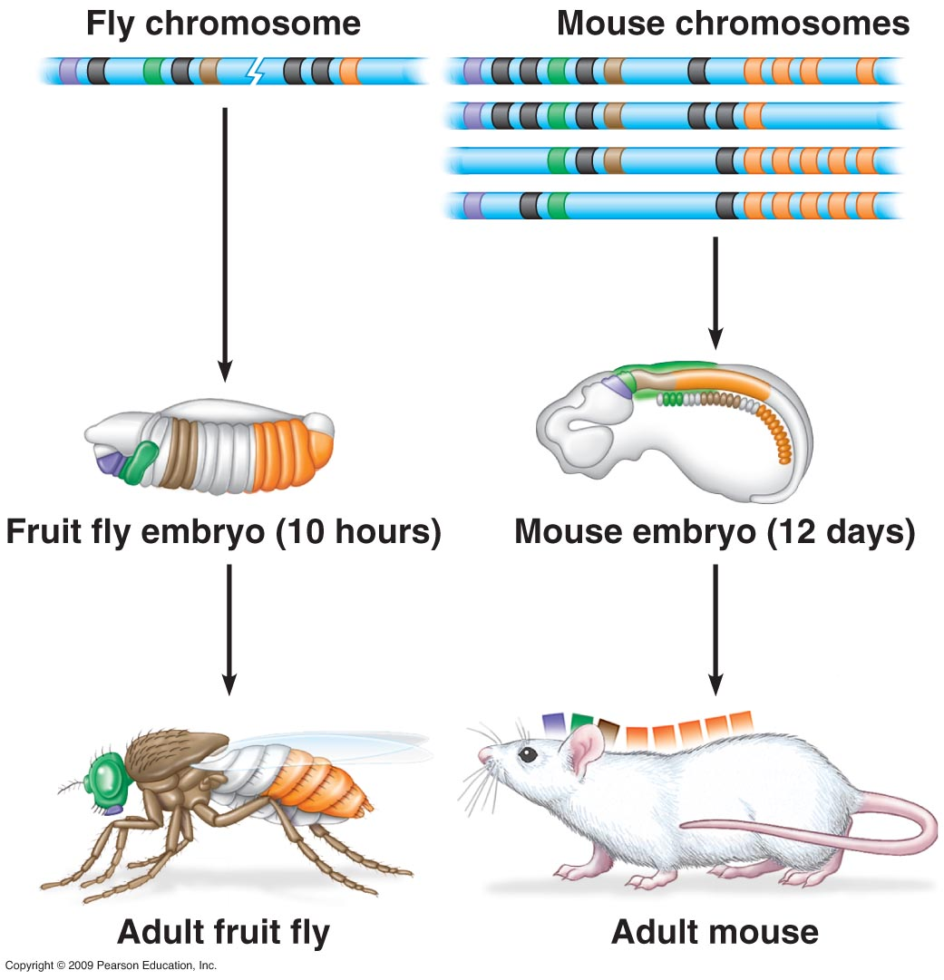
Homeotic genes
Each homeotic gene acts on a different body segment.
Each gene contains one or more copies of a 180 nucleotide sequence called a homeobox.
Each 180 base sequence codes for a 60 amino acid protein called a homeodomain.
This protein acts as a transcription factor to regulate transcription of other developmental genes.
Homeotic genes are located in the same order and correspond to analogous body regions for a number of different animals.
Similarity in body plan formation shows descent from common ancestor.

Slide 15
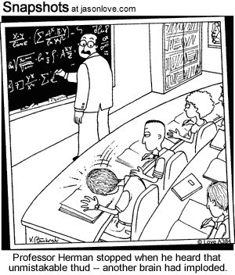
http://www.dnalc.org/view/16760-Animation-37-Master-genes-control-basic-body-plans-.html

Slide 16
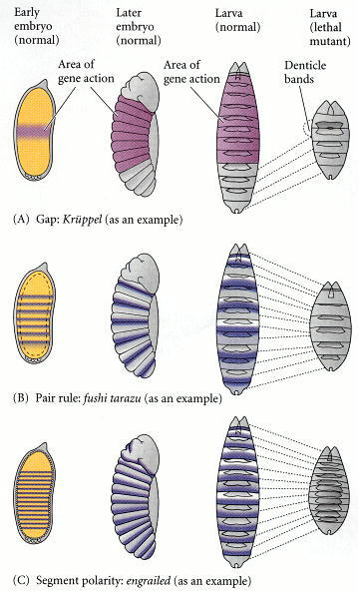
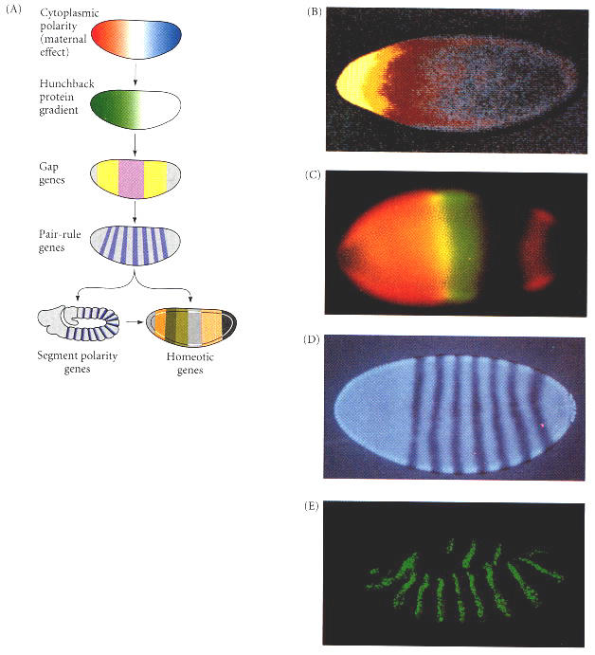

Slide 17
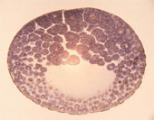
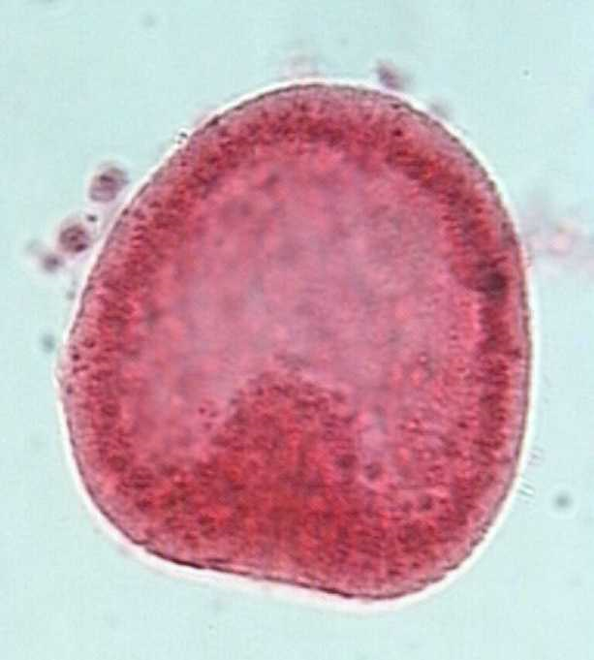
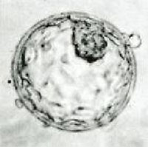
Frog sea star
human

Slide 18
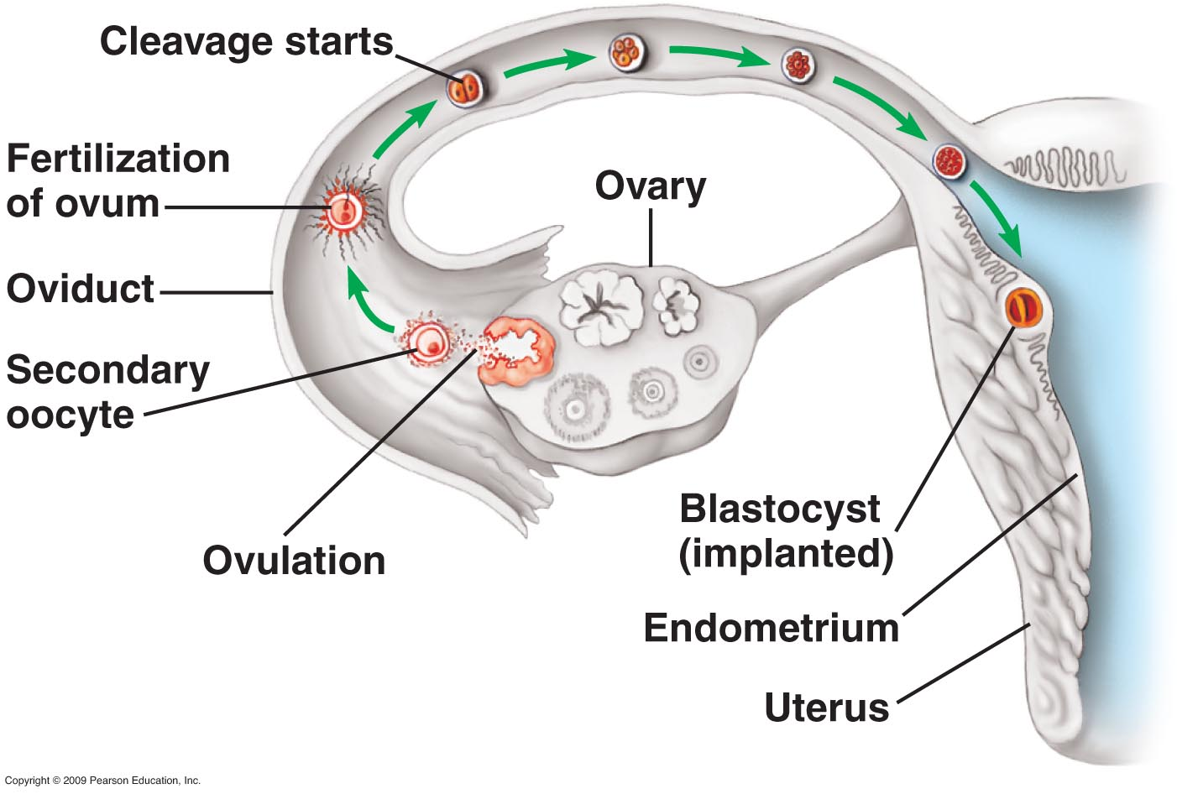
Fetal development
Fertilization occurs in oviduct.
Cleavage starts 24 hours after fertilization.
By 6th or 7th day,
embryo at 100 cell stage reaches uterus.
100 cell stage= blastocyst= hollow ball of cells = blastula of other animals.

Slide 19
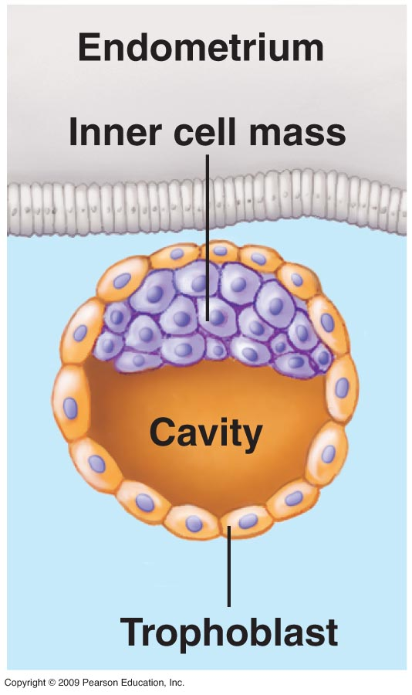
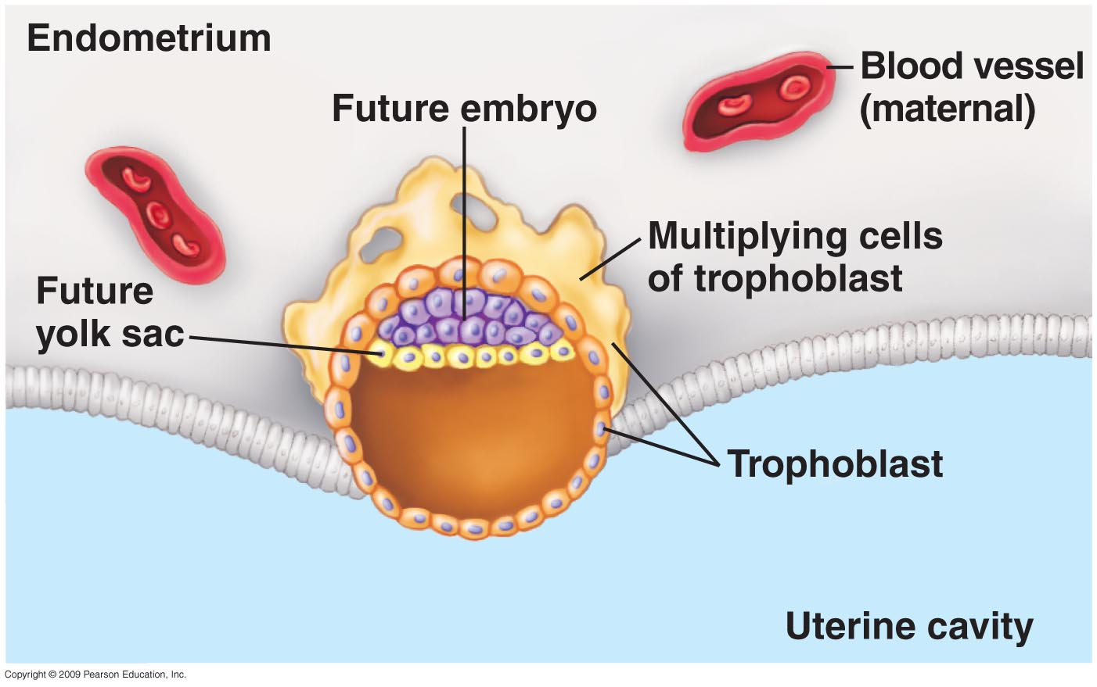
Fetal development
Blastocyst has fluid filled cavity, a cell mass that forms baby, and outer layer called trophoblast.
Trophoblast secretes enzymes to allow blastocyst to implant in uterus 7 days after conception.
Trophoblast cells spread into endometrium of uterus; becomes placenta; provides nourishment and O2 for embryo.
Extra embryonic membranes protect embryo:
a. Purple cells in cell mass → amnion
b. Yellow cells from cell mass → yolk sac.
c. From other trophoblast cells→ chorion.

Slide 20
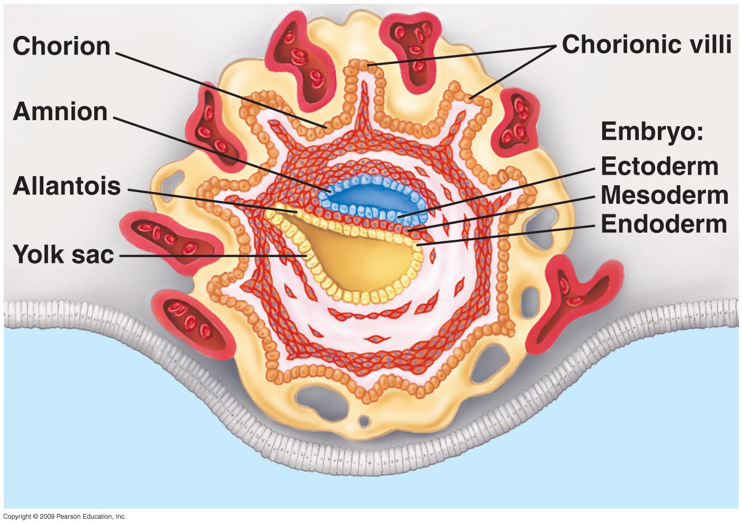
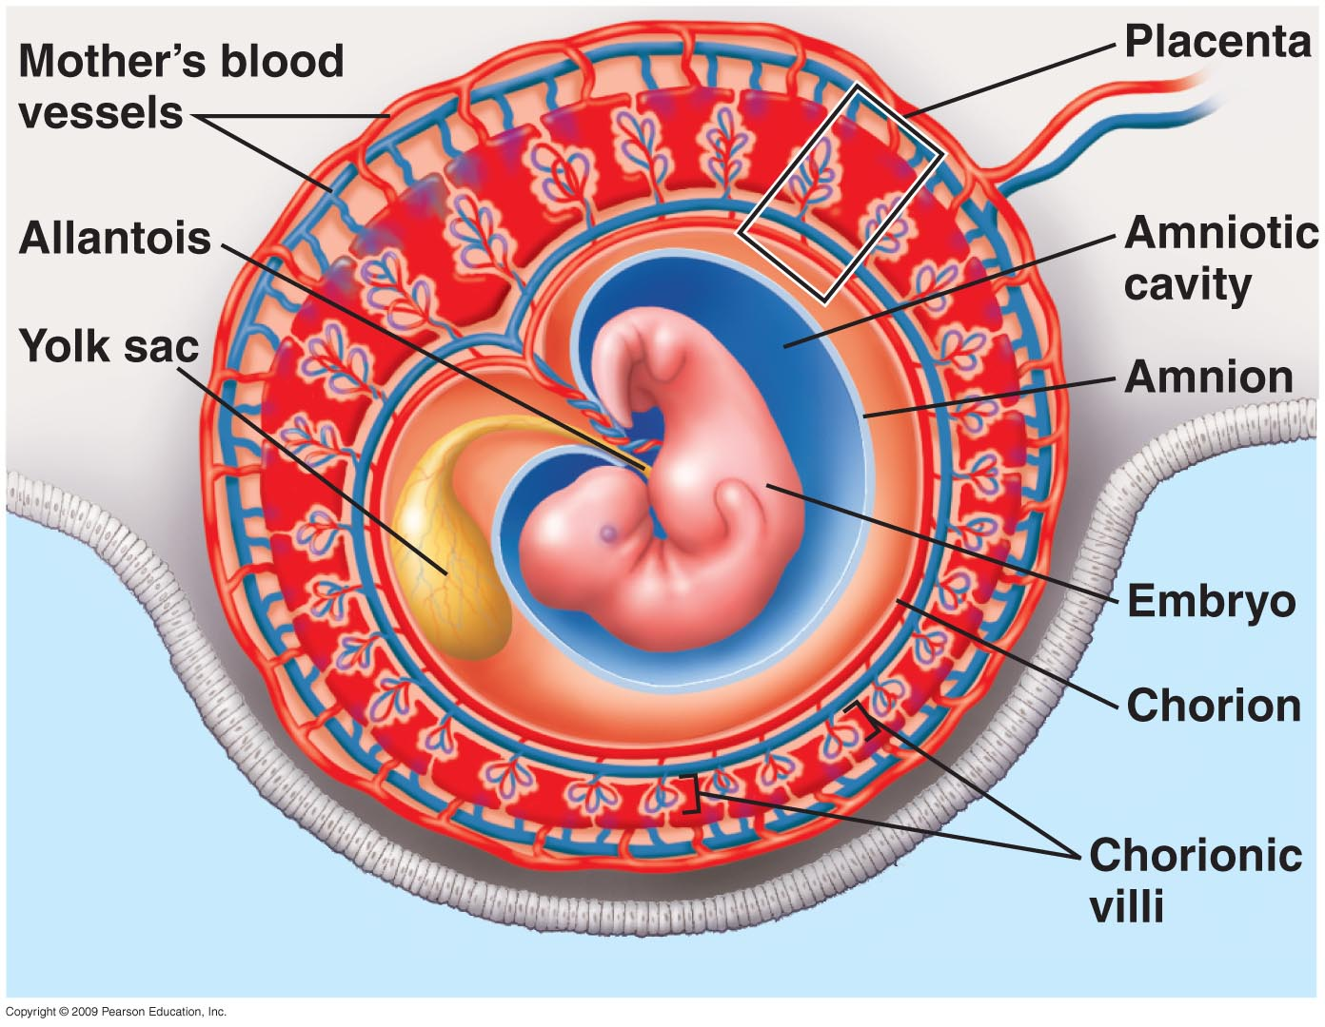
Fetal development
Embryo at 9 days after conception.
Gastrulation occurring in embryo.
Extra-embryonic membranes developing.
At one month, embryo life support from extra-embryonic membranes.
Amnion (amniotic cavity) encloses embryo.
Yolk sac-helps produce first blood cells & gametes.
Allantois- forms umbilical cord.
Chorion - contains other membranes; merges with placenta; functions in gas exchange.

Slide 21
Fetal development
Chorionic villi- projections from chorion and blood vessels from the lining of mother’s uterus form the placenta.
Placenta used to exchange nutrients, gases, waste.
Baby is attached to placenta by the umbilical cord.

Slide 22
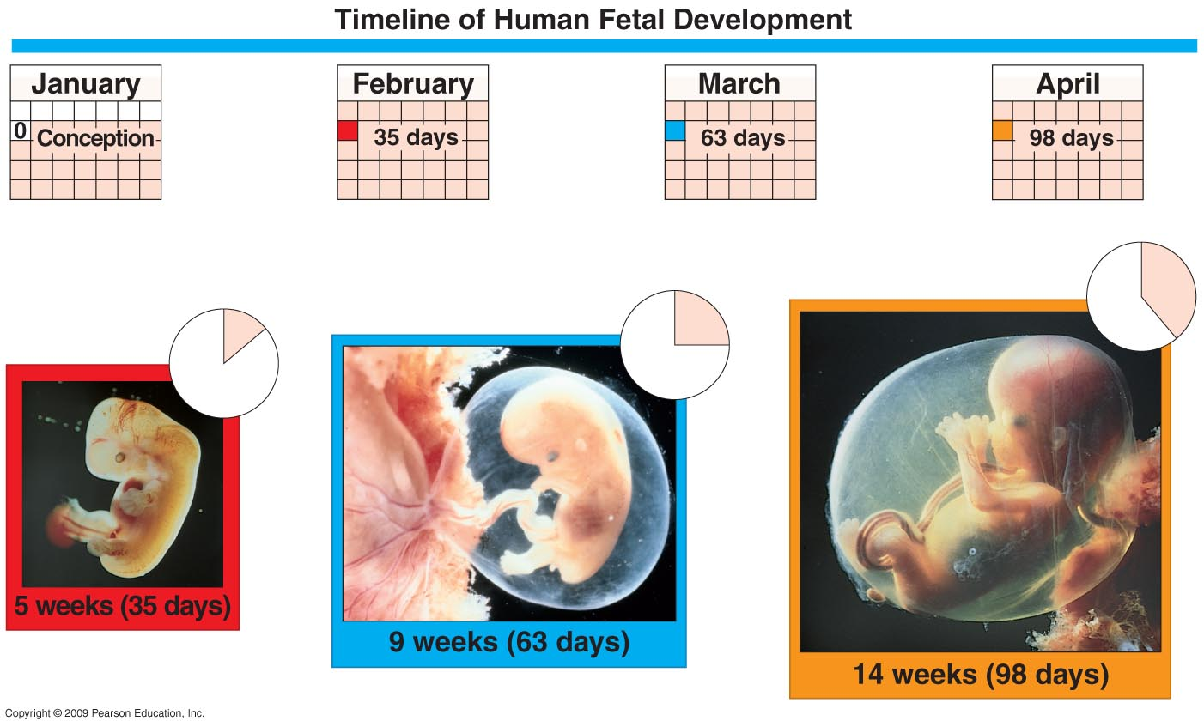
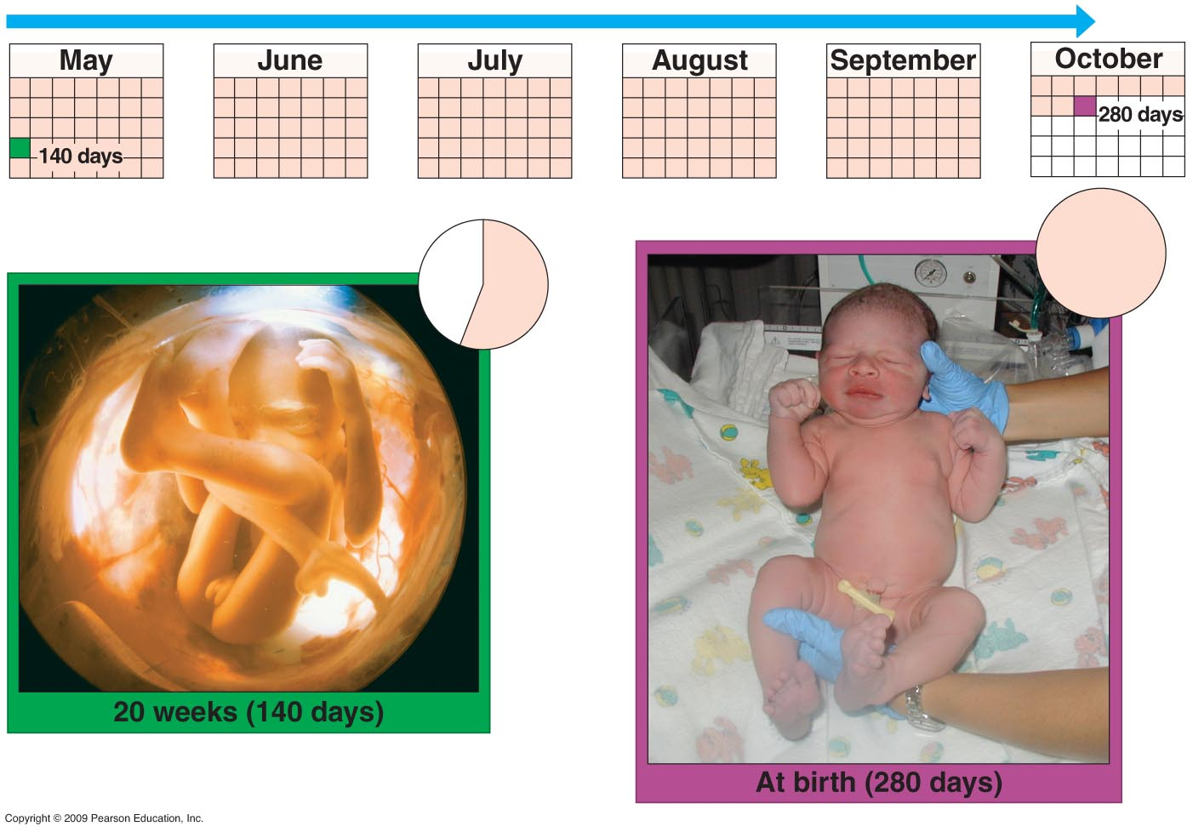
ra
First trimester
From 5 – 9 weeks grows from 7mm to 5.5 cm in size.
Embryo grows into fetus; moves arms, legs, turns head.
Dramatic changes occur.
Second trimester
Developmental changes during 2nd trimester involve increase in size & refinement of human features.
20 wks – fetus is 19 cm long and weighs ½ kb
Third trimester
1. Fetus continues to grow rapidly; about 50 cm long at birth and weighs 3-4 kg.

Slide 23
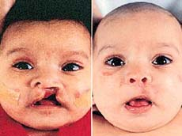
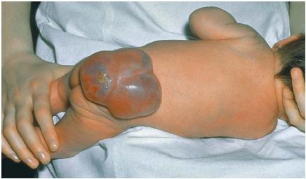
Birth defects
Structural or functional abnormalities present at birth; cause physical or mental disability; 1000’s of birth defects.
Cause –
1. Defective genes
2. Defective chromosomes
3. Environmental causes; rubella, drugs, etc.
Structural defect – abnormality in physical structure.
cleft palate spina bifida

Slide 24
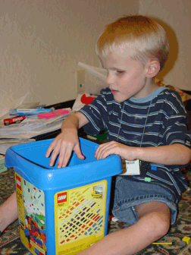
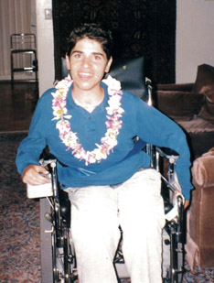
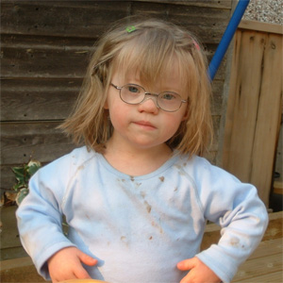
Birth defects
Functional defect – abnormality in how a body system works; can lead to developmental disability
Down’s syndrome blindness muscular dystrophy
Treatments vary with defect.

Slide 25
Checkpoint- jeopardy
The similarities in animal morphogenesis suggests : a common ancestor
What are the genes that control body plan: homeotic
What is a homebox : 180 nucleotide sequence
What is a homeodomain: 60 amino acid protein
At what developmental stage does implantation occur?
The embryo at the 100 cell stage is called the ___________
What are the 3 parts of the blastocyst?
Trophoblast cells turn into the ______.
At 9 days, the embryo reaches which stage of development?
What is the function of amnion? – enclose baby
What is the function of yolk sac - blood cells gametes
What membrane forms the umbilical cord? allantois
What is the function of the chorion? Merge with placenta gas exchange
What is the function of the yolk sac : make blood cells and gametes
How is the baby attached to the placenta?
Which trimester has the most dramatic developmental change?
What are 3 causes of birth defects?
What are 2 major types of birth defects?
What are 3 forms of spina bifida

Slide 26
Objectives
Topic 3: Mechanisms of Cell Differentiation
Explain molecular hybridization.
Compare the selective loss hypothesis and the genetic equivalence hypothesis and describe which hypothesis was supported by experimental evidence.
Define determination and compare it to differentiation.
Explain how differences in cytoplasm explain determination.
Summarize cell to cell interaction.

Slide 27
Differentiation- what happens to genes that are not used.
Selective gene loss hypothesis: differentiating cells loose some genes.
Genetic equivalence hypothesis: cells contain same gene, but some become inactive during differentiation.
Research supports genetic equivalence hypothesis.

Slide 28
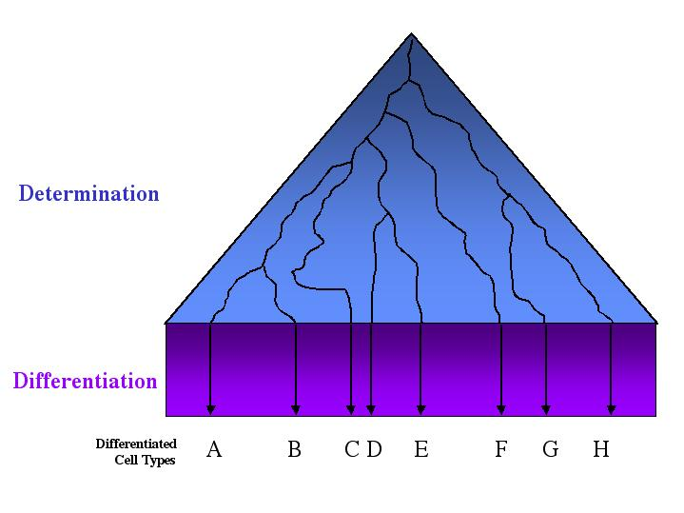
Differentiation vs. Determination
The developmental potential, (potency) of a cell = range of different cell types it CAN become.
Zygote and its very early descendents are totipotent - these cells have the potential to develop into a complete organism.
As development proceeds, developmental potential of individual cells decreases until their fate is determined.
.

Slide 29
Determination vs. Differentiation
The determination of different cell types (cell fates) involves progressive restrictions in their developmental potentials.
When a cell “chooses” a particular fate, it is said to be determined, although it still "looks" just like its undetermined neighbors.
Determination implies a stable change - the fate of determined cells does not change.

Slide 30
Determination vs. Differentiation
Differentiation follows determination, as the cell elaborates a cell-specific developmental program.
Differentiation results in the presence of cell types that have clear-cut identities, such as muscle cells, nerve cells, and skin cells

Slide 31
Determination
Snail at 2 cell stage – Large cell produces mesoderm and endoderm; small cell produces ectoderm.
Determination has occurred ; commitment to a path of development.
Sea star at 2 cell stage - Either cell is totipotent and can produce an entire organism.
Determination has not occurred.

Slide 32
Cytoplasmic Determination
Researchers determined the cytoplasm looked different in the small lobe (cell) from the large cell.
Regulatory molecules (m RNA) are distributed differently in cytoplasm of large and small cells.
The regulatory molecules control gene expression and differentiation.
http://bcs.whfreeman.com/thelifewire/content/chp20/2002002.html

Slide 33
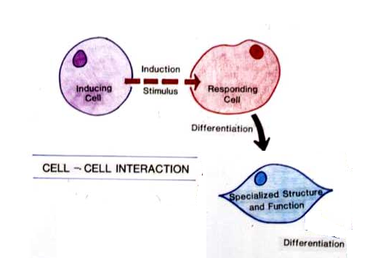
Embryonic Induction
Action of one group of cells (inducing cells) on another leads to a developmental pathway in responding tissue; important in embryo development of complex organisms.
Many scientists believe molecules on surface of responding tissues recognize signal molecules on the surface of inducing tissues.
Sometimes cell to cell contact is necessary; other times a signal protein is sent from inducing to responding cell.
Development of many tissues & organs influenced by embryonic induction; eye and ear structures, vertebral cartilage, kidneys.
Primary embryonic induction: During gastrulation, proteins in the mesoderm influence the ectoderm to develop into neural tissue.

Slide 34
Embryonic Induction
http://bcs.whfreeman.com/thelifewire/content/chp20/2002s.swf

Slide 35
Checkpoint
Explain the difference between selective gene loss and genetic equivalence hypotheses.
Explain how determination and differentiation are related?
What is embryonic induction?

Slide 36
Vocabulary
Define the following:
Asexual Reproduction:
1. Binary Fission:
2. Budding:
3. Fragmentation:
Sexual Reproduction:
Haploid
Diploid
What are the benefits to asexual reproduction?
What are the benefits to sexual reproduction?

Slide 37
Objectives
Topic 4: Asexual Reproduction
Describe the types of asexual reproduction and compare that to sexual reproduction
Compare haploid (n) to diploid cells (2n).
Differentiate between homologous chromosomes, autosomes, and sex chromosomes
Compare and contrast two chromatids of a chromosome with two homologous chromosomes.
Differentiate between somatic cells and gametes.

Slide 38
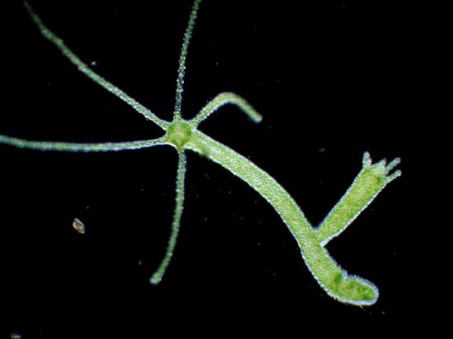
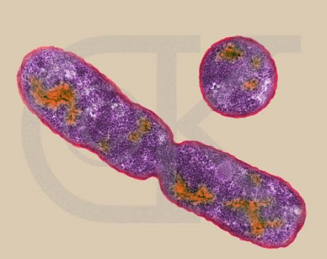
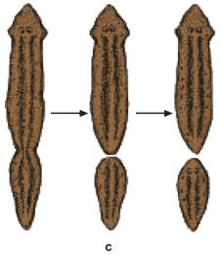
Asexual Reproduction
Requires one parent; offspring identical to parent (clone).
Budding – Organisms for buds which develop into adult and breaks away from parent.
Binary Fission – Single celled organisms divide into two.
Fragmentation - Organism breaks into pieces which form new organism.

Slide 39
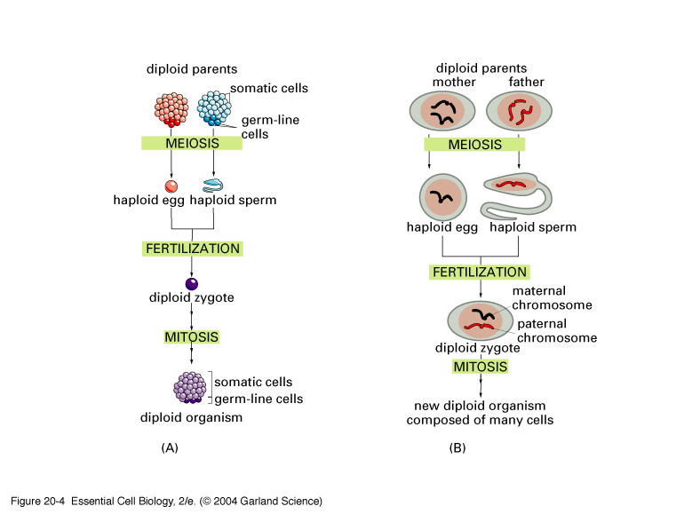
Sexual Reproduction
Requires 2 parents; offspring is not genetically identical to parent.
Each parent contributes a haploid (n) gamete.
Haploid = ½ chromosomes.
Offspring are diploid (2n).
Diploid = full set of chromosomes.

Slide 40
Asexual vs. Sexual Reproduction
Asexual reproduction beneficial in stable
environments; organisms unable to locate mates; costs less energy metabolically.
Sexual reproduction beneficial in changing environments; adds genetic variety; meiosis reduces inheritance of harmful genes.

Slide 41
Movie
http://www.youtube.com/watch?v=Wns5OQR74OQ

Slide 42
Vocabulary
Homologous chromosome
Autosome
Sex chromosome
Gamete
Somatic Cell

Slide 43
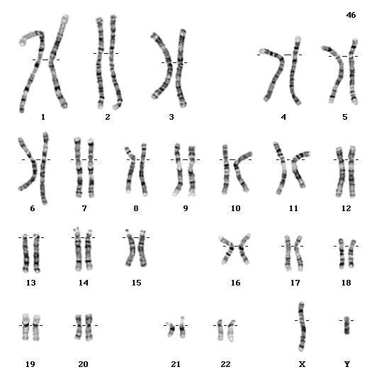

Slide 44
Chromosomes
Homologous chromosomes-
Matched pair in diploid cell;
Possess the same genes (alleles) at the same gene loci.
Autosomes – Pairs 1-22 in humans; non-gender related chromosomes.
Sex chromosome – Pair 23 in humans; X and Y chromosomes mediate gender.

Slide 45
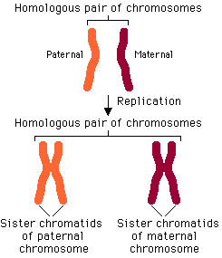
Chromatids vs. Chromosomes

Slide 46
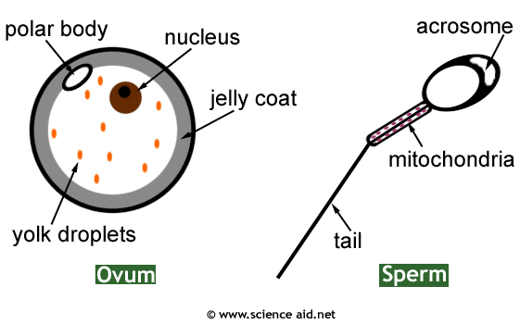
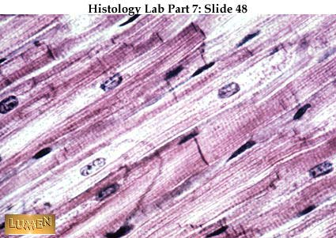
Somatic cell vs. Gamete
Gamete: Sex cell; eggs and sperm; haploid
Somatic cell: Any cell not a sex cell; diploid

Slide 47
Vocabulary review-Tic Tac Toe
Haploid chromatids autosome
Somatic reproduction gamete
Diploid homologous - sex-
chromosomes chromosomes
Write a sentence for each of the 3 columns.
Write a sentence for each of the 3 rows.
Write a sentence for each diagonal.

Slide 48
Topic 5 Objectives
Draw and describe each stage of meiosis.
Explain how meiosis produces daughter cells that differ from each other and the parent cell.
Explain how variation in offspring is created through independent assortment, crossing over, and random fertilization.
Explain how the purpose of meiosis differs from that of mitosis.
Draw and describe how meiosis creates gametes (4 sperm cells, 1 egg cell).
Differentiate between sexual and asexual reproduction and compare the evolutionary advantages and disadvantages of each.

Slide 49
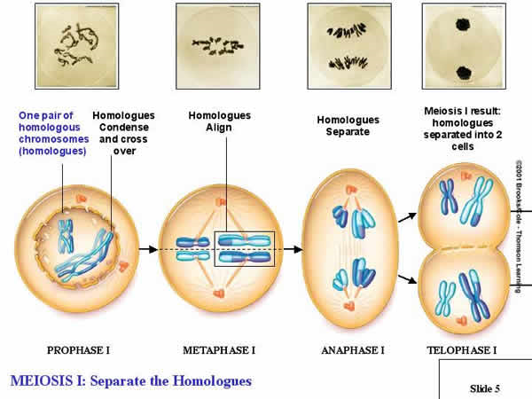
Meiosis

Slide 50
Animation Meiosis
http://highered.mcgraw-hill.com/sites/0072495855/student_view0/chapter28/animation__how_meiosis_works.html
http://www.cellsalive.com/meiosis.htm

Slide 51

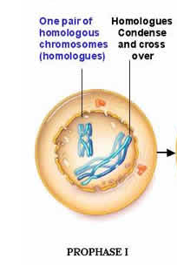
Meiosis I
Meiosis is preceded by interphase.
Chromosomes replicate.
Centrioles duplicate
Prophase I most complex and longest phase.
Chromosomes condense, mitotic spindle forms, nuclear envelope breaks down.
Homologous chromosomes each with two sister chromatids undergo synapsis to create a tetrad.
Crossing over occurs.

Slide 52
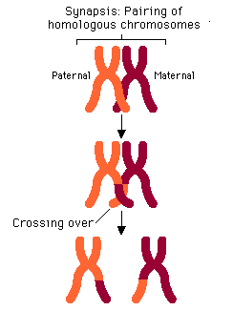
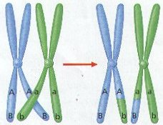
Prophase I
Synapsis – Process in which 2 replicated homologous chromosomes pair together to form a structure called a tetrad.
Crossing over is the exchange of genetic material between corresponding segments of homologous chromosomes.
It can occur because homologous chromosomes are in close proximity.
Chromosomes are recombinants; they carry different genes than the ones originally donated by parents.

Slide 53
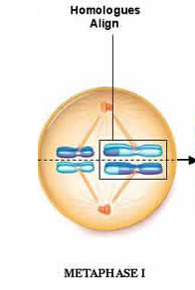
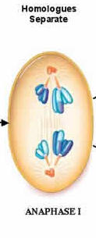
Meiosis I
Metaphase I – Homologous chromosomes line up in center of cell and attach to spindle.
Note one homologous chromosome (with 2 sister chromatids) attaches to a spindle fiber and the other homologus chromosomes attaches to a spindle fiber from the opposite pole.
Anaphase I - Chromosomes migrate to poles of the cell.
Only tetrads split up. Each spindle fiber holds one replicated homologous chromosome from the pair.

Slide 54
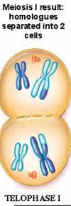
Meiosis
Telophase I - Chromosomes arrive at poles of the cell.
Cytokinesis occurs.
Each cell has a chromosome consisting of two sister chromatids.
Each cell has a haploid number of chromosomes.
In some species, an interphase occurs; in others the process proceeds directly to meiosis II.
No replication of chromosomes occurs before meiosis II.

Slide 55
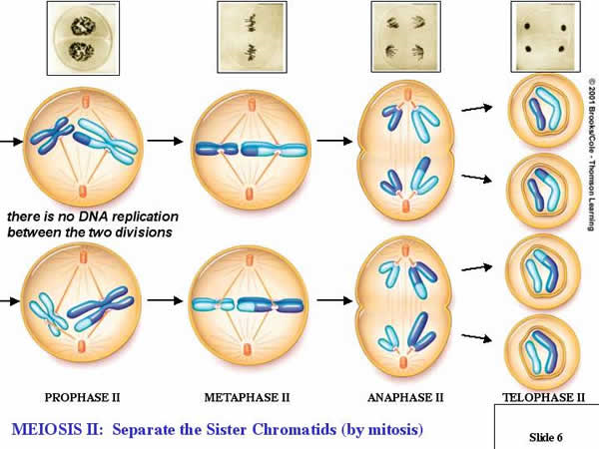
Meiosis
Meiosis II –
Phases are identical to meiosis I.
Difference in outcome.
Separation occurs between sister chromatids.
After cytokinesis, 4 haploid cell with one chromatid from each of the homologous pairs results.

Slide 56
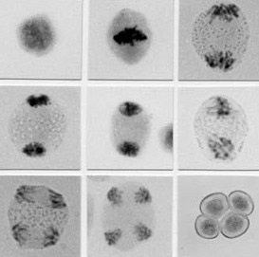

Slide 57
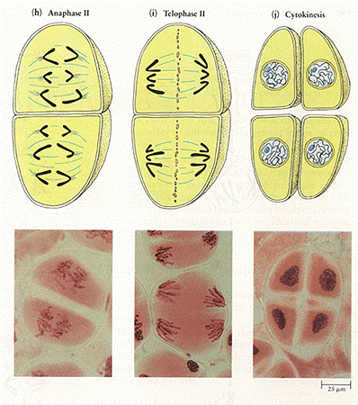

Slide 58
Pop Bead Meiosis
Create two homologous chromosomes in two different colors.
During interphase, DNA replication occurs. Replicate each of the chromosomes.
Question: How many chromatids are present? How many chromosomes?
During prophase I, tetrad formation and crossing over occurs. Cross over non-identical sister chromatids.
Line up the homologous chromosomes on the metaphase I plate.
During anaphase I, homologous chromosomes begin to migrate toward opposite poles.
Homologous chromosomes arrive at opposite poles during telophase I.
Cytokinesis occurs.
Question: Are the two daughter cells identical? Why or why not? Are the daughter cells diploid or haplioid
Prophase II and metaphase II: Line up the sister chromatids at the metaphase plate.
Anaphase II: Individual sister chromatids migrate toward the opposite poles.
Telophase II and cytokinesis: Sister chromatids complete their migration and cytokinesis occurs.
Question: Are the daughter cells diploid or haploid? Are the daughter cells genetically identical?

