Slide 1
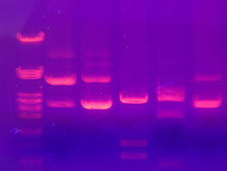
Gel Electrophoresis

Slide 2
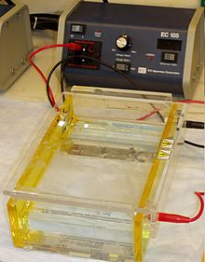

What is it, and how does it work?
Technique used to separate samples of DNA, RNA, and protein according to charge and/or size
Smaller molecules move farther and faster through the agarose gel
Opposite charges each other
  DNA products run from the cathode to the anode

Slide 3

Why do we care?
Using GE, one can compare sizes of DNA fragments, and possibly compare/find similarities between different strands of DNA
Helps us separate many different pieces of DNA and RNA fragments
Discover new species
Can help find a culprit in a crime

Slide 4
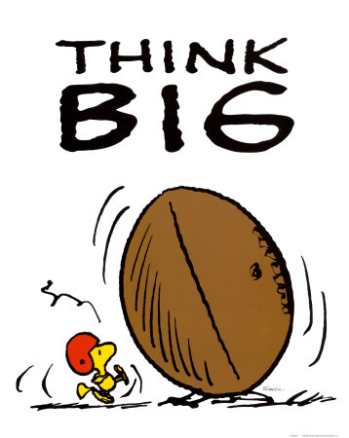
Big Picture
Gel electrophoresis used for analytical purposes- gives us a general picture
More specific= RFLP, PCR, DNA sequencing, Southern blotting
  These methods help look at specific fragments
May lead to manipulating a gene => making new proteins => eg. make oil, transform a bacteria which can be used to eliminate a disease ☺

Slide 5
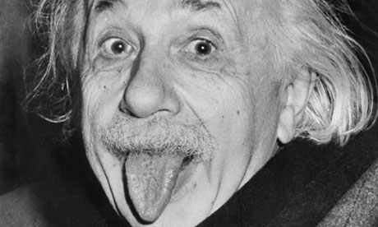
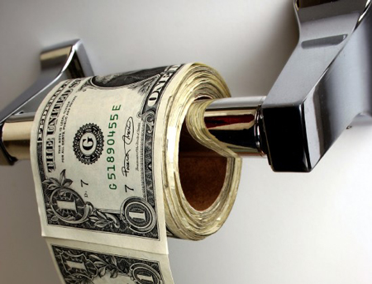

Take home message
Innovative ideas- do science at home
Think outside the textbook realm
Molecular biology = very important for new ideas
  Fame
  $$
  Save the planet

Slide 6


iGem and I
We are looking for innovative ideas that will use molecular biology and make something new and cool!
Join iGem club at your future school
iGem for high school= in the making
  Check for us online

Slide 7
Questions!
In separating DNA by Gel, why is size and not charge important in analyzing the results?
Proteins: Why do they have to be denatured before running Gel? (HINT* Think structures!)
Why is a buffer necessary for Gel Electrophoresis? (*Think of the definition of a buffer, and keep in mind the charges)
We can’t see DNA, RNA, or proteins like we can see food colouring. How do we visualize the separation patterns in our samples?

Slide 8
Happy Summer ☺!

