Slide 1
Cold Shock Response in Saccharomyces cerevisiae and the Effects of GLN3 Deletion
Kasey O’Connor
Ashley Rhoades
Department of Mathematics
Loyola Marymount University
BIOL 398/MATH 388
May 9, 2013
Seaver 202

Slide 2
Outline
What transcription factors in Saccharomyces cerevisiae contribute to cold shock response when GLN3 has been deleted?
Exposing S. cerevisiae to temperatures of 13°C causes the yeast cells to adapt and change gene expression
To observe the significant changes in gene expression, raw data from microarrays was centered and scaled to find significant changes in gene expression
The data was entered into STEM and YEASTRACT to be profiled and to create a regulation matrix
The MATLAB models were used to show the relative contribution of each transcription factor on gene regulation during cold shock

Slide 3
S. cerevisiae and Decreases in Temperature
In their natural habitat, yeast cells are constantly exposed to changes in temperature daily and seasonally
Low temperatures result in a decrease in membrane fluidity and diffusion rates, alterations in molecular topology, or modifications in enzymes (Gast et al, 1993)
Optimal growth temperature is between 25°C and 35°C, and they experience cold shock from 10°C to 18°C
Yeast cells used for wine making and brewing are exposed to cold shock temperatures but remain viable and can perform fermentation (Aguilera et al, 2007)
Little is known about cold shock mechanisms and the transcription factors that regulate the adaptations in fungi

Slide 4
Microarray Data and Statistical Analysis
Microarray data was gathered from S. cerevisiae exposed to temperatures of 13°C and allowed to recover back to 30°C with GLN3 deleted
  GLN3 is known to encode a transcriptional activator that is involved in regulating genes that are involved in nitrogen catabolism (Courchesne & Magasanik, 1988)
RNA was collected before the cold shock, during cold shock at 15 minutes, 30 minutes, and 60 minutes, and then twice in recovery at 90 minutes and 120 minutes
The ratio of red to green flourescent for each spot was calculated and log transformed
  decreases in gene expression are negative numbers
  Increases in gene expression are positive numbers
The raw data was scaled and centered in Excel before computing the t-statistic and p-value to determine a significant change in expression for every gene

Slide 5
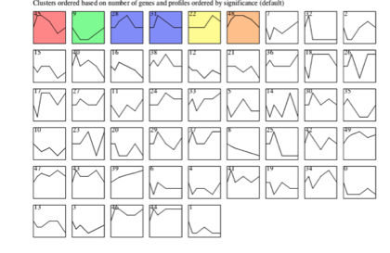
Using STEM to Create Gene Cluster Profiles
The colored profiles show the significant clusters found from the microarray data after input into STEM

Slide 6
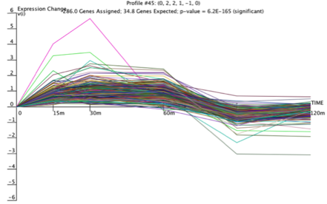
One Profile of Up Regulated Genes was Chosen for the Model
There were 286 genes associated with profile 45, and a p-value for the enrichment of genes was 6.2x10⁻¹⁶⁵
The top 5 transcription factors for this profile were:
  Ste12p - 29.5%
  Rap1p - 23.5%
  Sko1p - 16.4%
  Sok2p - 15.7%
  Ino4p - 14.6%

Slide 7
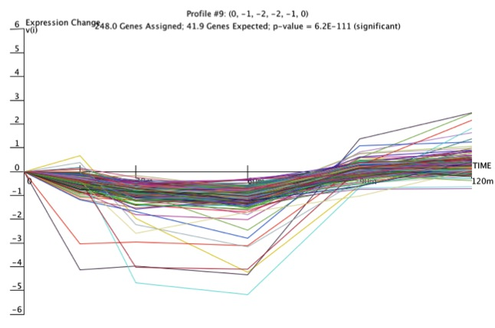
One Profile of Down Regulated Genes was Chosen
There were 248 genes associated with profile 9, and a p-value for the enrichment of genes was 6.2x10⁻¹¹¹
The top 5 transcription factors for this profile were:
  Ste12p: 28.6%
  Rap1p: 18.8%
  Ino4p: 11.7%
  Sok2p: 11.7%
  Aft1p: 10.4%

Slide 8
YEASTRACT Networks for the Transcription Factors
Transcription factors from profile 45:
ACE2, AFT2, CIN5, FHL1, FKH2, HAP5, HMO1, HOT1, MAL33, MBP1, MGA2, MSS11, PHD1, RAP1, SKN7, SKO1, SMP1, SOK2, STE12, SWI4, SWI6, YAP6, and ZAP1
Transcription factors from profile 45:
ACE2, AFT2, CIN5, FHL1, FKH2, HAP5, HMO1, HOT1, INO4, MAL33, MBP1, MGA2, MSS11, PHD1, RAP1, SKN7, SKO1, SMP1, STE12, SWI4, SWI6, YAP6, and ZAP1

Slide 9
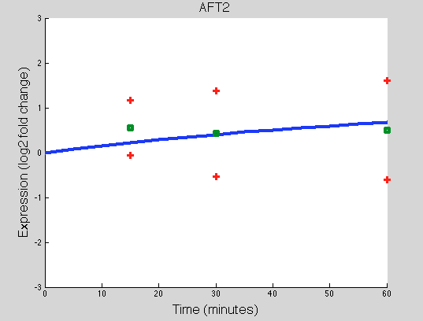
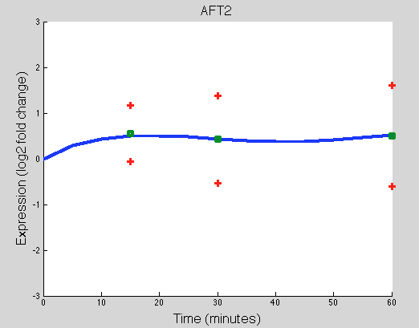
Running Two Different MATLAB Programs Yields Different Results
AFT2 expression using the Michaelis-Menten model from profile 45
AFT2 expression using the Sigmoidal model from profile 45

Slide 10
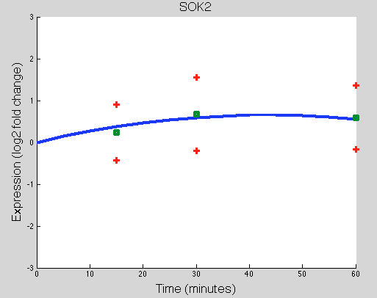
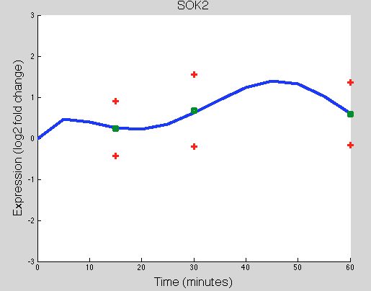
Running Two Different MATLAB Programs Yields Different Results
SOK2 expression using the Michaelis-Menten model from profile 45
SOK2 expression using the Sigmoidal model from profile 45
Notes:
In line with the linear increase in both glucose and ammonia flux

Slide 11
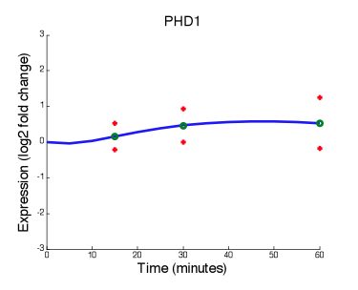
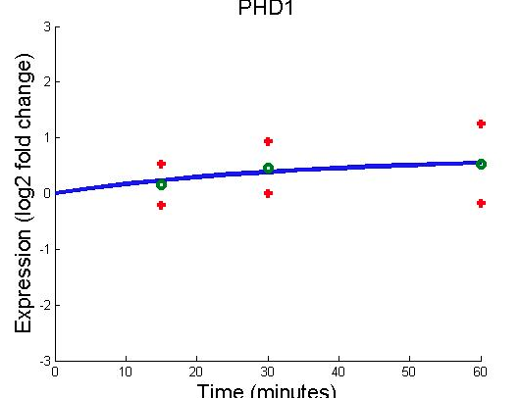
Running Two Different MATLAB Programs Yields Different Results
PHD1 expression using the Michaelis-Menten model from profile 9
PHD1 expression using the sigmoidal model from profile 9
Notes:
In line with the linear increase in both glucose and ammonia flux

Slide 12
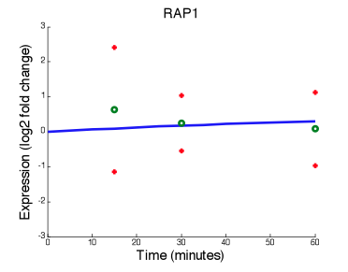
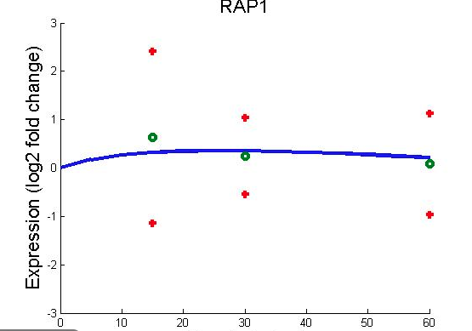
Running Two Different MATLAB Programs Yields Different Results
RAP1 expression using the Michaelis-Menten model from profile 9
RAP1 expression using the sigmoidal model from profile 9
Notes:
In line with the linear increase in both glucose and ammonia flux

Slide 13
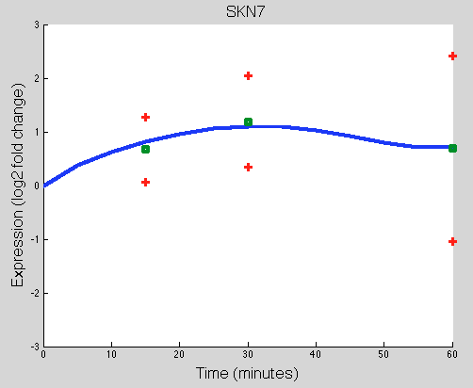
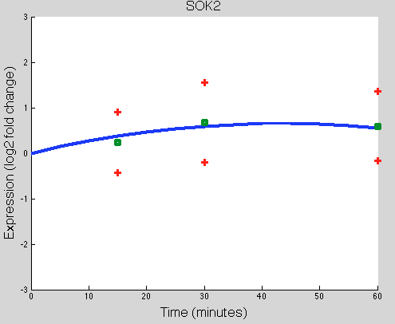
Comparison to the STEM Profiles
For profile 45, the sigmoidal program created the most accurate depiction of the gene expression

Slide 14
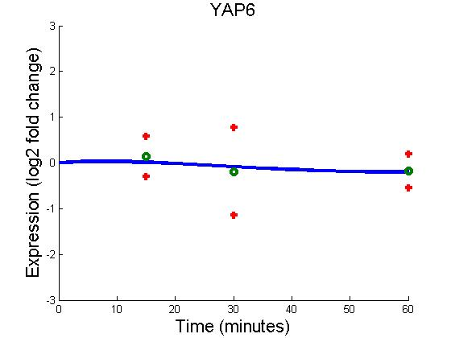
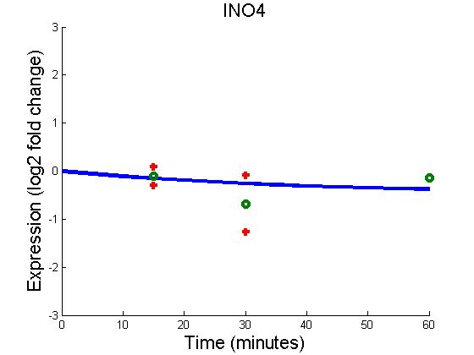
Comparison to the STEM Profiles
For profile 9, the sigmoidal program created the most accurate depiction of the gene expression

Slide 15
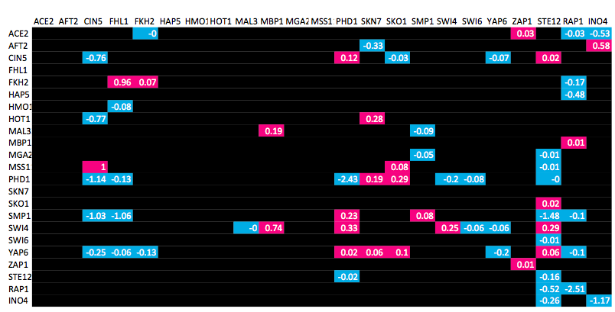
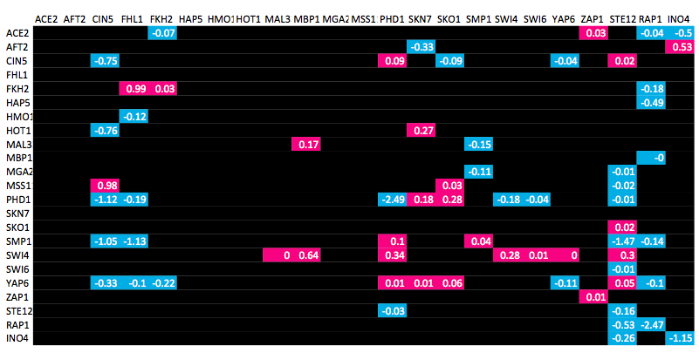
Using Heat Maps to Determine the Differences Between the Models
The top image shows the gene regulation patterns using the Sigmoidal with fix b = 0 model.
The bottom image shows the gene regulation patterns using the sigmoidal with fix b = 1 model.
There are no visible differences among what genes are up regulated and down regulated in the two models

Slide 16
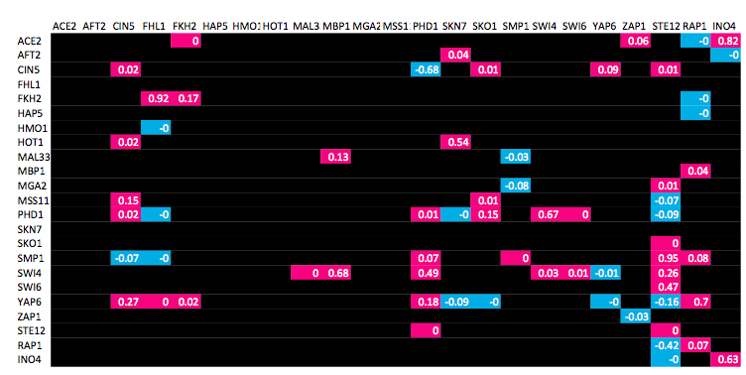
Using Heat Maps to Determine the Differences Between the Models
The top image shows the gene regulation patterns using the Sigmoidal with fix b = 0 model.
The bottom image shows the gene regulation patterns using the Michaelis-Menten model.
There are differences among what genes are up regulated and down regulated in the two models

Slide 17
Conclusions
Overall, we see that the Sigmoidal resulted in transcription factor profiles that were more similar to the ones created by STEM
Both the sigmoidal with the fix b = 0 and the sigmoidal with the fix b = 1 resulted in the same heat map of up regulation and down regulation
The heat map of the sigmoidal model versus the Michaelis-Menten model produced very different heat maps

Slide 18
Future Research
Looking at another model, perhaps a linear one, may create profiles closer to the one generated by STEM
We can also use another program to determine which of the models previously run were more correct
We can expand our data set and include more transcription factors to see how these affect the weights of the others
Looking at the wild type data in comparison to the GLN3 deleted data could give insight into the effects of the deletion

Slide 19
Summary
Exposing S. cerevisiae to temperatures of 13°C causes the yeast cells to adapt and change gene expression
After running a microarray, and statistical analysis, the data was executed in the STEM and YEASTRACT program to find gene profiles and a regulation matrix
The MATLAB models used these transcription factors related to both up regulated and down regulated genes in Saccharomyces cerevisiae exposed to cold shock
The three different profiles run resulted in the following:
  The sigmoidal model with fixb = 0 had the same genes up regulated and down regulated in the sigmoidal model with fixb = 1
  The Michaelis-Menten had very different genes being up regulated and down regulated

Slide 20
References
Aguilera, Jaime, Francisca Randez-Gil, and Jose Antonio Prieto. "Cold Response in Saccharomyces Cerevisiae: New Functions for Old Mechanisms." FEMS Microbiology Reviews 31.3 (2007): 327-41. Print.
Courchesne WE and Magasanik B (1988) Regulation of nitrogen assimilation in Saccharomyces cerevisiae: roles of the URE2 and GLN3 genes. J Bacteriol 170(2):708-13
Gast K, Damaschun G, Damaschun H, Misselwitz R & Zirwer D (1993) Cold denaturation of yeast phosphoglycerate kinase: kinetics of changes in secondary structure and compactness on unfolding and refolding. Biochemistry 32: 7747–7752.

Slide 21
Acknowledgments
Ben G. Fitzpatrick, Ph.D.
Department of Mathematics
Loyola Marymount University
Kam D. Dahlquist, Ph.D.
Department of Biology
Loyola Marymount University

