Slide 1
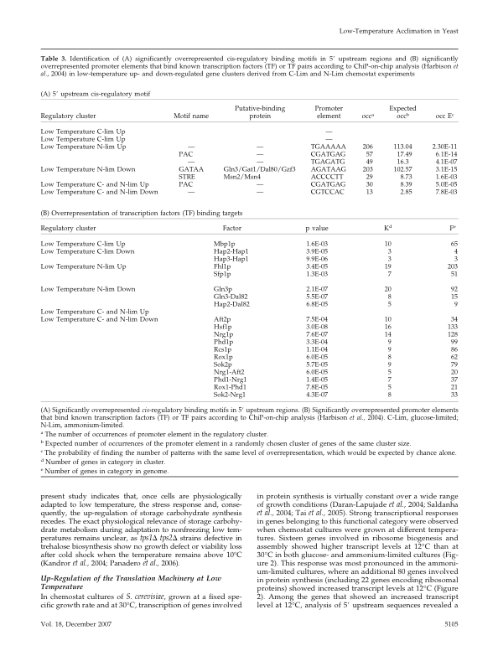
Table 3: 5’ upstream cis-regulatory motif
Significantly overrerpresed cis-regulatory binding motifs in 5’ upstream regions.
occ= number of occurances
Expected occ= expected number of occurrences
occ E= the probability of find number of pattersn with same overrepresentation

