Slide 1
Siebel Scholars
SynBERC.
Synthetic Biology Panel Discussion
Joint BioEnergy Institute
Dec. 13, 2011

Slide 2
Megan Palmer Deputy Director of Practices, SynBERC
Siebel Scholar (2010)
Jeffrey Dietrich Co-founder, Lygos
Siebel Scholar (2010)
David Breslauer CSO, Refactored Materials
Douglas Crawford Managing Director, Mission Bay Capital
Nathan Hillson Director of Synthetic Biology, JBEI
Holly Million Executive Director, BioBricks Foundation
Zach Serber Director of Biology, Amyris
Bill Shelander Business and Entrepreneurial Development, LBNL

Slide 3
Federal synthetic biology investment
2005-2010: $800M gov’t
  Genome Sciences Program and JGI account for ≈80%

Slide 4
VC synthetic biology investment
Bioprocessing: $1.89B
Algae: $191M
Adapted from Lux Research, Inc.

Slide 5
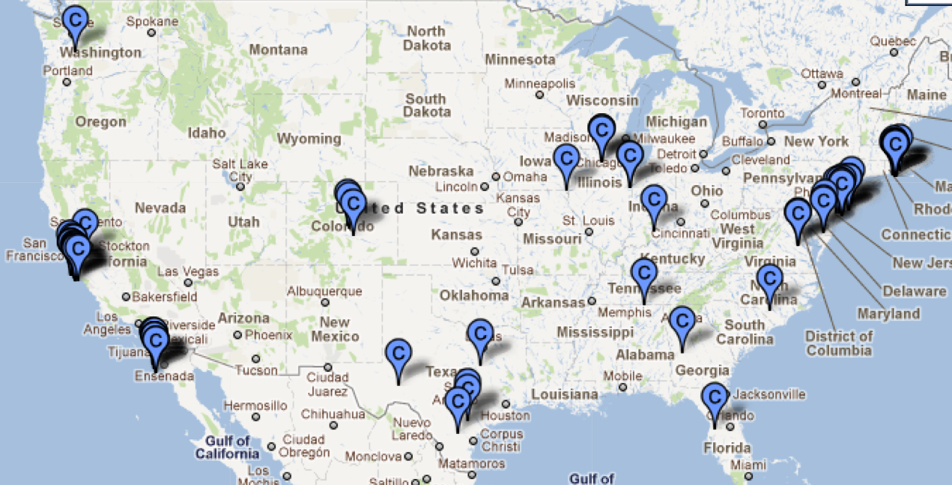
Where is the research taking place?
Source: Synthetic Biology Project

Slide 6
R&D trends
Adapted from Rob Carlson, www.synthesis.cc

Slide 7
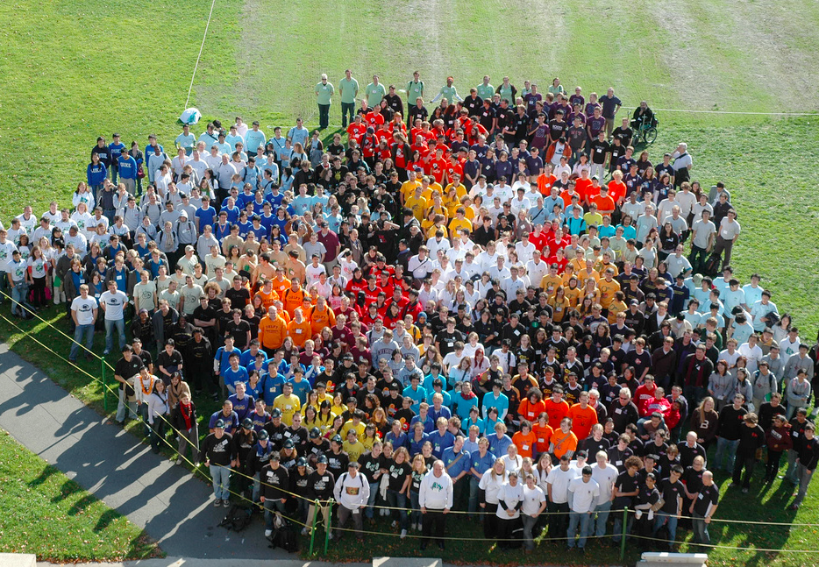



Ownership, Sharing & Innovation
Registries of Parts
One Example: iGEM 2008
_{1500 new BioBricks Parts}
_{~1000 students in 30 countries}
_{~ $4M total budget}
Utilities filings on all 2008 parts ~ $ 37.5M
Geometric Growth in Parts Collection
_{Commercial FTO unclear}

Slide 8

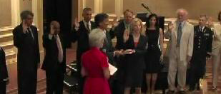
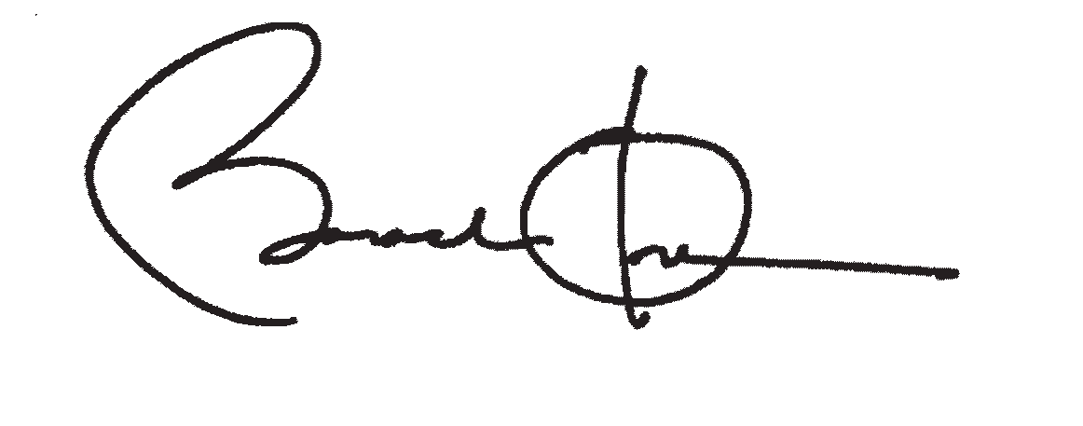
Syn Bio Hits the Big Time
As you know, scientists have announced a milestone in the emerging field of cellular and genetic engineering research known as synthetic biology…It is vital that we as a society consider, in a thoughtful manner, the significance of this kind of scientific development.
PCSBI concluded that “synthetic biology is capable of significant but limited achievements posing limited risks.”

Slide 9
Public Perceptions of Syn Bio
_{Areas of Concern}
_{Biosecurity (27%)}
_{Ethics (25%)}
_{Biosafety :} _{Humans (23%)}
_{Biosafety: Environment (13%)}
_{Who knows the most?}
_{White Male (18-49 )}
_{College Educated}
_{Income > $ 70K}
Source: Hart Research Associates; Synthetic Biology Project, n=1000

Slide 10

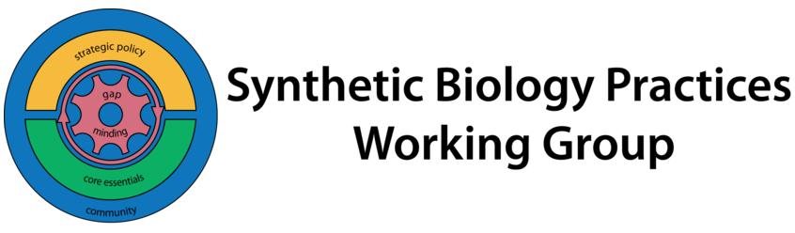
Thank You & Stay Involved
synberc.org
jbei.org
siebelscholars.com
amyris.com
openwetware.org/SBPWG

