Slide 1
CD4 T Cell Decline Shows No Correlation With Genetic Divergence in the HIV-1 env Gene
Colin Wikholm
William Fuchs
BIOL 368: Bioinformatics Laboratory
Department of Biology
Loyola Marymount University
October 10, 2016

Slide 2
Outline
The env gene is important in the host invasion, immune system evasion, and survival of HIV-1.
Markham et al. (1998) found that a greater genetic diversity and divergence of env was associated with rate of CD4 T cell decline in human subjects.
We re-analyzed data from the Markham et al. (1998) to look for an inverse correlation between env genetic divergence and CD4 T cell count in select subjects.
We found no significant correlation between genetic divergence and CD4 T cell count.
Future studies should address the limitations posed by the methods of this study.

Slide 3
Outline
The env gene is important in the host invasion, immune system evasion, and survival of HIV-1.
Markham et al. (1998) found that a greater genetic diversity and divergence of env was associated with rate of CD4 T cell decline in human subjects.
We re-analyzed data from the Markham et al. (1998) to look for an inverse correlation between env genetic divergence and CD4 T cell count in select subjects.
We found no significant correlation between genetic divergence and CD4 T cell count.
Future studies should address the limitations posed by the methods of this study.

Slide 4
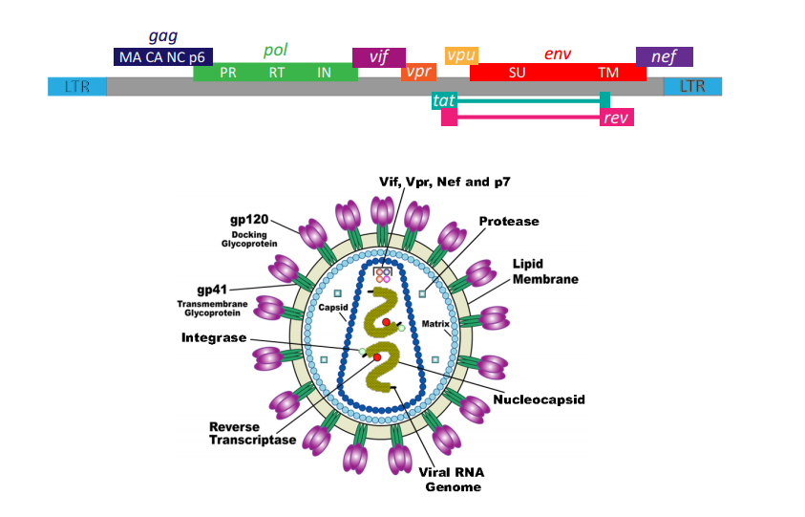
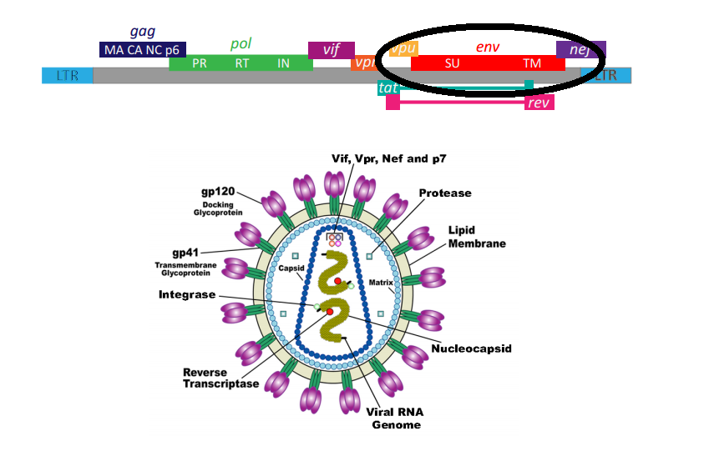
The env Gene is One of Nine HIV-1 Genes
The env gene of HIV-1 plays a major role in viral infection of a human host.
http://people.mpi-inf.mpg.de/~fmueller/thesis/thesis_mueller.pdf

Slide 5
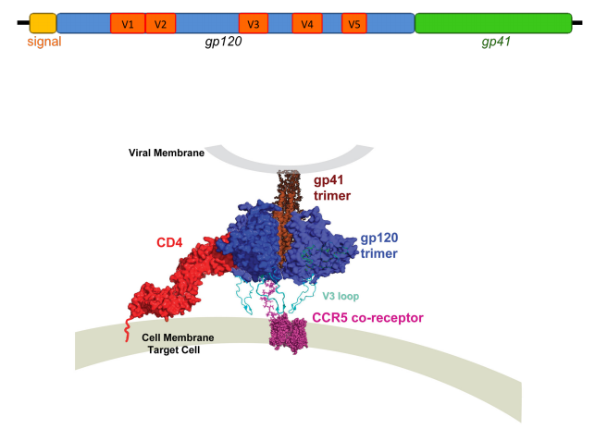
The env Gene Codes for gp160, Which is Composed of gp120 and gp41
http://people.mpi-inf.mpg.de/~fmueller/thesis/thesis_mueller.pdf

Slide 6
The env Gene Codes for gp160, Which is Composed of gp120 and gp41
The gp120 protein and V3 coded for on env are required for CCR5 co-receptor binding and subsequent cell fusion.
http://people.mpi-inf.mpg.de/~fmueller/thesis/thesis_mueller.pdf
Notes:
neutralizing antibodies, which recognize the principal neutralizing determinants of the gp120 envelope protein (the V3 loop region, residues 296 to 331), have been shown to effectively block cell fusion and virus infectivity independent of the initial gp120-CD4 binding.
AFTER NOTE ON V3 →

Slide 7
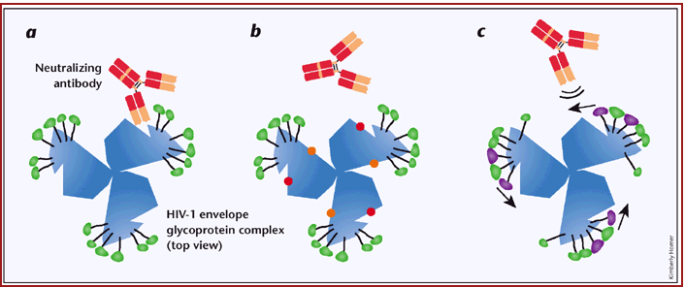
Mutations in the HIV-1 env Gene Facilitate Escape from Host Immune System
http://people.mpi-inf.mpg.de/~fmueller/thesis/thesis_mueller.pdf
Notes:
Figure 1. A comparison of the direct epitope variation and the glycan shield models of HIV-1 immune escape. a, Neutralizing antibodies bind to the viral envelope glycoprotein complex, which consists of 3 identical gp120-gp41 heterodimers. b, Traditional viral escape involves random mutations (resulting envelope changes depicted with red and orange dots) that alter the neutralizing epitope (red dots) and diminish antibody binding. c, The glycan shield model proposed by Wei et al. suggests that steric hindrance rather than epitope variability prevents neutralizing antibodies from binding their cognate epitopes. Added or repositioned glycans are shown in purple. The gp120 glycoprotein can accommodate only a limited number of carbohydrates, so the shifting of glycans to occlude one epitope seems to leave other regions vulnerable. Moreover, complete shielding would interfere with critical virus-cell interactions and result in a defective virus. Thus, neutralization escape mutants adapt to neutralizing antibodies but do not become completely neutralization resistant. Ultimately, viral immune escape probably results from a combination of mechanisms that balance viral fitness with evasion from both humoral and cellular immune responses.

Slide 8
Outline
The env gene is important in the host invasion, immune system evasion, and survival of HIV-1.
Markham et al. (1998) found that a greater genetic diversity and divergence of env was associated with rate of CD4 T cell decline in human subjects.
We re-analyzed data from the Markham et al. (1998) to look for an association between env genetic divergence and CD4 T cell count in select subjects.
We found no significant correlation between genetic divergence and CD4 T cell count.
Future studies should address the limitations posed by the methods of this study.

Slide 9
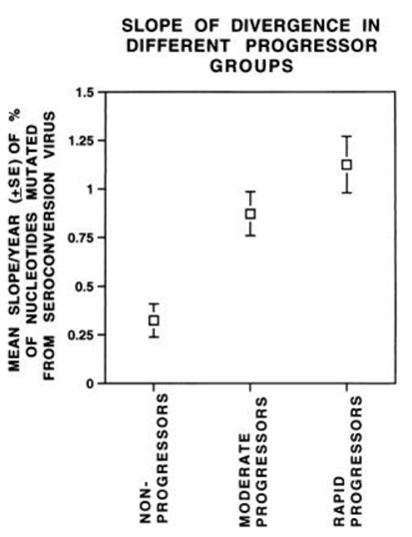
Markham et al. (1998) Found Higher env Sequence Divergence and Diversity in Subjects With More Rapid Progression of CD4 T cell decline.
Would there still be a relationship between genetic divergence and CD4 T cell decline if we used different statistical methods to test only the moderate progressors?
We predict that CD4 T cell decline would be positively correlated with genetic divergence.
Notes:
Note no difference b/w rapid progressors and nonprogressors

Slide 10
Outline
The env gene is important in the host invasion, immune system evasion, and survival of HIV-1.
Markham et al. (1998) found that a greater genetic diversity and divergence of env was associated with rate of CD4 T cell decline in human subjects.
We re-analyzed data from the Markham et al. (1998) to look for an inverse correlation between env genetic divergence and CD4 T cell count in select subjects.
We found no significant correlation between genetic divergence and CD4 T cell count.
Future studies should address the limitations posed by the methods of this study.

Slide 11
Subjects 6, 8, 9, and 14 were Analyzed for Having the Highest Number of Visit Data Points
1. Watterson nucleotide diversity, theta (θ), was calculated using
sequence alignment in Biology Workbench.
2. Phylogenetic trees were constructed for each of the subjects.
3. Diversity was calculated: Divergence = [ (|(θ2-θ1)/θ1|)/time ]
- Because of limited time and resources, we calculated divergence as proportional change in θ over time.
- Markham calculated divergence as change in nucleotides from the seroconverter.
4. A test for correlation was performed between genetic divergence
and CD4 T cell count for consolidated data and by individual
subject.
Notes:
For 4, make sure to mention test for normality during presentation
Change in procedure assumes that, in general, clones will not regress back to seroconversion sequence

Slide 12
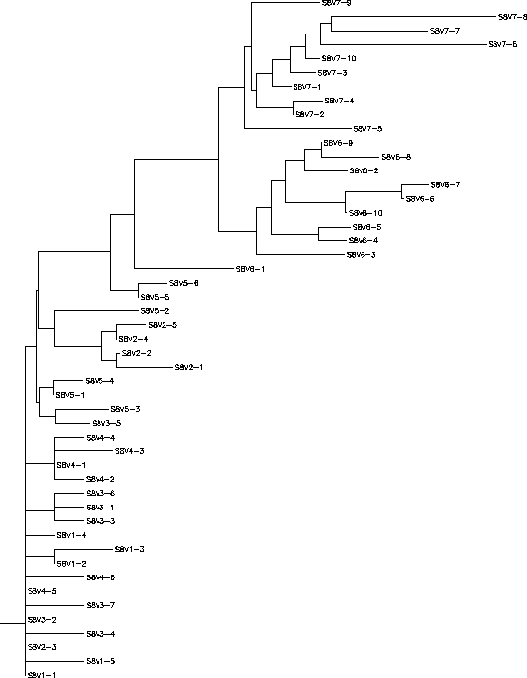
Phylogenetic Trees Showed Diversity due to Divergent Evolution
Subject 8
Notes:
For 4, make sure to mention test for normality during presentation
Change in procedure assumes that, in general, clones will not regress back to seroconversion sequence

Slide 13
Outline
The env gene is important in the host invasion, immune system evasion, and survival of HIV-1.
Markham et al. (1998) found that a greater genetic diversity and divergence of env was associated with rate of CD4 T cell decline in human subjects.
We re-analyzed data from the Markham et al. (1998) to look for an inverse correlation between env genetic divergence and CD4 T cell count in select subjects.
We found no significant correlation between genetic divergence and CD4 T cell count.
Future studies should address the limitations posed by the methods of this study.

Slide 14
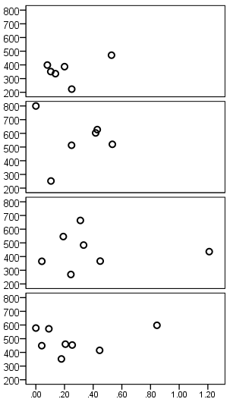
CD4 T Cell Count Was Not Significantly Correlated With Divergence in Individual Subjects
Subject 6: r=.40, p=.43
(n = 6)
Subject 8: r=-.031, p=.95
(n = 6)
Subject 9: r=.0055, p=.99
(n = 7)
Subject 14: r=.20, p=.63
(n = 8)
CD4 T Cell Count
Divergence [ (|(θ2-θ1)/θ1|)/time ]
Notes:
Be sure to explain to your audience what r and p mean.
For 4, make sure to mention test for normality
HIV-1 mutates to avoid recognition by the host immune response. This allows the virus to chronically replicate and to eventually wear down the body's defenses by destroying the very cells necessary to coordinate an effective immune response¹. A key feature of immune escape is the ability of HIV-1 to conceal itself from neutralizing antibodies that would otherwise bind the virus and block its entry into cells.

Slide 15
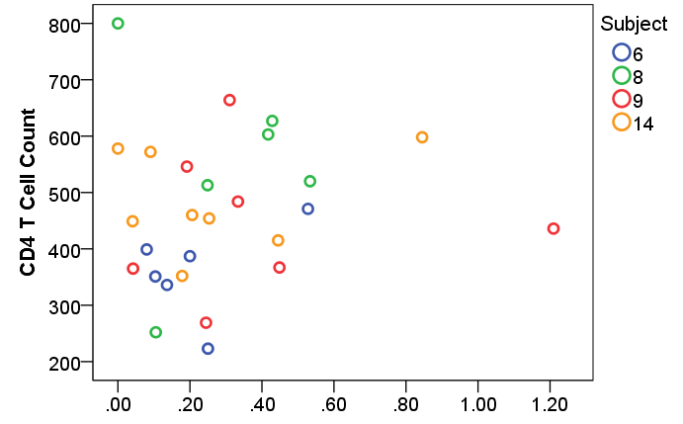
CD4 T Cell Count Was Not Significantly Correlated With Divergence in the Combined Data
(r=.090, n=27, p=.66)
Divergence [ (|(θ2-θ1)/θ1|)/time ]
Notes:
For 4, make sure to mention test for normality during presentation

Slide 16
Lack of Correlation was Likely Due to Method Limitations
We only analyzed subjects 6, 8, 9, and 14.
- Analyzing other moderate progressors would increase sample size and decrease standard error
- Including other groups might show more easily detectable differences between subjects.
- Subject 9 had especially high diversity.
We did not use the same measure of divergence used by Markham et al. (1998).
- Greater time and manpower would allow us to do this in the future.
Future studies should include all subjects and calculate divergence as in the original.
Recent studies show co-linear increase in genetic divergence and diversity, a plateau, and then possibly a decrease (Merk & Subramaniam 2013).
Notes:
For 4, make sure to mention test for normality
Do you think your results were influenced by the fact that as moderates, the CD4 count was not changing much and the divergence was not changing too much either? What do you think would happen if you included rapids and nons where, at least in rapids, the divergence should be increasing and the CD4 should be decreasing?

Slide 17
Summary
The env gene codes for gp120, which is important in the host invasion, immune system evasion, and survival of HIV-1.
Markham et al. (1998) found increased divergence of the V3 region of gp120 of HIV-1 in subjects with greater rates of CD4 T cell decline.
We used tests for correlation to analyze divergence and CD4 T cell decline in four moderate progressors with the most sequence data from the Markham et al. (1998) dataset.
We did not find a correlation between CD4 T cell count and the divergence of the V3 region in HIV-1.
Other studies have shown co-linear increase and plateau of diversity and divergence in various pathogens.
Future studies should include all subjects of Markham et al. and only alter the statistical test.

Slide 18

Acknowledgements
Anu Varshneya
Mia Huddleston
Kam D. Dahlquist, Ph.D.

Slide 19
References
Evering, T. H., Kamau, E., St. Bernard, L., Farmer, C. B., Kong, X.-P., & Markowitz, M. (2014). Single genome analysis reveals genetic characteristics of Neuroadaptation across HIV-1 envelope. Retrovirology, 11, 65. http://doi.org/10.1186/s12977-014-0065-0
Gall, A., Kaye, S., Hué, S., Bonsall, D., Rance, R., Baillie, G. J., … Kellam, P. (2013) Restriction of V3 region sequence divergence in the HIV-1 envelope gene during antiretroviral treatment in a cohort of recent seroconverters. Retrovirology, 10, 8. http://doi.org/10.1186/1742-4690-10-8\
Oliver, A., Cantón, R., Campo, P., Baquero, F., & Blázquez, J. (2000). High frequency of hypermutable Pseudomonas aeruginosa in cystic fibrosis lung infection. Science, 288(5469), 1251-1253.
Markham, R. B., Wang, W.-C., Weisstein, A. E., Wang, Z., Munoz, A., Templeton, A.,… Yu, X.-F. (1998). Patterns of HIV-1 evolution in individuals with differing rates of CD4 T cell decline. Proceedings of the National Academy of Sciences of the United States of America, 95(21), 12568–12573.
Mascola, J. R., & Montefiori, D. C. (2003). HIV-1: nature's master of disguise. Nature medicine, 9(4), 393-394.
Merk, A., & Subramaniam, S. (2013). HIV-1 envelope glycoprotein structure. Current Opinion in Structural Biology, 23(2), 268–276. http://doi.org/10.1016/j.sbi.2013.03.007
Müller, F. (2009). Assessing Antibody Neutralization of HIV-1 as an Initial Step in the Search for gp160-based Immunogens (Doctoral dissertation, Universität des Saarlandes Saarbrücken).
Wang, W., Nie, J., Prochnow, C., Truong, C., Jia, Z., Wang, S., … Wang, Y. (2013). A systematic study of the N-glycosylation sites of HIV-1 envelope protein on infectivity and antibody-mediated neutralization. Retrovirology, 10, 14. http://doi.org/10.1186/1742-4690-10-14

