Slide 1
E.coli Tic Tacs
Dustin Ebert
Sufia Munim
Sudeep Shakya

Slide 2
The aim of the project is to…
Create an E. coli that glows green while smelling like wintergreen in presence of salicylic acid.

Slide 3
Biobrick parts used…
Wintergreen gene (BBa_J45004)
Salicylic acid → methyl salicylate
Methyl salicylate smells like wintergreen
Green Fluorescent Protein (BBa_E0040)
Turns the recombinant E.coli green
Promoter (BBa_I0500)
induced by L-arabinose

Slide 4
Project overview
To isolate the Biobricks parts necessary for the project. Next step is to add and ligate parts together in four different experimental arrangements.
Promoter–Wintergreen gene
Promoter-GFP
Promoter-Wintergreen-GFP
Promoter-GFP-Wintergreen gene
The biobricks would all end up arranged on a pSB1A3 plasmid except for (b) which would be on a pSB1A2 plasmid.

Slide 5
Project overview
2. Experiment with different concentration of
L-Arabinose to examine the promoter activity.
3. If time permits, we will look for a promoter that allows this arrangement:
Regular
Promoter
Wintergreen gene
Methyl salicylate
Induced promoter
GFP
This would prove that the wintergreen smell has been expressed in the culture. We might be able to find a methyl salicylate induced promoter in nature.

Slide 6
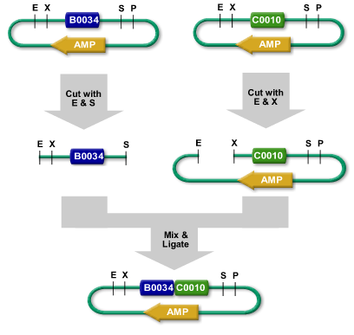
Protocols
Since all the parts we are using are Biobricks , we won’t need to do PCR.
Use standard Biobricks restriction sites to cut out and arrange our parts.

Slide 7
Protocols
Promoter→Wintergreen gene
Cut promoter out and add to wintergreen plasmid
Promoter→GFP gene
Cut promoter out and add to GFP plasmid

Slide 8
Protocols
Promoter→Wintergreen→GFP
Cut promoter out and add to wintergreen plasmid
Cut GFP out and add it to our plasmid after the wintergreen plasmid.
Promoter→GFP→Wintergreen
Cut promoter out and add it to GFP
Cut promoter-GFP product out and add to wintergreen plasmid.

Slide 9
Testing the gene expression
Smell it.
If the promoter-wintergreen-GFP arrangement glows/green, we could assume that the wintergreen gene was expressed.
Try to find Methyl salicylate induced promoter.

Slide 10
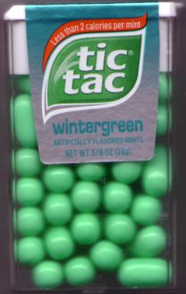
The end result

