Slide 1
The Cloning of Atrolysin A from Crotalus atrox
By AJ Goos
&
Kayla Ohrt

Slide 2
Atrolysin A
Comes from Crotalus atrox which is the Western Diamondback Rattlesnake.
We have attained a tissue sample from the Kentucky Reptile Zoo.
Atrolysin A is a hemorrhagic toxin that works by not allowing platelet adhesion, and works only in a neutral pH.
In acidic conditions the venom denatures.

Slide 3
The Atrolysin A has been sequenced in mRNA form. The Genbank accession number is U01234.
The mRNA is 1640 base pairs and the coding region is 1263 base pairs. The coding region starts at base pair 1 and codes to 1263.
If the gene would amplify with PCR we would need to make sure it wasn’t larger than 1260 base pairs.

Slide 4
Primers Sequence
- 5‘gaattcgcggccgcttctagag atg gaaagactca ccaaaagata tgttgacctt gtcatagtt 3'
5' gaaagactca ccaaaagata tgttgagctt gtcatagttg cggatcaccg aatgttcacg aaatacaacg gcaatttaaa aaagataaga aaatggatat atcaaattgt caacactata aatgagattt acataccttt gaatattcgt gtcgcactgg ttcgcctaga aatttggtcc aacggagatt tgattgatgt gacatcagca gcaaatgtta ctttgaagtc atttggaaac tggagagtga caaatttgct gaggcgcaaa agtcatgata atgctcagtt actcacggcc attgatcttg atgaagaaac tttaggattg gctcctttgg gcaccatgtg tgacccgaag ctttctatag gaattgttca ggatcatagt ccaataaatc ttttggttgc agttacaatg gcccatgagc tgggtcataa tctgggcatg gttcatgatg aaaatcggtg tcattgcagt actcccgcat gcgttatgtg tgctgtgcta aggcaacgac cttcctatga gttcagcgat tgtagtctga atcactatcg aacgtttatt atcaattata acccacaatg cattctcaat gaacccttgc aaacagatat aatttcacct ccagtttgtg gaaatgaact tttggaggtg ggagaagaat gcgactgtgg ctctcctaga acttgtcgag atccatgctg tgatgctgca acctgtaaac tacactcatg ggtagagtgt gaatctggag agtgttgtca gcaatgcaaa tttacgagtg caggaaatgt atgccggcca gcaaggagtg agtgtgacat tgctgaaagc tgcactggcc aatctgctga ctgtcccaca gatgacttcc ataggaatgg aaaaccatgc ctacacaact tcggttactg ctacaatggg aattgcccca tcatgtatca ccaatgttat gctctctggg ggtcaaatgt aactgtggct ccagatgcat gttttgatat taaccagagc ggcaataatt ctttctactg cagaaaggaa aatggtgtaa atattccatg
Forward Mutagen 5'ggcaataattctttctactgcagaaaggaaaatggtgtaa 3'
Reverse Mutagen 5'ttacaacattttcctttctgcagtagaaagaattattgcc 3'
tgcacaagag gatgtaaagt gtggcaggtt attctgcaat gttaatgatt ttctatgccg acacaaatat tcagatgatg gaatggttga tcatggaaca aaatgcgcag atggaaaggt ctgcaaaaac aggcagtgtg ttgatgtgac tacagcctac aaatcaacct ctggcttctc
3'atgtcggatg tttagttggag acggaagagtcagatttgaagtctaaact gacgtcgccggcgatgatcat 5'-suffix

Slide 5
PCR Primer Sequences
Forward: 5’ ATG GAA AGA CTC ACC AAA AGA TAT GTT GAC CTT GTC ATA GTT G 3’
Reverse Primers: 5’ TCA AAT CTG AGA GAA GCC AGA GGT TGA TTT GTA GGC TGT A 3’
Mutagen Forward Site 5’- GGC AAT AAT TCT TTC TAC TGC AGA AAG GAA AAT GTT GTA A - 3’
Mutagen Reverse Site 5'- TTA CAA CAT TTT CCT TTC TGC AGT AGA AAG AAT TAT TGC C -3'

Slide 6
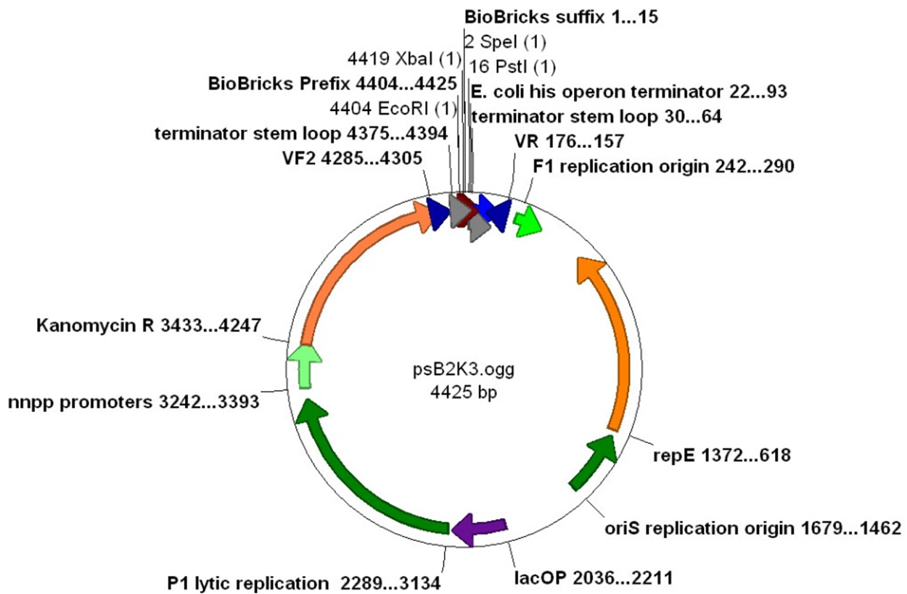
Promoter pBad/araC, 1200 Bp
L-arabinose inducible & Kanomycin Resistant
Plasmid backbone-pSB 2K3.ogg
BBa_I0500

Slide 7
1st DNA Extraction Protocol
A. B. L. C. D.
We ran Undigested and Digested samples of the DNA
Only faint banding was seen
Undigested B DNA
Digested B DNA
1000 Bp ladder
Undigested A DNA
Digested A DNA

Slide 8
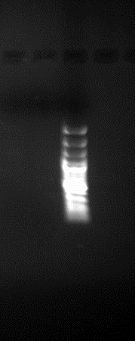
1st Extraction w/ more tissue
A. B. L.
Doubled amount of tissue.
Left it in the incubator/shaker for 72 hours.
Didn’t dilute sample as much.
Result: no DNA either, but still tried a PCR on the 1st extraction.
A. Sample 1
B. Sample 2
L. 1000 Bp Ladder

Slide 9
PCR
L. A. B. C. D. L. E. F. G.
Nothing was amplified.
DNA probably was not present.
L. 1000 Bp Ladder
A. Positive control
B. Primer set 2 Negative control
C. DNA Sample #2 Primer set 2
D. DNA Sample #1 Primer set 2
L. 1000 Bp Ladder
E. Primer set 1 Negative control
F. DNA sample #2 Primer set 1
G.DNA sample #1 Primer set 1

Slide 10
2nd DNA Extraction Protocol
L. A. B. C.
Bands were seen at 3,000+ Bp.
Likely to be DNA.
L. 1000 Bp Ladder
A. Sample #1 Undigested
B. Sample #1 Digested
C. Sample #3 Digested

Slide 11
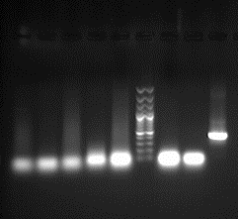
PCR of 2nd DNA Extraction
A. B. C. D. E. L. F. G. H.
The "A" samples contain 5 microliters of DNA and the "E" samples contain 0.5 microliter of DNA.
There were no bands present which meant that the amplification did not work.
*Stock Solution of Primers was used.*
A. A1 Sample (65 degrees)
B. E1 Sample (65 degrees)
C. A2 Sample (55 degrees)
D. E2 Sample (55 degrees)
E. A3 Sample (50 degrees)
L. 1000 Bp Ladder
F. E3 Sample (50 degrees)
G. Neg. Control (50 degrees)
H. Pos. Control (50 degrees)

Slide 12
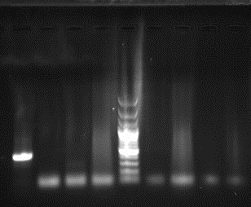
PCR w/modifications of 2nd Extraction
A. B. C. D. L. E. F. G. H.
Same concentrations and temperatures were used.
*Working solution primers were used.*
No bands showed up on the gel.
A. Pos. Control (50 degrees) (400 bp mark)
B. Neg. Control (50 degrees)
C. E3 Sample (50 degrees)
D. A3 Sample (50 degrees)
L. 1000 Bp Ladder
E. E2 Sample (55 degrees)
F. A2 Sample (55 degrees)
G. E1 Sample (65 degrees)
H. A1 Sample (65 degrees)

Slide 13
PCR w/ Lower temps
A. B. C. L. D. E.
This is the gel of the PCR that we had ran 5 microliters of DNA sample #3.
Lowered our PCR temperatures 5 degrees overall. No bands were seen in the in the sample lanes except for A3.
The Positive control was seen at the 400 Bp mark.
Pos. Control (45 degrees) (400 Bp mark)
Neg. Control (degrees)
A3 (at 45 degrees)
1000 Bp ladder
A2 (at 50 degrees)
A1 (at 60 degrees)

Slide 14
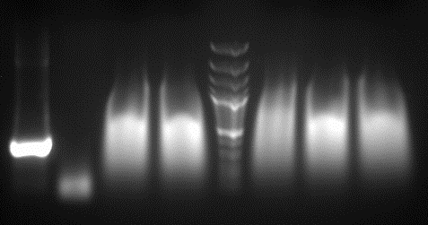
PCR of High DNA Concentration
A. B. C. D. L. E. F. G.
We used samples 1 and 2 which were more concentrated.
Used wider temperature range.
Used 5mintues for extension time.
No definite bands.
No more DNA to use.
A. Pos. Control (45 degrees) (400 bp mark)
B. Neg. Control (45 degrees)
C. A5 Sample (45 degrees)
D. A4 Sample (48.8 degrees)
L. 1000 Bp Ladder
E. A3 Sample (57 degrees)
F. A2 Sample (61 degrees)
G. A1 Sample (65 degrees)

Slide 15
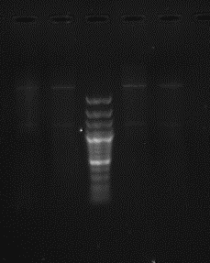
Plasmid Prep
A. B. L. C. D.
The bands that showed up were light, but present. They showed up around the 1200 bp mark and the 4425 bp mark.
1200 bp= insert
4425 bp= backbone
A. K4 Sample
B. K3 Sample
L. 1000 Bp Ladder
C. K2 Sample
D. K1 Sample

Slide 16
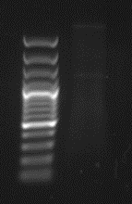
Destination Plasmid
A B
Banding seen at 1200 bp and 4425 bp.
1200 bp= insert
4425 bp= backbone
A.1000 Bp Ladder
B. Insert w/Backbone

Slide 17

Conclusion
Size of gene
Intron possibility
Primers possible don’t work

Slide 18
References
"Agarose gel electrophoresis." OpenWetWare. October 2012. http://openwetware.org/wiki/Agarose_gel_electrophoresis.
Anderson, John. Part:BBa_I0500. 4 Aug. 2006. Registry of Standard Biological Parts. 4 Aug. 2006. http://partsregistry.org/wiki/index.php?title=Part:BBa_I0500.
"Crotalus atrox hemorrhagic toxin a, atrolysin a (Ht-a) mRNA, partial cds." National Center for Biotechnology Information. 2012. http://www.ncbi.nlm.nih.gov/nuccore/U01234.1.
Eguchi, Tomoko and Yukinori. High yield DNA extraction from the snake cast-off skin or bird feathers. 19 May 2000. University of Ryukyus. 19 May 2000. http://scholar.google.com/scholar?hl=en&q=getting+DNA+from+snake+skin&btnG=&as_sdt=1%2C16&as_sdtp.
Fetzner, James W. Extracting High-Quality DNA from Shed Reptile Skins: A Simplified Method. June 1999. Brigham Young University. June 1999. http://www.biotechniques.com/multimedia/archive/00014/99266bm09_14694a.pdf.
Site-Directed Mutagenesis. 22 Aug. 2012. Wikipedia. 22 Aug. 2012. http://en.wikipedia.org/wiki/Site-directed_mutagenesis.
"Standard PCR Setup." Openwetware. October 2012. http://openwetware.org/wiki/840:153g:Materials.

