Slide 1
GRN MAPPING DCIN5/WILDTYPE

Slide 2
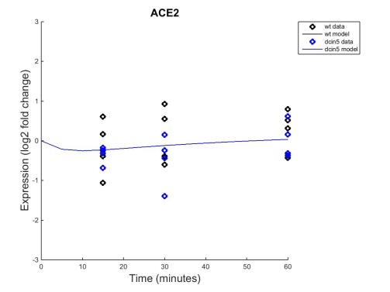
Estimate-b

Slide 3
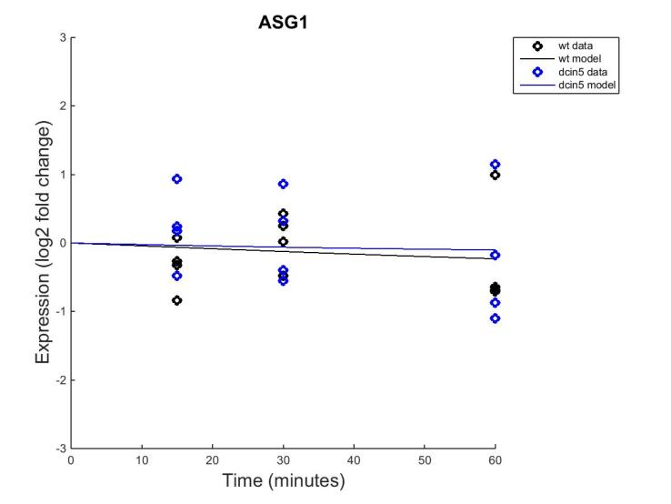
Estimate-b

Slide 4
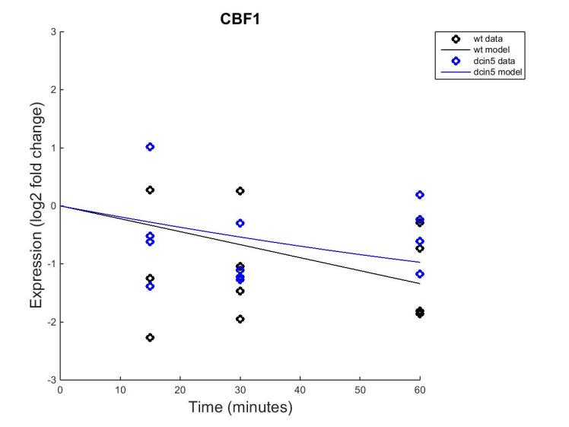
Estimate-b

Slide 5
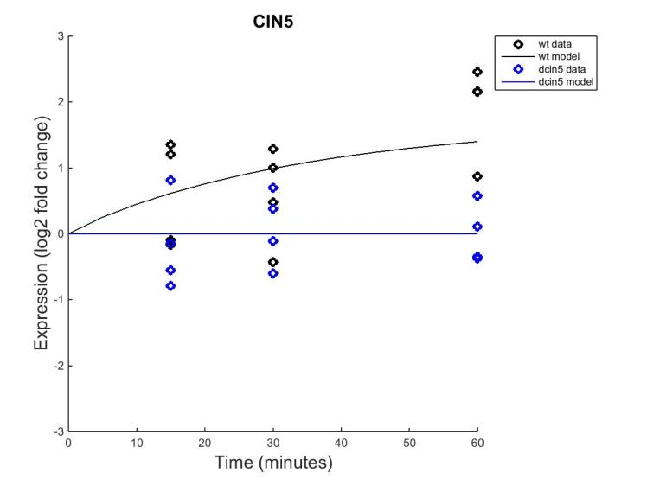
Estimate-b

Slide 6
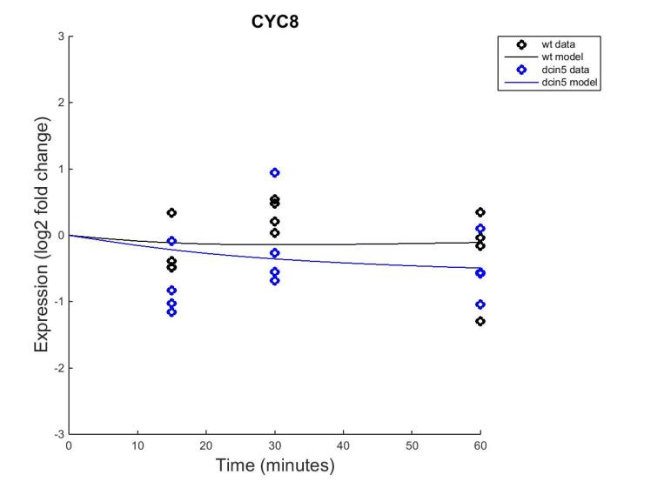
Estimate-b

Slide 7
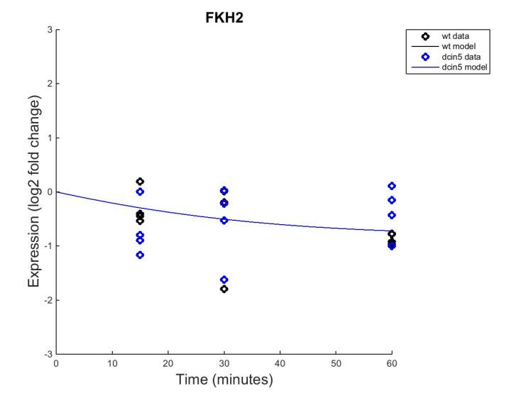
Estimate-b

Slide 8
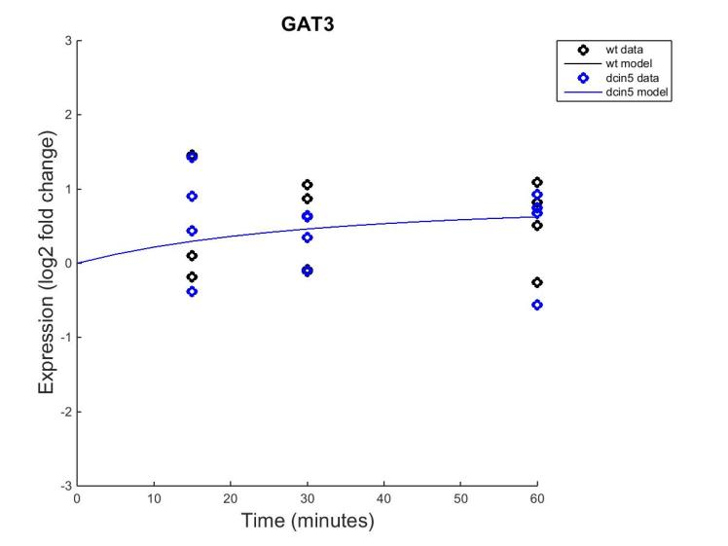
Estimate-b

Slide 9
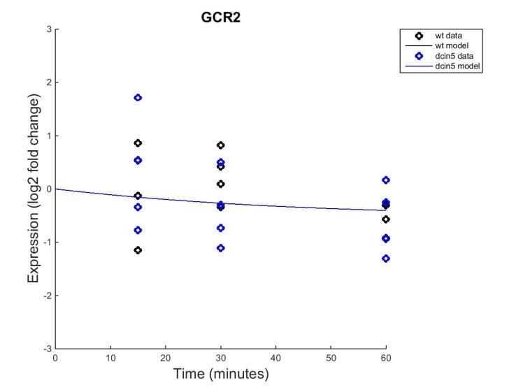
Estimate-b

Slide 10
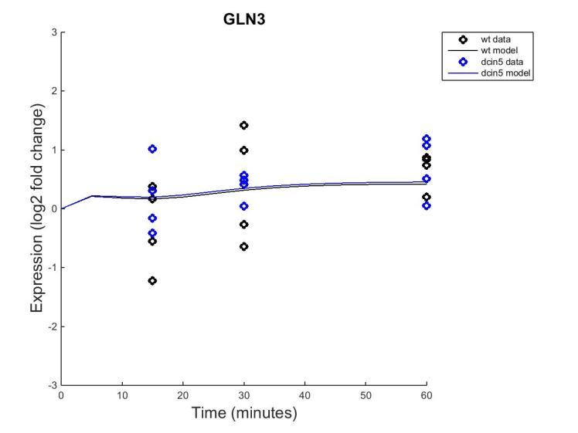
Estimate-b

Slide 11
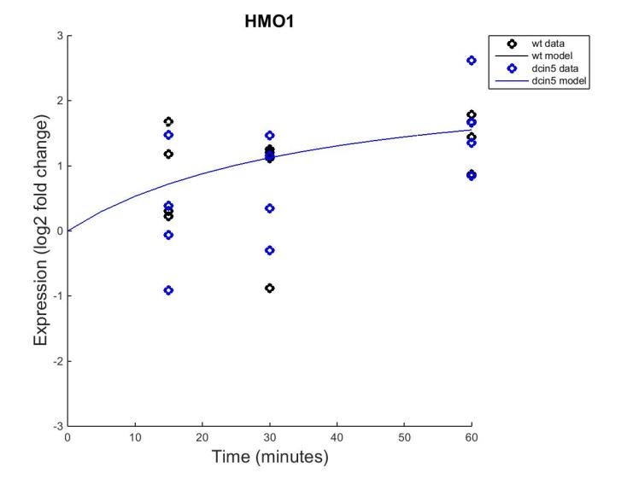
Estimate-b

Slide 12
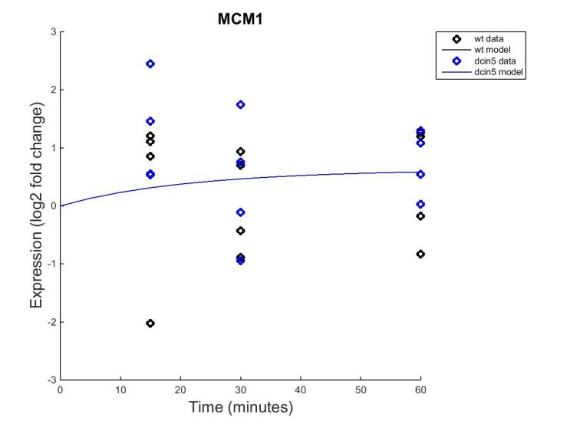
Estimate-b

Slide 13
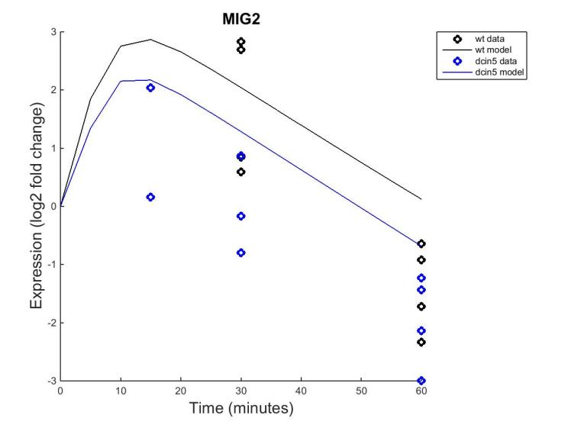
Estimate-b

Slide 14
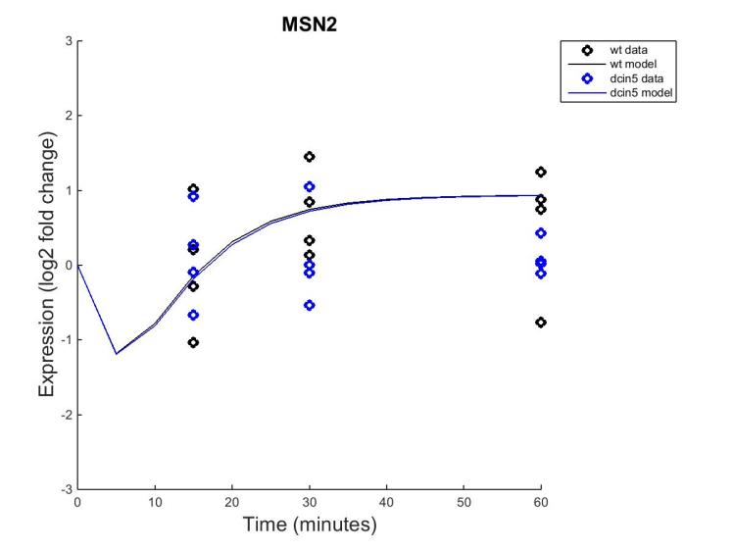

Slide 15
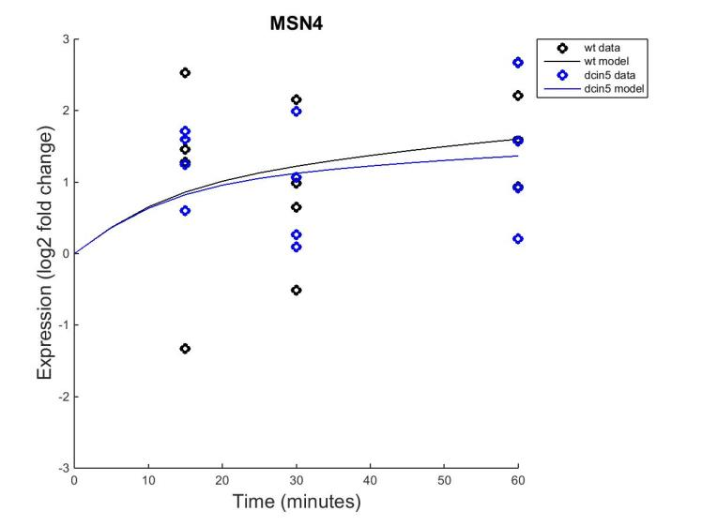
Estimate-b

Slide 16
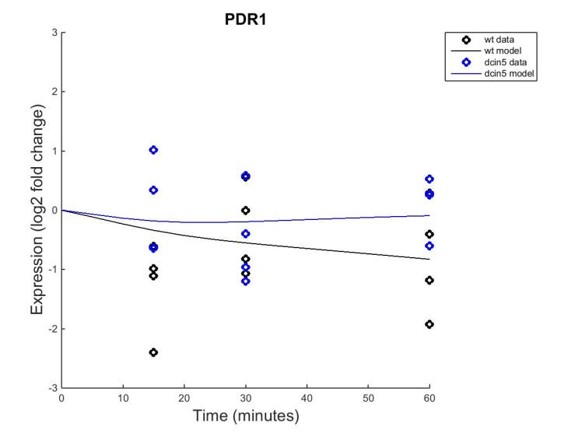
Estimate-b

Slide 17
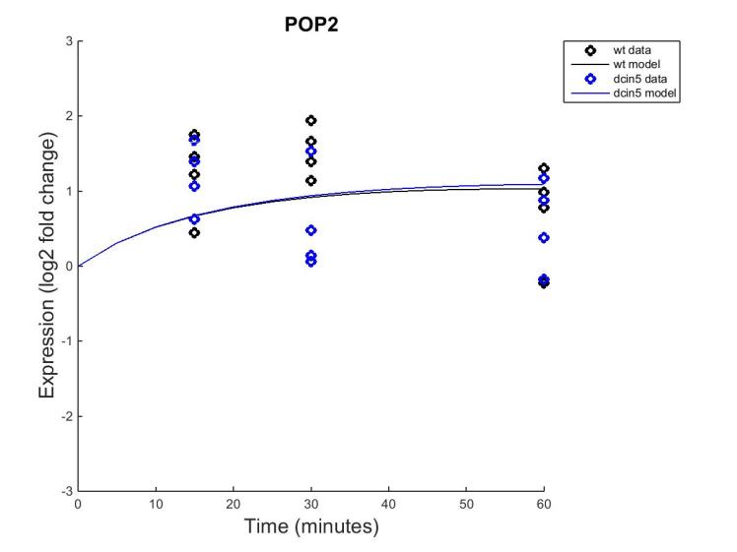
Estimate-b

Slide 18
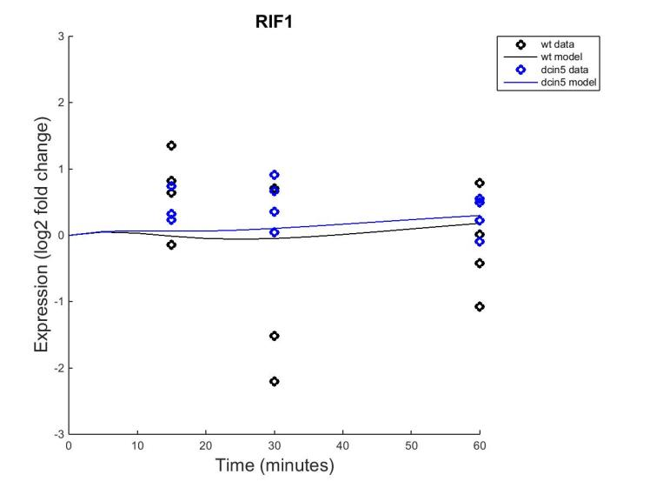
Estimate-b

Slide 19
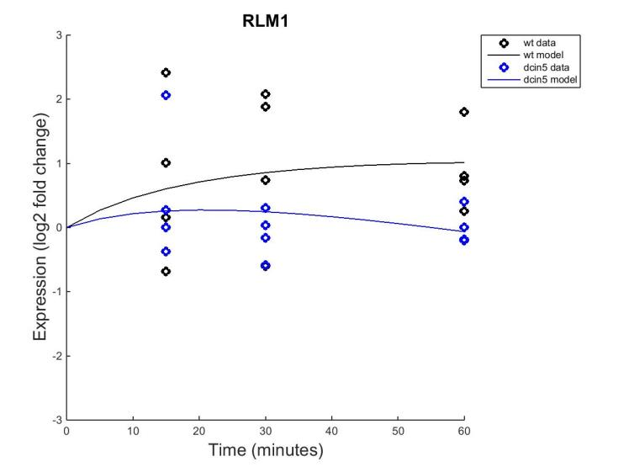
Estimate-b

Slide 20
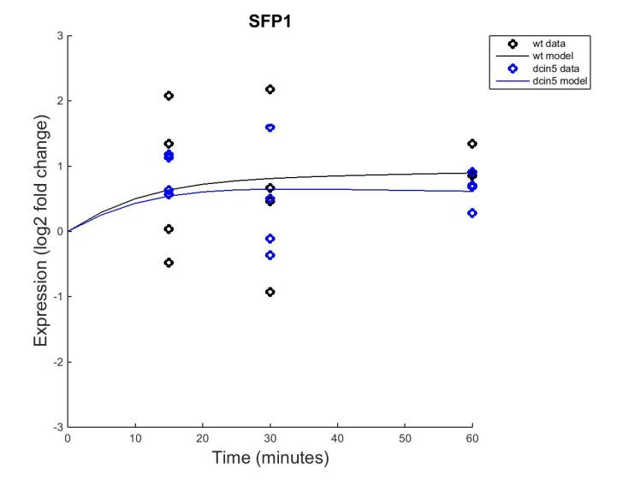
Estimate-b

Slide 21
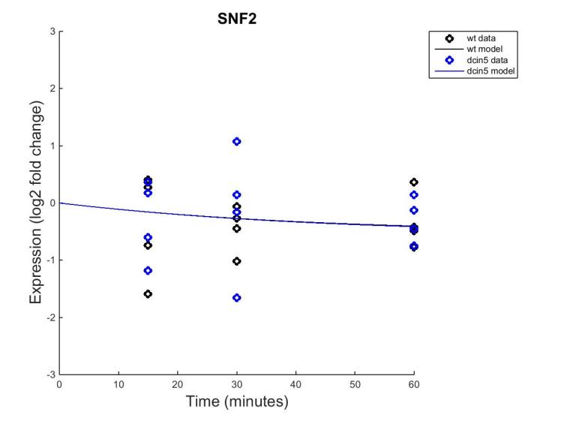
Estimate-b

Slide 22
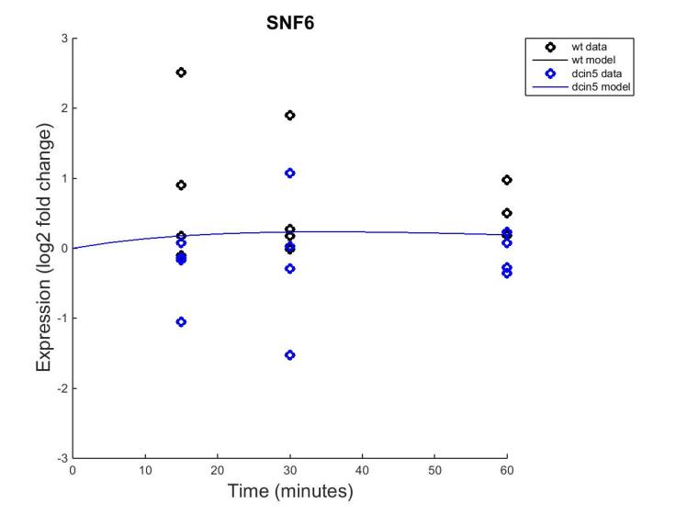
Estimate-b

Slide 23
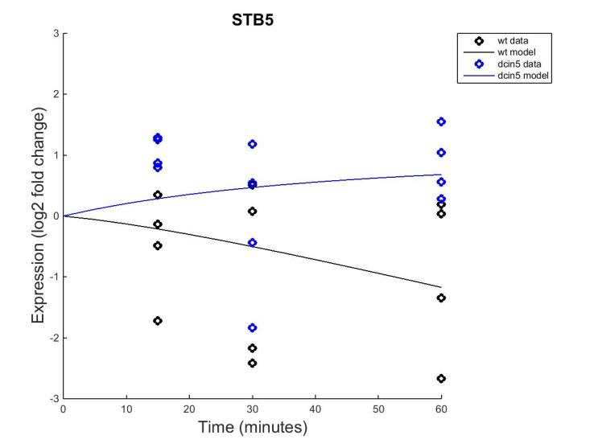
Estimate-b

Slide 24
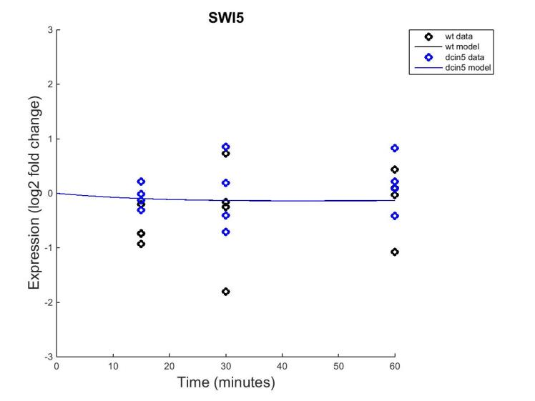
Estimate-b

Slide 25
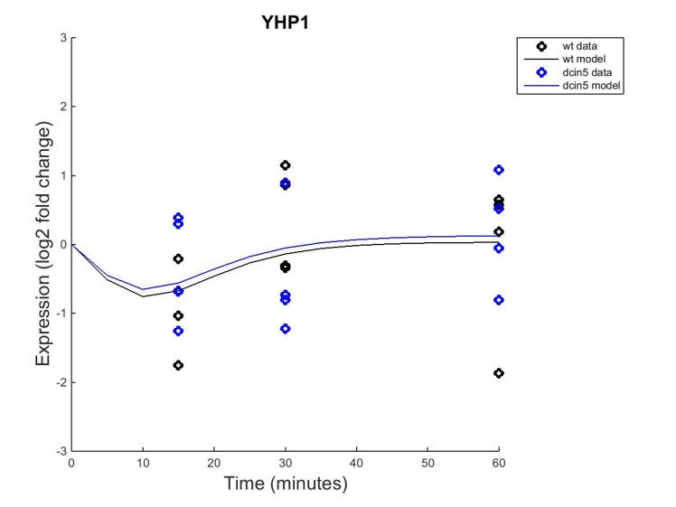
Estimate-b

Slide 26
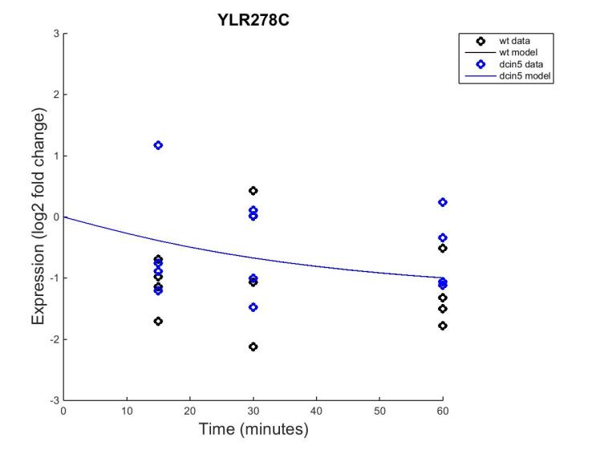
Estimate-b

Slide 27
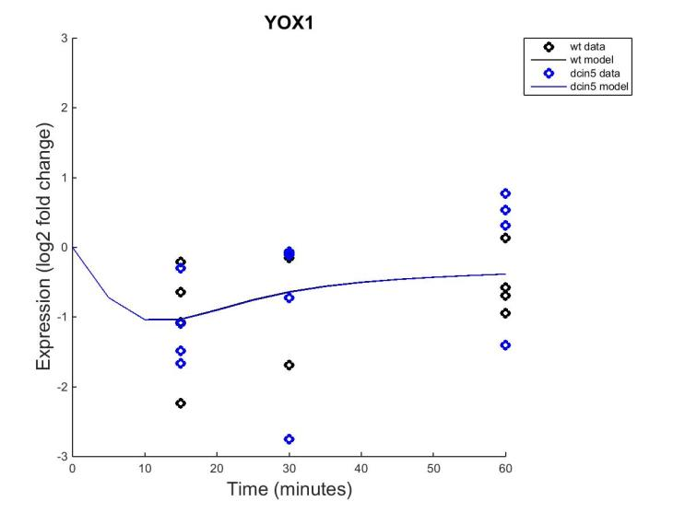
Estimate-b

Slide 28
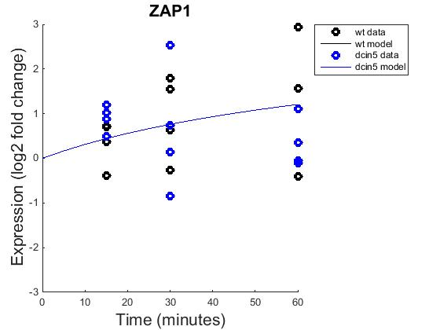
Estimate-b

Slide 29
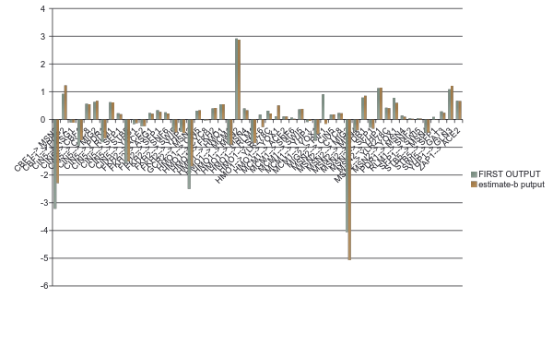
Weighted Values Comparison

Slide 30
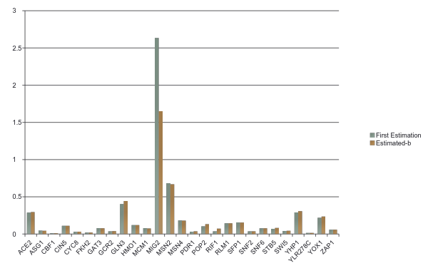
Production Rates Comparison

Slide 31
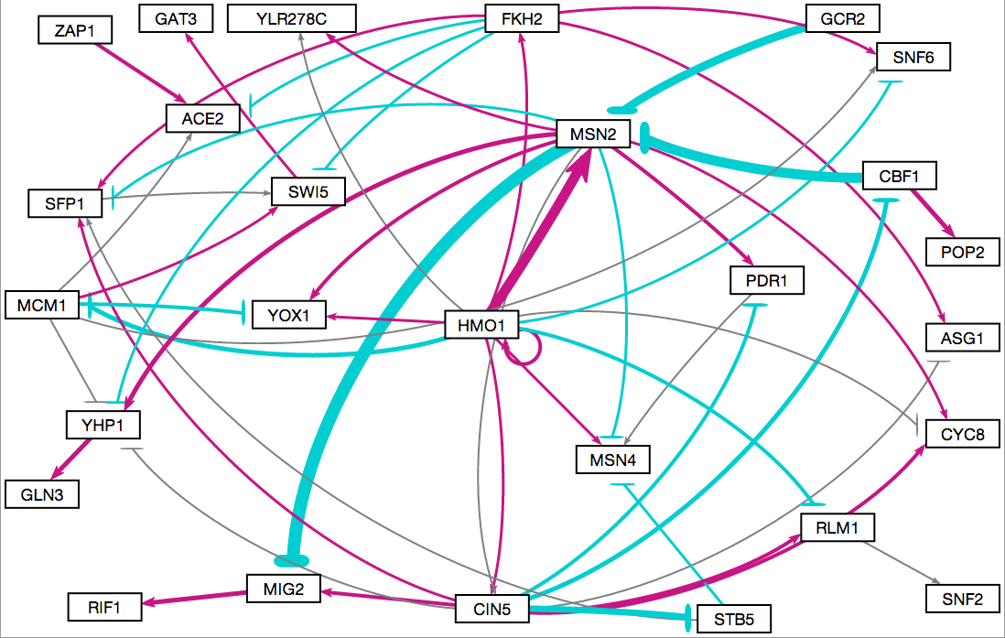
First Approximation

Slide 32
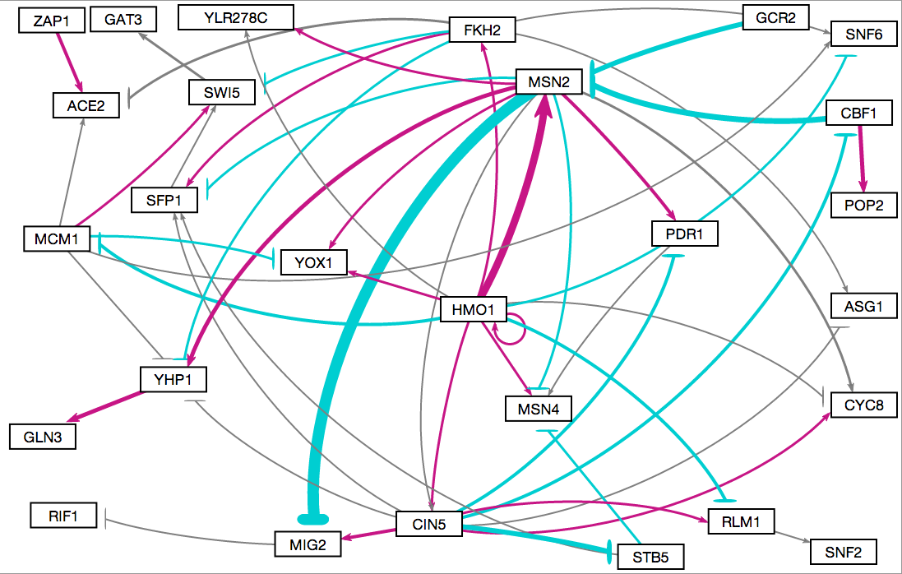
Second Approximation

Slide 33
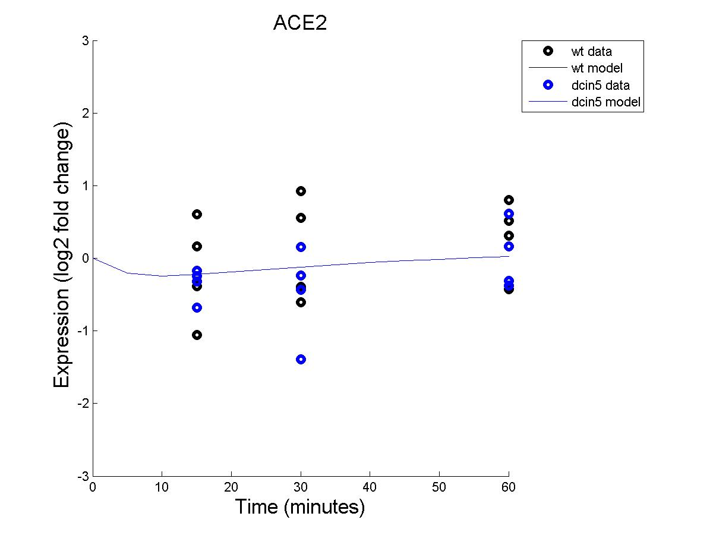
First Analysis

Slide 34
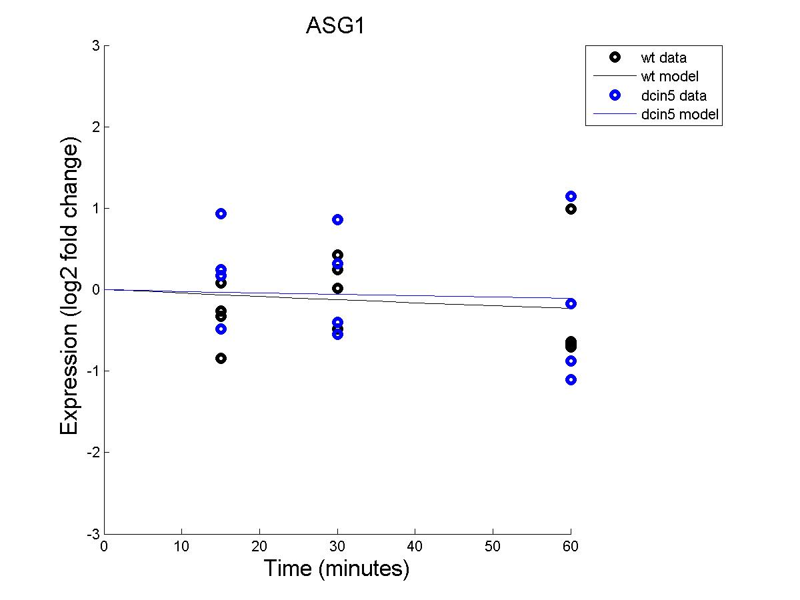
First Analysis

Slide 35
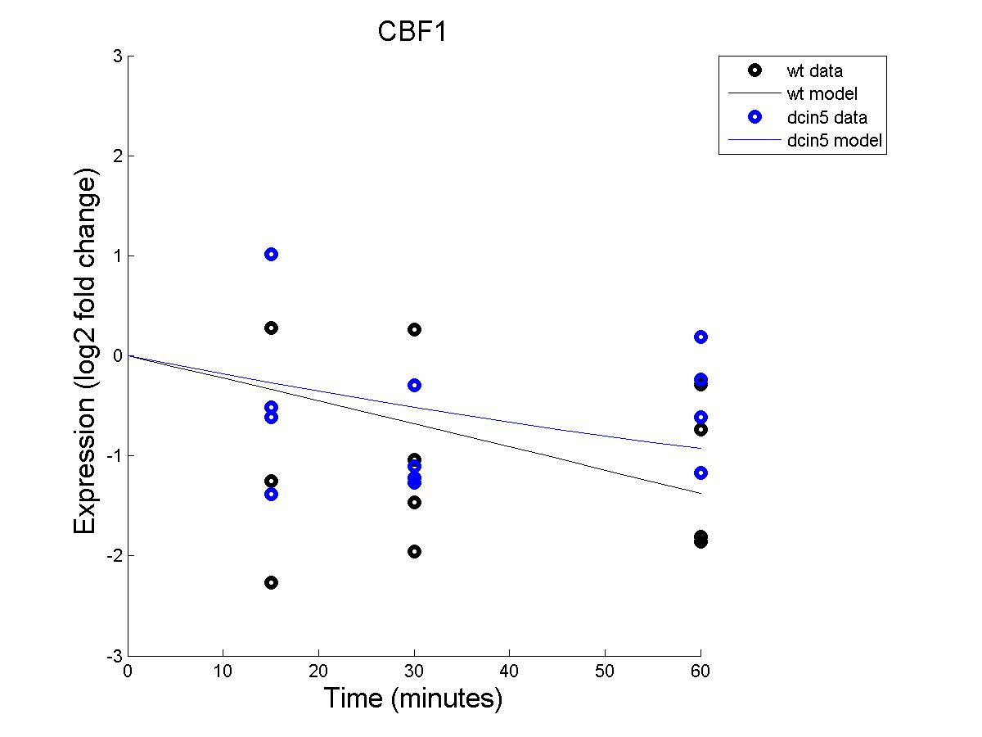
First Analysis

Slide 36
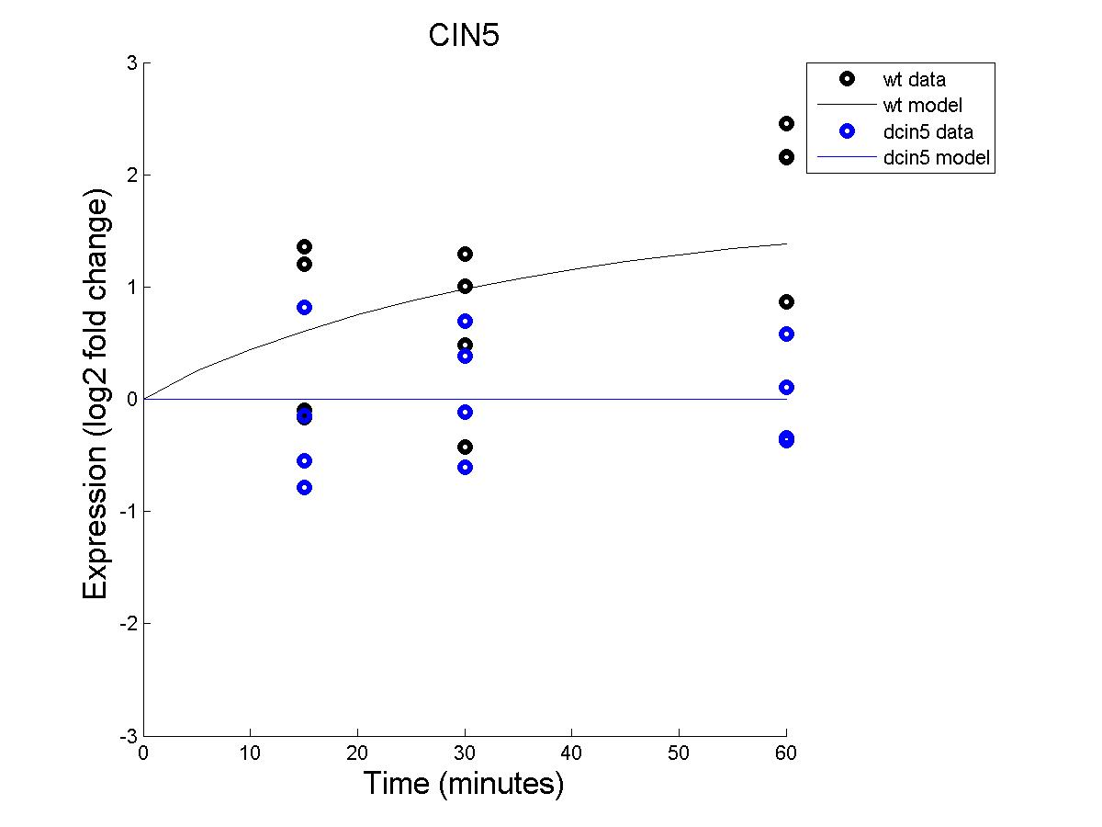
First Analysis

Slide 37
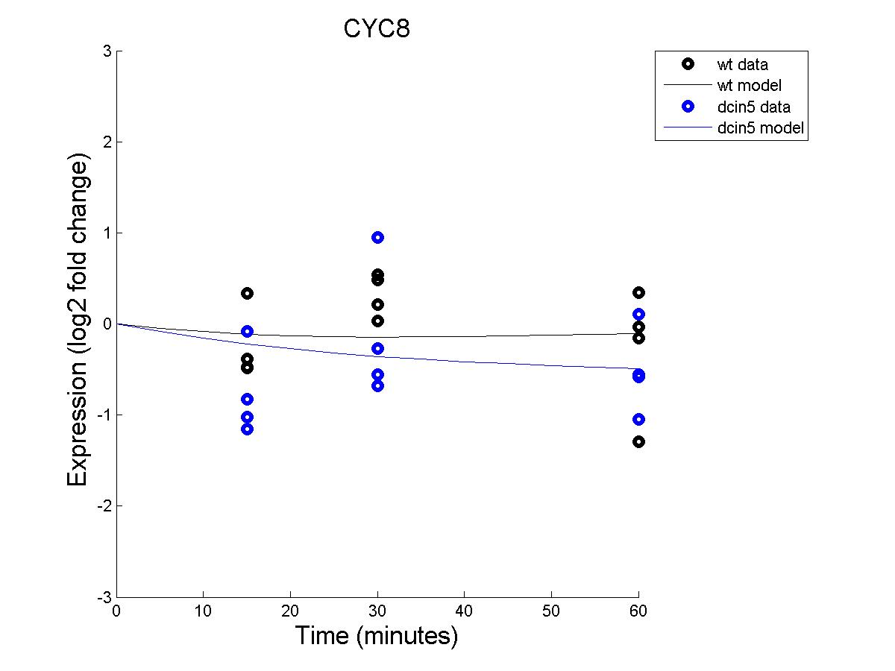
First Analysis

Slide 38
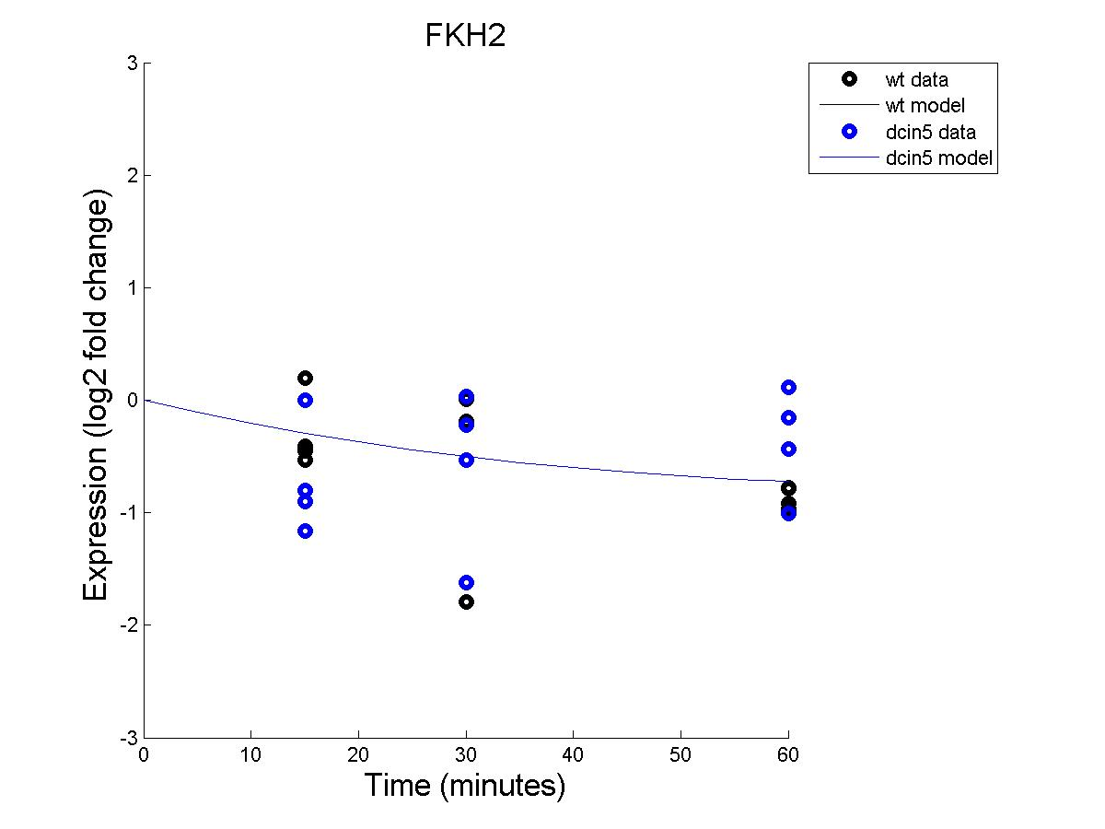
First Analysis

Slide 39
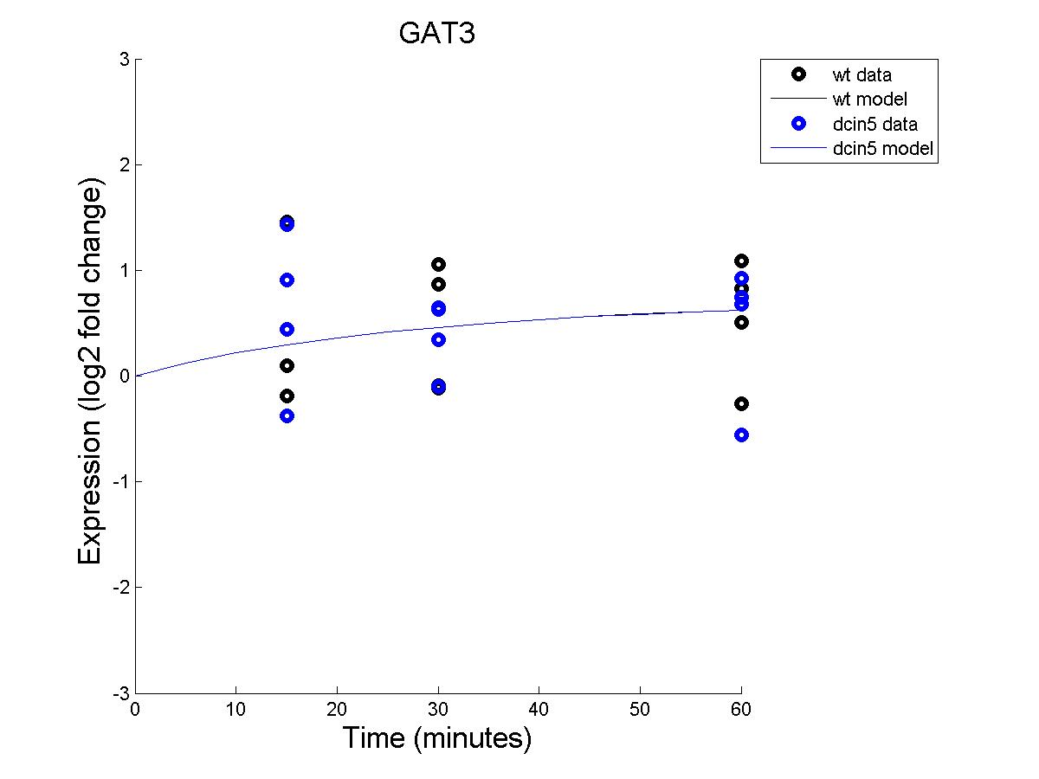
First Analysis

Slide 40
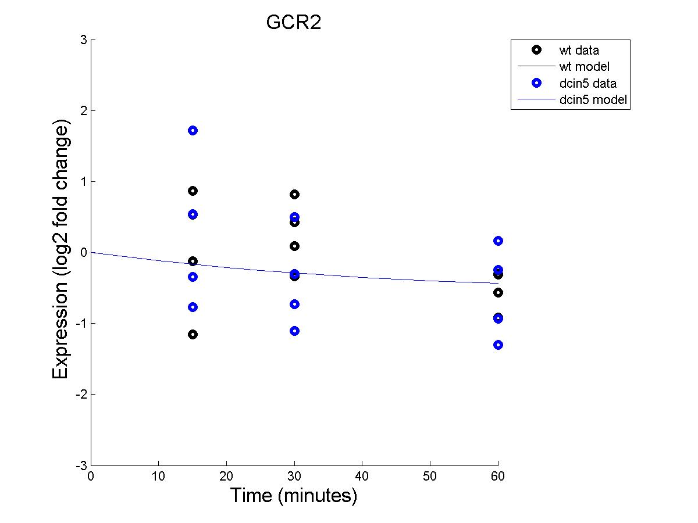
First Analysis

Slide 41
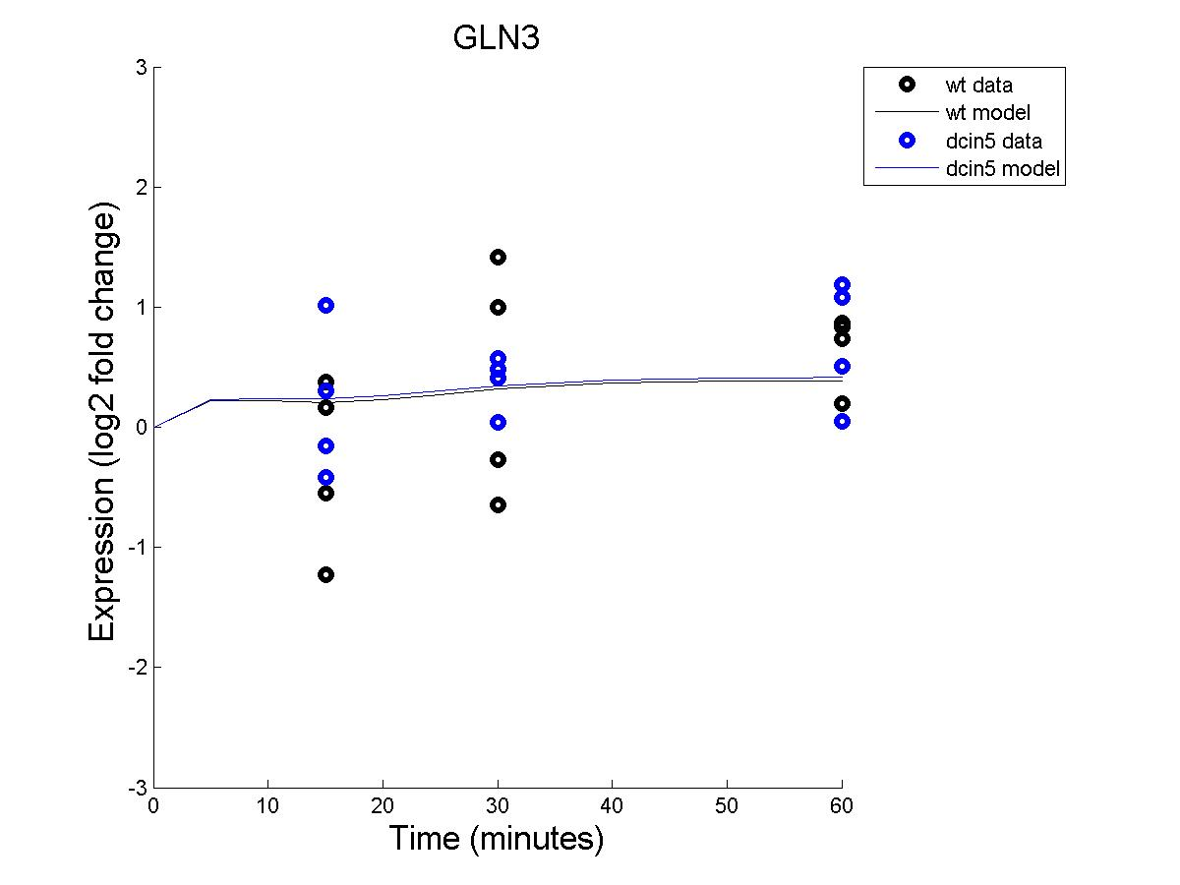
First Analysis

Slide 42
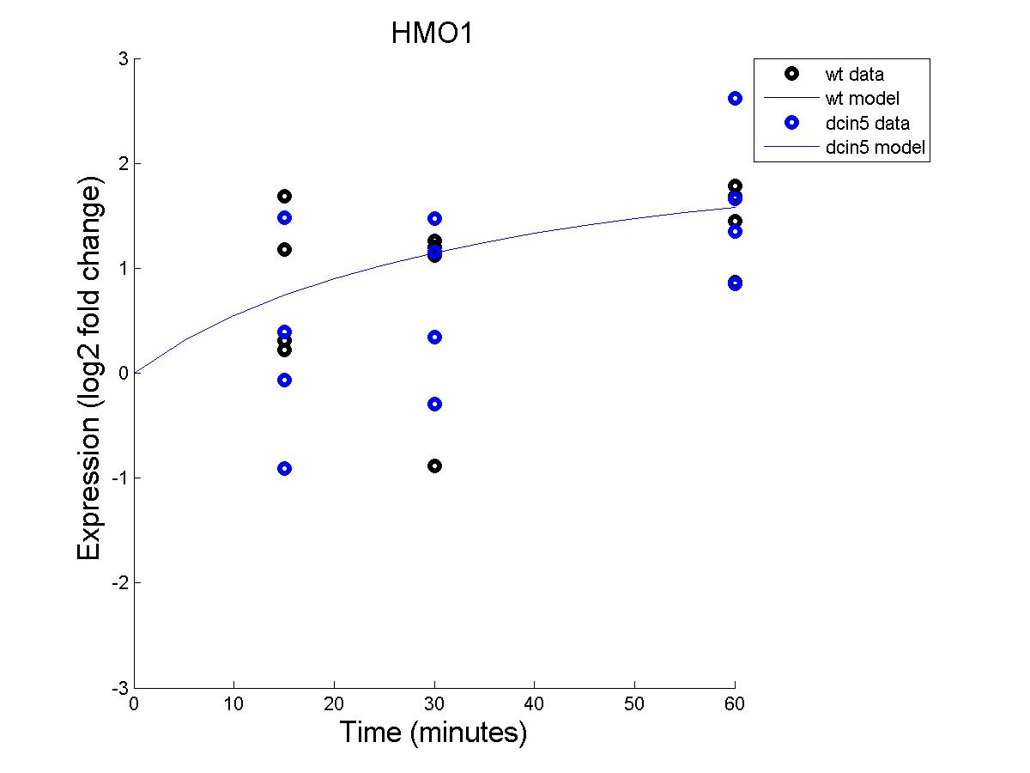
First Analysis

Slide 43
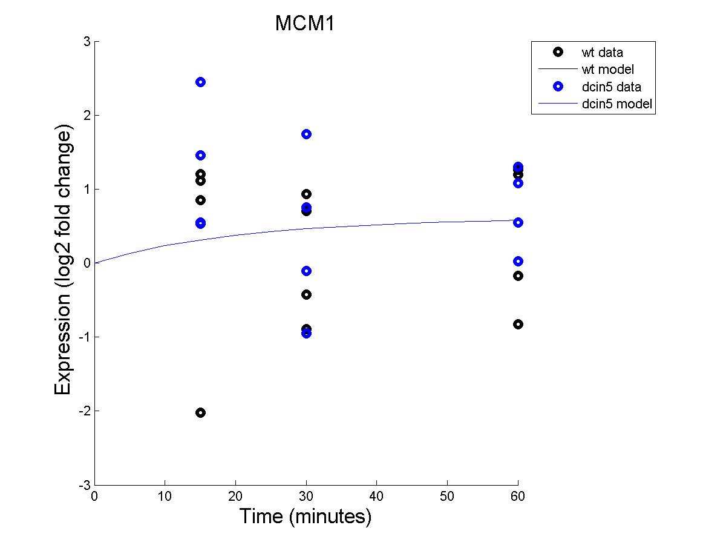
First Analysis

Slide 44
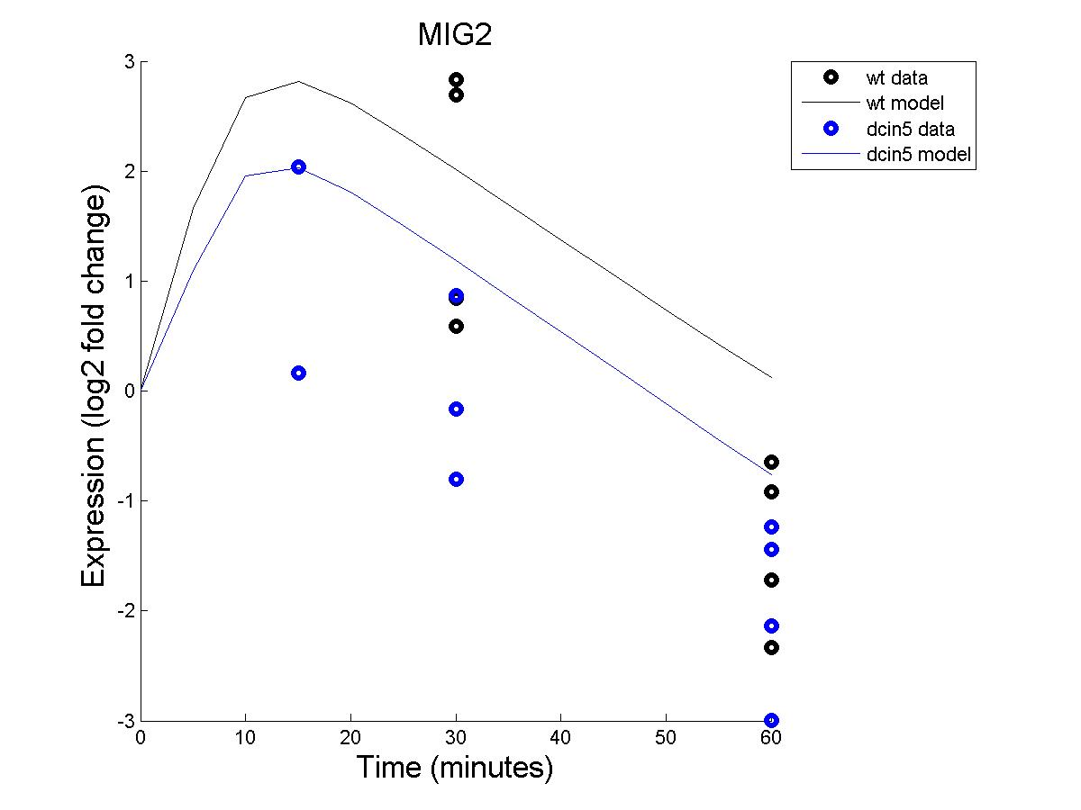
First Analysis

Slide 45
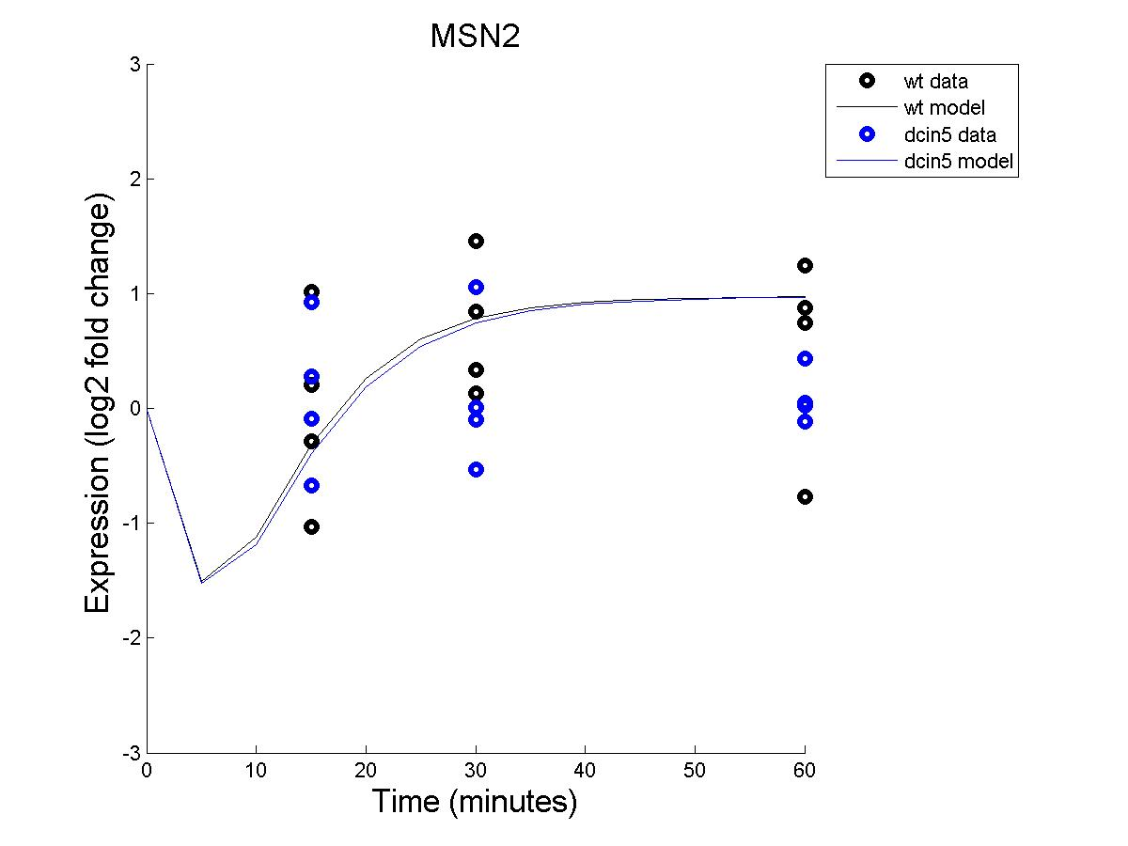
First Analysis

Slide 46
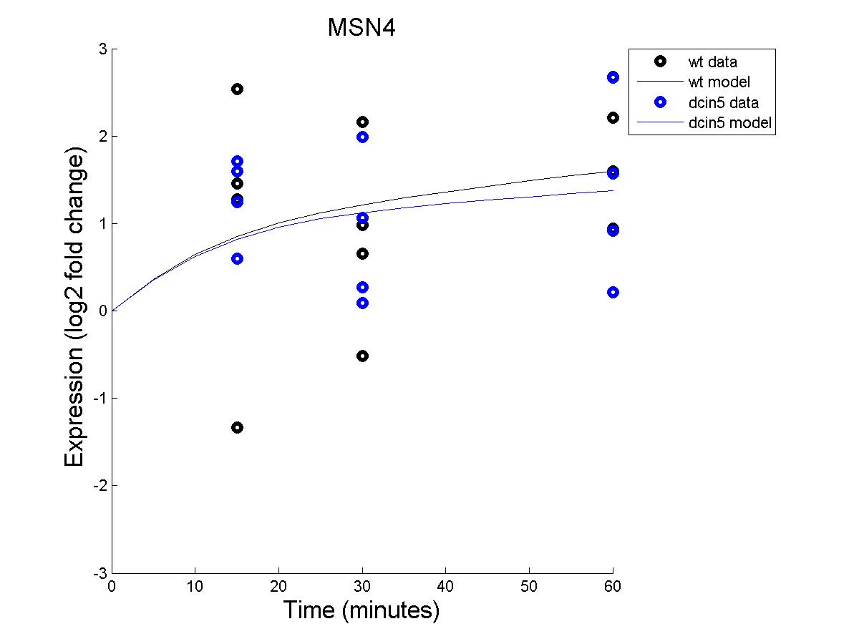
First Analysis

Slide 47
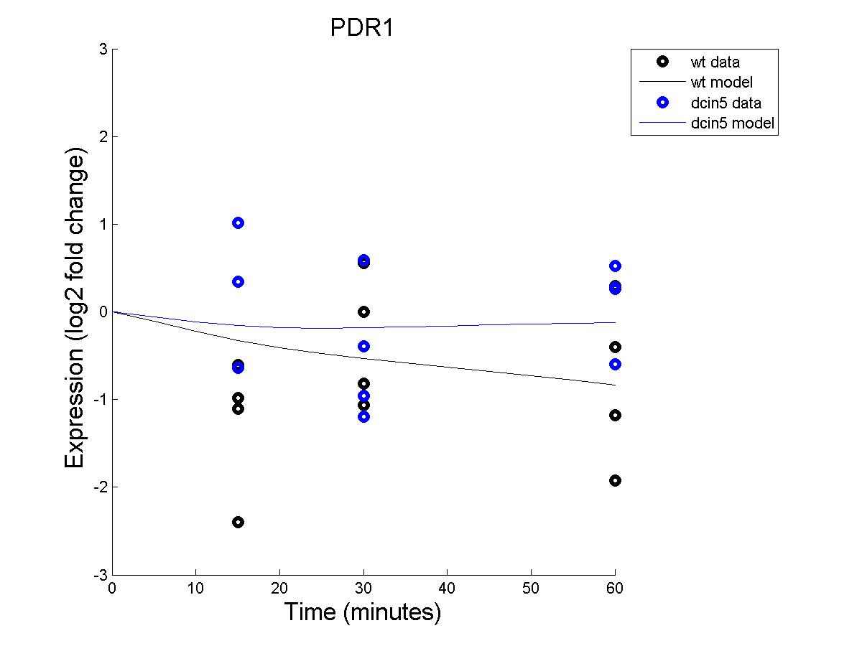
First Analysis

Slide 48
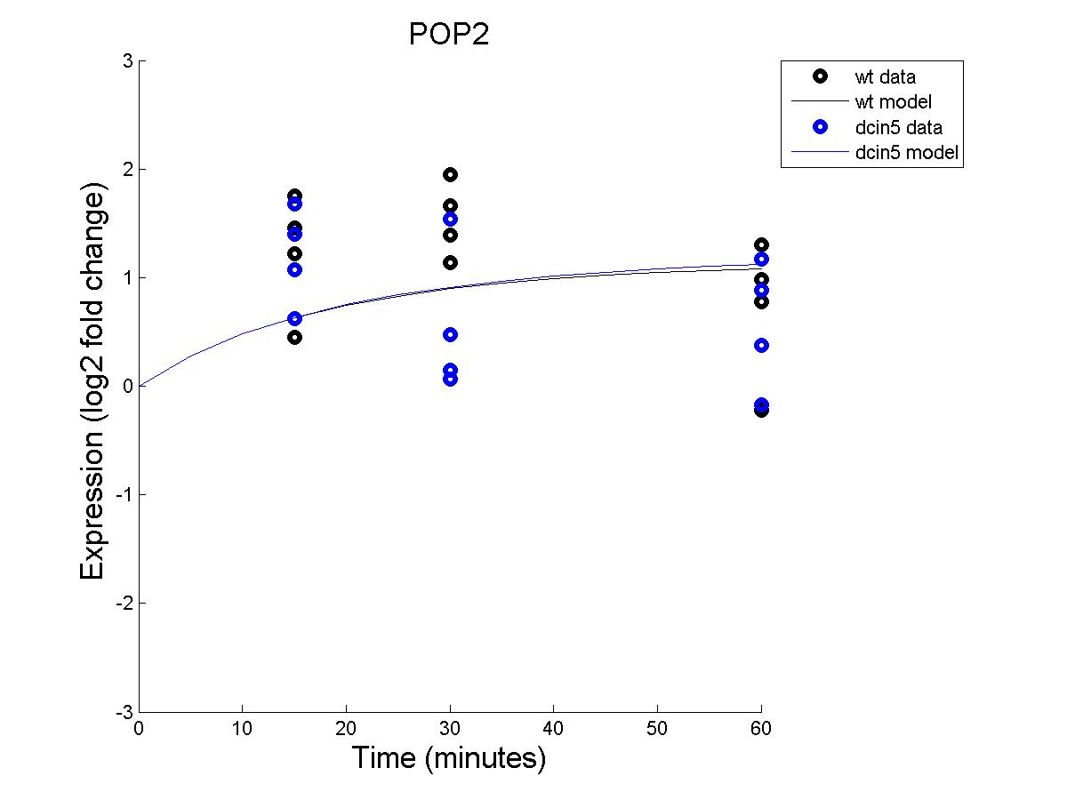
First Analysis

Slide 49
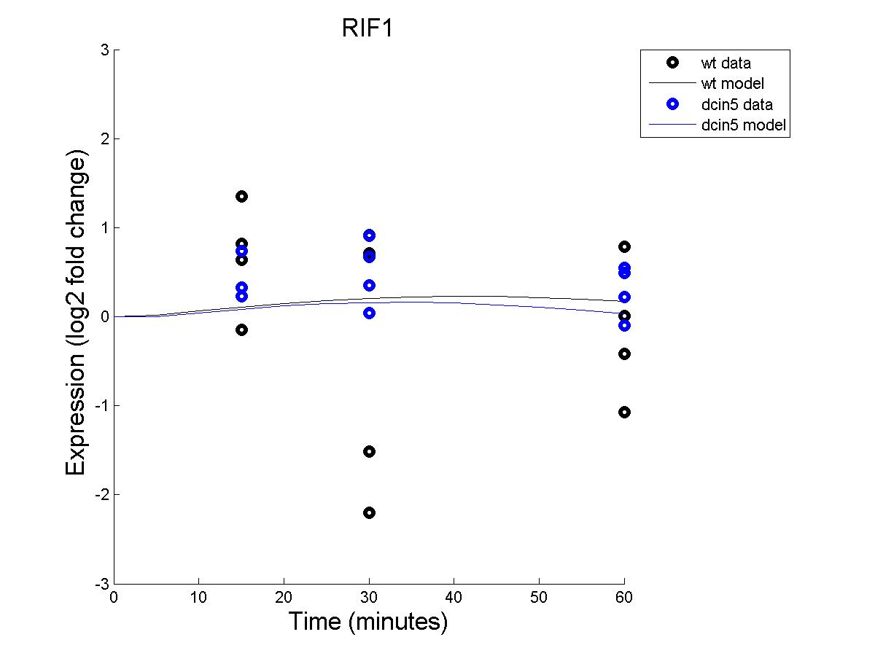
First Analysis

Slide 50
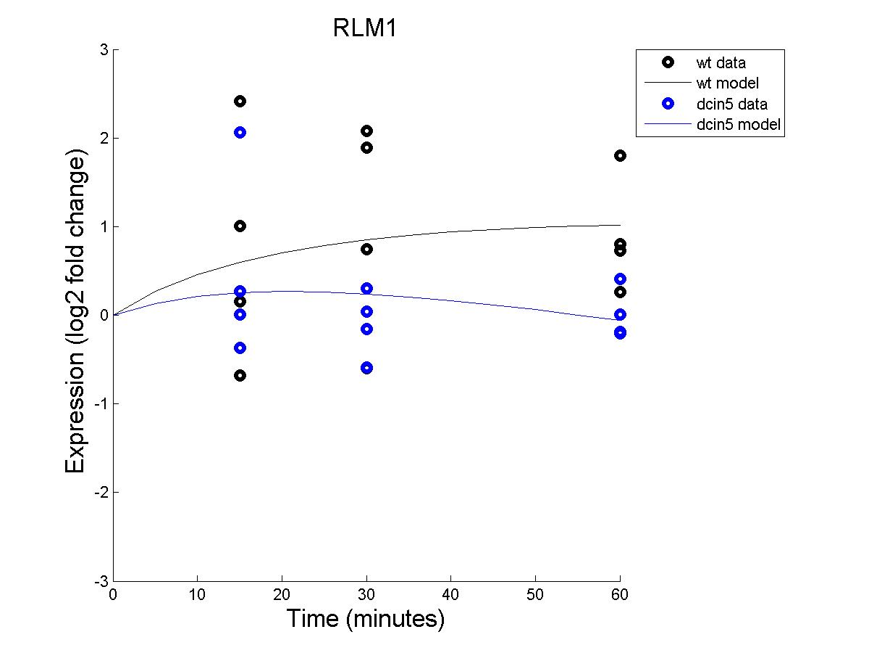
First Analysis

Slide 51
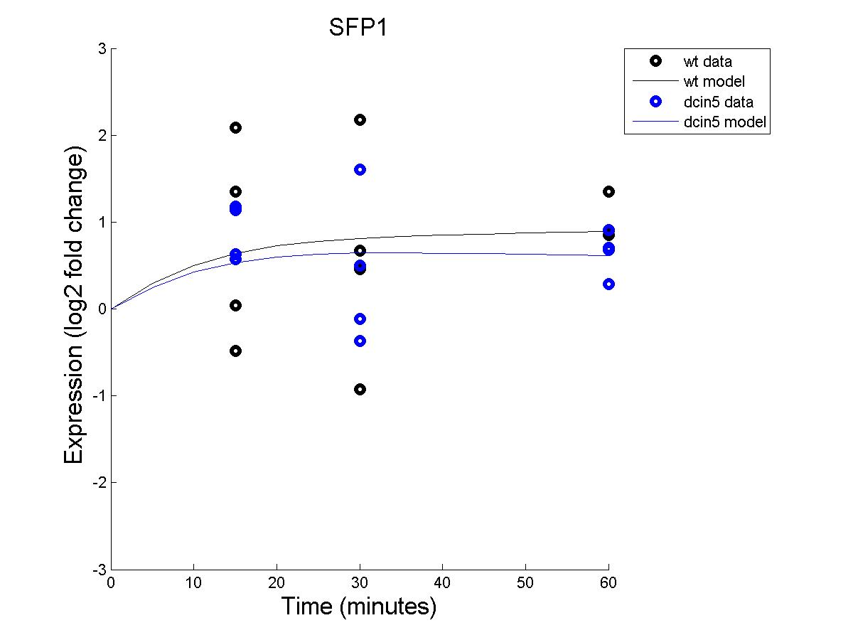
First Analysis

Slide 52

First Analysis

Slide 53

First Analysis

Slide 54

First Analysis

Slide 55

First Analysis

Slide 56

First Analysis

Slide 57

First Analysis

Slide 58

First Analysis

Slide 59

First Analysis

