Slide 1
Tissue Engineering
Lecture 16
Paper Review
4-5-16

Slide 2
Introduction, Motivation
Cartilage doesn’t heal well, and deteriorates over time.
We already have ways to culture chondrocytes (cartilage-making cells) in matrices, and we know that they make matrix via lots of different extracellular stimuli.
BUT, we don’t really have a way to keep that matrix around.
  Chondrocytes make matrix and then the matrix diffuses away, useless
ALSO, the matrix degradation kinetics isn’t the same as the chondrocyte matrix production kinetics. MISMATCH.
Goal of this paper, tune the degradation kinetics of the scaffold system to the matrix production kinetics, then use this gel for cartilage repair.

Slide 3
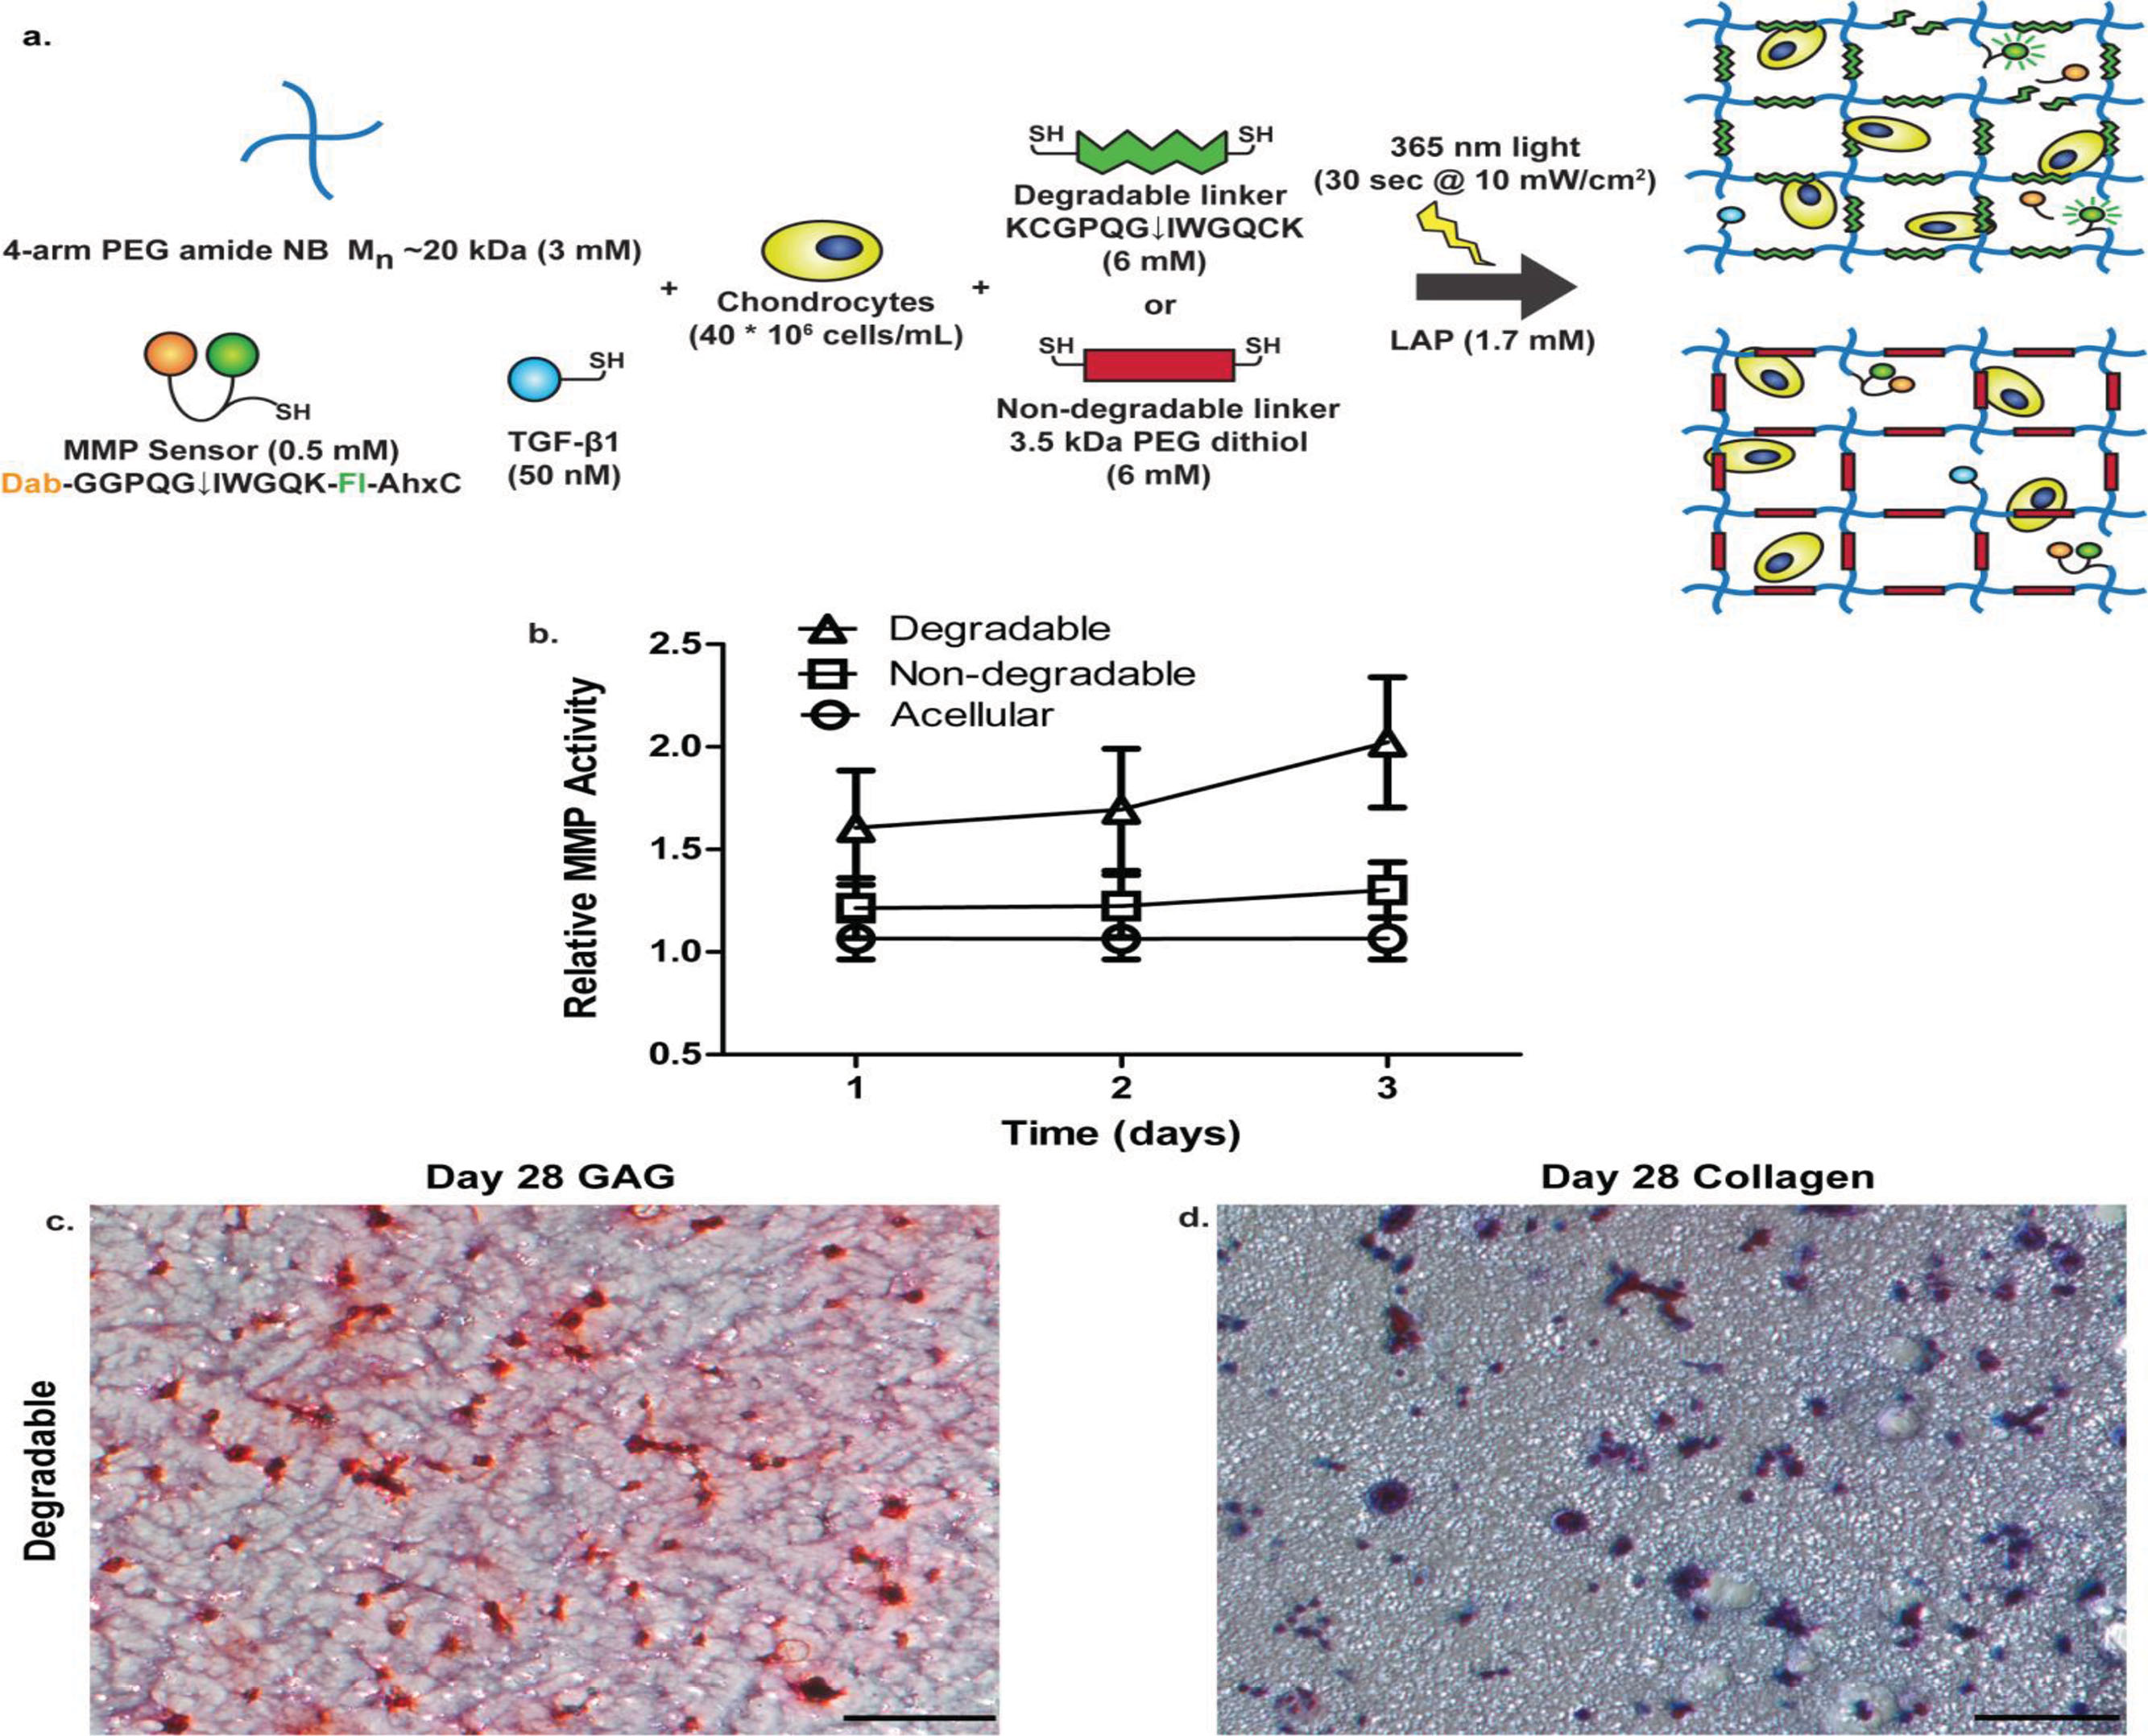
Figure 1a: Gladys Saruchera

Slide 4
Figure 1b-d: Veronica Murray

Slide 5
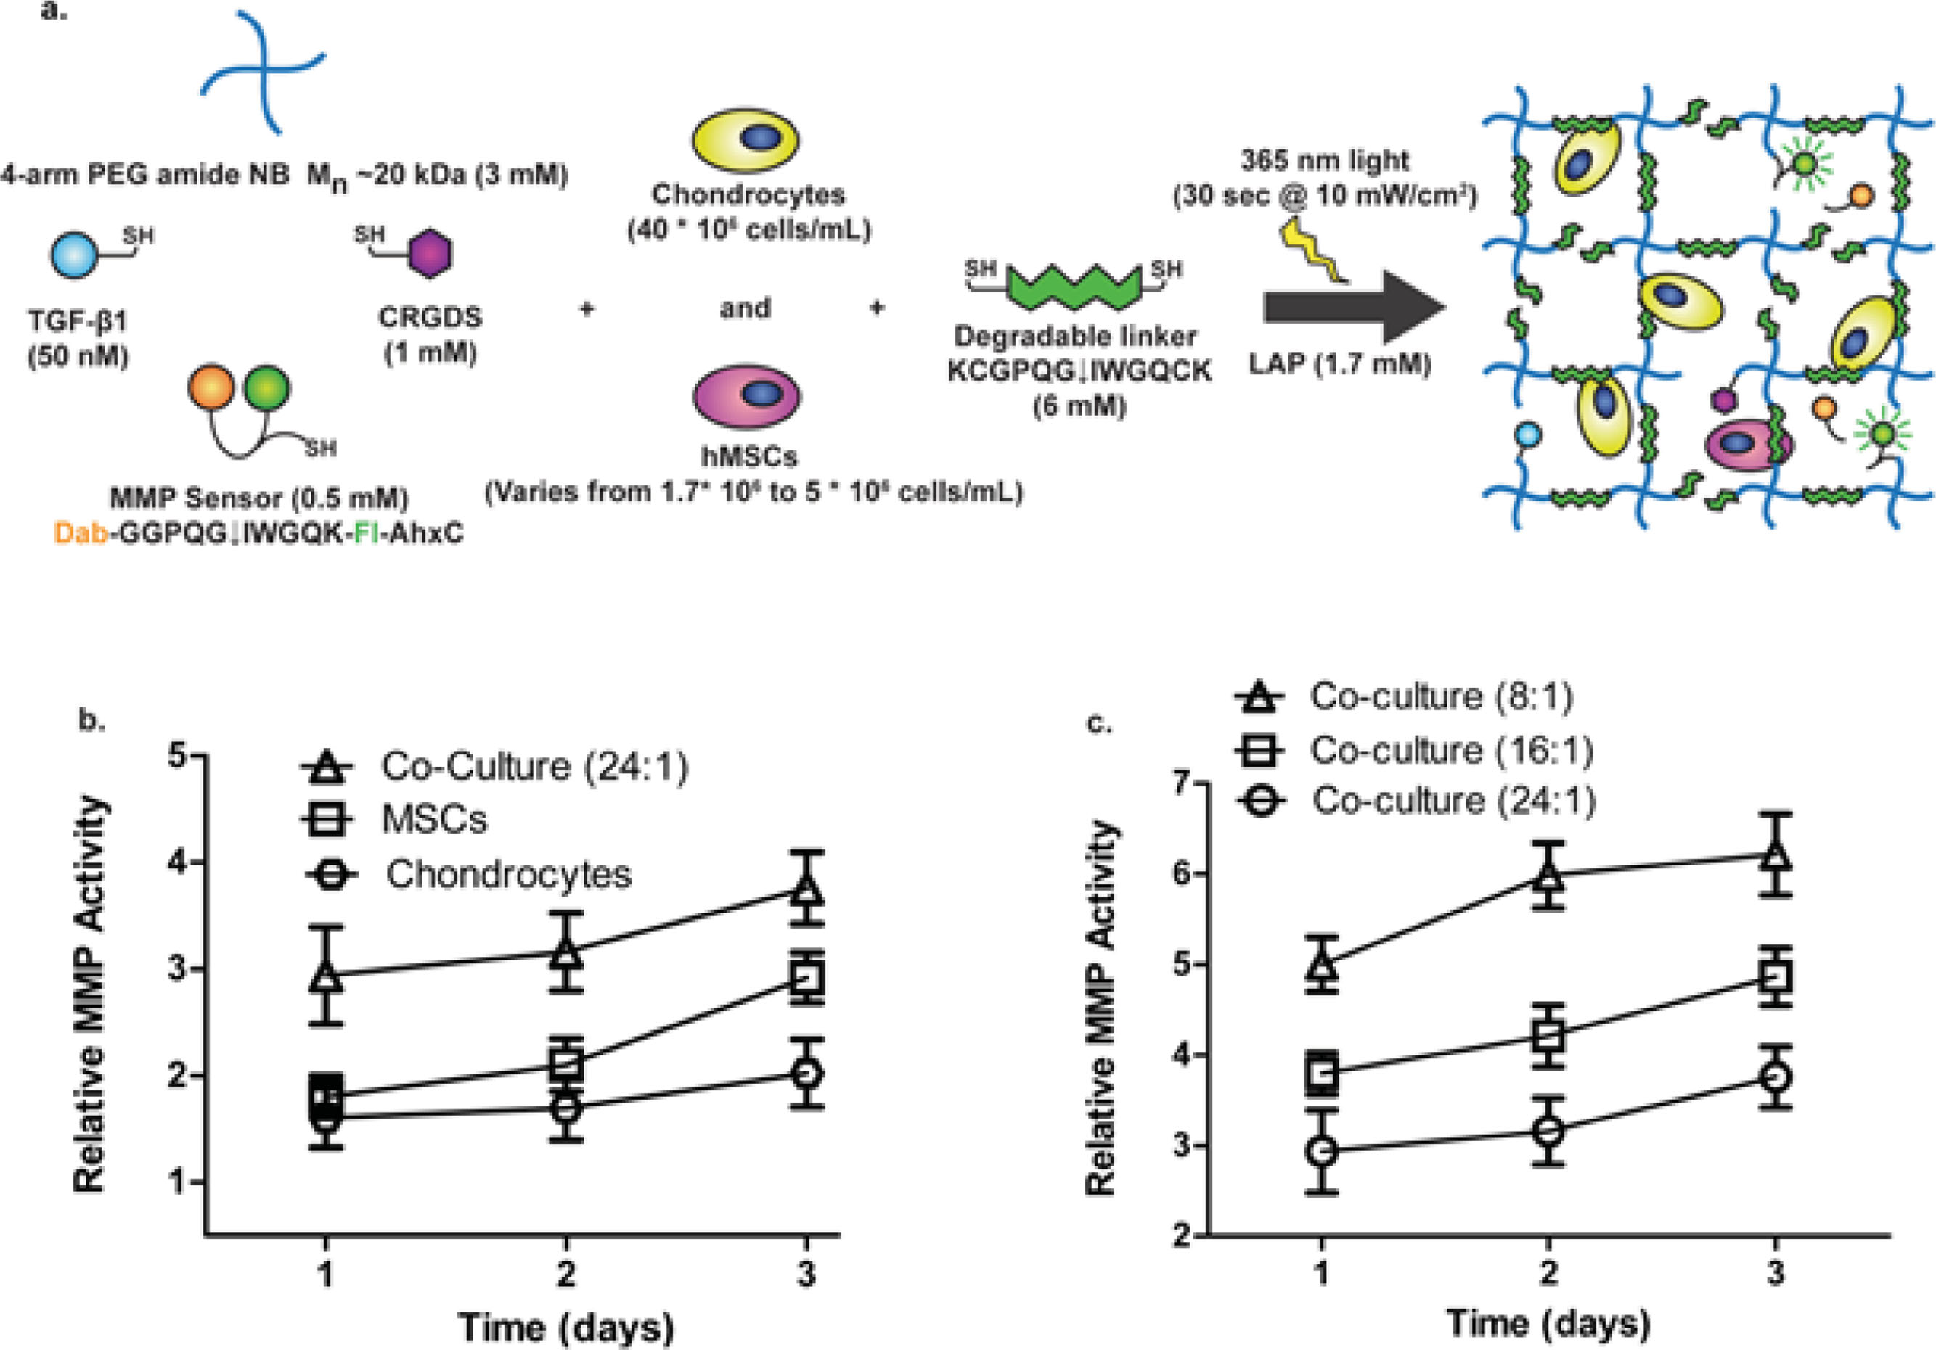
Figure 2a: Jack LaBelle

Slide 6
Figure 2b-c: Brandon Morgan

Slide 7
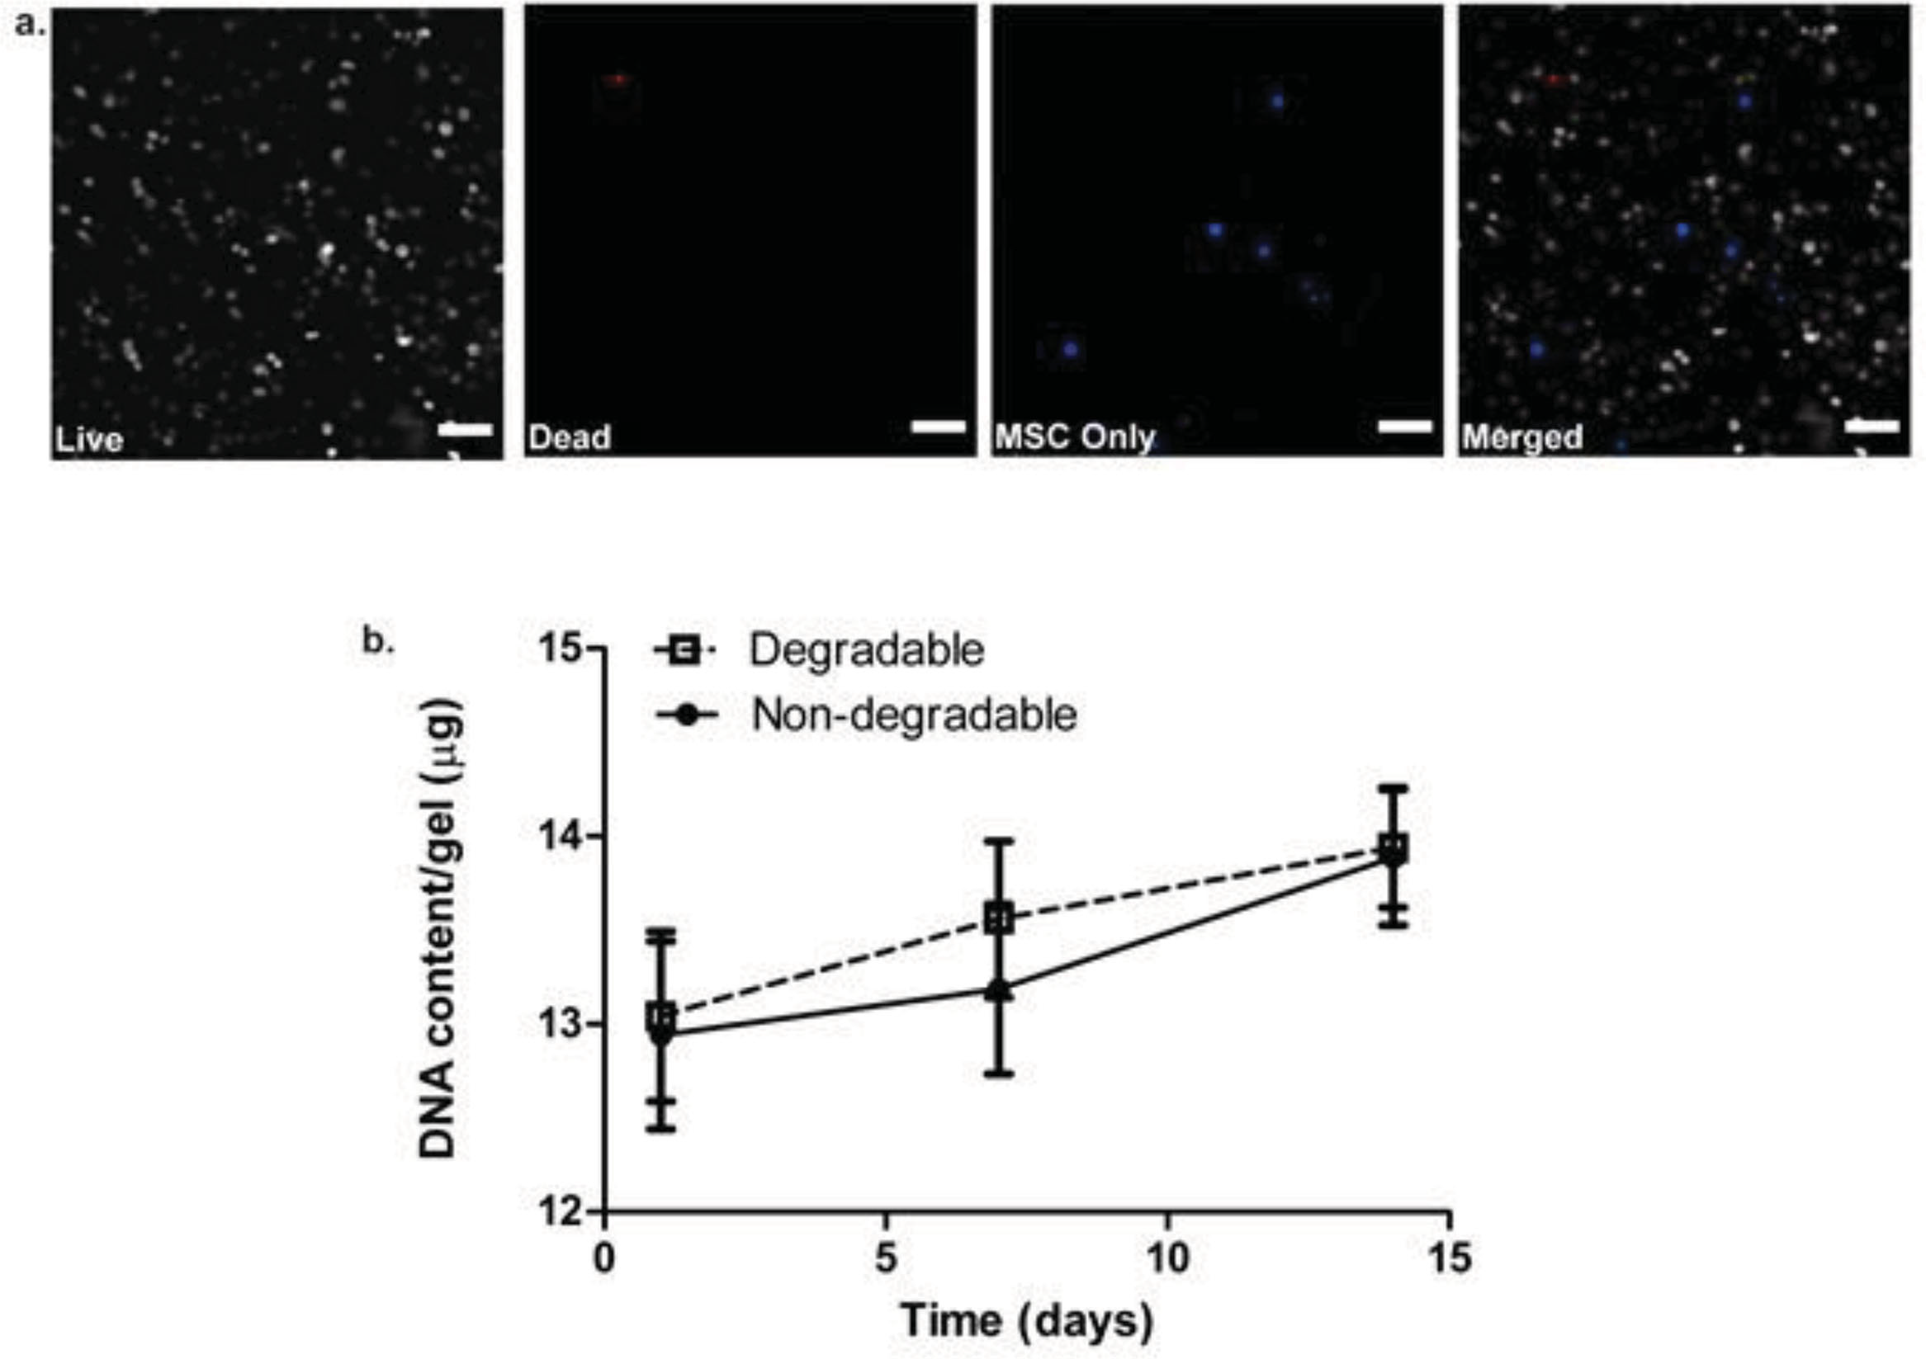
Figure 3: John Vetrano

Slide 8
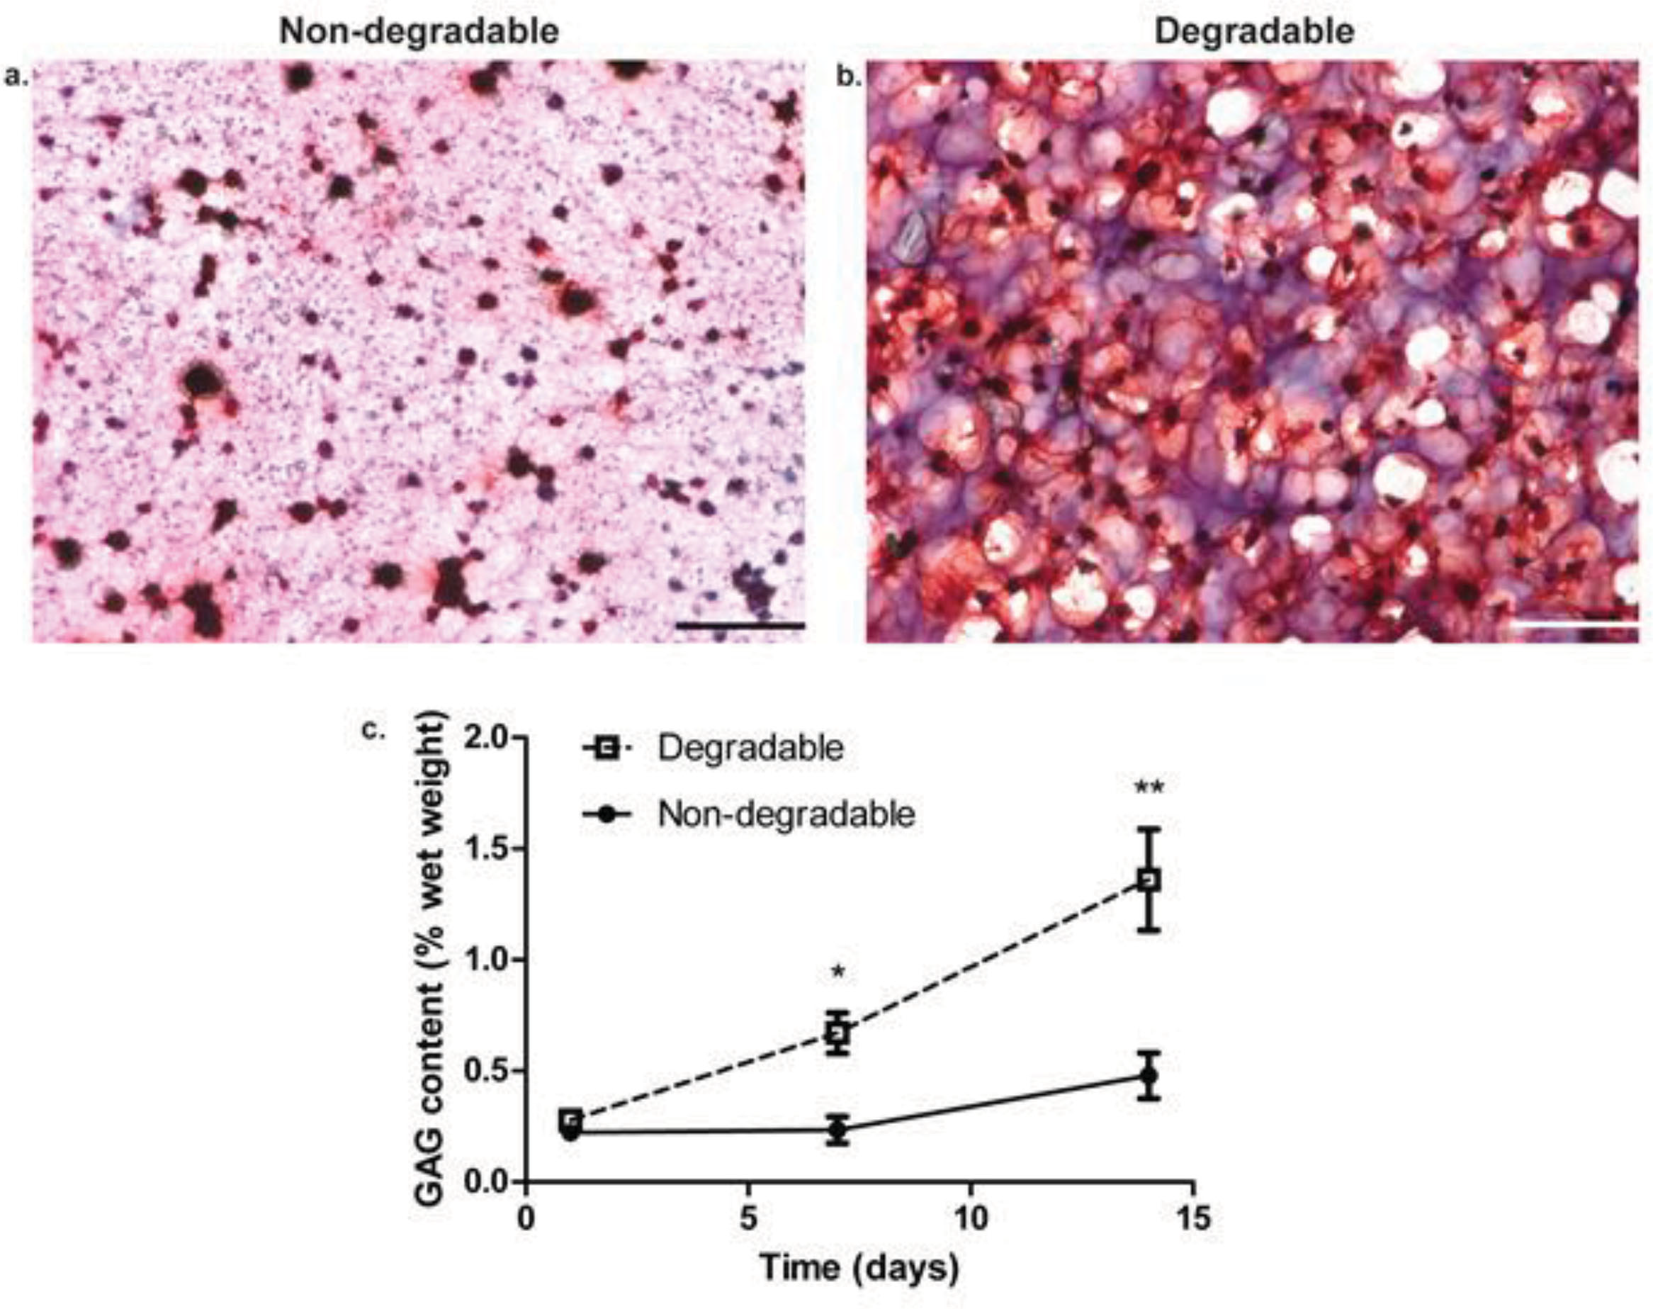
Figure 4: Rob Wang

Slide 9
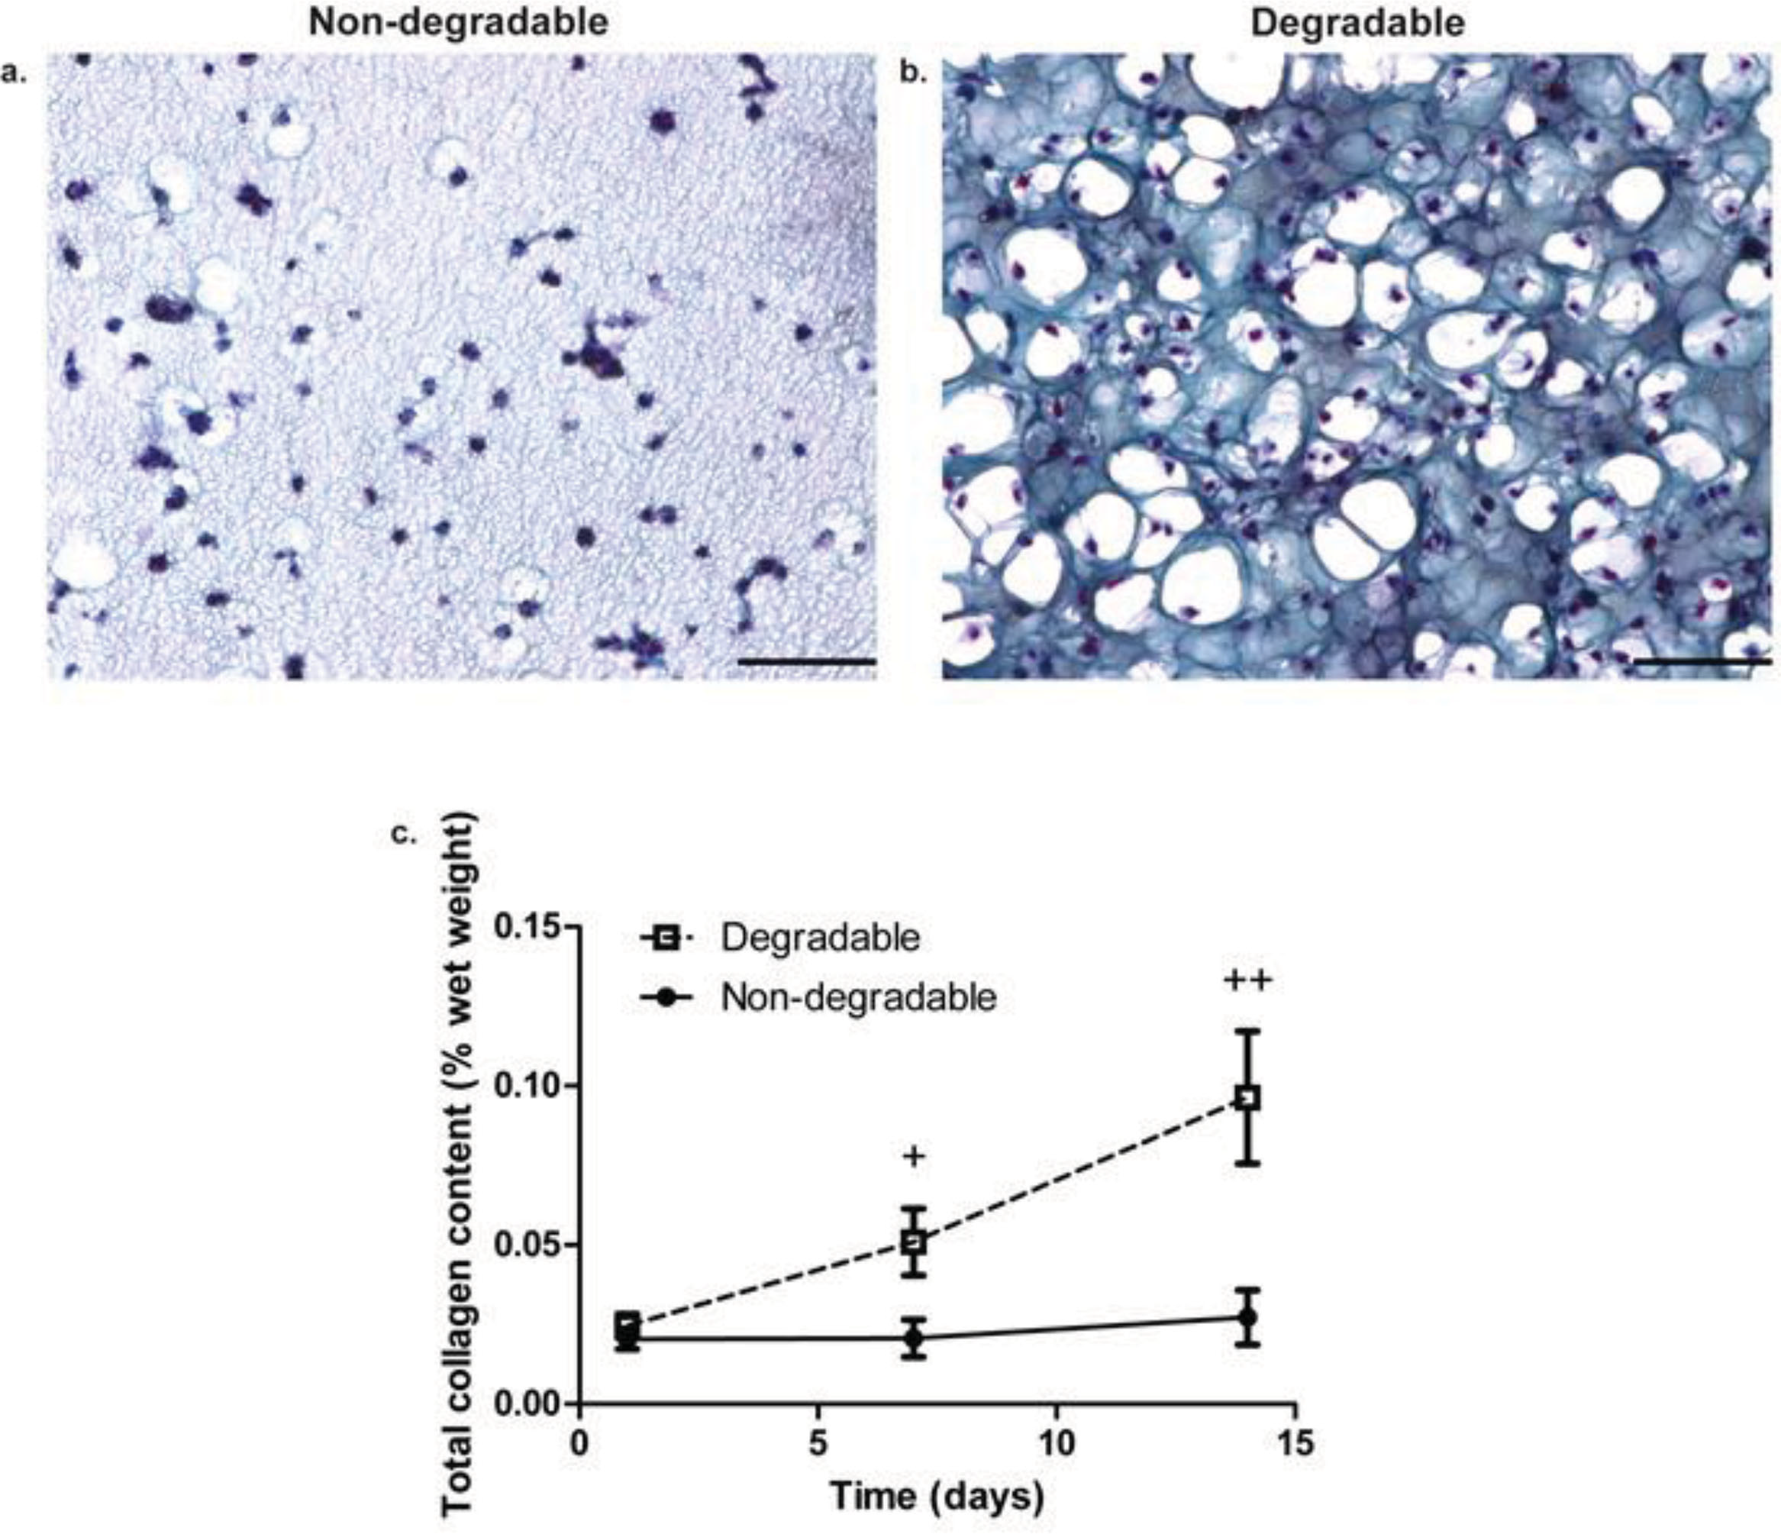
Figure 5: Matt Long

Slide 10
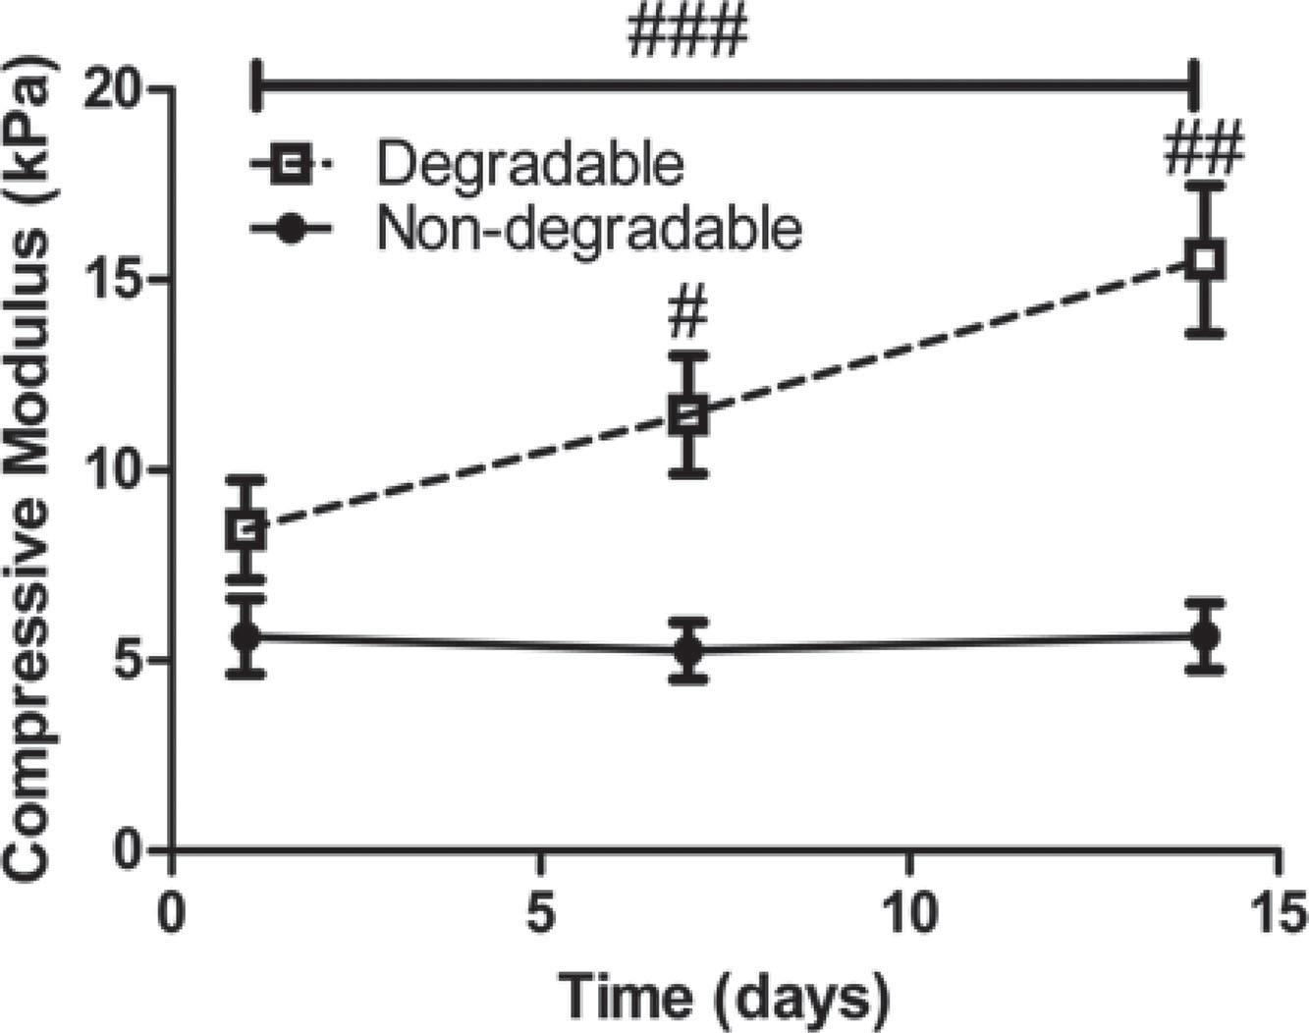
Figure 6: Jon Velez

Slide 11
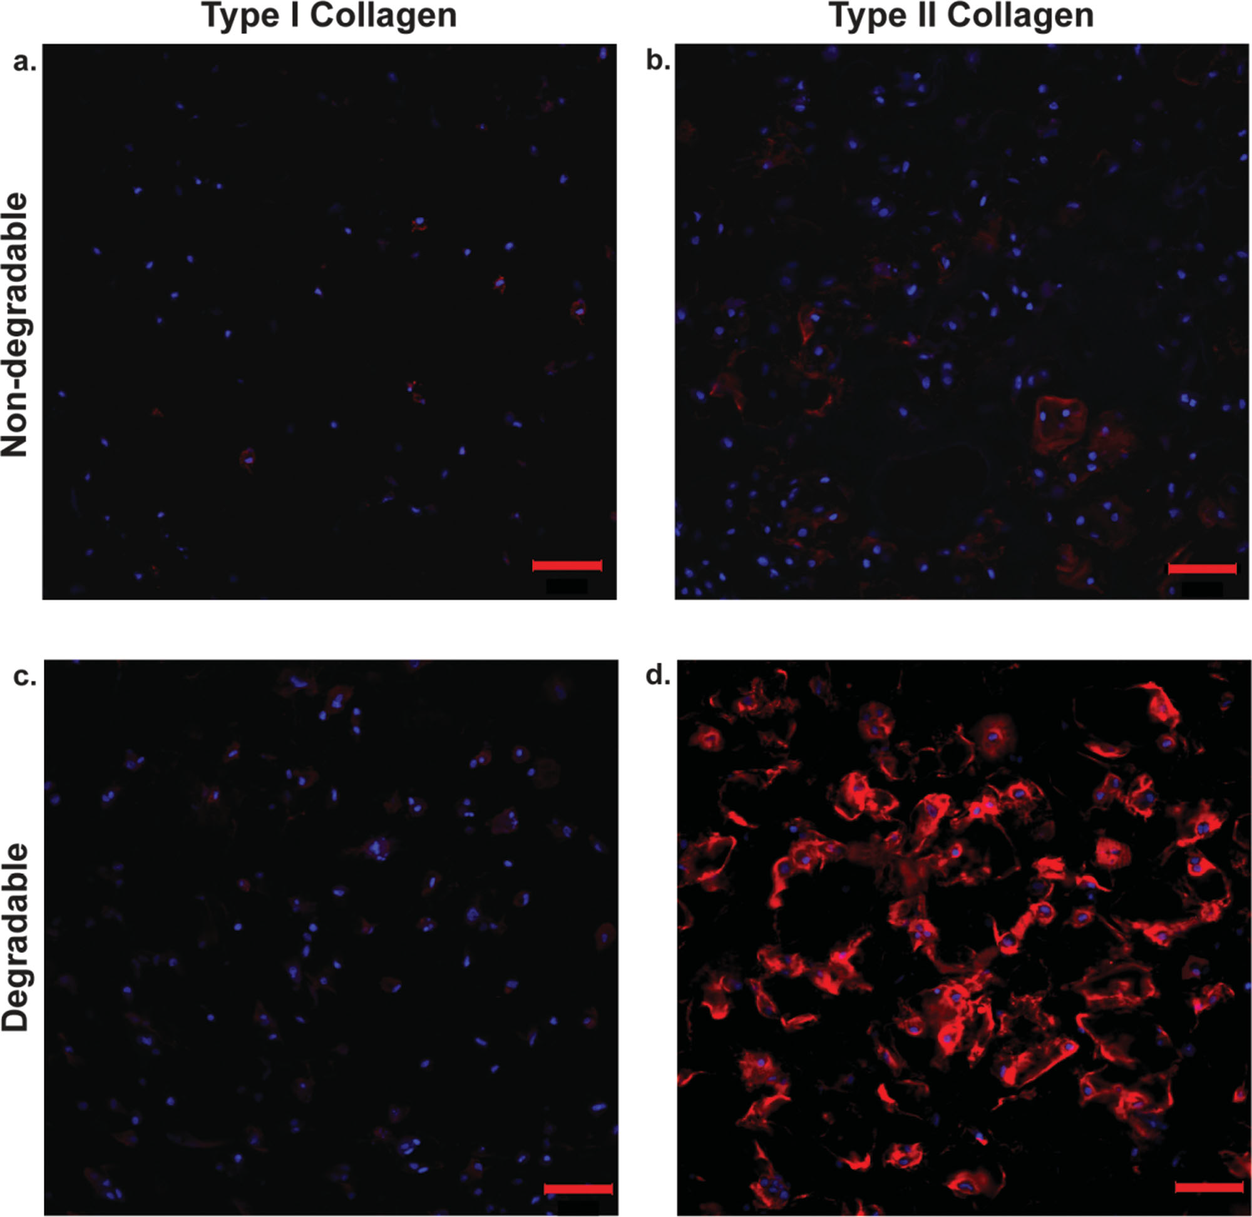

Figure 7 and Table 1: Megan Greiner

Slide 12
Conclusions, Perspectives

