Slide 1
Data analysis of Fontan et al. results does not support the findings of the paper
Nicole Anguiano
BIOL 368: Bioinformatics Laboratory
December 10, 2014
Loyola Marymount university

Slide 2
OUTLINE
σ^{B} plays a role in the stress response of M. tuberculosis
DNA microarrays were used to measure changes in gene expression during cell envelope stress
Data analysis aimed to verify the findings given in the paper, but problems were encountered
GenMAPP and MAPPFinder analysis used to further analyze the data
Significant differences exist between the findings of the paper and my analysis

Slide 3
OUTLINE
σ^{B} plays a role in the stress response of M. tuberculosis
DNA microarrays were used to measure changes in gene expression during cell envelope stress
Data analysis aimed to verify the findings given in the paper, but problems were encountered
GenMAPP and MAPPFinder analysis used to further analyze the data
Significant differences exist between the findings of the paper and my analysis

Slide 4
Sigma factors bind to RNA polymerases and increase promoter specificity
A sigma factor (σ^{B}) allows the RNA polymerase to bind to the promoter and begin transcription
Different sigma factors are used when the cell is under different environmental stresses
More sigma factors → more adaptability to stress
M. tuberculosis has 13 sigma factors

Slide 5
Transcription of sigB is induced during the stress response
σ^{B} is closely related to σ^{A}, the primary sigma factor
The structural gene for σ^{B}, sigB, is positively regulated by σ^{E}, σ^{H}, and σ^{L}
σ^{E} regulates the response to cell envelope stress, and σ^{H} regulates the response to heat and oxidative stress
σ^{B} is a member of both regulons
Due to sigB expression being controlled by many regulatory pathways, it likely plays a central role in the stress response

Slide 6
sigB importance in the stress response was tested both in vivo and in vitro
Three strains were used in the tests:
A wild type strain
A sigB mutant with a disrupted sigB gene
A complemented strain that re-introduces the sigB gene elsewhere in the DNA
In vitro, cell envelope, heat, and oxidative stress was tested:
Cell envelope stress: application of 0.05% SDS and 5mM diamide
Heat stress: heated to 45°C for 24 hours
Oxidative: sealed for 4 days
In vivo, the three strains were raised in mice, guinea pigs, and macrophage-like cells

Slide 7
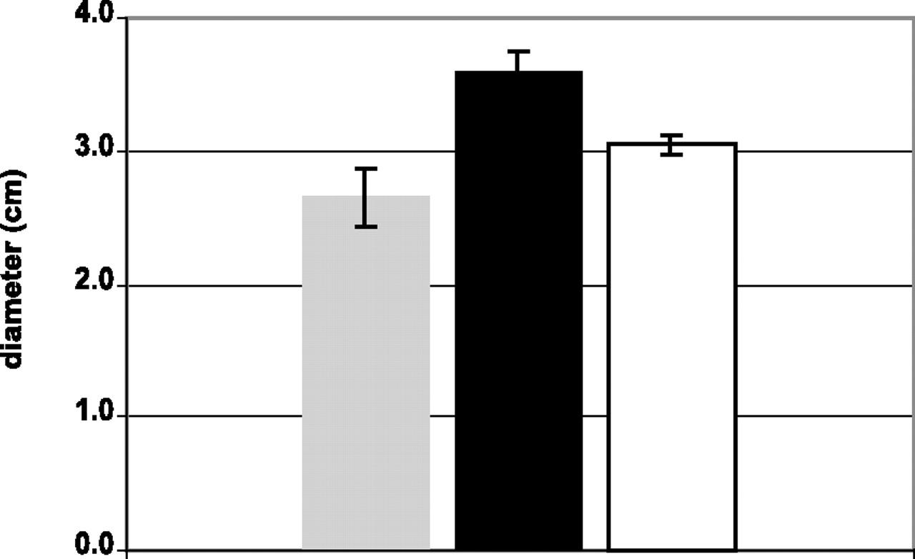
The sigB mutant was more sensitive to SDS than the complemented or wild type strains
Gray: wild type
Black: sigB mutant
White: complemented strain
Higher colony diameter seen in sigB mutant

Slide 8
OUTLINE
σ^{B} plays a role in the stress response of M. tuberculosis
DNA microarrays were used to measure changes in gene expression during cell envelope stress
Data analysis aimed to verify the findings given in the paper, but problems were encountered
GenMAPP and MAPPFinder analysis used to further analyze the data
Significant differences exist between the findings of the paper and my analysis

Slide 9
DNA microarrays measured changes in gene expression
Controls marked with Cy3, treatment marked with Cy5
Gene-specific spots with induction ratios outside of the top or bottom 5% were used to normalize the intensities of Cy3 and Cy5
Noise value determined by calculating the average intensity of the bottom 20% of spots
Three biological replicates and two microarrays per replicate were used
A false discovery rate of >2% and a regulation of at least 1.8-fold were used to determine if a gene was significantly regulated

Slide 10
SDS treatment had downregulation in genes coding for cell envelope stress response
72 genes were found to be downregulated, mostly genes involved in the cell envelope stress response
Transcriptional regulators also found to be downregulated
Specific genes mentioned: ideR and mbt cluster
ideR downreglates the genes in the mbt cluster (mbtB, mbtD, mbtE, mbtF, mbtH)
As ideR was downregulated in the sigB mutant, concaminant increase in mbt cluster was expected
Every gene in the mbt cluster found to be significantly upregulated

Slide 11
OUTLINE
σ^{B} plays a role in the stress response of M. tuberculosis
DNA microarrays were used to measure changes in gene expression during cell envelope stress
Data analysis aimed to verify the findings given in the paper, but problems were encountered
GenMAPP and MAPPFinder analysis used to further analyze the data
Significant differences exist between the findings of the paper and my analysis

Slide 12
Problems were encountered when attempting to perform data analysis
Raw data was not provided, and the calculations performed on the processed data were not given
The Gene IDs that corresponded to each Reporter Identifier were not given
Which Gene ID corresponded to which Reporter Identifier had to be assumed
Could cause discrepancies in data if the wrong gene is assigned to the wrong Reporter Identifier

Slide 13
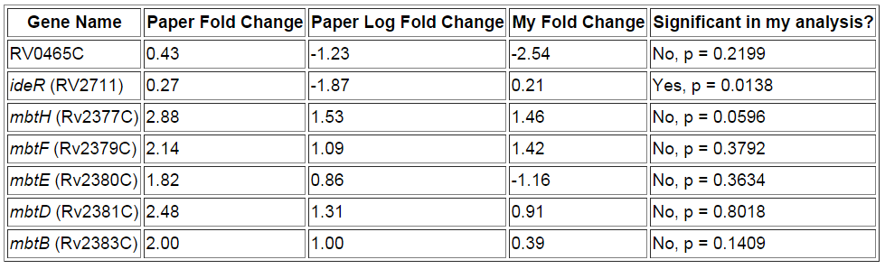
Significant genes in the paper were not found to have significance in my analysis
Only ideR found to have significance, but found to be upregulated in my analysis
All other significant genes mentioned in the paper were not found to be significant

Slide 14
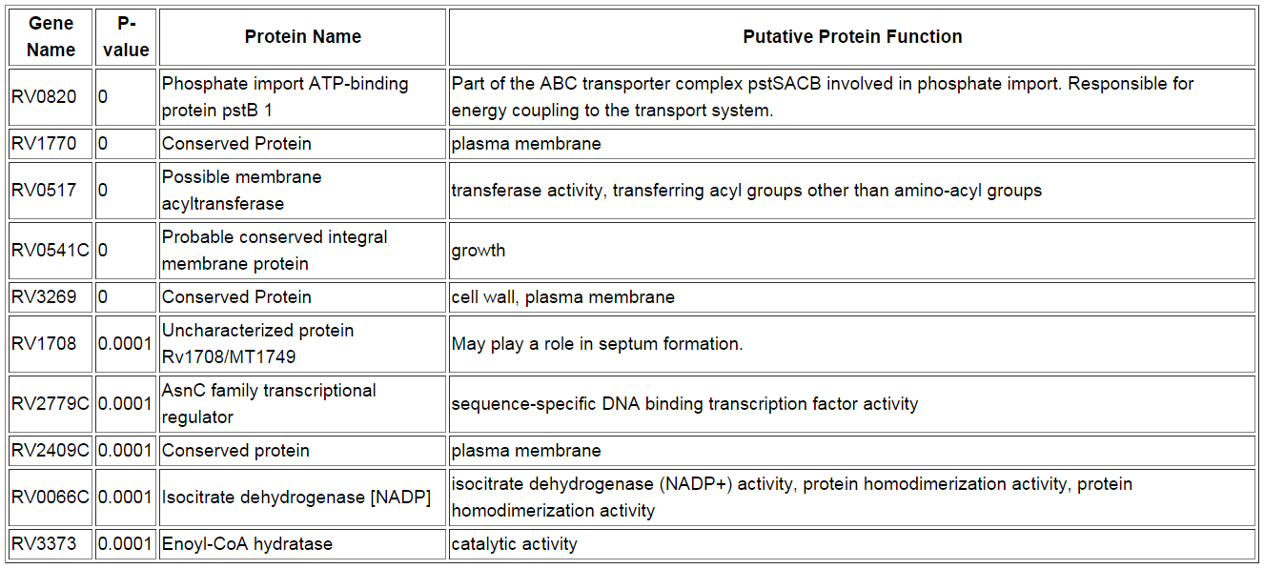
Top 10 most significant genes not found to be significant in the paper
None of the genes with a p-value of less than 0.0002 were considered significantly upregulated or downregulated in the paper

Slide 15
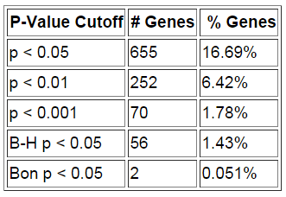
Despite discrepancy, sanity check found a significant number of changed genes
3,924 total genes used to calculate the percentages
The B-H and Bonferroni p values did not find a significant number of genes
However, each of the p-value cutoffs did find a significant number of genes

Slide 16
OUTLINE
σ^{B} plays a role in the stress response of M. tuberculosis
DNA microarrays were used to measure changes in gene expression during cell envelope stress
Data analysis aimed to verify the findings given in the paper, but problems were encountered
GenMAPP and MAPPFinder analysis used to further analyze the data
Significant differences exist between the findings of the paper and my analysis

Slide 17
MAPPFinder criteria aimed to find the most significant GO categories
Normalized data was used in the GenMAPP analysis
45 errors found when importing the data into GenMAPP
Four criteria were used in the GenMAPP analysis:
IncreasedBH: Average Log Fold Change > 0.25, B-H p-value < 0.05
DecreasedBH: Average Log Fold Change < -0.25, B-H p-value > 0.05
Increased: Average Log Fold Change > 0.25, p-value < 0.05
Decreased: Average Log Fold Change < -0.25, p-value > 0.05
Ultimately ended up using the “Increased” and “Decreased” categories

Slide 18
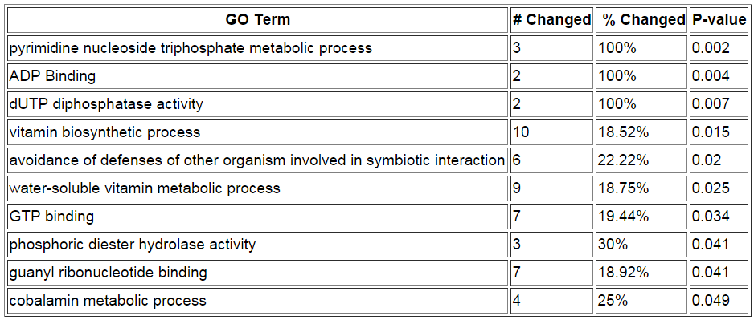
MAPPFinder found upregulation in metabolism of phosphates
Criteria:
Z-score > 2
PermuteP < 0.05
Number Changed ≥ 2
43 total categories found, with significant overlap

Slide 19
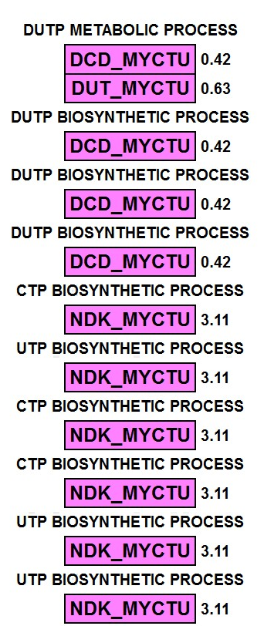
Pyrimidine nucleoside triphosphate metabolic process is heavily upregulated
None of these genes mentioned or found to be significant in the paper
In other bacteria, such as Staphylococcus aureus, pyrimidine metabolism is downregulated during stress (Song)
SigB may have a vital role in this downregulation

Slide 20
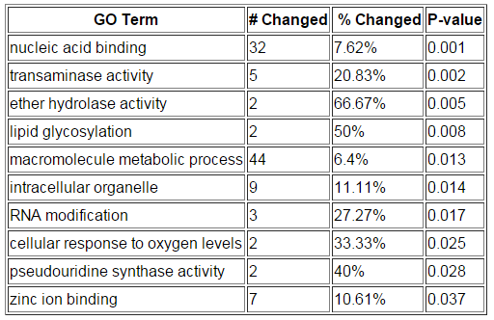
MAPPFinder found varied categories in downregulation
Criteria:
Z-score > 2
PermuteP < 0.05
Number Changed ≥ 2
29 total categories found, with significant overlap
ideR, the gene found in the paper, is involved in zinc ion binding

Slide 21
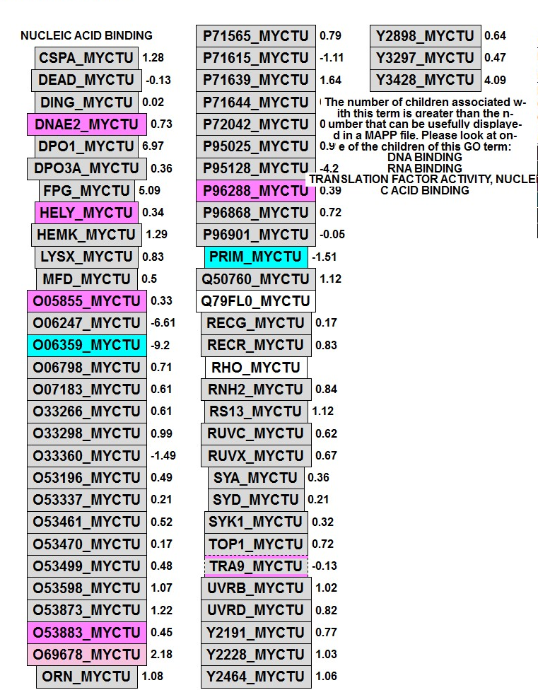
Nucleic acid binding has a mix of upregulation and downregulation
The removal of transcription factor SigB lead to upregulation and downregulation of other transcription factors
However, only 32 of 433 genes in the category were changed

Slide 22
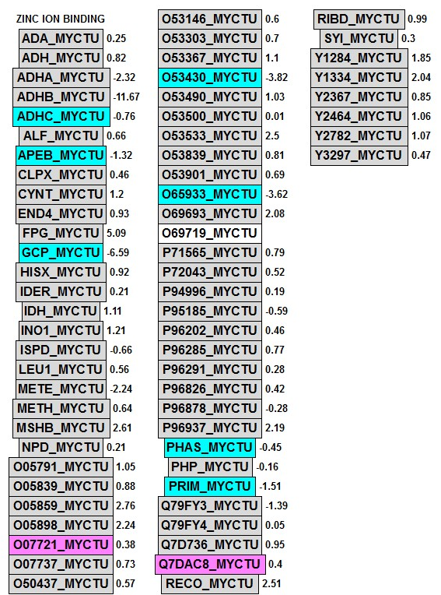
Zinc ion binding category did not show expected downregulation of ideR
ideR, a protein focused on in the paper, was not found to be significantly downregulated
The genes in the mbt cluster concurrently were not shown to be upregulated
mbtH was not present in MAPPFinder

Slide 23
OUTLINE
σ^{B} plays a role in the stress response of M. tuberculosis
DNA microarrays were used to measure changes in gene expression during cell envelope stress
Data analysis aimed to verify the findings given in the paper, but problems were encountered
GenMAPP and MAPPFinder analysis used to further analyze the data
Significant differences exist between the findings of the paper and my analysis

Slide 24
Overall analysis does not support Fontan et al’s findings
The genes focused on for SDS stress, ideR and the mbt cluster, were not found to be significantly regulated
The most significant genes in my analysis were not found to be significant in the paper
The discrepancy was most likely due to the lack of adequate knowledge of which Gene IDs corresponded to which Reporter Identifier
The authors would need to be contacted to get the list of Gene IDs to perform a more accurate study

Slide 25
SUMMARY
σ^{B} plays a role in the stress response of M. tuberculosis
DNA microarrays were used to measure changes in gene expression during cell envelope stress
Data analysis aimed to verify the findings given in the paper, but the absence of a reference stating which Gene IDs corresponded to which Reporter Identifier made accuracy difficult
GenMAPP and MAPPFinder analysis was used to further analyze the data
My analysis revealed that the genes mentioned by the paper, ideR and the mbt cluster, were not significantly up or downregulated

Slide 26
Citations
Fontán P. A., Voskuil M. I., Gomez M., Tan D., Pardini M., Manganelli R., Fattorini L., Schoolnik G. K., Smith I. (2009 July 10). The Mycobacterium tuberculosis sigma factor sigmaB is required for full response to cell envelope stress and hypoxia in vitro, but it is dispensable for in vivo growth. J. Bacteriol, 191, 5628-5633. doi:10.1128/JB.00510-09
Song Y., Rubio A., Jayaswal R. K., Silverman J. A., Wilkinson B. J. (2013 March 15). Additional Routes to Staphylococcus aureus Daptomycin Resistance as Revealed by Comparative Genome Sequencing, Transcriptional Profiling, and Phenotypic Studies. PLOS ONE. doi: 10.1371/journal.pone.0058469

Slide 27
ACKNOWLEDGMENTS
Loyola Marymount University
Kam Dahlquist, Ph. D
Stephen Louie

