Slide 1
J. Walter, D. Greenfield, C. Bustamante, J. Liphardt
Light-powering Escherichia coli with proteorhodopsin
(PNAS, 2006)
Presented by: Katie Loh and Fori Wang
November 30, 2010
Notes:
Hi, I’m Katie and this is Fori. Today we will be presenting a paper entitled “Light-powering E. coli with proteorhodopsin” by Walter et al.

Slide 2
Powering E. coli
Proton motive force (pmf): electrochemical potential of protons across the membrane
Pmf ∝ flagellar motor speed
Under aerobic conditions pmf is maintained by oxidative phosphorylation
Proteorhodopsin (PR) is an alternative means of maintaining cellular pmf under anaerobic conditions
Objective: identify the role of PR in cellular energy fluxes via analyzing the speed of the E. coli flagellar motor
Notes:
First, we’ll give some background information on how E. coli is powered.
- The proton motive force, or pmf, -- NOT pms! -- is the electrochemical potential of protons across the membrane.
- Bacteria use the pmf to synthesize ATP, drive chemiosmotic reactions, and power the rotary flagellar motor.
- Thus, pmf is proportional to flagellar motor speed. With greater proton motive force, the flagellum moves faster.
- Under aerobic conditions, the pmf is maintained by oxidative phosphorylation
- Under anaerobic conditions, when respiration is not possible, proteorhodopsin, a light-driven, transmembrane proton pump, is an alternative means of maintaining cellular pmf.
- For this study, the authors analyzed the speed of the flagellar motor, which is driven by the cellular pmf, in order to identify the role of PR in cellular energy fluxes.

Slide 3
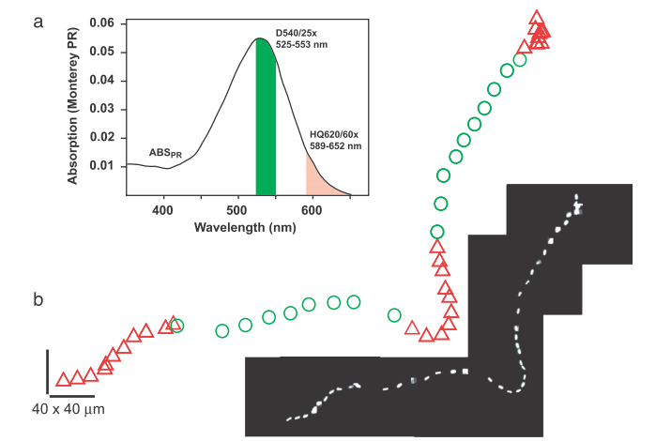
Expt 1: Velocity during green illumination is 96% higher than during red illumination alone
30 mM azide
Constant red dark-field illumination
Periodic illumination with green light
Notes:
PR transmits protons most effectively when the cell is illuminated at the peak absorption wavelength, which is around 530 nm and corresponds to green light.
In this initial study, the authors examined the effect of PR on cell velocity
PR+ expressing E. coli were tracked in two dimensions via red dark-field microscopy
In order to examine the effects during anaerobic conditions, cells were incubated in buffer containing 30 mM of azide, which is a respiratory poison that stops the flagellar motor
Cells were then periodically illuminated with green light in addition to the constant red illumination.
This figure shows the cell’s position sampled at 0.5 Hz.
The velocity during green illumination periods is 96% higher than during red illumination periods alone.

Slide 4
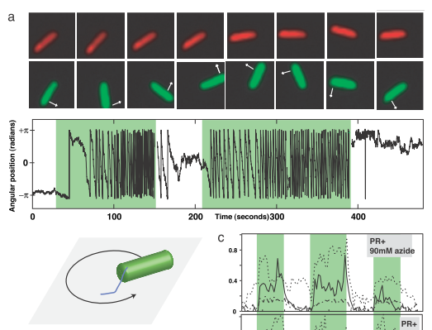
Expt 2: Angular velocity of a single bacterium
PR+ allowed to stick to coverslip via flagellum
Monitor angular rotation rate
-cheY mutants are smooth swimming
Notes:
- In order to increase the accuracy of the flagellar velocity measurements, the authors used a tethered cell geometry
- The PR is attached to coverslip at the flagellum and the angular velocity is measured as the bacterium rotates around the end of the flagellum.
- Additionally, the cheY gene was deleted to create smooth-swimming mutants, whose motors do not reverse direction
- This method allows a single bacterium to be observed over an extended period of time and under different illumination conditions
- Under red illumination alone, the bacterium diffuses rotationally, and when green illumination is added, the bacterium rotates counterclockwise.
A typical tethered cell rotates at 0.2-1Hz, depending on the length and position of the stuck flagellum along its body.

Slide 5
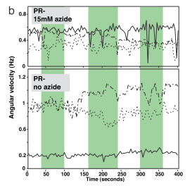
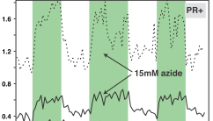
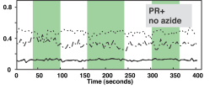
Expt 2: Light replaces respiration as an energy source
Angular velocity
Notes:
This figure shows that with or without azide, cells lacking PR show no response to green light
Additionally, cells with PR under aerobic conditions similarly do not respond to green light.
Under green illumination, there is no change in angular velocity.
However, when aerobic respiration is inhibited by adding azide, green illumination causes angular velocity to increase in PR expressing cells.

Slide 6
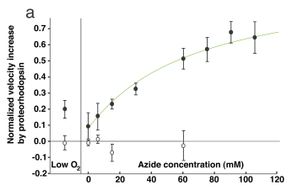
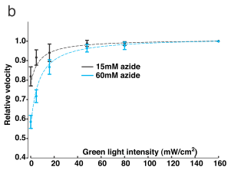
Expt 3: PR provides larger fraction of proton efflux with increased azide concentration and increased illumination
Increasing inhibition of the respiratory system
Increasing green light intensity
Notes:
In order to determine the extent to which light can replace respiration as an energy source, the azide concentrations and illumination intensities were varied.
PART A:
As proton extrusion by the respiratory system dropped with increasing azide, PR compensated more by pumping more protons to maintain the cellular pmf at the original, no-azide value
When the cells were illuminated with intense green light, their rotation rate was restored to the speed of cells with an unimpaired respiratory system.
At the highest azide concentration studied, the average cell velocity increased 70% upon green light illumination.
Furthermore, cells lacking PR exhibited no increasing angular velocity in green light, indicating that PR expression is required to maintain pmf.
PART B:
- Subsequently, the intensity of the green light illumination was varied.
- The rotation rate was clearly stimulated even at the lowest light intensity studied (about 5 mW/cm^2 )
- The velocity increases rapidly with increasing green light intensity, and is saturated around 10 or 20.
- Past 50, there is no detectable benefit of increased illumination.
- The intensity of light absorbed by PR in these experiments is equivalent to the energy absorbed by PR from the sun at sea level, demonstrating that light-driven PR provides sufficient proton efflux (F-lux).

Slide 7
Expt 4: Proteorhodopsin alters pmf via light-based proton pumping under anaerobic conditions
PR⁺ cells became light-responsive upon oxygen depletion
Similar to azide addition, without possible confounding effects
Illumination increased angular velocity by 45 ± 25%
Addition of CCCP causes uncoupling of proton gradient and permanently immobilizes bacteria (protonophore carbonyl cyanide 3-chlorophenylhydrazone)
Illumination does not restore movement
Cells unable to maintain pmf cannot be revived
Notes:
At this point, they wanted to confirm that what they thought was happening – that the changes in velocity resulted from the anaerobic conditions and altered proton gradient – was really happening.
As a follow up to the azide experiments, true anaerobic conditions were created by pumping the experiment chamber with nitrogen gas, which effectively depleted oxygen levels. And just as before, illumination increased angular velocity, this time by 45%.
In order to confirm the role of pmf, CCCP, which causes uncoupling of the proton gradient and permanantly immobilizes bacteria, was added to PR cells. As expected, illumination did not restore movement, demonstrating that a maintained pmf is required for PR-driven mobility.

Slide 8
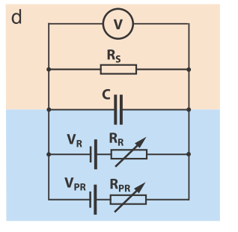
Modeling the relationship between pmf, azide, and light
(V): Magnitude of pmf = voltage drop across R_{s}
R_{s}: Sinks of pmf (flagellar motor, ATPase and transporters)
C: How quickly changes in proton flux are reflected in changes of pmf
V_{R} and V_{PR}: pmf “source” is the current produced by battery
R_{R} and R_{PR}: pmf “sink” are represented by internal resistance of battery
Notes:
To clarify the relationships between pmf, azide, and light, a highly simplified model of E. coli membrane fluxes was constructed.
- (V): Magnitude of pmf = voltage drop across R_{s}
- R_{s}: Sinks of pmf (flagellar motor, ATPase and transporters)
- C: How quickly changes in proton flux are reflected in changes of pmf
- Voltage is now time dependent
- Pmf exerts a thermodynamic force on charge transport reactions
Pmf up : outward pumping down
- V_{R} and V_{PR}: pmf “source” is the current produced by battery
- R_{R} and R_{PR}: pmf “sink” are represented by internal resistance of battery
- Batteries in parallel
- Proton transport between inside and outside of the cell, so batteries must be connected to the two parts of circuit that represent inside and outside
The model indicates that the maximum potential PR can generate is similar to the potential generated by E. coli respiration.
In E. coli respiring aerobically by using endogenous energy stores, PR cannot pump protons.
It is only when the pmf falls below the maximum potential during respiratory stress that PR begins to pump, and the proton flux through PR increases as the pmf falls.
PR is able to maintain E. coli cellular pmf near this maximum potential with sufficiently bright illumination.

Slide 9
Expt 5: PR sustains cellular pmf at a level that increases viability
Effect of sunlight on cell viability after exposure to 30mM azide
Azide resistance and ability to pump protons increases cell survival
Case | % survival
PR-RET- | 0
PR+RET- | 0
PR-RET+ | 1
PR+RET+ | 11
Notes:
- The results of these experiments along with the pmf model raised the possibility that PR could increase cell viability in addition to powering the flagellar motor.
- This experiment used retinal, also known as vitamin A aldehyde, which when bound to rhodopsins, allow conversion of light to mechanical energy.
In cases with no PR and no retinal, or just PR or just retinal, there was very little to no survival.
However, cells with both PR and retinal showed 11% survival, which through a Mann-Whitney U test was shown to be significantly more azide resistant than in all three other conditions.
Resistance to azide powers cell motility and increases cell survival, yielding cells that can withstand respiratory poisons and oxygen depletion via light harvesting.
In other words, the ability to pump protons increases cell survival.

Slide 10
Conclusions
Under anaerobic conditions, proteorhodopsin alters pmf to power the flagellar motor and increase cell viability via light-based proton pumping.
It is likely that PR provides similar benefits to other proteobacteria, as well as other more distantly related bacteria.
This could be used in synthesizing light-powered bacteria for variety of purposes.
Notes:
In conclusion, under anaerobic conditions, proteorhodopsin alters pmf to power the flagellar motor and increase cell viability via light-based proton pumping
- As far as future applications, it is likely that PR provides similar benefits to other proteobacteria, as well as other more distantly related bacteria.
- This could be used in synthesizing light-powered bacteria for variety of purposes

Slide 11
Questions?

