Slide 1
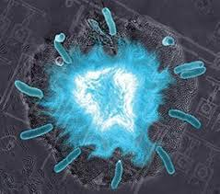
Flashing Bacteria
Morgan Haskell
Coby Turner

Slide 2
What We Wanted To Do
University of California in San Diego
  Biological synchronized clocks
    Flash to keep time
    Oscillator controlled by chemicals and temperature
  Quorum sensing = synchronized flashing
Quorum Sensing
  Have made synthetic switches
    Individual bacteria only
    Not together
    Movie
    http://blogs.discovermagazine.com/80beats/2010/01/21/video-fluorescent-bacteria-keep-time-like-a-clock/

Slide 3
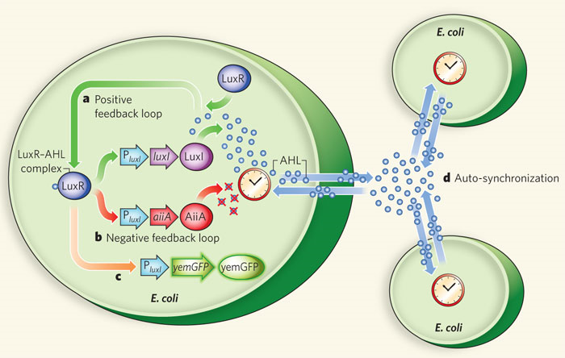
How It Works
luxI fromV. fischeri, AiiA from B. thurigensis, and yemGFP
  Under control of three identical luxI promoters
  luxI synthase enzymatically produces AHL (Acyl-homoserine lactone)
    Diffuses and mediates intercellular coupling
    Binds to LuxR
  luxR-AHL complex = transcriptional activator for luxI promoter
    AiiA negatively regulates promoter
  Degradation of AHL
AHL degraded by AiiA after accumulation
  Swept away by fluid flow in chamber
    Not enough inducer to activate expression from luxI promoter
  After time, promoters return to inactivated state
    AiiA production decreases = AHL accumulation
  Burst from promoters
At certain density = burst of light
  High density = light
    Burst of transcription of luxI promoters
    Increased levels of luxI, AiiA, and green fluorescent protein (GFP)
  Low density = nothing

Slide 4
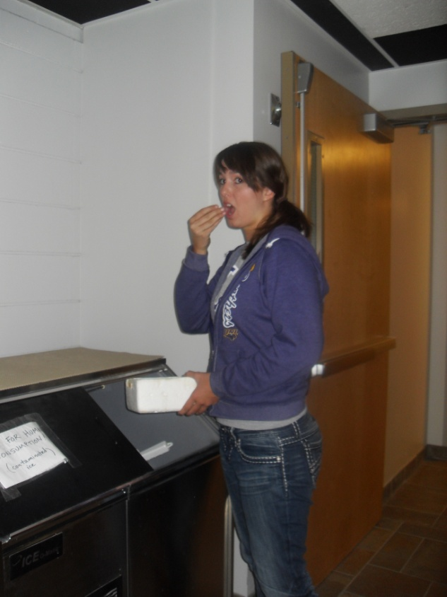
Failure From Day One
  Transformed E. coli with each biobrick part
    BBa_ J37015 (AHL &GFP) – Lux Superpart
    BBa_ J06504 – Cherry fluorescent protein
  Little to no growth (9/16)
  Second transformation
    Little to no growth on plates
    Left in incubator all night
      Lots of growth! (9/21)
  Attempted overnight cultures
    Put in incubator instead of shaker! (9/27 & 28

Slide 5
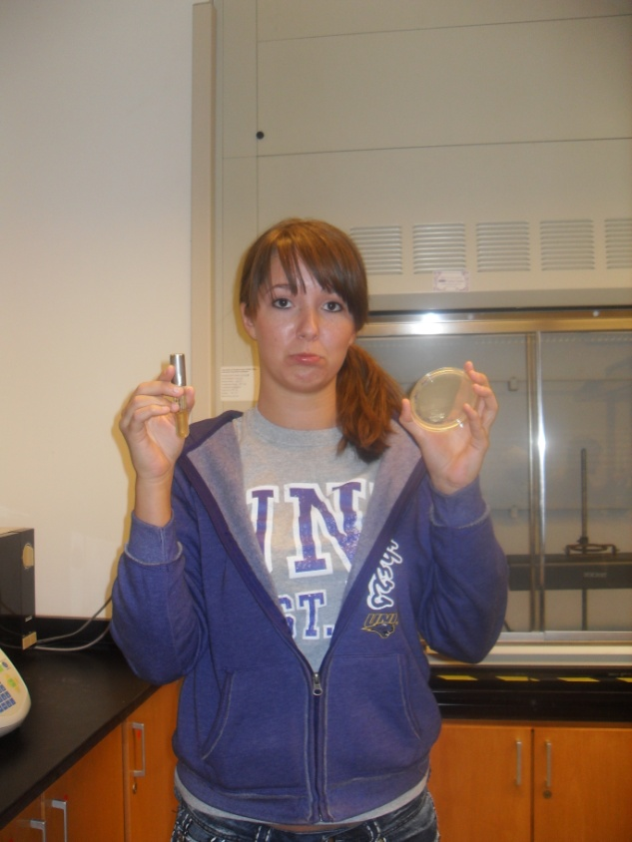
Continuing To Fail
  Transformed a third time
    J37015 (Lux Superpart), AiiA, and Lux promoter
    Group 9 transformed RFP.
      Lux promoter & superpart had colonies
      AiiA and RFP did not
    Overnight cultures of Lux superpart & promoter
      Growth happened! (9/28)
  Mini preps of superpart & promoter
    Used old & new overnight cultures

Slide 6
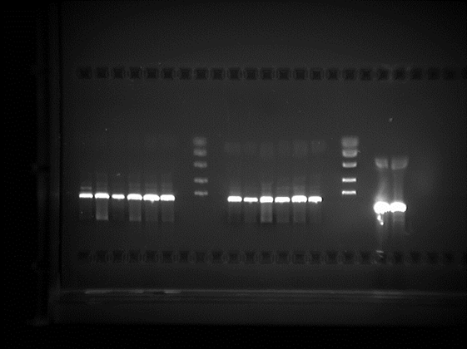
Next Steps
  Ordered primers for Lux superpart
    beginning primer (Lucy)
    end primer (Ricky)
    Fred & Ethel – primers without prefix & suffix (9/30)
      Ethel was too small
  Digest 14 mini-prep tubes
    Lux Superpart, Lux Promoter, RFP
    Enzymes E & S
  Ran electrophoresis gel
    Digestion didn’t work right
      Should have seen two bands for plasmid & vector
        May need higher gel concentration
        But DNA was present
      Repeat digestion
        Check all functional enzymes(10/5)

Slide 7
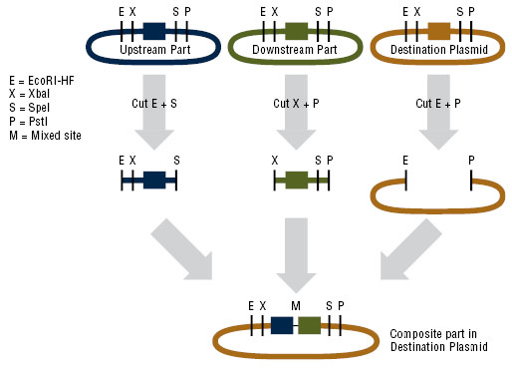

Slide 8
Digestion Failure
  Second digest & electrophoresis gel
    Check functionality of enzymes
    Should have seen two bands for every part
      At 714 bp & 2079bp (RFP), 55bp & 2079bp (promoter), & 2613bp & 2079bp (superpart)
      Super part might be to close together
      Promoter should have been easiest to seperate
      RFP had a ghost band
        May be too small to show up
    Digest again
      With control(10/7)

Slide 9
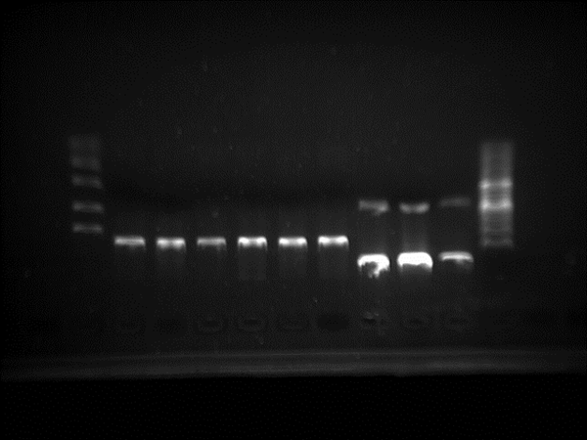
Digestion Failure
  Third digestion & gel
    Check functionality of enzymes using the lux promoter & control from group 11
      Xpe1 and Spe1
    Control worked
      Promoter didn’t show up
      Thought we were looking at band at 700 bp but should have been 55 bp
        Will need a higher gel concentration for better resolution
      Digest & run gel at 1.7% (10/12)

Slide 10
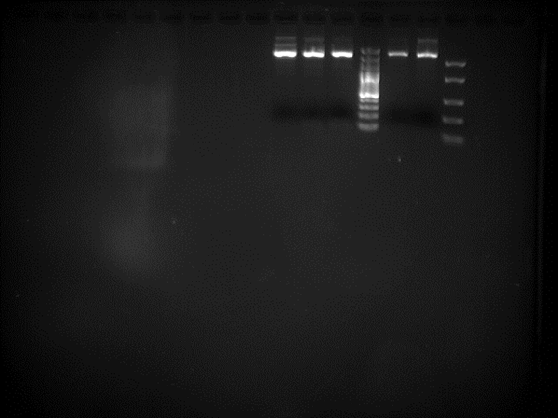
Digestion Failure
  Fourth digest of superpart & promoter
    Promoter: used more DNA, no water
    Made two separate mastermixes
    Accidently added loading to one tube before incubation
      Oops!
    Saw faint 55 bp bands for promoter
    Superpart didn’t digest
      Didn’t see two bands at 2079bp & 2613bp
      Attempted to order from iGEM
        Superpart (10/14)

Slide 11
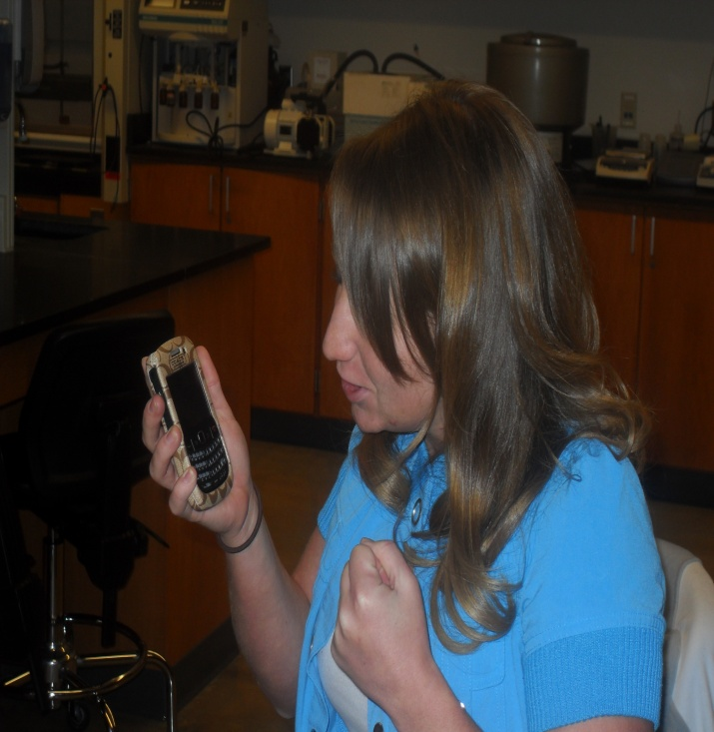
IGEM Difficulties
  IGEM
    “didn’t have our address”
    Phone number was wrong
    Busy with Jamboree
  While Waiting…. made overnight cultures
    Left glycerol stocks out of freezer too long!
      Plated & found still alive!
    Plated promoter glycerol stock & made overnight cultures of promoter part (10/20)
    Mini-preps of R0062 (promoter) were prepared (10/21)

Slide 12
IGEM Difficulties
  Weeks after original order…
    Plated parts that came from iGEM
    Ordered AiiA
      Mixed up part numbers – oops!
        Promoter part instead of AiiA
  Dissolved primers (10/26)
  Prepared overnight cultures of superpart & promoter from ordered parts (10/27)
  Mini-preps of superpart from ordered part
    Made glycerol stocks (10/28)

Slide 13
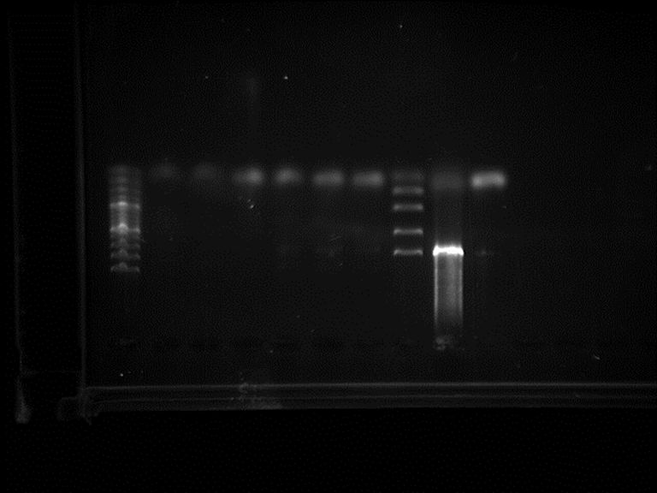
Getting Back on Track…ish
  Plated J04450 (RFP) from group 13
    Made overnight cultures
  Ran PCR of J37015 (Lux Super part)
    Amplify out the GFP
      Ran gradient PCR overnight
    Put in fridge next day (11/2)
  Electrophoresis gel of PCR products
    0.8% agarose gel
      a) there was no/not enough DNA
      b) the primers weren’t right
      c) wrong/no plasmid
  Primers ordered for RFP
    (GAATTCGCGGCCGCTTCTAG) 5’ – AAAGAGGAGAAATACTAGAT – 3’ beginning primer = Chips
    (TACTAGTAGCGGCCGCTGCAG) 5’ – TATAAACGCAGAAAGGCCCA – 3’ end primer = Salsa
      Controlled by different promoter…oops!
      Will need to ligate to Lux promoter(11/4)
  Mini-preps of J04450 (RFP)
  Glycerol stocks & dissolved primers (11/9)

Slide 14
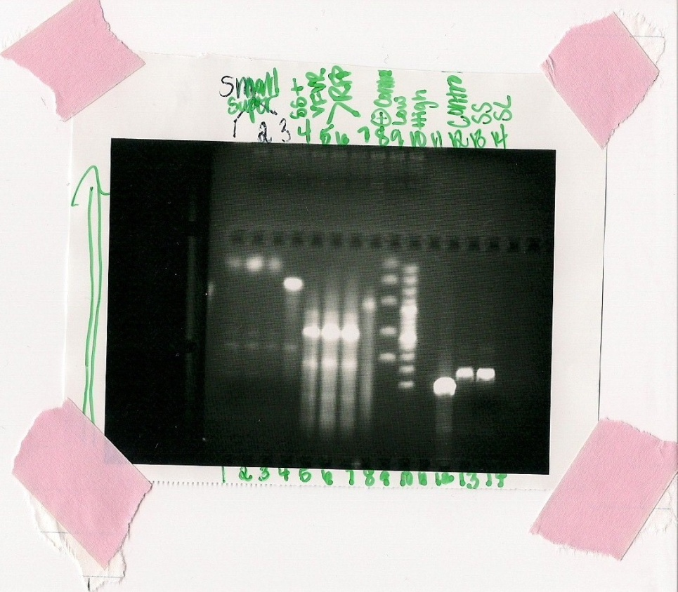
PCR Failure
  PCR of J37015 (Lux super part) & J04450 (RFP)
      Gradient PCR
    Amplify parts & check Lucy and Ricky
    Stored in fridge(11/11)
  Digestion of J37015 (Lux super part) & Electrophoresis
  Digested part and PCR products from previous PCR
      PCR didn’t work again for super part
      RFP amplified
        Need to check sequence to see if we got the right band
          Parts registry has no bp size
          Not sure if right
    Sent off superpart to be sequenced(11/16)

Slide 15
Nearing The End
    Digestion of lux promoter & electrophoresis gel
      Ligate it together with RFP PCR product
        Had ghost bands around 200 bp
          Too large
    Had the Promoter sent out to be sequenced
      Never got sent in(11/18)

Slide 16

Biobrick Failure
Lux Superpart sequencing
  Is Super Crap
Part was bad
  From day 1…

Slide 17
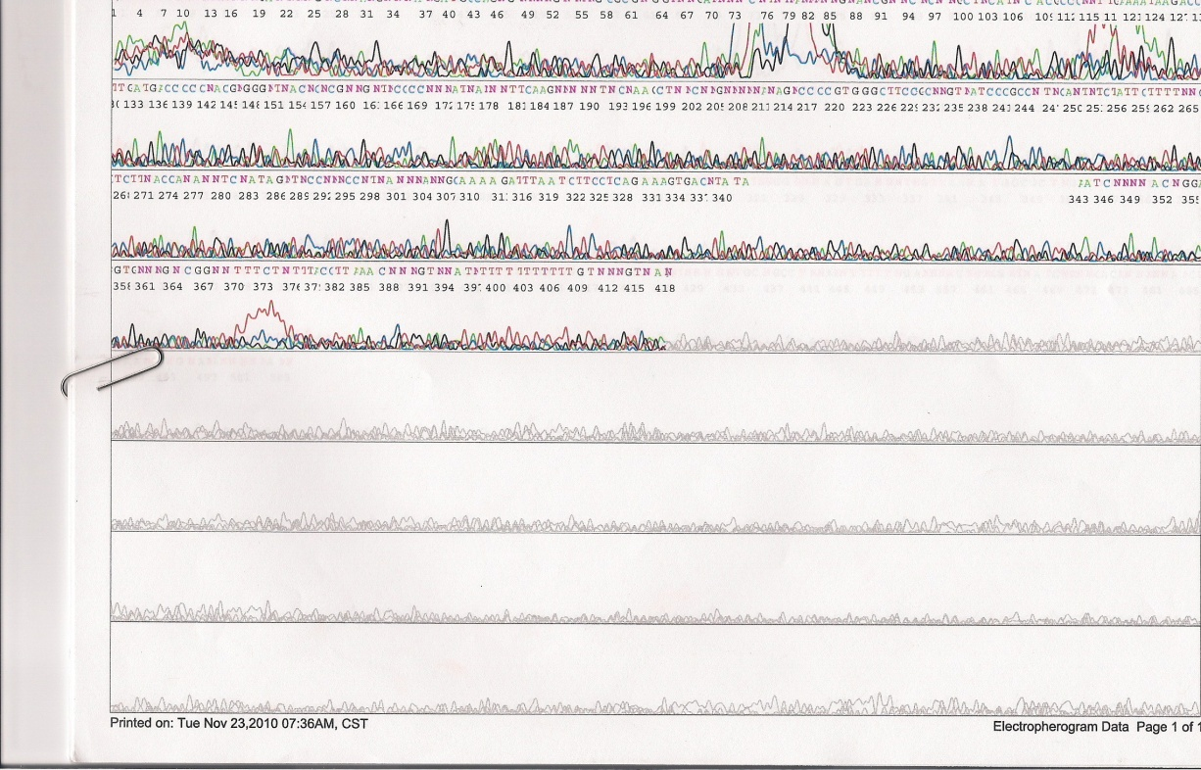
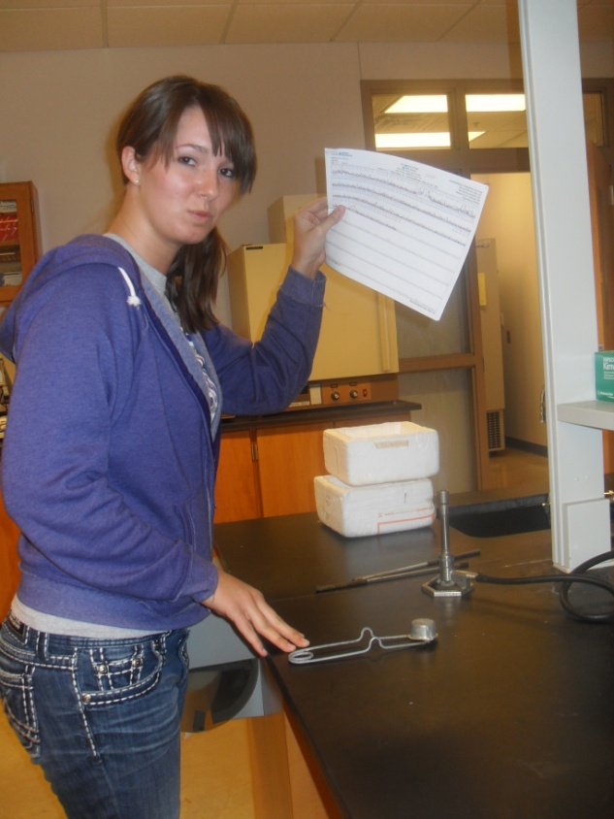

An Angry Morgan

Slide 18
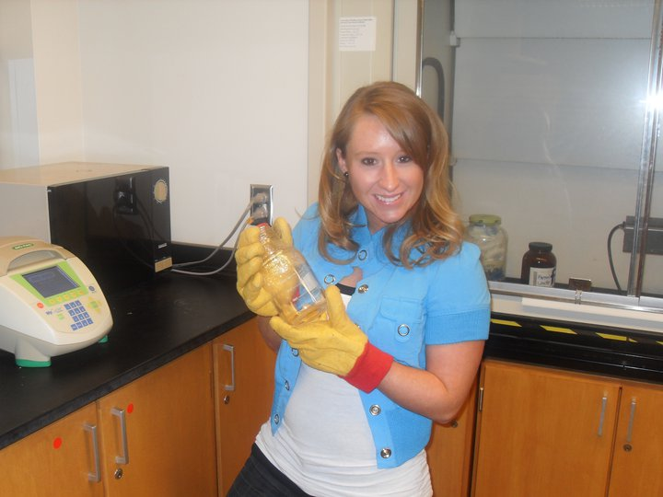
In conclusion…
list of accomplishments
1. can make and run gel
2. can do digestions
45 to be exact
3. can do mini-preps
20 to be exact
4. pipetting skills have improved
5. Got red glowing bacteria!!
  that we got from group 13 ☺
  6. masters of getting ice
  7. learned how to use the shaker
  8. learned how to PCR
  9. learned how to design our own primers
  10. learned how to transform

Slide 19
In conclusion cont…
things we didn't accomplish
1. obtaining our superpart...our superpart was super crap
2. cutting out GFP with PCR
3. ligating superpart with RFP
4. obtaining AiiA
5. creating our positive and negative feedback loops
6. making bacteria flash like fireflies

Slide 20
In conclusion cont…
things we could improve on
1. paying closer attention to details
    Shaker not incubator
    Know right bp size
    Get part order numbers correct
    Keep caps on tubes during centrifuge
  2. having parts sequenced beforehand
  3. learning how to take pictures with the imaging machine

