Slide 1
Number of Significantly Changed Genes in Wild-Type and dSWI4 Strains – At Any Point in Cold-Shock and/or Recovery
(Within-Strain ANOVA)
ANOVA | WT | dSWI4
p < 0.05 | 2377 (38.4%) | 2583 (41.7%)
p < 0.01 | 1531 (24.7%) | 1679 (27.1%)
p < 0.001 | 850 (13.7%) | 869 (14.0%)
p < 0.0001 | 449 (7.3%) | 446 (7.2%)
B & H p < 0.05 | 1673 (4.3%) | 1855 (30.0%)
Bonferroni p < 0.05 | 226 (%) | 179 (2.9%)

Slide 2
Number of Significantly Changed Genes in dSWI4 Deletion Strain, at Various Points in Cold-Shock and Recovery
(T-test)
dSWI4 | Cold Shock |  | Recovery
 | t₁₅ | t₃₀ | t₆₀ | T₉₀ | t₁₂₀
Average Log Fold Change > 0.25 and p < 0.05 | NA | 765 (12.3%) | 798 (12.9%) | 501 (8.1%) | 330 (5.3%)
Average Log Fold Change < -0.25 and p < 0.05 | NA | 725 (11.7%) | 947 (15.3%) | 570 (9.2%) | 370 (6.0%)
Total p < 0.05 | NA | 1497 (24.2%) | 1757 (28.4%) | 1075 (17.4%) | 705 (11.3%)
Total B & H p < 0.05 | NA | 4 (0.06%) | 7 (.1%) | 1 (.01%) | 0 (0%)
Total Bonferroni p < 0.05 | NA | 2 (0.03%) | 1 (.01%) | 1 (.01%) | 0 (0%)

Slide 3
Number of Significantly Different Genes between wt and Various Deletion Strains
(Two-Strain ANOVA)
 | p < 0.05 | B-H p < 0.05
wt vs. dCIN5 | 563 | 4
wt vs. dGLN3 | 720 | 36
wt vs. dHAP4 | 640 | 23
wt vs. dHMO1 | 556 | 5
wt vs. dZAP1 | 553 | 31
wt vs. S. paradoxus | 1498 | 703

Slide 4
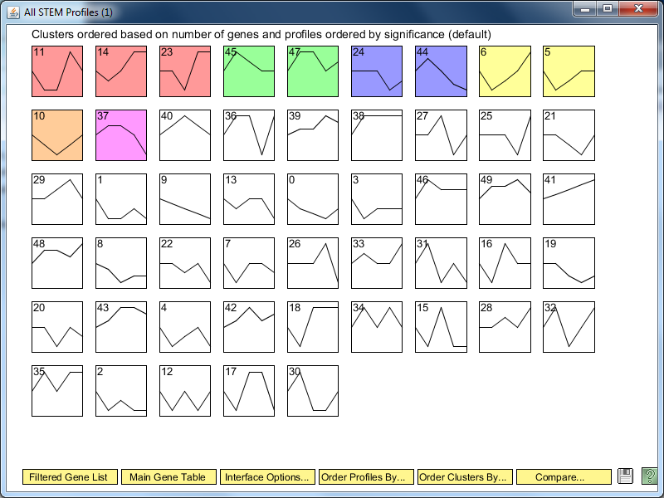

Slide 5
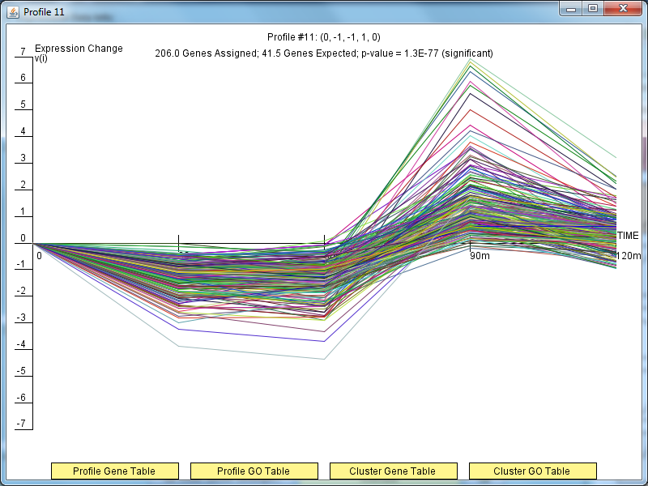

Slide 6
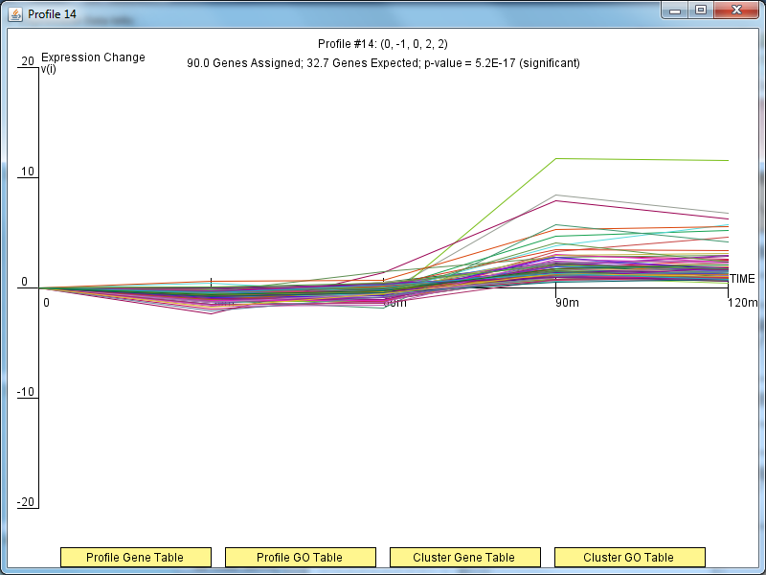

Slide 7
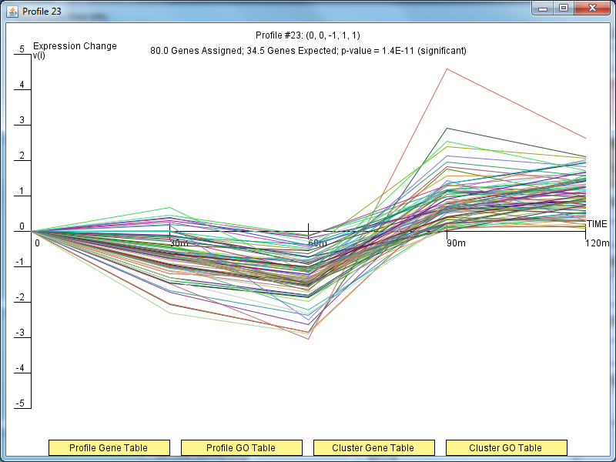

Slide 8
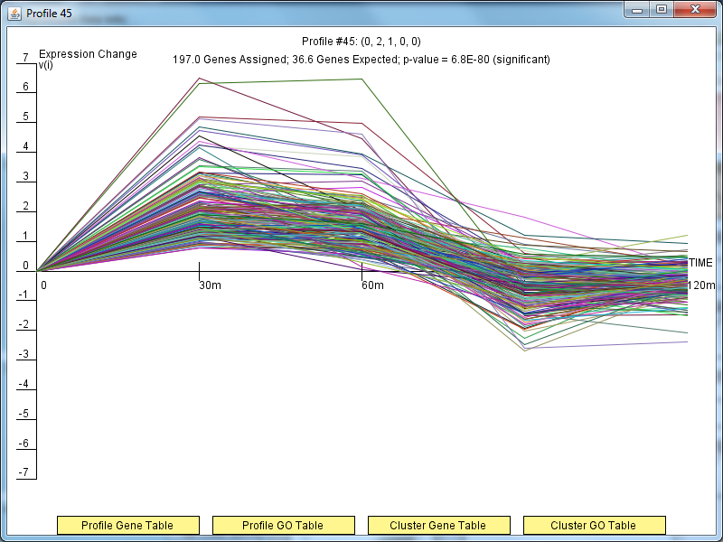

Slide 9
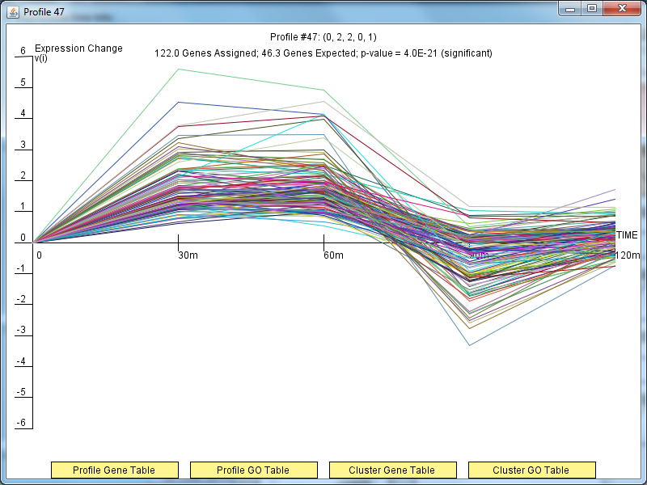

Slide 10
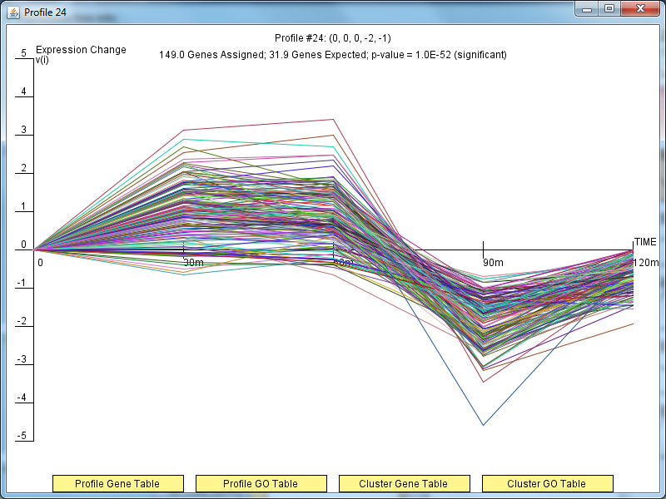

Slide 11
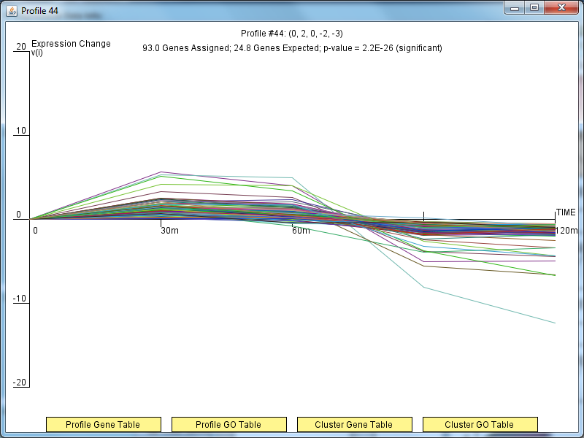

Slide 12
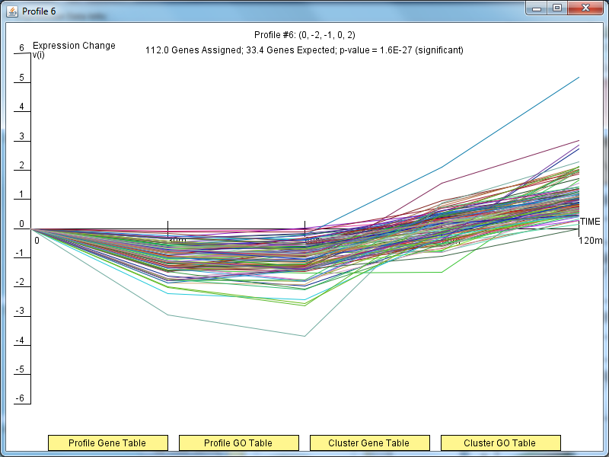

Slide 13
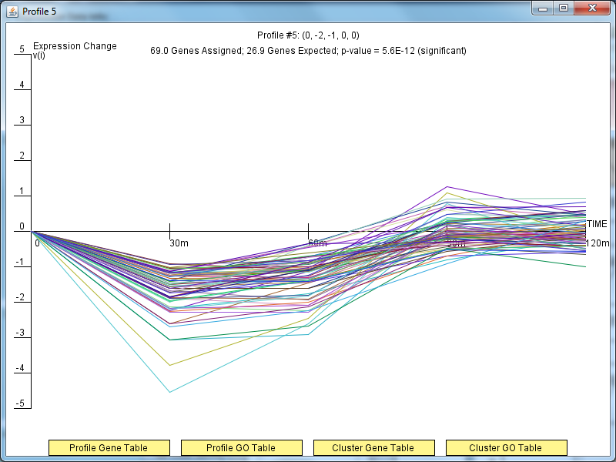

Slide 14
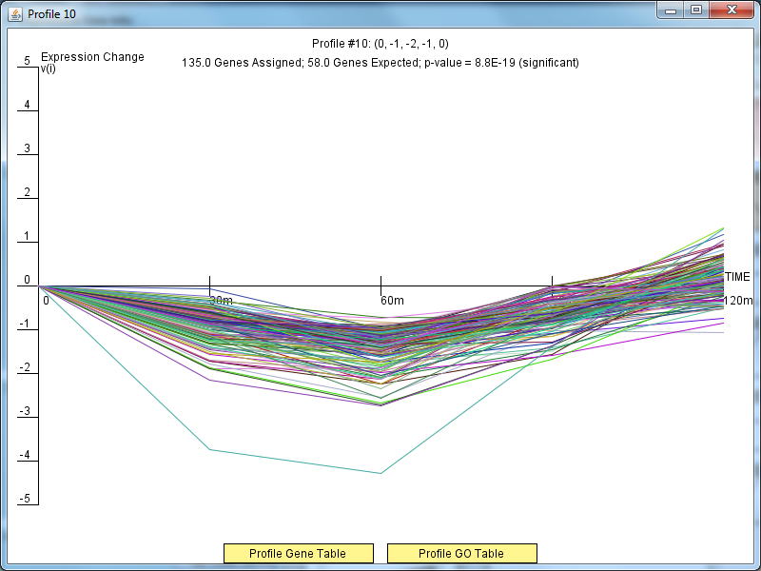

Slide 15
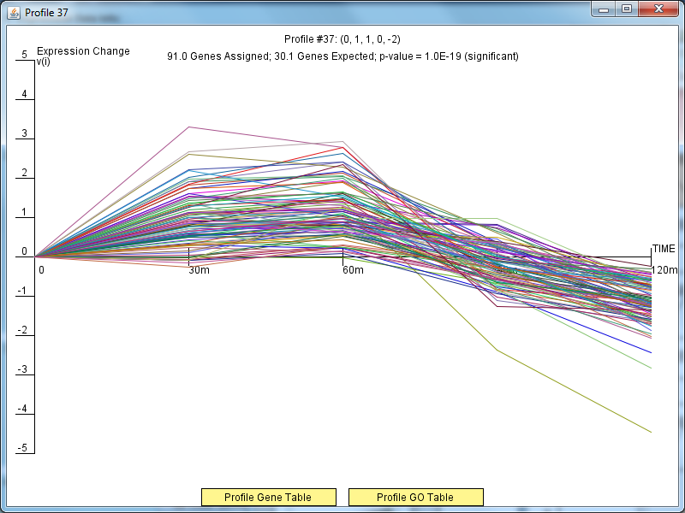

Slide 16
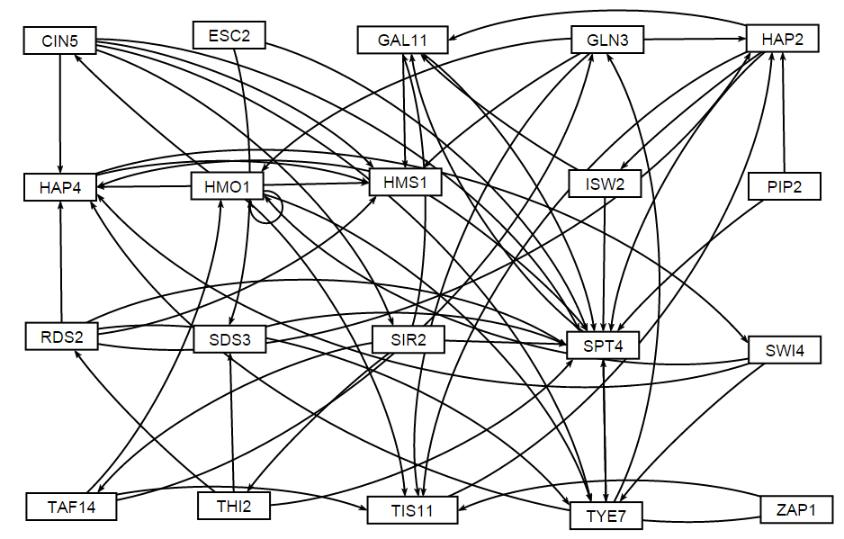
Gene Regulatory Network of Profile #6; Based on DNA Binding Plus Expression Evidence

Slide 17
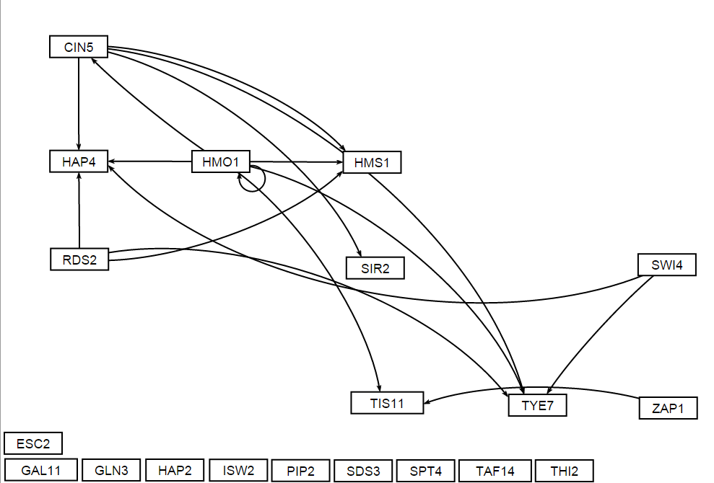
Gene Regulatory Network of Profile #6; Based Only on DNA Binding Expression Evidence

Slide 18
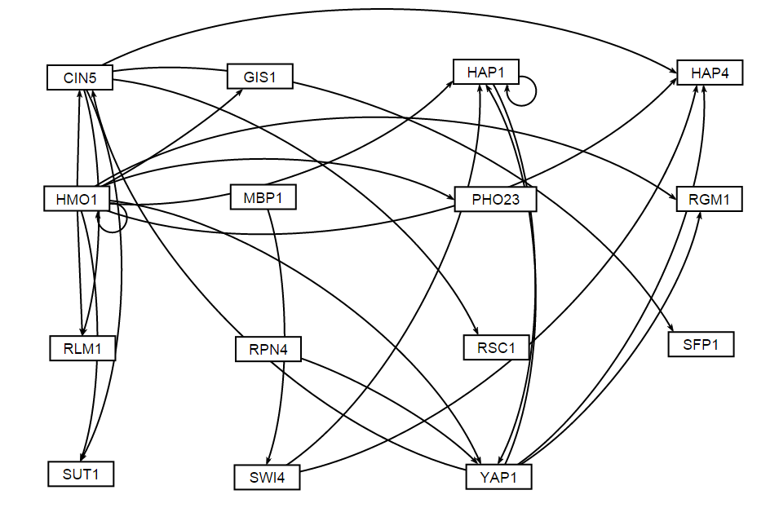
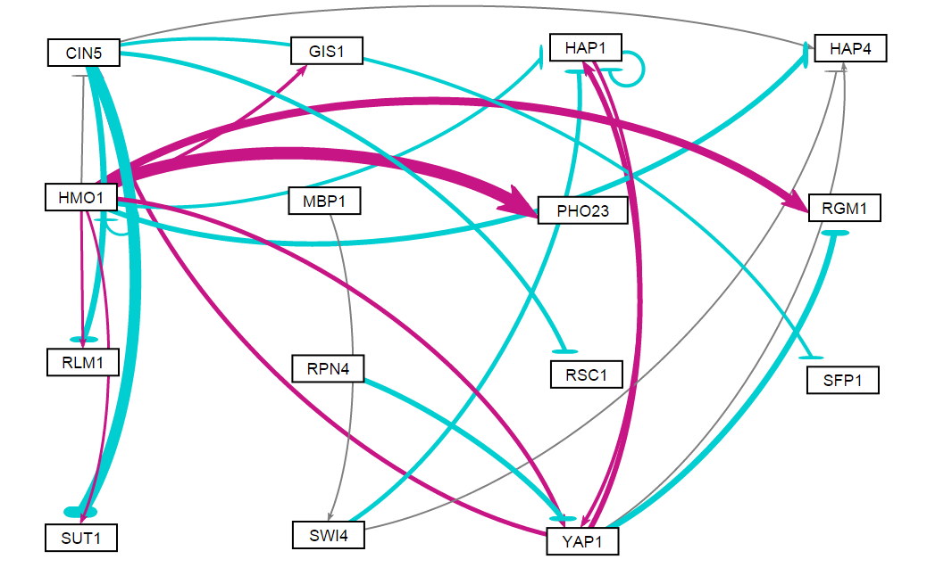
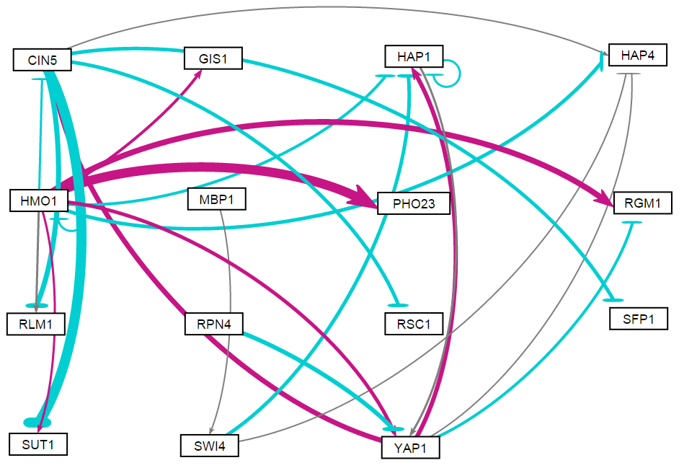
Gene Regulatory Network of Profile #14 (Plus YAP1); Based Only on
DNA Binding Expression Evidence
This Network Used for GRNmap
Fixed b Parameter
Estimated b Parameter

Slide 19
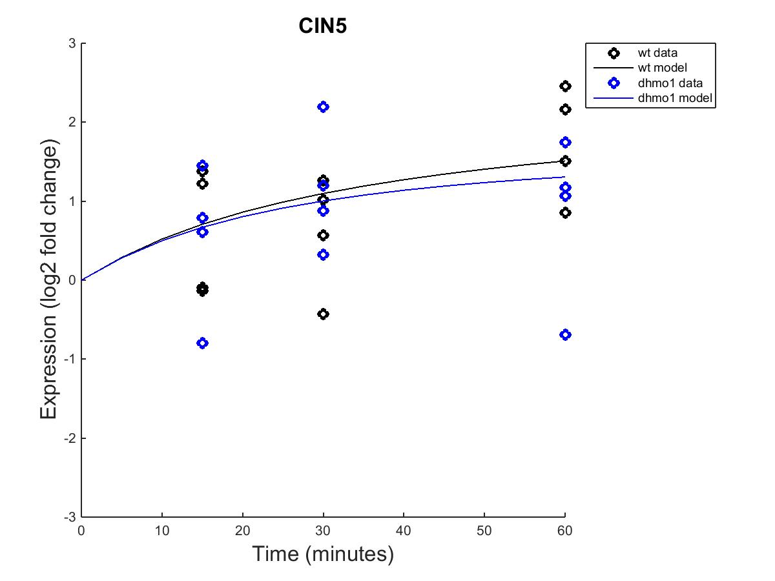

MATLAB Results – wt and dHMO1
Fixed B Parameter Estimated B Parameter

Slide 20
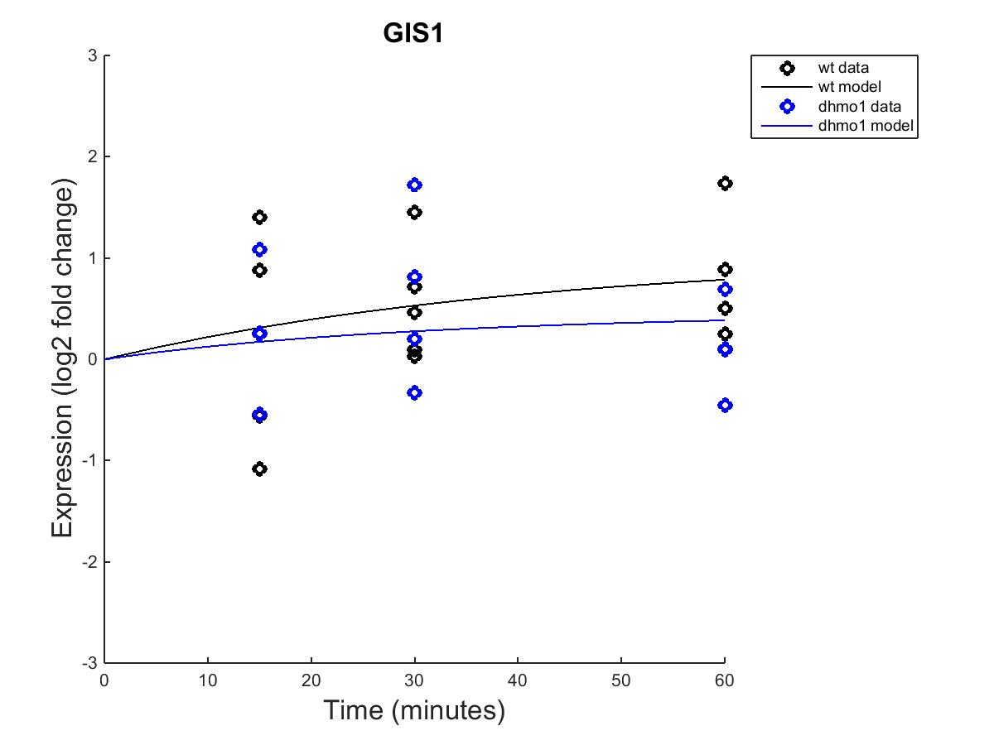

MATLAB Results – wt and dHMO1
Fixed B Parameter Estimated B Parameter

Slide 21
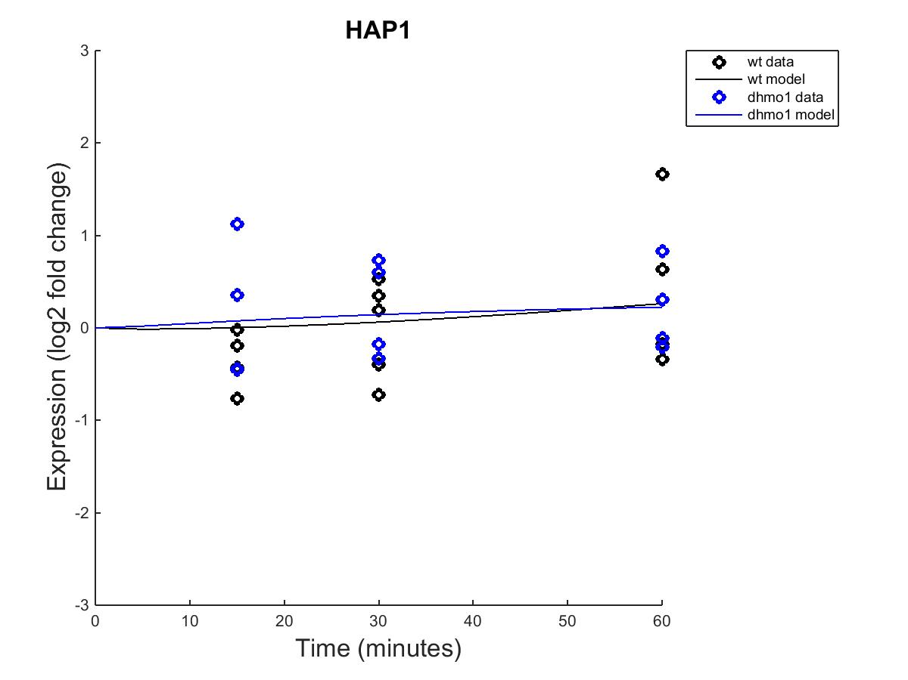
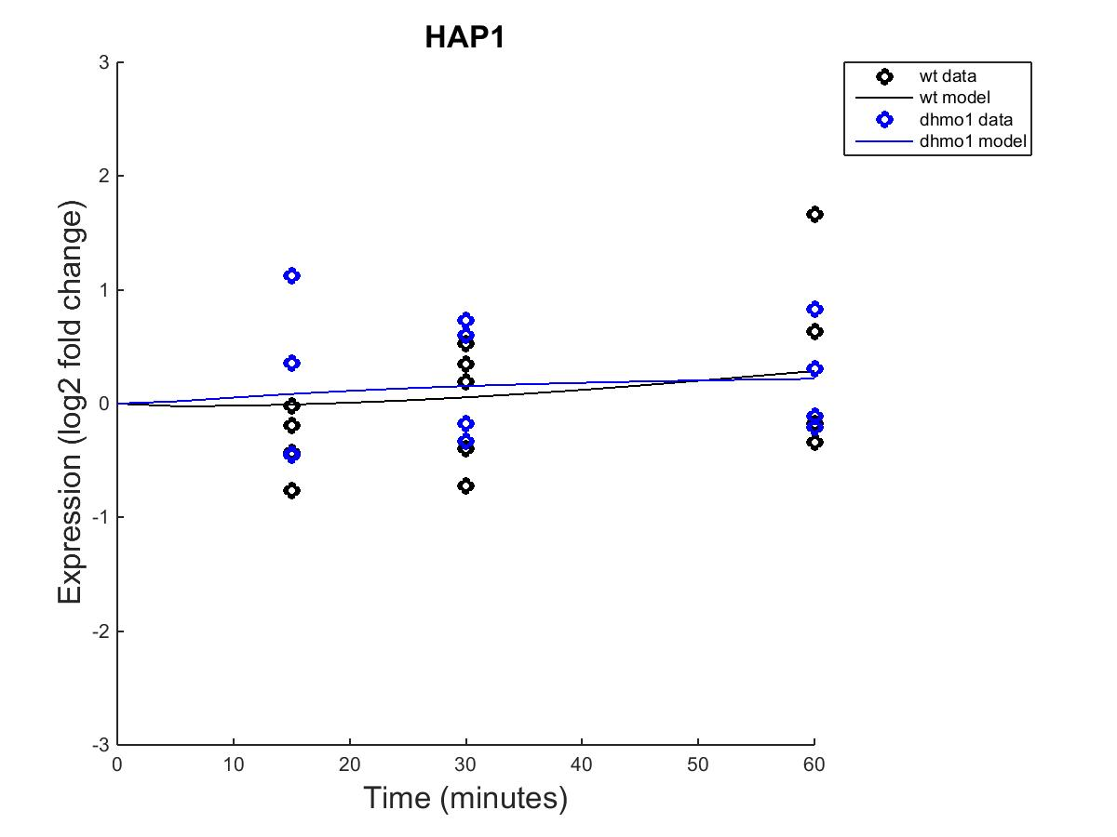
MATLAB Results – wt and dHMO1
Fixed B Parameter Estimated B Parameter

Slide 22
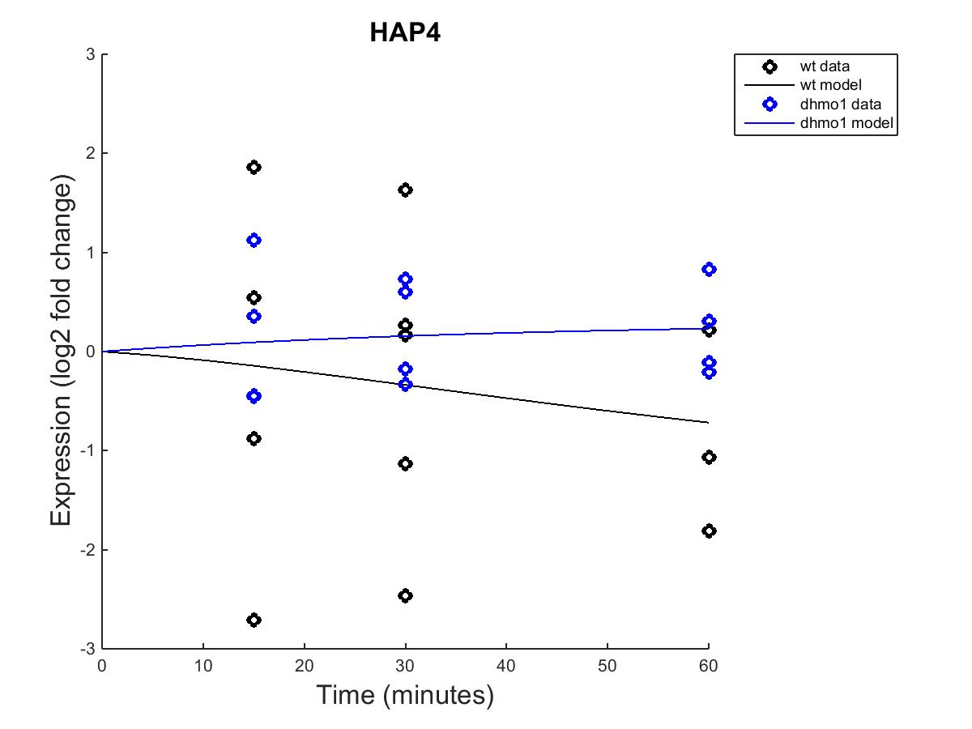

MATLAB Results – wt and dHMO1
Fixed B Parameter Estimated B Parameter

Slide 23
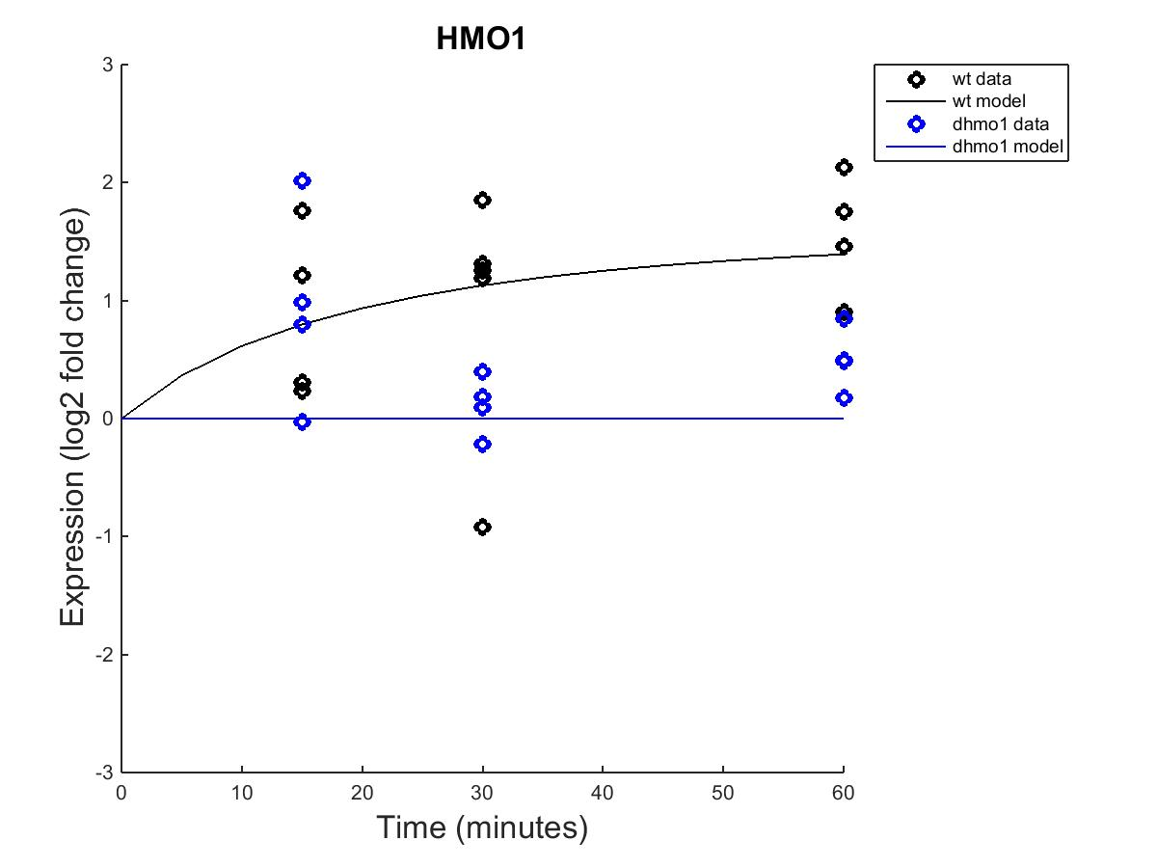

MATLAB Results – wt and dHMO1
Fixed B Parameter Estimated B Parameter

Slide 24
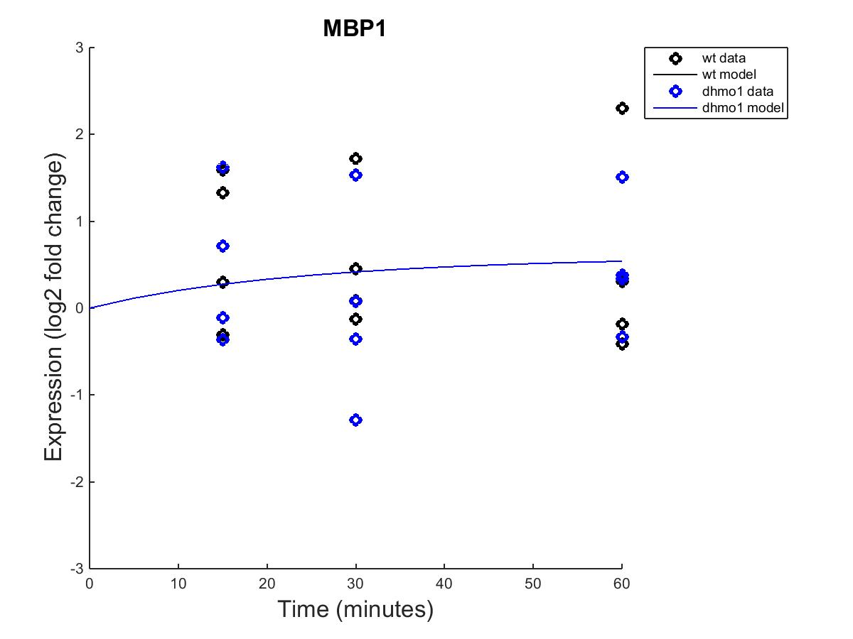

MATLAB Results – wt and dHMO1
Fixed B Parameter Estimated B Parameter

Slide 25
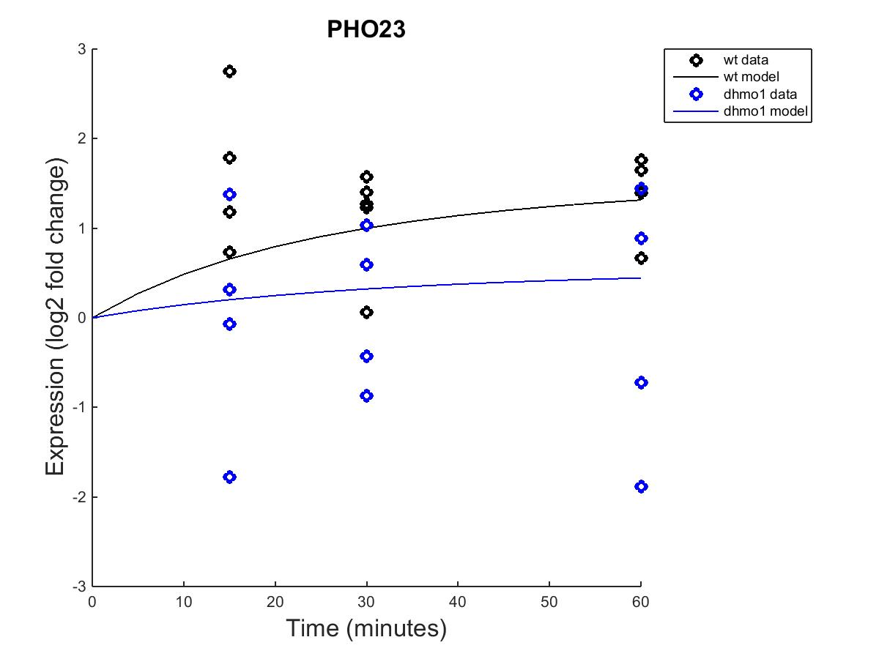
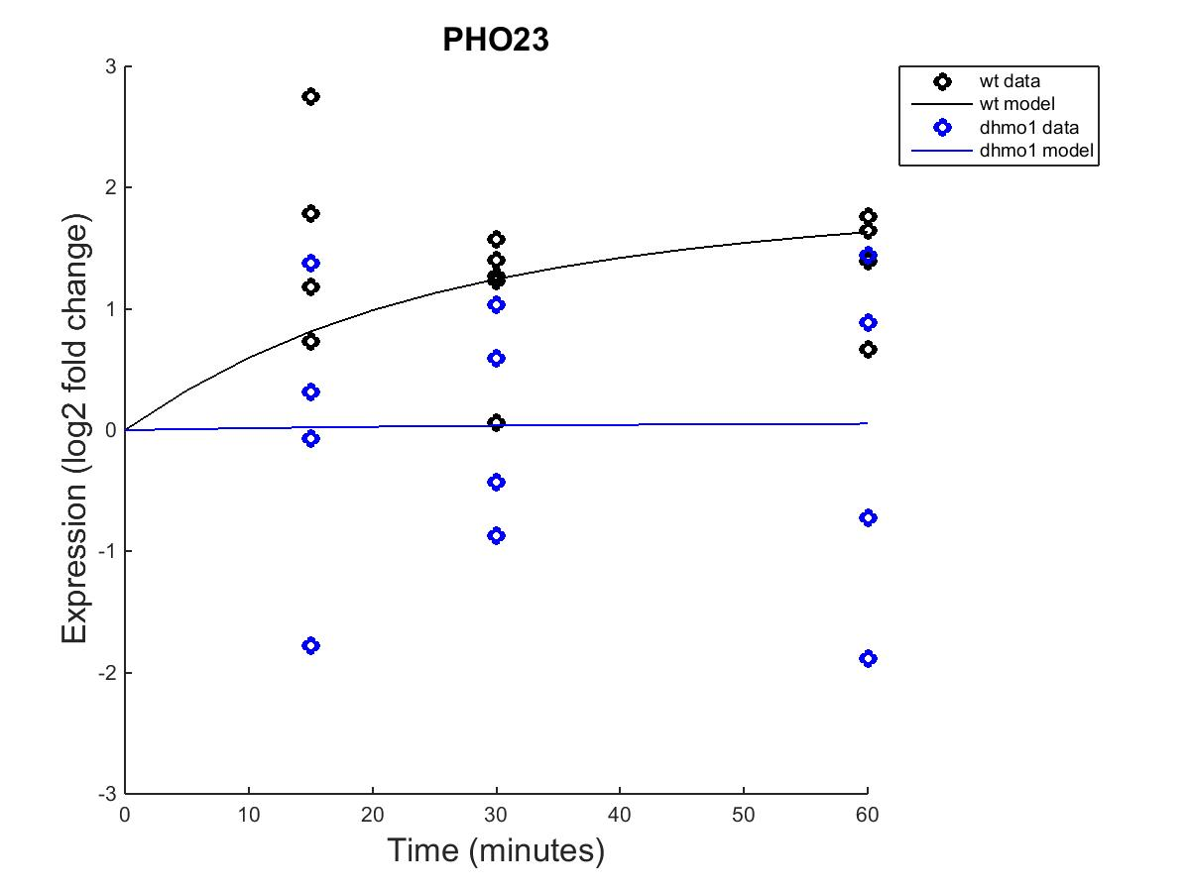
MATLAB Results – wt and dHMO1
Fixed B Parameter Estimated B Parameter

Slide 26
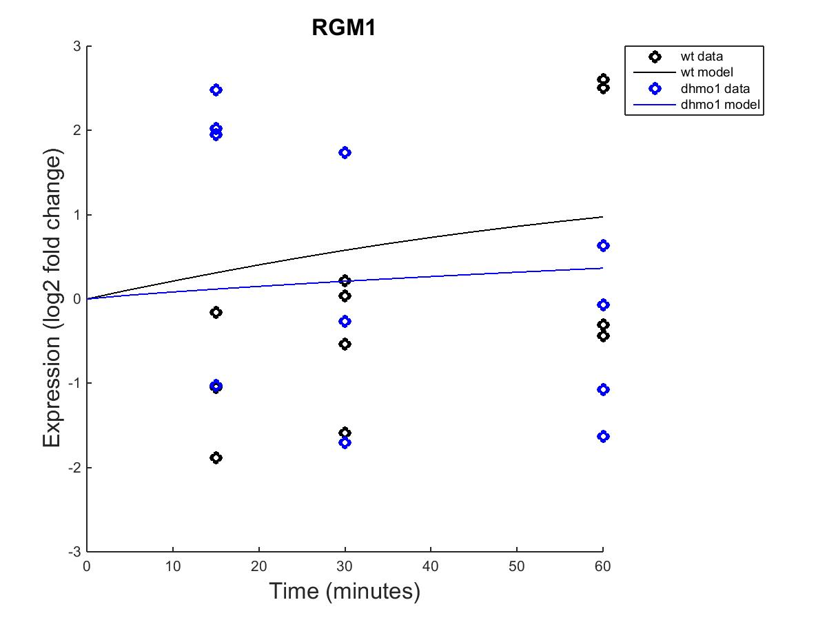
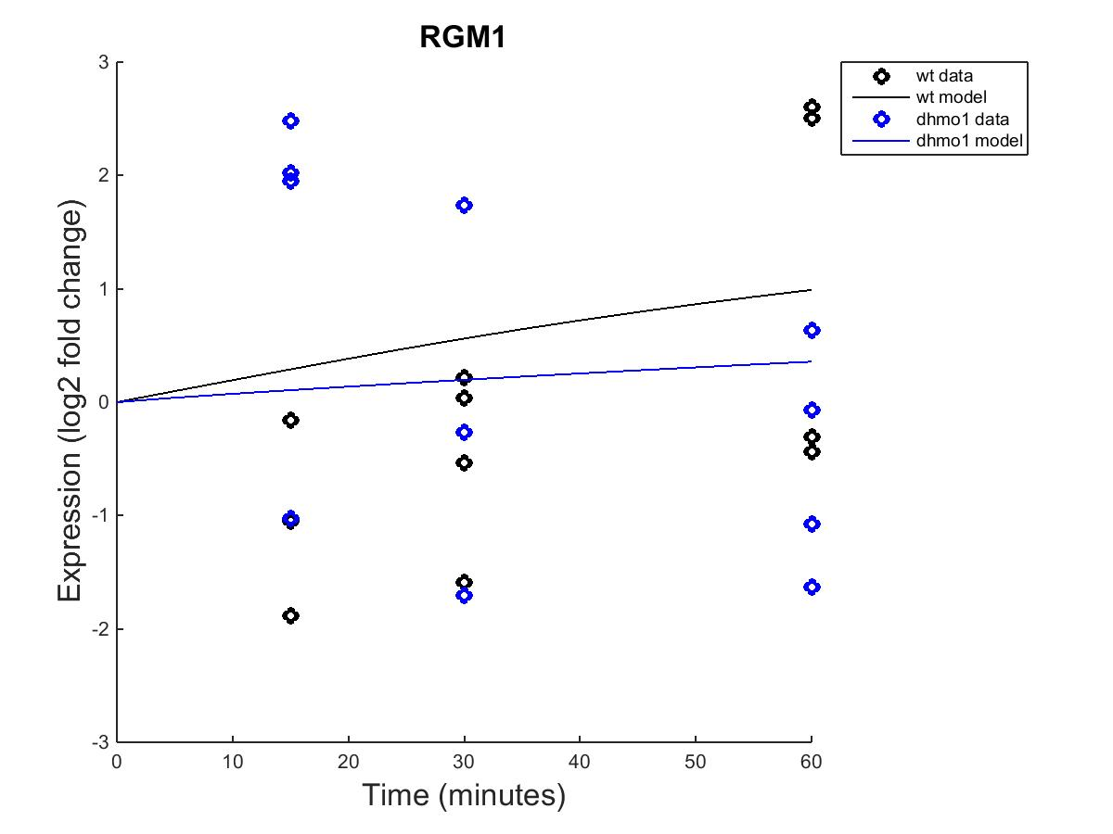
MATLAB Results – wt and dHMO1
Fixed B Parameter Estimated B Parameter

Slide 27
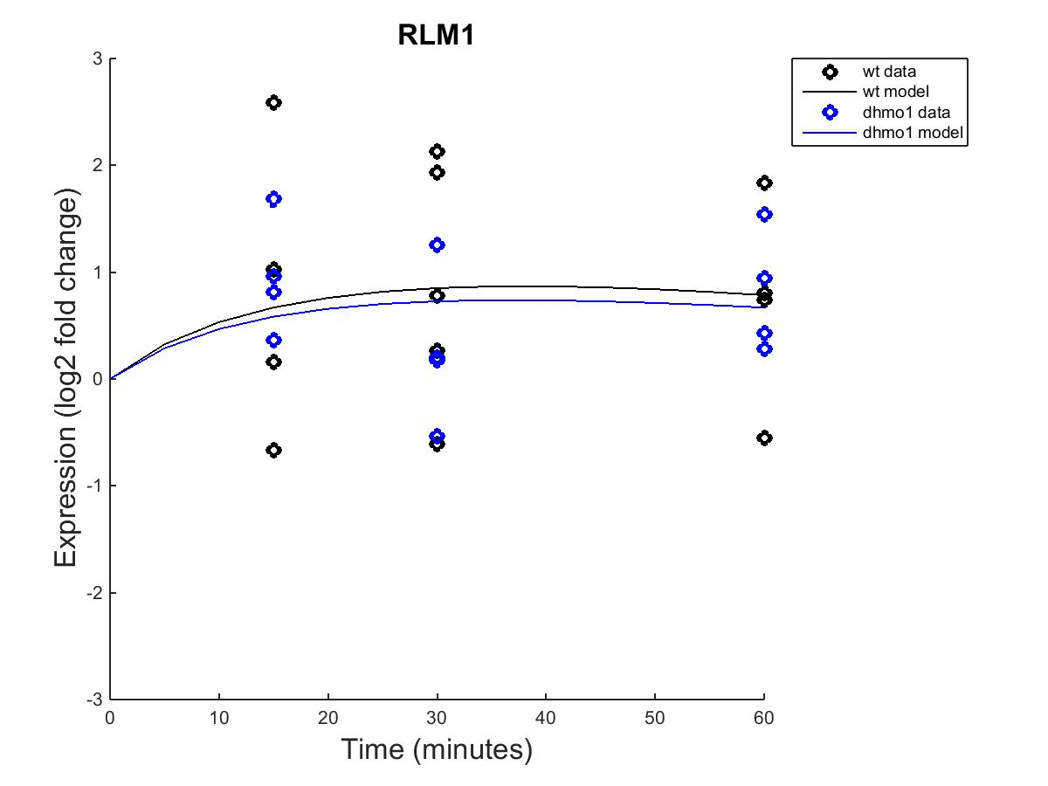
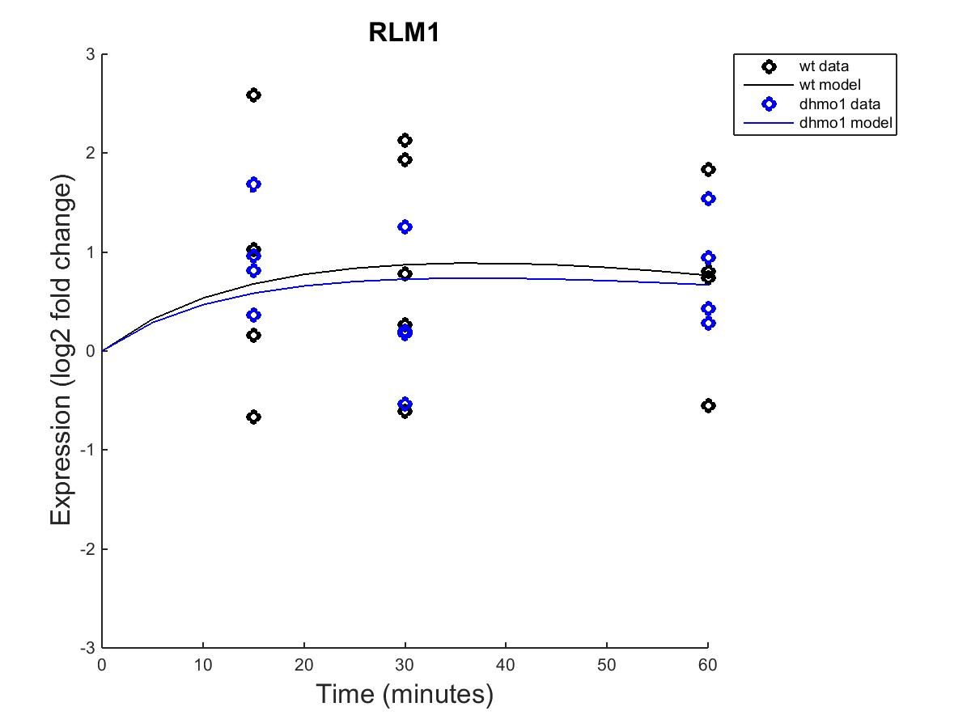
MATLAB Results – wt and dHMO1
Fixed B Parameter Estimated B Parameter

Slide 28
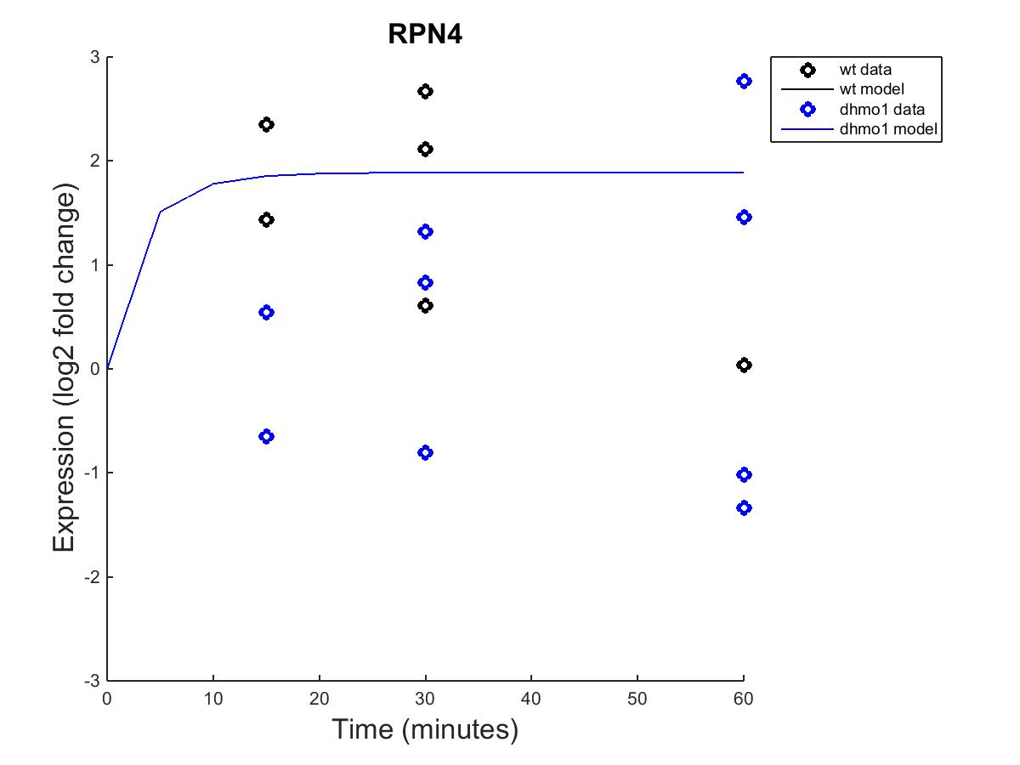

MATLAB Results – wt and dHMO1
Fixed B Parameter Estimated B Parameter

Slide 29
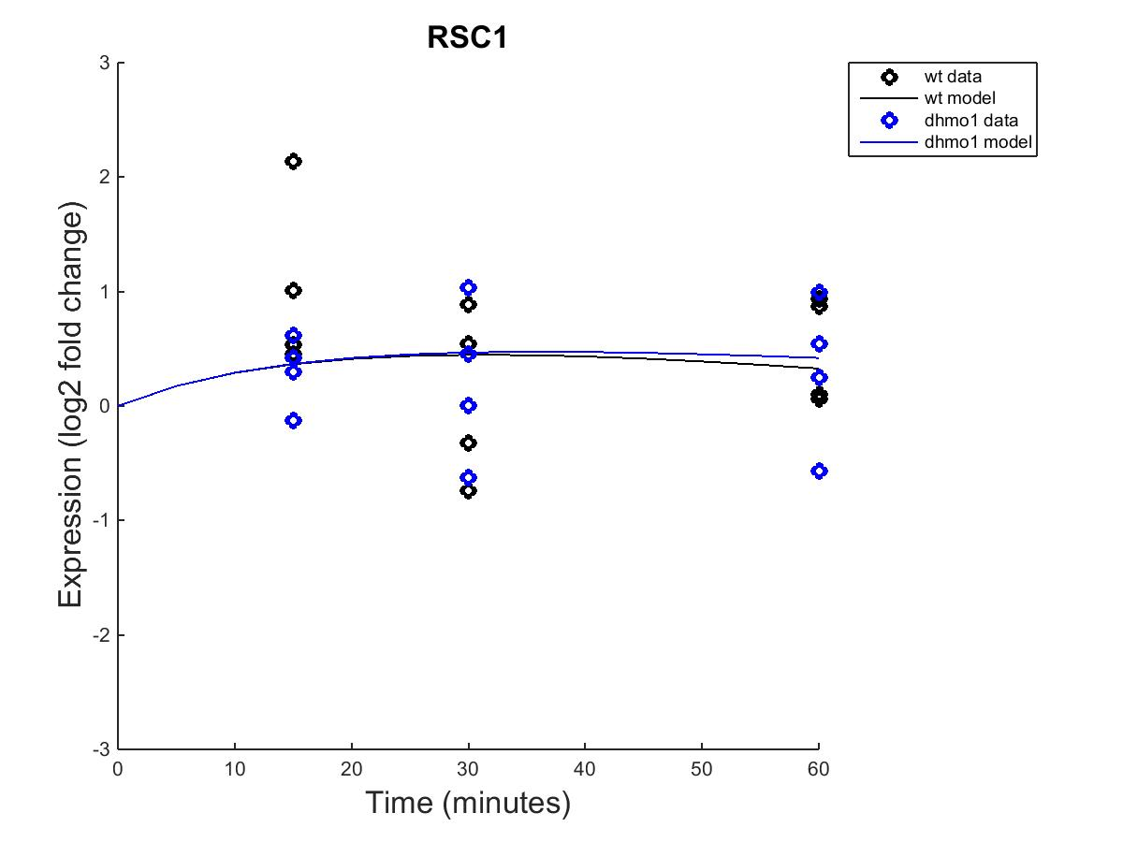
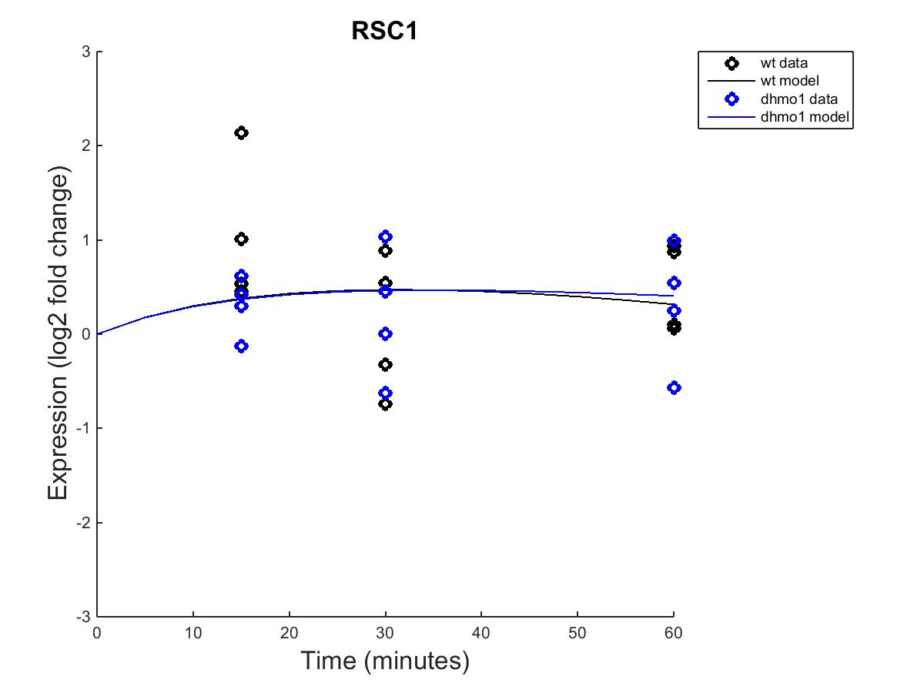
MATLAB Results – wt and dHMO1
Fixed B Parameter Estimated B Parameter

Slide 30
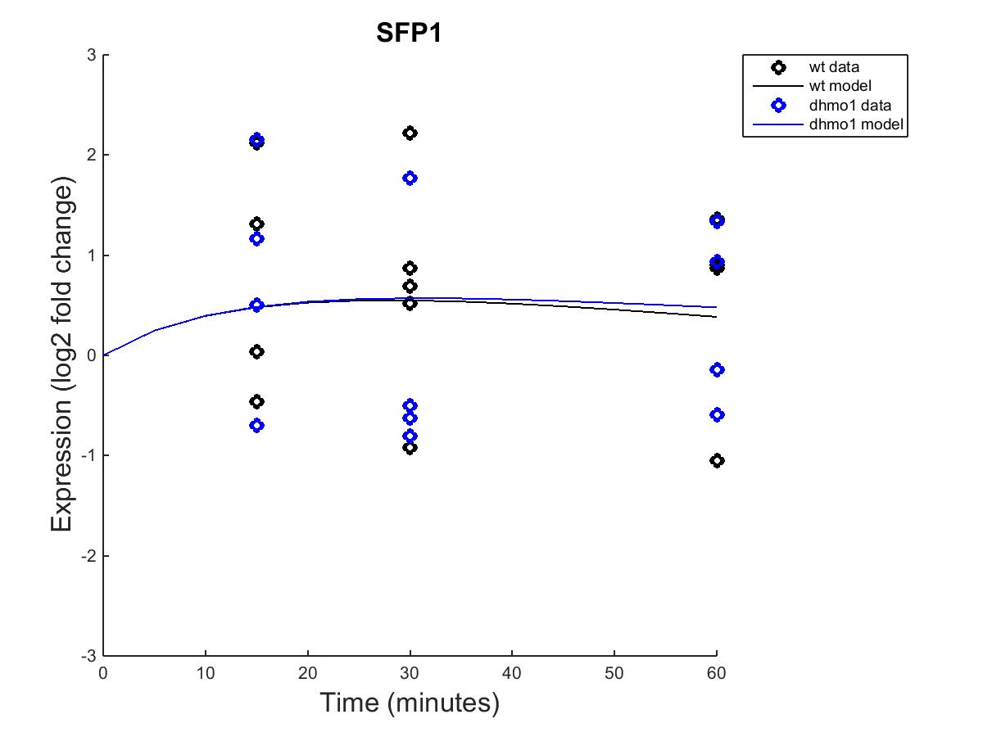
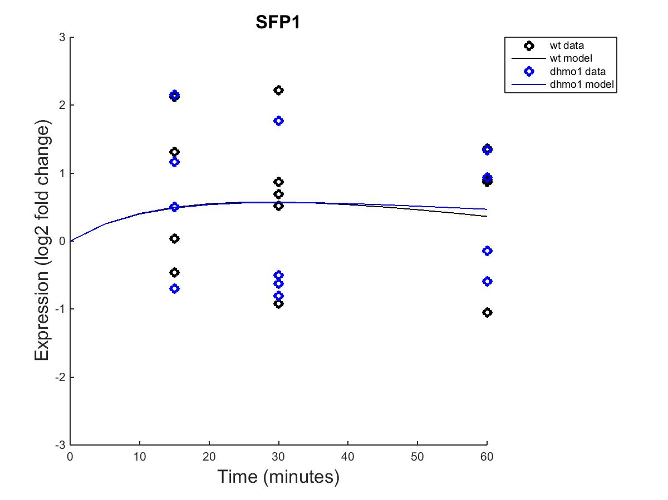
MATLAB Results – wt and dHMO1
Fixed B Parameter Estimated B Parameter

Slide 31
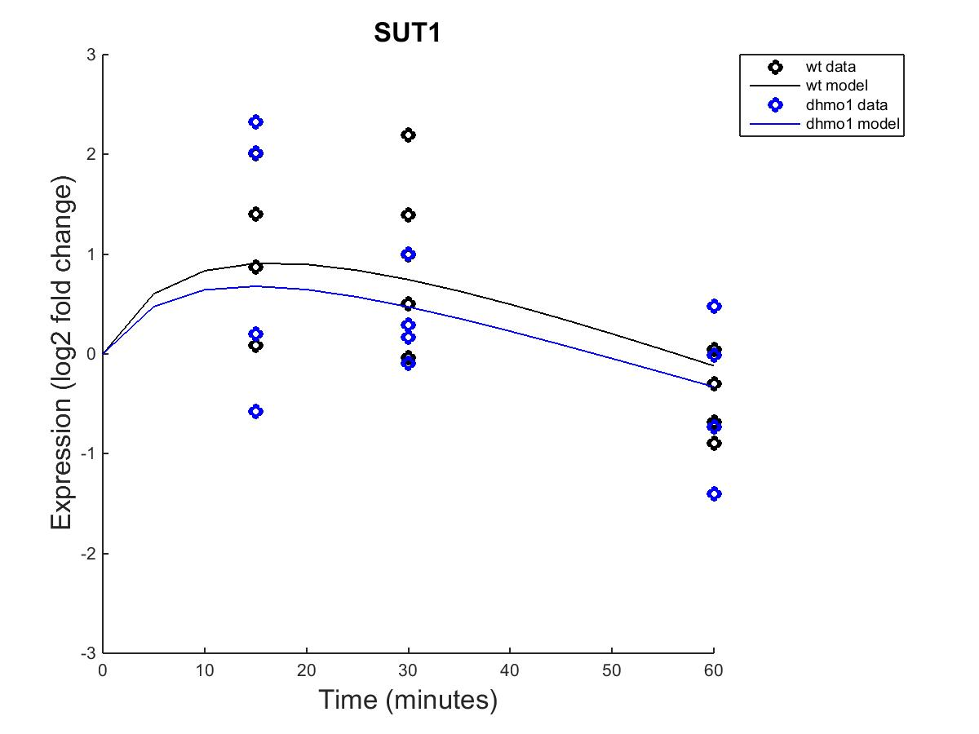
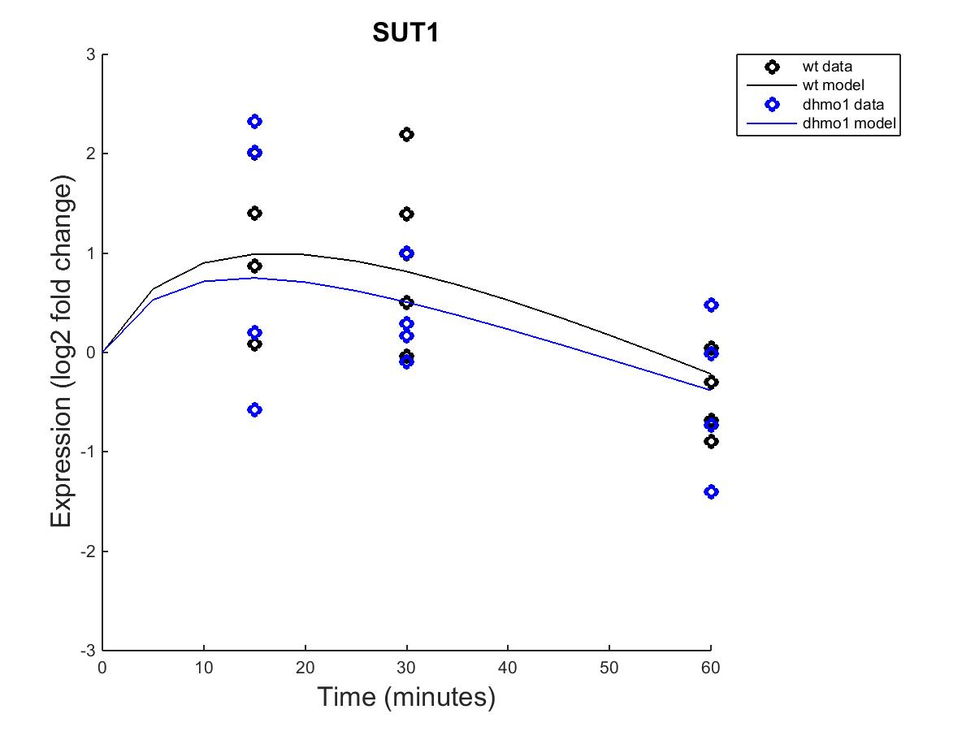
MATLAB Results – wt and dHMO1
Fixed B Parameter Estimated B Parameter

Slide 32
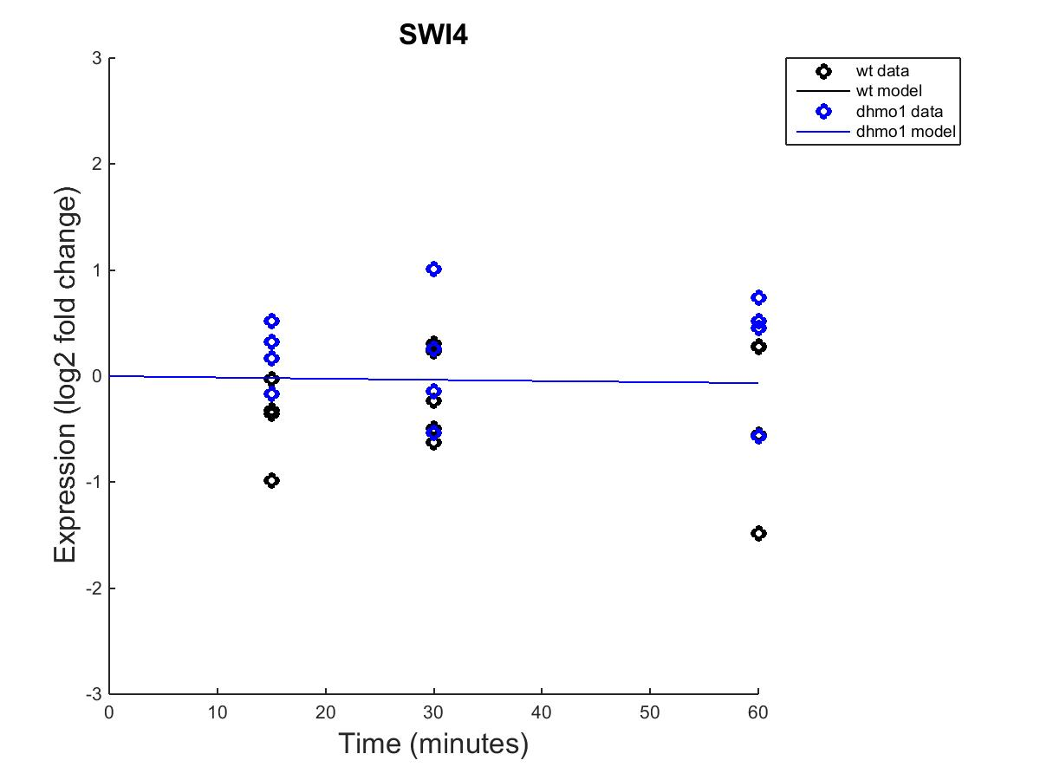

MATLAB Results – wt and dHMO1
Fixed B Parameter Estimated B Parameter

Slide 33
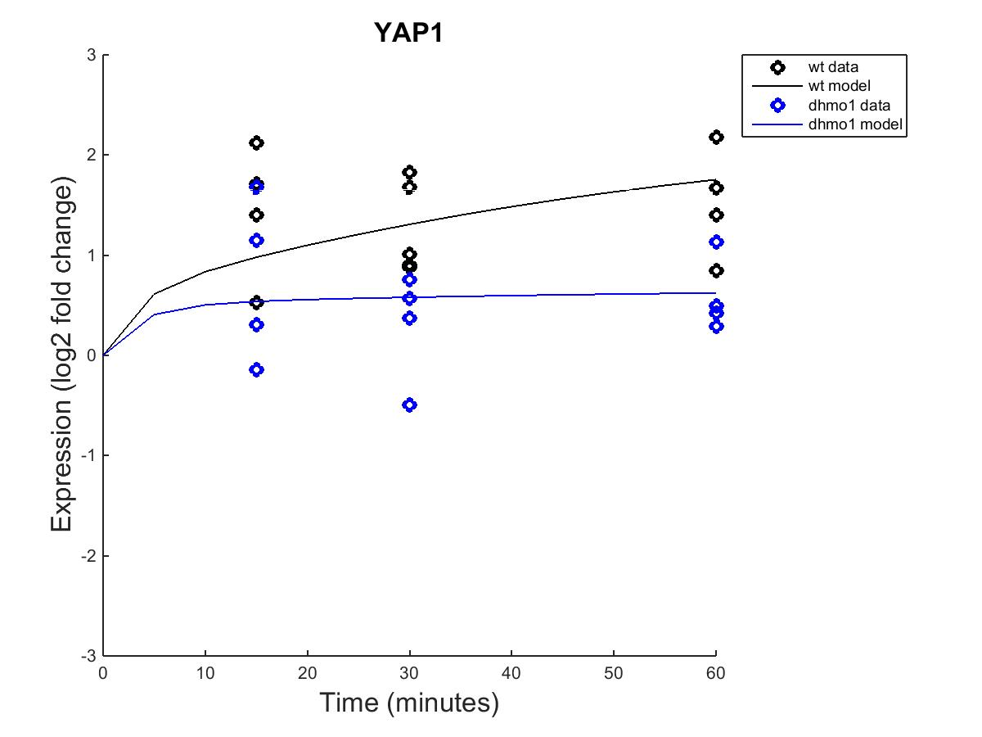
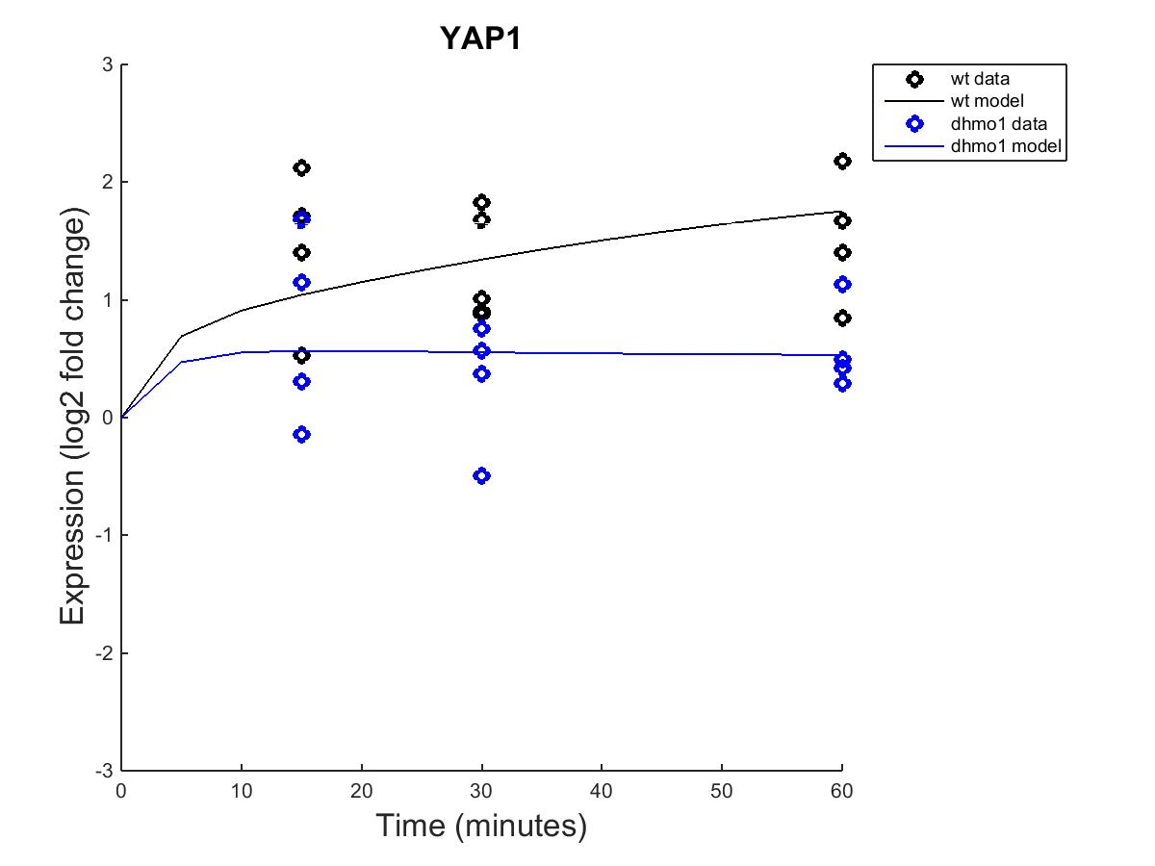
MATLAB Results – wt and dHMO1
Fixed B Parameter Estimated B Parameter

Slide 34
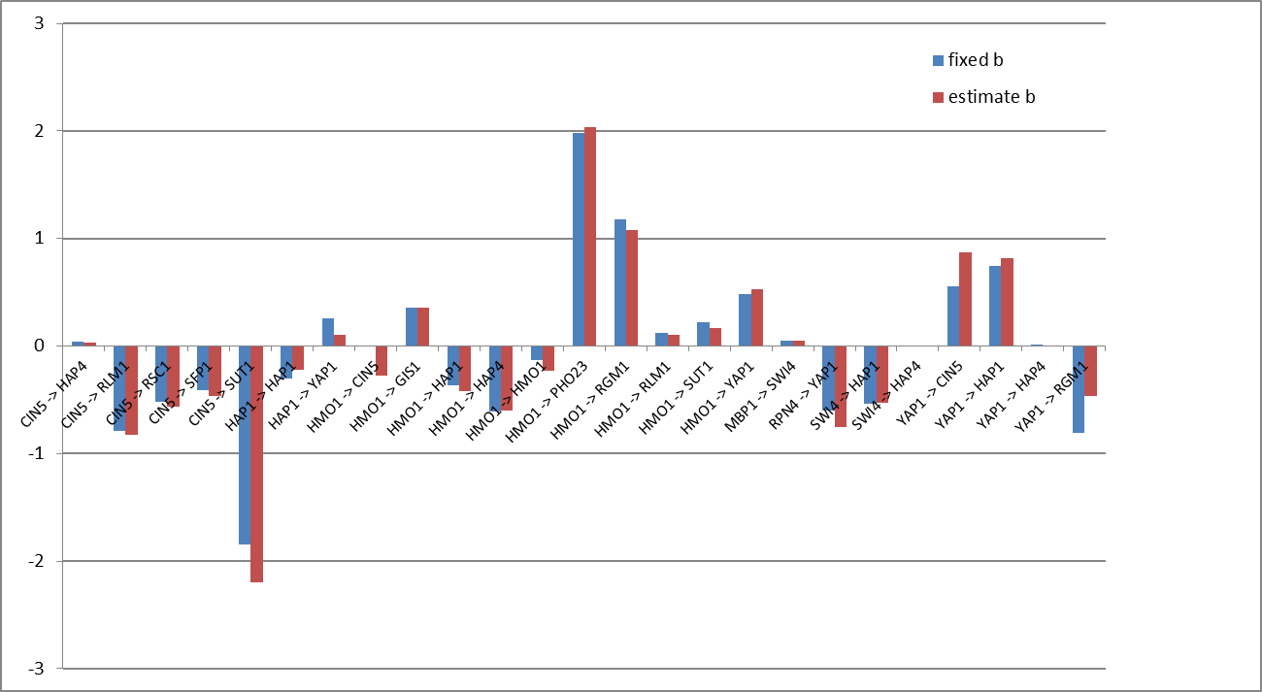
Comparison of GRNmap Analysis Using Fixed and Estimated b Parameters
Weight of control

