Slide 1
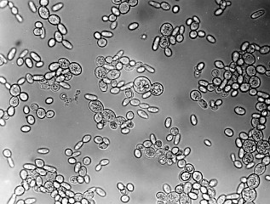
Biomathematical Modeling: The Deletion of HMO1 and its Effect on Cold Shock Reaction in S. cerevisiae
Lauren Magee & Lucia Ramirez
Department of Mathematics and Biology
Loyola Marymount University
May 7, 2015

Slide 2
Outline
S. cerevisiae, a eukaryote known for cold-shock adaption, used in cold-shock experiments
Deletion strand HMO1 and the comparison of microarray data at different time points through an ANOVA test
Choosing Profile #43 with 15 significant genes from the list of significant network profiles generated by STEM
Visualizing differing networks using YEASTract and GRNmap, choosing DNA Binding Expression ONLY due to the number of edges in the network
Running “Fixed B” and “Estimated B” separately in MATLAB GRNmodel showed no difference when changing b
Significance of results and adding to research on cold-shock
Notes:
Each bullet point should express the results in each procedure.
There is no need to repeat Outline slide

Slide 3
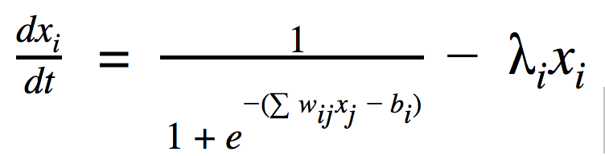
S. cerevisiae in relation to Cold Shock Experiments
Saccharomyces cerevisiae studied due to it’s applicability to other eukaryotes, but ability to handle laboratory environments
Cold-shock experiments and area of focus as they give clues to how environmental stresses effect on transcription
Heat shock has been extensively studied, but little is known of the effects of cold shock in the inter-cellular processes of eukaryotic organisms
Derivation of production rate, where b is the threshold parameter

Slide 4
HMO1 is involved in compacting, bending, bridging and looping DNA
rDNA-binding component that regulates transcription from RNA polymerase I promoters
Regulates start site selection of ribosomal protein genes via RNA polymerase II promoters
Integral part of successful transcription
Gene was deleted and DNA microarray analysis was completed for five different time points: 15, 30, 60, 90, 120 minutes
Cold shock time points 15, 30, 60 minutes
Notes:
This bullet point was deleted bc it was obvious : “Working with a strain of S.cerevisiae that has the HMO1 gene deleted from its genome”

Slide 5
dHMO1 Strain has less significant genes than the wild type strain
ANOVA | WT | HMO1
p < 0.05 | 2378 (38%) | 903 (14.6%)
p < 0.01 | 1527 (25%) | 337 (5.4%)
p < 0.001 | 860 (14%) | 69 (1.1%)
p < 0.0001 | 460 (7%) | 18 (0.3%)
B-H p < 0.05 | 228 (4%) | 39 (0.6%)
Bonferroni p < 0.05 | 228 (4%) | 8 (0.1%)
ANOVA test is determining the genes which change significantly between time points
Notes:
Changed the title: Significance Table from ANOVA Test

Slide 6
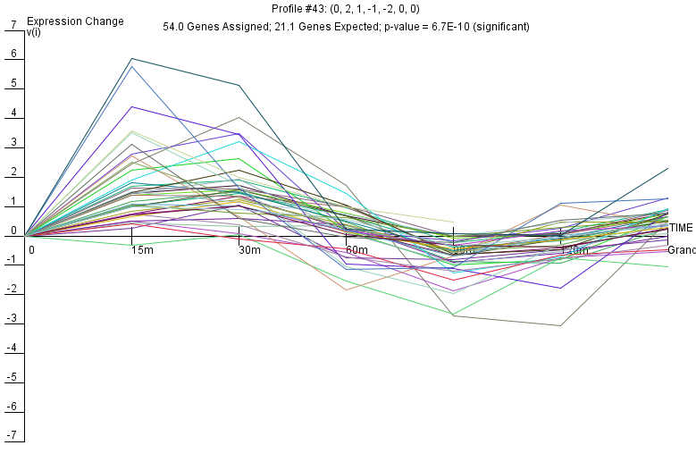
HMO1 Profile #43 in STEM
9 significant profiles recognized in STEM
Profile 43 produced 11 significant genes when entered into YEASTRACT
CIN5, GLN3, HMO1, and ZAP1 added to the network, due to their relevance in transcription
Total of 15 genes added in YEASTRACT to produce networks
Notes:
There is up regulation during cold shock and down regulation during recovery

Slide 7
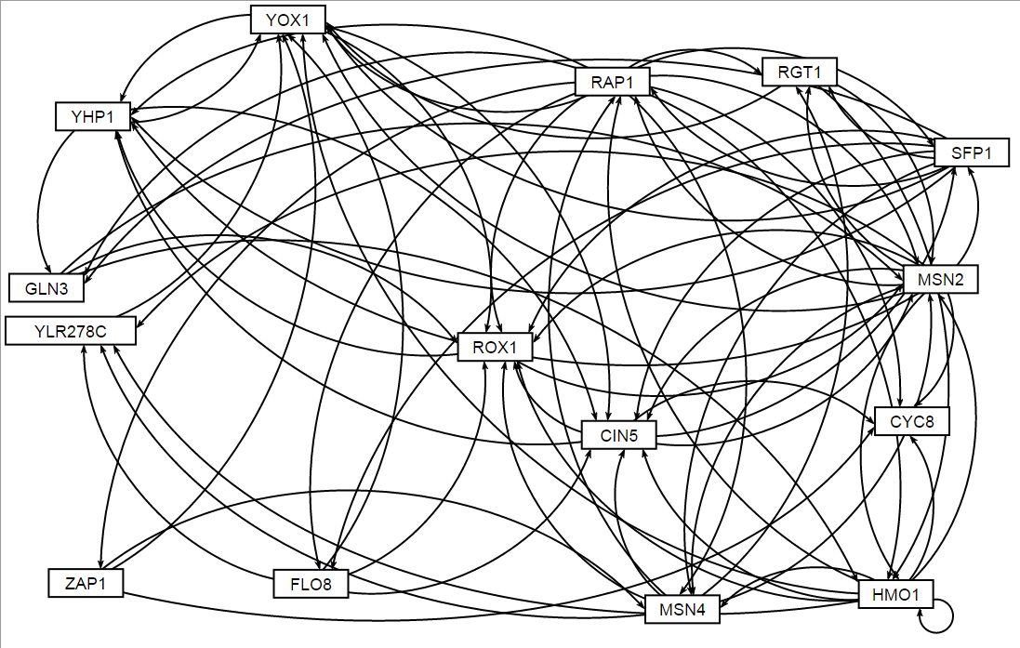
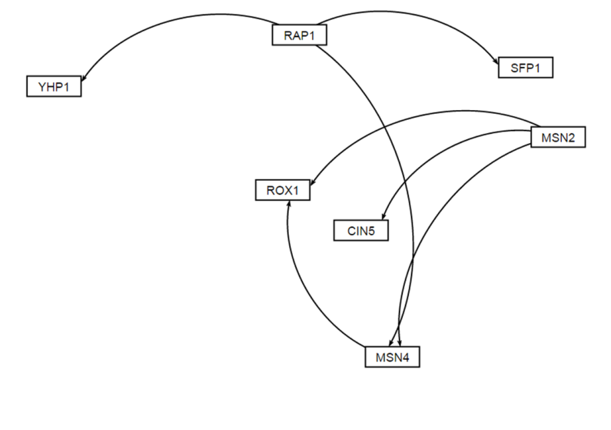
GRNMap Networks Too Few or Too Many Edges
DNA Binding Plus Expression Evidence
DNA Binding AND Expression Evidence
Notes:
Change title to be more detailed

Slide 8
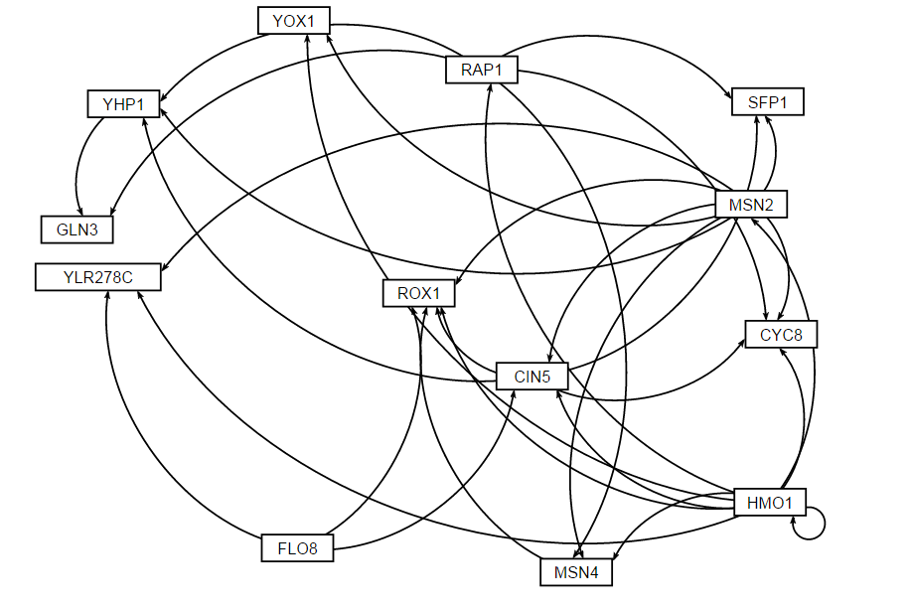
GRNMap Network with Right Amount of Edges Chosen for Further Analysis
ONLY DNA Binding Evidence
ZAP1 deleted from network
14 genes included
31 edges in the network

Slide 9
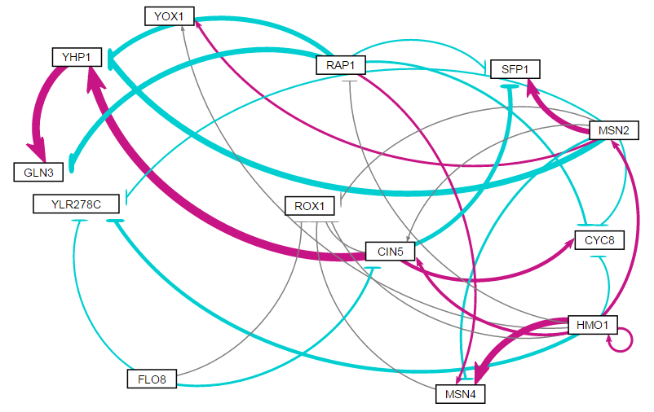
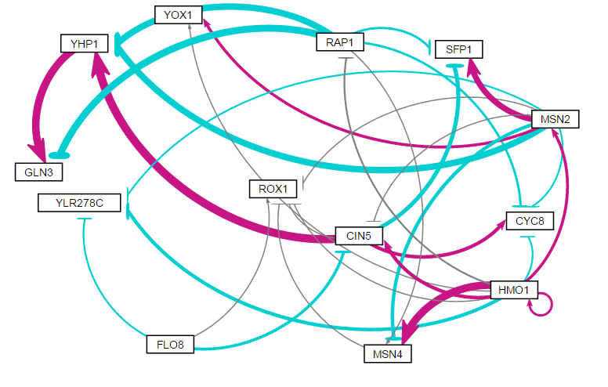
Estimated b
Weighted Networks
Fixed b

Slide 10
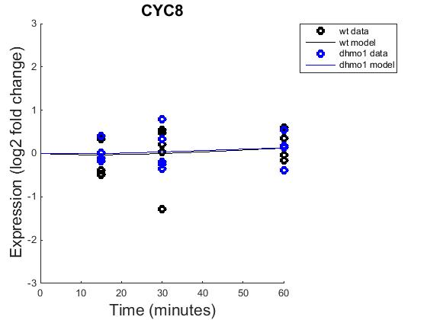
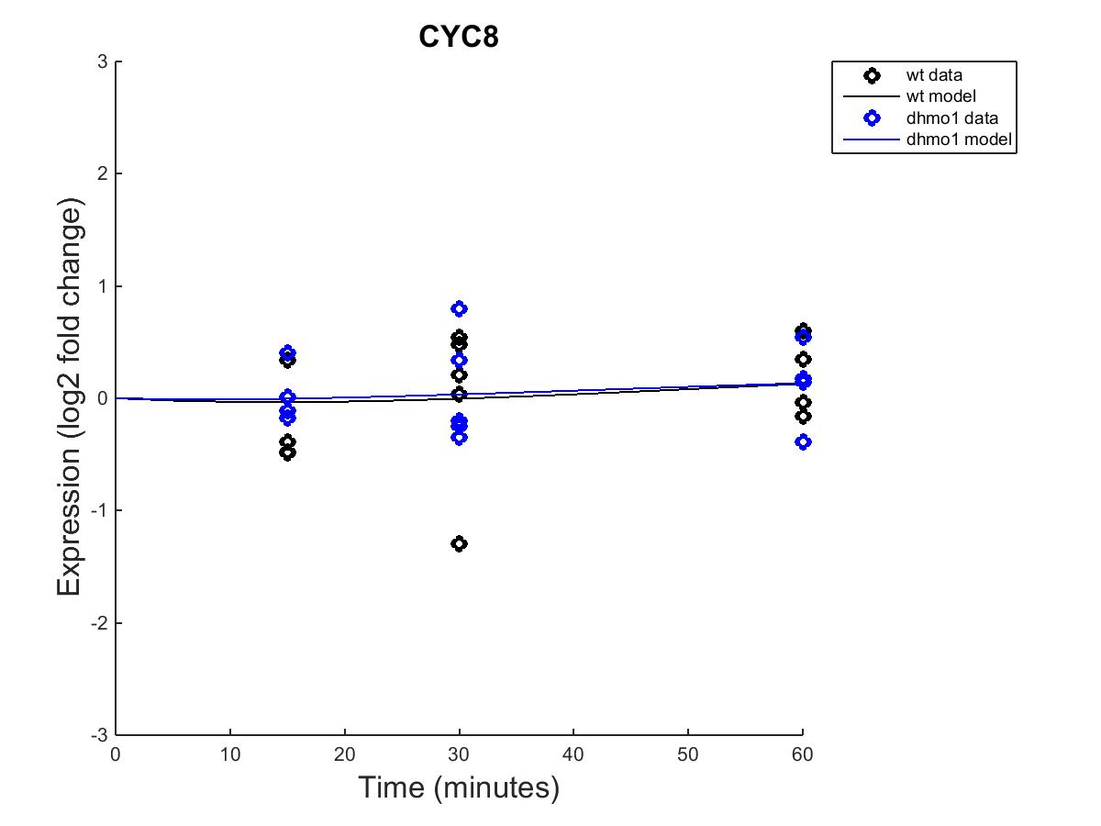
GRNmap model that expresses a good fit
Fixed b
Estimated b
Notes:
Don’t include all genes. Choose 4-5. One that expresses:
Fits the best
Fits the worst
Difference between DHMO1 and WT (MSN4, CIN5, and HMO1 should definitely be kept)
Difference between Fixed b and est. b

Slide 11
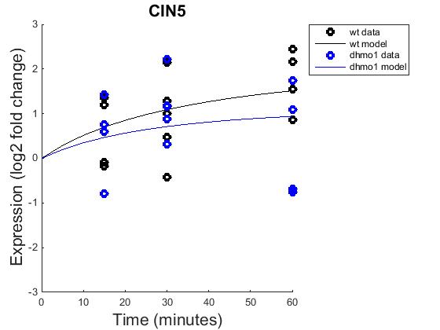
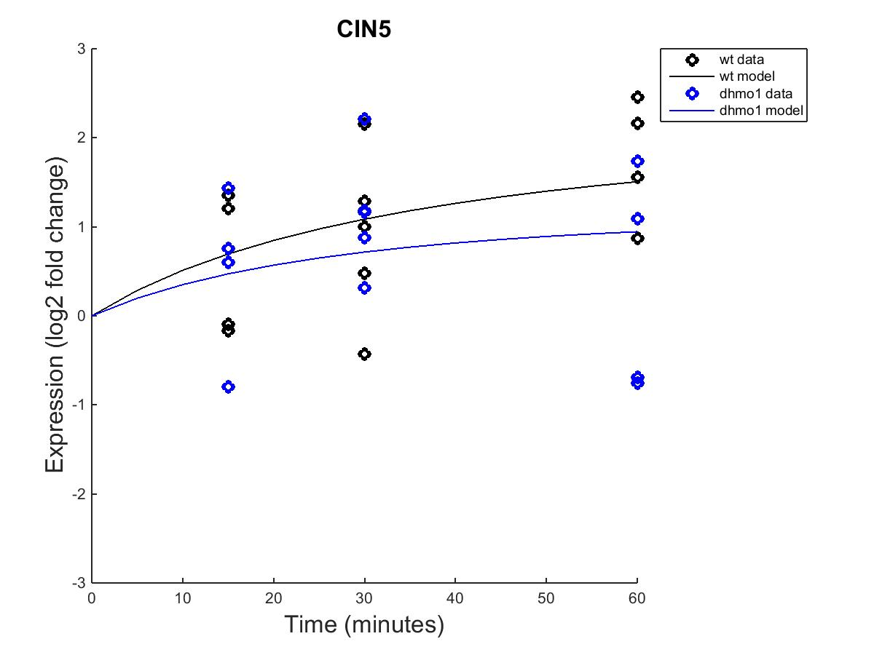
GRNmap model that expresses a good fit
Fixed b
Estimated b

Slide 12
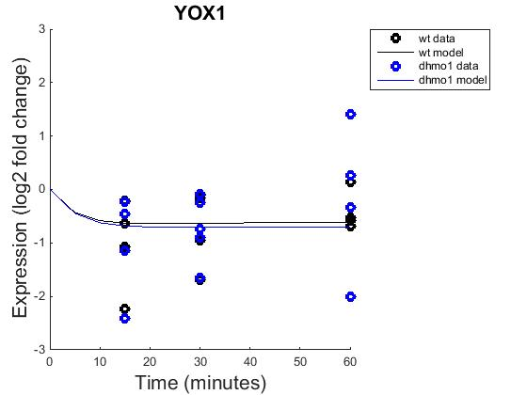
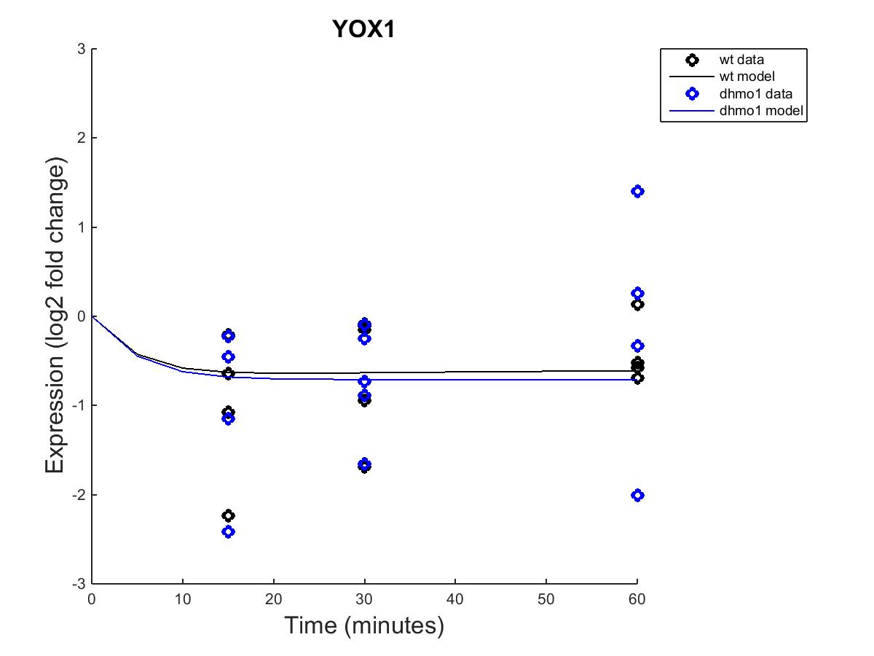
GRNmap model that expresses a bad fit
Fixed b
Estimated b

Slide 13
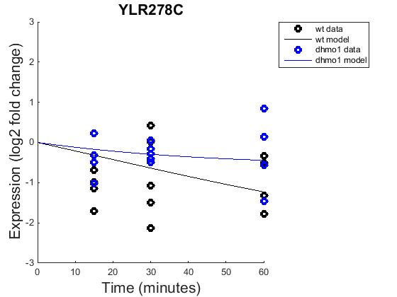
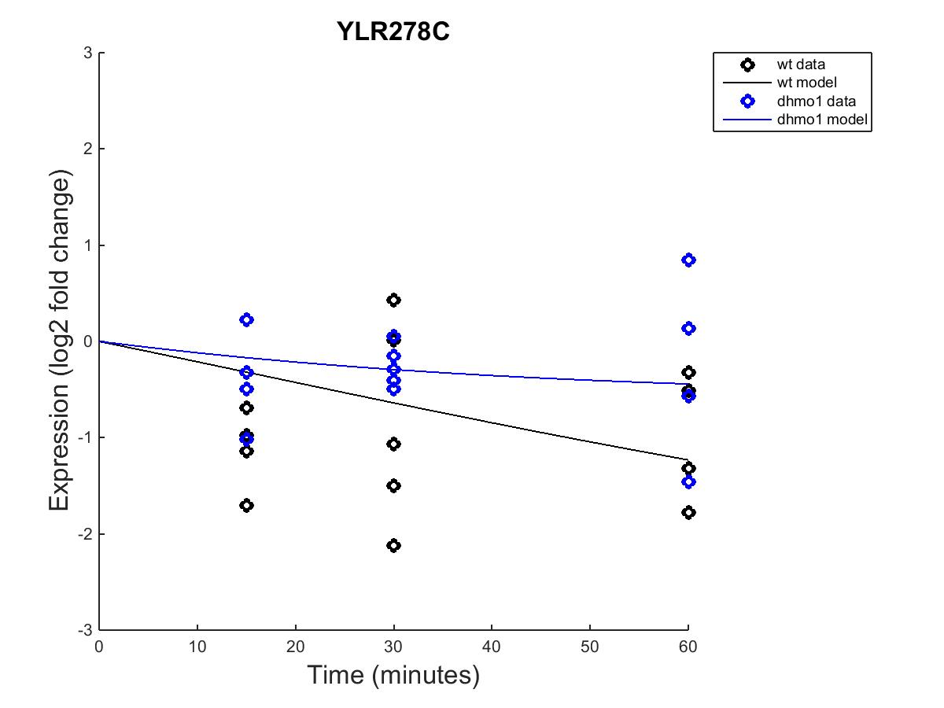
GRNmap model that expresses a slight difference between fixed and estimated b
Fixed b
Estimated b

Slide 14
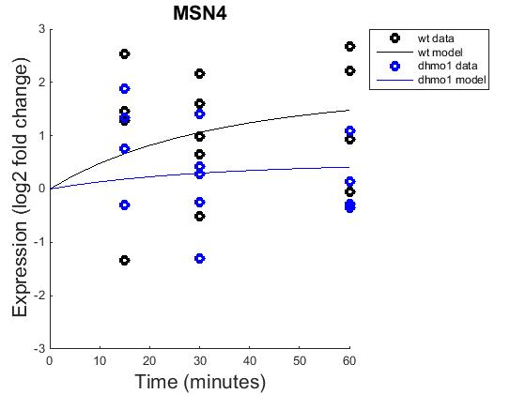
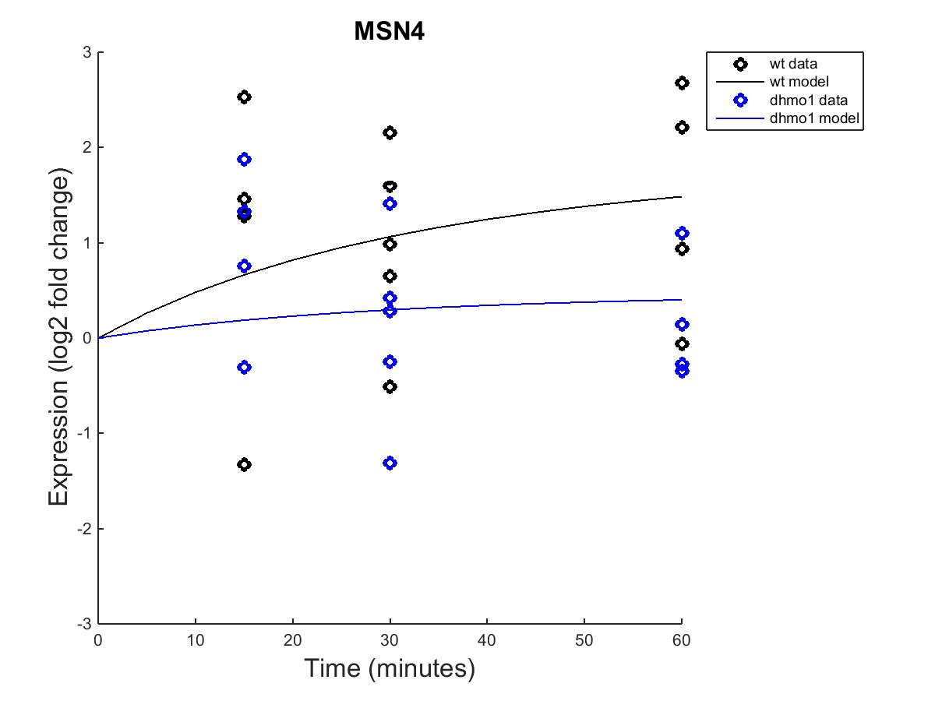
GRNmap model that expresses a difference between HMO1 and WT
Fixed b
Estimated b

Slide 15
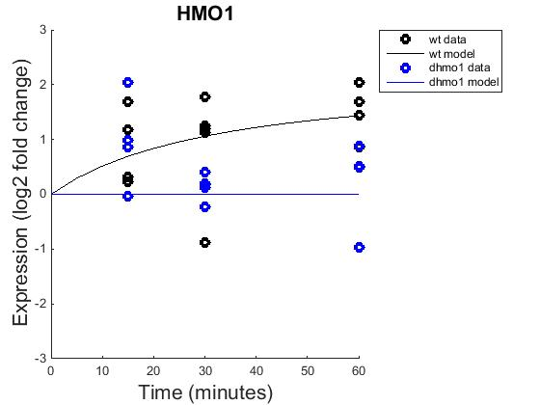

GRNmap model of Deletion Strand
Fixed b
Estimated b

Slide 16
Estimated vs. Fixed b
Notes:
Change the controll -> target genes. We just have the labeling flipped.

Slide 17
Significance and Future Directions
Learning from yeast could benefit us in understanding in other eukaryotes
Cold-shock experiments and area of focus as they give clues to how environmental stresses effect on transcription
Application: tissue and organ storage, bioprocessing, therapeutic treatment of brain damage and understanding of stress responses

Slide 18
Summary
S. cerevisiae, a eukaryote known for cold-shock adaption, used in cold-shock experiments
Deletion strand HMO1 and the comparison of microarray data at different time points through an ANOVA test
Choosing Profile #43 with 15 significant genes from the list of significant network profiles generated by STEM
Visualizing differing networks using YEASTract and GRNmap, choosing DNA Binding Expression ONLY due to the number of edges in the network
Running “Fixed B” and “Estimated B” separately in MATLAB GRNmodel showed no difference when changing b
Significance of results and adding to research on cold-shock

Slide 19
References
Saccharomyces: Genome Database. http://www.yeastgenome.org/locus/S000002581/overview
B. Al-Fageeh, Mohammed and Smales, C. Mark (2006). Control and regulation of the cellular responses to cold shock: the responses in yeast and mammalian systems. Biochemical Society. 256(5).
Thieringer, Heather A., Pamela, G. Jones, and Inouye, Masayori (1998). Cold shock and adaptation. BioEssays. 49-55.

Slide 20
Acknowledgments
Thank you to Dr. Dahlquist and Dr. Fitzpatrick for their continued assistance and support throughout this project.
Thank you to the class of BIOL 398/MATH 388 for living the struggle alongside us…bless you all.

