Slide 1
Consolidation of Gephi Stats
Kristen Horstmann
3.2.17

Slide 2
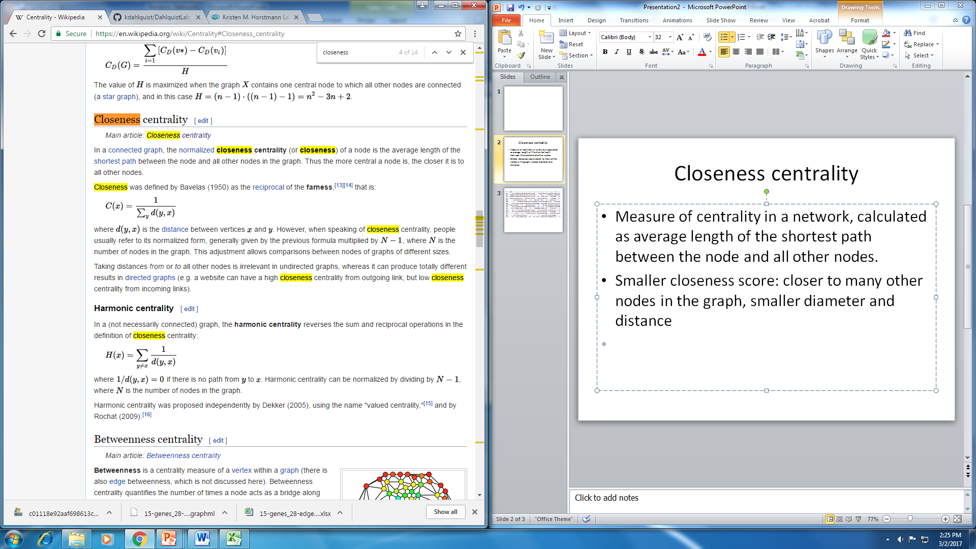
Closeness centrality
Measure of centrality in a network, calculated as average length of the shortest path between the node and all other nodes.
Smaller closeness score: closer to many other nodes in the graph, smaller diameter and distance

Slide 3
id | HAP4 | 1 | 2 | 3 | 4 | 5 | 6 | 7 | 8 | 9 | 10 | 11
ACE2 | 0.5 | 0.243902 | 0.419355 | 0.309524 | 0.297872 | 0.297872 | 0 | 0.333333 | 0.184211 | 0.434783 | 0.255319 | 0.285714
ASH1 | 0.666667 | 0.384615 | 0.309524 | 0.285714 | 0.411765 | 0.411765 | 1 | 0.375 | 0 | 0.388889 | 0.22807 | 0.344828
CIN5 | 0.636364 | 0.357143 | 0.351351 | 0.309524 | 0.259259 | 0.259259 | 0.5 | 0.36 | 0.215385 | 0.5 | 0.230769 | 0.5
GCR2 | 0.458333 | 0.384615 | 0.371429 | 0.6 | 0.285714 | 0.285714 | 0.5 | 0.433333 | 0.269231 | 0 | 0.190476 | 0.5
GLN3 | 0 | 0.344828 | 0.361111 | 0.218182 | 0 | 0 | 0.521739 | 0.375 | 0 | 0.44 | 0.324324 | 1
HAP4 | 0 | 0 | 0.40625 | 0.244898 | 0.358974 | 0.358974 | 0.428571 | 0.333333 | 0.166667 | 0.529412 | 0.25 | 0.434783
HMO1 | 0.55 | 0.277778 | 0.288889 | 0.315789 | 0.358974 | 0.358974 | 0.666667 | 0.375 | 0.205882 | 0.318182 | 0.272727 | 0.323529
MSN2 | 0.769231 | 0.434783 | 0 | 0 | 0.482759 | 0.482759 | 0 | 0 | 0.245614 | 0.444444 | 0.292683 | 0.393939
SFP1 | 0.4 | 0.342105 | 0.351351 | 0.230769 | 0.341463 | 0.341463 | 0.4 | 0 | 0.4 | 0.388889 | 0.255319 | 0.407407
STB5 | 0.375 | 0.37037 | 0.288889 | 0.3 | 0 | 0 | 0.666667 | 0.473684 | 0.318182 | 0.5 | 0.352941 | 0
SWI4 | 0.8 | 0.28 | 0.27451 | 0.413793 | 0.368421 | 0.368421 | 0.5 | 0.28125 | 0.368421 | 0.285714 | 0.171429 | 0.4
SWI5 | 0.5 | 0.322581 | 0.481481 | 0.413793 | 0.264151 | 0.264151 | 0.413793 | 0.28125 | 0.285714 | 0.35 | 0.307692 | 0
YHP1 | 1 | 0.3125 | 0 | 1 | 0.378378 | 0.378378 | 0.55 | 0.461538 | 0.388889 | 0.5 | 0.196721 | 0.392857
YOX1 | 0 | 0.217391 | 0.351351 | 0.333333 | 1 | 1 | 0 | 0.5 | 0.325581 | 0.269231 | 0.206897 | 1
ZAP1 | 0.4 | 0.375 | 0.288889 | 0.292683 | 0.4 | 0.4 | 0.375 | 0.375 | 0.245614 | 0.363636 | 0.272727 | 0

Slide 4
Harmonic Centrality
Reverses the sum and reciprocal operations in the definition of closeness centrality
Higher number indicates greater centrality

Slide 5
id | HAP4 | 1 | 2 | 3 | 4 | 5 | 6 | 7 | 8 | 9 | 10 | 11
ACE2 | 0.611111 | 0.326667 | 0.525641 | 0.367949 | 0.355952 | 0.355952 | 0 | 0.456667 | 0.27894 | 0.566667 | 0.395933 | 0.361667
ASH1 | 0.75 | 0.495 | 0.411538 | 0.424405 | 0.511905 | 0.511905 | 1 | 0.475 | 0 | 0.540476 | 0.326587 | 0.42
CIN5 | 0.761905 | 0.428333 | 0.444872 | 0.361538 | 0.360714 | 0.360714 | 0.611111 | 0.498148 | 0.284609 | 0.654762 | 0.381581 | 0.6
GCR2 | 0.5 | 0.536667 | 0.496154 | 0.722222 | 0.346429 | 0.346429 | 0.680556 | 0.538462 | 0.338095 | 0 | 0.288525 | 0.6
GLN3 | 0 | 0.478333 | 0.457692 | 0.412831 | 0 | 0 | 0.625 | 0.553704 | 0 | 0.560606 | 0.493849 | 1
HAP4 | 0 | 0 | 0.487179 | 0.391171 | 0.44881 | 0.44881 | 0.506944 | 0.461667 | 0.258648 | 0.62963 | 0.382143 | 0.566667
HMO1 | 0.651515 | 0.351667 | 0.366667 | 0.377778 | 0.440476 | 0.440476 | 0.75 | 0.490741 | 0.325879 | 0.409524 | 0.420933 | 0.4
MSN2 | 0.85 | 0.578333 | 0 | 0 | 0.589286 | 0.589286 | 0 | 0 | 0.332823 | 0.552083 | 0.411111 | 0.515385
SFP1 | 0.520833 | 0.447436 | 0.444872 | 0.302778 | 0.40119 | 0.40119 | 0.520833 | 0 | 0.514286 | 0.464286 | 0.395933 | 0.5
STB5 | 0.547222 | 0.486667 | 0.398718 | 0.431349 | 0 | 0 | 0.75 | 0.601852 | 0.421429 | 0.595238 | 0.454167 | 0
SWI4 | 0.875 | 0.388095 | 0.340476 | 0.493056 | 0.460714 | 0.460714 | 0.608333 | 0.383333 | 0.460714 | 0.379167 | 0.27249 | 0.5
SWI5 | 0.611111 | 0.395 | 0.596154 | 0.465278 | 0.322619 | 0.322619 | 0.493056 | 0.383333 | 0.429762 | 0.445238 | 0.433333 | 0
YHP1 | 1 | 0.395 | 0 | 1 | 0.458333 | 0.458333 | 0.651515 | 0.5625 | 0.464286 | 0.628788 | 0.285152 | 0.484848
YOX1 | 0 | 0.310238 | 0.444872 | 0.456944 | 1 | 1 | 0 | 0.574074 | 0.495238 | 0.378571 | 0.298247 | 1
ZAP1 | 0.520833 | 0.5 | 0.398718 | 0.397222 | 0.514286 | 0.514286 | 0.547222 | 0.435185 | 0.312585 | 0.4375 | 0.420933 | 0

Slide 6
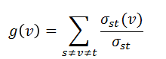
Betweenness Centrality
centrality measure that indicates how often a node is found on a shortest path between two nodes, s and t.
Nodes with high betweenness are higher connected with regulating other genes

Slide 7
id | HAP4 | 1 | 2 | 3 | 4 | 5 | 6 | 7 | 8 | 9 | 10 | 11
ACE2 | 3 | 14 | 63.5 | 0 | 13.5 | 13.5 | 0 | 15.5 | 27 | 2 | 34.66667 | 7
ASH1 | 10 | 40 | 4.5 | 17 | 17.5 | 17.5 | 5 | 0 | 0 | 22 | 0 | 15
CIN5 | 5 | 27 | 17.5 | 0 | 31.5 | 31.5 | 9 | 29 | 35 | 34 | 78 | 19.5
GCR2 | 0 | 27.5 | 66.5 | 56.5 | 22.5 | 22.5 | 8.5 | 0 | 19.5 | 0 | 31 | 23.5
GLN3 | 0 | 30.5 | 7.5 | 27.5 | 0 | 0 | 0 | 23 | 0 | 0 | 74 | 10
HAP4 | 0 | 0 | 37 | 13.5 | 11.5 | 11.5 | 0 | 8.5 | 25 | 5 | 0 | 48
HMO1 | 0 | 36 | 19.5 | 53 | 25.5 | 25.5 | 1 | 52 | 29 | 31 | 70 | 3
MSN2 | 14 | 40 | 0 | 0 | 66 | 66 | 0 | 0 | 25 | 3 | 73.33333 | 0
SFP1 | 9 | 12 | 14 | 11 | 21 | 21 | 13 | 0 | 99 | 25 | 31.5 | 6
STB5 | 0 | 14 | 15 | 0 | 0 | 0 | 11 | 20 | 84 | 30 | 55.16667 | 0
SWI4 | 0 | 0 | 0 | 66 | 40 | 40 | 14 | 4 | 41 | 2 | 13.83333 | 26
SWI5 | 7 | 43 | 65 | 56.5 | 3.5 | 3.5 | 0 | 0 | 27 | 9 | 44 | 0
YHP1 | 11 | 6 | 0 | 6 | 33.5 | 33.5 | 23 | 2 | 38 | 0 | 22.5 | 0
YOX1 | 0 | 7 | 18.5 | 39 | 7 | 7 | 0 | 30 | 24 | 7 | 22 | 10
ZAP1 | 0 | 19 | 1.5 | 11 | 34 | 34 | 5.5 | 33 | 48.5 | 3 | 14 | 0

Slide 8
Eccentricity Centrality
shows how easily accessible a node is from other nodes, calculates max distance between other nodes
Only takes out degree into account
High value means it has a higher impact on other nodes

Slide 9
id | HAP4 | 1 | 2 | 3 | 4 | 5 | 6 | 7 | 8 | 9 | 10 | 11
ACE2 | 0.5 | 0.243902 | 0.419355 | 0.309524 | 0.297872 | 0.297872 | 0 | 0.333333 | 0.184211 | 0.434783 | 0.255319 | 0.285714
ASH1 | 0.666667 | 0.384615 | 0.309524 | 0.285714 | 0.411765 | 0.411765 | 1 | 0.375 | 0 | 0.388889 | 0.22807 | 0.344828
CIN5 | 0.636364 | 0.357143 | 0.351351 | 0.309524 | 0.259259 | 0.259259 | 0.5 | 0.36 | 0.215385 | 0.5 | 0.230769 | 0.5
GCR2 | 0.458333 | 0.384615 | 0.371429 | 0.6 | 0.285714 | 0.285714 | 0.5 | 0.433333 | 0.269231 | 0 | 0.190476 | 0.5
GLN3 | 0 | 0.344828 | 0.361111 | 0.218182 | 0 | 0 | 0.521739 | 0.375 | 0 | 0.44 | 0.324324 | 1
HAP4 | 0 | 0 | 0.40625 | 0.244898 | 0.358974 | 0.358974 | 0.428571 | 0.333333 | 0.166667 | 0.529412 | 0.25 | 0.434783
HMO1 | 0.55 | 0.277778 | 0.288889 | 0.315789 | 0.358974 | 0.358974 | 0.666667 | 0.375 | 0.205882 | 0.318182 | 0.272727 | 0.323529
MSN2 | 0.769231 | 0.434783 | 0 | 0 | 0.482759 | 0.482759 | 0 | 0 | 0.245614 | 0.444444 | 0.292683 | 0.393939
SFP1 | 0.4 | 0.342105 | 0.351351 | 0.230769 | 0.341463 | 0.341463 | 0.4 | 0 | 0.4 | 0.388889 | 0.255319 | 0.407407
STB5 | 0.375 | 0.37037 | 0.288889 | 0.3 | 0 | 0 | 0.666667 | 0.473684 | 0.318182 | 0.5 | 0.352941 | 0
SWI4 | 0.8 | 0.28 | 0.27451 | 0.413793 | 0.368421 | 0.368421 | 0.5 | 0.28125 | 0.368421 | 0.285714 | 0.171429 | 0.4
SWI5 | 0.5 | 0.322581 | 0.481481 | 0.413793 | 0.264151 | 0.264151 | 0.413793 | 0.28125 | 0.285714 | 0.35 | 0.307692 | 0
YHP1 | 1 | 0.3125 | 0 | 1 | 0.378378 | 0.378378 | 0.55 | 0.461538 | 0.388889 | 0.5 | 0.196721 | 0.392857
YOX1 | 0 | 0.217391 | 0.351351 | 0.333333 | 1 | 1 | 0 | 0.5 | 0.325581 | 0.269231 | 0.206897 | 1
ZAP1 | 0.4 | 0.375 | 0.288889 | 0.292683 | 0.4 | 0.4 | 0.375 | 0.375 | 0.245614 | 0.363636 | 0.272727 | 0

