Slide 1
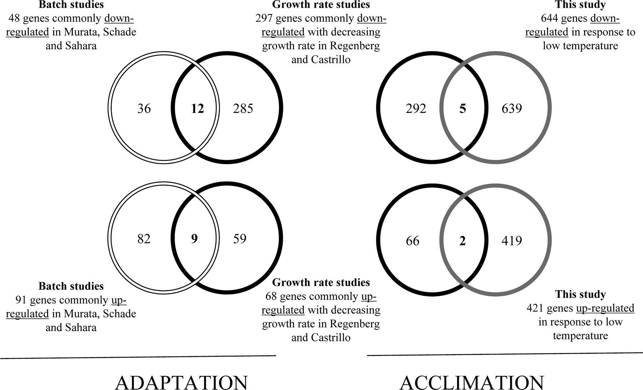
Fig 5. Comparison of the genes specifically up- or down-regulated
-Adaptation refers to “cold shock”
-Acclimation refers to constant low temp. conditions
-Venn diagrams compare gene regulation in the batch studies to growth rate studies, as well as the growth rate studies to this study
-comparisons are of gene up-regulation or gene down-regulation

