Slide 1
A Yeast Synthetic Network for In Vivo Assessment of Reverse-Engineering and Modeling Approaches
Cantone, I., Marucci, L., Iorio, F., Ricci, M., Belcastro, V., Bansai, M., Santini, S., Bernardo, M., Bernardo, D., and Cosma, M.
Cell (2009) 137: 172-181
Presented by: Alfred Ramirez
April 11, 2012

Slide 2
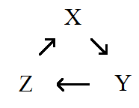
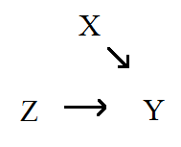
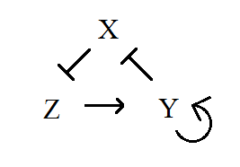
Problem: Determining Networks
Elucidating and validating a gene regulatory network is hard and time consuming.

Slide 3
Solution: Need in vivo benchmarking tool
Design a novel gene regulatory network
Characterize the parameters of the network
Model the network mathematically
Test your reverse-engineering algorithm on the model

Slide 4
Design: A Novel Network
Desired characteristics
Inducible
Orthogonal
Well characterized and nonessential parts

Slide 5
Design: A Novel Network
Promoter/repressor/activator pairs
HO/swi5_{AAA} and HO/Ash1D
MET16/CBF1
GAL1-10/GAL4
Ash1D/swi5_{AAA}
One protein-protein interaction
GAL4/GAL80
Chassis: YM4271 Yeast

Slide 6
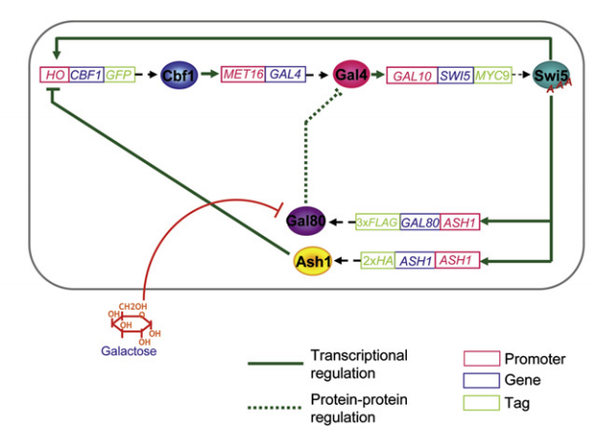
Design: The IRMA Network

Slide 7
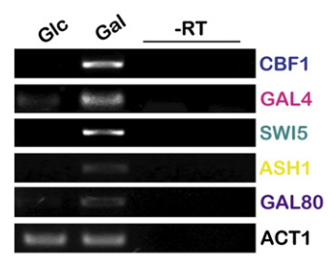
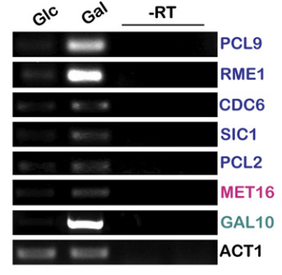
Design: The IRMA Network

Slide 8
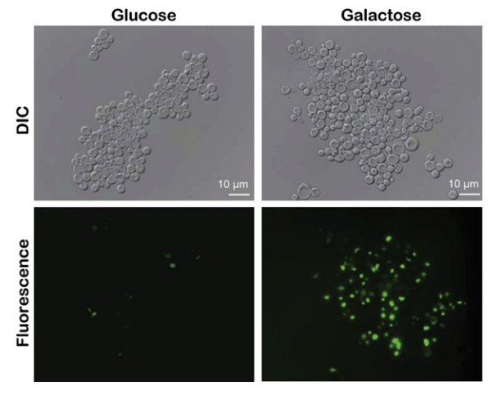
Design: The IRMA Network

Slide 9
Model: A DE Approach
Model network as a systems of differential equations (DE)
Need to make assumptions!

Slide 10
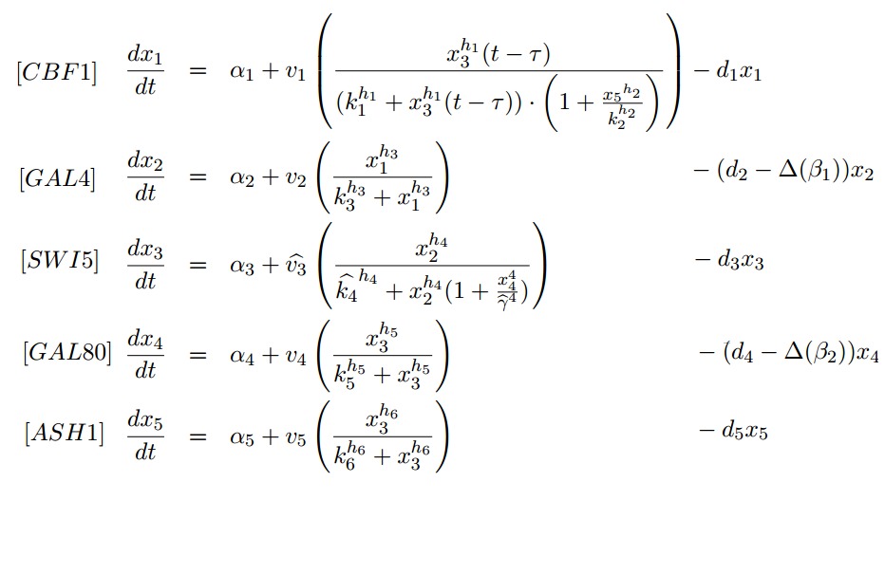
Model: A DE Approach

Slide 11
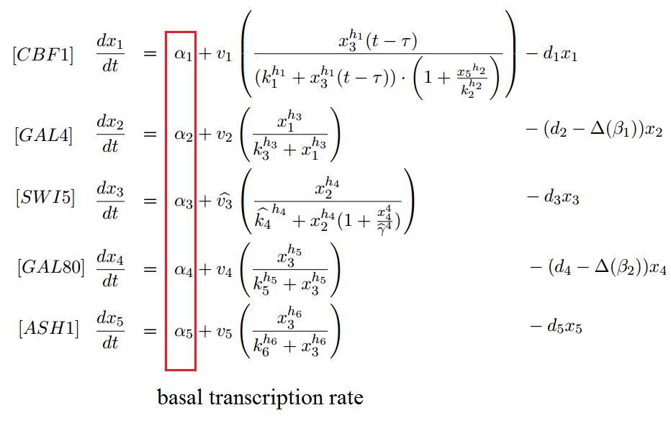
Model: A DE Approach

Slide 12
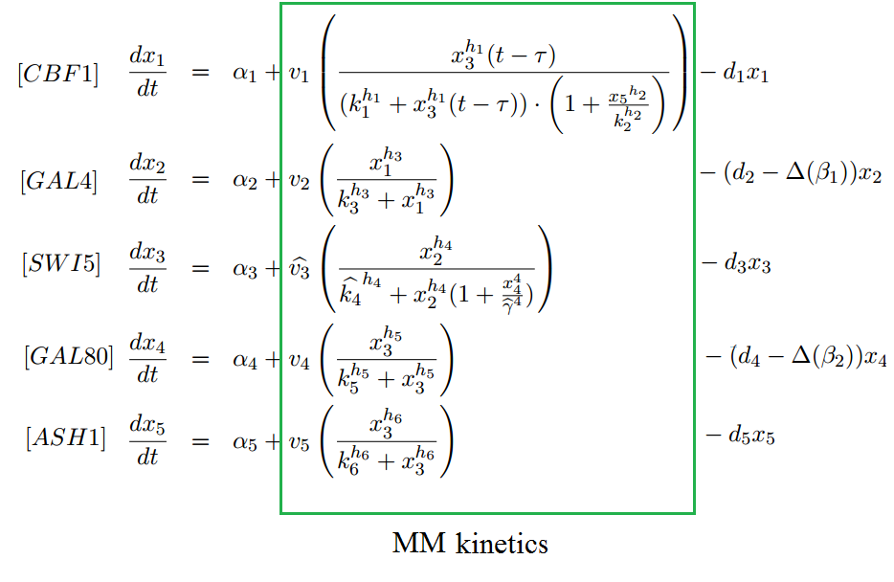
Model: A DE Approach

Slide 13
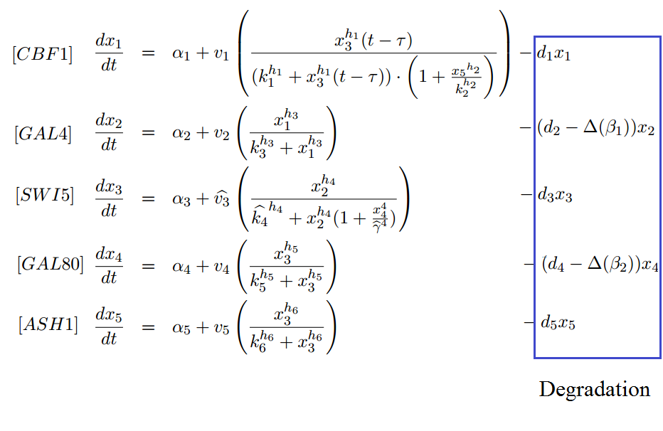
Model: A DE Approach

Slide 14
Characterize: Two Types of Perturbations
Want to characterize the dynamics of the system
Two types of perturbations
Single perturbation and measure mRNA levels at different time points
Multiple perturbations and measure steady-state mRNA levels

Slide 15
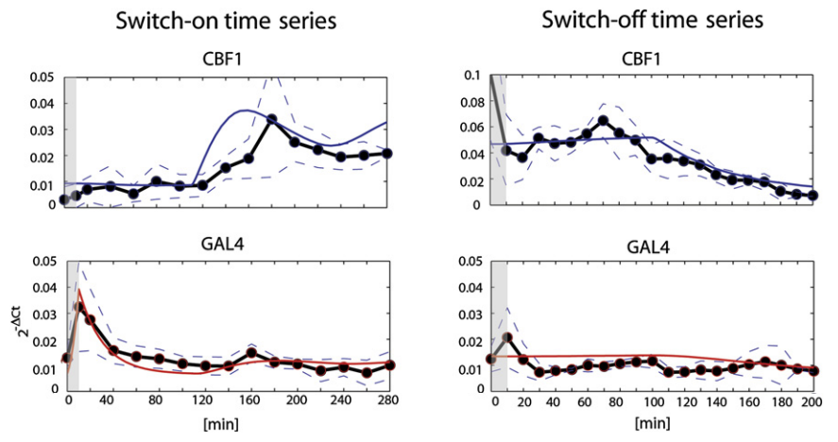
Characterize: A Single Perturbation

Slide 16
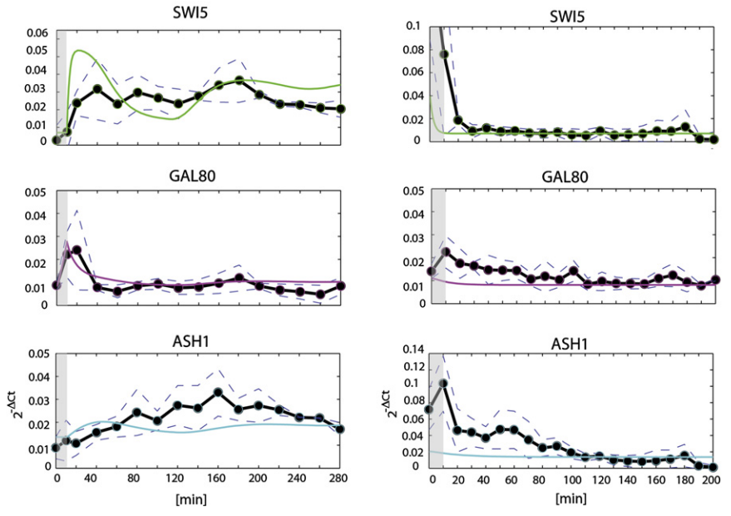
Characterize: A Single Perturbation

Slide 17
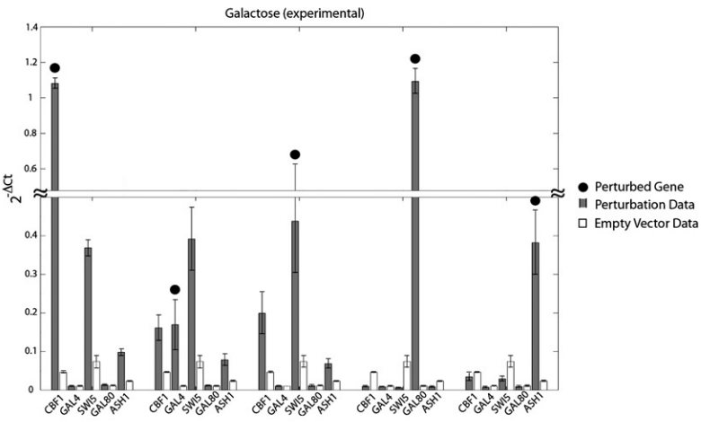
Characterize: Multiple Perturbations

Slide 18
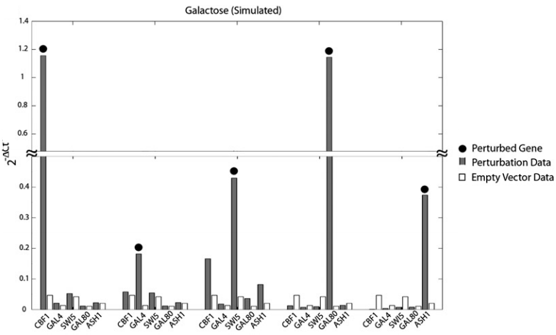
Characterize: Multiple Perturbations

Slide 19
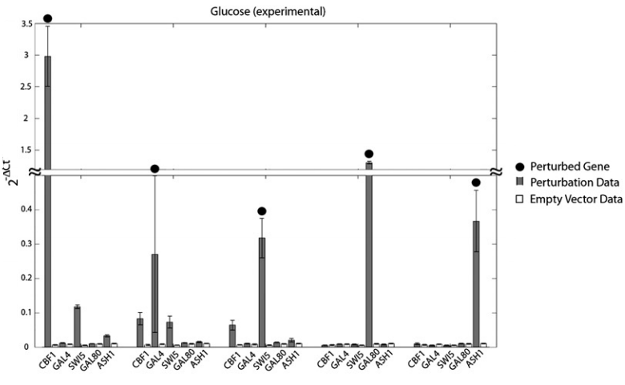
Characterize: Multiple Perturbations

Slide 20
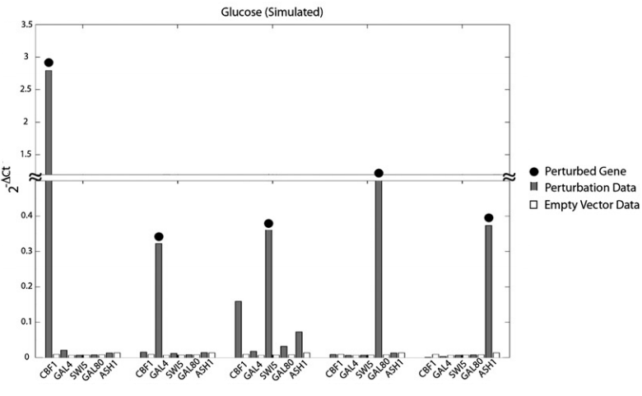
Characterize: Multiple Perturbations

Slide 21
Test: Reverse Engineering
From model parameters, test to see which algorithms can derive a network closest to the true network
TSNI: Time Series Network Identification
NIR: Network Inference by Regression

Slide 22
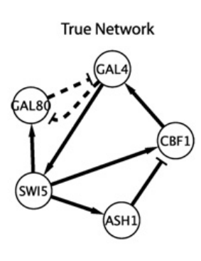
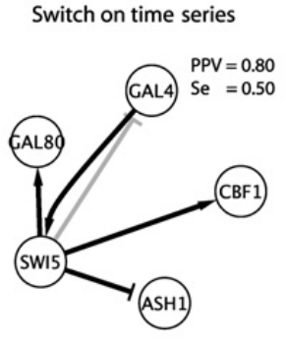
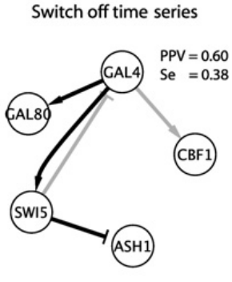
Test: TSNI

Slide 23
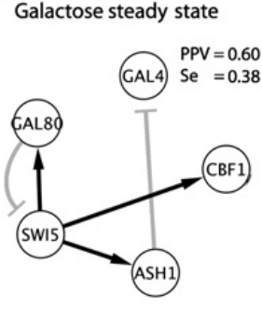
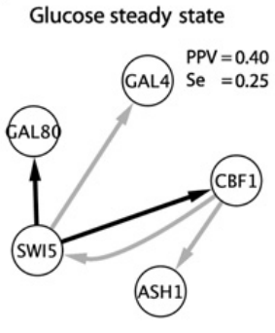
Test: NIR

Slide 24
Test: Simplified Network
Most false interactions involve the protein regulators GAL4 and GAL80.
Simplify the true network by eliminating the protein-protein interaction, leaving only transcriptional regulation

Slide 25
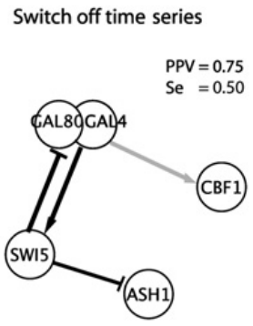
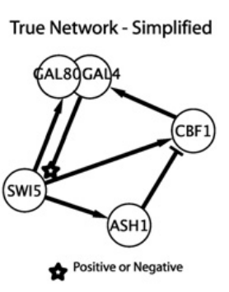
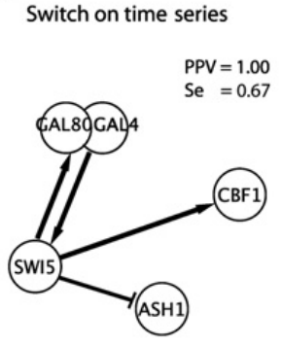
Test: TNSI

Slide 26
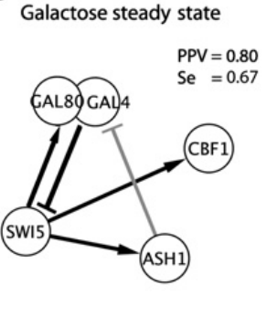
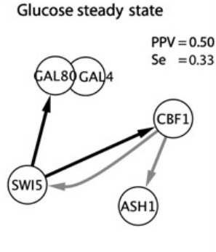
Test: NIR

Slide 27
Conclusions
Developed and characterized a novel synthetic system
Can be used to assess different models and network prediction algorithms

Slide 28
Significance
Computational approaches help elucidate regulatory interactions in biological processes.
Offers a tool to test and improve computational models and network algorithms

Slide 29
Concerns
Mathematical model could use additional refining
Made claims that didn’t necessarily emerge from the data.

Slide 30
Questions?

