Slide 1
Why to standarise?
Ideally, biological engineers might develop a
design and construction framework that makes routine the incorporation
of basic biological functions into many-component integrated
genetic systems that behave as expected. Mature engineering disciplines
have developed similar frameworks by using the concept of abstraction
to define sets of standardized, functional objects that can be used in
combination, together with composition rules that specify how such
objects should be assembled.

Slide 2





Engineering Approach
Abstraction
Standardisation
Quality Control
Industrial Revolutions
Mechanical
Transport
Chemical
Digital
Machine Tool
Trains
Large scale
production
Hardware
Car / Road
Communication
protocols
Nuts & Bolts
File Format

Slide 3
How is engineering biology different from electronic engineering
Reproduction – cell growth & division
Evolution – survival pressures
Mutation – evolutionary pressures can force new mutations
Diffusion – can lead to cross-talk of systems (no PCB)
Decoupling – existing biological chassis are complicated, device may interact with endogenous pathways
BioBricks - behave differently in various environments
Performance varies with labs due to variety of practices used to handle parts
-> Need for well characterised behaviour of parts:
in isolation
assembled‏

Slide 4
The Role of Registry
Registry functions as an open source to allow clear determination of standardisation issues to allow targeting them precision and in an effective manner by professionals.

Slide 5



Towards a BioBrick Standard
Developing a standardised framework
Prefix Sequence
DNA part
Suffix Sequence

Slide 6
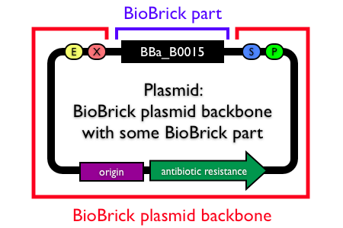

Towards a BioBrick Standard
In registry so called:
Plasmid backbones
Prefix Sequence
DNA part
Suffix Sequence
RS1
RS2
RS3
RS4

Slide 7
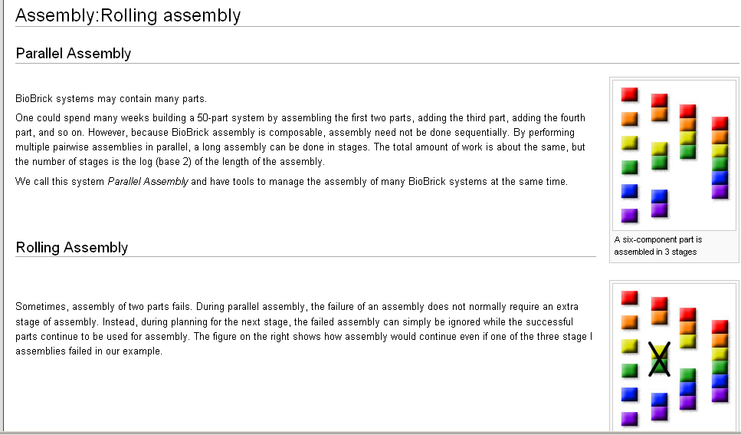

Slide 8
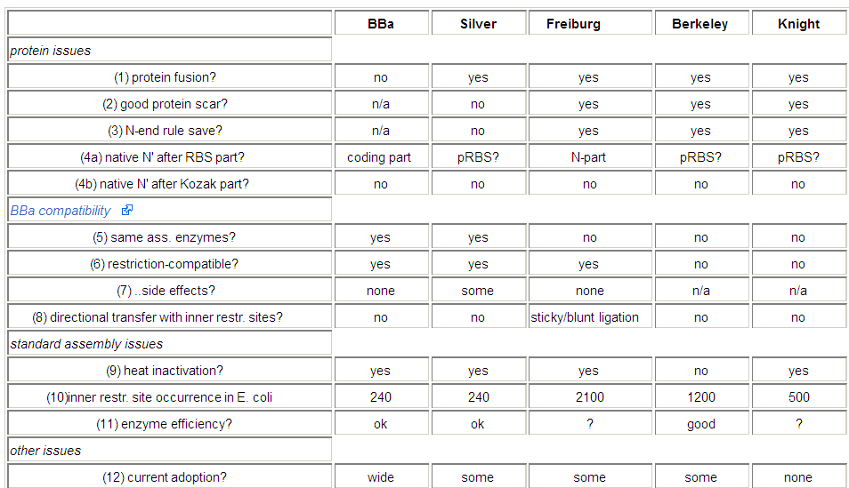
Assembly standards

