Slide 1
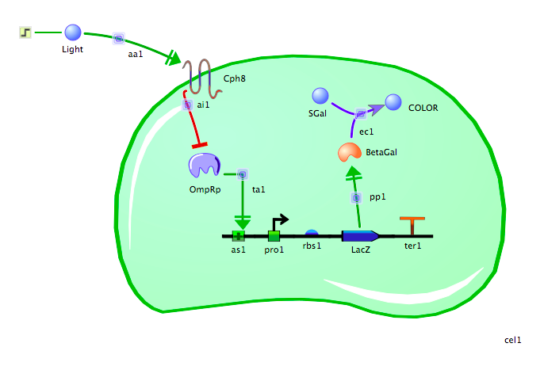
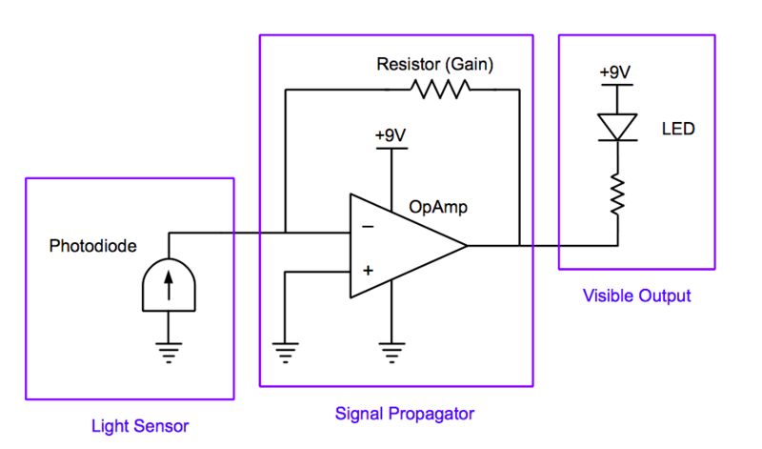
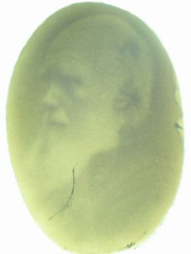
Lab 3: Picture This
Itinerary:
Lab Introduction
Perform the student lab:
Find a picture
TinkerCell
Electronics
Teacher preparation:
Homework

Slide 2
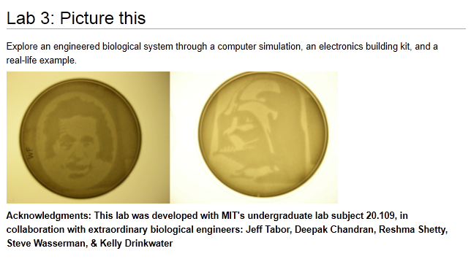

Slide 3
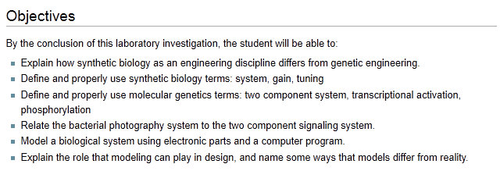

Slide 4
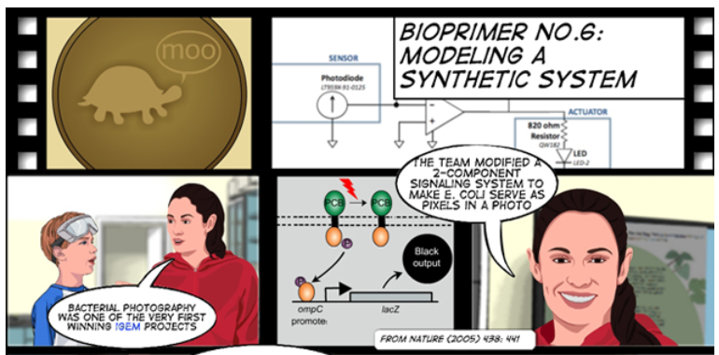

Slide 5
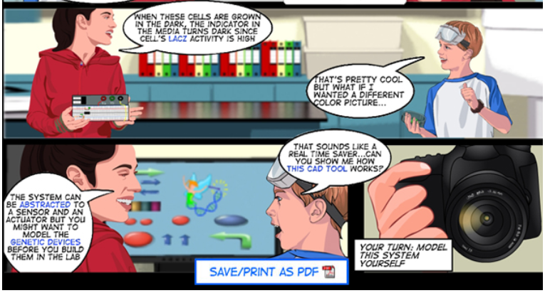

Slide 6
An engineering paradigm
The focus of this lab
Design
Build
Test

Slide 7
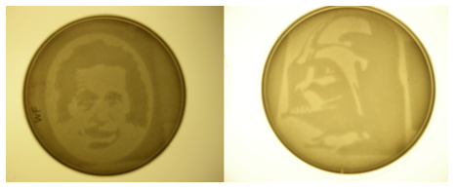
With the two component bacterial photography system
bacteria can grow light or dark and take “photos” like these…
The genetic system that produces these is complicated.
We can make illustrations that represent the model

Slide 8
What happens in the bacterial photography system?
No light
P
Lac Z On
B-gal is produced
Light Sensor
Cph8
OmpR
In the dark:
The Cph8 sensor is stimulated
OmpR (a transcription factor) is phosphorylated
Which activates the promoter
Lac Z gene is expressed
Beta gal enzyme is made
Beta gal converts S-gal into pigment
And the media becomes dark.
Dark pigment

Slide 9
light
Lac Z Off
No B-gal
Light Sensor
Cph8
OmpR
In the light:
The Cph8 sensor is not stimulated
OmpR (a transcription factor) is dephosphorylated
Promoter is not active
Lac Z gene is not expressed
No Beta gal to convert S-gal into pigment
So no pigment is produced by the bacteria and the pigment stays light
No Pigment

Slide 10
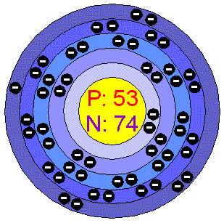
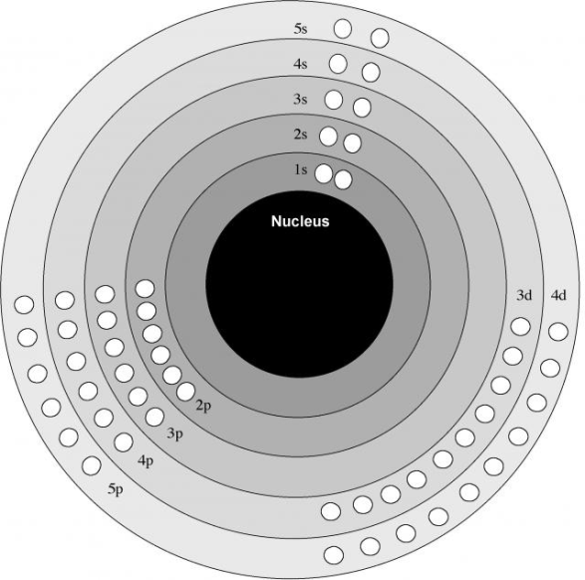
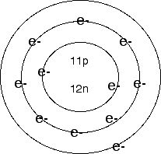
In science and engineering, a model can be defined as: a simplified representation or description of a system or complex entity, especially one designed to facilitate calculations and predictions.
For instance, we are all familiar with the Bohr model of the atom
These pictures are illustrations of that model:

Slide 11
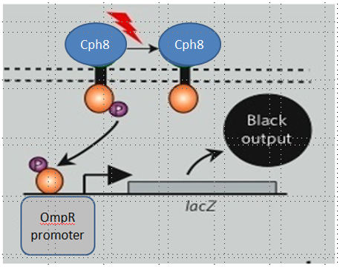
We’ve just seen one representation of a model of the bacterial photography system.
Here’s another way to illustrate the model…
How does the info in this picture differ from the preceding?

Slide 12
A more powerful representation will allow us to simulate how the model behaves
Here is a computer aided design (CAD) generated model:
Here
Or we might change this…
Or here
We can alter this and see what happens
Or here
Or here
Or here
Or here

Slide 13
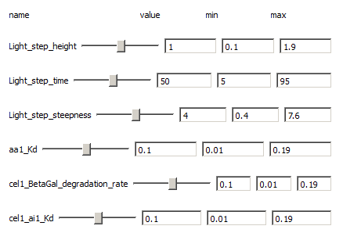
We can use these slide bars to alter the system

Slide 14
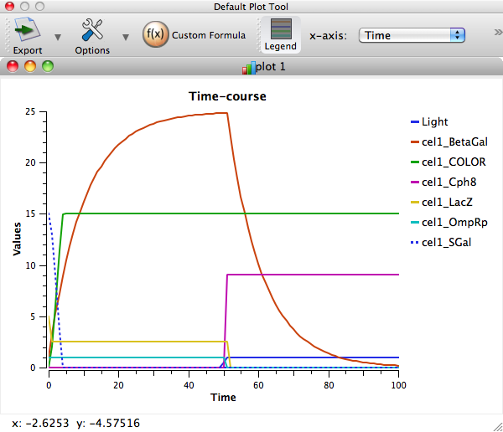
And generate data like this…
How might doing this help engineers in designing their systems?

Slide 15
And we can model the system with electronic components and see what happens when we change things…
Of course, we’ll have to figure out how this is analogous to what happens in a cell…

Slide 16
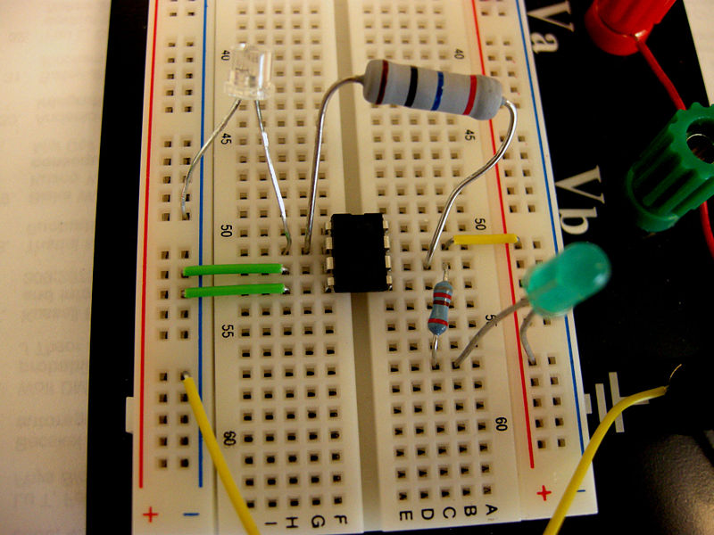
Can this really help us understand what happens in a cell?

Slide 17
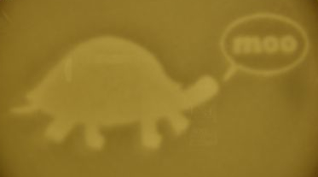
But first, you will select a picture so you can make your own
bacterial picture…

