Slide 1
Data Analysis and GRNmap Testing
Grace Johnson and Natalie Williams
June 24, 2015

Slide 2
General Overview
Microarray Data Analysis Workflow
GRNmap Testing SURP 2015
Notes:
Conclusions I drew from the testing natalie and I did throughout SURP

Slide 3
Microarray Data Analysis Workflow
Generating Log2 Ratios with GenePix Pro
Within- and Between-chip Normalization with R
Statistical Analysis
  Within-strain ANOVA
  Modified t-test for each time point
  Between-strain ANOVA
GenMAPP
Clustering with STEM
YEASTRACT
GRNmap and GRNsight

Slide 4
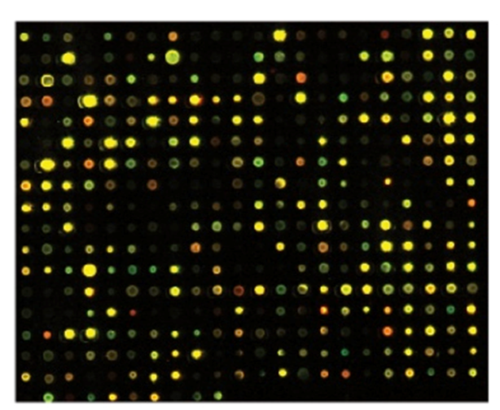
Generating Log2 Ratios with GenePix Pro
Microarray chips are raw data from wet lab (wt, dCIN5, dGLN3, dHAP4, dHMO1, dSWI4, dZAP1, Spar)
Quantitate the fluorescence signal in each spot by counting pixels
Calculate the ratio of red/green fluorescence
Log2 transform the ratios to put them on the same scale
  2 fold increase becomes 1
  2 fold decrease becomes -1

Slide 5
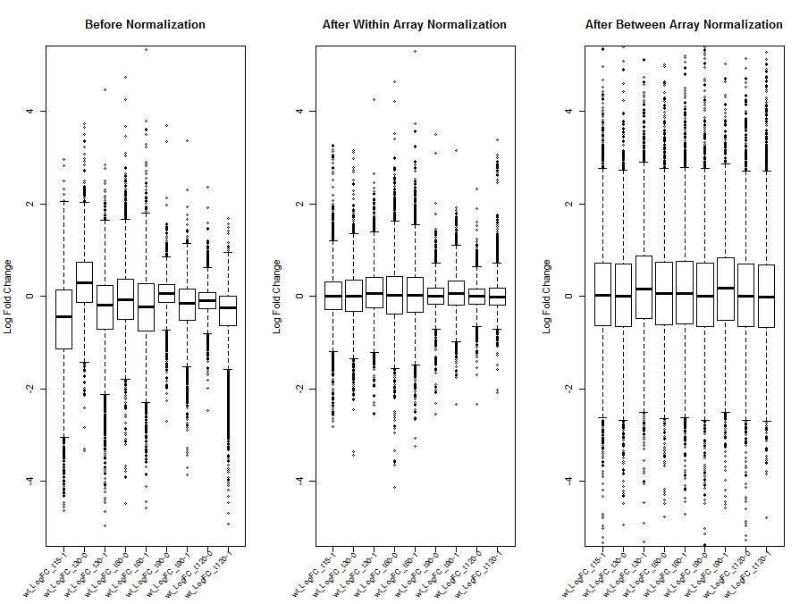
Within- and Between-chip Normalization with R
Normalization scripts written for R 3.1.0 (64bit)
Within array normalization for Ontario chips
Within array normalization for GCAT chips
Between array normalization for all chips
Visualization plots of before and after normalization

Slide 6
Statistical Analysis
Each group continued on, analyzing either wt, dCIN5, dGLN3, dHAP4 or dSWI4
Within-strain ANOVA told us how many genes had significant expression changes at any time point
Modified t-test told us how many genes had significant changes at each time point
Between-strain ANOVA told how many genes change their expression between strains
  wt vs. deletion strain

Slide 7
Between-Strain ANOVA for wt Microarray Data
ANOVA | WT | dCIN5 | dGLN3 | dHAP4 | dSWI4
p < 0.05 | 2377 (38.41%) | 1995 (32.23%) | 1856 (29.99%) | 2387 (38.57%) | 2583 (41.74%)
p < 0.01 | 1531 (24.74%) | 1157 (18.69%) | 1007 (16.27%) | 1489 (24.06%) | 1679 (27.13%)
p < 0.001 | 850 (13.73%) | 566 (9.15%) | 398 (6.43%) | 679 (10.97%) | 869 (14.04%)
p < 0.0001 | 449 (7.25%) | 280 (4.52%) | 121 (1.96%) | 240 (3.88%) | 446 (7.21%)
B & H p < 0.05 | 1673 (27.03%) | 1117 (18.05%) | 889 (14.36%) | 1615 (26.09%) | 1855 (29.97%)
Bonferroni p < 0.05 | 226 (3.65%) | 109 (1.76%) | 20 (0.32%) | 61 (0.99%) | 179 (2.89%)

Slide 8
P-values Used in Statistical Analysis
Uncorrected (0.05, 0.01, 0.001, 0.0001)
  We run into the multiple testing problem
Bonferroni corrected (0.05)
  Multiply each p-value by the number of experiments (6189)
  More stringent
Benjamini and Hotchberg corrected (0.05)
  Adjust Bonferroni by dividing by p-value rank
  Less stringent
Notes:
300 show up as significant by chance

Slide 9
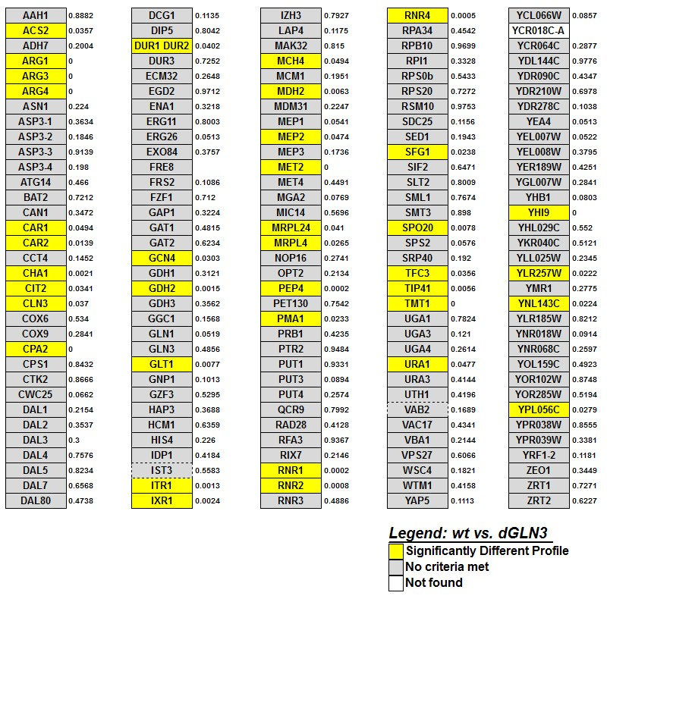
GenMAPP Guided Further Wet Lab Research
In GenMAPP, we visualized results from ANOVA and t-tests, and categorized based on p-value significance
We set up a voting system to determine which strains to test further (visible, significant dynamics)
  Microarray winner: dYAP1
  Test for growth impairment winners: dNRG1, dPHD1, dRSF2, dYHP1, dRTG3, dYOX1

Slide 10
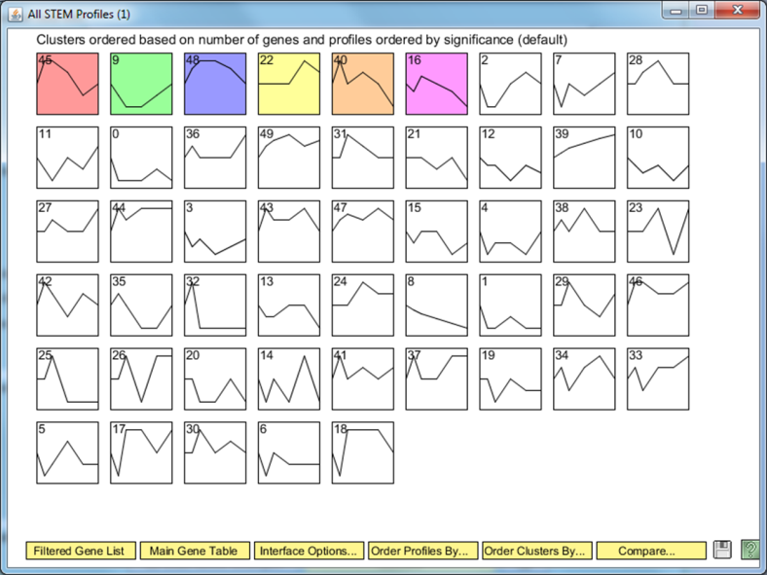
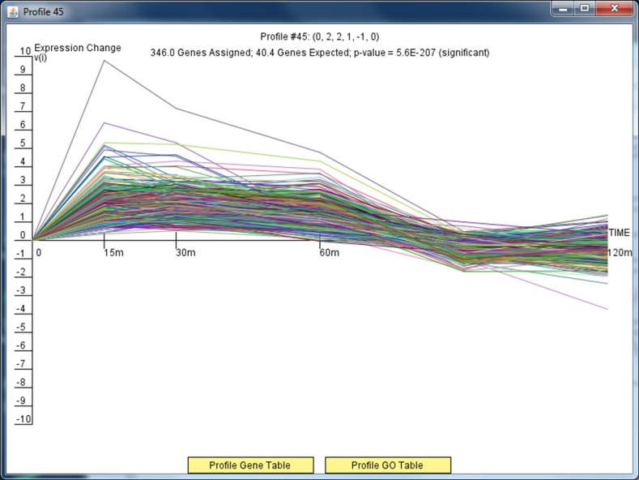
Clustering with STEM
STEM (short time series expression miner) groups genes based on similar dynamics
We built STEM profiles from genes with B&H p < 0.05 from within-strain ANOVA for our strain
Profiles include GO information

Slide 11
YEASTRACT
Genes from significant STEM profiles were entered as target genes into YEASTRACT
  Inferring that the same set of TFs regulate genes that have similar dynamics
YEASTRACT outputs a list of candidate TFs ranked by significance

Slide 12
Using YEASTRACT to create a hypothesis network
To the resulting list of significant regulators, CIN5, GLN3, HAP4, HMO1, SWI4, and ZAP1 were added
The new list of 15-30 genes was entered into the YEASTRACT Gene Regulation Matrix as both regulators and target genes
YEASTRACT outputs adjacency matrix that can be fed into GRNmap and visualized with GRNsight
  Selecting “DNA binding evidence plus expression evidence” gives a more connected network
  Selecting “only DNA binding evidence” gives a less connected network

Slide 13
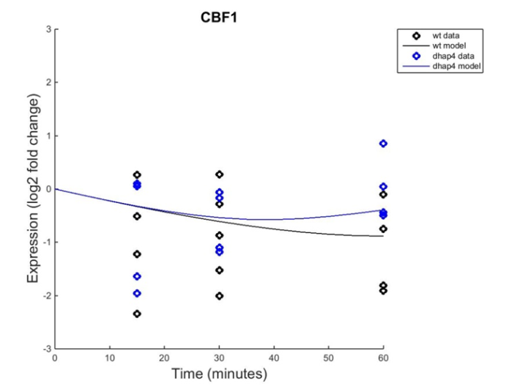
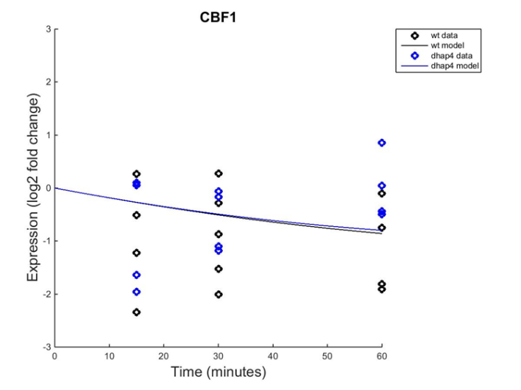
GRNmap Estimates Parameters and Runs a Forward Simulation
Networks from YEASTRACT were formatted in input sheet for MATLAB
  Input sheet included log2 fold change data from wt and deletion strains
Outputs were obtained by fitting model to wt data and chosen deletion strain data. Production rates and weights were estimated.
Fix b Estimated b

Slide 14
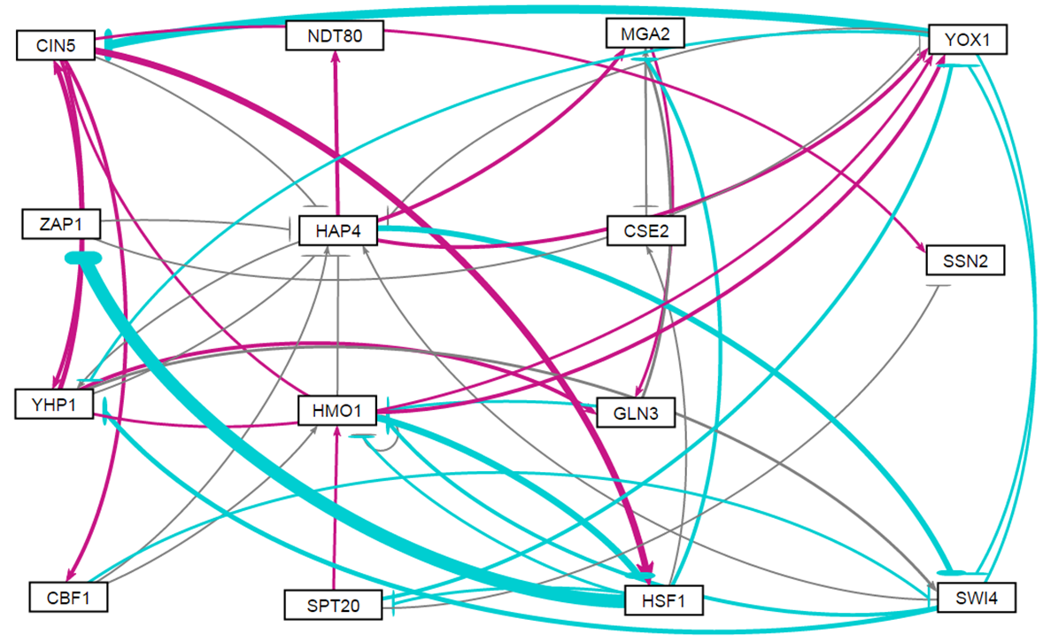
Estimated weights from GRNmap were visualized using GRNsight
Profile 16 Plus from STEM, using wt and dHAP4 data

Slide 15
GRNmap Testing SURP 2015
Analyzed each gene based on:
  Fit (visual, SSE)
  Dynamics (B&H p-value)
  Dynamics of regulators (B&H p-value)
  Output production/degradation rate ratio
Genes fell into three categories when looking at the validity of inputs
  Inputs to the gene are wired correctly
  Inputs to the gene are wired incorrectly
  Validity of inputs is uncertain due to the number and type of estimated parameters
Notes:
Did a bunch of data collection/testing, decided to focus on full analysis of each gene in the network

Slide 16
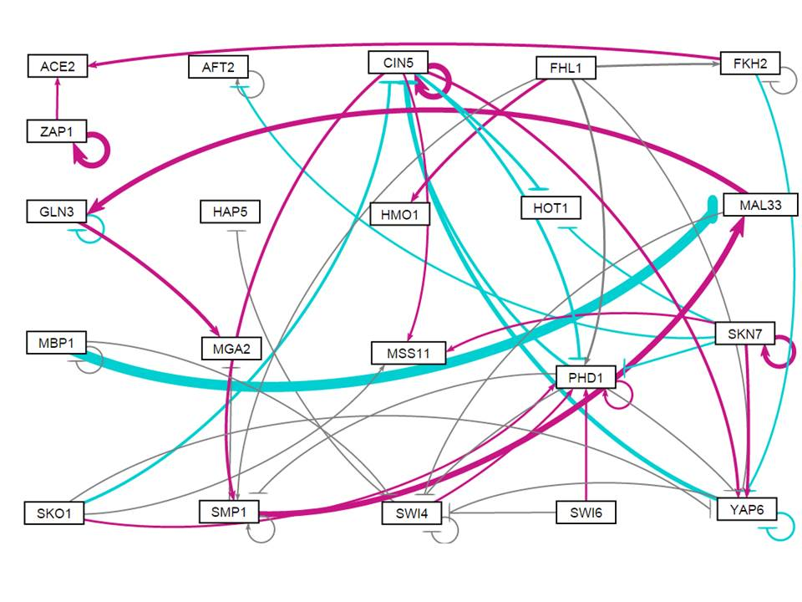
Analyzed Each Gene from wt Alone Run
21-gene, 50-edge weighted network

Slide 17
Analyzed Each Gene from wt Alone Run
21-gene, 50-edge weighted network

Slide 18
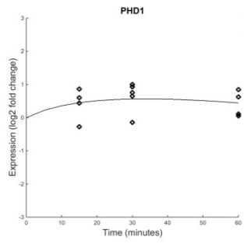
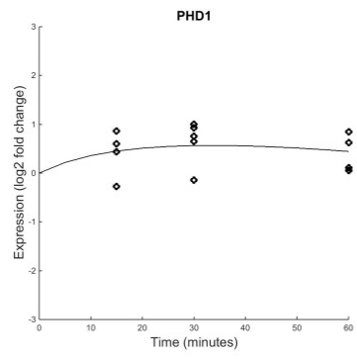
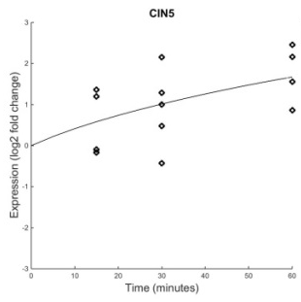
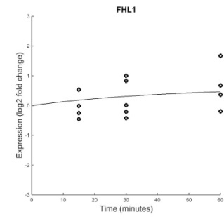
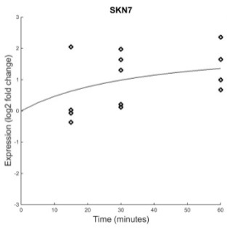
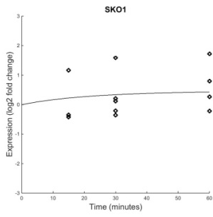
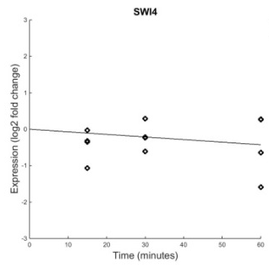
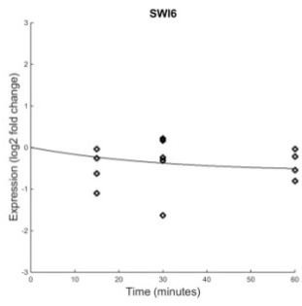
PHD1 is Modeled Well
B&H p=0.0017
Regulators: PHD1, CIN5, FHL1, SKN7, SKO1, SWI4, SWI6
Weight: 0.16
B&H p=0.0017
B&H p=0.0642
Weight: -0.28
B&H p=0.4454
Weight: 0.062
B&H p=0.0228
Weight: -0.10
PHD1 has a good fit with significant dynamics
Most regulators also have significant dynamics, making the weights easier to estimate
Production rate is 3X degradation rate (a relatively stable value)
Although it is difficult to tell with so many inputs, PHD1’s model follows the trend of its inputs well
  Initially activated, then slightly repressed as the two repressors (CIN5 and SKN7) increase their expression
PHD1’s inputs seem justified
B&H p=0.1330
Weight: 0.085
B&H p=0.6367
Weight: 0.16
B&H p=0.1178
Weight: 0.14
Total repression: -0.38
Total activation: 0.61

Slide 19
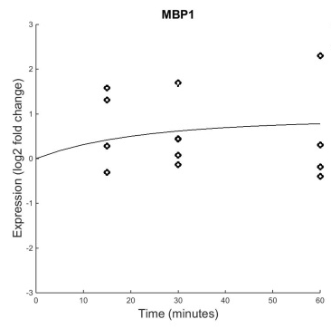
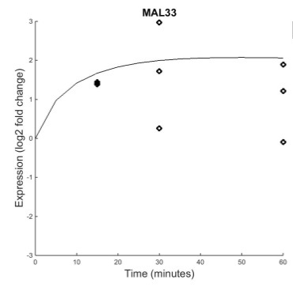
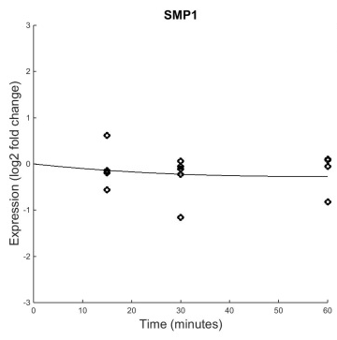
MAL33 is Modeled Poorly
Regulators: MBP1 and SMP1
B&H p=0.5240
B&H p=0.0101
Weight: -1.45
B&H p=0.6046
Weight: 0.77
Production rate is huge relative to other genes. The model is attempting to fit the large initial spike
  Are these dynamics due to a regulator we’re not seeing?
Because inputs have no dynamics, it is difficult to estimate w’s and b
Unsure of MAL33 connection

Slide 20
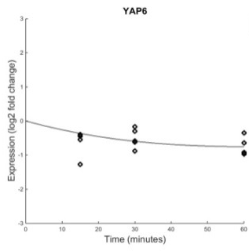
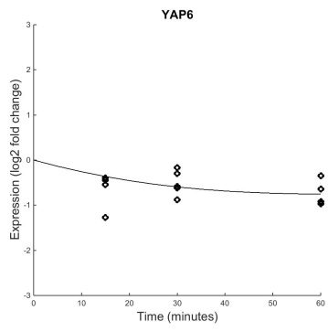

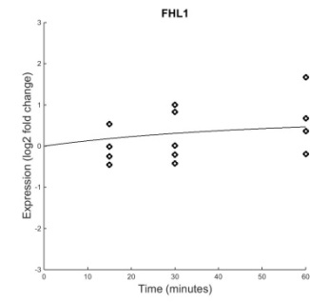
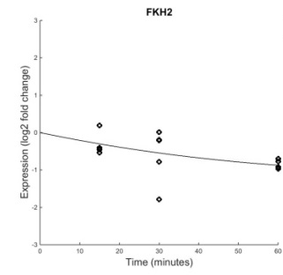



YAP6 Could Be Modeled Well
B&H p=0.0003
Regulators: YAP6, CIN5, FHL1, FKH2, PHD1, SKN7, SKO1
Weight: -0.17
B&H p=0.0003
B&H p=0.0642
Weight: 0.26
B&H p=0.4454
Weight: -0.022
B&H p=0.1274
Weight: -0.17
YAP6 has significant dynamics and is modeled fairly well
Because YAP6’s regulators are mostly dynamic, the weights are probably estimated well. However, the validity of these inputs is uncertain without further knowledge of actual production and degradation rates.
Estimated production rate is less than the degradation rate. This is contributing to the downward trend, even when the strongest weights (coming from genes with significant dynamics) are activating YAP6
B&H p=0.0017
Weight: -0.01
B&H p=0.0228
Weight: 0.19
B&H p=0.1330
Weight: -0.026
Total repression: -0.39
Total activation: 0.45

Slide 21
General Conclusions
Genes fell into three categories when looking at the validity of inputs
  5 genes have correctly wired inputs and are modeled well
  4 genes are modeled poorly
  For the other 12 genes (and really all 21 genes), the validity of inputs is uncertain due to the number and type of estimated parameters
Genes with less dynamics are more difficult to model
It is difficult to make any conclusive statements about the connections in the network without knowing the production and degradation rates.

Slide 22
Acknowledgments
Dr. Dahlquist
Dr. Fitzpatrick
Dondi
Natalie Williams

