Slide 1
Systems modeling and statistical analysis allows comparison in the response to cold shock in Saccharomyces cerevisiae between Hap4 and a randomly generated network
Kristen M. Horstmann, Ben G. Fitzpatrick, Kam D. Dahlquist
Departments of Biology and Mathematics
Loyola Marymount University
Undergraduate Research Symposium
March 25, 2017

Slide 2
Outline
Yeast respond to cold shock by changing gene expression.
Microarray data was generated for yeast under cold shock conditions.
A family of related networks was generated from the YEASTRACT database while random networks were generated from an R-script
The dynamics of each gene in the network was modeled using ordinary differential equations.
Gephi was used to analyze connectivity and statistics of nodes in ΔHAP4 derived network
FINDINGS

Slide 3
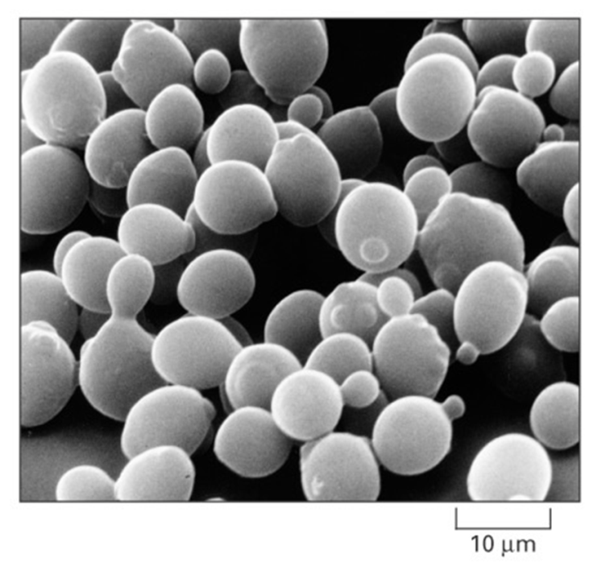
Saccharomyces cerevisiae is an Ideal Model Organism for Systems Biology
Budding yeast is considered model organism due to its small genome size of approximately 6000 genes.
These genes are regulated by ~250 transcription factors, which can increase or decrease gene expression.
Yeast deletion strains and other molecular genetic tools are readily available.
Cold shock (10-18 ℃) response are not as well documented as heat shock
Alberts et al. (2004)

Slide 4
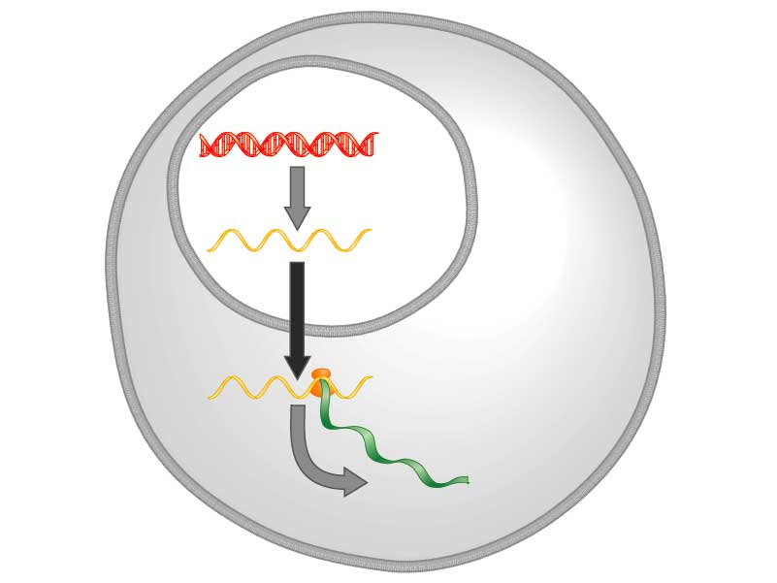
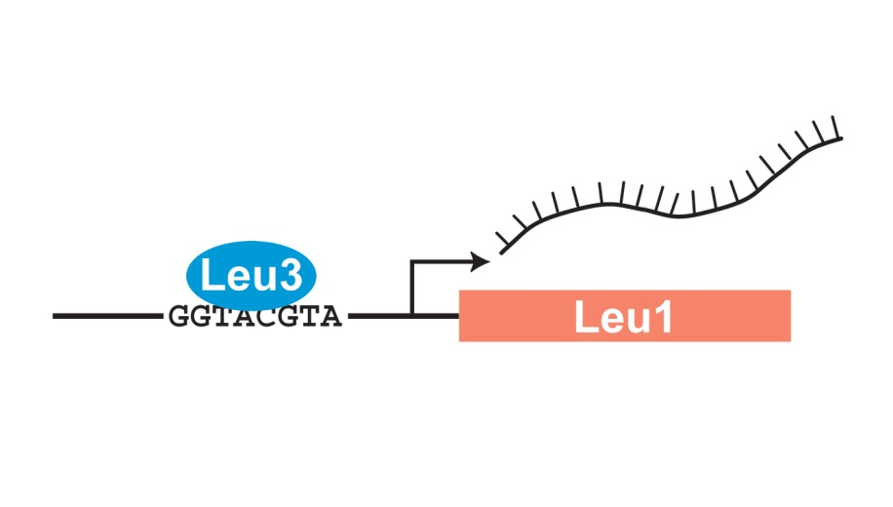
Yeast respond to cold shock by changing the level of gene expression
Transcription factors control gene expression by binding to regulatory DNA sequences.
Activators increase expression while repressors decrease expression
Transcription factors are themselves proteins encoded by genes.
A gene regulatory network (GRN) is a set of transcription factors that regulate the expression of genes encoding other transcription factors.
DNA
Transcription
mRNA
Translation
Protein
Freeman (2003)

Slide 5
Outline
Yeast respond to cold shock by changing gene expression.
Microarray data was generated for yeast under cold shock conditions.
A family of related networks was generated from the YEASTRACT database while random networks were generated from an R-script
The dynamics of each gene in the network was modeled using ordinary differential equations.
Gephi was used to analyze connectivity and statistics of nodes in ΔHAP4 derived network
FINDINGS

Slide 6
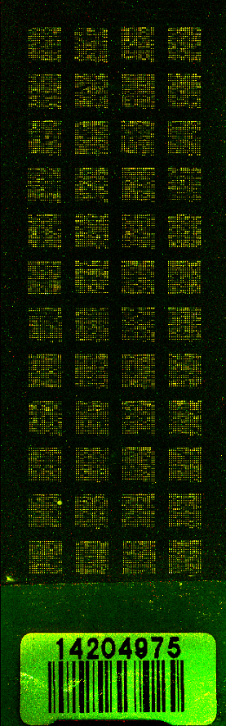
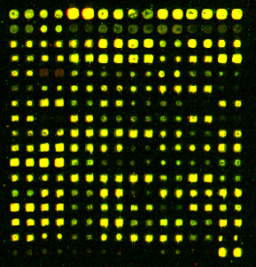
Microarray Data is Used to Observe Changes in Gene Expression for All 6000 Genes in Yeast
Each spot contains DNA from one gene.
  For each Spot:
    Increase Expression
    Decrease Expression
    No Change in Expression
DNA microarray experiments were performed for the wild type and five transcription factor deletion strains (ΔCIN5, ΔGLN3, ΔHAP4,ΔHMO1, and ΔZAP1).
For this analysis, the ΔHAP4 derived family was used as well as randomized networks generated
Randomized networks were generated using an R-script and based off the 15 genes from the ΔHAP4 derived network
Sample Microarray Slide from the Dahlquist Lab

Slide 7
Outline
Yeast respond to cold shock by changing gene expression.
Microarray data was generated for yeast under cold shock conditions.
A family of related networks was generated from the YEASTRACT database while random networks were generated from an R-script
The dynamics of each gene in the network was modeled using ordinary differential equations.
Gephi was used to analyze connectivity and statistics of nodes in ΔHAP4 derived network
FINDINGS

Slide 8
15-gene Network Was Created by Paring Down Genes from the Largest Network and Used To Create Random Networks
We started with a network of 35 genes made up of the most significant regulators, including the transcription factors for which we had deletion strain microarray data
Transcription factors and edges were removed from the GRN in a stepwise fashion in order of least to most significant until the network was pared down to 15 genes and 28 edges.
Random networks were created by using a code written on R software and the 15 most significant genes
Gephi and GRNsight was used to analyze 10 of these random networks.

Slide 9
Outline
Yeast respond to cold shock by changing gene expression.
Microarray data was generated for yeast under cold shock conditions.
A family of related networks was generated from the YEASTRACT database while random networks were generated from an R-script
The dynamics of each gene in the network was modeled using ordinary differential equations.
Gephi was used to analyze connectivity and statistics of nodes in ΔHAP4 derived network
FINDINGS

Slide 10
GRNmap Uses Ordinary Differential Equations to Model the Dynamics of Each Gene in the Network
The MATLAB code and executable are available under an open source license at: https://github.com/kdahlquist/GRNmap/.
The expression levels of the individual transcription factors were modeled using mass balance ordinary differential equations with a sigmoidal production function.

Slide 11
GRNmap Uses Ordinary Differential Equations to Model the Dynamics of Each Gene in the Network
The MATLAB code and executable are available under an open source license at: https://github.com/kdahlquist/GRNmap/.
The expression levels of the individual transcription factors were modeled using mass balance ordinary differential equations with a sigmoidal production function.
mRNA production rate
Protein degradation rate
weight term
Threshold unique
to each gene

Slide 12
Outline
Yeast respond to cold shock by changing gene expression.
Microarray data was generated for yeast under cold shock conditions.
A family of related networks was generated from the YEASTRACT database while random networks were generated from an R-script
The dynamics of each gene in the network was modeled using ordinary differential equations.
Gephi was used to analyze connectivity and statistics of nodes in ΔHAP4 derived network
FINDINGS

Slide 13
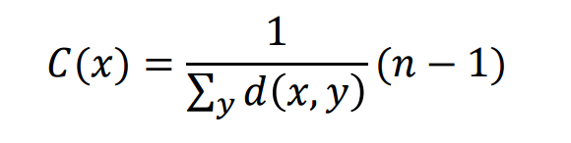
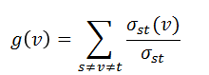
A statistical tool, Gephi, was used to analyze connectivity between nodes
Gephi is an open-source software for network visualization and network analysis. For this project, Gephi was used for finding in and out degrees, eccentricity centrality , and betweenness centrality.
Weighted in and out degrees: the summed weights of the edges connected in and out of a particular node.
Eccentricity centrality: shows how easily accessible a node is from others, and only takes out degree into account. Higher value means it has a greater impact on other nodes.
Betweenness centrality: measures how often a node is found on the shortest path between two other nodes, s and t.

Slide 14
Outline
Yeast respond to cold shock by changing gene expression.
Microarray data was generated for yeast under cold shock conditions.
A family of related networks was generated from the YEASTRACT database while random networks were generated from an R-script
The dynamics of each gene in the network was modeled using ordinary differential equations.
Gephi was used to analyze connectivity and statistics of nodes in ΔHAP4 derived network
FINDINGS

Slide 15
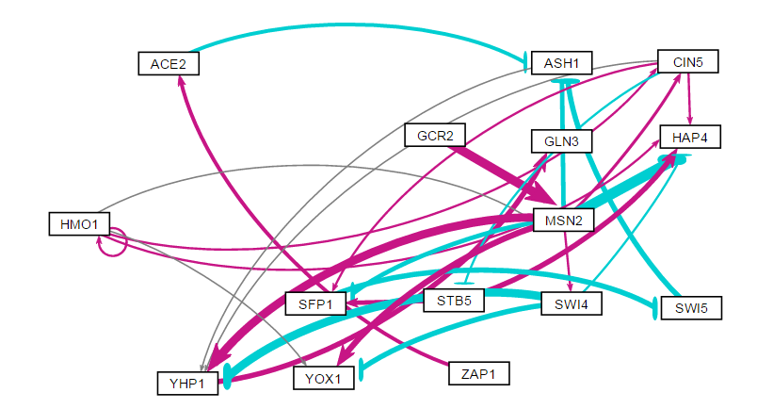
The ΔHAP4 derived network
Might get 0 for betweenness if nothing coming in or out or if there’s an equal amount of weighted in and out values for the shortest path (SWI4).
Can observe the highly connected betweenness nodes in the visualization. Also note how much lower the eccentricity values are
ID | In-Degree | Out-Degree | Degree | Eccentricity | Between
MSN2 | 3.325 | -0.866 | 2.459 | 2 | 14
YHP1 | 0.032 | 1.799 | 1.830 | 1 | 11
ASH1 | -4.231 | 0.103 | -4.128 | 2 | 10

Slide 16
The 10 Randomized Networks Were Consolidated and Compared
ID | In Degree | Out Degree | Degree | Eccentricity | Between
SFP1 (8) | 2.262438 | -0.73132 | 1.531117 | 5 | 99
STB5 (8) | -3.20411 | 4.052939 | 0.848825 | 6 | 84
CIN5 (10) | 1.957744 | 0.257661 | 2.215405 | 9 | 78
GLN3 (10) | 0.07316 | 1.512576 | 1.585736 | 7 | 74
MSN2 (10) | -1.95213 | -0.83221 | -2.78434 | 6 | 73.33333
The largest betweenness centrality values from the random networks happened to arise from random networks 8 and 10.

Slide 17
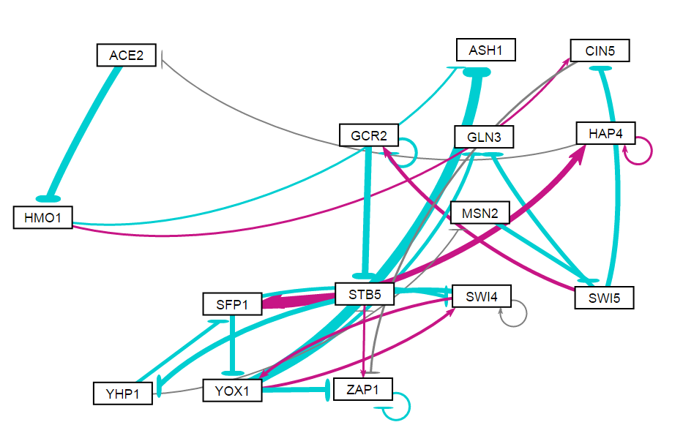
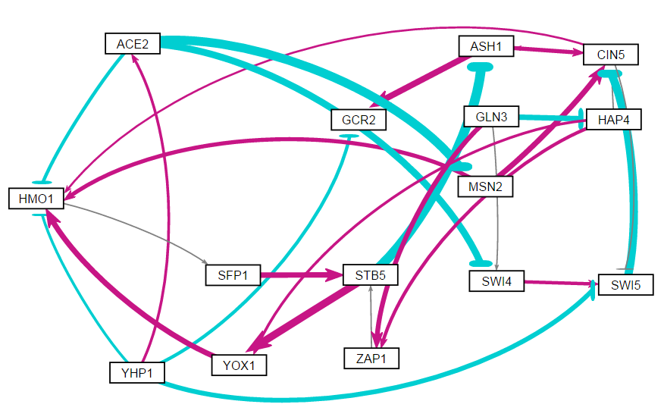
Random Networks 8 and 9

Slide 18
https://www.sci.unich.it/~francesc/teaching/network/betweeness.html
Betweenness centrality measures the extent to which a vertex lies on paths between other vertices. Vertices with high betweenness may have considerable influence within a network by virtue of their control over information passing between others. They are also the ones whose removal from the network will most disrupt communications between other vertices because they lie on the largest number of paths taken by message
Betweenness centrality differs from the other centrality measures. A vertex can have quite low degree, be connected to others that have low degree, even be a long way from others on average, and still have high betweenness. Consider a vertex A that lies on a bridge between two groups of vertices within a network. Since any path between nodes in different groups must go through this bridge, node A acquires high betweenness even though it is not well connected (it lies at the periphery of both groups) and hence it might not have particularly high values for degree, eigenvector, and closeness centrality

