Slide 1
The Effects of an Increasing Dilution Rate on Biomass Growth and Nitrogen Metabolism of Saccharomyces cerevisiae
Kasey O’Connor
Ashley Rhoades
Department of Mathematics
Loyola Marymount University
BIOL 398-03/MATH 388
February 26, 2013
Seaver 202
Notes:
both

Slide 2
Outline
How does increasing the dilution rate of the chemostat affect the growth of Saccharomyces cerevisiae?
Using the chemostat model and the parameters discussed in the ter Schure paper allowed for watching the effects of a changing dilution rate.
Increasing the dilution rate in a nitrogen limiting culture with the differential equation model showed that:
the biomass stayed relatively constant.
there was an increase in glucose residual and decrease in nitrogen residual.
Under the same conditions as the model, the ter Schure paper showed that
nitrogen and glucose flux increased linearly.
CO2 production and O2 consumption increased sixfold with the increasing dilution rate.
There was little change in the concentrations of glutamate and glutamine.
Notes:
Ashley

Slide 3
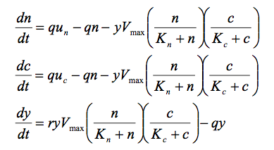
The System of Differential Equations Used to Model the Chemostat
Notes:
Ashley

Slide 4
State Variables Used in the Chemostat Model
These parameters were established according to information gathered from “The Concentration of Ammonia Regulates Nitrogen Metabolism in Saccharomyces cerevisiae,” by ter Schure et al.
Consumption rate of nitrogen - Vn = 53.8607
The consumption rate of carbon - Vc = 92.7348
Nitrogen saturation rate - Kn = 0.1000
Carbon saturation rate - Kc = 4.8231
Net growth rate - r = 7.4205
ter Schure, E.G., et. al. (1995) Journal of Bacteriology 177: 6672-6675.
Notes:
Ashley

Slide 5
Applying the Chemostat Model to the Parameters of the ter Schure Paper
To change the dilution rate, both nitrogen and carbon concentrations had to remain constant.
The source of carbon provided came from glucose, and the source of nitrogen was from NH₄Cl.
Following the direction of the paper, the carbon concentration, uc, was 9.5 g/l and the nitrogen concentration, un was 1.5 g/l
The yeast cells were grown at dilution rates of .05, .1, .15, .19, .29 h-1.
Notes:
Ter Schure found that at 8.5 g carbon and 1.5 g nitrogen, nitrogen was limiting, so he increased it by one more g/l to ensure the limitations
Ashley

Slide 6
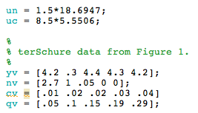
Changes Made to the Matlab Program to Run the Model

Slide 7
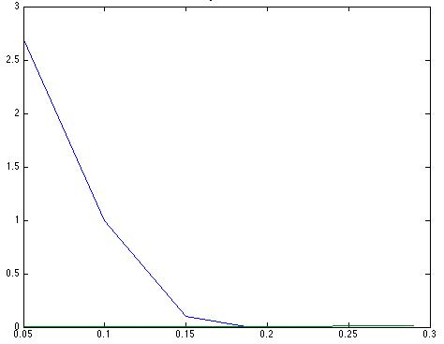
An Increasing Dilution Rate Causes a Steep Decrease in Nitrogen Residual
Nitrogen Residual
Residual concentration (mmol/l)
Residual nitrogen was 2.7 mmol/l at q = .05.
At q = .1 the residual nitrogen in the chemostat decreased to 1 mmol/l.
At q = .19 there was no traceable residual nitrogen.
dilution rate (per hour)
Notes:
Kasey

Slide 8
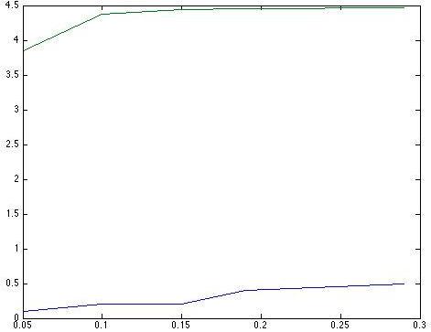
Under Excess Carbon Conditions, an Increase in Residual Carbon is Found
Residual Carbon
The residual glucose concentrations in the chemostat increased from .01 to .4 mmol/l with an increase in the dilution rate from .05 to .29
Residual concentration (mmol/l)
dilution rate (per hour)
Notes:
Kasey

Slide 9
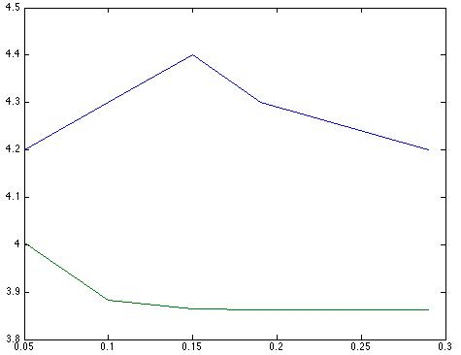
The Biomass Remains Constant Despite the Increase in Dilution Rate
Biomass
Biomass (g/l)
dilution rate (per hour)
The biomass remained relatively constant at 4.4 g/l.
Notes:
Kasey

Slide 10
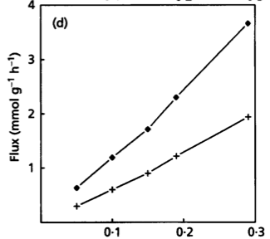
Ter Schure’s Chemostat Shows a Linear Increase in Ammonia and Carbon Flux
Both the carbon and ammonia flux increased linearly.
The linear increase of both fluxes and relatively no change in biomass shows no changes in carbon metabolism.
terSchure et al. Microbiology, 1995, 141:1101-1108)
Notes:
Kasey

Slide 11
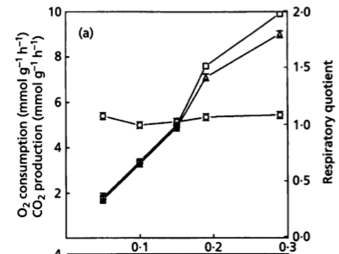
Changing the Dilution Rates increases O2 production and CO2 consumption sixfold
Measured O2 consumption and CO2 production.
O2 consumption increased from 1.5 mmol/gh to 9 mmol/gh.
CO2 production increased from 1.6 mmol/gh to 9.8 mmol/gh.
Consequently, the respiration quotient remained constant.
terSchure et al. Microbiology, 1995, 141:1101-1108)
Notes:
Kaset

Slide 12
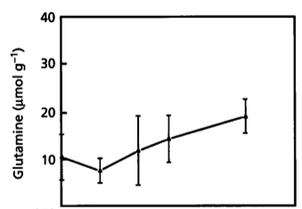
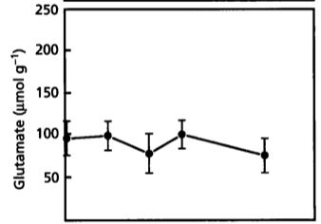
An Increase in Dilution Rates Has Little Effect on Amino Acid Concentrations
The glutamine and glutamate concentrations did not change and remained at about 27 and 100 mmol/g, respectively.
terSchure et al. Microbiology, 1995, 141:1101-1108)
Notes:
In line with the linear increase in both glucose and ammonia flux
Kasey

Slide 13
What Would the Effects of an Increasing Dilution Rate be on a Carbon Limited Chemostat?
Deciding the appropriate concentration values for carbon and nitrogen would require looking at the system at the highest dilution rate.
Using these concentrations, the differential equations could be used to get the model of the chemostat to see the effects of biomass on a nitrogen rich system.
In a similar manner, the concentrations of the amino acids could also be analyzed.
Notes:
Ashley

Slide 14
Summary
Increasing the dilution rate in a nitrogen limiting culture with the differential equation model showed that:
the biomass stayed constant.
there was an increase in glucose residual but a decrease in nitrogen residual.
Under the same conditions as the model, the ter Schure paper showed that:
nitrogen and glucose flux increased linearly.
CO2 production and O2 consumption increased sixfold.
the concentrations of glutamate and glutamine had no significant change.
In a nitrogen limited chemostat of S. cerevisiae, the significant increase in glucose uptake can be attributed to the increase of CO2 production and O2 consumption
Notes:
Both

Slide 15
References
Ter Schure, Eelko G., et al. "Nitrogen-regulated transcription and enzyme activities in continuous cultures of Saccharomyces cerevisiae." Microbiology 141.5 (1995). Print.
Ter Schure, Eelko G., et al. “The Concentration of Ammonia Regulates Nitrogen Metabolism in Saccharomyces cerevisiae." Journal of Bacteriology 177.22 (1995). Print.

Slide 16
Acknowledgments
Ben G. Fitzpatrick, Ph.D.
Department of Mathematics
Loyola Marymount University
Kam D. Dahlquist, Ph.D.
Department of Biology
Loyola Marymount University

