Slide 1
Tissue Engineering
Lecture 17, 4/9/15
Paper Review
Forces and Wound Healing

Slide 2
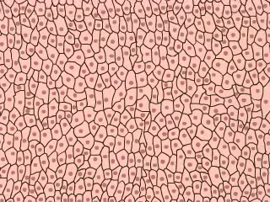
What is the motivation of this study?
Wound healing is a well-known process that many cells participate in.
We know that cells migrate in and rapidly divide to close the gap.
We also know that there are ‘forces’ involved.
First cells pull themselves forward
Cells behind push and pull to fill the gap
But, it has been hard, thus far, to measure the magnitude of these forces.
Notes:
Traction Force Microscopy
MDCK cells (dog kidney) – GFP labeled
On top of polyacrylamide gels
Laser ablate to form a wound.

Slide 3
Methods employed
Traction Force Microscopy
MDCK cells (dog kidney) – GFP labeled
On top of polyacrylamide gels
Laser ablate to form a wound.
Show supplementary Movie 1

Slide 4
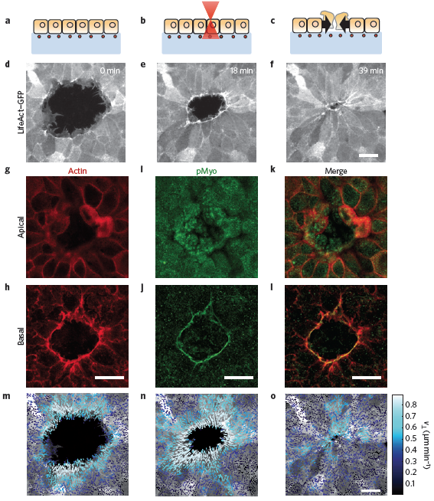
Figure 1a-o: Christine Davis
Notes:
Figure 1 | Cell morphology and kinematics during wound healing. a–c, Scheme of the experimental design. d–f, Time course of wound closure in
LifeAct–GFP Madin Darby canine kidney cells. Images are maximum projections of confocal z-stacks. g–l, Staining of phalloidin and pMyo at the apical
(g,i,k) and basal (h,j,l) planes. m–o, Vectorial representation of cell velocities measured by particle image velocimetry at the same time points as in d–f.

Slide 5
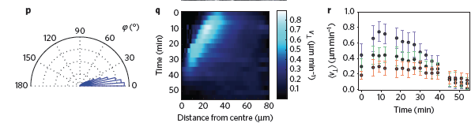
Figure 1p-r: Singyuk Hou
Notes:
p, Distribution of the angle ' between cell velocities and the direction normal to the wound edge. Data are a pool of all time points for one experiment.
q, Kymograph of the radial component of cell velocities (Supplementary Methods). r, Time evolution of cell velocities as a function of the distance from the
leading edge. The time axis indicates the time after the beginning of image acquisition (20 min after wounding). Each data set represents the average
radial velocity within concentric rings of width 15 m (blue for cells located between 0 and 15 m from the leading edge, green for 15–30 m, red for
30–45 m). Error bars represent standard deviation. Missing time points in r are due to image refocusing. Data for these time points have been interpolated
in q to help visualization. All scale bars are 20 m.

Slide 6
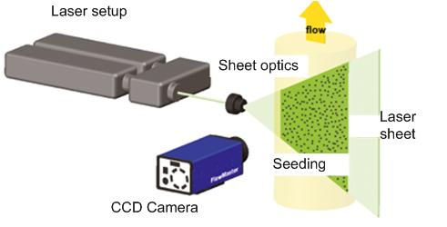
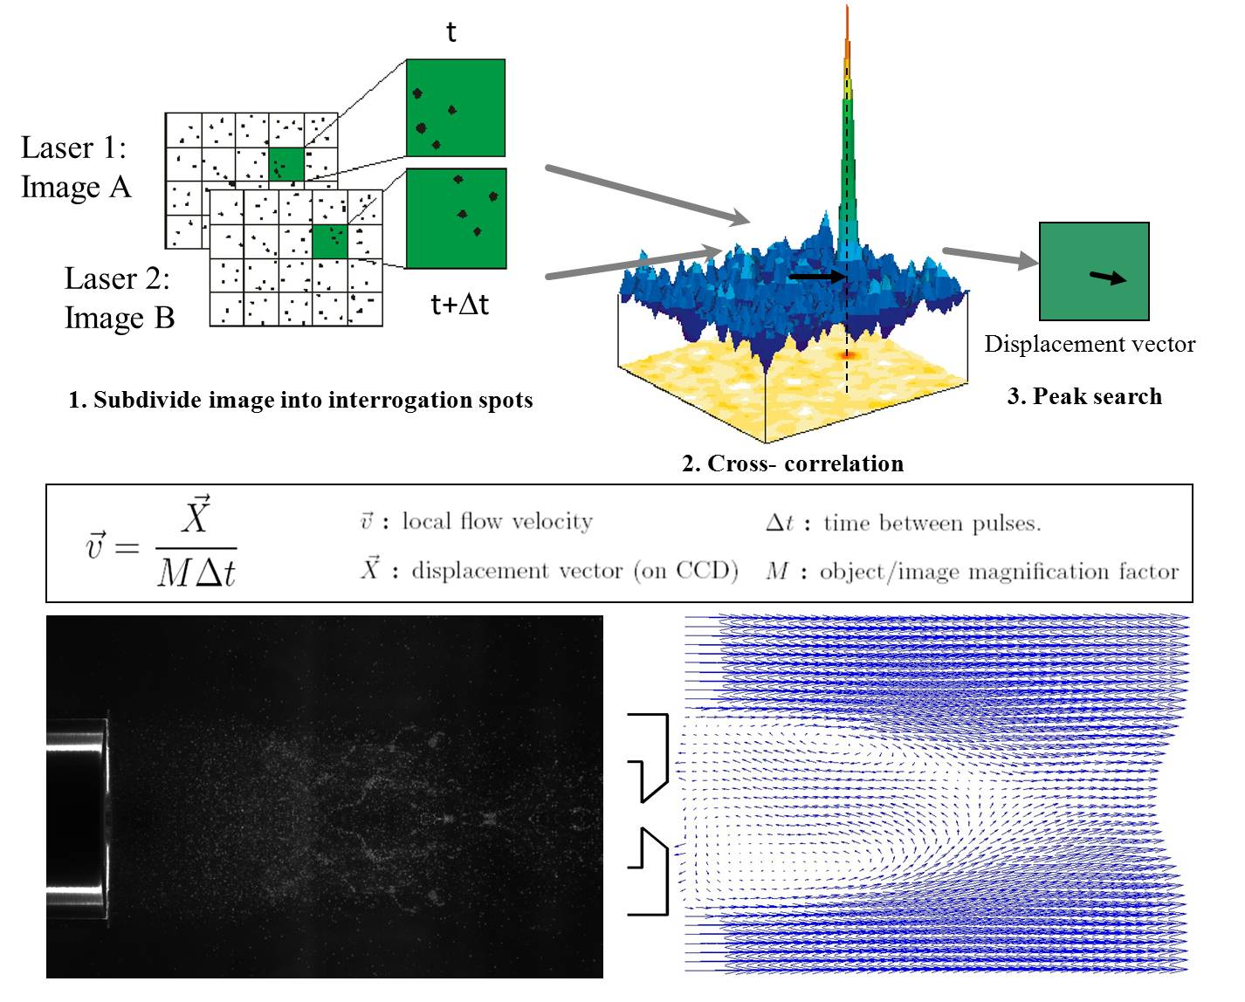
Particle image velocimetry

Slide 7
Measuring Forces
Overlaid force mapping to the same movie(s) from Figure 1
Show supplementary movie 2

Slide 8
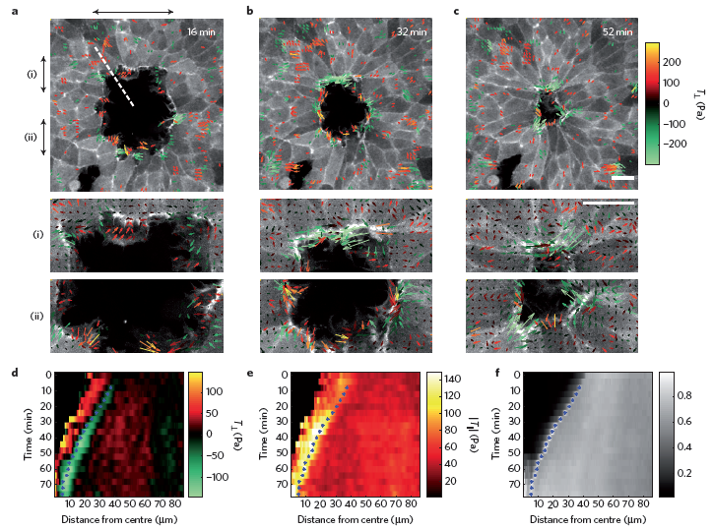
Figure 2a-f: Michael Grunwald
Notes:
Figure 2 | Traction forces during wound healing. a–c, Vectorial representation of traction forces in LifeAct–GFP Madin Darby canine kidney cells. Colour
coding is based on the values of the radial component, with positive forces pointing away from the wound. For clarity, values between 􀀀100 and 100 Pa
were not plotted. Panels labelled as i and ii show a close-up of the regions indicated by the arrows in a–c. Scale bar is 20 m. d, Kymograph for radial
traction component T?. e, Kymograph for tangential traction component Tk. f, Kymograph of actin-density-based LifeAct–GFP fluorescence. Blue asterisks
in d–f show the position of the maximum actin density for each time point.

Slide 9
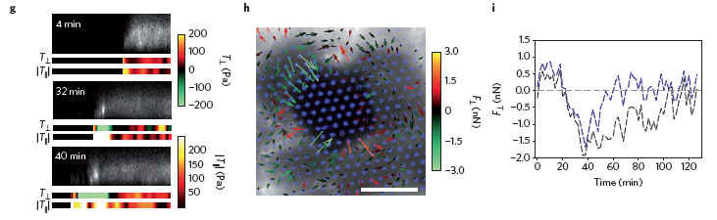
Figure 2g-i: Sarah Johnson
Notes:
g, A confocal z-section of LifeAct–GFP along the dashed line shown in a. Radial
and tangential traction forces along that dashed line are shown below LifeAct–GFP images. Total length is 68 m. h, Traction-force maps obtained using
micropillar arrays (blue). Scale bar is 10 m. Forces are colour-coded according to the radial component. i, Time evolution of the radial forces of two distinct
pillars. Positive forces point towards the wound exterior, whereas negative forces point towards the wound interior.

Slide 10
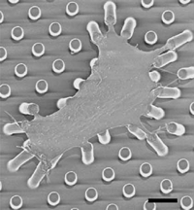
New method - micropillars
Moved to micropillar technique as a second way to measure forces of the migrating cells
Show supplementary movie 3

Slide 11
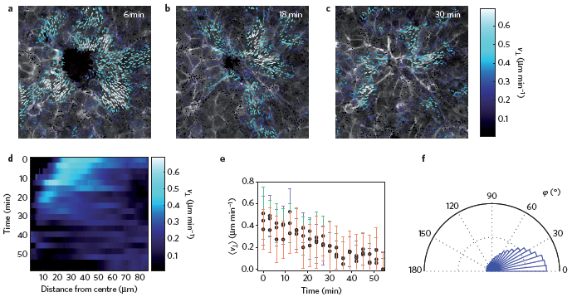
Figure 3a-f: Eric Stowe
Notes:
Figure 3 | Traction forces in the absence of an actomyosin ring. a–c, Vectorial plot of velocities measured by particle image velocimetry. d, Kymograph of
the radial component of velocities. e, Time evolution of velocities averaged over adjacent rings of width 15 m (blue for cells located between 0 and 15 m
from the leading edge, green for 15–30 m, red for 30–45 m). Error bars represent standard deviation. f, Angular distribution of the angle ' between cell
velocities and the direction normal to the wound edge.

Slide 12
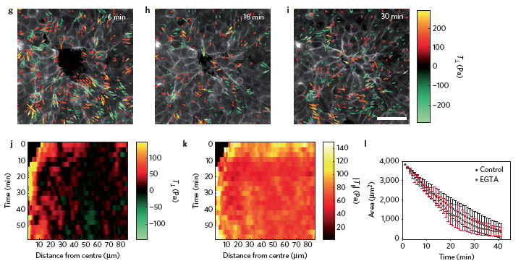
Figure 3g-l: Ezra Aurian-Blajeni
Notes:
g–i, Vectorial representation of measured tractions. Colour coding is based on the values of the
radial component. For clarity, values between 􀀀100 and 100 Pa were not plotted. j,k, Kymographs of radial (j) and tangential (k) components of traction
forces. l, Time evolution of the wound area in control cells and EGTA-treated cells. Error bars indicate standard deviation of nD5 (control) and nD6 (EGTA)
samples. All scale bars are 40 m.

Slide 13
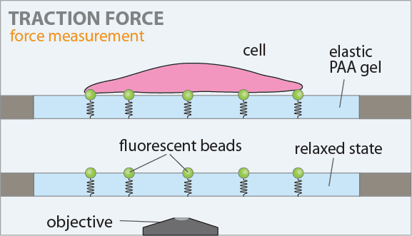
Using beads to measure traction forces
http://www.cellmechanics.de/Images/Traction.gif

Slide 14
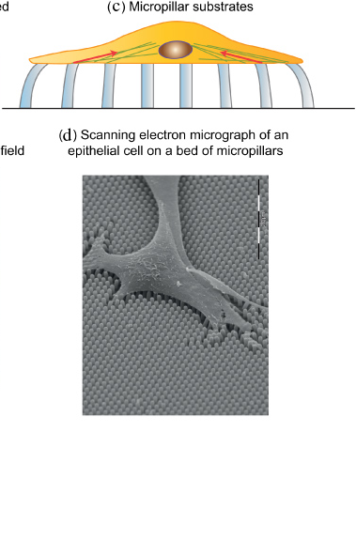
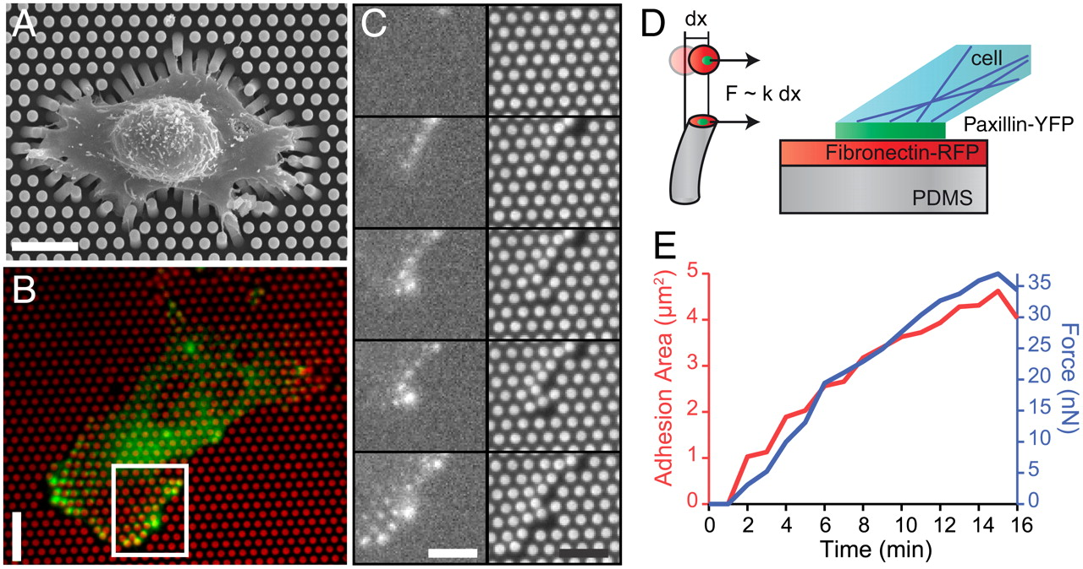
Using micropillars to measure traction forces
http://ej.iop.org/images/0034-4885/75/11/116601/Full/rpp301965f09_online.jpg
http://www.pnas.org/content/109/18/6933/F1.large.jpg

Slide 15
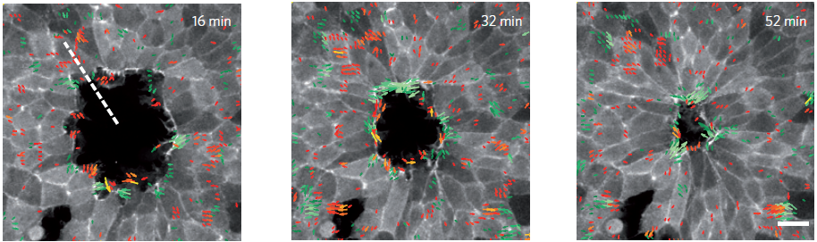
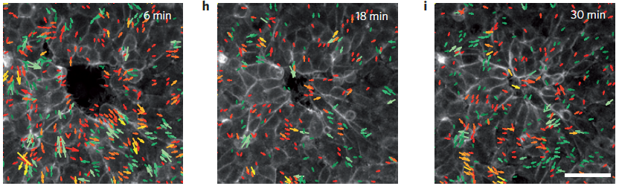
Radial traction vectors: Control (top) vs. 2-4mM Ca²⁺ chelator (bottom)
(note: top image (Fig. 2) is zoomed in ~2x, relative to bottom (Fig. 3))

Slide 16
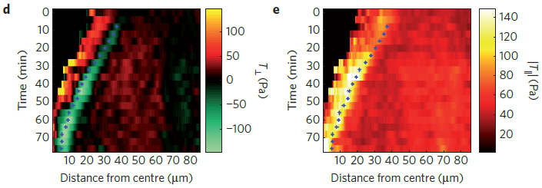
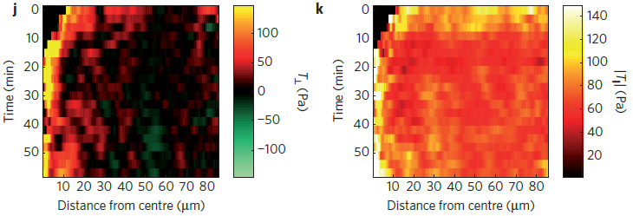
Radial and tangential traction kymographs: Control (top) vs. 2-4mM Ca²⁺ chelator (bottom)

Slide 17
Ablating the ring at multiple spots
Show supplementary movie 5

Slide 18
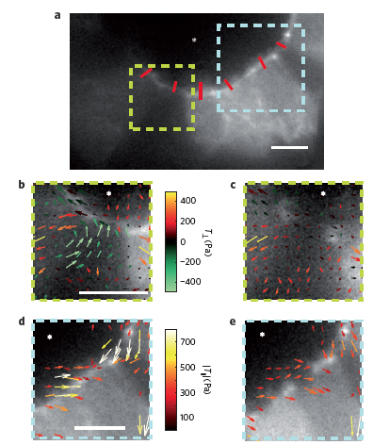
Figure 4a-e: Cody Siroka
Notes:
Figure 4 | Traction forces after laser ablation of the actomyosin ring.
a, Fluorescence image of LifeAct–GFP cells before laser ablation. Red
segments mark the sites of ablation. b,c, A region showing inward-pointing
tractions before (b) and after (c) ring ablation. c, Immediately after ablation,
normal tractions were abrogated. d,e, A region with strong tangential
tractions before (d) and after ablation (e). e, Tangential tractions were
strongly attenuated by ring ablation. For clarity, only forces forming angles
of less than 45 with the tangent were plotted.

Slide 19
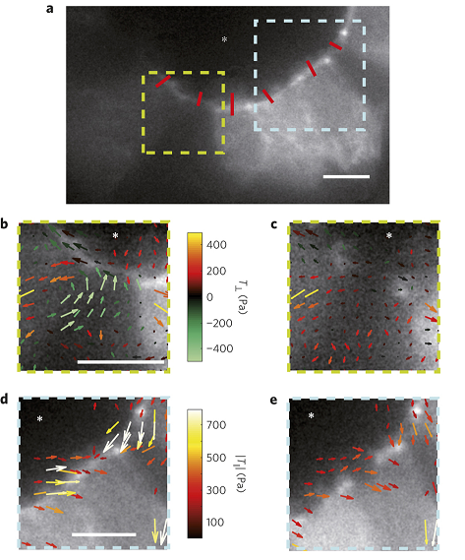
Figure 4a-e
Further investigation of IPTL being reliant on transmission of contractile force from the actomyosin ring
To contrast to the previous calcium chelation results
A: shows the tissue being targeted for laser ablation in the location of the red lines.
B & C: traction forces before (b) and after (c) laser ablation.
D & E: tangential forces before (d) and after (e) laser ablation
Scale bars: 10 μm
*: interior of wound

Slide 20
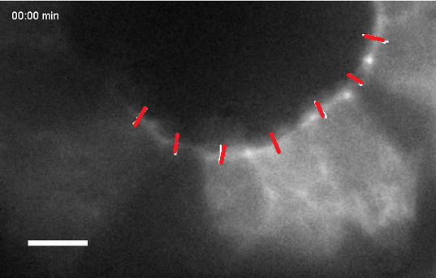
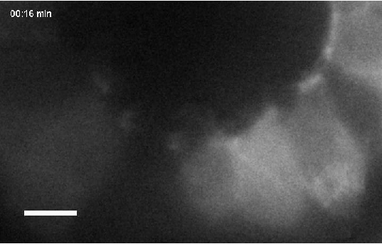
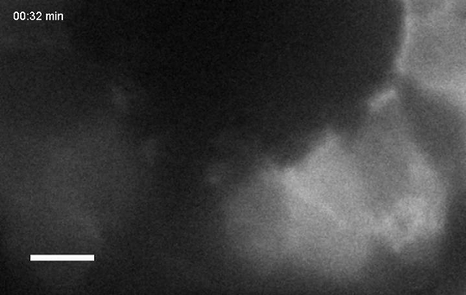
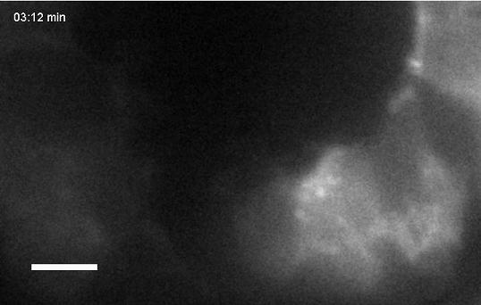
Supplementary movie 5

Slide 21
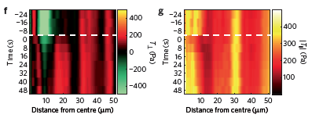
Figure 4f-g: Robert Gaspardi
Notes:
F and G show more detail with another kymograph. Walk through graph.
-0 shows forces, normally, then at ablation the radial forces (F, meaning across the cells) dissipate and equilabrate across the tissue.
G is the tangential forces (from cell to substrate), you see a disruption at ablation, but then these forces recover to the pre-ablation state after 30 min or so.
Conclusion: our results establish that the IPTL (inward-pointing traction layer) originates from
transmission of forces from the ring to the substrate- since forces in G recover, whereas F dissipates.

Slide 22
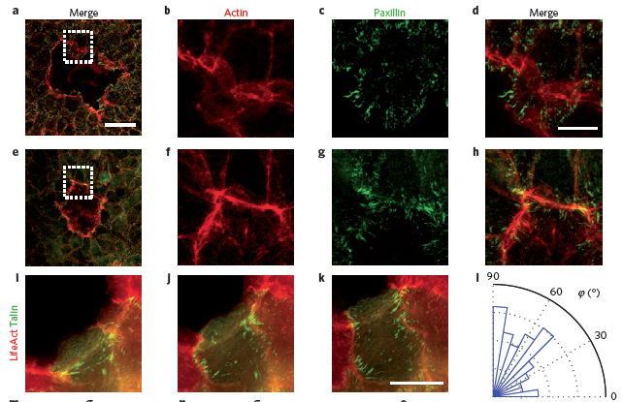
Figure 5a-l: Akarawin Hongdusit
Notes:
Figure 5 | Force transmission from the ring to the substrate creates heterogeneous stresses and inward-pointing displacements of the underlying
substrate. a–h, Representative immunofluorescence micrographs of paxillin and F-actin showing the characteristic structural organization of the leading
edge during early (a–d) and late (e–h) stages of wound closure. a–d, During initial stages, focal adhesions were localized at the tip of lamellipodia and were
perpendicular to the leading edge. e–h, During later stages, focal adhesions appeared under the actomyosin ring. i–k, Time-lapse snapshots of Madin Darby
canine kidney cells expressing LifeAct–Ruby and talin–GFP at three dierent time points of wound closure (Supplementary Movie 4). l, Angular distribution
of focal adhesion orientation with respect to the normal direction (0 is normal to the ring, nD112 focal adhesions from five experiments). The analysis is
performed in a 3-m-thick band located immediately behind the ring (including the ring).

Slide 23
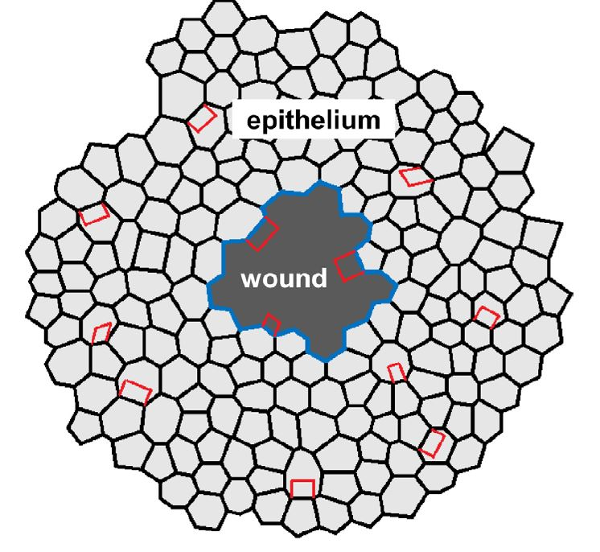
Akarawin Hongdusit, Supplemental

Slide 24
Figure 5m-r: Ronen Zeidel
Notes:
m–r, Substrate stress and displacements during wound healing.
m,p,n,q, Radial normal stress (rr; m,p) and tangential normal stress (tt; n,q) in the upper surface of the gel during the latest stages of wound closure.
o,r, Radial displacement of the gel surface. Negative displacements point towards the wound. The two time points considered in m–r correspond to b and c
in Fig. 2. Scale bars are 40 m for a and e, 10 m for b–d and f–k, and 20 m for o.

Slide 25
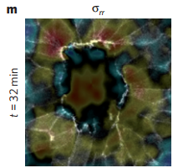
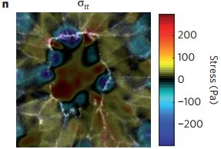
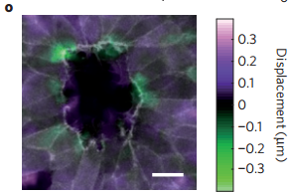
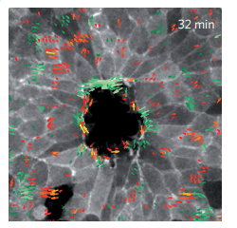

Ronen Zeidel, cont.
At 32 minutes
Corresponds to fig. 2b
Fig. 5m-n: Stress maps displaying the uneven distribution of compressive and tensile stress
Fig. 5m: stress perpendicular to the actomysin ring
Fig. 5n: stress tangential to actomyosin ring (Shear stress)
“-”:Compressive
“+”: Tensile
Fig. 5o: Radial displacement of the gel surface
Researchers though that the shear stress would be counter productive
The net dipole points towards the center of the ring
“-”:Away from the ring’s center
“+”:Towards the ring’s center

Slide 26

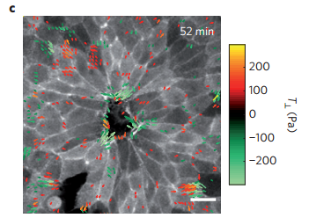
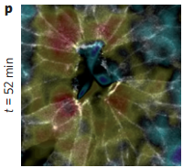
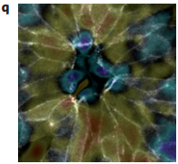
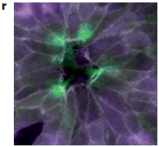

Ronen Zeidel, cont.
At 52 minutes
Correspond to Fig. 2c
Fig. 5p-q: Stress maps displaying the uneven distribution of compressive and tensile stress
Fig. 5p: stress perpendicular to the actomysin ring
Fig. 5q: stress tangential to actomyosin ring (Shear stress)
“-”: Compressive
“+”: Tensile
Fig. 5r: Radial displacement of the gel surface
Researchers though that the shear stress would be counter productive
The net dipole points towards the center of the ring
“-”:Away from the ring’s center
“+”:Towards the ring’s center

Slide 27
Conclusions, Perspectives
When a contractile force dipole is applied to the surface of an elastic material, it generates material displacements towards the dipole centre and normally to the dipole's direction.
If several such dipoles are arranged in an annular geometry, their contraction will result in a net displacement of the gel surface towards the centre of the ring.
Thus, by applying traction forces tangentially to the wound, cells create net substrate displacements that are radial and point towards the wound, thereby contributing to drag the cell sheet into the wound area.
Closure of wound is a result of both the purse-string closure method through the cells, and by forces applied on the substrate.

