Slide 1
Comparing the Dynamics of the wild-types of S. cerevisiae and S. paradoxus under Cold Shock
Natalie Williams
BIOL 398-04/S15
Biology Department
Loyola Marymount University
May 7, 2015

Slide 2
Outline
The cold shock experimental design
Statistical analysis of the microarray data resulted in significant expression levels in various genes
Genes were chosen due to their significance in YEASTRACT
MATLAB results exemplify the differing responses each strain has to cold shock
  Worst Fit
  Opposite curves for S. cerevisiae and S. paradoxus
  Biggest Dynamics
Changing the threshold value did not alter the outputs of the graphs
  Optimized Weights
  Production Rates
Future directions and Final implications

Slide 3
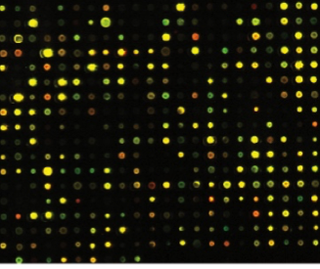

A sigmoidal function was used to create the model to fit a curve to the data produced from the microarray
Microarray data was taken from the Dahlquist lab
A series of differential equations based on the sigmoidal function were used for each expression term
P_{i} is mRNA production rate for gene i
d_{i} is mRNA degradation rate for gene I
w is the weight term, determining the level of activation or repression of j on i
b is a unique threshold for each gene

Slide 4
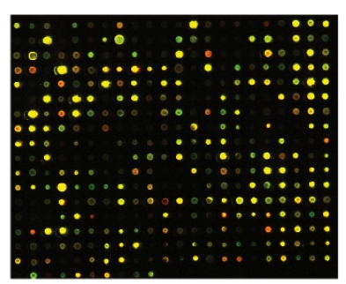
Significance of the model
A gene regulatory network (GRN) consists of a set of transcription factors that regulate the level of expression of a set of target genes, which can include other transcription factors
We are using mathematical modeling to determine the relative influence of each transcription factor in the GRN that controls the cold shock response.

Slide 5
Outline
The cold shock experimental design
Statistical analysis of the microarray data resulted in significant expression levels in various genes
Genes were chosen due to their significance in YEASTRACT
MATLAB results exemplify the differing responses each strain has to cold shock
  Worst Fit
  Opposite curves for S. cerevisiae and S. paradoxus
  Biggest Dynamics
Changing the threshold value did not alter the outputs of the graphs
  Optimized Weights
  Production Rates
Future directions and Final implications

Slide 6
The WT of S. cerevisiae shows a higher percentage of significant changes in gene expression, which is seen in p-values.
P-value | S. cerevisiae | S. paradoxus
p < 0.05 | 2378 (38.42 %) | 2262 (36.55%)
p < 0.01 | 1527 (24.67%) | 1400 (22.62%)
p < 0.001 | 860 (13.90%) | 684 (11.05%)
p < 0.0001 | 460 (7.043%) | 314 (5.073%)
B-H p < 0.05 | 1656 (26.76%) | 1501 (24.25%)
Bonferroni p < 0.05 | 228 (3.86%) | 145 (2.343%)
Notes:
Implications:
Larger percentage suggests that there could be more false positives
More genes are being said to have significance even though it is by chance
Genes in S. cerevisiae react more to cold shock and has to change more of its gene expression in order to survive

Slide 7
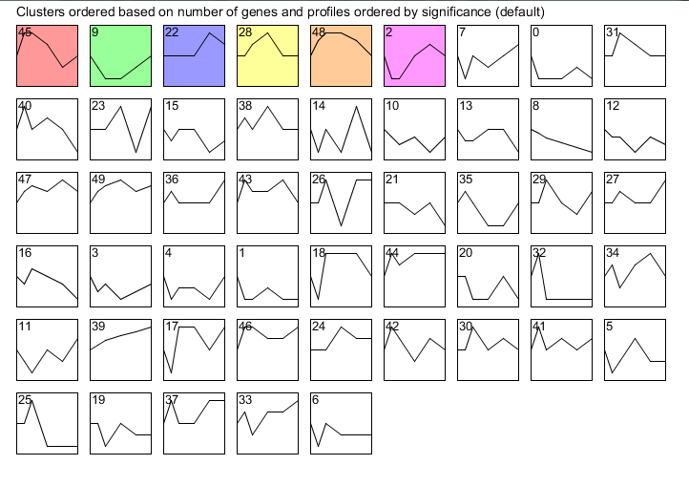
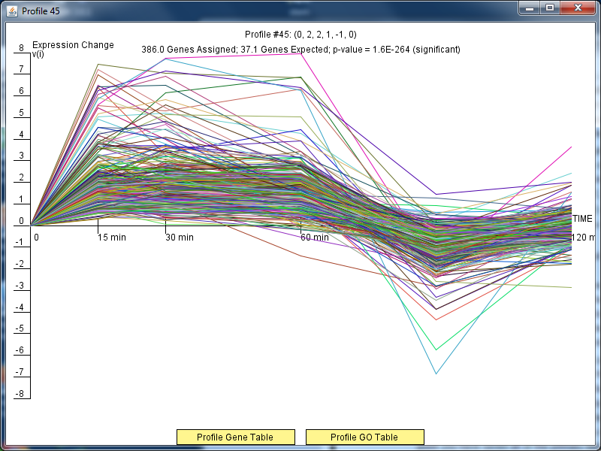
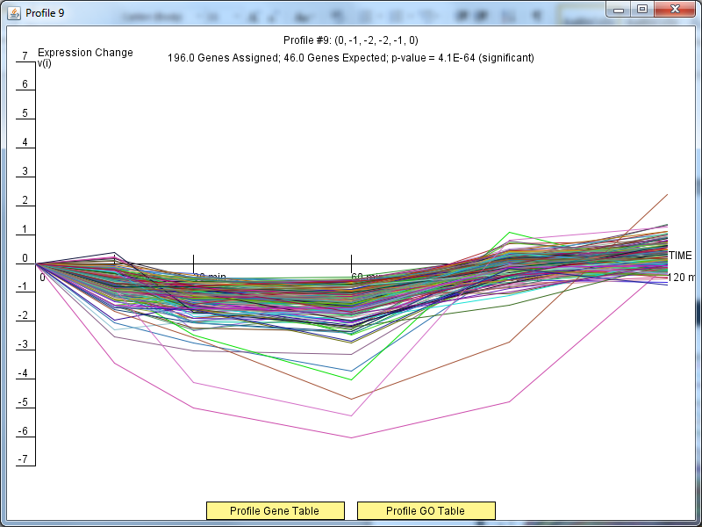
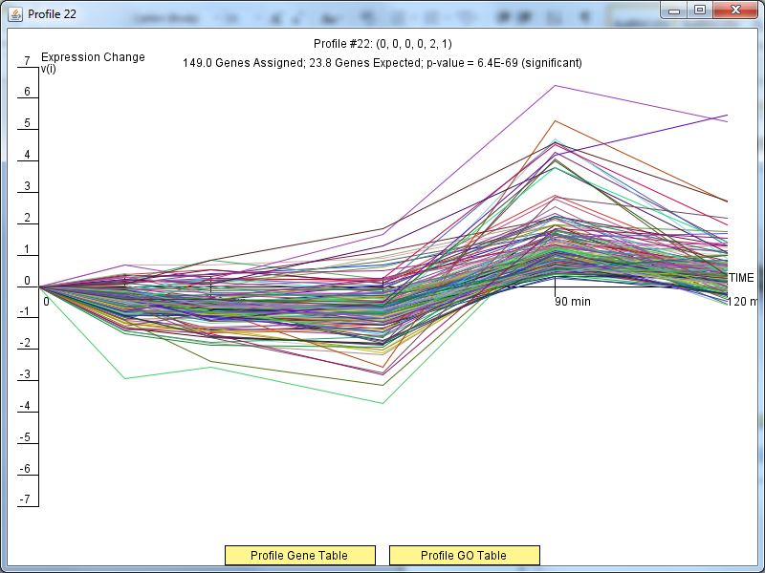
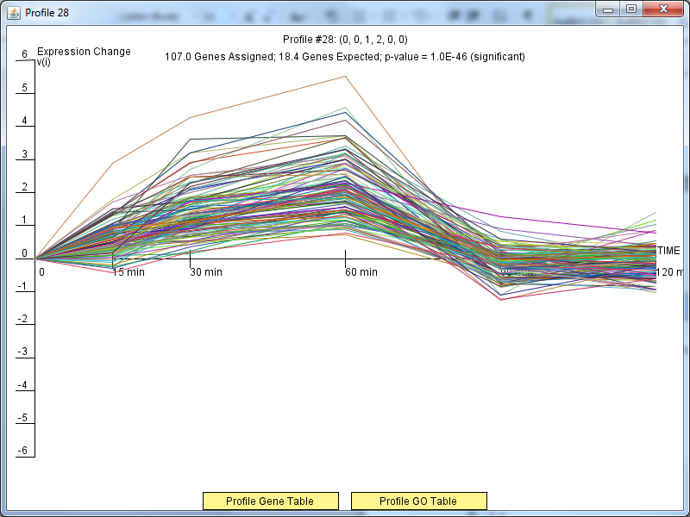
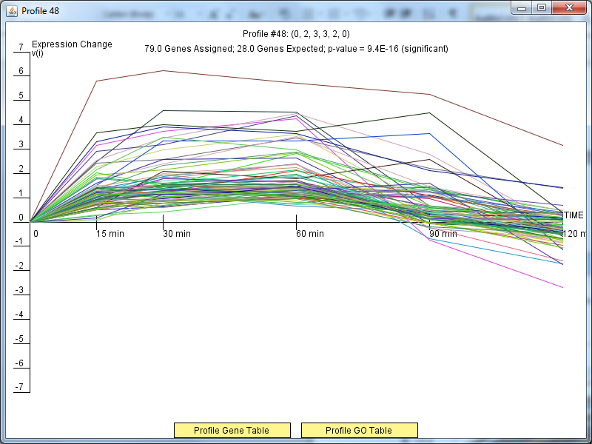
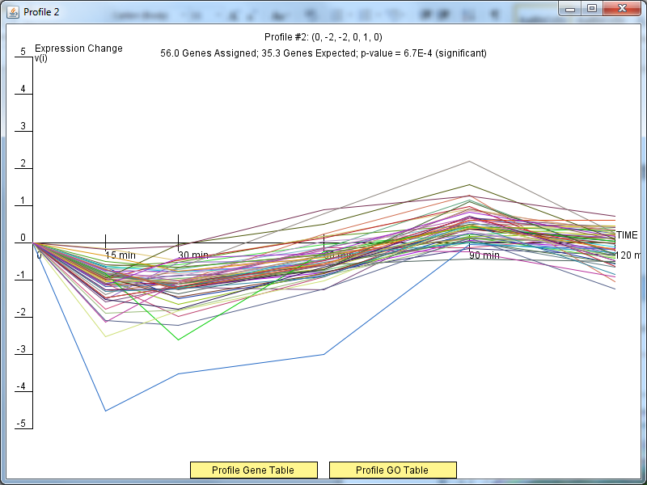
Results of stem show 6 different profiles, signifying that S. paradoxus has a collection of genes that reacts to cold shock.
Notes:
B-H p-values were used to get the clustering data
STEM = Short Time-series Expression Miner >> clusters genes with similar expression patterns in the same profile

Slide 8
Outline
We were tasked with modeling the dynamics of the wild-type of S. cerevisiae and S. paradoxus.
The percentage of genes that changed significantly in wild-type of S. cerevisiae were higher than S. paradoxus.
Genes were chosen due to their significance in YEASTRACT and the network was visualized
MATLAB results exemplify the differing responses each strain has to cold shock
  Worst Fit
  Opposite curves for S. cerevisiae and S. paradoxus
  Biggest Dynamics
Changing the threshold value did not alter the outputs of the graphs
  Optimized Weights
  Production Rates
Future directions and Final implications

Slide 9
Profile #45 was chosen for the analysis of significant genes.
Notes:
- Large number of genes in the profile meant that we would have more options when constructing our GRN

Slide 10
The amount of transcription factors responsible for gene regulation decreases as the criteria get stricter in YEASTRACT’s regulation matrix.
Restrictions/Settings | Nodes | Edges
DNA binding plus expression | 41 | 384
ONLY DNA binding | 38* | 102*
DNA binding and expression | 20* | 23*
* Amounts before alterations were done to see the visualized GRN in GRNSight

Slide 11
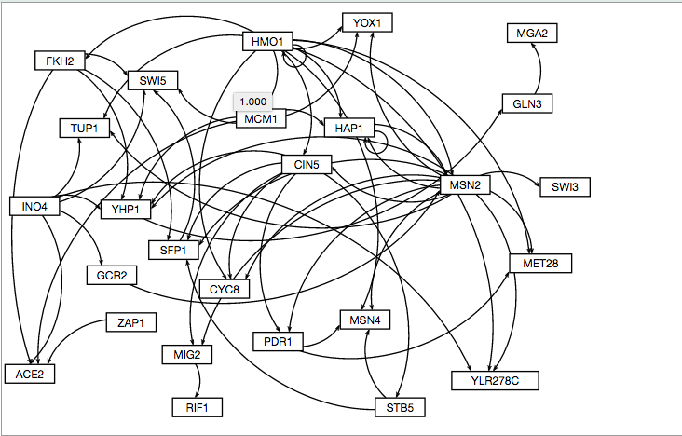
Modified GRN from Only DNA binding evidence with a few genes deleted
Deleted:
SRB8
RLM1
SPT20
MIG1
CST6
MET31
SPT2
SNF5
PIB2
SNF6
SNF2
CBF1
SSN2
SKO1
YAP6
Notes:
- The deleted genes were chosen based on having higher p-values than other genes in the network

Slide 12
The table that depicts the altered amounts of transcription factors responsible for gene regulation is shown below.
Restrictions/Settings | Nodes | Edges
DNA binding plus expression* | 41 | 384
ONLY DNA binding | 26 | 58
DNA binding and expression | 17 | 21
* A visualization was not able to be produced due to the number of nodes and edges.

Slide 13
The following transcription factors were studied and included in the GRN.
SFP1
STB5
YHP1
YOX1
CYC8
SWI5
ACE2
MSN2
FKH2
YLRC278C
GCR2
RIF1
MIG2
SWI3
HAP1
PDR1
MCM1
TUP1
MET28
INO4
MGA2
ZAP1
MSN4
CIN5
GLN3
HMO1
Notes:
Due to their higher significant values and/or their previously known significance to cold shock
An adjacency matrix was made from these transcription factors

Slide 14
Outline
We were tasked with modeling the dynamics of the wild-type of S. cerevisiae and S. paradoxus.
The percentage of genes that changed significantly in wild-type of S. cerevisiae were higher than S. paradoxus.
Genes within Profile #45 were chosen due to their significance in YEASTRACT
MATLAB results exemplify the differing responses each strain has to cold shock
  Worst Fit
  Opposite curves for S. cerevisiae and S. paradoxus
  Biggest Dynamics
Changing the threshold value did not alter the outputs of the graphs
  Optimized Weights
  Production Rates
Future directions and Final implications

Slide 15
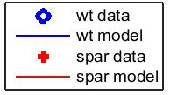
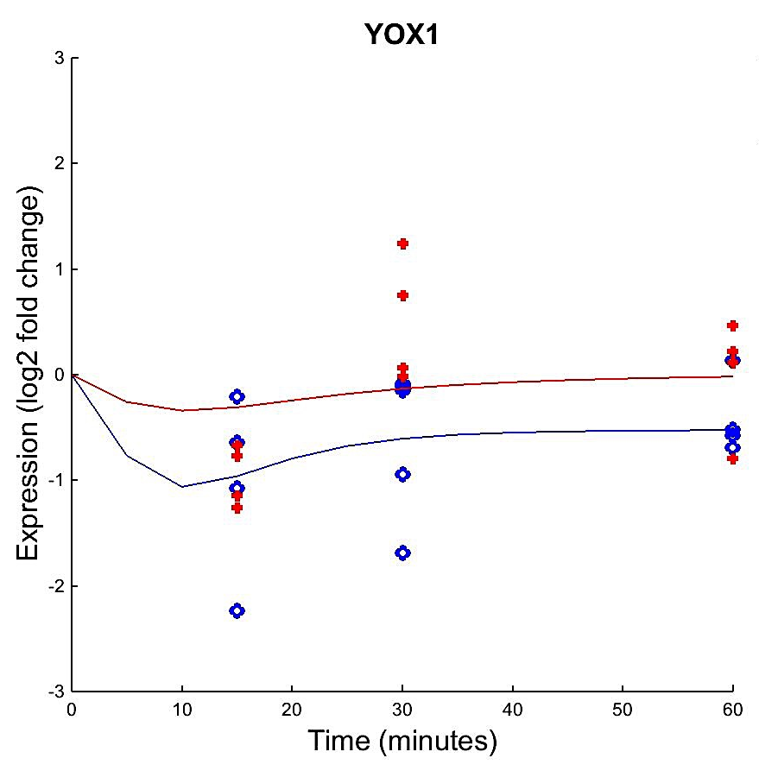
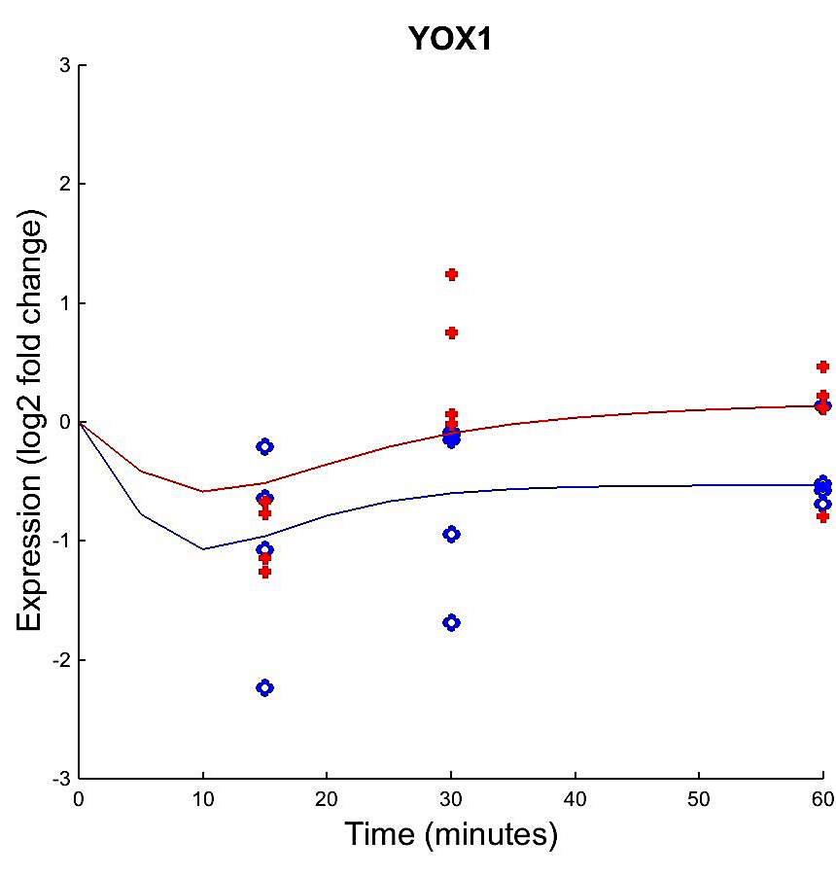
The fit of the model for S. paradoxus was poor.
Fixed B
Estimated B
Notes:
May be poor due to an equal amount of repression and activation from two strong regulators – MSN2 and HMO1

Slide 16
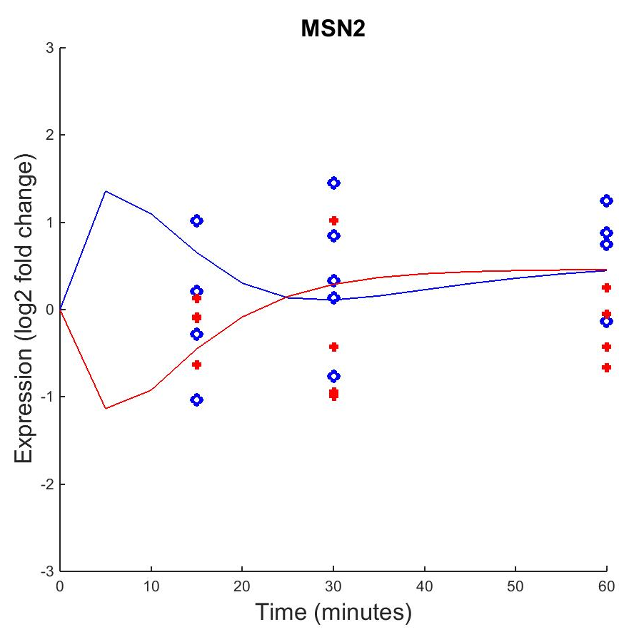
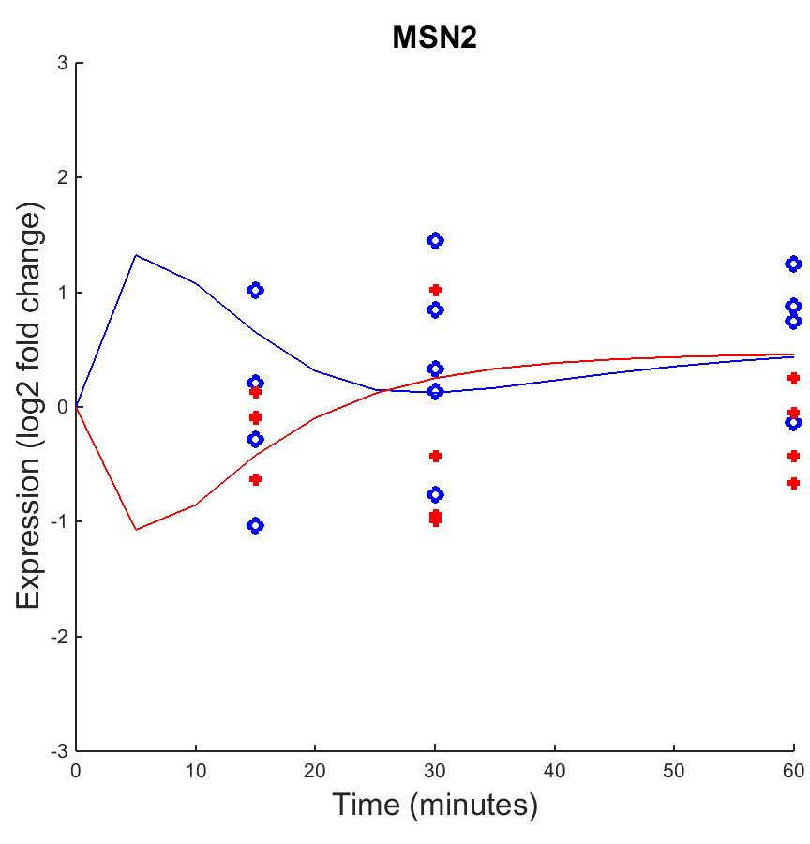
The model does not hit the average data points for the three collection times and misses S. paradoxus’ 60 time point.
Fixed B
Estimated B
Notes:
- Wild model fit could be because of the two inputs for MSN2 = HAP1 and HMO1

Slide 17
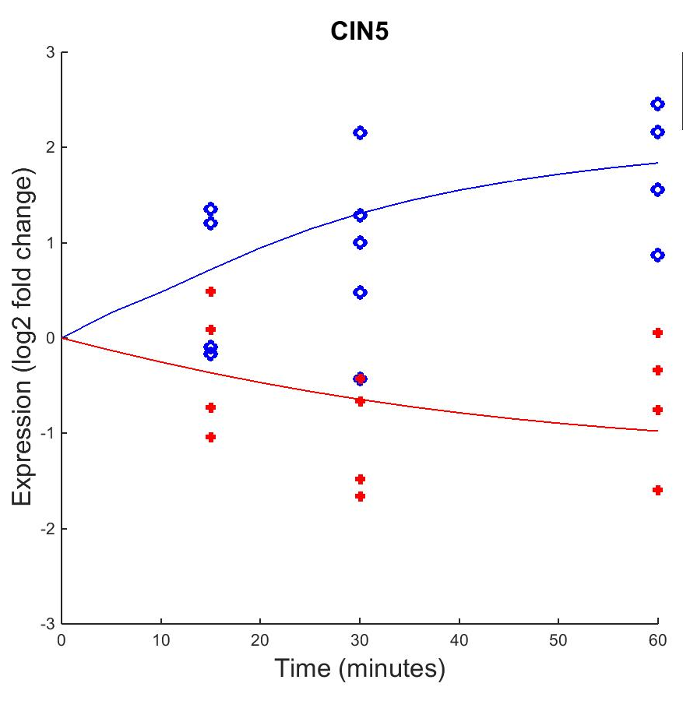

S. cerevisiae and S. paradoxus appear to have opposite dynamics in CIN5.
Fixed B
Estimated B
Notes:
- S. cerevisiae may depend on CIN5’s presence in the cell; CIN5 may be essential to dealing with cold shock in S. cerevisiae

Slide 18
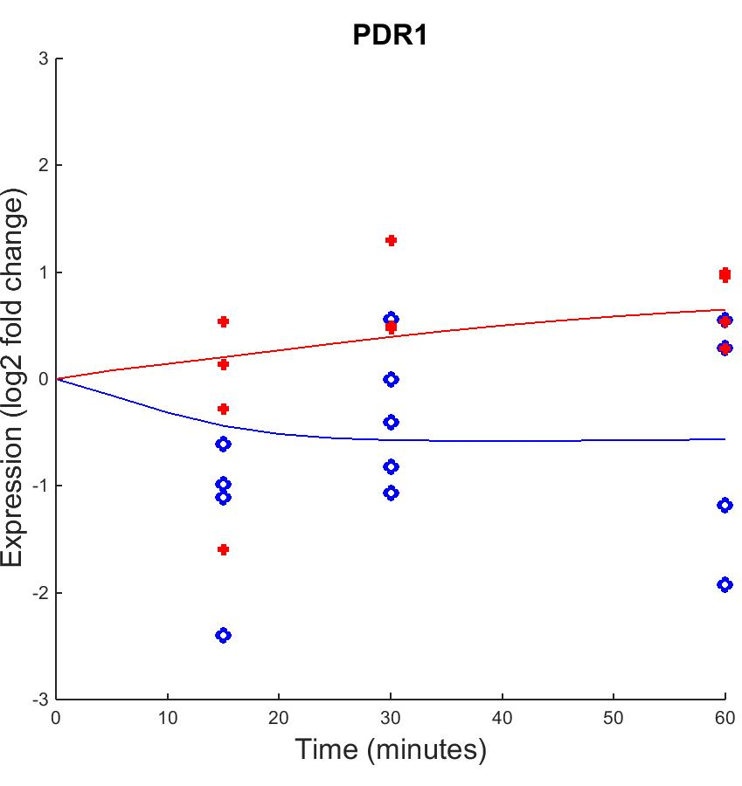
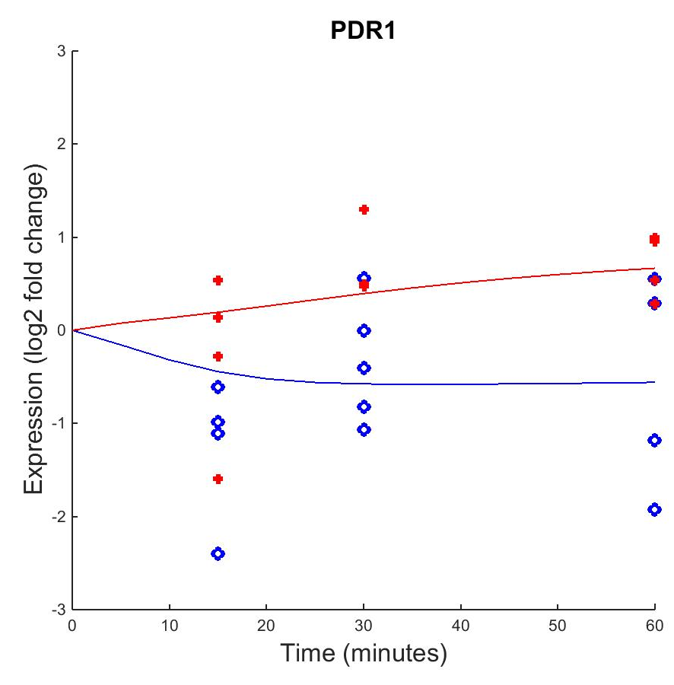
PDR1 is down-regulated in S. cerevisiae compared to its up-regulation in S. paradoxus.
Fixed B
Estimated B
Notes:
- PDR1 has more influence in S. paradoxus and its survival in the cold than in S. cerevisiae

Slide 19
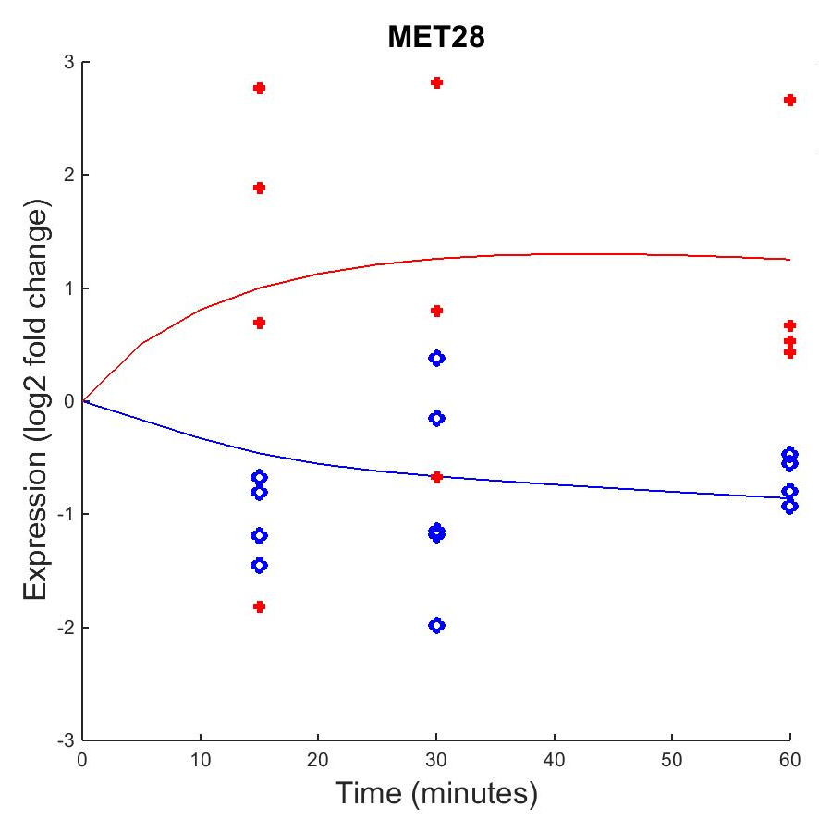
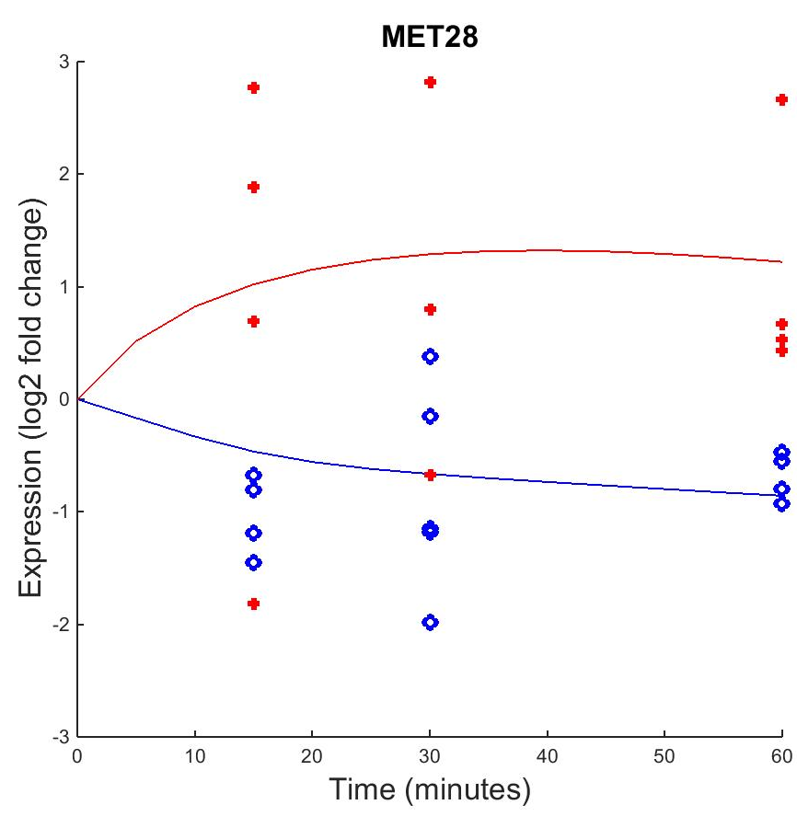
MET28 is up-regulated during cold shock in S. paradoxus and down regulated in S. cerevisiae.
Fixed B
Estimated B
Notes:
- MET28 could have a central role in gene regulation in S. paradoxus and how it copes with cold shock

Slide 20
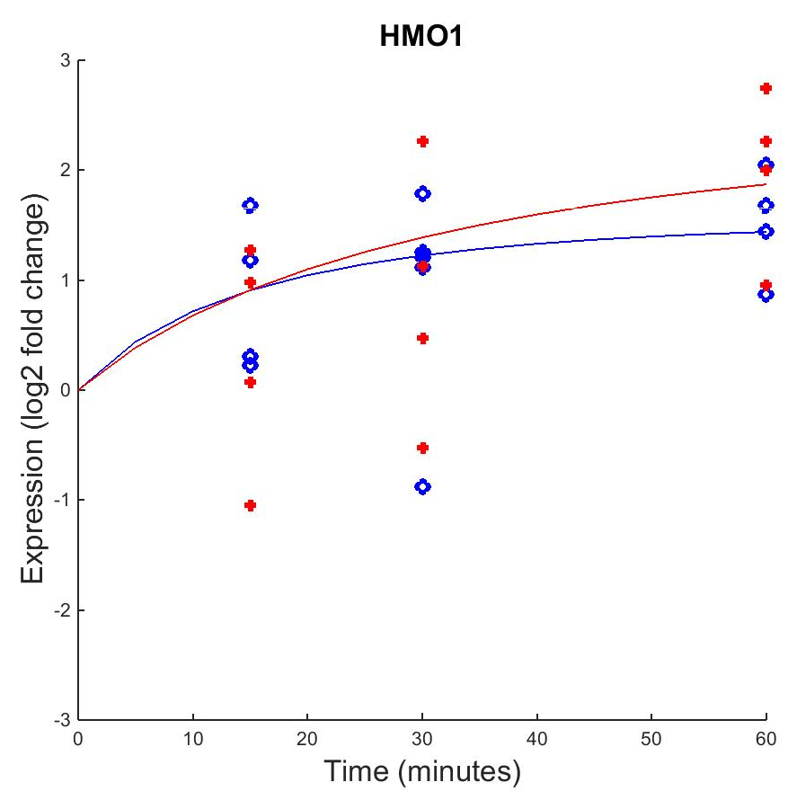

The dynamics of both species showed significant changes.
Fixed B
Estimated B
Notes:
- HMO1 is highly connected in the GRN and regulates around 5 – 8 other genes; hence it would be heavily up-regulated

Slide 21
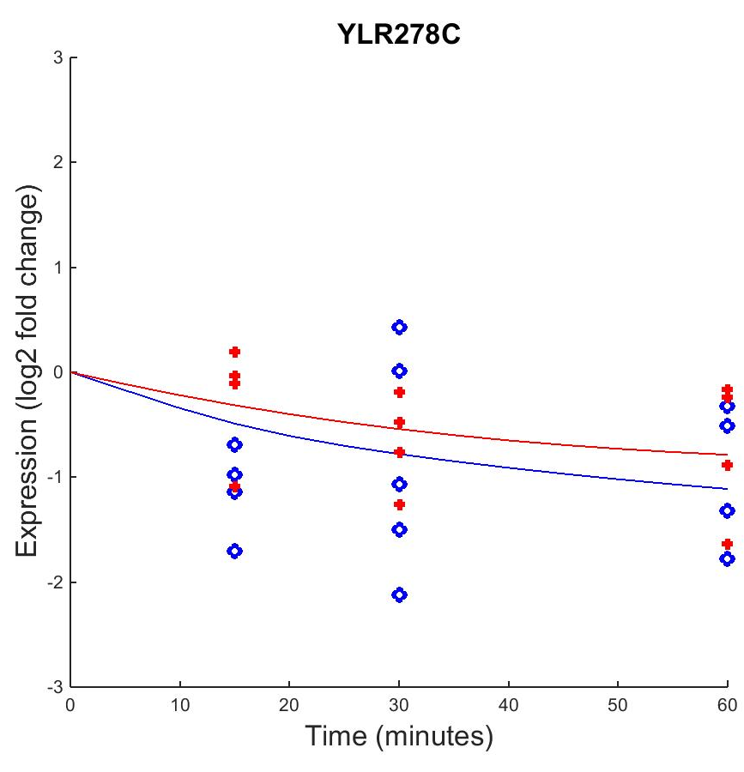

YLR278C saw significant down regulation compared to its original expression level.
Fixed B
Estimated B
Notes:
- Receives down-regulation cues from INO4 and MSN2 which both have a lot of influence on other genes in the network

Slide 22
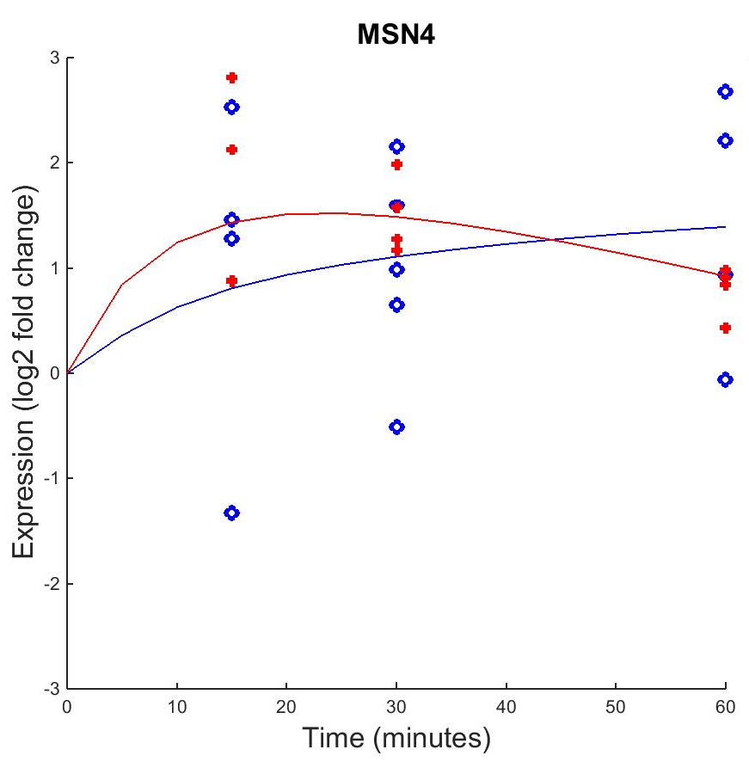

The dynamics seem to change more for S. paradoxus compared to S. cerevisiae’s steady up-regulation.
Fixed B
Estimated B
Notes:
- In S. paradoxus it may not be needed as heavily as it is needed in S. cerevisiae

Slide 23
Outline
We were tasked with modeling the dynamics of the wild-type of S. cerevisiae and S. paradoxus.
The percentage of genes that changed significantly in the wild-type of S. cerevisiae were higher than S. paradoxus.
MATLAB results exemplify the differing responses each strain has to cold shock
  Worst Fit
  Opposite curves for S. cerevisiae and S. paradoxus
  Biggest Dynamics
Changing the threshold value did not significantly alter the outputs of the graphs
  Optimized Weights
  Production Rates
Future directions and Final implications

Slide 24
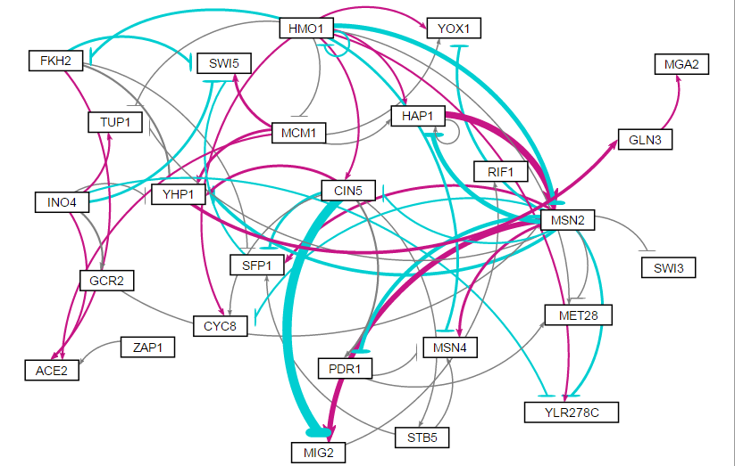
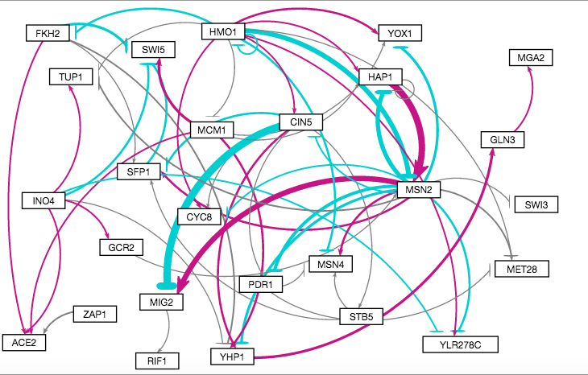
Little difference was seen in the visualization of the GRN with fixed and then estimated b values.
Fixed b
Estimated b
Notes:
Colors are the same
Thickness of the lines are also the same, therefore, b values did not make a difference

Slide 25
There was little difference in optimized weight parameters when b was estimated or fixed.

Slide 26
There was little differences seen among the various production rates that were estimated under the conditions of “b” being fixed values vs. estimated values.

Slide 27
Outline
We were tasked with modeling the dynamics of the wild-type of S. cerevisiae and S. paradoxus.
The percentage of genes that changed significantly in the wild-type of S. cerevisiae were higher than S. paradoxus.
MATLAB results exemplify the differing responses each strain has to cold shock
  Worst Fit
  Opposite curves for S. cerevisiae and S. paradoxus
  Biggest Dynamics
Changing the threshold value did not significantly alter the outputs of the graphs
  Optimized Weights
  Production Rates
Future directions and Final implications

Slide 28
From the visualized GRN, there are three major regulators in the network.
HMO1, INO4, and MSN2
Future studies: Test this constructed GRN by deleting the above transcription factors to look at the dynamics of the model
Learn more about the transcription factors that seem to have opposite dynamics, like CIN5 or MET28

Slide 29
A summary of the analysis of modeling the dynamics of S. cerevisiae and S. paradoxus and their response to cold shock
A medium-scale GRN was constructed from Profile #45 to model the dynamics of two species of yeast induced to cold shock
Some of the genes in S. cerevisiae and S. paradoxus had inverted dynamics of each other
  Some genes have more influence in the GRN depending on the strain
Estimation of b did not have a significant affect on the outputs of the model
There seemed to be three major regulators in the GRN

Slide 30
Acknowledgments
Dr. Kam Dahlquist
Dr. Ben Fitpatrick
WT S. cerevisiae data analysis from Karina Alvarez & Grace Johnson

Slide 31
References
Dahlquist, Kam., Fitzpatrick, Ben., Camacho, Erika., Entzminger, Stephanie., Wanner, Nathan. (2015). Parameter estimation for gene regulatory networks from microarray data: cold shock response in Saccharomyces cerevisiae. Submitted.
Dário Abdulrehman, Pedro T. Monteiro, Miguel C. Teixeira, Nuno P. Mira, Artur B. Lourenço, Sandra C. dos Santos, Tânia R. Cabrito, Alexandre P. Francisco, Sara C. Madeira, Ricardo S. Aires, Arlindo L. Oliveira, Isabel Sá-Correia, Ana T. Freitas (2011). YEASTRACT: providing a programmatic access to curated transcriptional regulatory associations in Saccharomyces cerevisiae through a web services interface Nucl. Acids Res., 39: D136-D140, Oxford University Press.
Freeman, S. (2002). Biological science (First ed.). Prentice Hall.

