Slide 1
SynBioLGDB: a resource for experimentally validated logic gates in synthetic biology
20.385 Spring 2015 Ellie Laukaitis

Slide 2
SynBioLGDB is an accessible, comprehensive resource for understanding and using logic gates.
Collection of logic gates curated from papers
Included information: type, authors, input/output category, species, method of validation…
Search by keyword, gate category, sequence
Notes:
The authors of the paper are presenting SynBioLGDB, which they bill as an accessible, comprehensive resource for understanding and using logic gates.
DB includes eight types of logic gates curated from published research
For each gate, lots of information is provided…
Users can look up a logic gate by keyword, gate category, or sequence of the gene, protein or promoter of interest.

Slide 3
Why?
Comprehensive collection of experimentally validated parts
Similar to iGEM Registry: database of parts that have been proven successful
Simplifies development of novel gene networks
Notes:
WHY?
Driving motivation for creating the database is information accessibility.
Database is a comprehensive collection of logic gates that have been validated in published works
Database is similar to the iGEM registry in that it compiles parts from other experiments to make them accessible to other users
In general, the database is intended as a great resource for researchers who seek to develop novel gene networks because they won’t have to try to develop each new part on their own → also less likely to miss options because all published logic gates will be compiled in one place

Slide 4
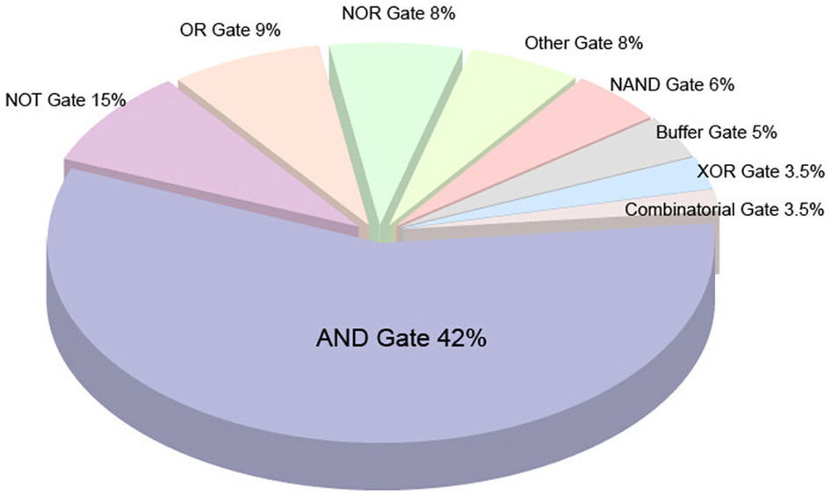
SynBioLGDB today
Original site: 189 documented logic gates
Today: 189 documented logic gates
Notes:
Original site at the time of submission in October contained 189 parts
Site today documents….189 logic gates across three species: human, E. coli, Bacillus clausii

Slide 5
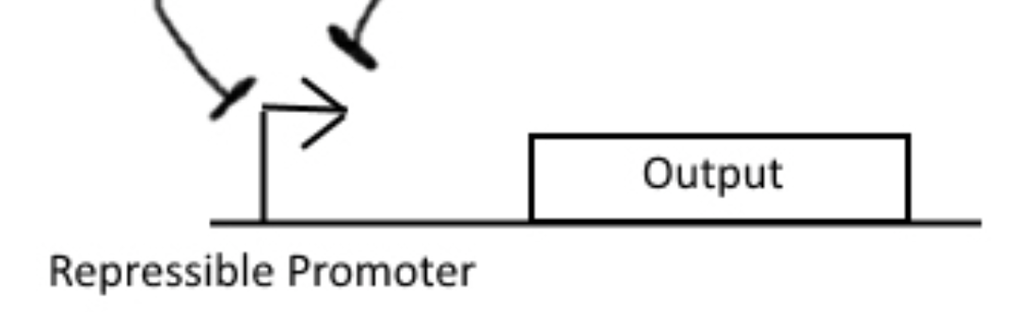
How useful is it?
Example - 20.020 Human Health team: NOR
http://www.bioinformatics.ac.cn/synbiolgdb/index.html
Notes:
To test how useful the database is, use Human Health group’s logic gate:
Want: NOR gate, outputting GFP → presence of either signal S1 or S2 represses promoter and doesn’t produce fluorescence.
FIND: almost exclusively E. coli, varying levels of information for each gate….eg. “A”, “B” vs. full sequence → no standardization
For some, have to have some background in genetic engineering to understand how to assemble logic gates. For some, I don’t know if they would be of use to the 20.020 team because they aren’t well described.

Slide 6
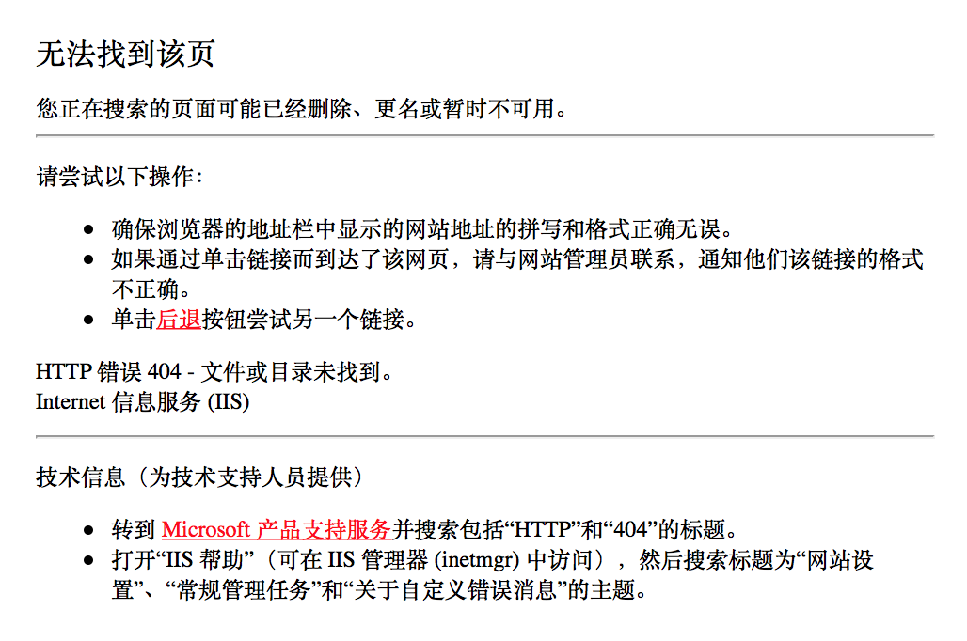
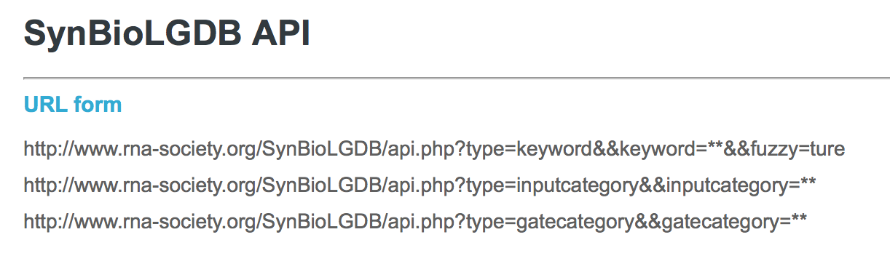
Concerns
Website issues…
Material review?
Up-to-date?
Long-term database monitoring?
Is it thorough enough?
Is this useful for design?
Is this a sensible model?
Notes:
CONCERNS
Will material be adequately reviewed before it’s published on the website? Logic gates taken from PubMed papers → authors can submit their own, but must include a PubMed ID for their work.
How often is the database updated, and how long does it take for material to be added?
Are posts reviewed after they are initially posted → do the authors monitor retractions or papers that update the existing gates?
Some website issues, including typos in API links (“true” = “ture”), and links taking to Chinese 404 pages
Includes other types of logic gates → RNA-based, etc.?
Only 1 gate with Bacillus clausii, 12 with human → don’t cover all categories. How relevant are they?
Is this useful for design? Evidence from 20.020 team example.
Is this a reliable, smart way to build a database → manually curating papers based on keywords?

Slide 7
Assumptions – things of note
Repeated analogy:
synthetic biology : electronic engineering
Same group:
MNDR – mammalian ncRNA diseases
ViRBase – virus-host ncRNA interactions
RAID – RNA association interactions

Slide 8
Wang L, Qian K, Huang Y, Jin N, Lai H, Zhang T, Li C, Zhang C, Bi X, Wang C, Wu H, Tan P, Lu J, Chen L, Li K, Li X, Wang D. Scientific Reports 2015, 5:8090. doi: 10.1038/srep08090

