Slide 1
Integrin-EGFR
Cross-Activation
Elizabeth Brooks
Department of Chemical Engineering
University of Massachusetts, Amherst
Peyton Lab Group Meeting
December 14, 2015

Slide 2
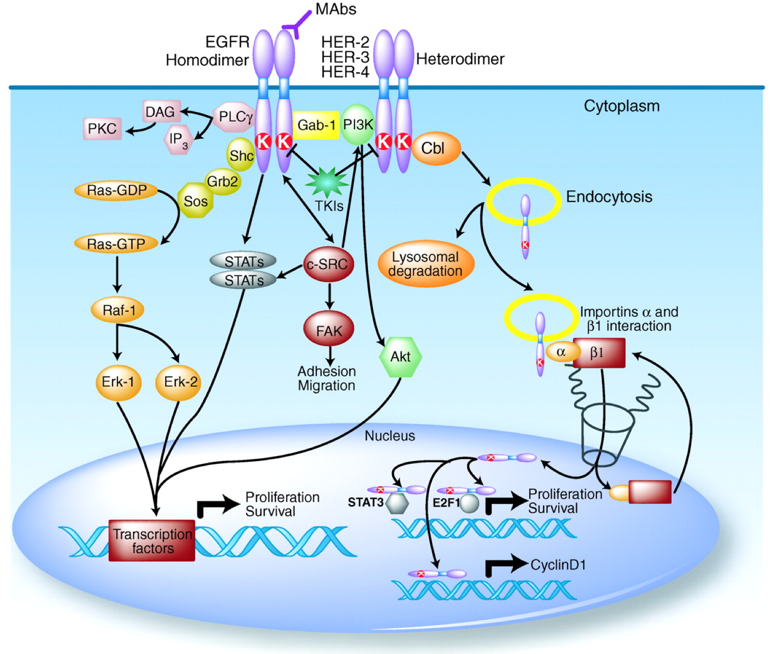
EGFR Signaling
EGFR is in a receptor tyrosine kinase in the same family as HER2
Activated by binding of EGF and TGF-α
  Becomes an active homodimer
  May also form a heterodimer with other members of the ERBB family
The dimerization of EGFR results in autophosphroylation and downstream signaling pathways are activated
  MAPK
  Akt
  JNK
  Important in cell migration, adhesion, and proliferation---integrins are also involved in these processes
Scaltriti et al., Clinical Cancer Research, 2006

Slide 3
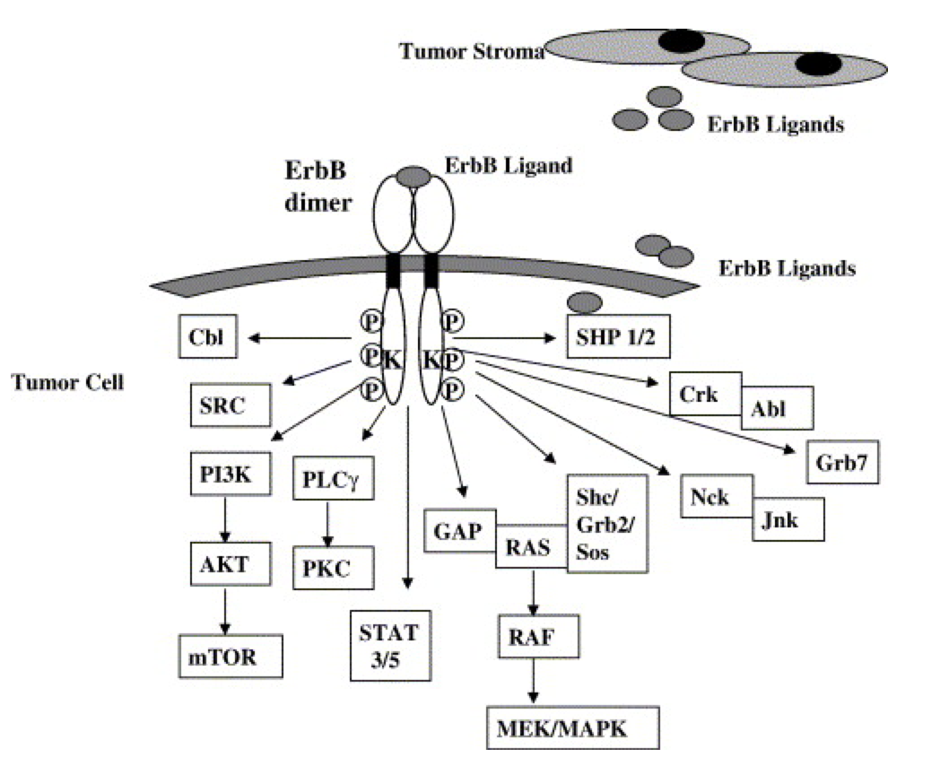
The role of EGFR in Cancer
EGFR is overexpressed in many cancers
Overexpression of EGFR in breast cancer is associated with poor clinical outcomes
EGFR inhibitors have been developed with limited clinical success
Normanno et al., Gene, 2005

Slide 4
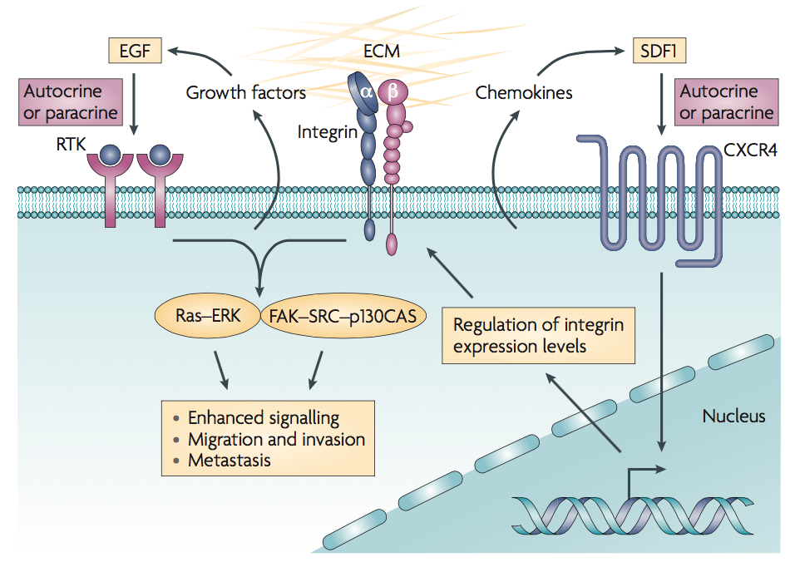
Integrin-EGFR cross-activation
Desgrosellier et al., Nature Reviews, 2010

Slide 5
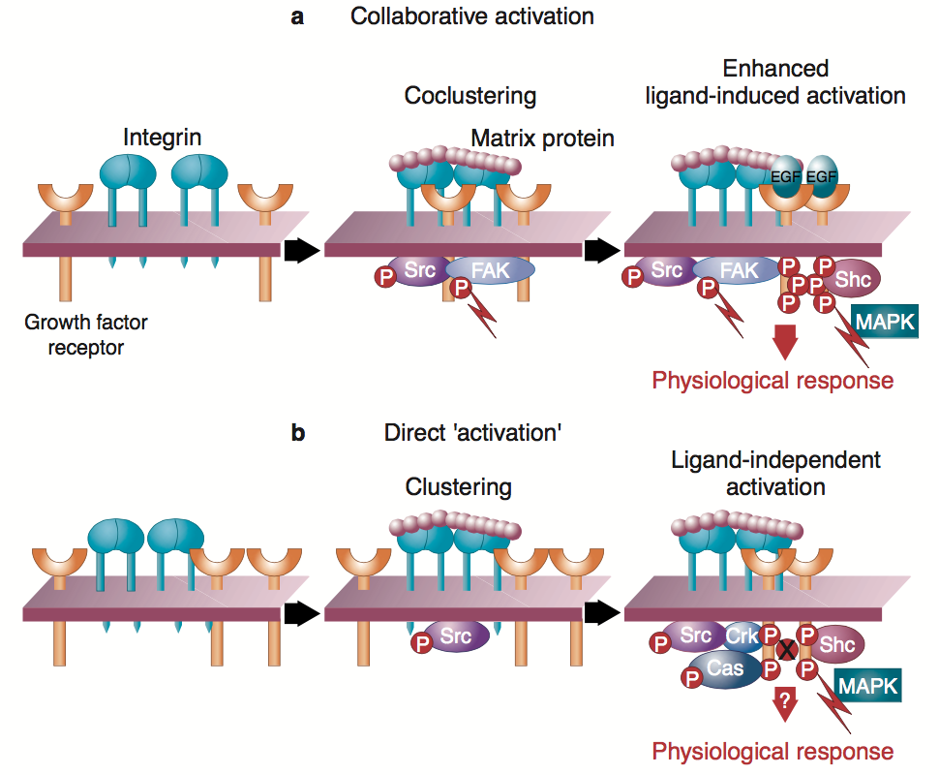
Integrin-EGFR cross-activation
Clustering is induced by matrix proteins followed by phosphorylation of FAK
Binding of a growth factor ligand is necessary for MAPK signaling
Integrins induce tyrosine phosphorylation of a growth factor receptor through a Src-dependent pathway that is different from typical ligand binding
Integrins can directly phosphorylate growth factor receptors
Not at the typical phosphorylation site of EGF, instead for other sites are phosphorylated for MAPK signaling
Schwartz et al., Curr. Opin. Cell Biol. 1999; Yamada, K. M. et al., Humana Press, 2000; Moro, L. et al. J. Biol. Chem., 2002;
Miyamoto, S. et al., Cell Biol., 1996; Sundberg, C. et al., Cell Biol., 1996; Wang, R. et al., PNAS, 1996; Moro, L. et al., EMBO J.,1998; Wang, J. F., Zhang, X. F. et al., J. Biol. Chem., 2001; Danilkovitch-Miagkova, A. et al., J. Biol. Chem., 2000.

Slide 6
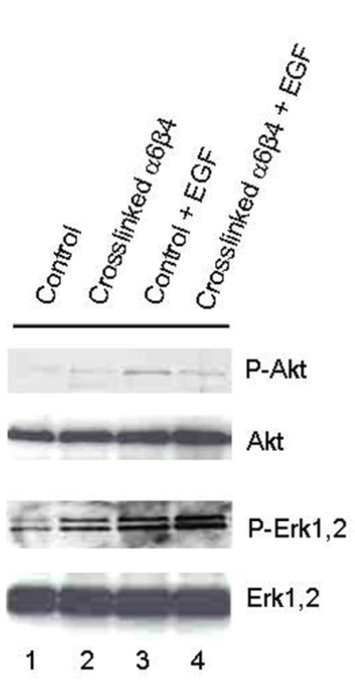
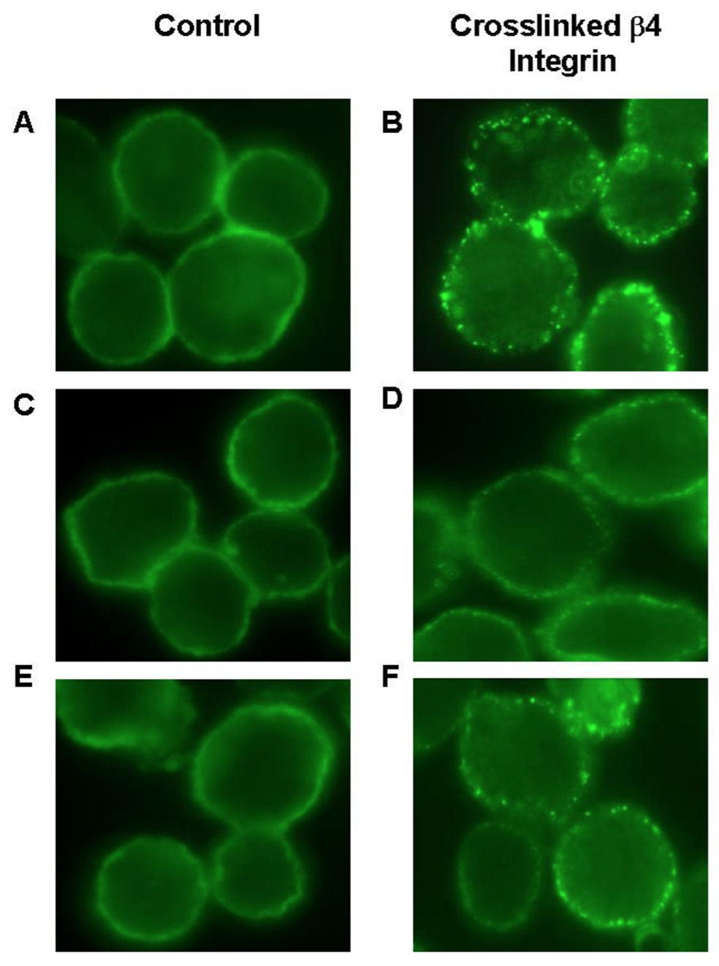
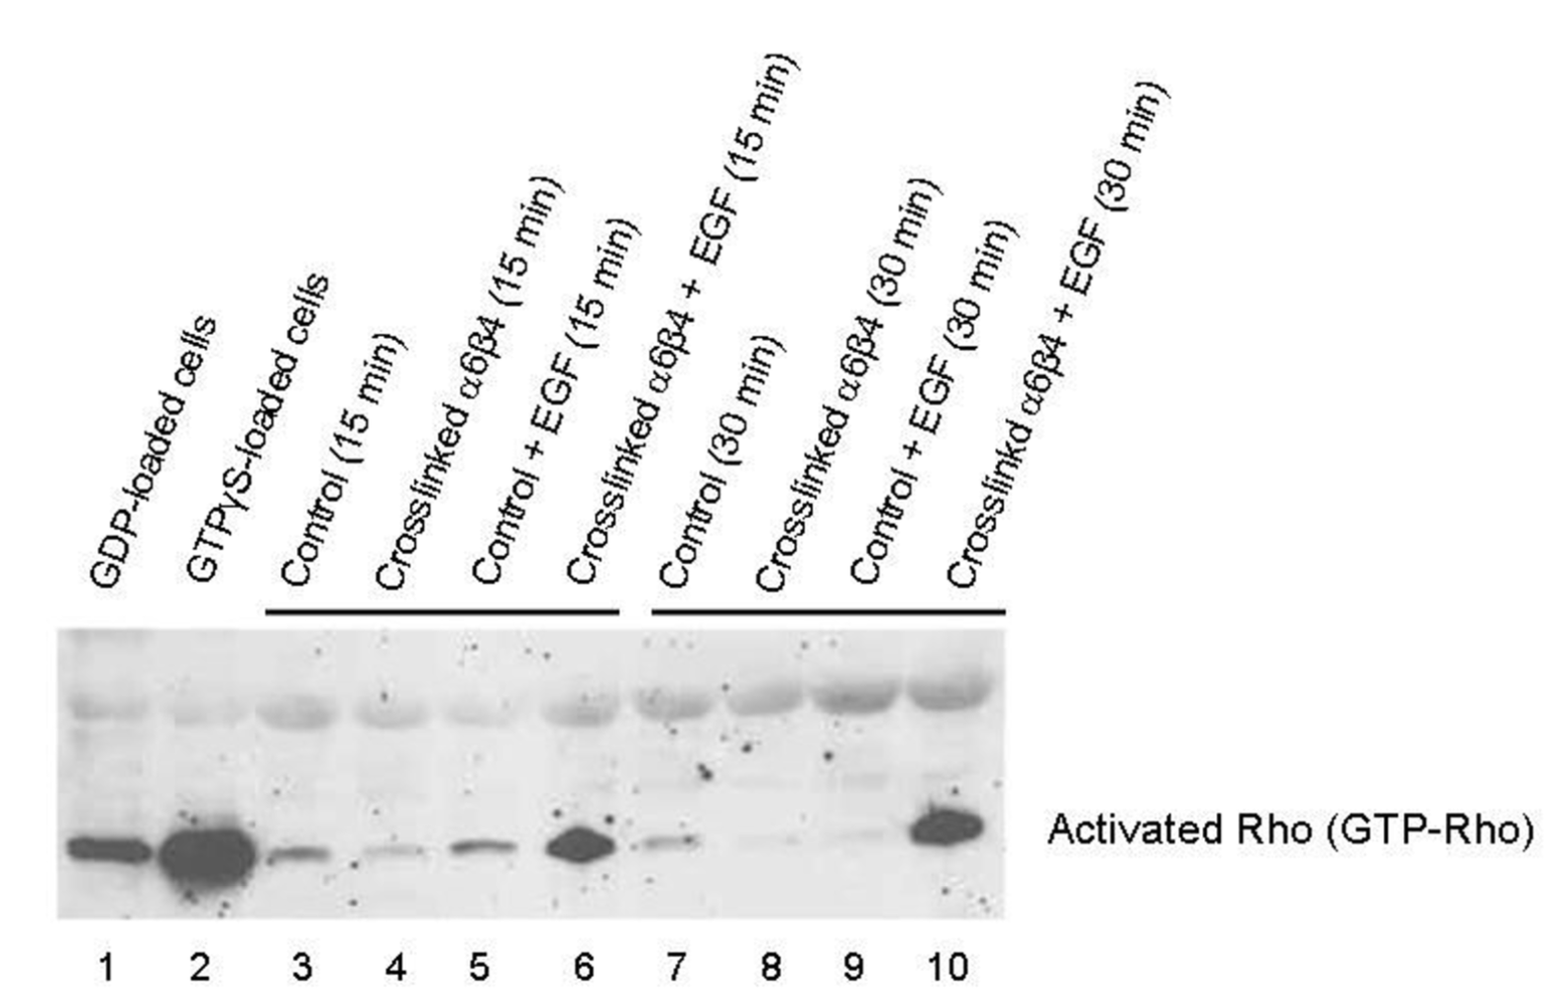
α6β4 crosslinking induces EGFR clustering in breast cancer cells
Adhesion-independent cross linking of α6β4 induces EGFR clustering and function in MDA-MB-231 cells
Hypothesized that α6β4-induced EGFR clustering augments particular tumor cell responses to EGF
EGFR clustering has limited effects on pAkt and pERK1,2 in response to EGF
EGFR clustering does have an effect on Rho activation response to EGF
  This integrin-EGFR crosstalk may affect cytoskeleton rearrangements important for tumor progression
Gilcrease et al., Experimental & Clinical Cancer Research, 2009

Slide 7
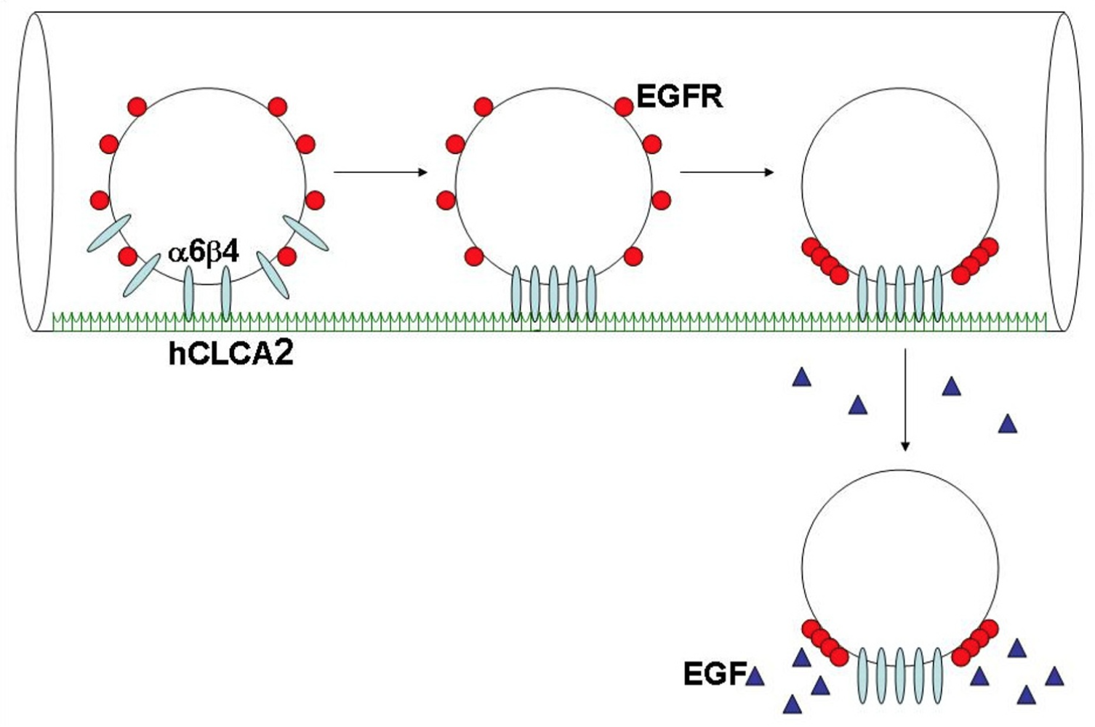
Hypothetical model for integrin-induced EGFR clustering for cancer progression
Circulating cancer cells bind to endothelial hCLCA2 (found in the lung, thinking about α6β4 binding to laminin)
Crosslinking of α6β4 induces EGFR clustering
This enhances EGF-mediated activation of Rho
Therefore, clustered EGFR might direct cell movement towards EGF in adjacent tissue
Gilcrease et al., Experimental & Clinical Cancer Research, 2009
Notes:
Thinking about Alyssa’s project: flow cells over 3D hydrogel that contains integrin binding sites. Test with and without EGF in the media or put EGFR in the hydrogels and see if cells invade into the 3D hydrogel.

Slide 8
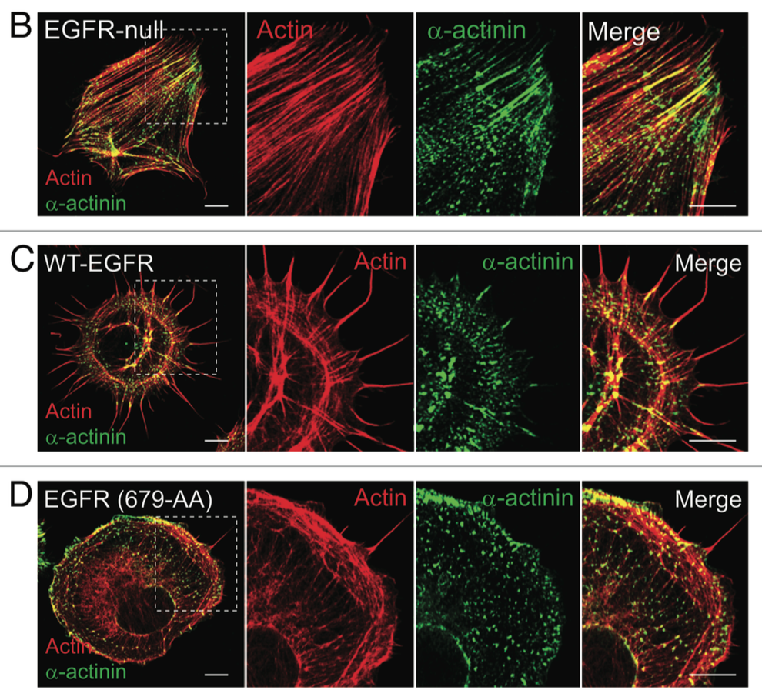
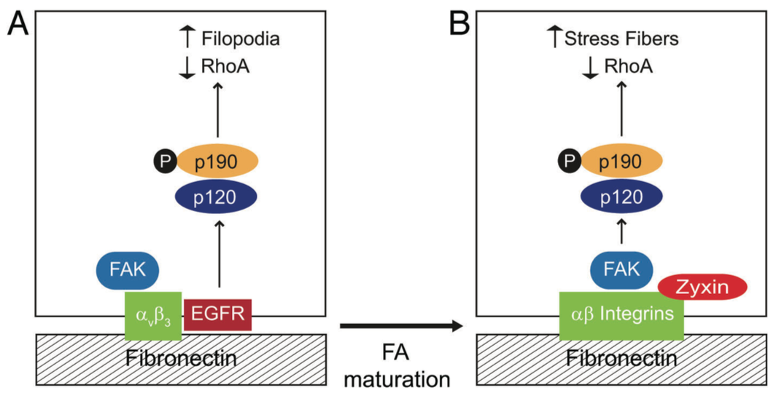
Cross-talk between fibronectin integrins and EGFR
EGFR is compartmentalized to immature focal adhesions
Zyxin is found at more mature focal adhesions without the presence of EGFR
EGFR modulates α-actin in distribution
EGFR null cells form vertical stress fibers
WT-EGFR cells form filopodial extensions
Balanis et al., Cellular Logistics, 2012

Slide 9
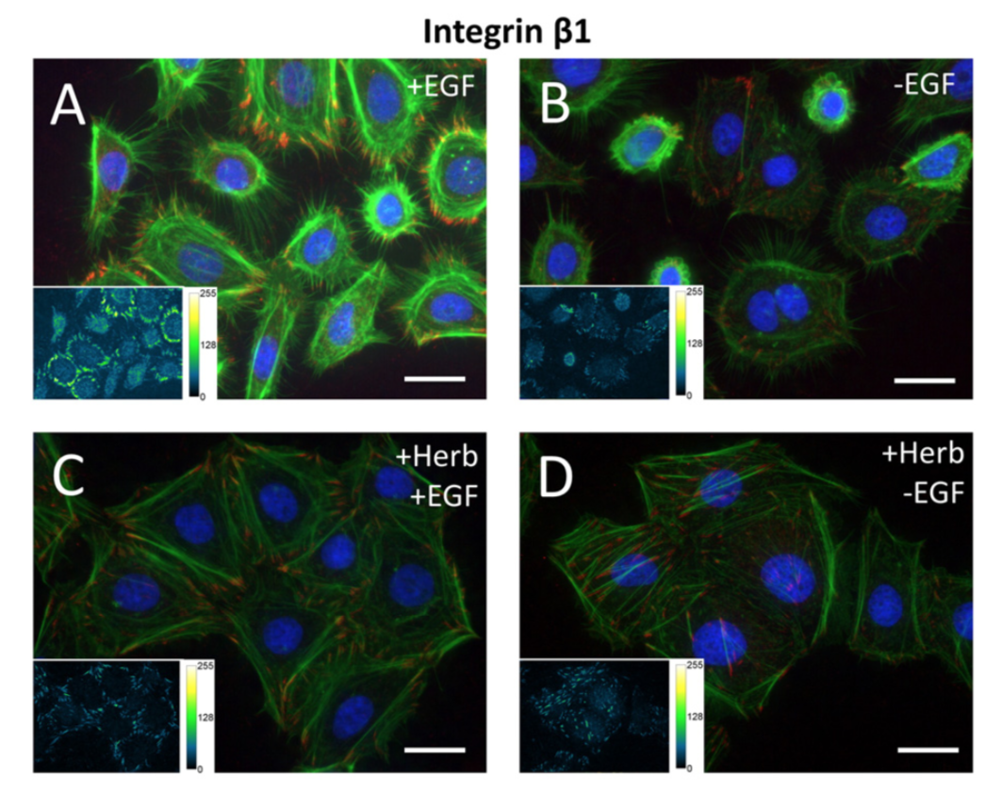
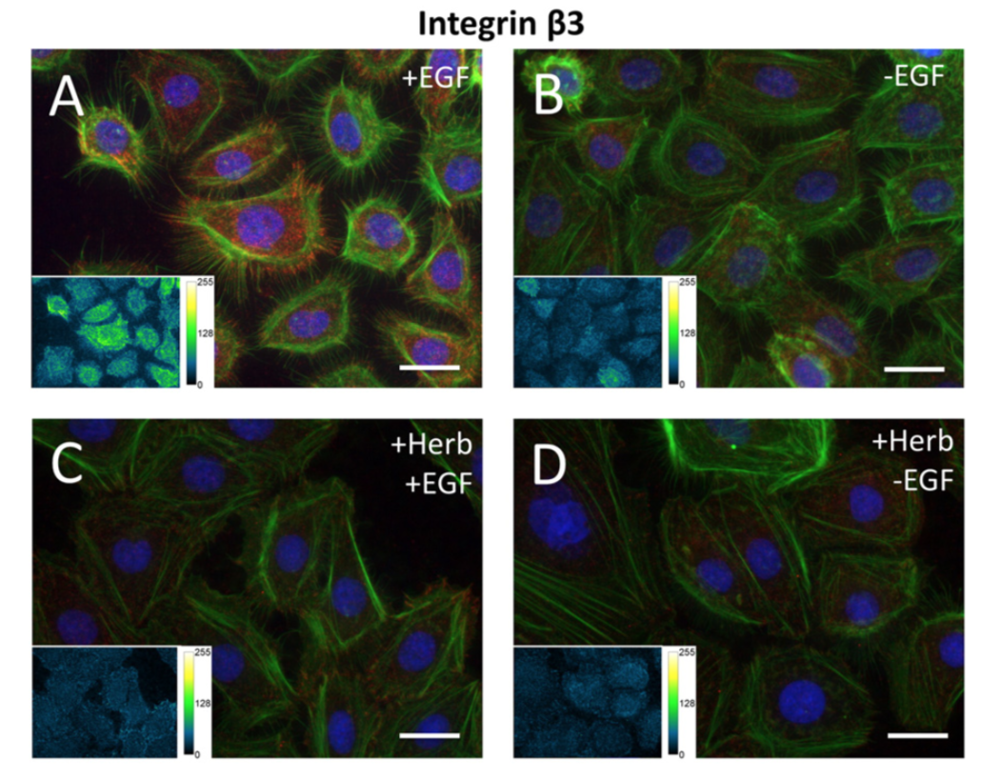
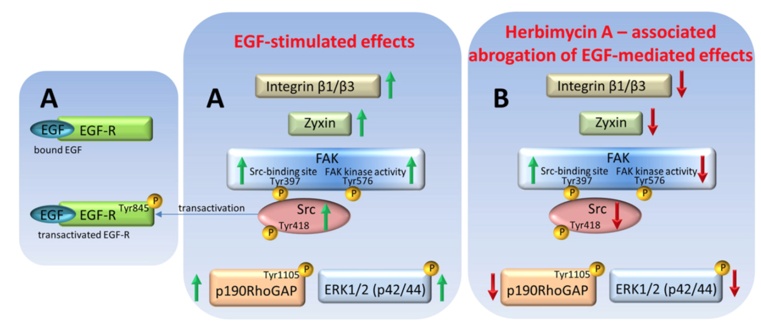
The impact of integrin-EGFR cross talk on focal adhesions
Eberwein et al., Biochimica et Biophysica Acta, 2015

Slide 10
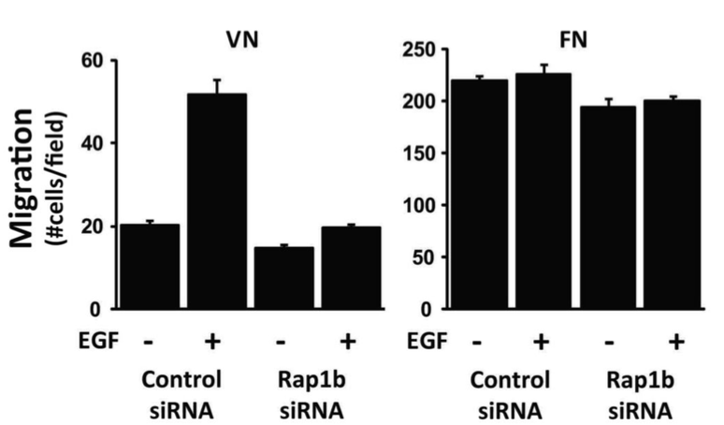
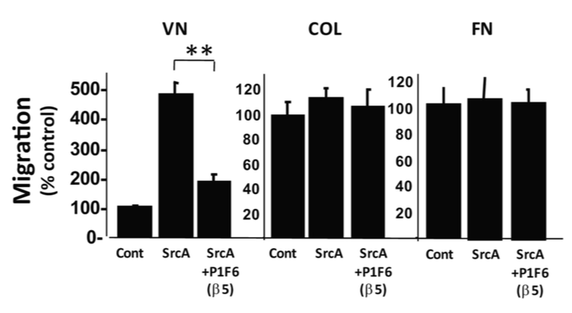
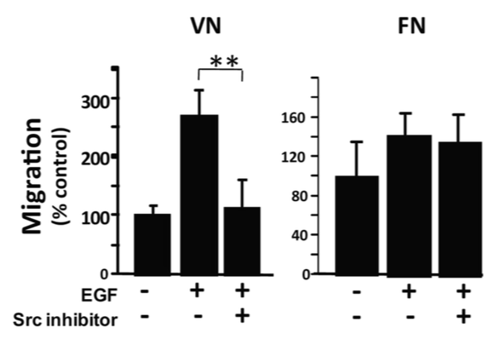
Carcinoma invasion and metastasis is promoted by specific integrin and EGFR crosstalk
EGF stimulation induces αvβ5-mediated carcinoma cell migration on vitronectin
Carcinoma cells migrate on integrin β1-mediated substrates (fibronectin or collagen) in an EGF- independent manner
Src kinase is sufficient for β5-mediated migration
Pretreatment of with a Src inhibitor blocked EGF-induced migration
Ricono et al., Cancer Research, 2009

Slide 11
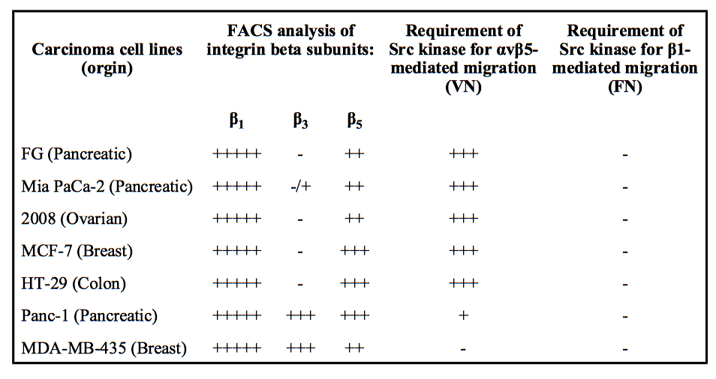
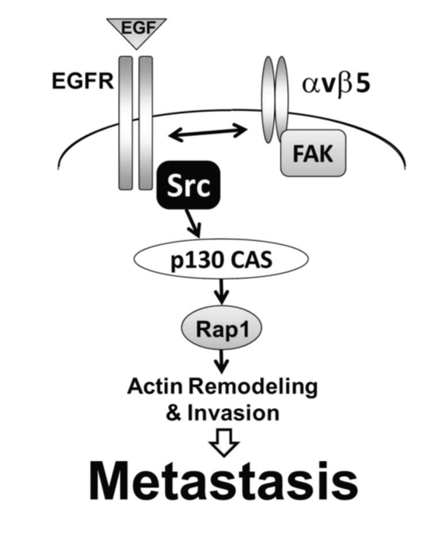
Carcinoma invasion and metastasis is promoted by specific integrin and EGFR crosstalk
Ricono et al., Cancer Research, 2009

Slide 12
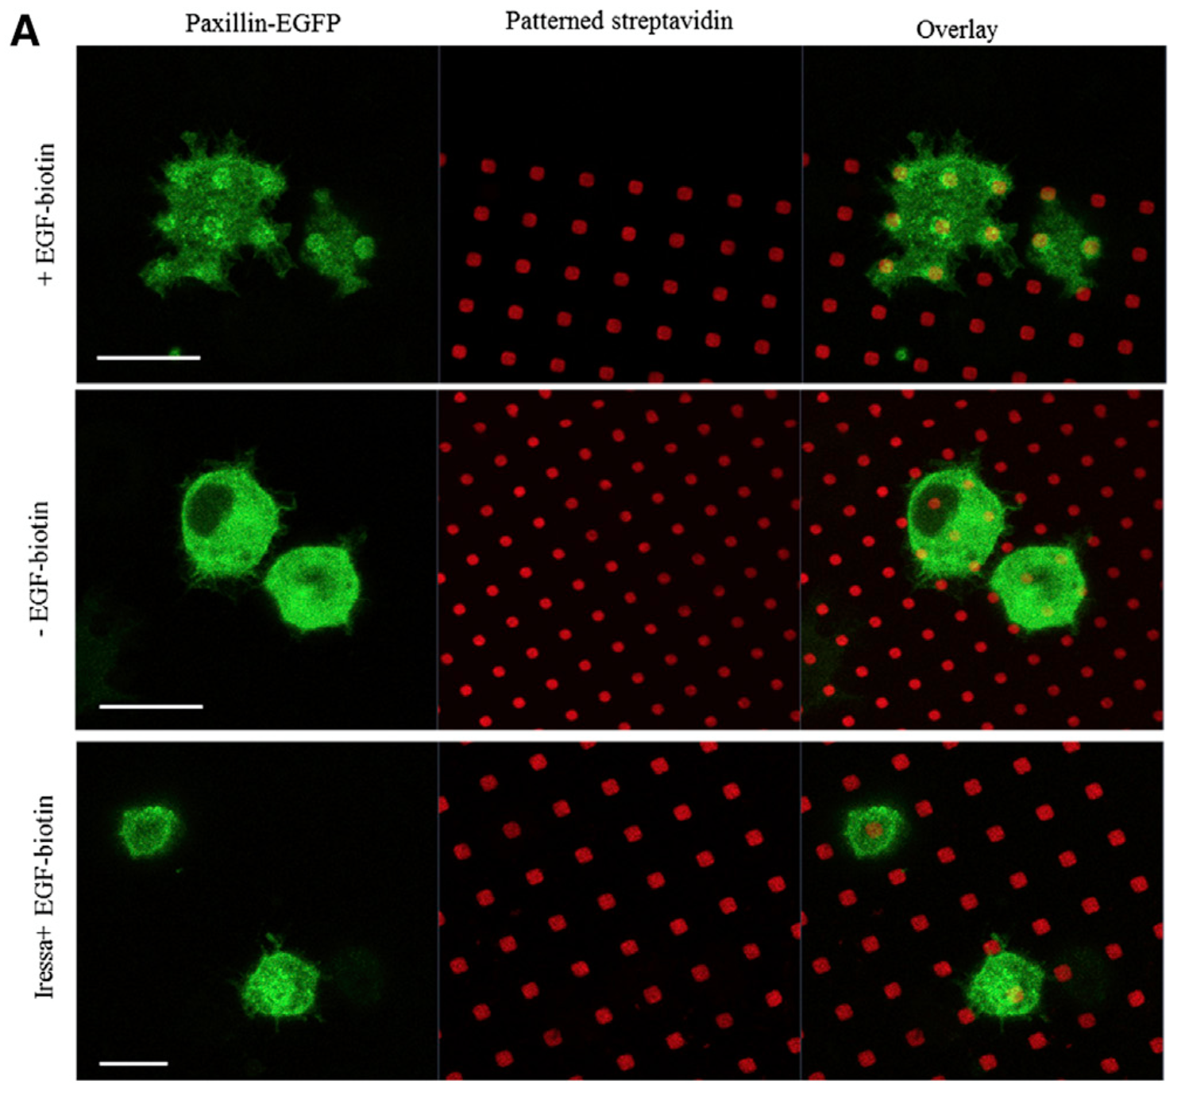
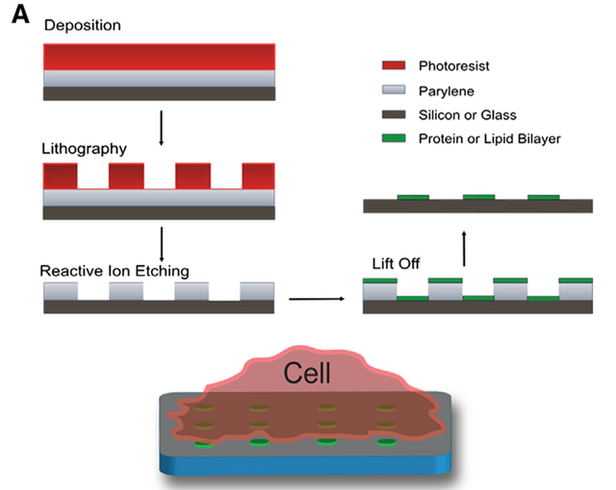
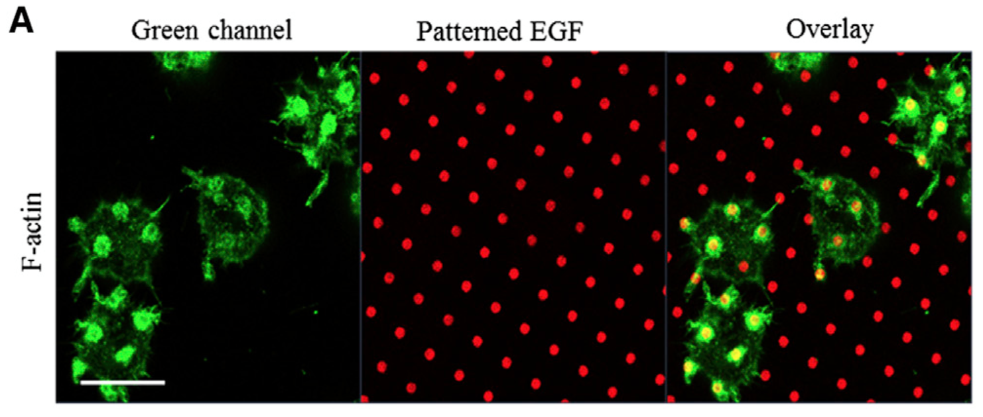
Spatially defined EGFR Activation Reveals the Role of β1
Miropatterning of EGF on surface
Paxillin is recruited to EGF patterns in a ligand dependent manner
F-actin coredistributes with EGFR at the plasma membrane
Singhai et al., Biophysical Journal, 2014
Notes:
Thinking about Sam’s project: understand the impact of growth factors and integrins in a spatially controlled fashion

Slide 13
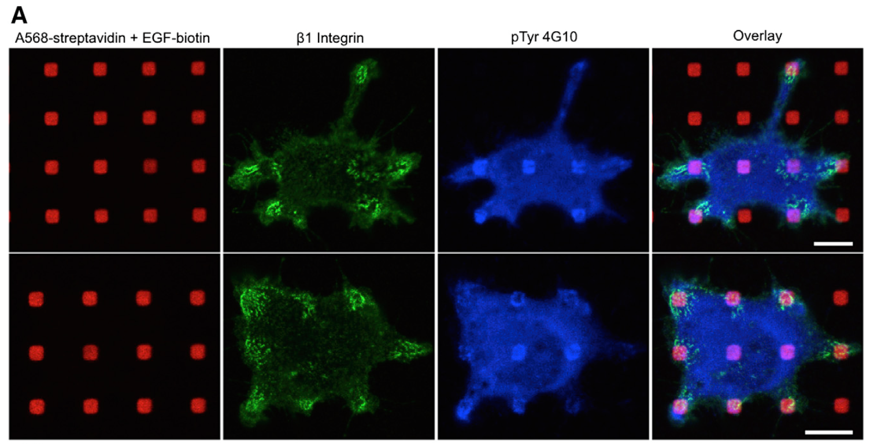
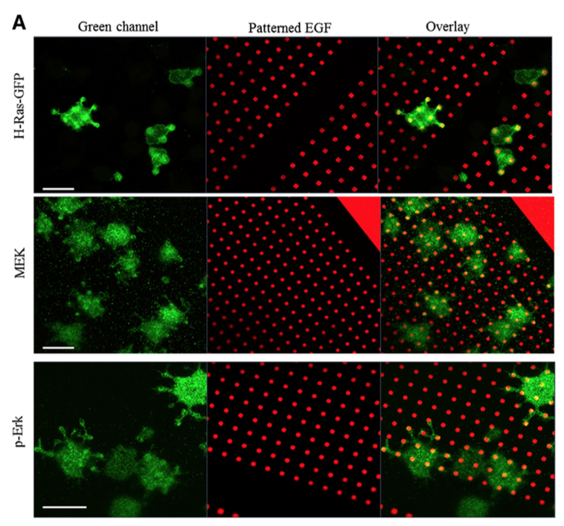
Spatially defined EGFR Activation Reveals the Role of β1
β1 containing integrins are localized to pattern-recruited EGFR signaling complexes
Higher concentrations are found at peripheral EGF patterned features
Ras, MEK, and pErk coredistribute with EGFR signaling complexes at the plasma membrane.
Singhai et al., Biophysical Journal, 2014

Slide 14
Conclusions
Integrin-EGFR cross-talk can enhance the effects signaling pathways
Integrins can activate growth factor receptor binding in the absence of a growth factor ligand
Integrin-EGFR cross-talk plays an important role in focal adhesions
Integrin-EGFR cross-activation does not occur with all integrins and depends on cell type

Slide 15
Future directions and unanswered questions
Does integrin-mediated or ligand independent phosphorylation of EGF produce unique biological effects?
In our model systems it is important to consider that growth factors and integrins could be working together
What types of integrin/growth factor receptor interactions may be worth focusing on?

