Slide 1
Using Image J Kymograph
Or go to: http://www.embl.de/eamnet/downloads/kymograph/kymograph_description.pdf

Slide 2
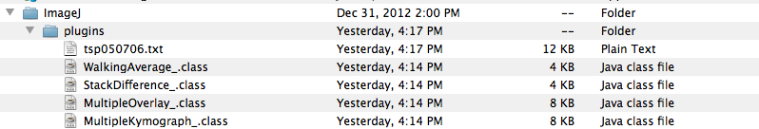
Getting started
Go to: http://www.embl.de/eamnet/html/body_kymograph.html
Download three plugins & macro
Add the files to ImageJ plugins folder (drag/drop)

Slide 3
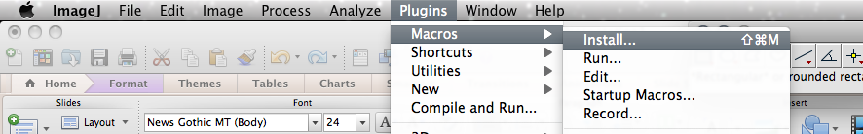
Install Macro (don’t need to specify)
And you’re done!

Slide 4
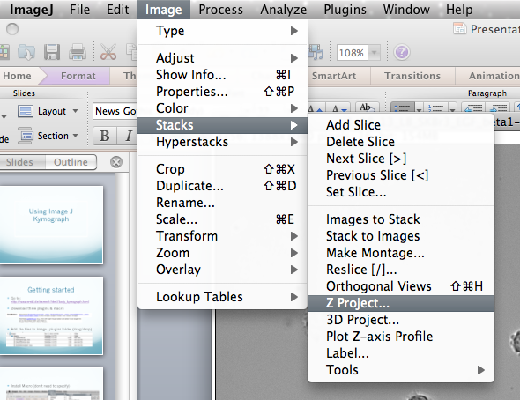
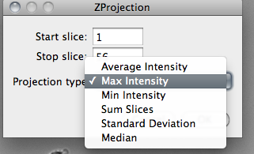
Using Kymograph
Load file normally
Create z-projection image
Image > Stack > Z project
Select average or max
You can also set the slices you make this from (does not affect final output

Slide 5
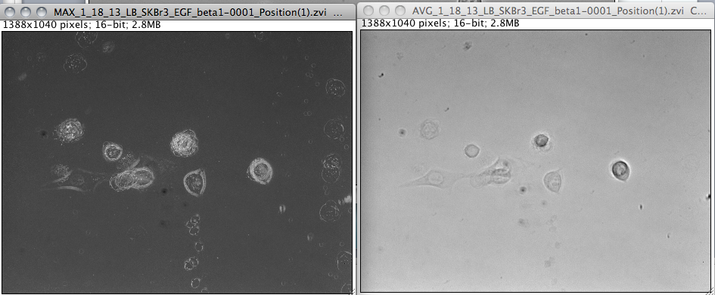
Max intensity vs. average (I prefer max, but it’s not important)

Slide 6
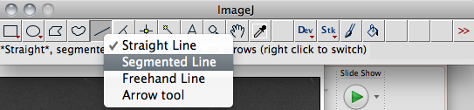
Select segmented line in toolbar

Slide 7
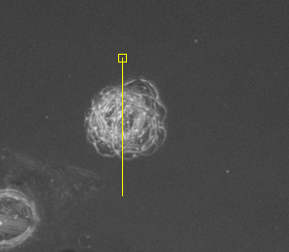
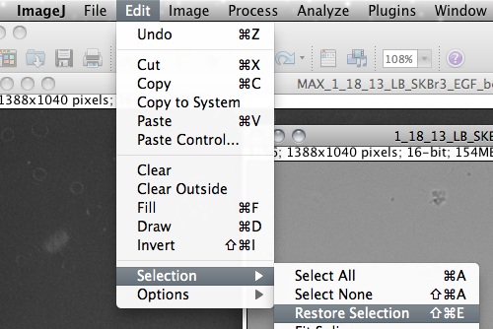
Draw segmented line through cell in z-projection
(you have to click the box to stop the line segment selection)
Go to original window (or re-open the file)
With original window selected go to Edit > Selection > Restore Selection

Slide 8
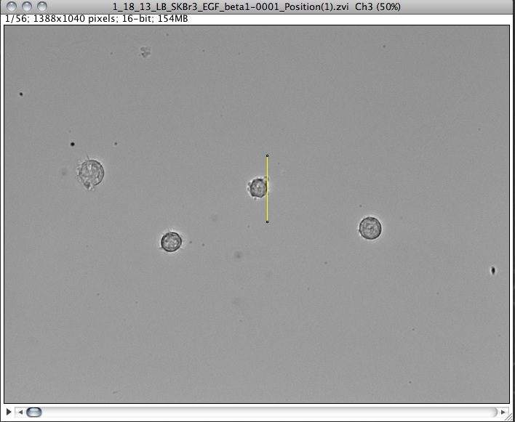
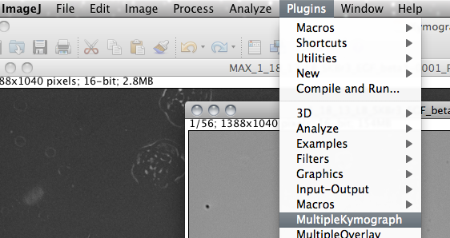
Should look something like this: (the line may not run through the center of the cell)
Now go to Plugins > MultipleKymograph
Make sure to save!

Slide 9
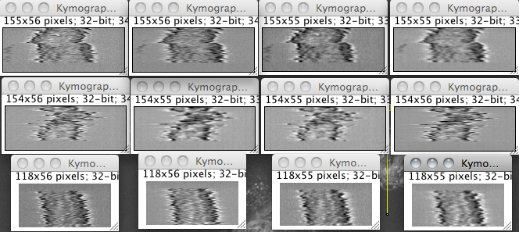
Changing settings
You can change line width, and also do Walking Average(must do to stack image, not z-projection, before generating kymograph). Original Line Width = 5 Walking Average = 2 Both

Slide 10
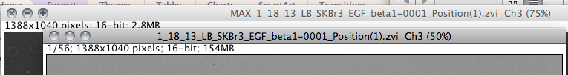
Notes
You should also save-as the z-project image after making each line selection to save where you selected the line. This saves a new tiff with the line selection going through it. I made a new one for each cell.
You must make sure the appropriate window in imageJ is selected when doing each step, including saving!
(you can tell by shading of window. Obviously the one in front is selected in this example)

