Slide 1

Control of skin cancer by the circadian rhythm
Background presented by
Nathalie Javidi-Sharifi
Druker Lab

Slide 2

Topics we will cover:
UV Radiation and Repair
  DNA Damage
  Nucleotide Excision Repair
  What happens without NER
Circadian Clock
  The Molecular Clock
  Central and Peripheral Clocks
Regulation of NER by the Clock
NER and Chronotherapy

Slide 3
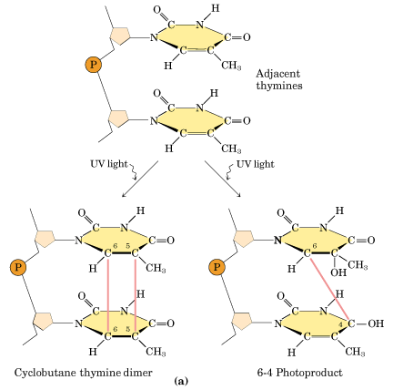
UV-Induced DNA Damage
2 major UV-induced lesions:
  Cyclobutane pyrimidine dimer (CPD)
  Pyrimidine-pyrimidone (6-4) photoproducts (6-4PP)
The potential for mutations is realized by faulty DNA replication across such lesions
Besaratinia A , Pfeifer G P Carcinogenesis 2006;27:1526-1537
Notes:
helix-distorting DNA base lesions, including the
UV-induced cyclobutane pyrimidine dimer (CPD) and
the pyrimidine–pyrimidone (6-4) photoproduct (6-
4PP)c aused by base damage
The potential for mutations is realized by faulty DNA replication across such lesions.

Slide 4
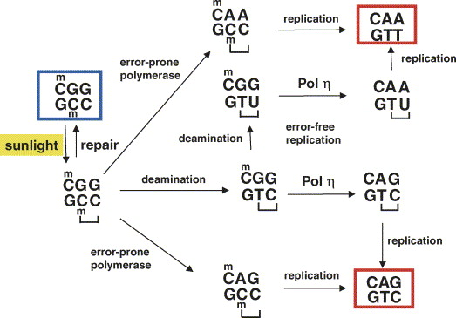
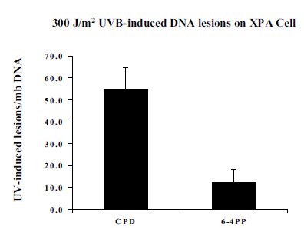
UV-Induced DNA Damage
How much damage is induced?
  55 CPD and 12 6-4PP lesions per million bases
How much is repaired?
  half of the (6–4) photoproducts are removed during the first hour after radiation (human cell line, 10 J/m²)
  CPD repair is much slower, with 50% of lesions remaining after 20h (human fibroblasts, 20 J/m²)
  Error-free lesion bypass of CPDs is >95% efficient
What kinds of mutations arise?
  CPD formation at a 5-methylcytosine
  C to T
  CC to TT
Pfeifer G P et al, Mutation Research, 2005;571:19-31
Notes:
Cell line derived from an XPA patient, NER-deficient.
CPDs forming preferentially at dipyrimidines with 5-methylcytosine CPDs (rather than 6-4 photoproducts or other lesions) are responsible for the great majority (>80%) of UVB-induced mutations. Why? high level of induction, slow repair by NER and efficient
replication bypass tolerance. Although (6–4)PPs are mutagenic when studied
as single site-specific lesions in vitro or in transfection experiments,
their direct contribution to solar UV mutagenesis in mammalian
cells is probably minor. This is because they are repaired much
more rapidly than the CPD photoproducts and because they
are induced only at very low levels.
Bypass of the CPD by an error-prone DNA polymerase could produce a C to T or CC to TT mutation. Deamination may occur within the CPD and may affect the 5-methylcytosine alone or the 5-methylcytosine and cytosine (double deamination). If the deaminated CPD is bypassed mostly error-free by DNA polymerase η, a C to T transition or CC to TT tandem transition mutation will occur. The starting sequence is marked by a blue box. The two mutated sequences, which are eventually produced, are marked by red boxes.

Slide 5
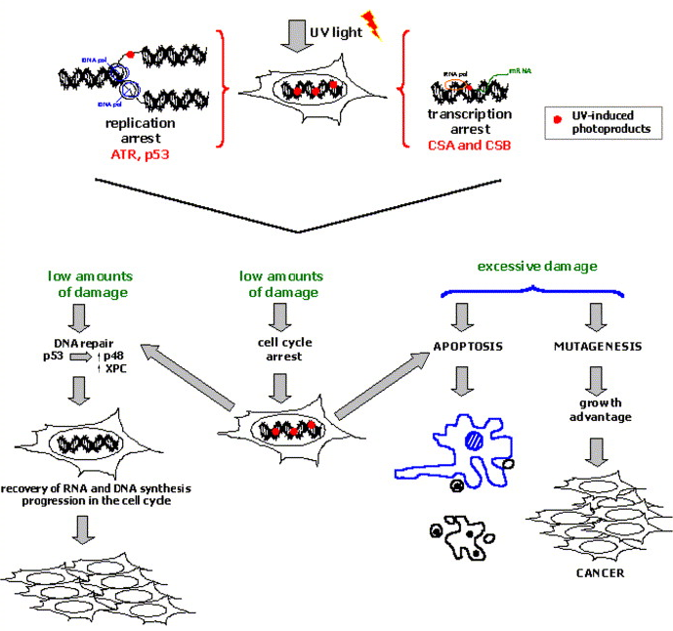
Cellular Responses to UV Damage
Blocked replication forks activate ATR and p53
Transcription arrest activates CSA and CSB
Induction of NER
Cell cycle arrest provides additional time
Excessive damage leads to apoptosis or mutagenesis
Costa M A et al, Biochemie, 2003;85:1083-1099
Notes:
Different cellular responses after detection of UV-induced photoproducts. Bulky lesions in DNA, such as CPDs and 6-4 PPs, represent a drastic physical hindrance to the progression of replication and transcription machineries. In blocked replication forks, sensors, such as ATR protein and p53, are involved in transmitting the signal of danger to other proteins in the cell. CSA and CSB proteins probably act in transcription stalled in front of lesions, recruiting TCR factors. DNA repair pathways can handle low amounts of DNA damage, what may involve p53-dependent induction of NER proteins as XPC and XPE/p48. Cell cycle arrest may provide additional time for the lesion removal. In the case of excessive genomic injury, a programmed cellular suicide (apoptosis) can protect the organism from genetic instability, leading to cell fragmentation, and phagocytosis by neighboring defense cells. When all these rescue mechanisms are not able to deal with DNA damage, persistence of lesions can be responsible for mutations, leading to genetic instability and carcinogenesis.

Slide 6
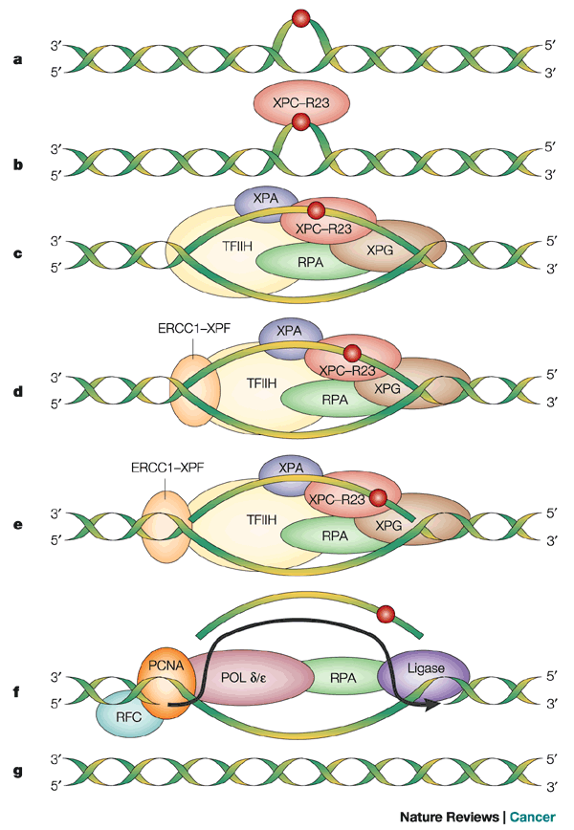
Nucleotide Excision Repair
Recognizes bulky lesions that block DNA replication (example: UV pyrimidine photodimers)
Common distortion in helix
Incision on both sides of lesion
Short patch of DNA excised, repaired by polymerization and ligation
Can be coupled to transcription (TCR, “transcription coupled repair”)
Defects in NER underlie Xeroderma pigmentosum
Notes:
a | Nucleotide excision repair (NER) operates on base damage caused by exogenous agents (such as mutagenic and carcinogenic chemicals and photoproducts generated by sunlight exposure) that cause alterations in the chemistry and structure of the DNA duplex . b | Such damage is recognized by a protein called XPC, which is stably bound to another protein called HHRAD23B (R23). c | The binding of the XPC–HHRAD23 heterodimeric subcomplex is followed by the binding of several other proteins (XPA, RPA, TFIIH and XPG). Of these, XPA and RPA are believed to facilitate specific recognition of base damage. TFIIH is a subcomplex of the RNA polymerase II transcription initiation machinery which also operates during NER. It consists of six subunits and contains two DNA helicase activities (XPB and XPD) that unwind the DNA duplex in the immediate vicinity of the base damage. This local denaturation generates a bubble in the DNA, the ends of which comprise junctions between duplex and single-stranded DNA. d | The subsequent binding of the ERCC1–XPF heterodimeric subcomplex generates a completely assembled NER multiprotein complex. e | XPG is a duplex/single-stranded DNA endonuclease that cuts the damaged strand at such junctions 3' to the site of base damage. Conversely, the ERCC1–XPF heterodimeric protein is a duplex/single-stranded DNA endonuclease that cuts the damaged strand at such junctions 5' to the site of base damage. This bimodal incision generates an oligonucleotide fragment 27–30 nucleotides in length which includes the damaged base. f | This fragment is excised from the genome, concomitant with restoring the potential 27–30 nucleotide gap by repair synthesis. Repair synthesis requires DNA polymerases or , as well as the accessory replication proteins PCNA, RPA and RFC. The covalent integrity of the damaged strand is then restored by DNA ligase. g | Collectively, these biochemical events return the damaged DNA to its native chemistry and configuration. ERCC1, excision repair cross-complementing 1; PCNA, proliferating cell nuclear antigen; POL, polymerase; RFC, replication factor C; RPA, replication protein A; TFIIH, transcription factor IIH; XP, xeroderma pigmentosum.

Slide 7
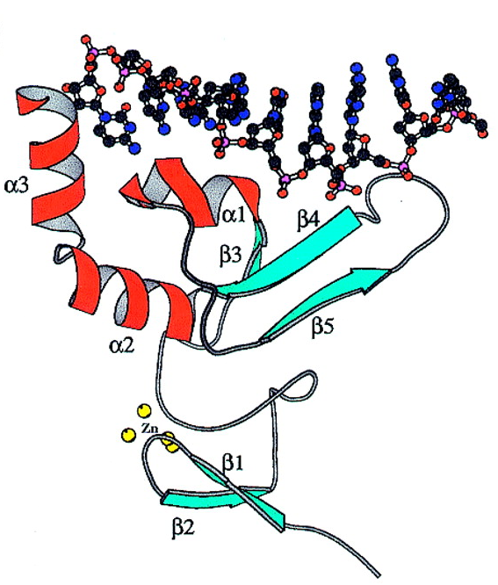
XPA (Xeroderma Pigmentosum complementation group A)
31 kDa metalloprotein
Minimal DNA-binding domain consists of two subdomains joined together by a linker sequence
  C-terminal zinc-binding core (no direct role in DNA binding)
  N‐terminal loop-rich subdomain (basic amino acid residues involved in DNA binding)
Affinity for helically distorted DNA
XPA and RPA are required for pre-incision complex
May serve as a regulatory subunit for the recruitment of NER factors
Rate-limiting factor
Buchko G W et al. Nucl. Acids Res. 2001;29:2635-2643
Notes:
The XPA gene product is a 32 kDa, Zn²⁺-finger, DNA binding protein that shows affinity for UV-damaged DNA [62] and [63]. In general, this affinity is related to the extent of helical distortion in the DNA backbone. This characteristic had led to the proposal of a role for this protein in lesion recognition. However, as XPC–hHR23B has been shown to act first in damage detection, the function of XPA was reconsidered (see below). In addition, XPA showed to interact with two novel proteins, XAB1 and XAB2, whose functions in NER are not clear. The XPA binding protein 1 (XAB1) is a cytoplasmic GTPase protein that appears to be involved in nuclear localization of XPA [64]. The XPA binding protein 2 (XAB2) also interacts with CSA and CSB proteins, as well as RNA pol II. Apparently, XPA and RPA are required for the formation of the pre-incision complex during NER. It has been proposed that these proteins are able to double check DNA bending and unwinding, and, as a consequence, they could serve as regulatory subunits that verify the damage-specific recruitment of NER factors. Alternatively, they could control the correct three-dimensional assembly of NER intermediates prior to endonucleolytic cleavage

Slide 8
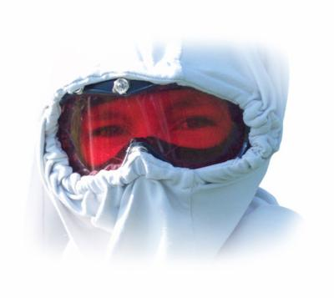
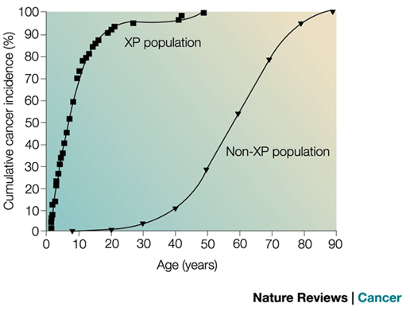
What happens without NER
Xeroderma pigmentosum
Autosomal recessive mutations in several complementation groups
Extreme sensitivity to sunlight
Predisposition to skin cancer (mean age of skin cancer = 8 yrs vs. 60 for normal population)
Notes:
Although DNA repair efficiently disposes of most damage, the probability that the replication apparatus will encounter sites of unrepaired damage has prompted evolutionary selection for mechanisms whereby such sites can be bypassed. Sites of base damage recognized as cognate lesions are bypassed accurately. However, noncognate substrates are bypassed inaccurately, which results in the introduction of mutations. This may contribute to much of the spontaneous mutation rate in normal cells. But, if repair systems are not operational, the burden on TLS may be such that mutagenesis can have severe phenotypic consequences.
Individuals with XP have a high incidence of premalignant actinic keratoses (proliferative lesions in the skin, which signal impending neoplastic change), as well as benign and malignant skin tumours. The median age of onset of skin cancer is 8 years, nearly 50 years younger than in the general US population. This is the earliest onset of neoplasia documented for any recessive human hereditary disease and reflects the importance of DNA repair in the prevention of these cancers in the general population. Neoplasms are predominantly basal cell and squamous cell carcinomas of the skin, but also include melanomas, keratoacanthomas (tumours that arise from cells of the skin appendages, such as hair follicles), angiomas and sarcomas. The cutaneous features of XP are essentially identical in patients with XP-AXP-G, although XP-E patients tend to have milder symptoms and a later onset of cancer, and XP-C patients are less frequently afflicted neurologically.

Slide 9
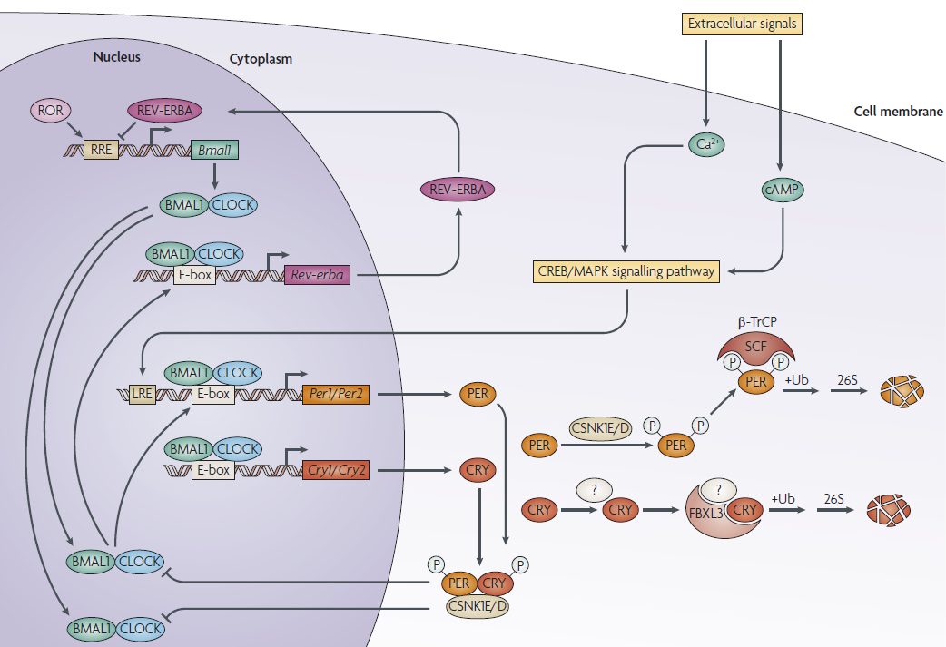
The Circadian Clock
Notes:
Circadian rhythm is the daily oscillation in the biochemical, behavioral, and physiological functions of organisms. 20% of the genome appears to be rhythmically regulated. So, it may not be so surprising that the cellular response to DNA-damaging agents such as UV is gated by the clock.
In mice and humans, the clock is present in essentially every cell and is generated by an autoregulatory transcription-translation feedback loop (TTFL): Clock and Bmal1 transcription factors bind to the E-box promoter elements of the Cryptochrome (Cry)1 and 2 and Period (Per)1 and 2 genes and activate their transcription. The Cry and Per proteins make oligomeric complexes that, after a time delay, inhibit the Clock·Bmal1 complex and hence the transcription of the Cry and Per genes. The time delay between the synthesis of Cry and Per and their action as repressors generates an oscillatory pattern of expression of Crys and Pers and other clock controlled genes that are regulated by Clock·Bmal1 but are not part of the TTFL. It is this oscillation of gene expression that affects cellular and organismic function to give rise to the circadian rhythm at a macroscopic level.

Slide 10
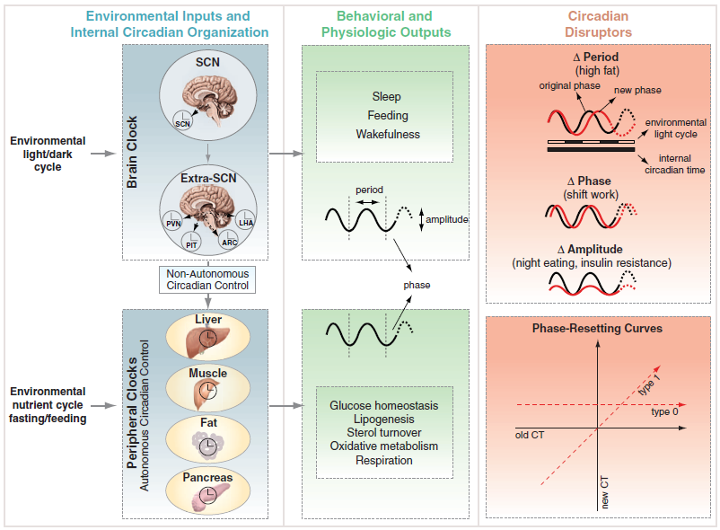
Central and Peripheral Clocks
Notes:
These peripheral circadian oscillations are synchronized with one another by the master circadian clock that is located above the optic chiasma, in the suprachiasmatic nuclei (SCN). The SCN coordinates the peripheral clocks in organs such as liver, kidney, and heart to give rise to the circadian rhythm at the organism level.

Slide 11
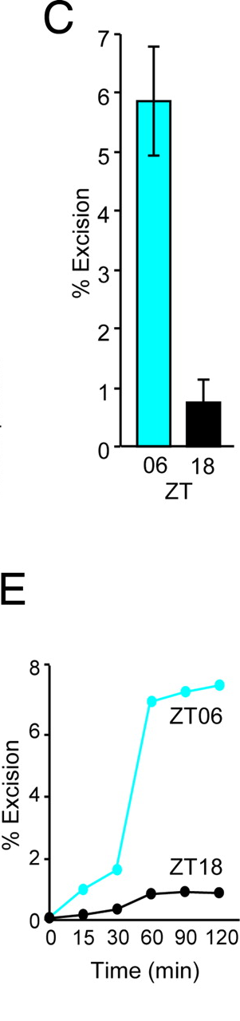
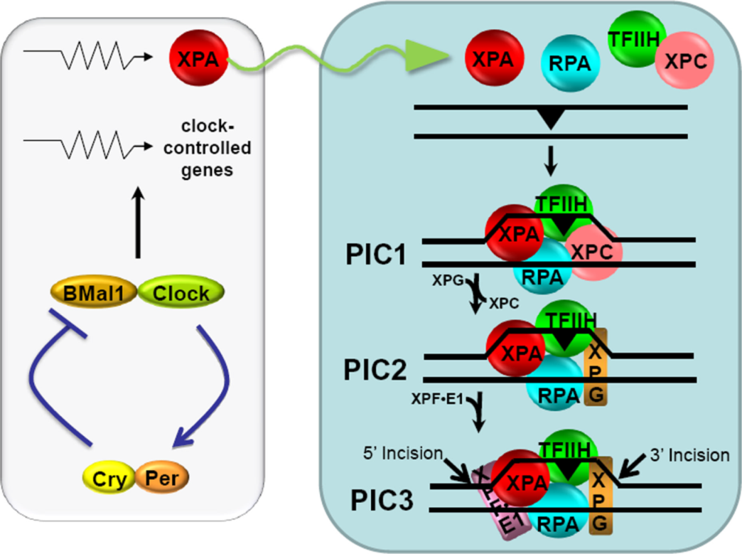
Regulation of NER by the Clock
Nighttime and
daytime NER
in mouse brain
Kang T et al. PNAS 2009;106:2864-2867
Notes:
Recently, in a study that analyzed liver and brain tissues from mice, it was
found that XPA is controlled by the core molecular circadian clock. More accurately, XPA levels are coordinately regulated by the circadian clock, the ubiquitin-proteasome system and DNA damage.
the rate of excision repair of a UV photoproduct in the mouse brain exhibits a daily rhythm. Furthermore, it appears that this rhythmic pattern is due to the circadian oscillation of the XPA. Even though in that study the damaged-DNA substrate was a UV photoproduct, we suggested that the findings were relevant to the repair of cisplatin because nucleotide excision repair is the only repair system capable of removing bulky DNA lesions produced by UV or by UV-mimetic agents such as cisplatin.

Slide 12
Excision Repair and Chronotherapy
Circadian time of delivery of chemotherapeutic drugs such as cisplatin contributes to the efficacy of the drug and the severity of its side effects.
tumor cells may or may not be in phase with the central circadian clock
if the circadian behavior of the tumor can be determined, the drug can be administered at the time of maximum efficacy
extent of the damage may be minimized by administering the drug at the time of maximum excision repair activity

