Slide 1
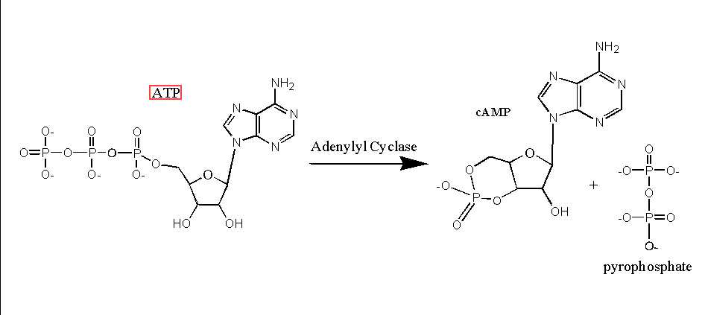
Pyrophosphate (K. Lee 6/29/2010)
Type of diphosphate
Found in bone, plasma, urine

Slide 2
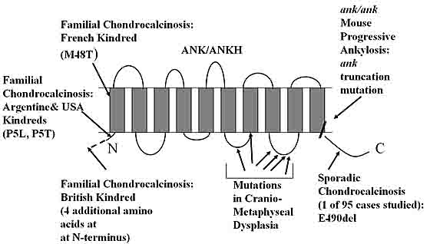
Pyrophosphate is transported by ANK
Johnson, Terkeltaub (2005)

Slide 3
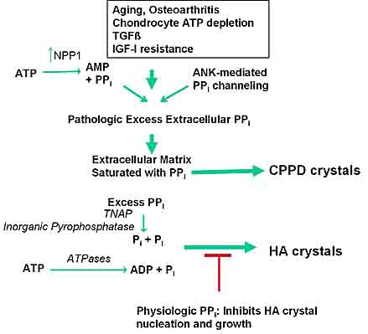
Johnson, Terkeltaub (2005)

Slide 4
Pyrophosphate can inhibit mineralization by binding crystals, prohibits precipitation of hydroxyapatite crystals
In the presence of alkaline phosphatase
  PPi→ Pi (orthophosphate)
  hydrolyzes/removes the inhibitor of mineralization
Too much PPi→mineral deposition
PPi acts as a buffer of mineralization: can form/prevent

Slide 5
Pi is an important signaling molecule
  Intracellular transport: sodium/phosphate cotransporter
  MAPK pathways
ATP-dual mechanism: P2Y and extracellular PPi generation by ENPP
No known extracellular pyrophosphate receptor
Notes:
Mitogen activated protein kinase
Mitogen- triggers cell division
ectonucleotide phosphodiesterase/pyrophosphatase
(ENPP) family

Slide 6
Pyrophosphate references
http://www.nature.com/nature/journal/v212/n5065/pdf/212901a0.pdf (pyrophosphate general info)
http://endo.endojournals.org/cgi/reprint/148/9/4208 (p2y and ppi)

Slide 7
Progressive ankylosis protein (ANK) in osteoblasts and osteoclasts controls bone formation and bone remodeling.
Kim HJ, Minashima T, McCarthy EF, Winkles JA, Kirsch T.
Musculoskeletal Research Center, Department of Orthopaedic Surgery, NYU Hospital for Joint Diseases, New York, NY.
JBMR, February 2010

Slide 8
BMSs, ank/ank mice and MC3T3-E1 cells
Mineralization, intracellular pyrophosphate, runx2, osterix, OPG/RANKL measurements
ANK is a positive regulator of osteoblastic and osteoclastic differentiation events toward a mature osteoblastic and osteoclastic phenotype
Notes:
Bone marrow stromal cells
Nuclear factor-kappa beta

Slide 9
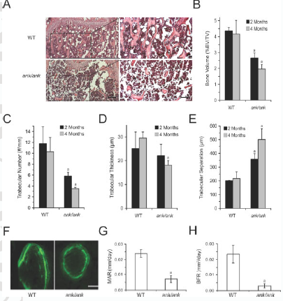
Results
Low bone mass, reduced bone formation rate, and reduced number of osteoclasts in tibias and femurs of ank/ank mice
Femur

Slide 10
Impaired osteoblastogenic differentiation and mineralization of bone marrow stromal cells (BMSs) and calvarial osteoblasts isolated from ank/ank mice
Mineralization was late but increased once initiated
Decrease of all osteoblast differentiation markers

Slide 11
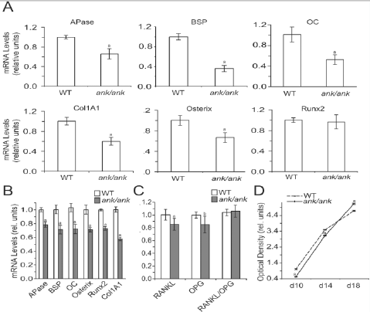
Notes:
Bone sialoprotein-component of mineralized tissues such as bone, dentin, cementum and calcified cartilage

Slide 12
Overexpression of ANK or CMD mutant ANK (F376del) enhances osteoblastogenic differentiation and runx2 transcriptional activity
COS cells transfected with empty vector, ANK, & mutant ank Empty vector and mutant ank→lost ability to transport PPi, resulting in high intracellular Ppi (5A)
ANK overexpression→ increased osteoblastic differentiation by mRNA markers Apase, BSP, OC, Col1A1, osterix
Notes:
COS cells- kidney cell line
CV-1 (simian) in Origin, and carrying the SV40 genetic material

Slide 13
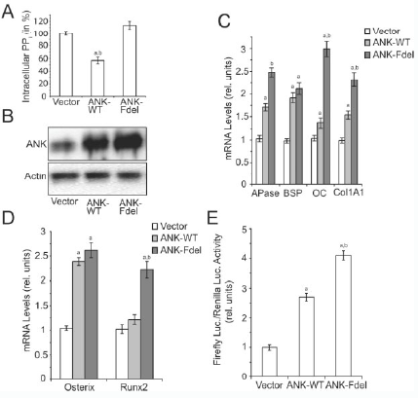

Slide 14
Levamisole treatment blocks Pi/sodium cotransporters
  MC3T3 cells→similar marker expression with levamisole treatment alone and levamisole/PPi treatment (slightly more effective in altering mRNA levels) (6B)→slight increases in gene expression
  PPi treatment alone increased markers
  Different degrees of mineralization first 6 days of culture
  Both Pi and Ppi stimulate osteoblastogenic differentiation and as a consequence mineralization (6A-C)
  additional 1.5mM Pi increased the mRNA levels of APase, BSP, osteocalcin, osterix and type I collagen of ank/ank BMSs to levels similar or higher than those of untreated wild-type cells (6D)

Slide 15
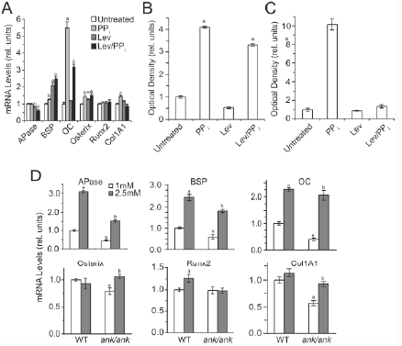
First 6 days of culture
Last 6 days of culture

Slide 16
ANK is expressed in osteoclast precursor cells and affects osteoclast differentiation
Isolated bone marrow stromal cells→high ANK expression in initial osteoclast differentiation, then decreased expression in later stages (7A)
-ank/ank had impaired osteoclast differentiation (7B-C)

Slide 17
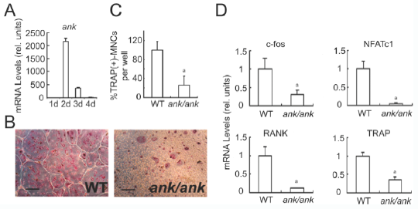
Notes:
Tartrate-resistant acid phosphatase-expressed by osteoclasts
Nuclear factor of activated T-cells, cytoplasmic 1 is a protein that in humans is encoded by the NFATC1 gene
c-Fos: a key regulator of osteoclast-macrophage lineage determination and bone remodeling.

Slide 18
Discussion
Both PPi and Pi regulate bone formation and bone resorption
Extracellular PPi directly regulates expression of osteoblast marker genes
Pi resulting from PPi hydrolysis regulates osteoblastogenic differentiation
  PPi/Pi homeostasis
Loss of ANK→delayed osteoblastogenic differentiation of BMSs
  Overexpression→increased osteoblastogenic differentiation in MC3T3-E1 cells
    (osterix increases, but runx2 expression is not affected)
    ANK is required for osteoblastogenic differentiation into mature osteoblasts and controls propagation of osteoblast ECM mineralization

Slide 19
1 hour Flow
Problem with coating?
  ANK and scrambled siRNA-treated slides were not near confluence (patchy) and had many floating cells
  Untreated group appeared normal pre-flow
  Post flow: no change in ANK and scrambled groups appearance, but many untreated cells lifted off and some had unnatural morphology

Slide 20
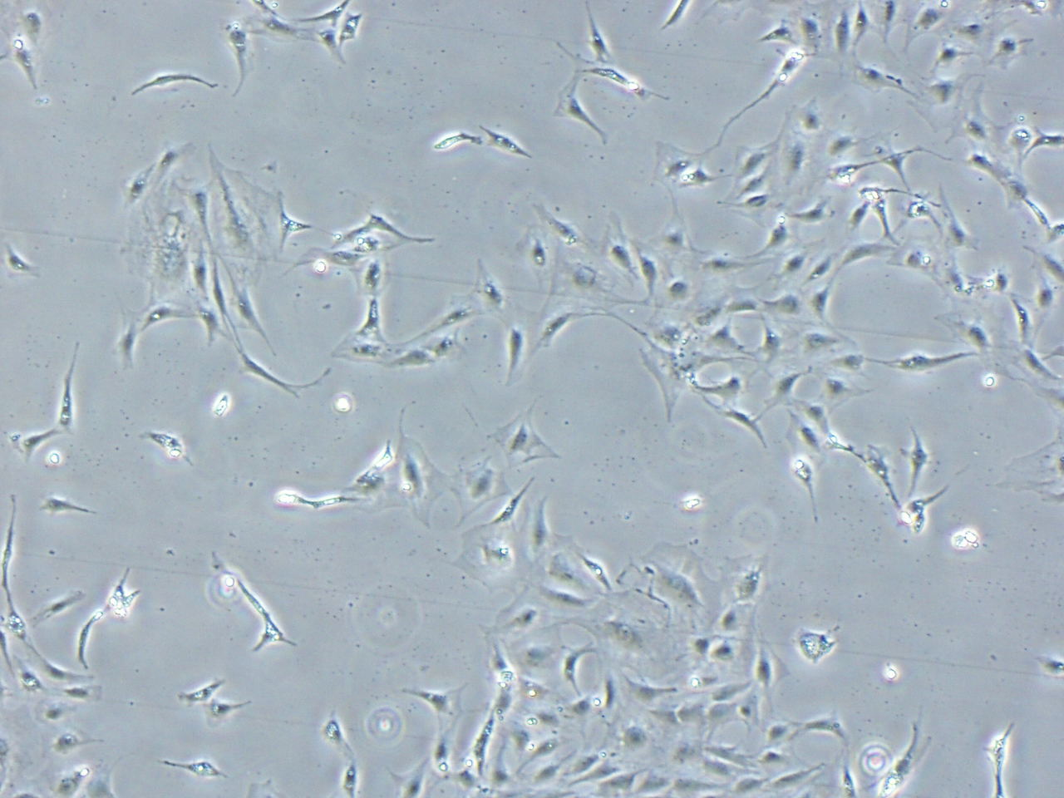
ANK siRNA treated slide, pre-flow

Slide 21
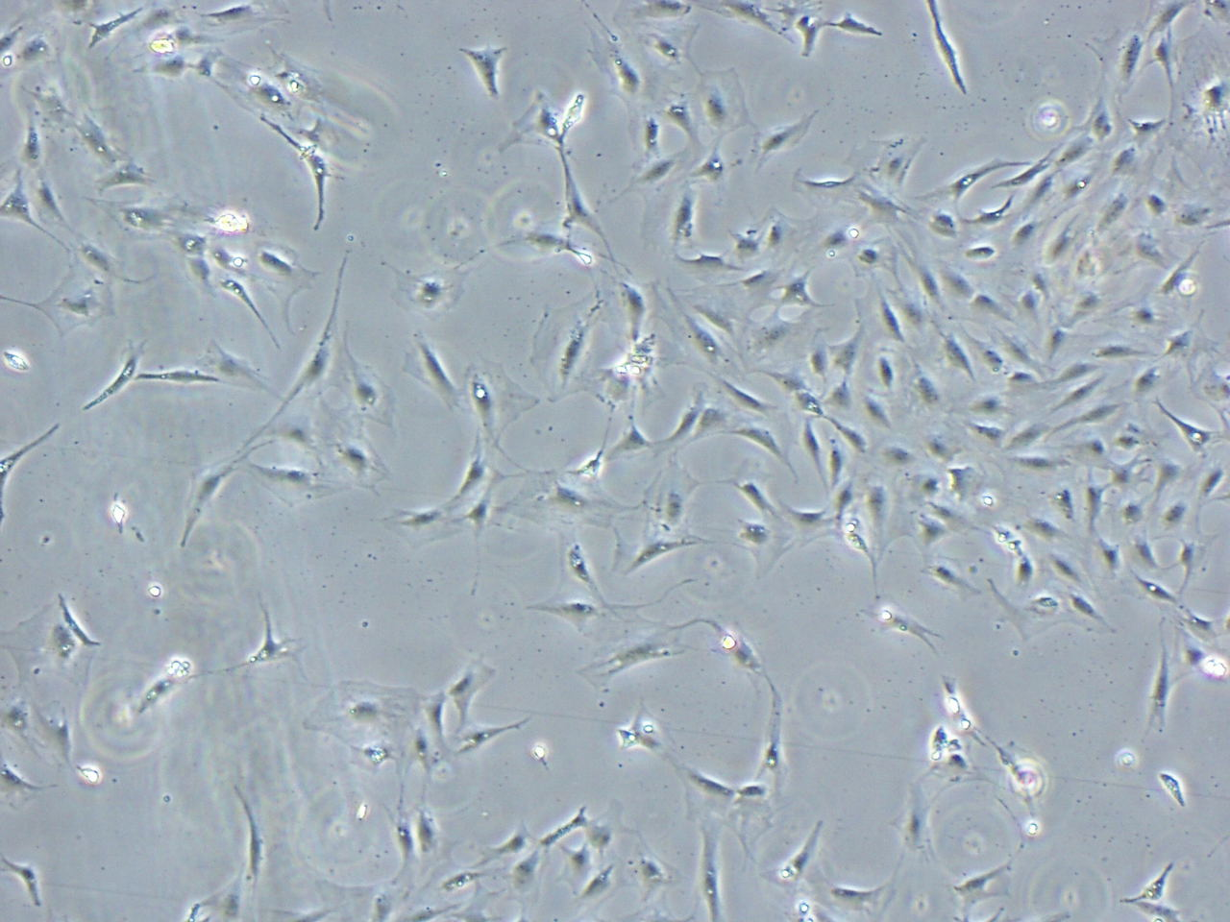
scrambled siRNA treated slide, pre-flow

Slide 22
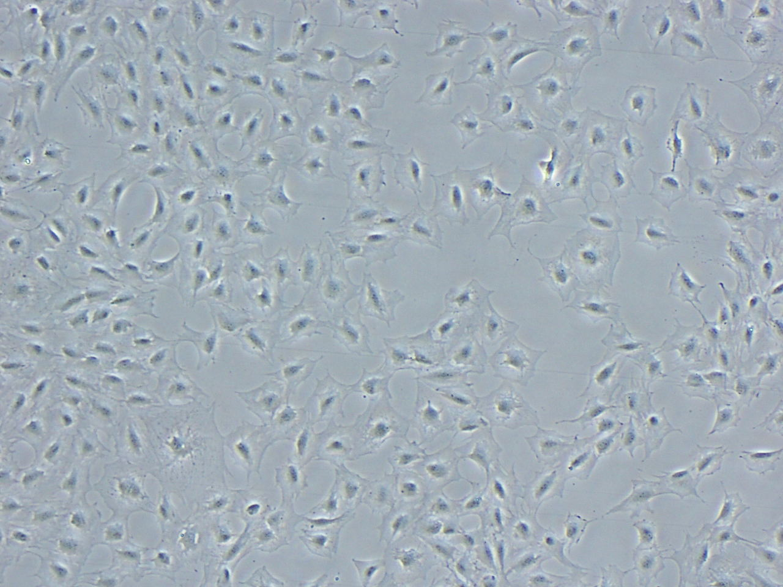
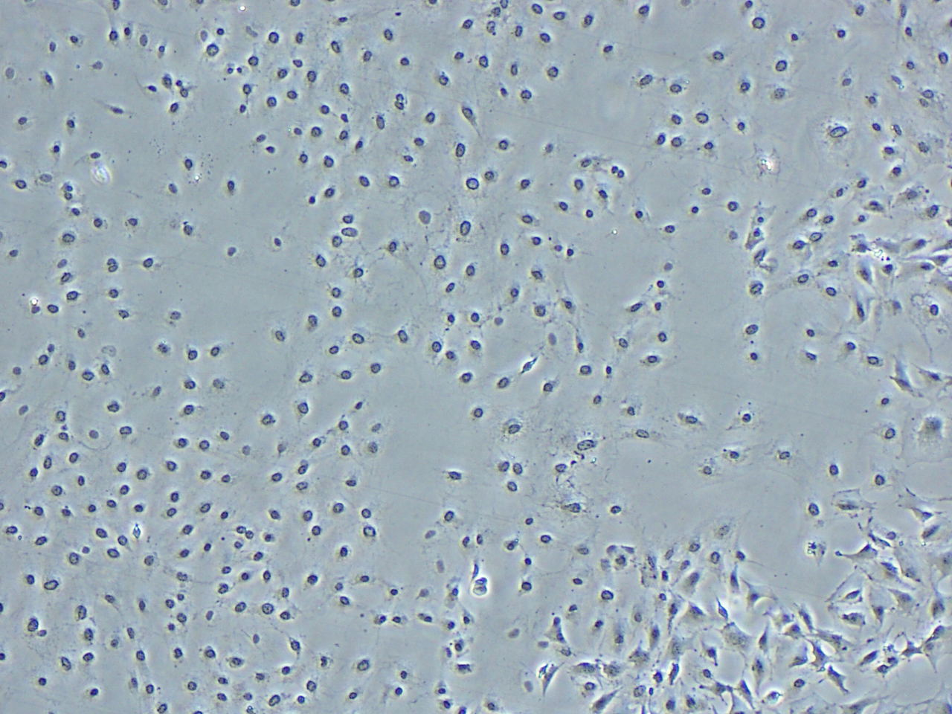
Untreated pre-flow
Untreated post-flow

Slide 23
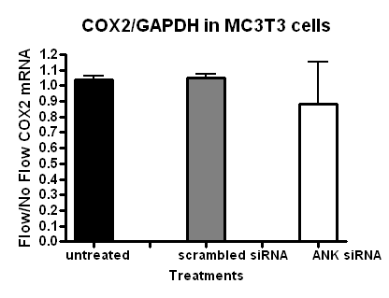
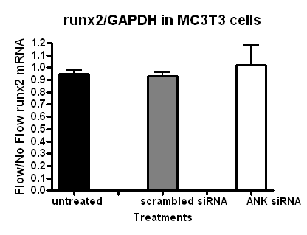
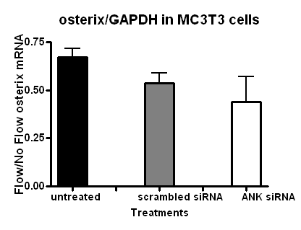
Means are not significantly
different
No increase with flow in 1 hour
Need to fix fibronectin coating

