Slide 1
Family: dHAP4
Genes: 15
Edges: 28
Strain Data: All 6 Strains
(Incomplete Run)

Slide 2
Family: dHAP4
Genes: 34
Edges: 102
Strain Data: All 6 Strains
(Incomplete Run)

Slide 3
Family: dHAP4
Genes: 15
Edges: 24
Strain Data: WT

Slide 4
Family: dHAP4
Genes: 30
Edges: 63
Strain Data: WT & dZAP1

Slide 5
Family: dGLN3
Genes: 16
Edges: 24
Strain Data: WT & dZAP1

Slide 6
Family: dGLN3
Genes: 15
Edges: 33
Strain Data: WT, dCIN5, dGLN3

Slide 7
Family: dZAP1
Genes: 15
Edges: 27
Strain Data: All 6 Strains
(Incomplete Run)

Slide 8
Family: dZAP1
Genes: 14
Edges: 15
Strain Data: WT & dZAP1

Slide 9
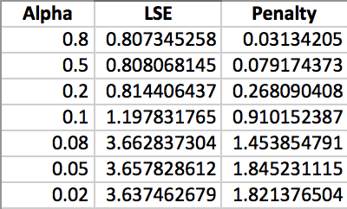
Family: dZAP1
Genes: 34
Edges: 98
Strain Data: All 6 Strains
(Incomplete Run)

Slide 10
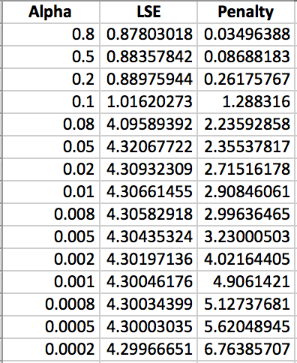
Family: dZAP1
Genes: 28
Edges: 43
Strain Data: WT &d ZAP1
(Incomplete Run)

