Slide 1



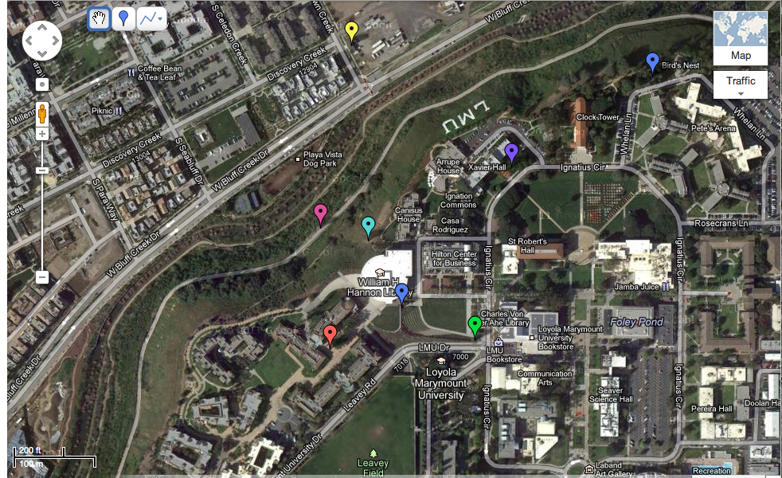
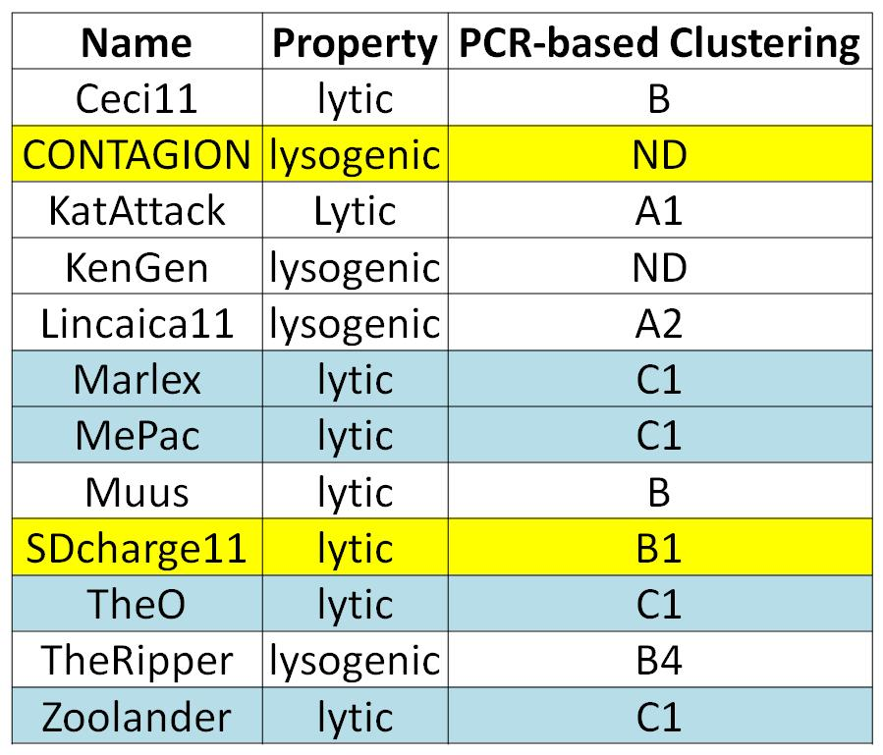

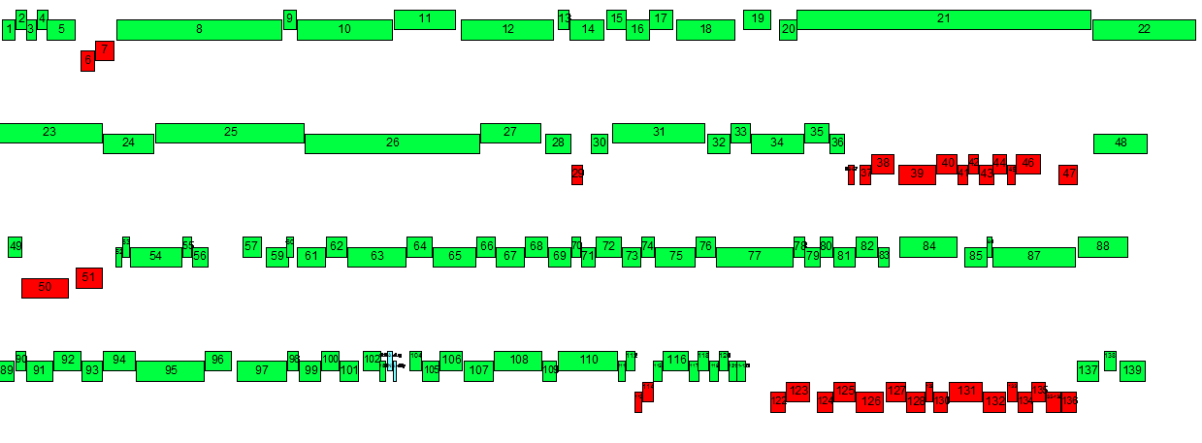
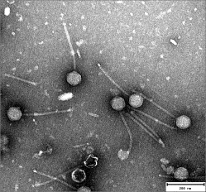
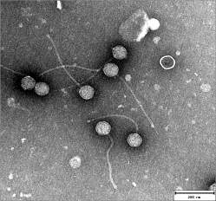
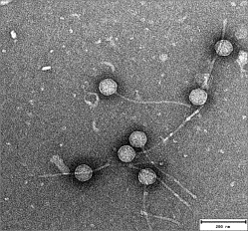
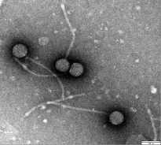
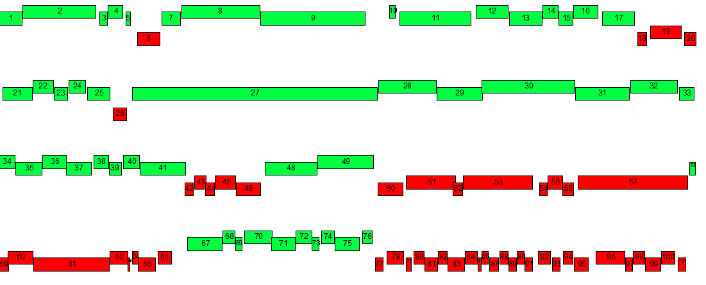
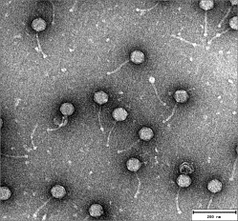
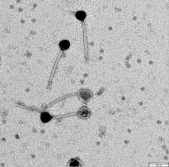
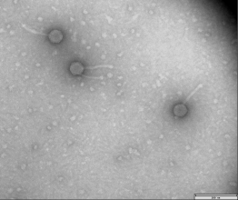
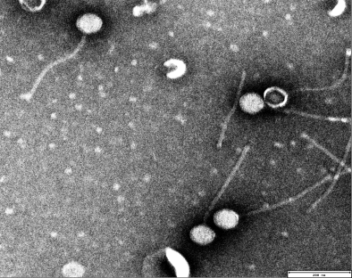
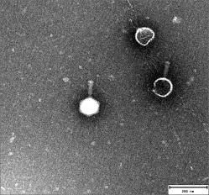
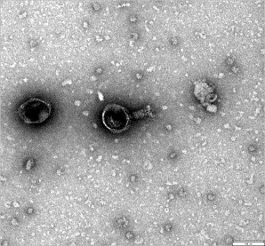
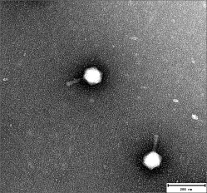
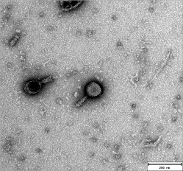
Isolation, Characterization and Annotation of the Novel Phages CONTAGION and SDCharge11
V. Bhula, D.-W. Chang, M. Courtois, H. Delgadillo, K. Fu, A. Gebreselassie, W. Gendron, M. Kerr, P. Lockwood, T. Medling, J. Pascual, A. Santiago, J. Tamhane, R. Totah, K. Wilkholm, G. Guerra, L. Magee, D. Mauch, M. Petredis, J. Santiago, C. Rhodes, A. Karacozoff, Y. Fang, G. Kuleck, and C. Urbinati
Department of Biology, Loyola Marymount University, 1 LMU Drive, Los Angeles, CA 90045
Abstract
Results
Results
As the second cohort of LMU SEA PHAGES Scholars, our class of 20 students was able to isolate and characterize 12 novel mycobacteriophages including 8 siphoviridae and 4 myoviridae from various locations within the LMU campus. Based on restriction map analysis, all appears to be different from each other. Initial PCR analysis utilizing cluster specific primers indicated that most of the phage isolated belonged to the A, B and C clusters. Two phages, CONTAGION and SDcharge11, were sequenced and annotated.
CONTAGION is a lysogenic E-cluster phage with the appearance of lopsided halo plaque morphology and with 139 putative genes including two tRNA genes. Interestingly, the majority of genes in CONTAGION are transcribed in the forward direction and most of reverse transcribe genes are of smaller size. SDCharge11 is a fast growing lytic B-cluster phage and contains putative 101 genes (no tRNA genes). The majority of reverse transcribed genes form two clusters located in the 3' end of the genome. We will discuss these results and the highlights of various bioinformatics analyses performed by the authors.
Figure 1: Location of LMU Phages
Table 1. Putative Phage Cluster Identification by PCR
Using standard set of PCR primer that are available, we have been able to place 10 out of 12 phages into putative clusters, including 4 C1-cluster phages (in blue) that show expected TEM morphology . One of them, SDCharge11 has been verified by sequencing.
Materials and Methods
Fig. 1. Aerial View shows the GPS location of 7 of 12 LMU phages in LMU campus.
Figure 3: Annotation of CONTAGION and SDCharge11
Isolate phage
Figure 2: TEM Images of 12 LMU phages
CONTAGION is named after the movie with the same name. It is a E cluster lysogenic phage containing putative 139 ORFs and 2 tRNAs. SDCharge11 is a fast growing lytic B1 phage with putative 100 ORFs.
*Collect environmental sample.
*Infect. M. smeg and pick one plaque.
*Use plate streaking or plugging until one
continuous strain is isolated
CONTAGION
SDCharge11
TheRipper
Ceci11
Contagion
Prepare phage for testing
*Create high titer lysate via flooding method.
*Isolate phage DNA and replicate using PCR.
*Send off isolated phage to HHMI facility for
sequencing.
KenGen
KatAttack
Lincaica11
Muus
SDCharge 11
TheO
Zoolander
Marlex
MePac
Acknowledgements & References
Acknowledgements: We would like to thank HHMI SEA, LMU Biology Department and Seaver college for their support in every aspect. We also want to thank Dr. Yong-Jun Li for his help in TEM and UCLA for allowing us to us their TEM facility. Our special thanks go to VCU sequencing center and Dr. Dan Russell, Dr. Welkin Pope and Dr. Allison Johnson for their untiring constant support.
References:
1. Pope WH, Jacobs-Sera D, Russell DA, Peebles CL, Al-Atrache Z, et al. (2011) . PLoS ONE 6(1): 1-20
2..Hatfull GF, Jacobs-Sera D, Lawrence JG, Pope WH, Russell DA, et al. Mol Biol. 2010;397:119–143.
Characterization and Analysis
*TEM and restriction mapping of all phages
*Bioinformatic analysis for CONTAGION and SDCharge 11:
annotation, characterization and analysis
Fig. 2. TEM pictures of 12 LMU phages. The ones highlighted in yellow/orange are lysogenic phages in clusters other than C cluster. The ones highlighted in purple/lavender are lytic phages. The ones in blue are C cluster phages. CONTAGION and SDCharge11 genomes are sequenced using 454 in VCU.
A snapshot from Phamerator regarding CONTAGION and SDCharge11.

