Slide 1
Synthetic Oscillatory Networks
SUSTC
PANDA
Match 30th

Slide 2
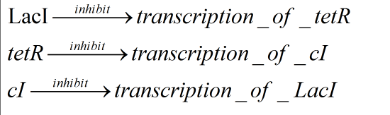
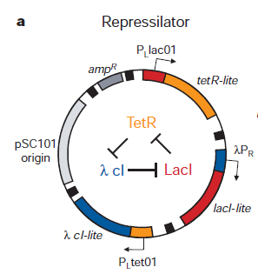
The constitution of repressilator
a hybrid plasmid containing LacI,
tetR and cI.
It’s a negative feedback loop
Which is shown in the center
Of the right figure.

Slide 3
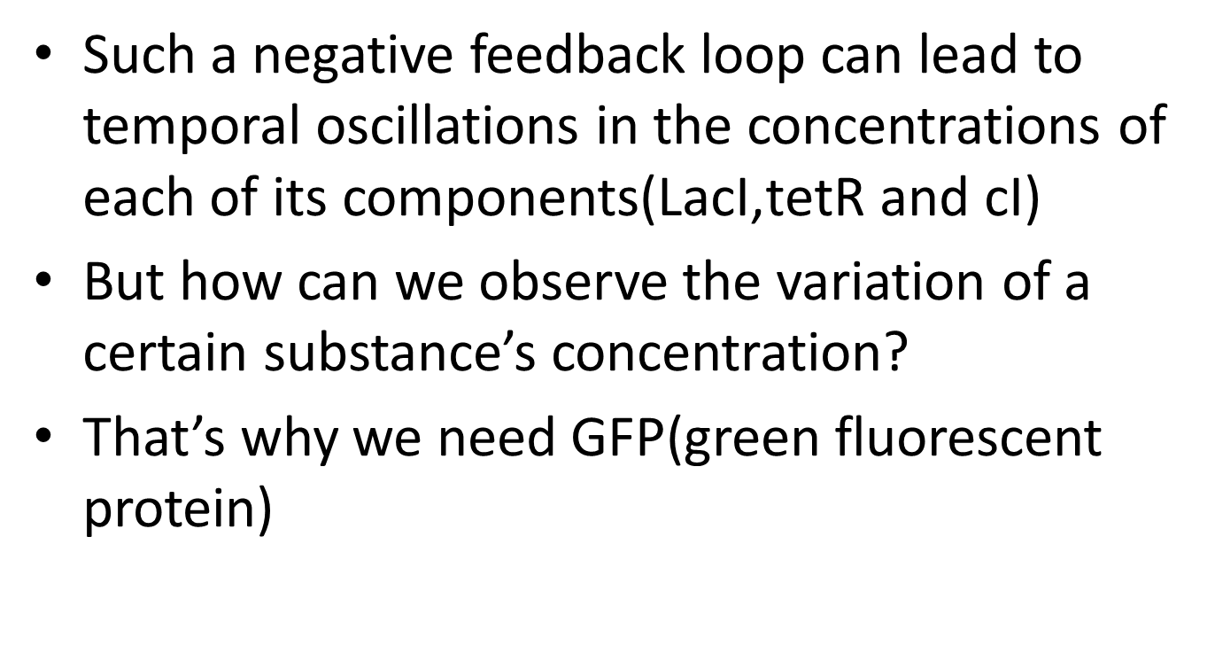
Such a negative feedback loop can lead to temporal oscillations in the concentrations of each of its components($\text{LacI}\text{,}\text{tetR} \text{and} \text{cI}$)
But how can we observe the variation of a certain substance’s concentration?
That’s why we need GFP(green fluorescent protein)

Slide 4
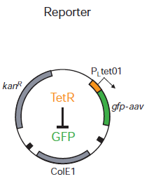
The constitution of reporter
reporter plasmid containing the tet-repressible promoter PLtetO1 fused to an intermediate stability variant of gfp
(使用这样的GFP使它能够及时分解。)

Slide 5
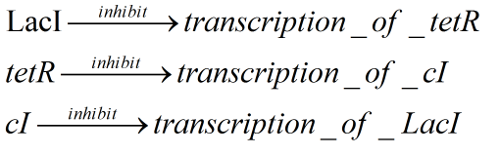
Constitution of the feedback loop
the 4th negative feedback
Since GFP’s concentration can be observed according to fluorescent intensity,
The intensity of GFP can reflect the variation of the entire system.

Slide 6
In this model, the action of the network depends on several factors:
1.The dependence of transcription rate on repressor concentration,
2.The translation rate
3.The decay rates of the protein and messenger RNA.
Depending on the values of these parameters(参数),at least two types of solutions are possible——

Slide 7
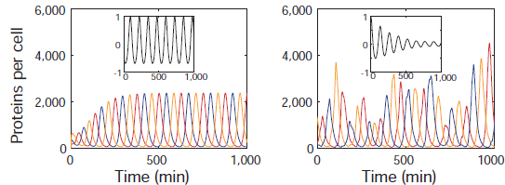
1.the system may converge toward a stable steady state
2.the steady state may become unstable, leading to sustained limit-cycle（有限周期） oscillations

Slide 8
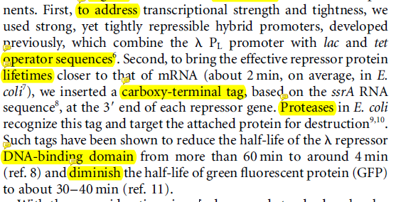
To make it the former situation

Slide 9
About IPTG
A culture of E. coli MC4100 containing the two plasmids and grown in media containing IPTG
displayed what appeared to be a single damped oscillation(简单阻尼振荡) of GFP fluorescence per cell after transfer to media lacking IPTG
（使用IPTG的作用主要是同步初始化。由于IPTG能够干扰LacI的遏制作用(repression)，将E.coli放入含IPTG的培养皿可以使所有细菌的LacI含量保持一致，这相当于物理学里面振动的强迫力的作用）

Slide 10
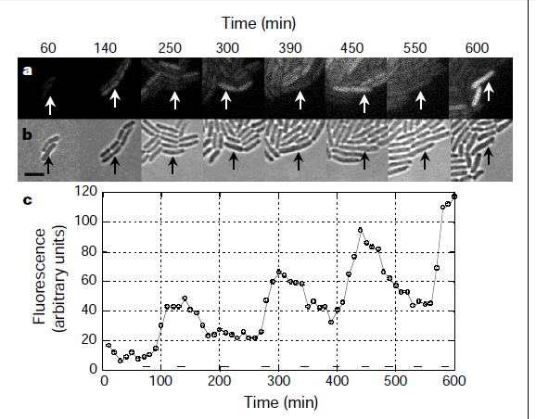
Time course of the fluorescence
（single cell observation）

Slide 11
What we get from the timecourse
Temporal oscillations occur with a period of around 150 minutes, roughly threefold longer than the typical cell-division time.（振动周期大约是细胞分裂周期的三倍）
This indicates that the state of the network is transmitted to the progeny cells.(系统的状态能够传递给子细胞)

Slide 12
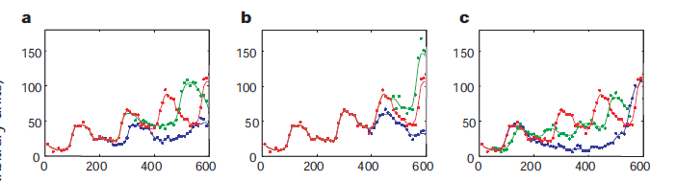
Time course of the fluorescence
（multi-cells observation）
Obviously, the synchronization was destroyed after a few periods.(同步性消失)

Slide 13
What we get from the timecourse
We observed significant variations in the period and amplitude of the oscillator output both from cell to cell
单个细胞虽然依然有周期性，但是细胞与细胞之间的同步性遭到破坏。
Recent theoretical work has shown that stochastic effects (随机效应)may be responsible for noisy operation in natural gene-expression networks.

Slide 14
A fast, robust and tunable synthetic gene oscillator
We have just discussed the negative feedback loop oscillators ,why not add a positive feedback?
And what role the positive feedback play in the oscillatory network?
Let’s continue ——

Slide 15
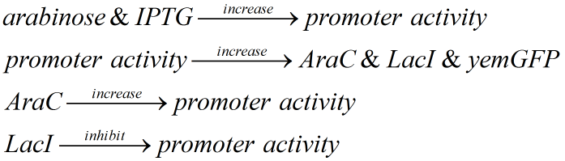
The feedback loops in this system
事实上这是一个引子，inducer
后面两个一个正反馈，一个负反馈。由引子引发振荡，最终由GFP荧光观测变化。

Slide 16
features
Cells grown in the absence of inducer initiated oscillations in a synchronous manner(不加入引子即可实现初始化)
The oscillation will begin as soon as the addition of inducer(加入引子即开始振荡)
Varying the IPTG concentration allowed for the tuning of the oscillator period.(可调频)
Robust(控制系统在一定的参数摄动下，维持某些性能的特性，这里指能够保持振荡状态。)

Slide 17
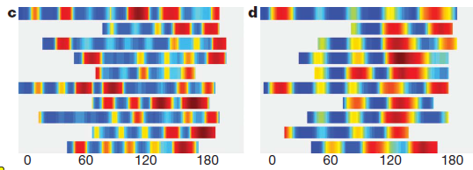

Why tunable?

Slide 18
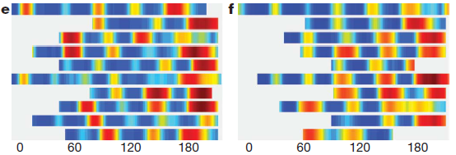

Why tunable?

Slide 19
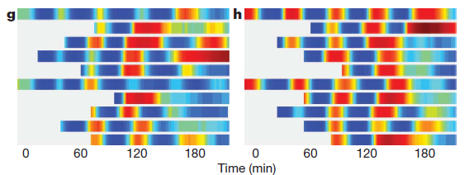
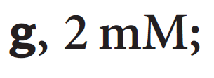

Why tunable?

Slide 20
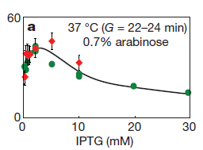
why tunable
随着IPTG浓度的升高，在低浓度时，IPTG与振动周期成正相关，在高浓度时，成负相关。
this nonmonotonic behaviour is probably caused by IPTG interference with AraC activation.
纵轴为振动周期

Slide 21
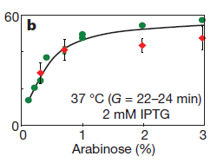
why tunable
振动周期与arabinose的浓度也有一定关系，与IPTG一样，在底浓度时，调频效果好。

Slide 22
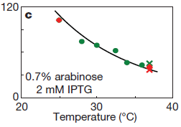
why tunable
温度与周期的关系如图所示，可以看到，调频效果没有之前两个好，而且温度改变过大会导致细胞死亡，不宜用作调频手段

Slide 23
What’s new compared with the first experiment?
The previous model failed to describe two important aspects of the experiments.
First, the model could not describe the observed functional dependence of the period on inducer levels.(无法解释引子浓度对周期的影响)
Second, and perhaps most importantly, because careful parameter tuning was necessary for oscillations in the original model, it was not able to describe the robust behaviour demonstrated in the experiments（在第一个实验模型中，对参数的控制极其重要，这无法解释这个实验的robust）

Slide 24
The previous model
In this model, the action of the network depends on several factors:
1.The dependence of transcription rate on repressor concentration,
2.The translation rate
3.The decay rates of the protein and messenger RNA.

Slide 25
A new model
directly model processes such as protein–DNA binding, multimerization, translation, DNA looping, enzymatic degradation and protein folding.
(this computational model is very robust to parameter variations and correctly describes the dynamics of the oscillator for a large range of IPTG and arabinose concentrations)(这个新模型很好的拟合实验结果)

Slide 26
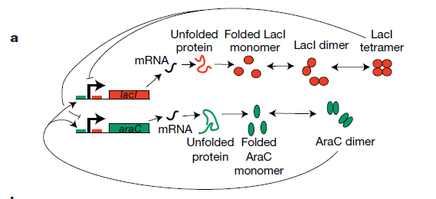
Time delay
These processes provide time delay for the entire system. That’s the difference from the original model.(时间延迟是重要参数)

Slide 27
Time delay
Computational modelling demonstrates that the key design principle for constructing a robust oscillator is a time delay in the negative feedback loop.(负反馈的延迟效应能使振荡更加稳定robust）
Time delay 是整个系统中一个不可忽略的部分，具有较大影响。

Slide 28
Q&A

Slide 29
THANKS!

