Slide 1
Modeling Different Substrate Rate Constant Values on Nitrogen Metabolism for S. Cerevisae
Alyssa Gomes and Tessa Morris
Department of Biology
Department of Mathematics
Loyola Marymount University
March 5, 2015

Slide 2
Outline
Objective is to answer: How does changing the rate constant values impact the rate of growth of S. cerevisiae?
Background on Nitrogen Metabolism as noted by ter. Schure et al (1995)
Overview of chemical reaction
System of equations
Overview of model
Implications

Slide 3
Outline
Objective is to answer: How does changing the rate constant values impact the rate of growth of S. cerevisiae?
Background on Nitrogen Metabolism
Overview of chemical reaction
System of equations
Overview of model
Implications

Slide 4
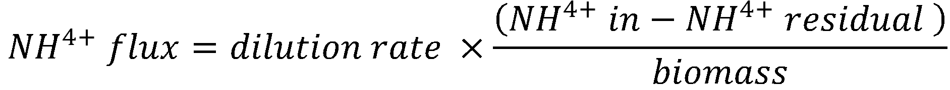
Background for Ammonia Metabolites
Yeast are used as a model organism because they have a smaller genome than humans, but are eukaryotic and display similar mechanisms to humans
Studies by The Journal of Bacteriology showed ammonia concentrations matter more than flux in nitrogen biomass
Ammonia is the preferred source of nitrogen for S. cerevisiae nitrogen metabolism
By adding and removing amino groups, α-ketoglutarate, glutamate and glutamine are interconverted, based on the needs of the cell
From ter Schure et al. there is evidence to support that there glutamate plays an important role in nitrogen metabolism

Slide 5
Outline
Objective is to answer: How does changing the rate constant values impact the rate of growth of S. cerevisiae?
Overview of chemical reaction
System of equations
Overview of model
Implications

Slide 6
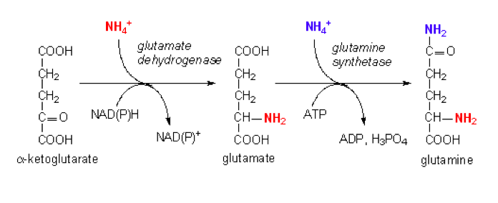
A B
r₁
r₋₁

Slide 7
C B
r₂
r₋₂

Slide 8
A + C 2 B
r₃
+
+

Slide 9
Outline
Objective is to answer: How does changing the rate constant values impact the rate of growth of S. cerevisiae?
Background on Nitrogen Metabolism
Overview of chemical reaction
System of equations
Overview of model
Implications

Slide 10
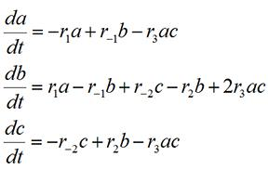
System of Equations for Modeling S. cerevisiae
We used this system of equations
to model the rates of change in
a, b, c
  a=α-ketoglutarate
  b=glutamate
  c=glutamine
The initial concentrations of a, b, c remained constant, which allows us to determine how initial rates affect overall growth in the model

Slide 11
Outline
Objective is to answer: How does changing the rate constant values impact the rate of growth of S. cerevisiae?
Background on Nitrogen Metabolism
Overview of chemical reaction
System of equations
Overview of model
Implications

Slide 12
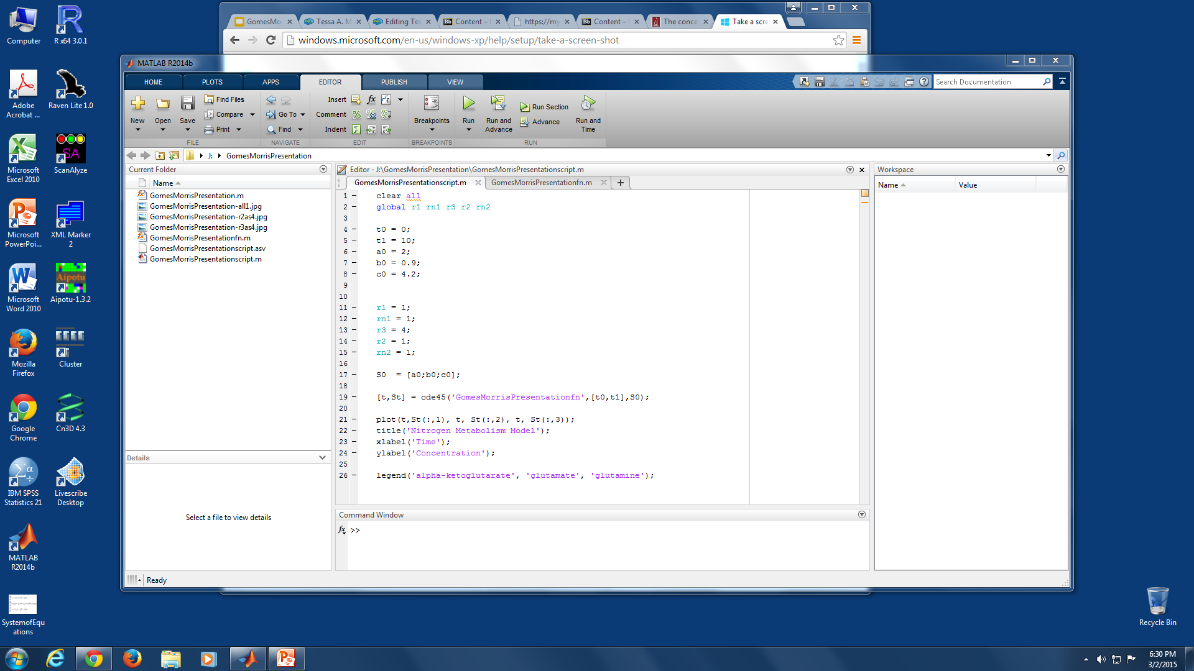
Parameters
initial time
final time
initial concentration of α-ketoglutarate
initial concentration of glutamate
initial concentration of glutamine

Slide 13
Rate Constants
We varied the value of the rate constants r₂ and r₃ , which are the rate constants for producing glutamate using α-ketoglutarate and glutamine
We compared these two plots with to the original plot, which had all rate constants set to 1
This allowed us to study the effect each constant has on the overall nitrogen metabolism

Slide 14
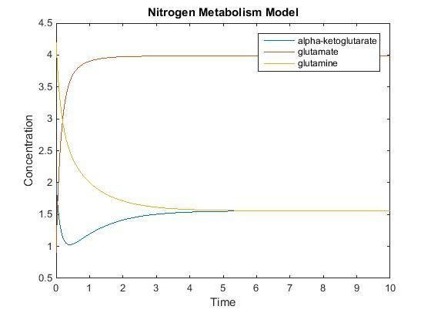
Model with all Rate Constants Set to 1
hi ill contribute in five walking back to my room
Okay cool I feel like we’re pretty much done. What do you think?
r₁=1
r₋₁=1
r₃=1
r₂=1
r₋₂=1
t₀=0
t₁=10
a₀=2
b₀=0.9
c₀=4.2

Slide 15
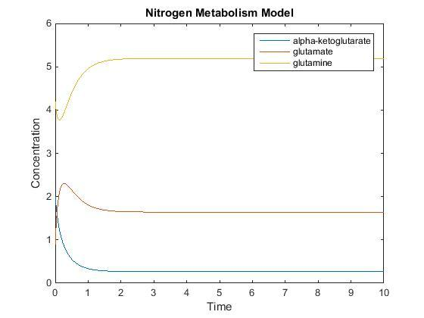
r₂ set to 4
r₁=1
r₋₁=1
r₃=1
r₂=1
r₋₂=1
t₀=0
t₁=10
a₀=2
b₀=0.9
c₀=4.2
r₂=1 (original plot)
r₂=4

Slide 16
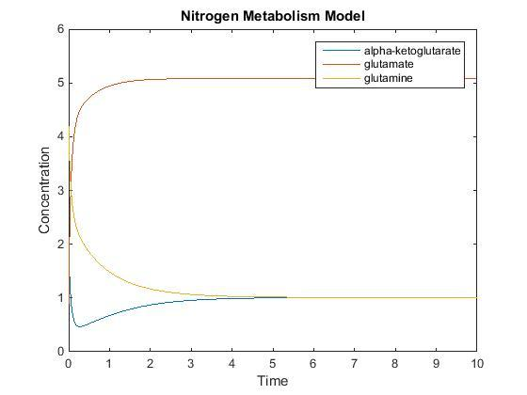
r₃ set to 4
r₁=1
r₋₁=1
r₃=1
r₂=1
r₋₂=1
t₀=0
t₁=10
a₀=2
b₀=0.9
c₀=4.2
r₃=4
r₃=1 (original plot)

Slide 17
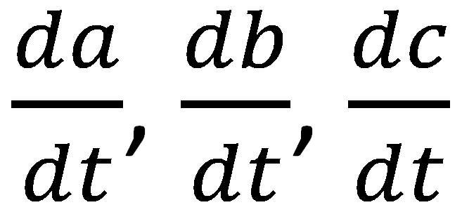
Steady-State
The steady-state is obtained by setting
equal 0
For all values in , there will always be a steady state
The system will eventually stabilize, where the concentration of each substrate or product will not increase or decrease (remain constant), thus the partial derivative for each goes to zero

Slide 18
Outline
Objective is to answer: How does changing the rate constant values impact the rate of growth of S. cerevisiae?
Background on Nitrogen Metabolism
Overview of chemical reaction
System of equations
Overview of model
Implications

Slide 19
Implications of this model
Changing the value of r₃ resulted in a system that resembled the original system in shape, but created a more drastic increase of glutamate, and decrease in α-ketoglutarate and glutamine
  r₃ is present in all three of the equations, thus it affected all of the substrates / products
Increasing r₂ ,the rate glutamine is converted into glutamate, changes the rate at which glutamine and α-ketoglutarate decrease and glutamate increases
This implies that there will be a similar trend when changing the rate α-ketoglutarate converts into glutamate, r₁

Slide 20
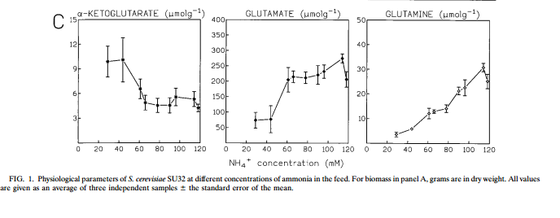
Model vs. ter Schure et al.

Slide 21
Implications of this model
Further experiments could involve modeling NADPH-GDH, NAD-GPH, GS-transferase, and gene expressions
If the ammonia concentration is the regulator, this may imply that S. cerevisiae has an ammonia sensor which could be a two-component sensing system for both glucose and ammonia
Glucose and ammonia can both be used as a carbon and nitrogen sources, both of which are the main nutrients used by S. Cerevisiae (ter Shure Microbiology)

Slide 22
Acknowledgements
A special thanks to Dr. Dahlquist for the biology background necessary to model this system and Dr. Fitzpatrick for his assistance in the logistics of modeling

Slide 23
References
ter Schure, E.G., Sillje, H.H.W., Verkleij, A.J., Boonstra, J., and Verrips, C.T. (1995) Journal of Bacteriology 177: 6672-6675.
ter Schure, E. G. Ter, H. H. W. Sillje, L. J. R. M. Raeven, J. Boonstra, A. J. Verkleij, and C. T. Verrips. "Nitrogen-regulated Transcription and Enzyme Activities in Continuous Cultures of Saccharomyces Cerevisiae." Microbiology (1995): 1101-108. Print.

