Slide 1
Accounting For Carbon Metabolism Efficiency in Anaerobic and Aerobic Conditions in Saccharomyces cerevisiae
Kevin McKay, Laura Terada
Department of Biology
Loyola Marymount University
BIOL 398-03/MATH 388
February 26, 2013

Slide 2
Outline
How does carbon metabolism change in Saccharomyces cerevisiae under anaerobic and aerobic conditions?
Carbon metabolism in S. cerevisiae can be related to the two ter. Schure et al (1995) papers in Journal of Bacteriology and Microbiology.
Two proposed models are given on how yeast utilize carbon:
Model #1: Accounting For Different Usage Rates of Glucose
Model #2: Breaking Up Yeast Growth Rate and Carbon Usage in Anaerobic and Aerobic Conditions
Future considerations

Slide 3
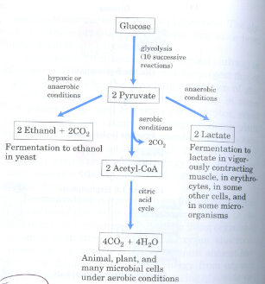
Saccharomyces cerevisiae Prefers Different Methods of Carbon Metabolism Under Varying Glucose Concentrations
Glucose Pathways
During high glucose concentrations, S. cerevisiae prefer anaerobic metabolism.
During low glucose concentrations, S. cerevisiae prefer aerobic metabolism.
Source: Nelson et al. (2008) Principles of Biochemistry.

Slide 4
The Original Chemostat Model Does Not Account For Anaerobic and Aerobic Carbon Metabolism
Parameter | Variable
Dilution rate | q
Nitrogen feed | u_{n}
Carbon feed | u_{c}
Growth rate | r
Reaction rates | V_{n}, V_{c}
Constants | K_{n}, K_{c}
Original System of Differential Equations
Carbon: dc₁dt = q*u_{c}- q*c₁ -((y*c₁*V_{c})/(K_{c}+c₁))*(c₂/(c₂+K_{n}))
Nitrogen: dc₂dt = q*u_{n} - q*c₂ -((y*c₁*V_{n})/(K_{c}+c₁))*(c₂/(c₂+K_{n}))
Yeast: dydt = (y*r)*(c₁)/(K_{c}+c₁)*(c₂/(c₂+K_{n})) - q*y
State Variables | Variable
Carbon | c₁
Nitrogen | c₂
Yeast | y

Slide 5
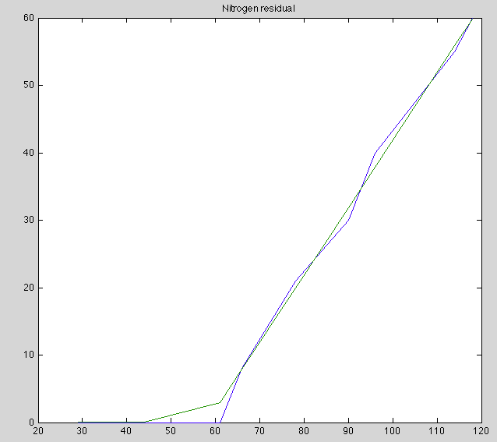
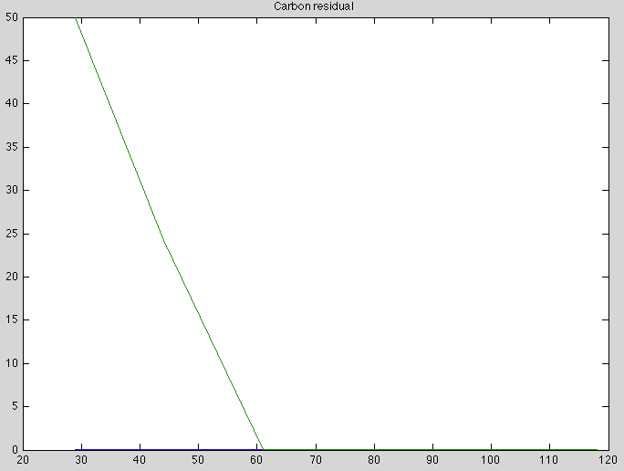
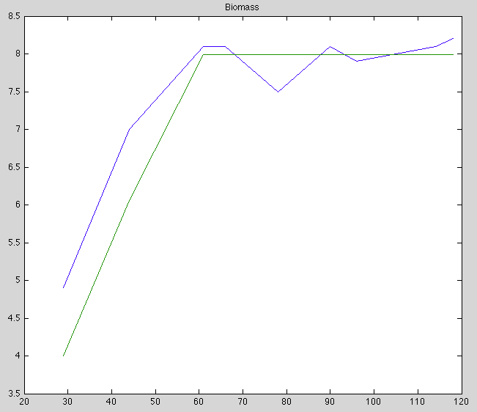
The Original Model Does Not Correspond With The Actual Values From ter. Schure et al (1995) paper in the Journal of Bacteriology
Nitrogen Residual
Carbon Residual
Biomass
= Original Model
= ter. Schure Model
Nitrogen residual (mM)
Carbon residual (mM)
Biomass (g/l)
NH₄⁺ concentration (mM)
NH₄⁺ concentration (mM)
NH₄⁺ concentration (mM)
Glucose was kept constant in the paper, leading to a glucose limited condition.
Carbon metabolism did not significantly change with increasing ammonia concentration above 44 mM NH₄⁺ in the paper, while the original model we suggested in class proposes that carbon residual changes.
Biomass and nitrogen were relatively accurate to the paper.

Slide 6
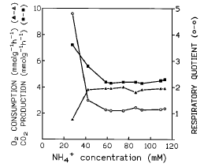
How Does Carbon Metabolism Under Anaerobic and Aerobic Conditions Relate to the ter. Schure et al (1995) paper in the Journal of Bacteriology?
Respiratory quotient= CO2 produced/O2 consumed
Fermentation occurs at 29 mM NH₄⁺.
Respiration occurs at 44 mM NH₄⁺.
Carbon metabolism does not significantly change after 44 mM NH₄⁺.
Yeast switch between fermentation and respiration depending on carbon concentration.

Slide 7
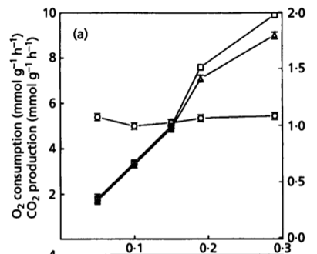
How Does Carbon Metabolism Under Anaerobic and Aerobic Conditions Relate to the ter. Schure et al (1995) paper in Microbiology?
There is an increase in both carbon dioxide production and oxygen consumption when increasing dilution rate (D) from 0.05 to 0.29 h⁻¹.
The respiration quotient was constant at all D values.
D (h⁻¹)

Slide 8
Model #1: Accounting For Different Usage Rates of Glucose
Edited System
Carbon: dc₁dt = q*u_{c}- q*c₁ -(((y*V_{c})*((c₁)²+c₁))/(K_{c}+ (c₁)²)*(c₂/(c₂+K_{n}))
Nitrogen: dc₂dt = q*u_{n} - q*c₂ -((y*V_{n})*((c₁)²+c₁)/(K_{c}+(c₁)²)*(c₂/(c₂+K_{n}))
Yeast: dydt = (y*r)*((c₁)²+c₁)/(K_{c}+(c₁)²)*(c₂/(c₂+K_{n})) - q*y
This system accounts for the differing rates of carbon use in shortage and surplus of glucose.
Yeast are inefficient with glucose use when glucose concentration is high. This model factors this in.
Parameter | Variable
Dilution rate | q
Nitrogen feed | u_{n}
Carbon feed | u_{c}
Growth rate | r
Reaction rates | V_{n}, V_{c}
Constants | K_{n}, K_{c}
State Variables | Variable
Carbon | c₁
Nitrogen | c₂
Yeast | y

Slide 9
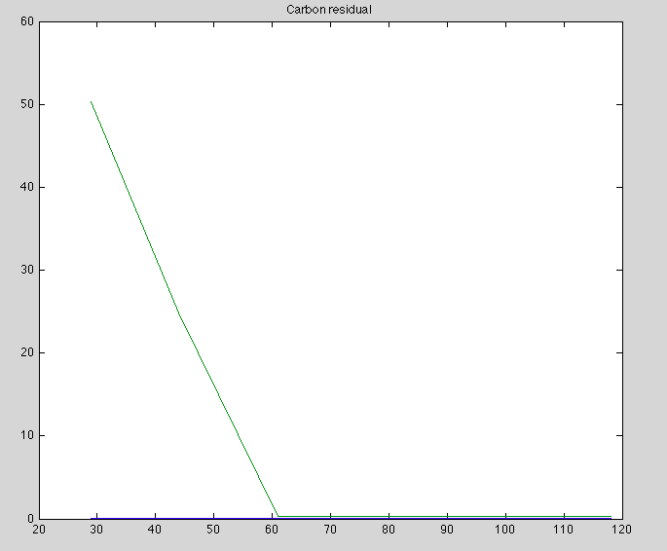
Model #1 First Run
Carbon Residual
Parameters | First Run
V_{n} | 53.8607
V_{c} | 92
K_{n} | 0.1000
K_{c} | 4.9
r | 7.4205
= Model #1
= ter. Schure Model
Carbon residual (mM)
NH₄⁺ concentration (mM)
Carbon residual did not change from the ter. Schure paper.
These are the same parameter values as the paper.

Slide 10
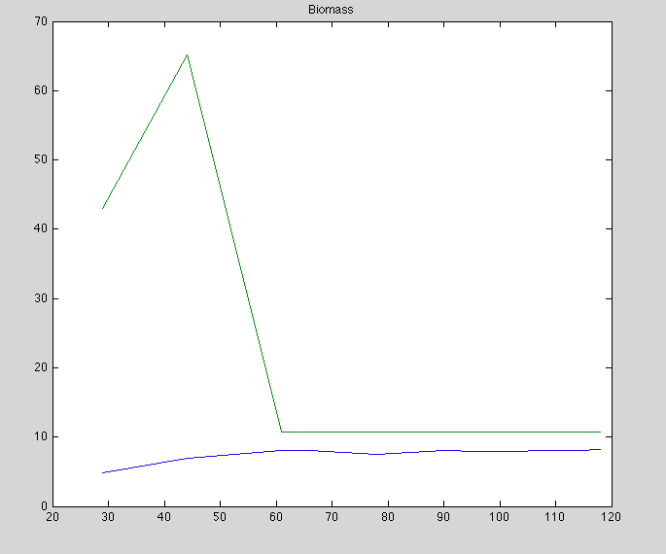
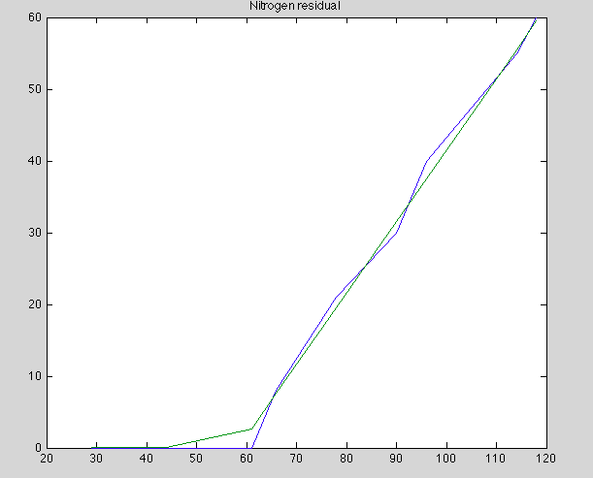

Model #1 First Run
Biomass
Nitrogen Residual
Biomass (g/l)
Nitrogen residual (mM)
NH₄⁺ concentration (mM)
NH₄⁺ concentration (mM)
Biomass peaked at 66 g/l when NH₄⁺ was 40 mM.
Nitrogen residual values were relatively accurate to the ter. Schure paper.

Slide 11
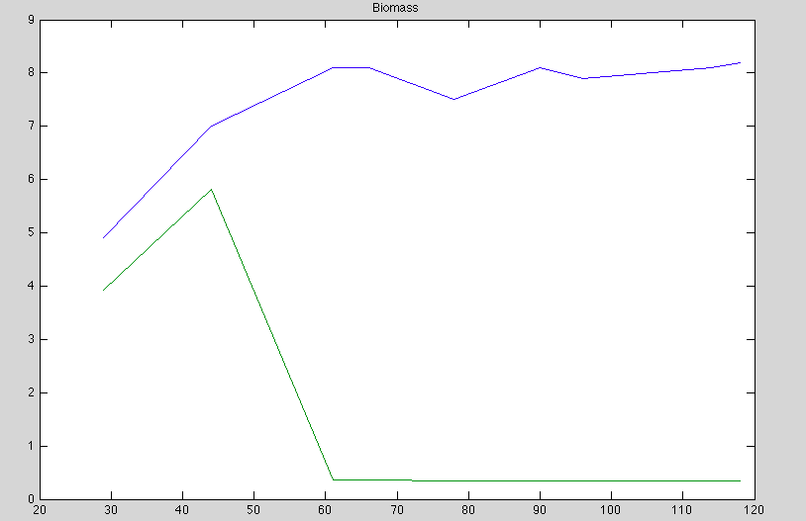
Model #1 Second Run
Biomass
Parameters | First Run | Second Run | Third Run
V_{n} | 53.8607 | 53.8607 | 53.8607
V_{c} | 92 | 92 | 92
K_{n} | 0.1000 | 0.1000 | 0.1000
K_{c} | 4.9 | 0.1 | 100
r | 7.4205 | 7.4205 | 7.4205
Biomass (g/l)
NH₄⁺ concentration (mM)
K_{c} value was decreased from 4.9 to 0.1, and the yeast population came close to dying off.

Slide 12
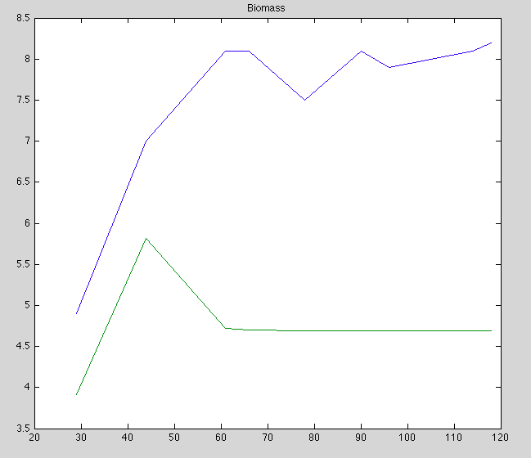
Model #1 Third Run
Biomass
Parameters | First Run | Second Run | Third Run
V_{n} | 53.8607 | 53.8607 | 53.8607
V_{c} | 92 | 92 | 92
K_{n} | 0.1000 | 0.1000 | 0.1000
K_{c} | 4.9 | 0.1 | 100
r | 7.4205 | 7.4205 | 7.4205
Biomass (g/l)
NH₄⁺ concentration (mM)
The value of K_{c} was changed to 100, and the yeast population reached a steady state at 4.8 g/l.

Slide 13


Model #2: Breaking Up Yeast Growth Rate and Carbon Usage in Anaerobic and Aerobic Conditions
System of Differential Equations
Carbon: dc₁dt = q*u_{c}- q*c₁ -((y*c₁*V_{c})/(K_{c}+c₁))*(c₂/(c₂+K_{n}))
Nitrogen: dc₂dt = q*u_{n} - q*c₂ -((y*c₁*V_{n})/(K_{c}+c₁))*(c₂/(c₂+K_{n}))
Yeast: dydt = (y*r)*(c₁)/(K_{c}+c₁)*(c₂/(c₂+K_{n})) - q*y
MATLAB Script Additions:
Parameter | Variable
Dilution rate | q
Nitrogen feed | u_{n}
Carbon feed | u_{c}
Growth rate | r
Reaction rates | V_{n}, V_{c}
Constants | K_{n}, K_{c}
State Variables | Variable
Carbon | c₁
Nitrogen | c₂
Yeast | y

Slide 14
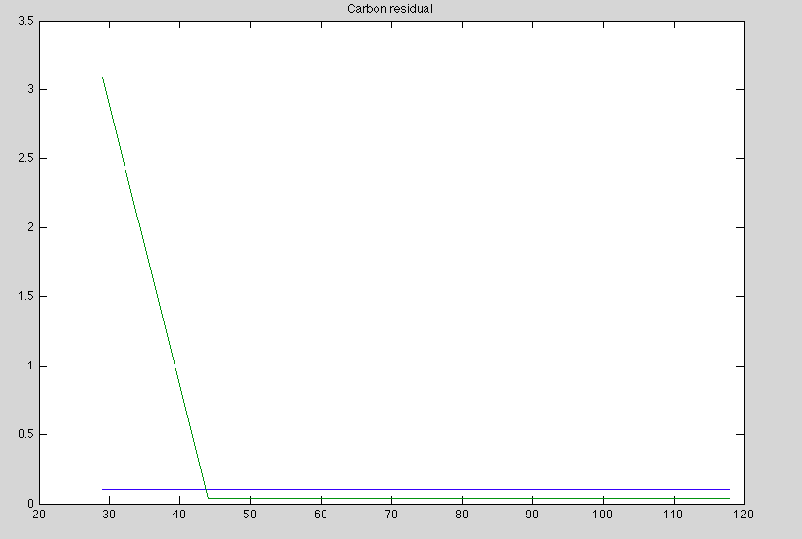
Model #2 First Run
Parameters | First Run
V_{n} | 53.8607
V_{cae} | 90
V_{can} | 180
K_{n} | 0.1000
K_{c} | 4.8231
r_{ae} | 7
r_{an} | 20
c_{an} | 10
Carbon Residual
= Model #2
= ter. Schure Model
Carbon residual (mM)
NH₄⁺ concentration (mM)
This model accounts for carbon use in anaerobic and aerobic growth conditions more accurately with respect to carbon residual.
The carbon residual values are much closer to the values in the ter. Schure paper.

Slide 15
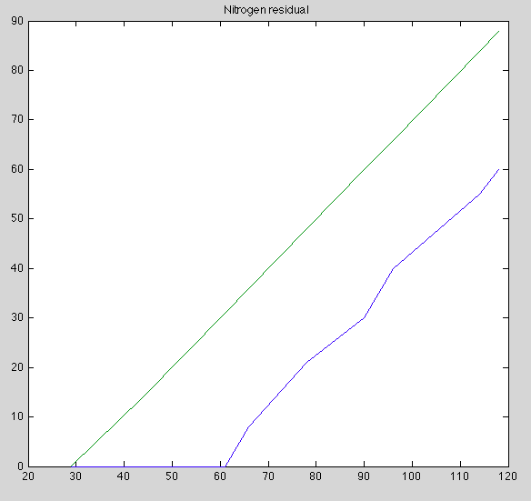
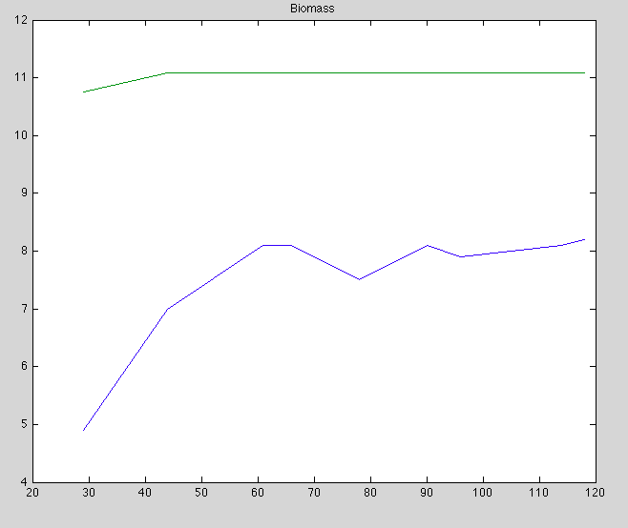

Model #2 First Run
Nitrogen Residual
Biomass
Nitrogen residual (mM)
Biomass (g/l)
NH₄⁺ concentration (mM)
NH₄⁺ concentration (mM)
Residual nitrogen and biomass were less accurate when compared to the ter. Schure paper data.

Slide 16
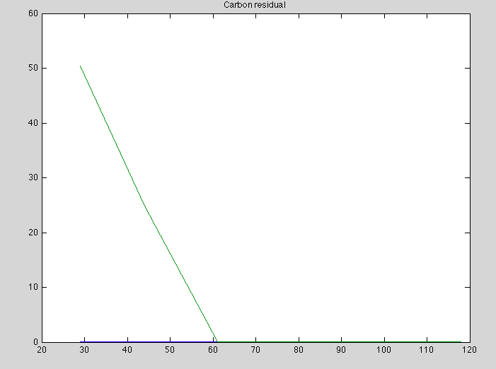
Model #2 Second Run
Parameters | First Run | Second Run
V_{n} | 53.8607 | 53.8607
V_{cae} | 90 | 90
V_{can} | 180 | 180
K_{n} | 0.1000 | 0.1000
K_{c} | 4.8231 | 4.8231
r_{ae} | 7 | 7
r_{an} | 20 | 20
c_{an} | 10 | 0.1
Carbon Residual
Carbon residual (mM)
NH₄⁺ concentration (mM)
The c_{an} value was decreased from 10 to 0.1 to test less anaerobic respiration and more aerobic respiration.
This run does not compare well for residual carbon.

Slide 17
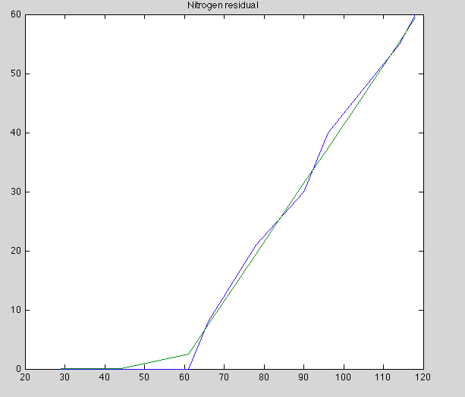
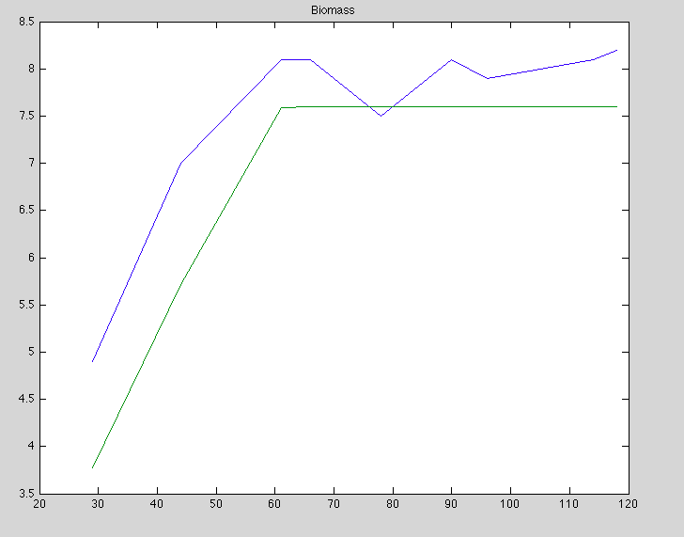
Model #2 Second Run
Nitrogen Residual
Biomass
Nitrogen residual (mM)
Biomass (mM)
NH₄⁺ concentration (mM)
NH₄⁺ concentration (mM)
Residual nitrogen and biomass values were similar to both Model #1 and the ter. Schure paper values.

Slide 18
Summary
The original chemostat model does not account for anaerobic and aerobic rates of carbon use efficiency and yeast growth.
Two models proposed alternate attempts at aligning our data with the data in the ter. Schure et al (1995) paper in Journal of Bacteriology.
Model #2: Breaking Up Yeast Growth Rate and Carbon Usage in Anaerobic and Aerobic Conditions
The second model’s residual carbon was the most accurate to the data presented in the paper for the parameter values that we tested.

Slide 19
Future Considerations
Testing for more parameter values
Using an exponential function to describe growth rate
Individual carbon use efficiency per yeast cell
Using a different modeling program to model the system

Slide 20
Works Cited
Differential Equations with Boundary-Value Problems. 7th ed. CA: Brooks/Cole, Cengage Learning, 2009. Print.
Nelson, David L., and Michael M. Cox. Principles of Biochemistry. 5th ed. New York: W.H. Freeman and Company, 2008. Print.
Ter Schure, Eelko G., et al. "Nitrogen-regulated transcription and enzyme activities in continuous cultures of Saccharomyces cerevisiae." Microbiology 141.5 (1995): n. pag. Print.
Ter Schure, Eelko G., et al. “The Concentration of Ammonia Regulates Nitrogen Metabolism in Saccharomyces cerevisiae." Journal of Bacteriology 177.22 (1995): n. pag. Print.

Slide 21
Acknowledgements
Dr. Dahlquist
Department of Biology
Loyola Marymount University
Dr. Fitzpatrick
Department of Mathematics
Loyola Marymount University

