Slide 1
RAW DATA STEM

Slide 2
DATA TABLE
ANOVA | WT
p < 0.05 | 2600, 42%
p < 0.01 | 1727, 27%
p < 0.001 | 1015, 16%
p < 0.0001 | 574, 9%
B & H p < 0.05 | 302, 5%
Bonferroni p < 0.05 | 1936, 31%

Slide 3
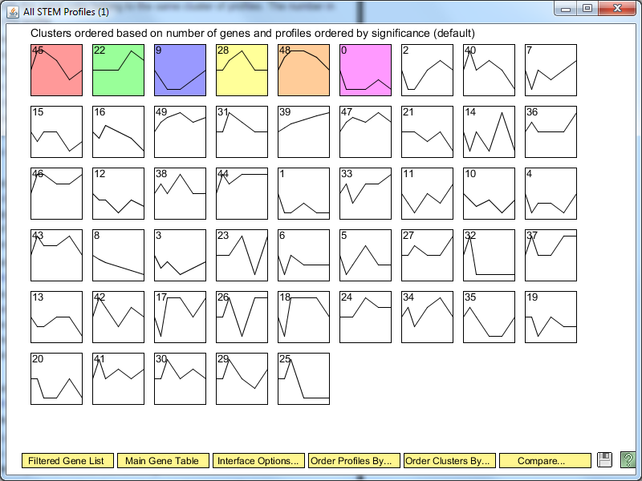

Slide 4
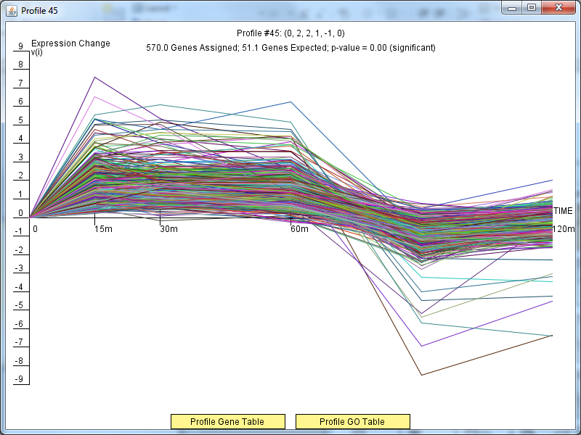

Slide 5
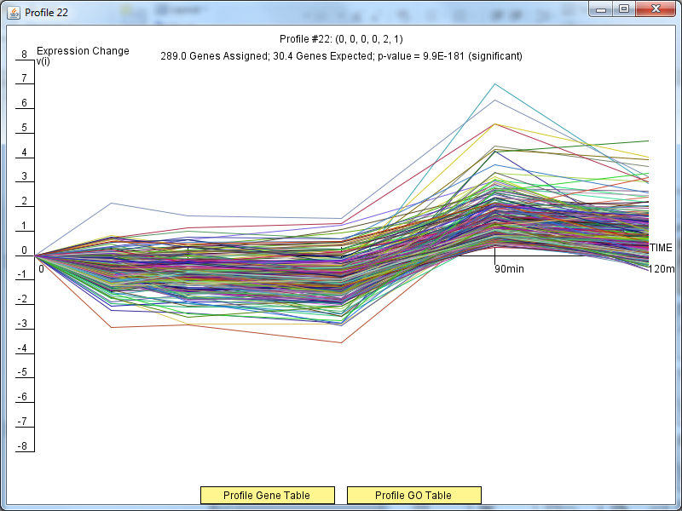

Slide 6
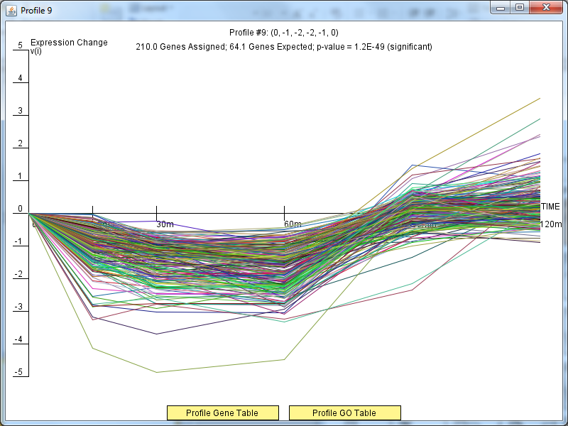

Slide 7
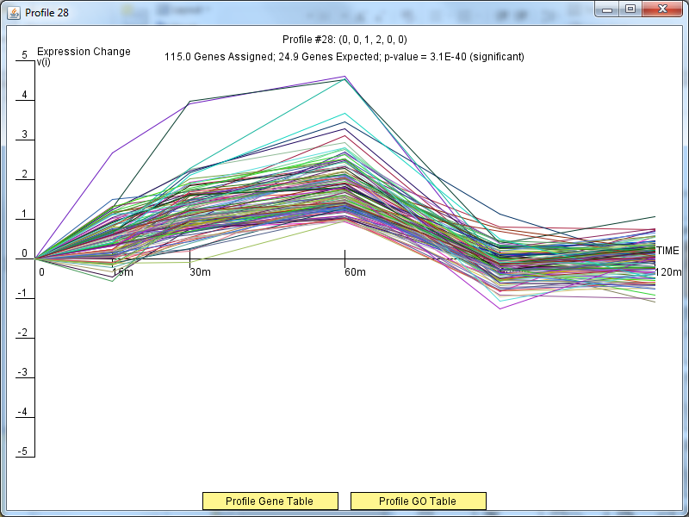

Slide 8
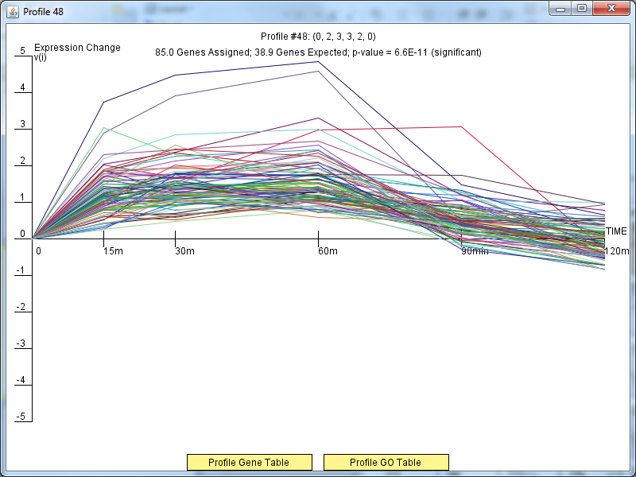

Slide 9
