Slide 1
Cytoscape: A Software Environment for Integrated Models of Biomolecular Interaction Networks
Shannon, P., Markiel, A., Ozier, O., Baliga, N. S., Wang, J. T., Ramage, D., ... & Ideker, T. (2003). Cytoscape: a software environment for integrated models of biomolecular interaction networks. Genome research, 13(11), 2498-2504.
Nicole Anguiano and Anu Varshneya
5/20/15

Slide 2
Outline
Cytoscape is a visualization tool that allows for the visualization of many biological pathways and networks.
Cytoscape’s user interface allows for graph customization.
Cytoscape allows for the use of plugins to expand functionality.
Cytoscape can perform more tasks than GRNsight at the cost of greater complexity and resource use.

Slide 3
Outline
Cytoscape is a visualization tool that allows for the visualization of many biological pathways and networks.
Cytoscape’s user interface allows for graph customization.
Cytoscape allows for the use of plugins to expand functionality.
Cytoscape can perform more tasks than GRNsight at the cost of greater complexity and resource use.

Slide 4
Background
Computer-aided data visualization of biological networks is a key aspect of systems biology.

Slide 5
Background
Computer-aided data visualization of biological networks is a key aspect of systems biology.
However, many softwares focus on specific processes or pathways.

Slide 6
What is Cytoscape?
A data visualization tool for creating network diagrams incorporating both biomolecular interactions and states, bridged with model parameters and other biological attributes (GO classifications).

Slide 7
Outline
Cytoscape is a visualization tool that allows for the visualization of many biological pathways and networks.
Cytoscape’s user interface allows for graph customization.
Cytoscape allows for the use of plugins to expand functionality.
Cytoscape can perform more tasks than GRNsight at the cost of greater complexity and resource use.

Slide 8
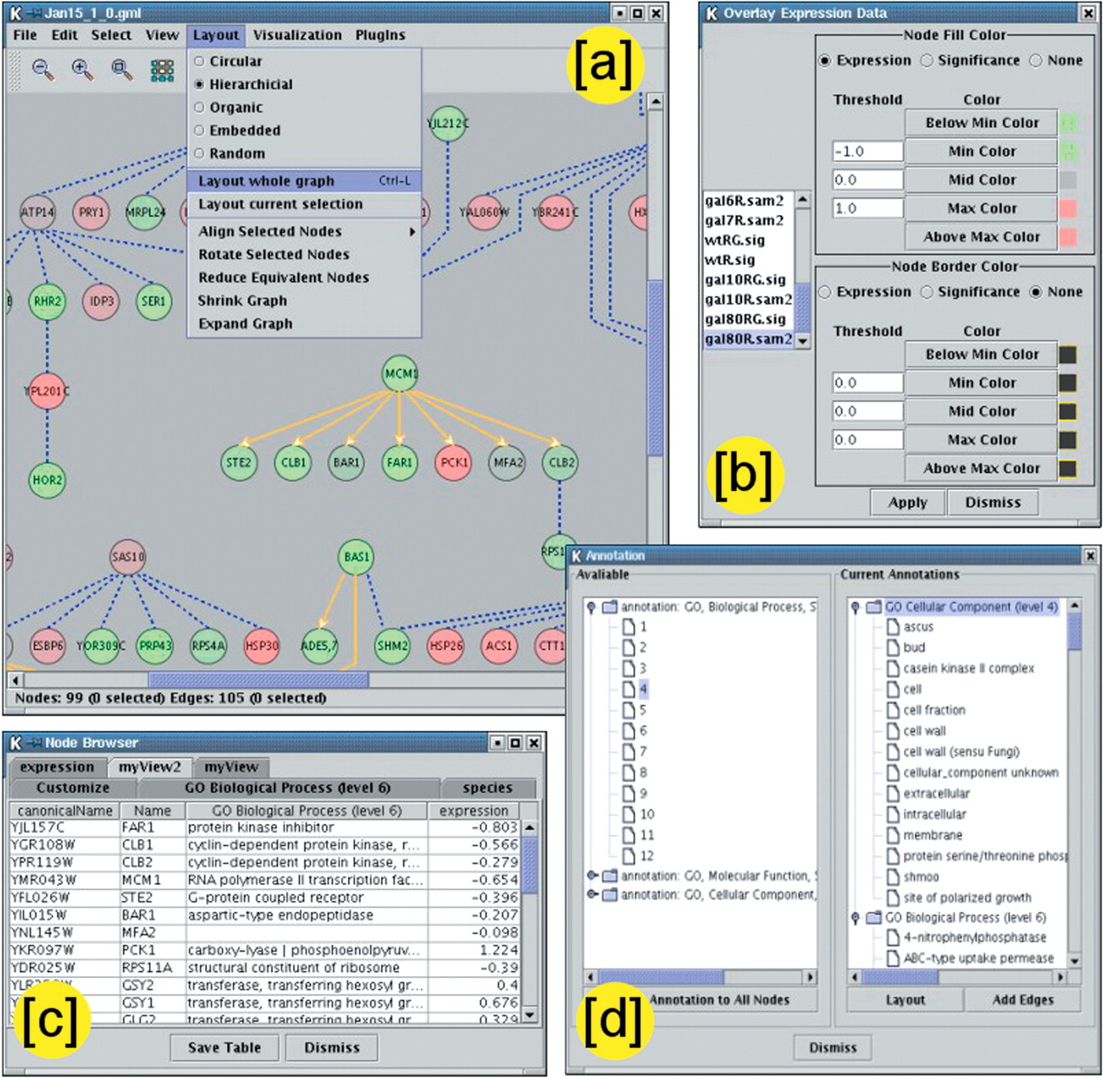
Various menu options demonstrating Cytoscape’s core functionality

Slide 9
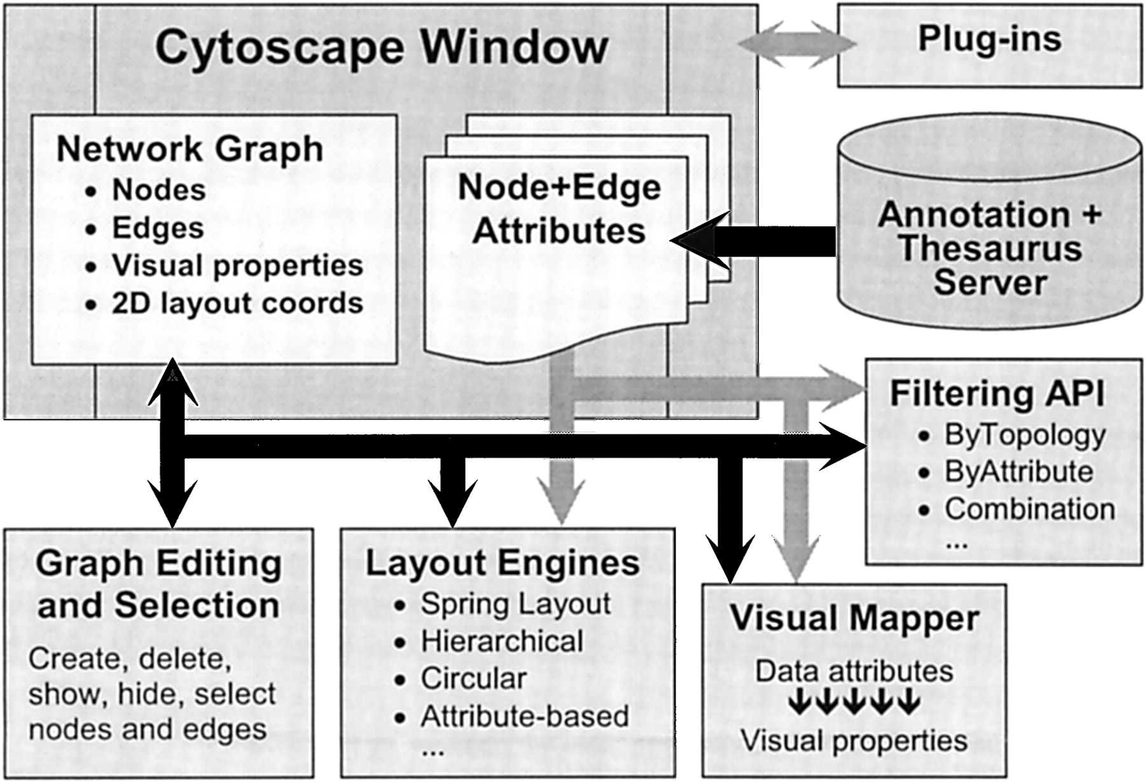
Cytoscape’s core architecture including key operations

Slide 10
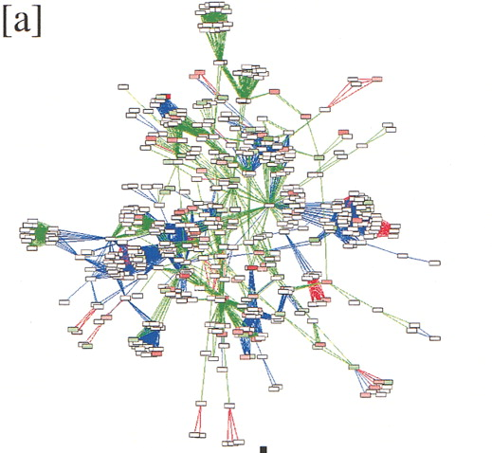
Largest connected component of Halobacterium with color coded edges and nodes

Slide 11
Attribute based layout organizes the network according to functional classes (edges hidden for clarity)

Slide 12
A highly connected subnetwork revealing suppression effects on metabolic pathways

Slide 13
Outline
Cytoscape is a visualization tool that allows for the visualization of many biological pathways and networks.
Cytoscape’s user interface allows for graph customization.
Cytoscape allows for the use of plugins to expand functionality.
Cytoscape can perform more tasks than GRNsight at the cost of greater complexity and resource use.

Slide 14
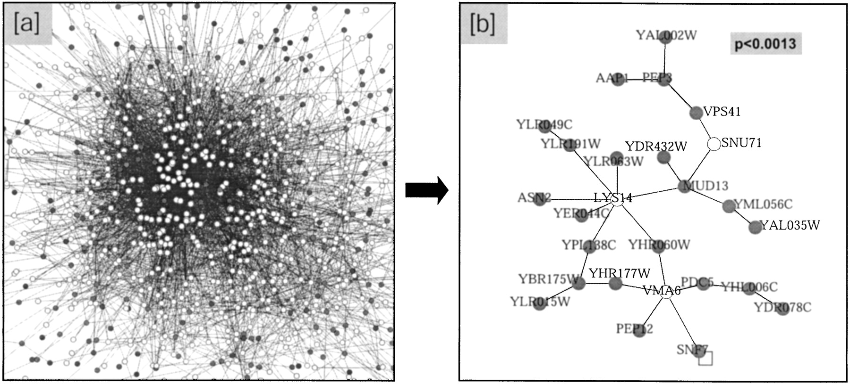
Cytoscape can simplify to only required proteins, and further to only highly significant proteins
[b] ActiveModules plug-in

Slide 15
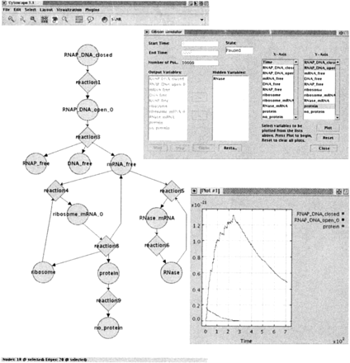
A plugin that allows Cytoscape to interpret Systems Biology Markup Language (SBML)-encoded biological models

Slide 16
Cytoscape’s future goals were focused on plugin development
While the Cytoscape core handles basic features such as network layout, the major features are plugin-based.
At the time of the writing of the paper, they were aiming to expand the Cytoscape core to establish direct connection to external databases (DIP, GEO, GO)
Direct connection with GO is in the Cystoscape core
The rest are implemented in plugins

Slide 17
Outline
Cytoscape is a visualization tool that allows for the visualization of many biological pathways and networks.
Cytoscape’s user interface allows for graph customization.
Cytoscape allows for the use of plugins to expand functionality.
Cytoscape can perform more tasks than GRNsight at the cost of greater complexity and resource use.

Slide 18
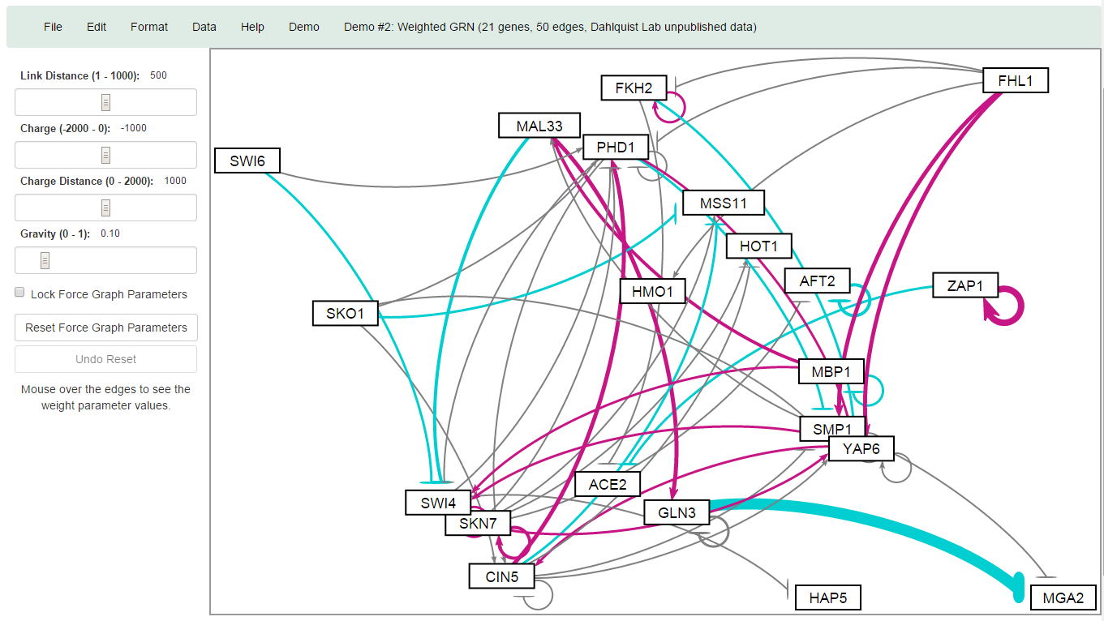

Slide 19
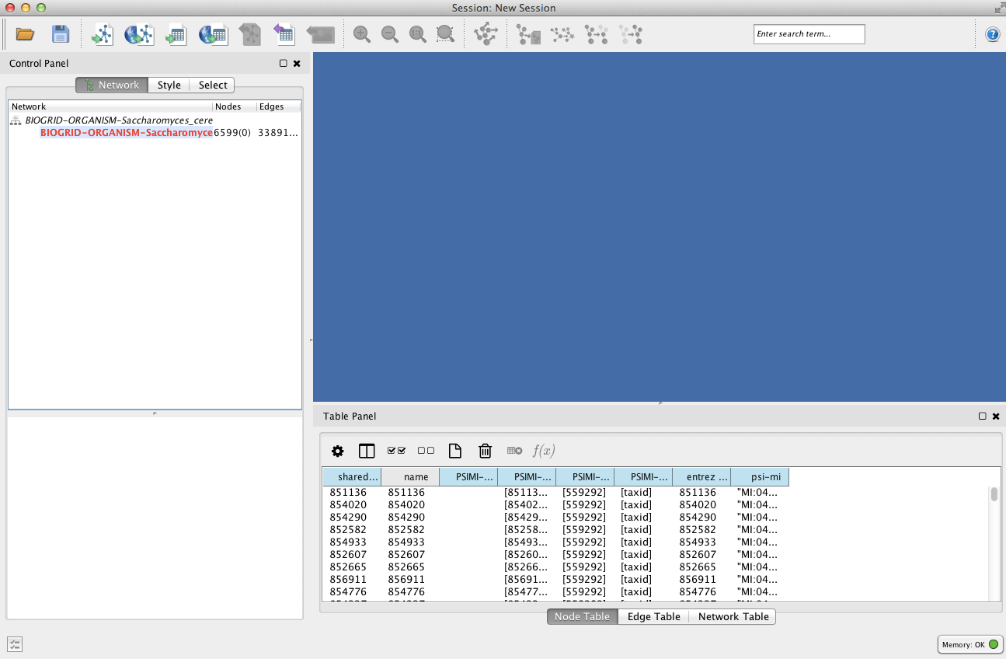
Cytoscape’s user interface has changed since the writing of the paper

Slide 20
Cytoscape allows the processing of large networks at the cost of significantly greater complexity
GRNsight performs a much more specific function - the visualization of GRNs
Fast, lightweight program
Intuitive and easy to use
Cytoscape allows for visualization of very large GRNs and biological pathways, clustering of loaded networks, and allows for integrations
In exchange for the customizability, it is significantly more complex
Much more resource intensive to run

Slide 21
Summary
Cytoscape is a visualization tool that allows for the visualization of biological pathways and networks.
Cytoscape’s user interface allows for graph customization.
Cytoscape allows for the use of plugins to expand functionality and adjust graph layout.
Cytoscape can perform more tasks than GRNsight, at the cost of greater complexity and resource use.

Slide 22
Citation
Shannon, P., Markiel, A., Ozier, O., Baliga, N. S., Wang, J. T., Ramage, D., ... & Ideker, T. (2003). Cytoscape: a software environment for integrated models of biomolecular interaction networks. Genome research, 13(11), 2498-2504.

Slide 23
Acknowledgments
Loyola Marymount University
Kam D. Dahlquist, Ph. D

