Slide 1
Percentages of specific p-value data
Table 1: Bonferroni-adjusted p-value proved most selective with 3.68% while, as expected, the other data became more specific as the p-value became more stringent
ANOVA | WT | dZAP1
p < 0.05 | 2378/6189 (31.42%) | 2264/6189 (36.58%)
p < 0.01 | 1527/6189 (24.67%) | 1445/6189 (23.35%)
p < 0.001 | 860/6189 (13.90%) | 792/6189 (12.80%)
p < 0.0001 | 460/6189 (7.43%) | 414/6189 (6.69%)
B-H p < 0.05 | 1656/6189 (26.76%) | 1538/6189 (24.85%)
Bonferroni p < 0.05 | 228/6189 (3.68%) | 192/6189 (3.10%)
Notes:
From Excel data/calculations

Slide 2
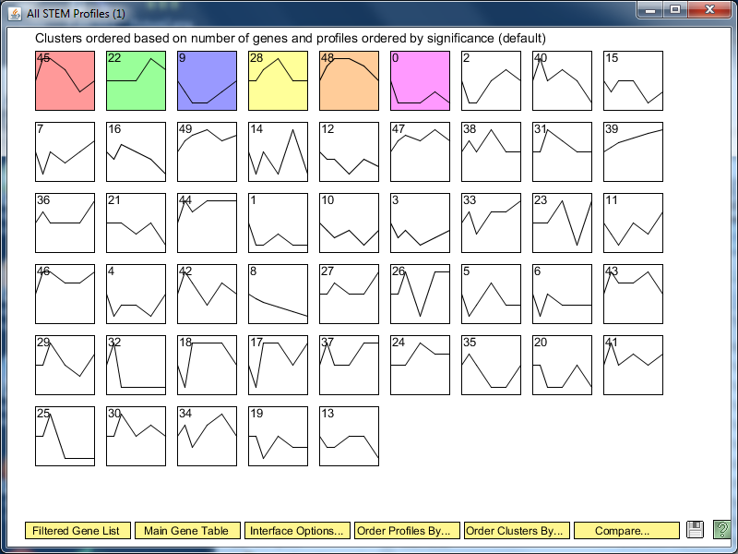
Overall STEM Profile Results for Wild Type

Slide 3
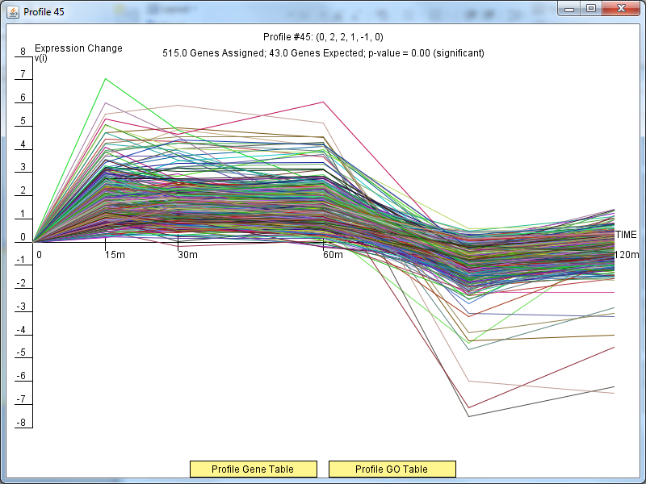
Profile 45 Results

Slide 4
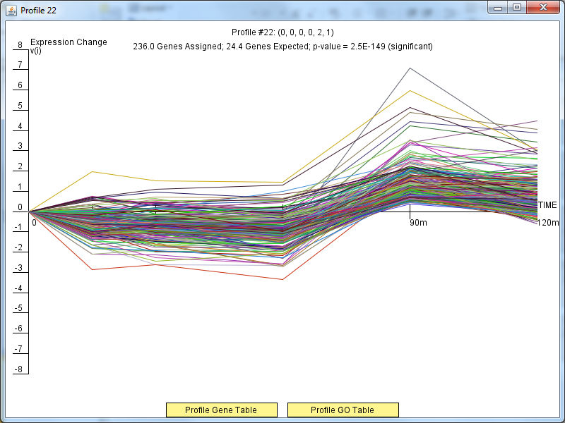
Profile 22 Results

Slide 5
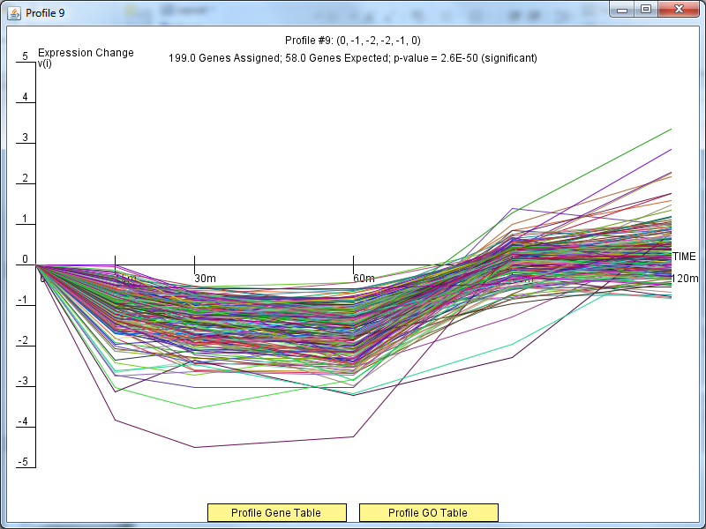
Profile 9 Results

Slide 6
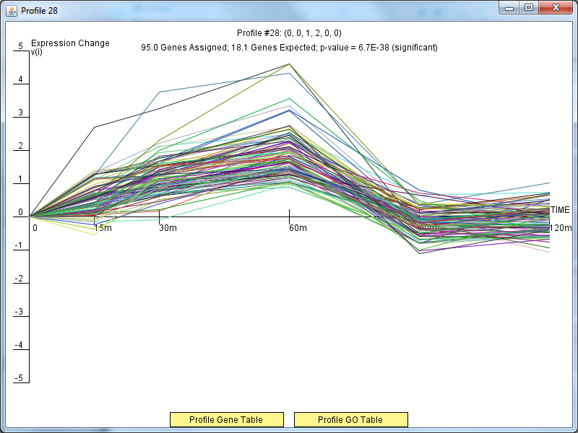
Profile 28 Results

Slide 7
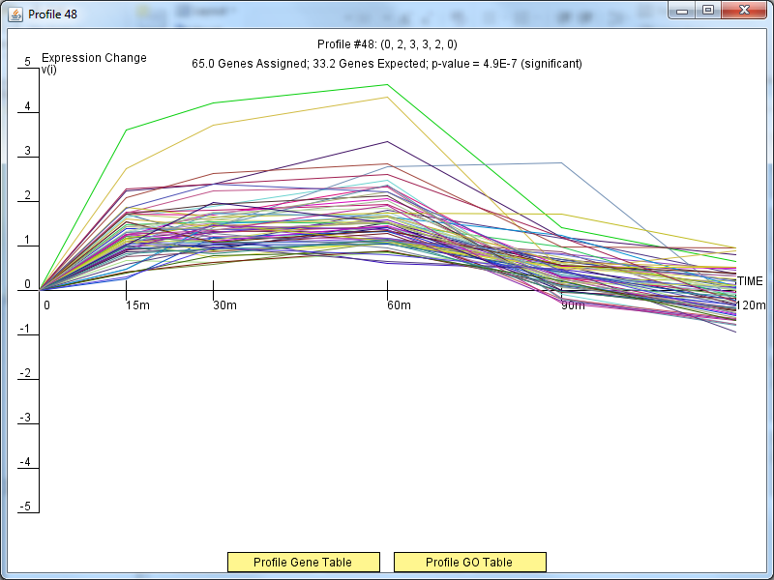
Profile 48 Results

Slide 8
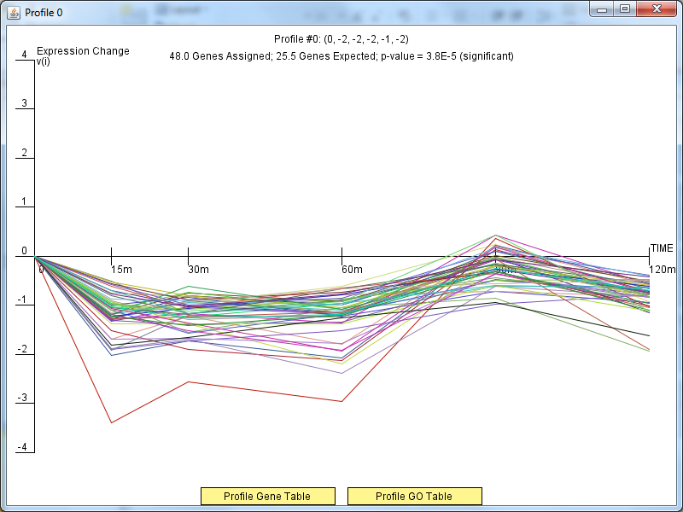
Profile 0 Results

