Slide 1
Kimberly Willis
Autumn Quarter 2013

Slide 2
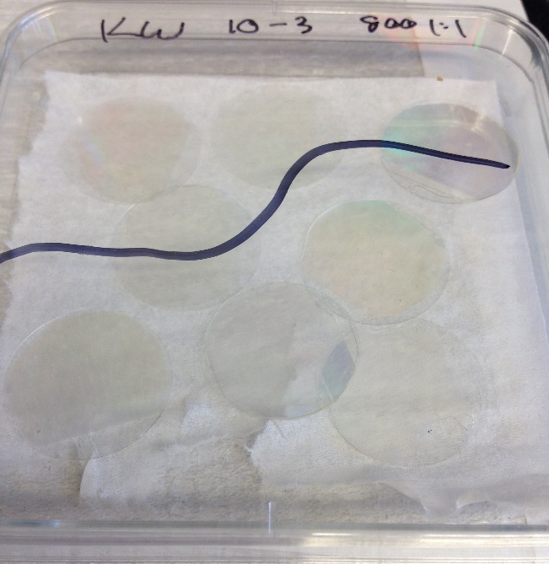
Fabrication
I began with fabricating patterned and flat scaffolds, priming my own glass soon after
Some of the scaffolds that I have made are now being used in a preliminary experiment of Cameron’s

Slide 3
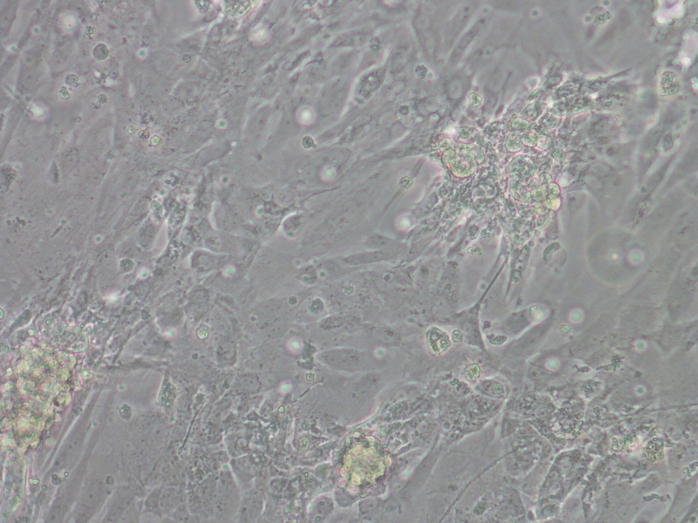
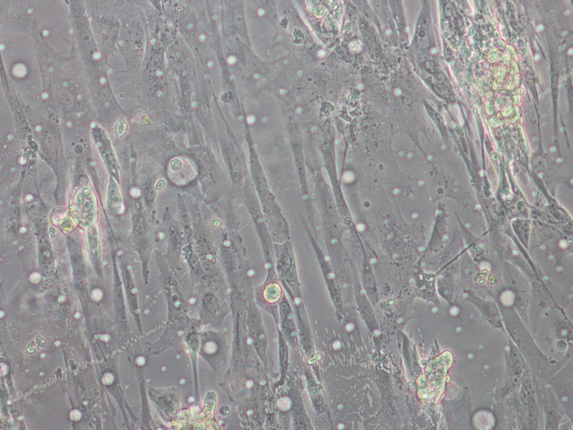
Monolayers on Patterns and Flats
Some preliminary experiments for the effects on aggregation of using an RGD peptide rather than fibronectin for cardiomyocytes have been imaged
Fibronectin coated 800 1:1 pattern
Peptide-coated 800 1:1 pattern

Slide 4
Future
Different cell phenotypes seem to be present
Nano islands seeded with CVPs will be imaged after fixing and staining
CVP cells on Pattern 11, Island 1

