Slide 1
Validated Automatic Segmentation of AMD Pathology Including Drusen and Geographic Atrophy in SD-OCT Images
Chiu, S. J., Izatt, J. A., O’Connell, R. V., Winter, K. P., Toth, C. A., & Farsiu, S. (2012). Validated Automatic Segmentation of AMD Pathology Including Drusen and Geographic Atrophy in SD-OCT Images. Invest Ophthalmol Vis Sci, 53(1), 53-61.
Brandon Klein
Department of Biology
Loyola Marymount University
June 17, 2015

Slide 2
Outline
AMD research needs automatic segmentation
  Discussion on AMD
  Uses of OCT imaging
  Importance of Segmentation
Development of an algorithm suited for AMD
  Segmentation guidelines
  Algorithm programming
  Assessment of results
Evaluation of the algorithm
  Algorithm is validated
  Errors persist
  Applications
Summary
Implications

Slide 3
Outline
AMD research needs automatic segmentation
  Discussion on AMD
  Uses of OCT imaging
  Importance of Segmentation
Development of an algorithm suited for AMD
  Segmentation guidelines
  Algorithm programming
  Assessment of results
Evaluation of the algorithm
  Algorithm is validated
  Errors persist
  Applications
Summary
Implications

Slide 4
Why Age-related Macular Degeneration Research?
Age-related macular degeneration (AMD) is the leading cause of irreversible blindness in Americans over the age of 60.
The pathogenesis of AMD is poorly understood.
  Nonneovascular (dry) AMD is characterized by drusen and geographic atrophy (GA).
  Neovascular (wet) AMD exhibits choroidal neovascularization and pigment epithelial detachment.
All forms of vision loss due to Nonneovascular AMD are presently irreversible.

Slide 5
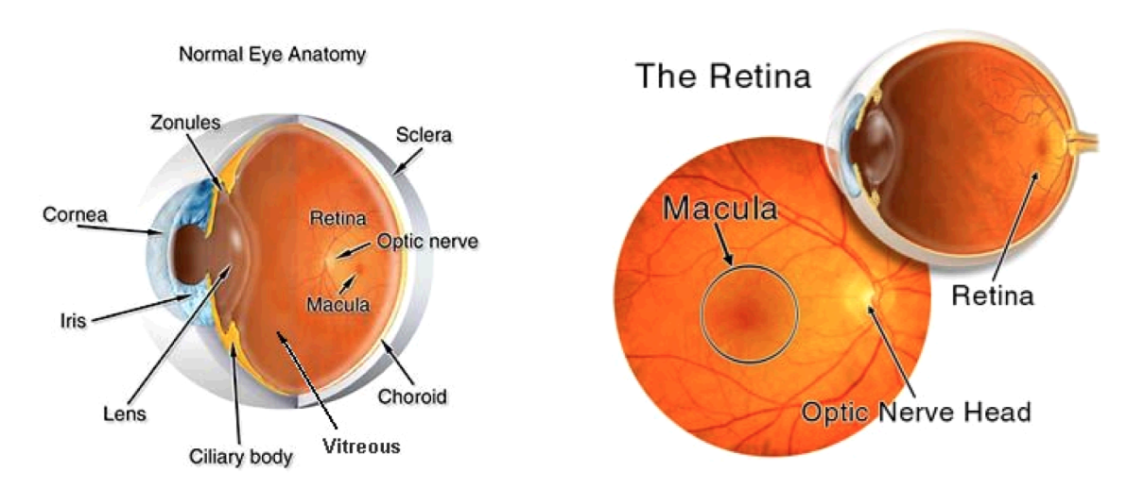
AMD Pathology Manifests in the Retina
The macula, located roughly in the center of the retina, is the site of degeneration in AMD.
Frank ter Haar. Automatic localization of the optic disc in digital colour images of the human retina. 2005.

Slide 6
Optical Coherence Tomography Visualizes the Retina
Optical Coherence Tomography (OCT) is used to generate cross-sectional images of the retina, called B-scans.
  This technology is non-invasive and can be used in vivo.
  The advent of spectral domain (SD) instruments greatly reduced exam time and increased image resolution.
SD-OCT instruments recently became commercially available.
  This has generated a boom in retinal data.

Slide 7
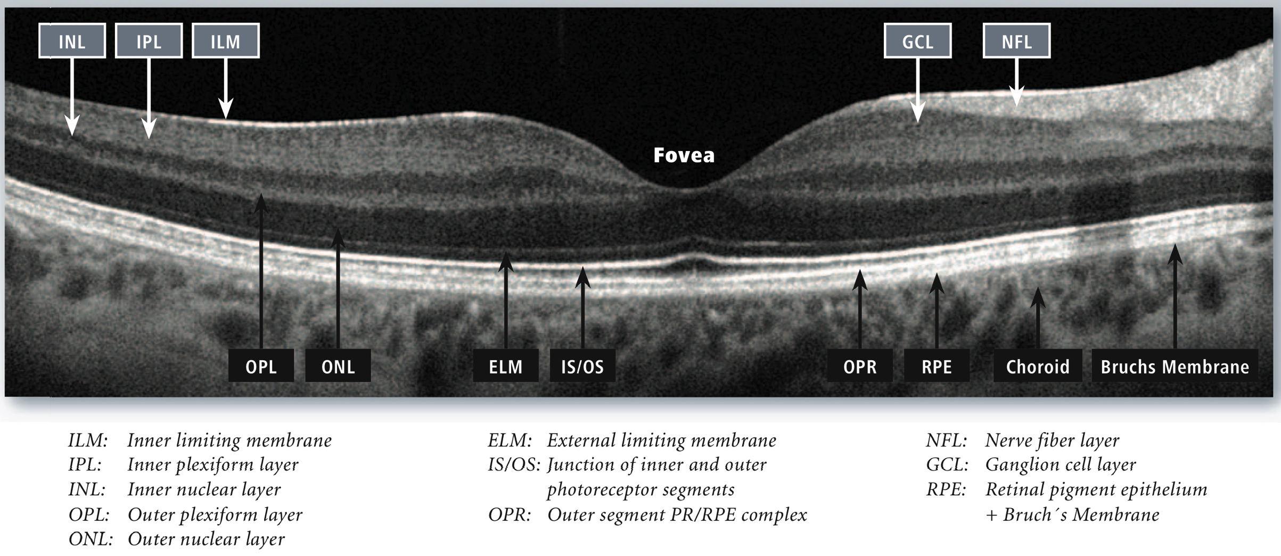
OCT Images Detail Microscopic Retinal Layers
*
*
*
*
All retinal layers can be distinguished in this high-resolution OCT image of a healthy individual. Note the NFL-OPL and IS-RPE regions for later.
Desinee Drakulich. OCT- What We Can See. 2012.

Slide 8
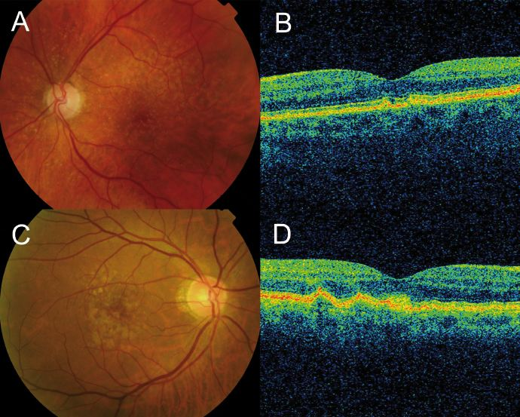
Drusen Form Complexes with the RPE
Drusen present as undulations in RPE, which together are termed the RPE+drusen complex (RPEDC).
Alfredo Garcia-Layana et al. AMD Book. 2011.

Slide 9
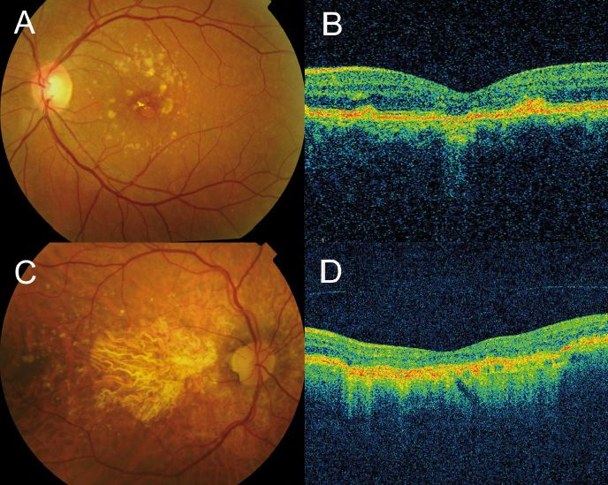
Geographic Atrophy Degrades the RPE
Geographic atrophy is characterized by RPE thinning and greater beam penetration into the choroid.
Alfredo Garcia-Layana et al. AMD Book. 2011.

Slide 10
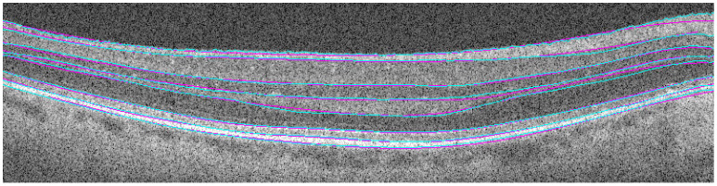
Algorithms Exist to Segment Retinal Layers in OCT Images
Boundaries drawn using an algorithm (cyan) accurately mirror certified manual segmentation (magenta).
Stephanie Chiu et al. Optics express. 2010.

Slide 11
Segmentation Algorithms for Use in AMD Studies Are Needed
Automatic segmentation of OCT images is of interest to AMD researchers.
  Segmentation can yield quantitative data to analyze pathology progression.
  Automation is far more practical for large data sets.
Current algorithms are unreliable in AMD cases.
  RPE distortions are not consistently segmented.
Question: Can current algorithms be improved to reliably segment OCT images from AMD patients?

Slide 12
Outline
AMD research needs automatic segmentation
  Discussion on AMD
  Uses of OCT imaging
  Importance of Segmentation
Development of an algorithm suited for AMD
  Segmentation guidelines
  Algorithm programming
  Assessment of results
Evaluation of the algorithm
  Algorithm is validated
  Errors persist
  Applications
Summary
Implications

Slide 13
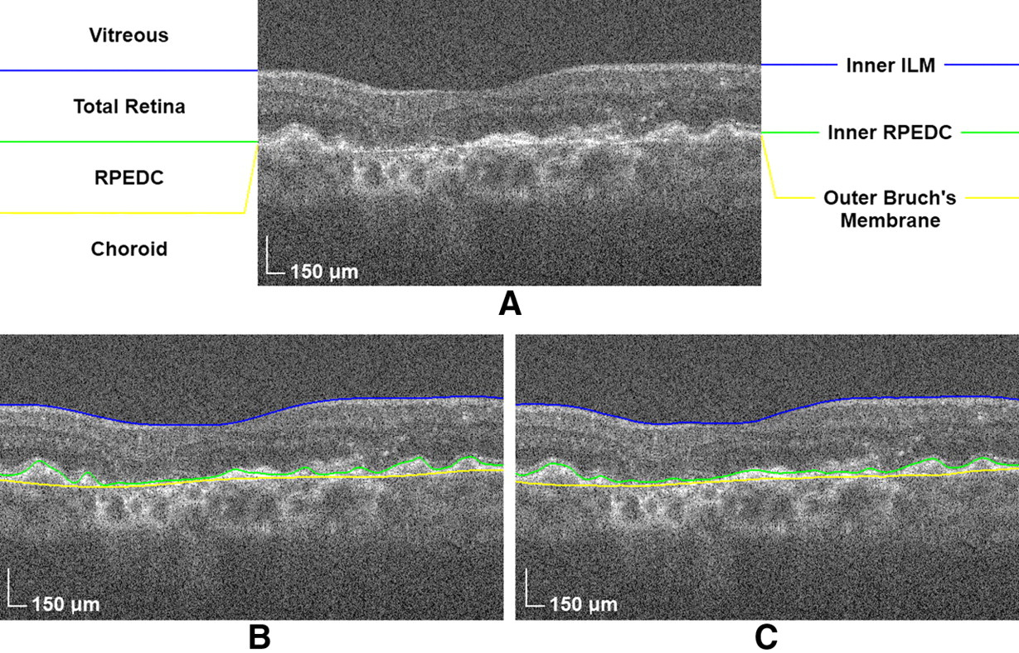
Novel Guidelines Proposed for Retinal Segmentation in AMD Cases
Figure 1 outlines the proposed barriers for automatic retinal segmentation in patients exhibiting AMD pathology.

Slide 14
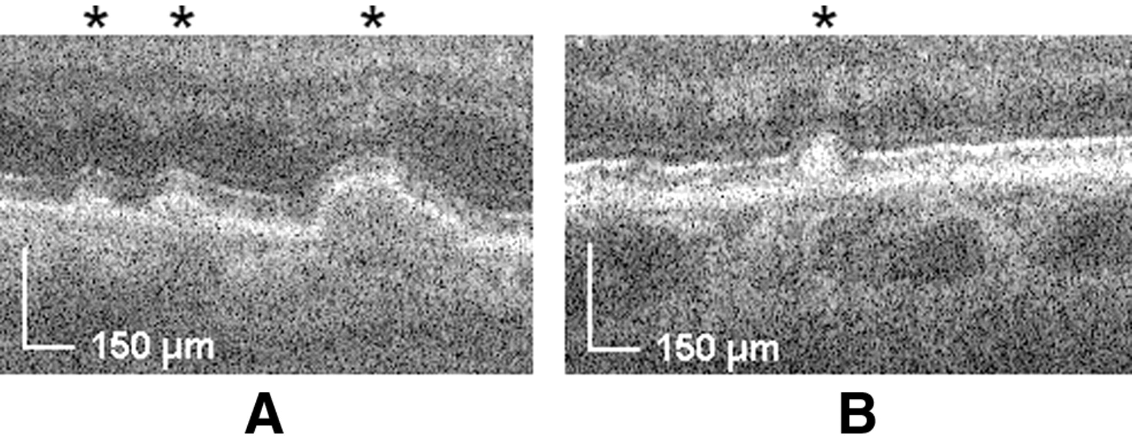
All Drusen Classify as RPEDC
Figure 2 pictures drusen types that will be classified as RPEDC.
(A) Asterisks denote drusen below the RPE.
(B) Asterisk denotes drusen above the RPE.

Slide 15
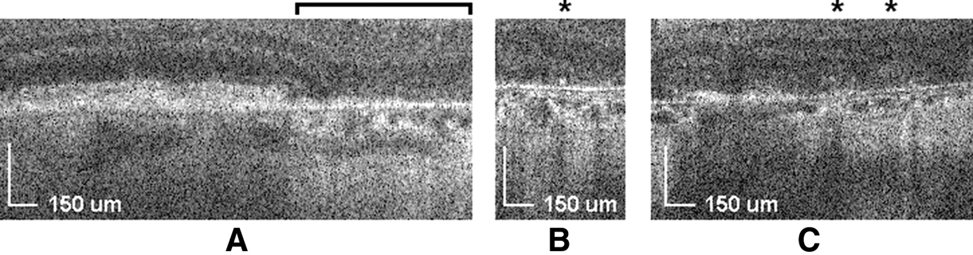
GA Artifacts Excluded from the RPEDC
Figure 3. In cases that exhibit geographic atrophy (A), artifacts above nearly absent RPE as in (B) and (C) are not classified as RPEDC.

Slide 16
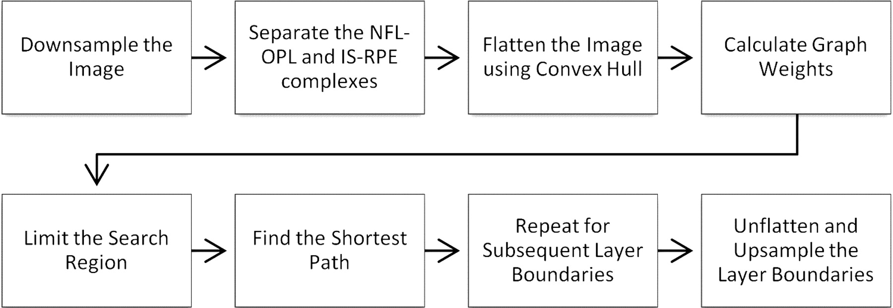
Eight Step Algorithm Used for Segmentation
Figure 4 presents the core steps used in the MATLAB segmentation algorithm to automatically segment OCT B-scans in a flow chart.

Slide 17
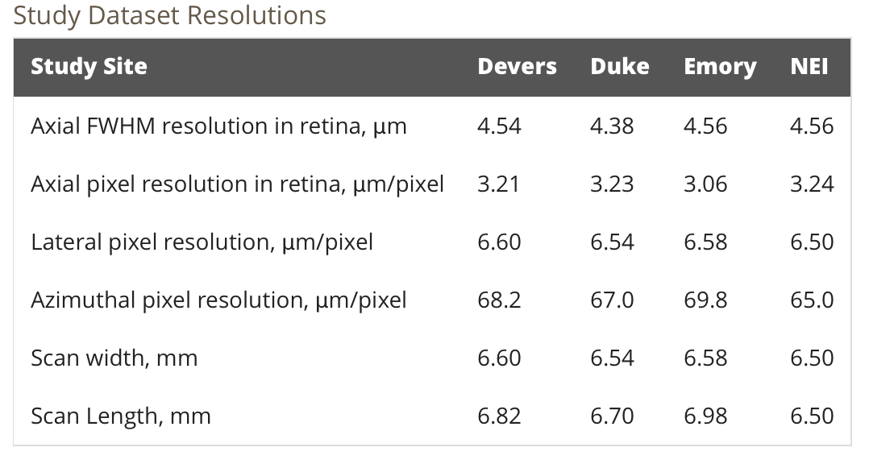
Resolutions of OCT Test Data Vary by Site
Table 1 demonstrates variability in various OCT measurement resolutions among different study datasets.

Slide 18
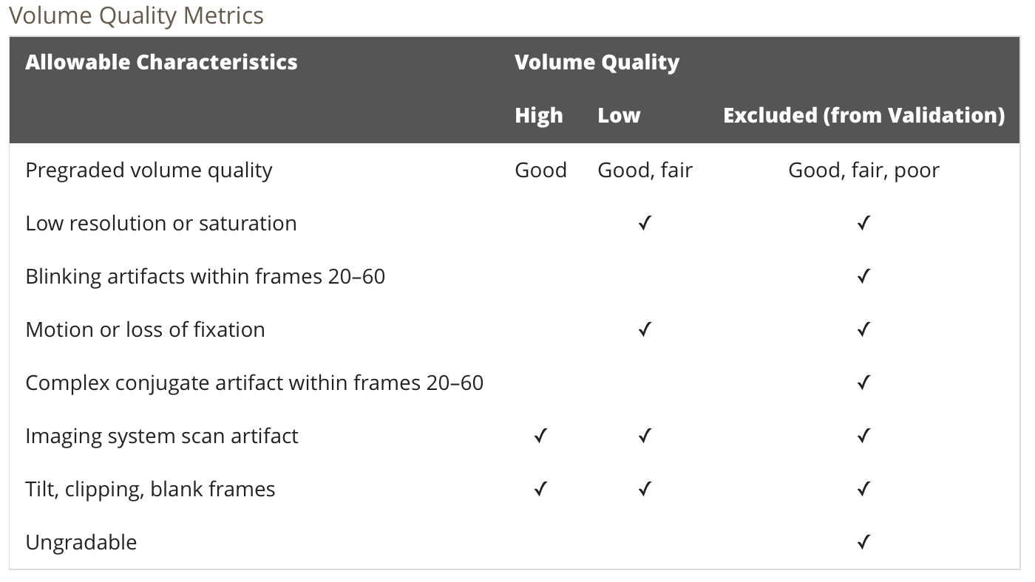
B-scans Graded by Volume Quality
Table 2 details the guidelines used for designation of exam quality based on seven key characteristics.

Slide 19
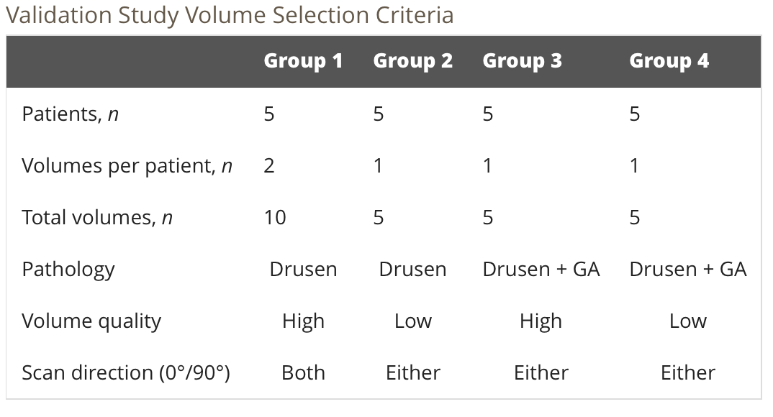
Five Patients from Each Group Selected for Validation Study
Table 3 details the four image groups from which volumes were drawn for reproducibility and accuracy testing.

Slide 20
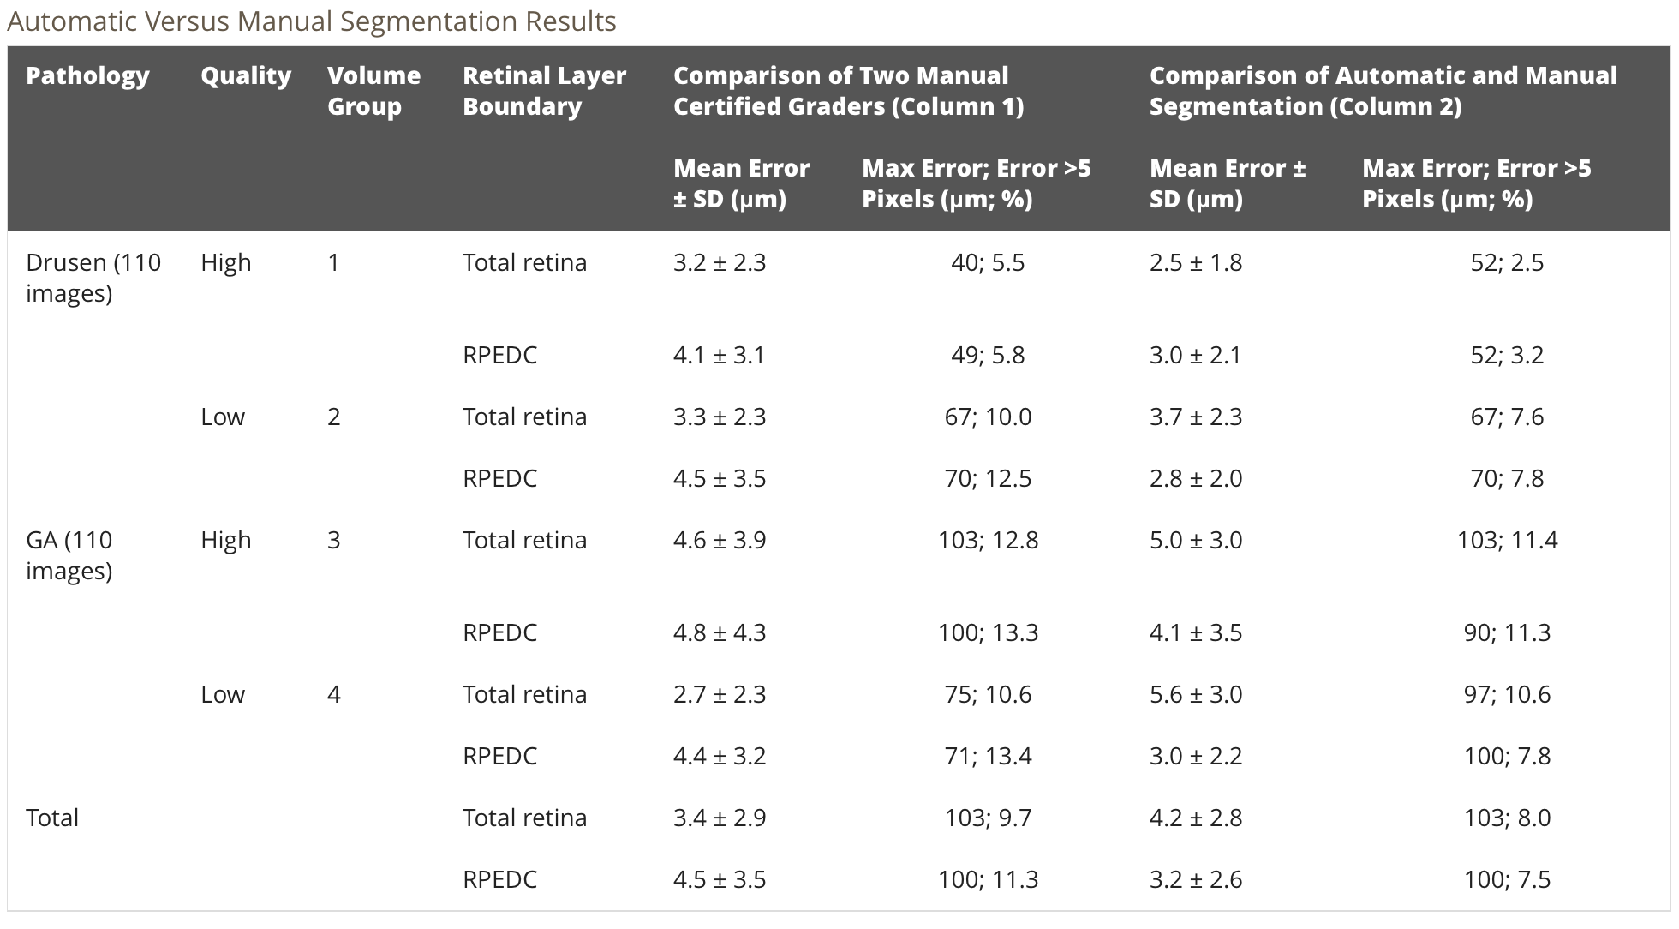
Automatic and Manual Segmentation Results Compare Favorably
Table 4 lists segmentation errors between two manual graders (column 1) as well as between a manual grader and the algorithm (column 2).

Slide 21
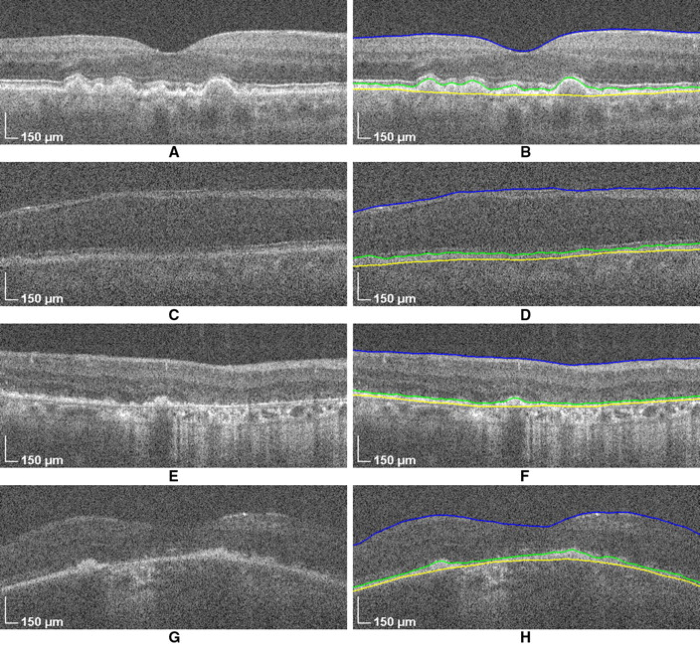
Algorithm Successfully Segments Images from All Groups
Group 1
Group 2
Group 3
Group 4
Figure 5 presents unsegmented B-scans from each image group and their corresponding automatically segmented results.

Slide 22
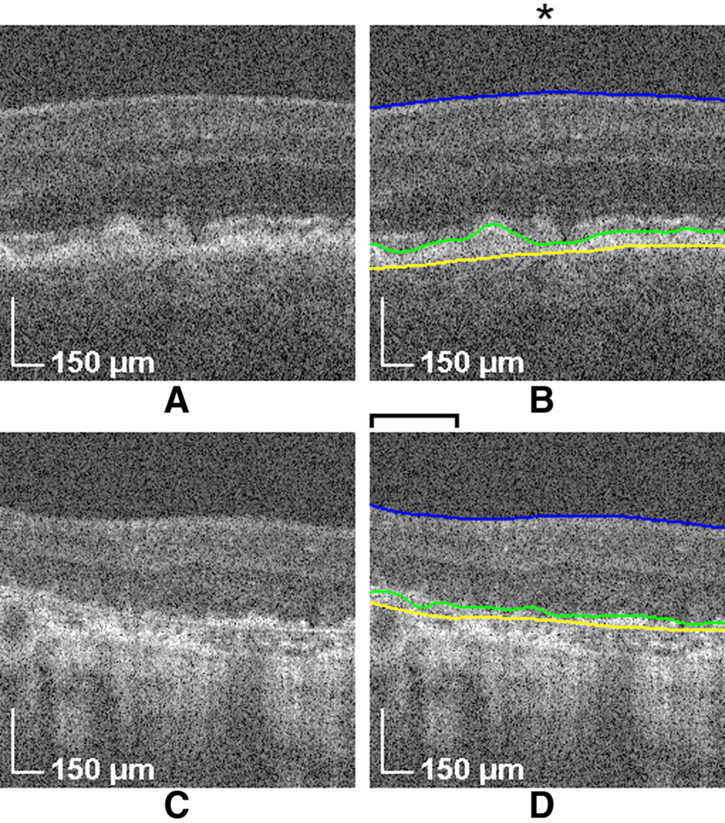
Erroneous Segmentation of Intermediate AMD Cases
Figure 6 exhibits cases in which the RPEDC was segmented improperly due to intermediately progressed drusen (A,B) and GA (C,D).

Slide 23
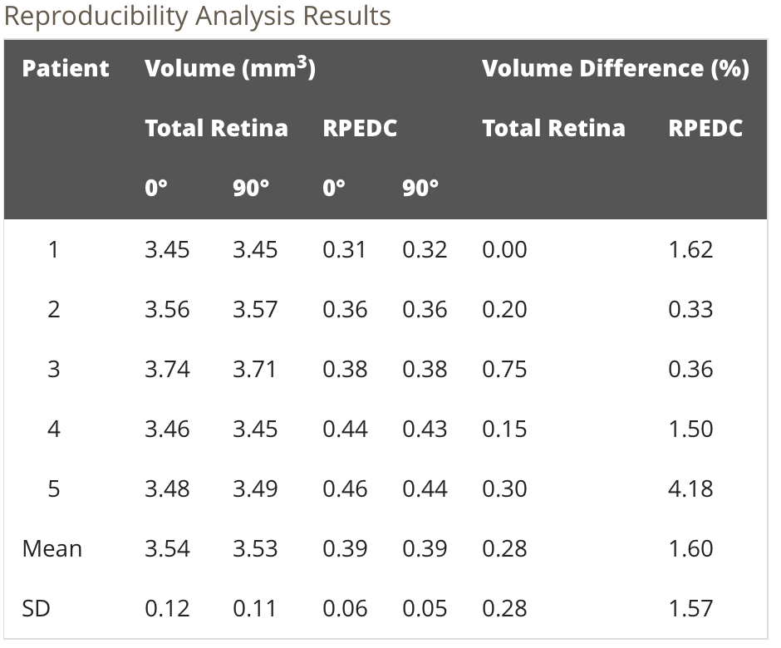
Segmentation Results are Reproducible
Table 5 compares volume calculations generated for the same patients using either a lateral or axial B-scans.

Slide 24
Outline
AMD research needs automatic segmentation
  Discussion on AMD
  Uses of OCT imaging
  Importance of Segmentation
Development of an algorithm suited for AMD
  Segmentation guidelines
  Algorithm programming
  Assessment of results
Evaluation of the algorithm
  Algorithm is validated
  Errors persist
  Applications
Summary
Implications

Slide 25
AMD Segmentation Algorithm is Validated
Automatic segmentation results are accurate, comparable to those of a second human grader.
  Errors mirrored inherent intraobserver variability.
  Low quality images did not significantly reduce accuracy.
Quantitative measurements produced by the algorithm are reproducible.

Slide 26
Inaccuracies in the Automatic Segmentation System Endure
Sub-retinal drusen deposits were often not included in the RPEDC.
The algorithm is less accurate when geographic atrophy is present.
Improving the segmentation algorithm may not be practical.
  More complex algorithms would sacrifice the efficiency that makes automation desirable.

Slide 27
Application Concerns
Automation is the far more efficient way to segment OCT images.
  Average segmentation times was reduced from 3.5 minutes manually to 1.7 seconds automatically.
  Efficiency enables larger scale studies.
This validated algorithm has inherent limitations.
  Human review of results is needed to check for errors.
  All types of drusen are segmented, despite not all of them being conclusively linked to AMD.
  The algorithm is only validated for dry AMD.

Slide 28
Outline
AMD research needs automatic segmentation
  Discussion on AMD
  Uses of OCT imaging
  Importance of Segmentation
Development of an algorithm suited for AMD
  Segmentation guidelines
  Algorithm programming
  Assessment of results
Evaluation of the algorithm
  Algorithm is validated
  Errors persist
  Applications
Summary
Implications

Slide 29
Summary
Introduction: AMD researchers would benefit from a segmentation algorithm for OCT images.
Methods/Results: Existing algorithms were modified to successfully process AMD pathology.
Discussion: The new segmentation algorithm is validated but retains shortcomings.

Slide 30
Outline
AMD research needs automatic segmentation
  Discussion on AMD
  Uses of OCT imaging
  Importance of Segmentation
Development of an algorithm suited for AMD
  Segmentation guidelines
  Algorithm programming
  Assessment of results
Evaluation of the algorithm
  Algorithm is validated
  Errors persist
  Applications
Summary
Implications

Slide 31
Implications
The introduction of automatic segmentation to AMD research opens up new possibilities.
  Larger scale analyses are possible due to increased segmentation efficiency.
  Longitudinal studies of AMD progression are more feasible with RPEDC volume measurements.
  ➔ Drusen volume measurements present a new parameter for larger scale and/or longitudinal AMD progression studies.

Slide 32

Acknowledgments
Dr. Khadjavi
Dr. George McMickle, MD
Dr. Dahlquist
Dr. Fitzpatrick
Dondi
Dahlquist Lab student researchers
  Thanks for listening!

Slide 33
References
Chiu, S. J., Izatt, J. A., O’Connell, R. V., Winter, K. P., Toth, C. A., & Farsiu, S. (2012). Validated Automatic Segmentation of AMD Pathology Including Drusen and Geographic Atrophy in SD-OCT Images. Invest Ophthalmol Vis Sci, 53(1), 53-61.
Chiu, S. J., Li, X. T., Nicholas, P., Toth, C. A., Izatt, J. A., & Farsiu, S. (2010). Automatic segmentation of seven retinal layers in SDOCT images congruent with expert manual segmentation. Optics express, 18(18), 19413-19428.
Drakulich, D (2012). OCT- What We Can See.
ter Haar, F. (2005). Automatic localization of the optic disc in digital colour images of the human retina. 1-81.

