Slide 1
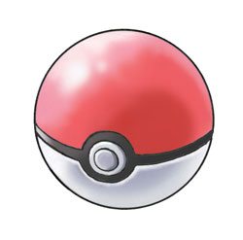
Robust Origami Containers
Harvard BioMod 2011

Slide 2
Goal
To create DNA origami containers that can load, hold, and release cargo
To do this, we must:
design and fold robust 3D origami featuring enclosed interiors with optimized volumes
design and implement mechanisms that allow us to controllably:
load cargo by attaching it to the inside of a container
close the container
solubilize cargo without leakage to the exterior of the container
open our container, releasing our cargo

Slide 3
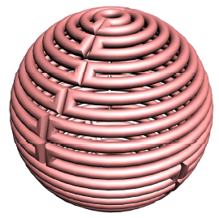
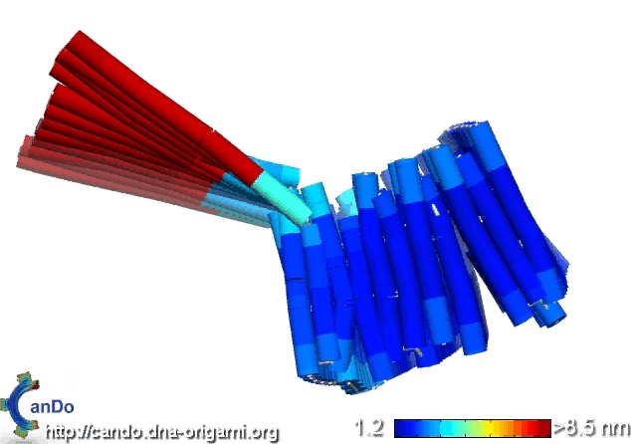
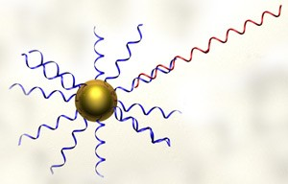
Current Designs
Container
Sphere
Box with lid
Cargo
5 nm gold particles
DNA/RNA strands

Slide 4
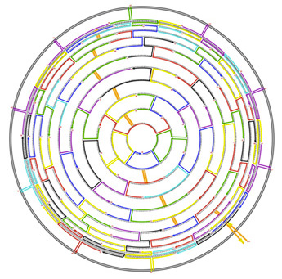
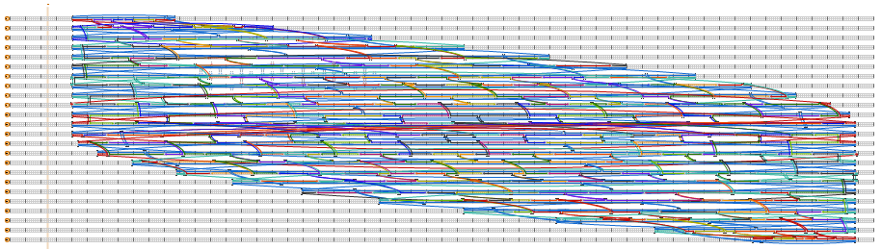
Sphere
D. Han et al., Science 332, 342 (2011)

Slide 5
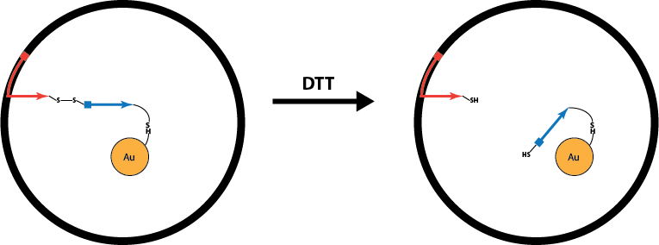
Disulfide Crosslinks: Solubilization

Slide 6
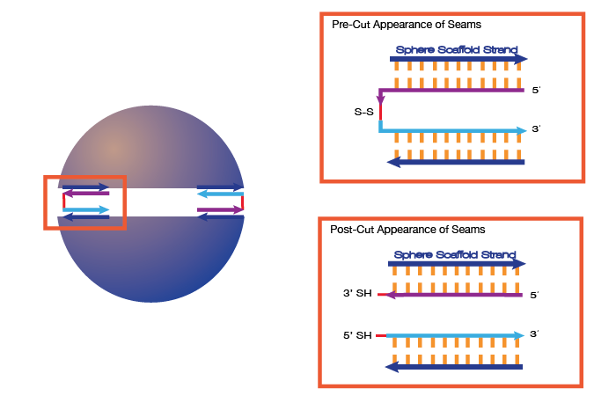
Disulfide Crosslinks: Opening Mechanism

Slide 7
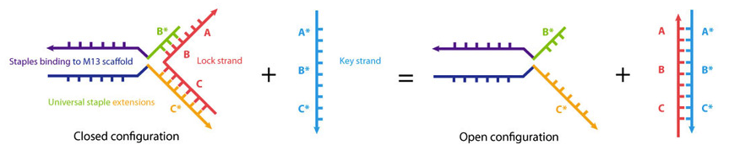
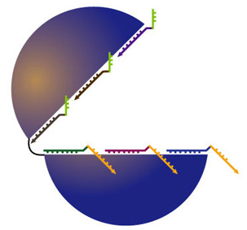
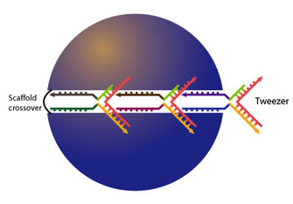
Strand Displacement: Opening Mechanism

Slide 8
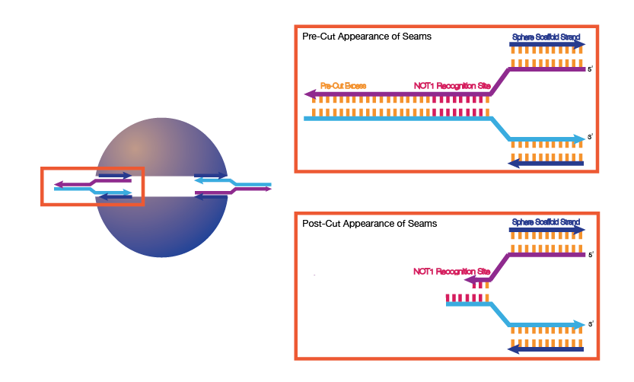
Restriction Enzyme: Opening Mechanism

Slide 9
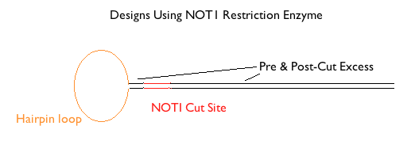
Testing the Restriction Enzyme Design

Slide 10
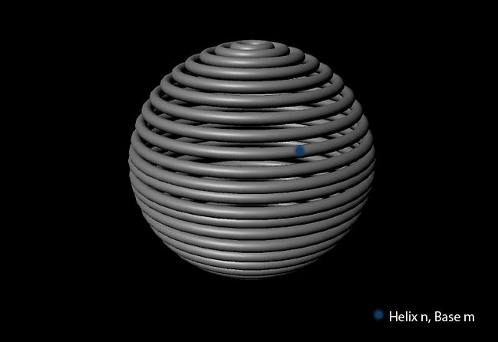
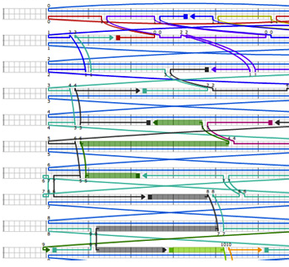

Visualization With SphereCAD
3D rendering assists in experimental synthesis of spherical origami
Maya 3D
caDNAno

Slide 11
Desired SphereCAD Function
Through creation and execution of scripts:
Highlight helix #, scaffold position of selected base
Convert spherical coordinates to pairs of helix # and scaffold position
Jump to any position on sphere based on user input
Draw nanoparticles on sphere surface
Determine whether placement agrees with base orientation

Slide 12
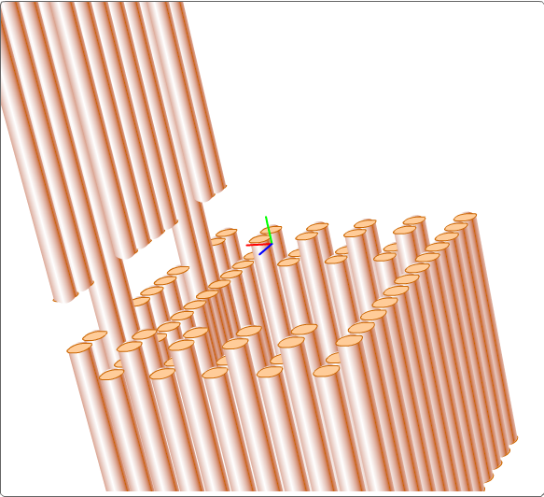
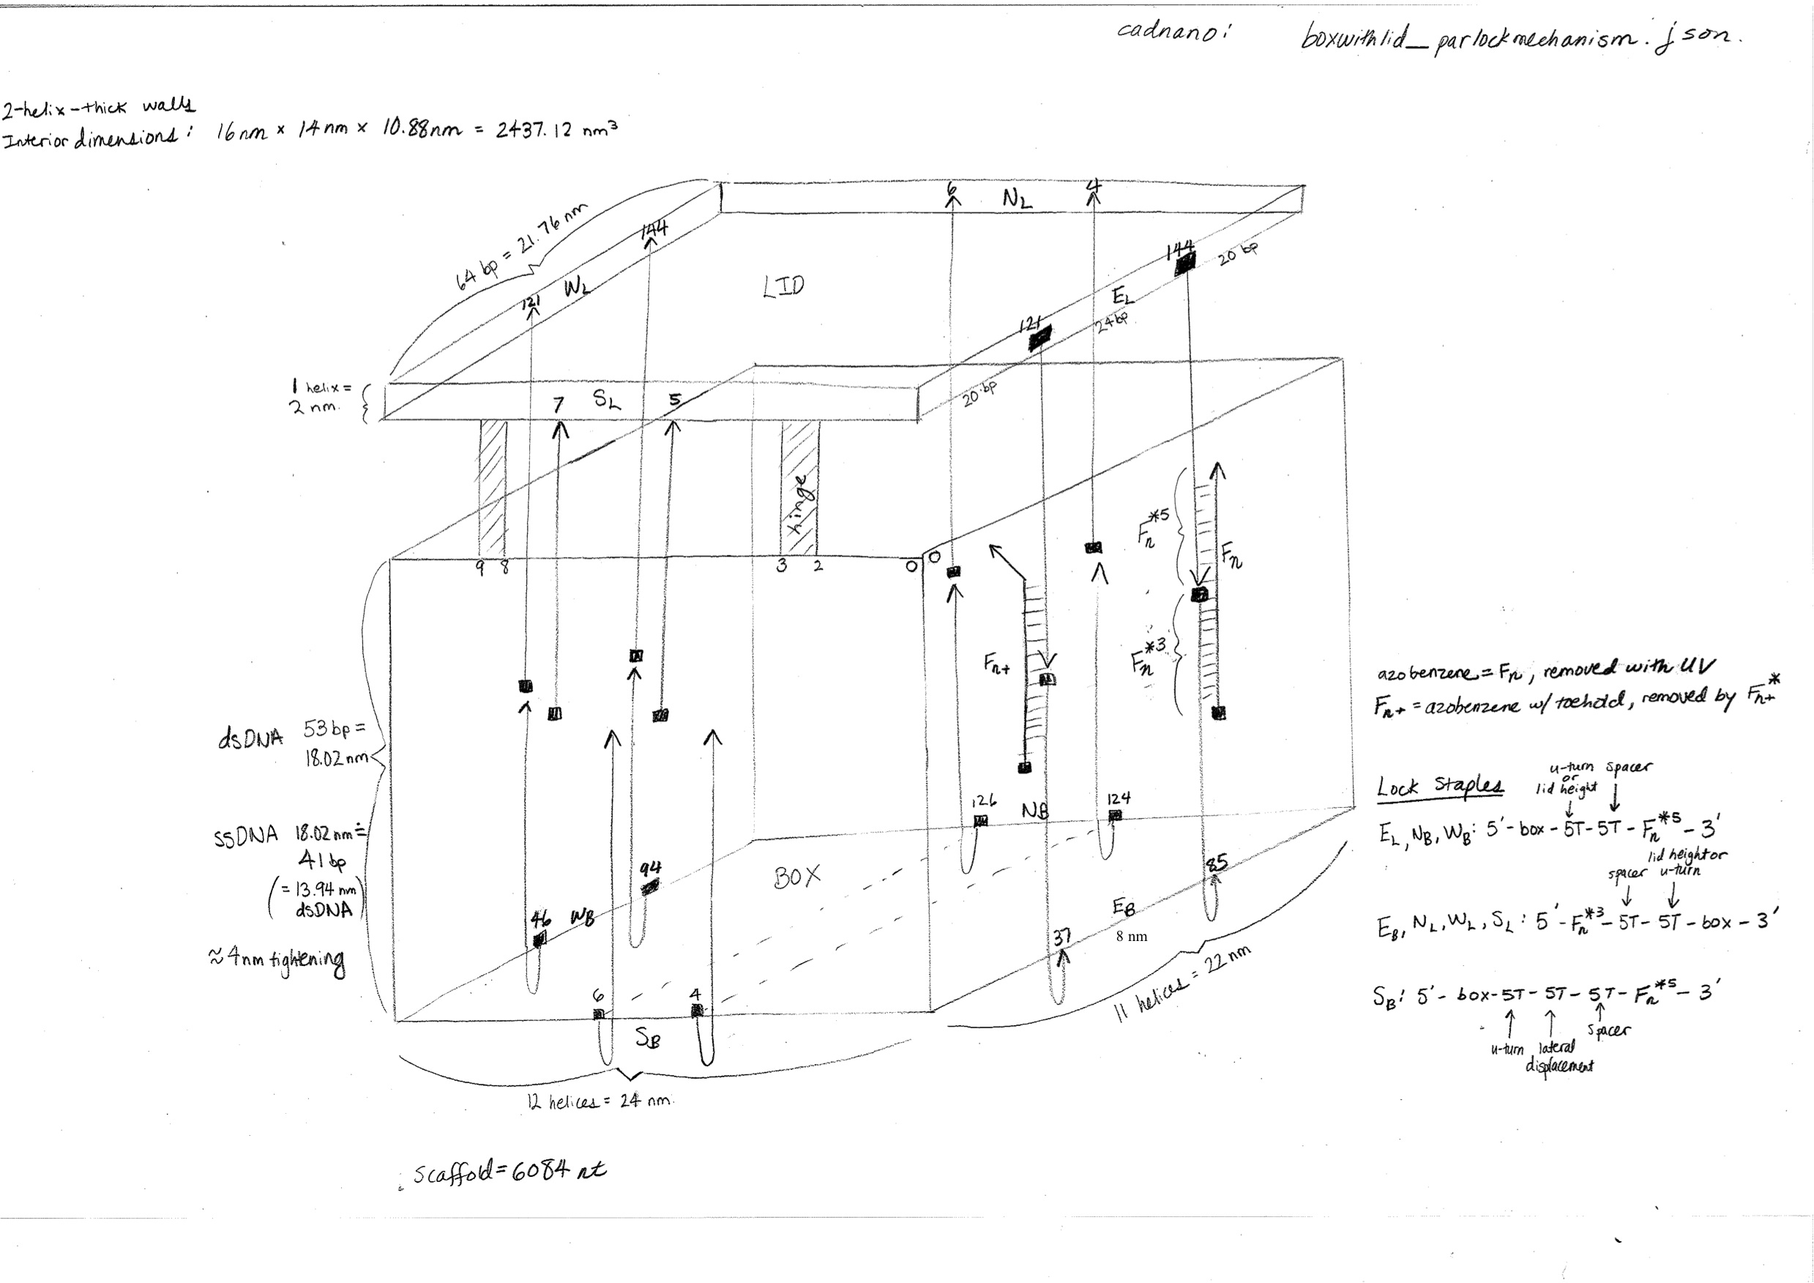
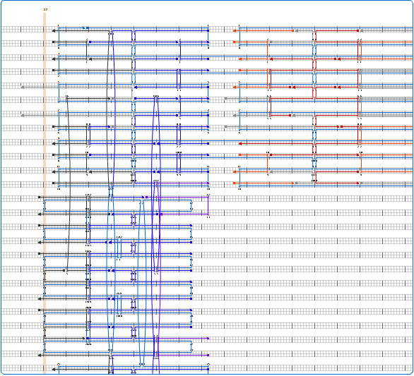
Box with Lid

Slide 13
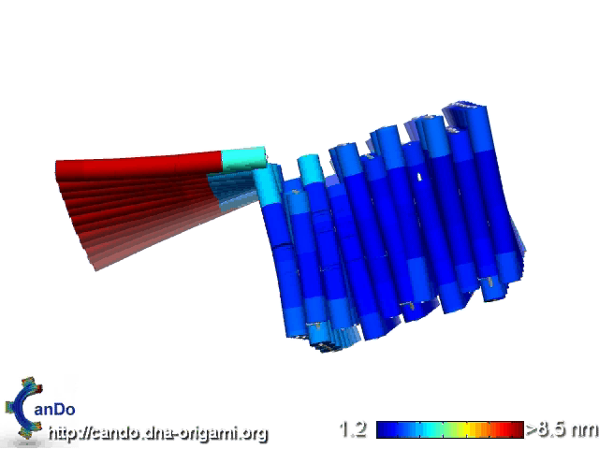
CanDo Interpretation

Slide 15
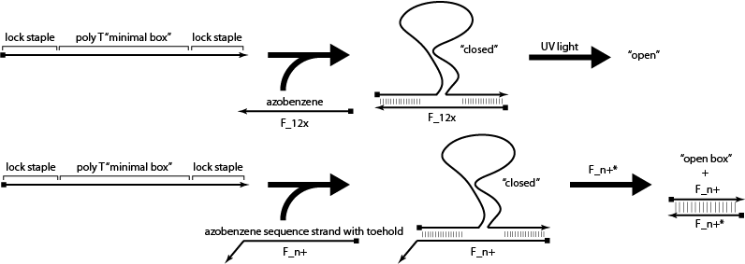
Minimal Box Test

Slide 16
Preliminary Experiments
Disulfide crosslinking
Nanoparticle conjugation
Nanoparticle chain

Slide 17
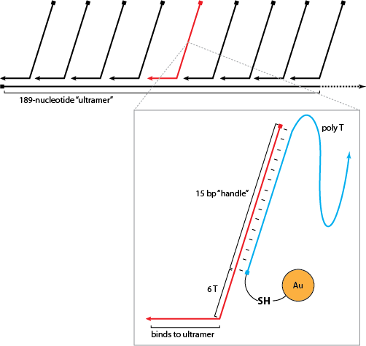
Nanoparticle Chain: World’s Smallest Necklace

Slide 18
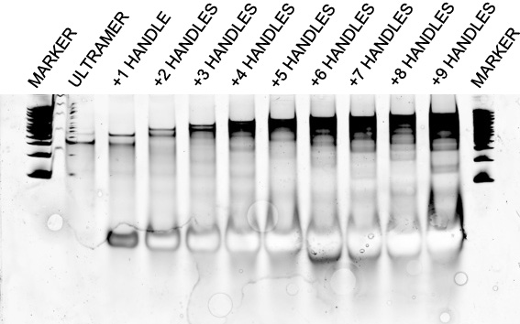
Annealing Handles to Ultramer

Slide 19
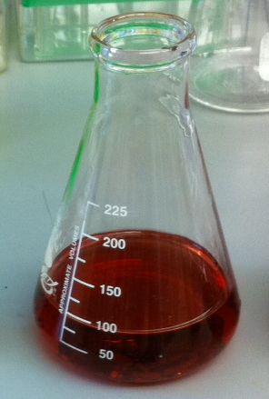
Making 5 nm Gold Nanoparticles
Heat aqueous gold chloride to 60°C
Add solution of citrate (stabilizer), tannic acid (reducing agent), potassium carbonate (pH adjustment)

Slide 20
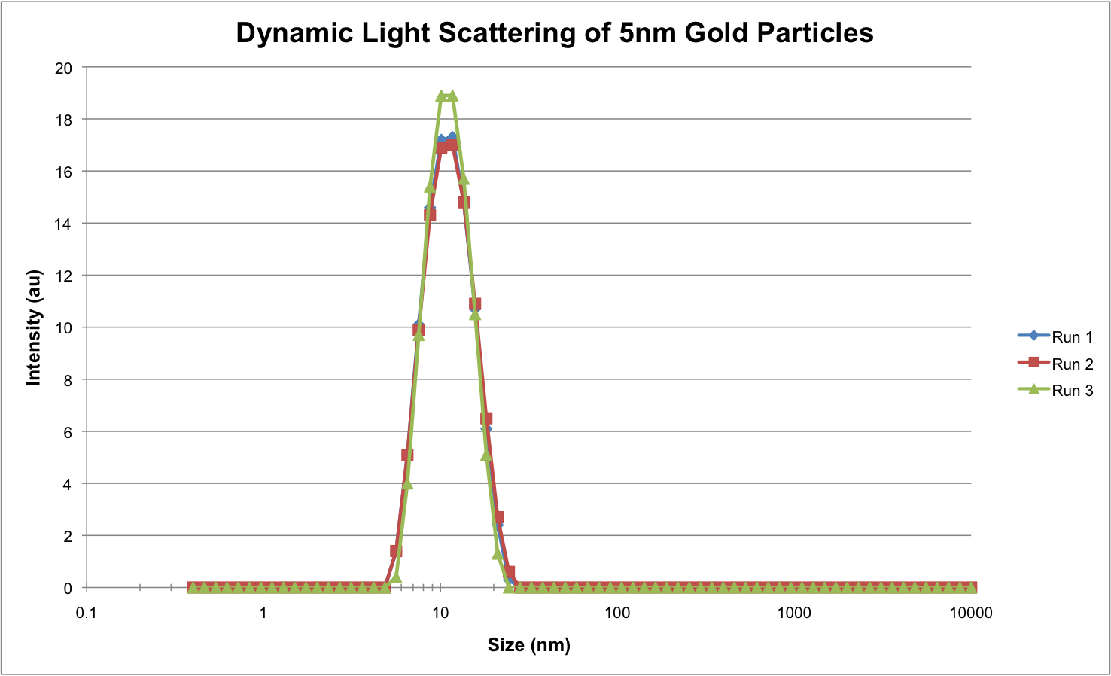
Characterizing Nanoparticles

Slide 21
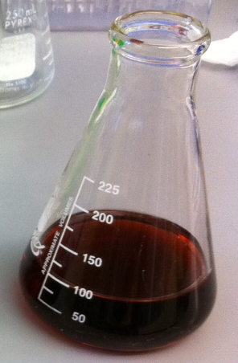
Making 15 nm Gold Nanoparticles
Heat aqueous gold chloride to 95°C
Add citrate (stabilizer and reducing agent)

Slide 22
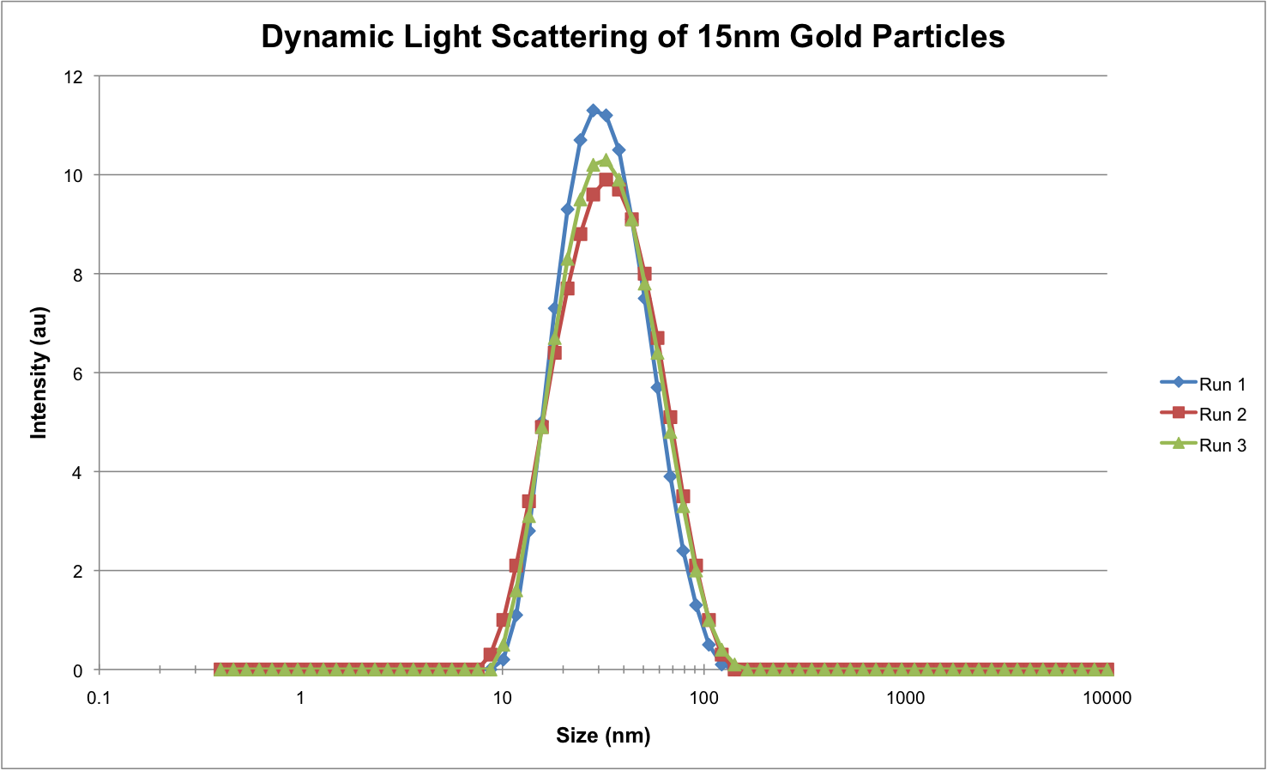
Characterizing Nanoparticles

Slide 23
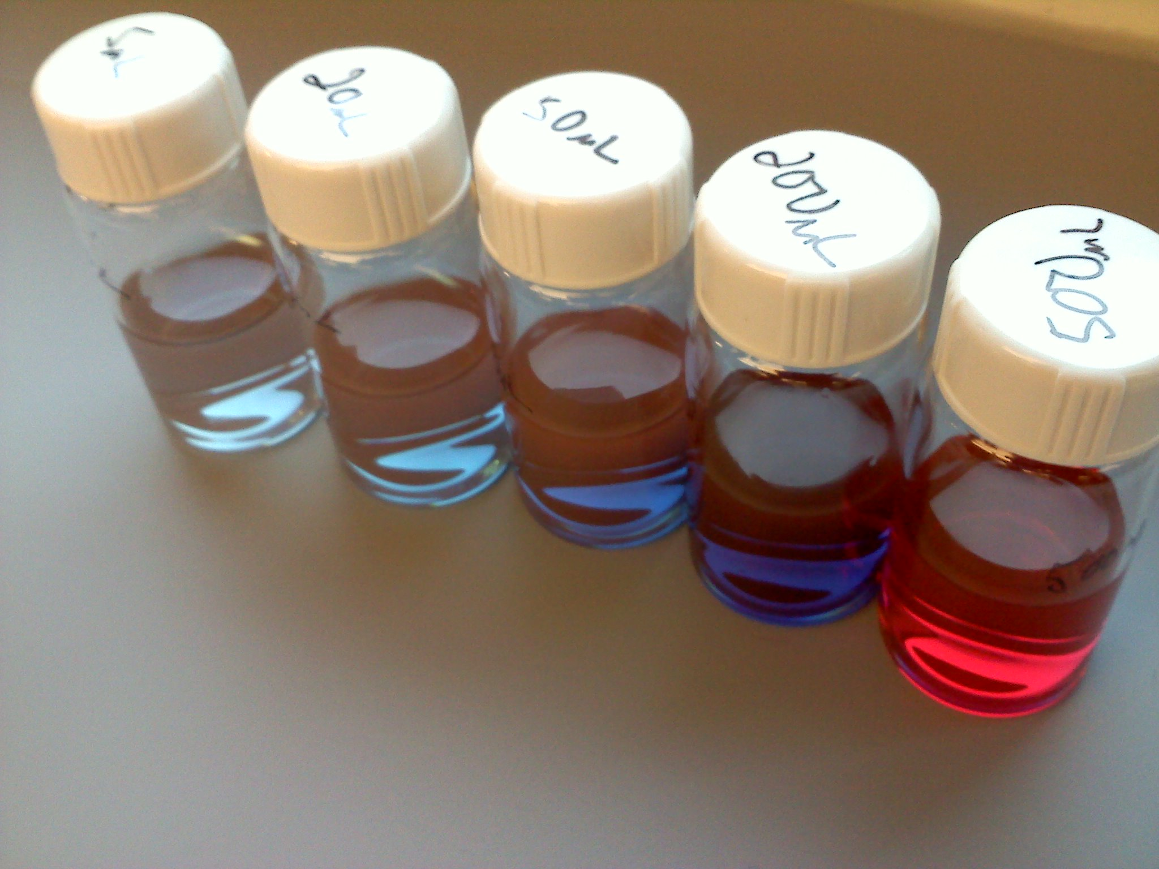
Making Larger Nanoparticles
Use 5 nm particles as seeds
Vary amount of seed solution
Add gold chloride
Add citrate
Produce ~50-150 nm gold particles

Slide 24
Characterizing Nanoparticles
500 uL of 5 nm seeds

Slide 25
Characterizing Nanoparticles
200 uL of 5 nm seeds

Slide 26
Characterizing Nanoparticles
50 uL of 5 nm seeds

Slide 27
Characterizing Nanoparticles
20 uL of 5 nm seeds

Slide 28
Characterizing Nanoparticles
5 uL of 5 nm seeds

