Slide 1
Inhibition of respiration by nitric oxide induces a Mycobacterium tuberculosis dormancy program
Voskuil, M.I., Schappinger, D., Visconti, K.C., Harrell, M.I., Dolganov, G.M., Sherman, D.R., and Schoolnik, G.K. (2003). J. Exp. Med. 198(5), 705-713. doi:10.1084/jem.20030205.
Journal Club Presentation
Isabel Gonzaga
BIOL 398: Bioinformatics Laboratory
November 12, 2014

Slide 2
Outline
Tuberculosis latency period is crucial for disease control
Dormancy regulon determined by NO, dormancy and hypoxia response
O₂ competes with NO for induction of dormancy regulon
Cytochrome oxidase is proposed as regulator to sense O₂ and NO levels in pathway

Slide 3
Outline
Tuberculosis latency period is crucial for disease control
Dormancy regulon determined by NO, dormancy and hypoxia response
O₂ competes with NO for induction of dormancy regulon
Cytochrome oxidase is proposed as regulator to sense O₂ and NO levels in pathway

Slide 4
Tuberculosis infection has three developmental stages
TB is a pulmonary infection caused by Mycobacterium tuberculosis
3 stage pathogenic sequence
Inhalation of infectious aerosol
Latency period
Unimpeded bacterial replication (onset of disease)
1/3 of the world is latently infected
The most aggressive TB cases exist in latent form
Latency promotional factors not widely investigated

Slide 5
O₂ depletion promotes M. tuberculosis latent period
Gradual O₂ depletion leads to:
Nonreplicating, persistent state
Structural, metabolic and chromosomal changes to the bacteria
Reduced O₂ tension leads to resistance to antimicrobials
Reintroduction of O₂ converts bacteria to active form

Slide 6
Nitric oxide (NO) controls M. tuberculosis growth by inhibiting aerobic respiration
The present study investigates role of NO in inducing latent period program in M. tuberculosis
High doses of NO is toxic for bacteria
NO inhibits aerobic respiration in mitochondria and bacteria
NO is an important signaling agent for eukaryotes

Slide 7
Outline
Tuberculosis latency period is crucial for disease control
Dormancy regulon determined by NO, dormancy and hypoxia response
O₂ competes with NO for induction of dormancy regulon
Cytochrome oxidase is proposed as regulator to sense O₂ and NO levels in pathway

Slide 8
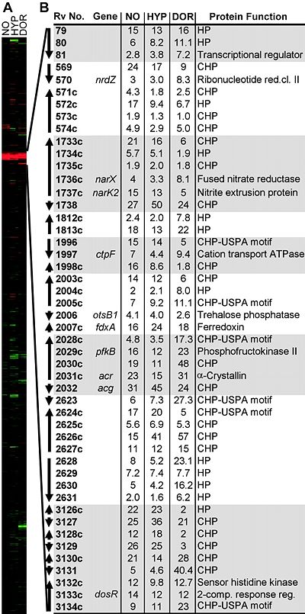
Dormancy regulon determined by coinduction by NO, low O₂ and adaptation to an in vitro dormant state
Red: induced
Green: repressed
Black: no change
Genes organized based on
average linkage clustering
NO: Mtb 1254 exposed to 50mM of DETA/NO for 4hrs
HYP: Mtb 1254 0.2% O₂ for 2 hrs
DOR: Mtb 1254 4 days gradual adaptation to lower O₂

Slide 9
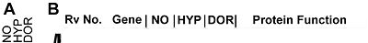
Dormancy regulon determined by coinduction by NO, low O₂ and adaptation to an in vitro dormant state
Red: induced
Green: repressed
Black: no change
Genes organized based on
average linkage clustering
NO: Mtb 1254 exposed to 50mM of DETA/NO for 4hrs
HYP: Mtb H37Rv .2% O₂ for 2 hrs
DOR: Mtb H37Rv 4 days gradual adaptation to lower O₂

Slide 10
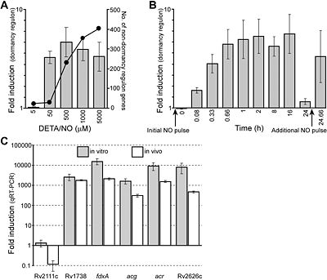
NO induces gene expression for 48 genes in vivo
40 minute exposure of varying concentrations of DETA/NO
DETA/NO releases NO and rapidly induced 48 gene set (dormancy region)
Bars:
Average induction of dormancy regulon (consistent 5-7 fold)
Plotted line:
Number of other induced genes in the array (with a greater than 2 fold induction)
Notes:
Additional studies show these genes to be located in 9 discretemodules, 7 with contiguous genes with multiple transcription units. Thus, it is able to have a rapid, pronounced and coordinated transcriptional response
There is a threshold level where higher levels of NO do not induce dormancy regulon

Slide 11
NO response not desensitized to subsequent doses
500 μM DETA/NO injected initially
Microarrays ran at various time points to test for fold induction
Additional NO dose administered after 24 hour point
NO dissipation returned induction to basal levels

Slide 12
qRT-PCR confirmed in vitro and in vivo induction of dormancy regulon
qRT-PCR measured induction magnitude of five sentinel NO induced genes
In vitro and in vivo (in mouse lungs) induction compared
mRNA levels up to 140x increase

Slide 13
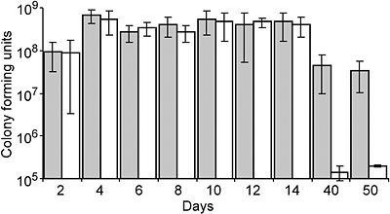
Dormancy regulon increases overall M. tuberculosis fitness in vitro
Grey: Wild type
White: Mutant (dormancy regulon knockout)
All samples grown in low O₂ induced dormant state
Wildtype showed 200 fold greater viability at 40 and 50 day time points compared to mutant

Slide 14
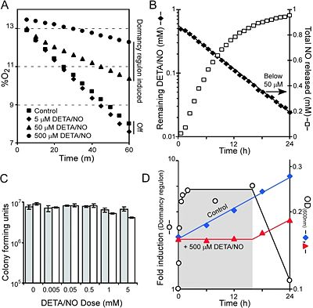
NO inhibits respiration for M. tuberculosis
Dormancy regulon induction dependent on amount of NO present

Slide 15
High levels of NO cause growth arrest
B: NO released over time
Concentration lowered below threshold level at ~16-17 hours
Bacterial growth after this point
D: Growth inhibition by NO overlaid with induction of dormancy regulon
Grey: basal levels
Growth resumes after NO concentration appears below threshold

Slide 16
Viability of M. tuberculosis unaffected by NO
Grey bars: 4 hours
White bars: 24 hours
Effects of low concentration are reversible because viability unaffected
High concentrations only have slight effect
Growth arrest by NO likely due to respiratory inhibition as a result of NO exposure
Notes:
Differences between dosages are made more extreme when observed at the longer time frame, thus growth arrest may be due to NO inhibiting respiration, which then causes growth arrest

Slide 17
Outline
Tuberculosis latency period is crucial for disease control
Dormancy regulon determined by NO, dormancy and hypoxia response
O₂ competes with NO for induction of dormancy regulon
Cytochrome oxidase is proposed as regulator to sense O₂ and NO levels in pathway
Notes:
Next, the researchers sought to find the relationship between O2 and NO

Slide 18
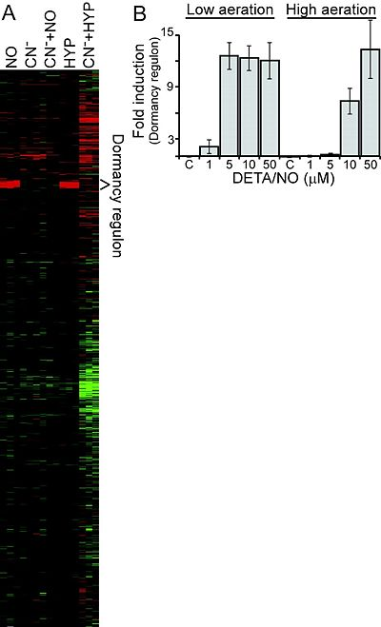
O₂ competitively inhibits NO mediated regulon induction
Microarray used to compare gene induction after exposing high vs. low aerated cultures to different combinations of NO
Low aeration: only 1-5μM DETA/NO needed to initiate induction of dormancy regulon
High aeration: at least 5x more NO necessary
Consistent with idea that same molecular sensor monitors O₂ and NO
Notes:
Knowing that both NO presence and low O2 could induce the dormancy regulon, the researchers wanted to investigated if the same molecular sensor was used to detect these changes. This would allow for a better understanding of the pathway and molecular mechanism involved in expression of these genes.
First, they compared high aeration and low aeration cultures on the anount of NO necessary for comparable fold inductio
Found that O2 inhibits NO mediated regulon induction competitivel, because 5x more NO was necessary to achieve comparable fold unduction in high aeration samples

Slide 19
Cyanide blocks expression of dormancy regulon genes induced by NO and low O₂
CN⁻+HYP
HYP CN⁻+NO
CN⁻
NO
Heme binds to NO and O₂; competitive inhibitor
Cyanide: heme-protein inhibitor
Found to block dormancy regulon gene expression without affecting overall transcription levels
Indicates that a heme-containing protein is likely to be a component of the NO/low O₂ signal transduction system
Notes:
Cyanide is a heme protein inhibitor – prevents induciton of dormancy regulon by NO and hypoxia

Slide 20
Outline
Tuberculosis latency period is crucial for disease control
Dormancy regulon determined by NO, dormancy and hypoxia response
O₂ competes with NO for induction of dormancy regulon
Cytochrome oxidase is proposed as regulator to sense O₂ and NO levels in pathway

Slide 21
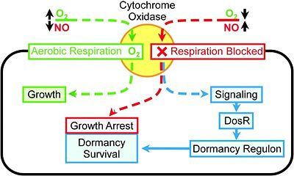
Cytochrome oxidase is hypothesized to be the sensor/integrator of NO and O₂ levels
CcO is shown to be reversibly inhibited by low concentrations of NO
This proposal must be supported by further functional studies comparing purified wild type and CcO mutant
Decreasing respiration initiates transcriptional response, and the pathogen is transformed to stabilize the protein. This lets the pathogen endure longer latency periods
NO thus serves as an environmental signal for activation of the bacteria by the immune system

Slide 22
Control of the dormancy regulon important for M. tuberculosis survival in latent periods
Dormancy regulon induction inhibits aerobic respiration and slows replication – crucial for bacteria to survive
Predicted gene roles have been supported by previous research of physiological properties in dormant state
Low NO concentrations induce 48 gene regulon using the DosR regulator
Dormancy regulon induction increases in vivo fitness in latency
NO and low O₂ induce dormancy regulon expression
Both reversible by removal of NO or provision of O₂
Molecular sensor for O₂ and NO levels likely to be heme-containing molecule (ie. Cytochrome oxidase)

Slide 23
Acknowledgments
Loyola Marymount University
Kam Dahlquist, Ph. D
TA: Stephen Louie

