Slide 1
Physiological and Transcriptional Responses to Anaerobic Chemostat Cultures of Saccharomyces cerevisiae Subjected to Diurnal Temperature Cycle
Hebly, M. (2014). Physiological and Transcriptional Responses of Anaerobic Chemostat Cultures of Saccharomyces cerevisiae Subjected to Diurnal Temperature Cycles. Appl. Environ. Microbiol., 80(14), 4433-4449. Retrieved from http://aem.asm.org/content/80/14/4433.full#cited-by
Kevin Wyllie and Monica Hong
05/27/15

Slide 2
Outline
Introduction
Diurnal temperature cycles (DTC)
Goal of this study
Methods and Results
Glucose fermentation during DTC
Transcriptional effects of DTC
Transcriptional effects of cyclic glucose concentration
Cell cycle distributions in DTC
Carbohydrate storage in DTC
Transcriptional response in acclimation to cold temperature
Discussion
S. cerevisiae’s growth kinetics and physiology in DTC are comparable to those of steady-state conditions.
DTC prompted a transcriptional response involving previously-identified temperature-stress-related genes, in addition to purine biosynthesis.
Cell cycle synchronization during DTC is due to fluctuations in “relative specific growth rate,” rather than direct effects of temperature.

Slide 3
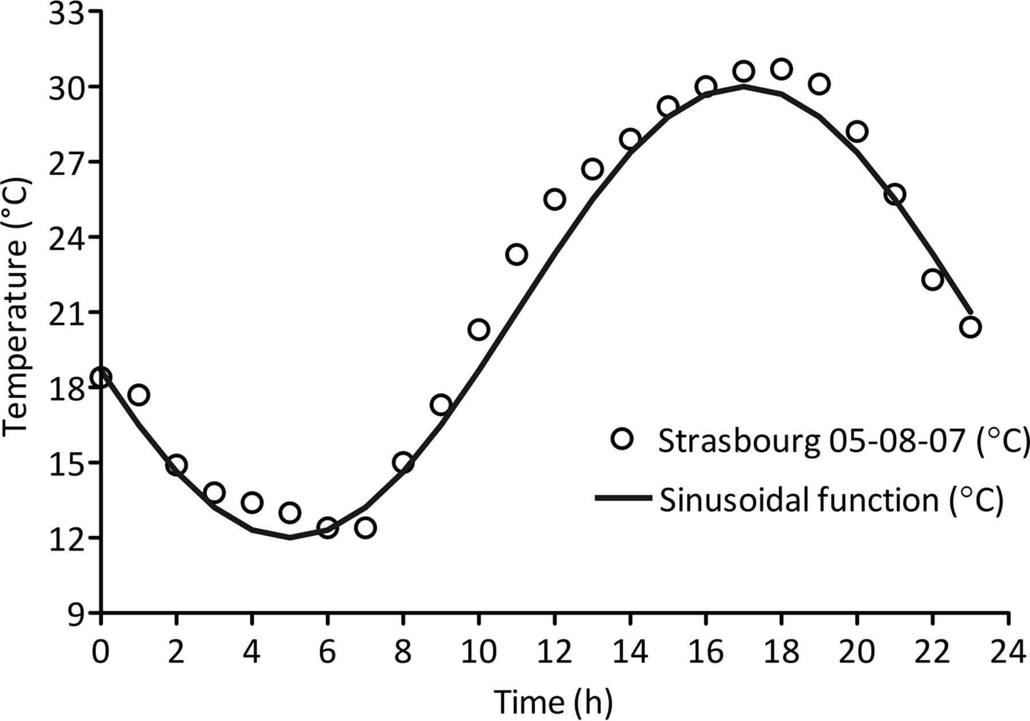
Introduction
Diurnal temperature cycle (DTC) is a sinusoidal temperature pattern, moving between 12°C and 30°C.
Figure 1
Marit Hebly et al. Appl. Environ. Microbiol. 2014;80:4433-4449

Slide 4
Introduction
The big question:
To what extent does S. cerevisiae’s response to DTC overlap with the response to steady-state conditions?

Slide 5
Methods
Saccharomyces cerevisiae, CEN.PK113-7D, haploid
Growth medium:
0.3 g/L (NH₄)₂SO₄
0.3 g/L KH₂PO₄
0.5 g/L MgSO₄ · 7H₂O
3.0 g/L NH4H₂PO₄
25 g/L glucose
0.42 g/L Tween80 growth hormone
10 mg/L ergosterol
Grown in chemostat and sequential batch reactors

Slide 6
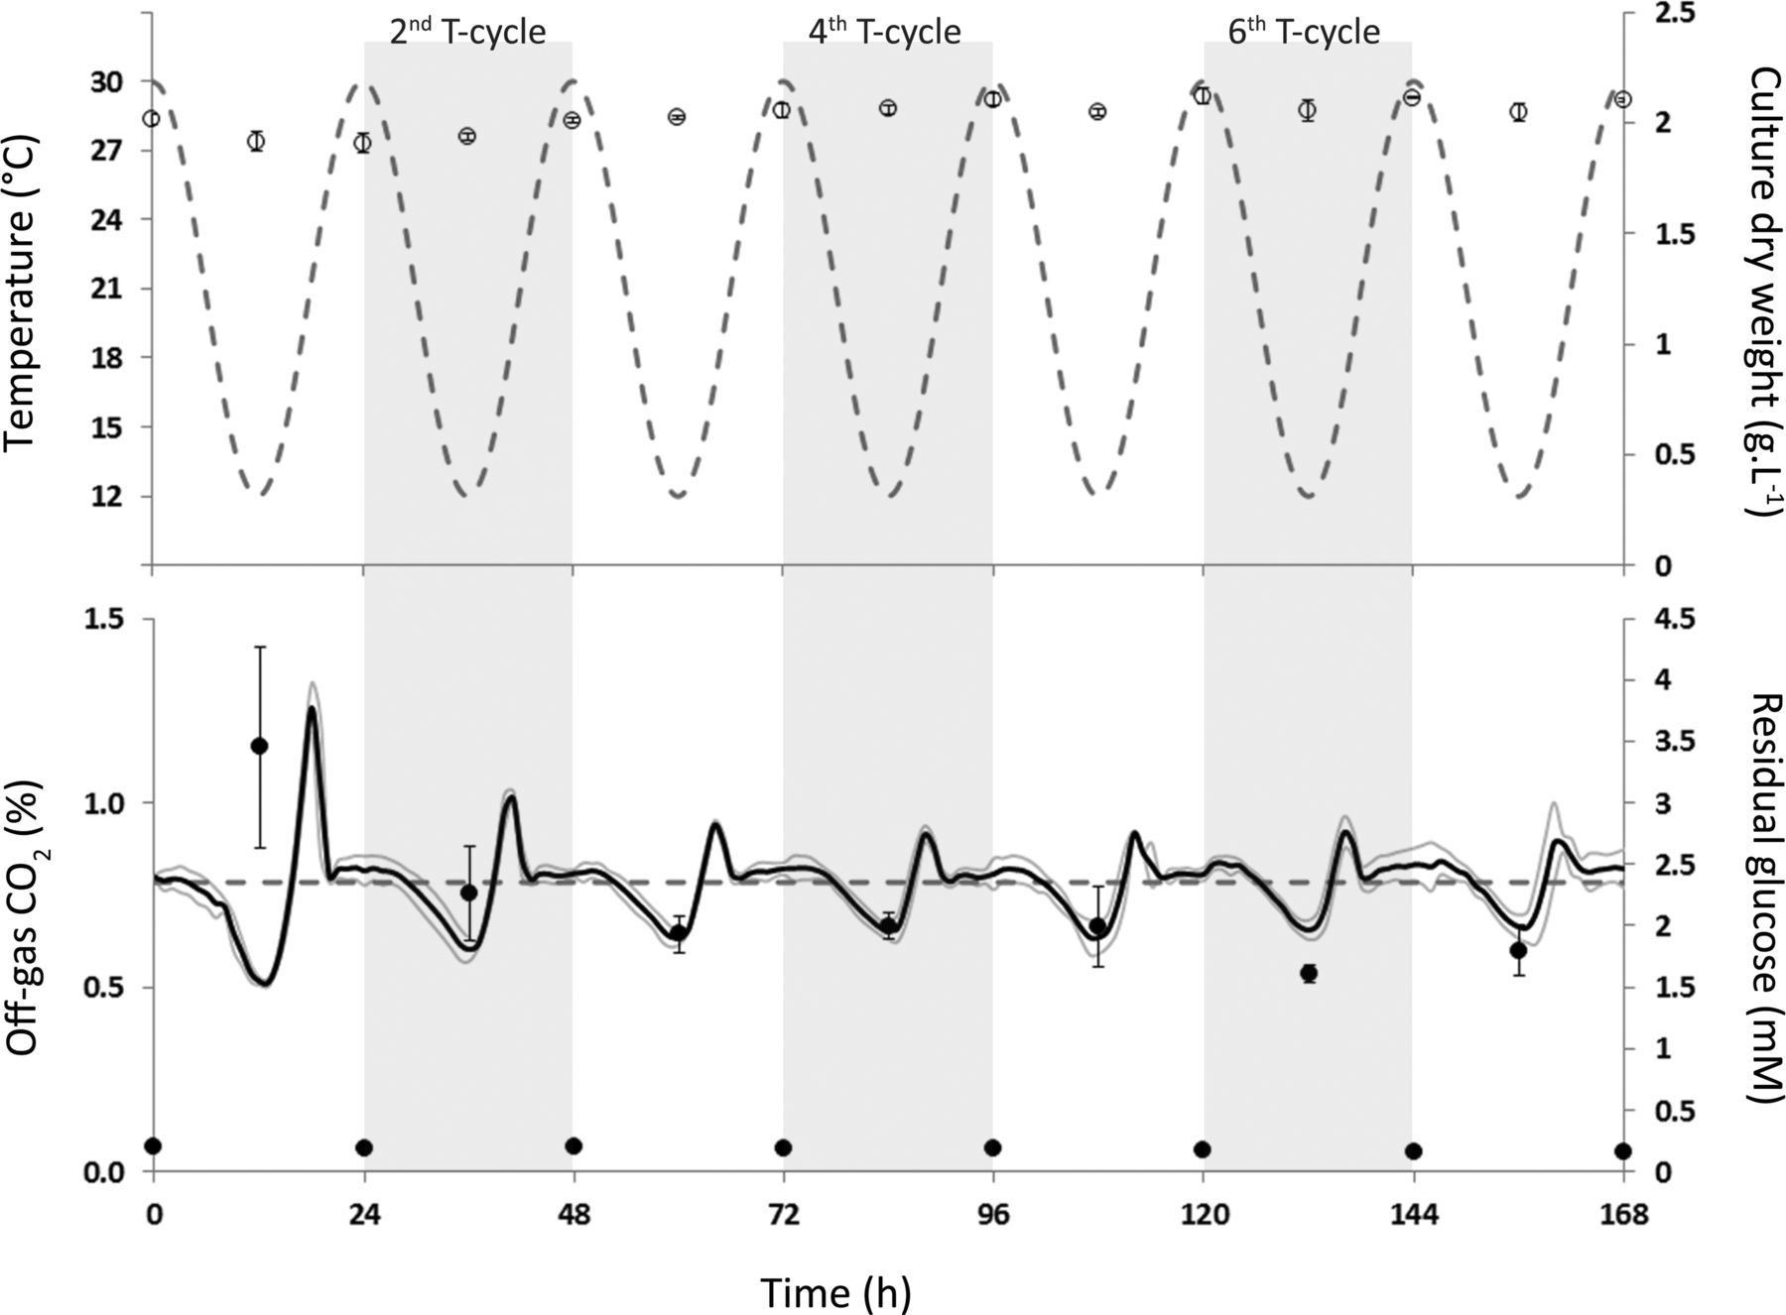
Results – Glucose Fermentation in DTC
Residual Glucose Concentration and CO₂ Production of S. cerevisiae Subjected to DTC
Figure 2
Marit Hebly et al. Appl. Environ. Microbiol. 2014;80:4433-4449

Slide 7
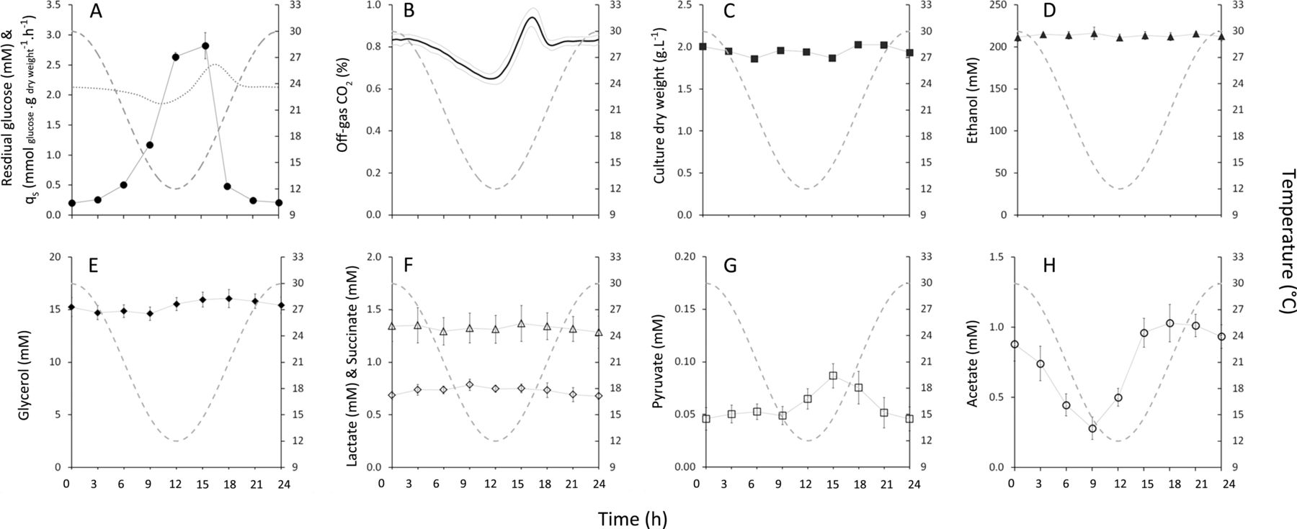
Results – Glucose Fermentation in DTC (continued)
Physiological Characterization of S. cerevisiae
During DTC
Figure 3
Marit Hebly et al. Appl. Environ. Microbiol. 2014;80:4433-4449

Slide 8
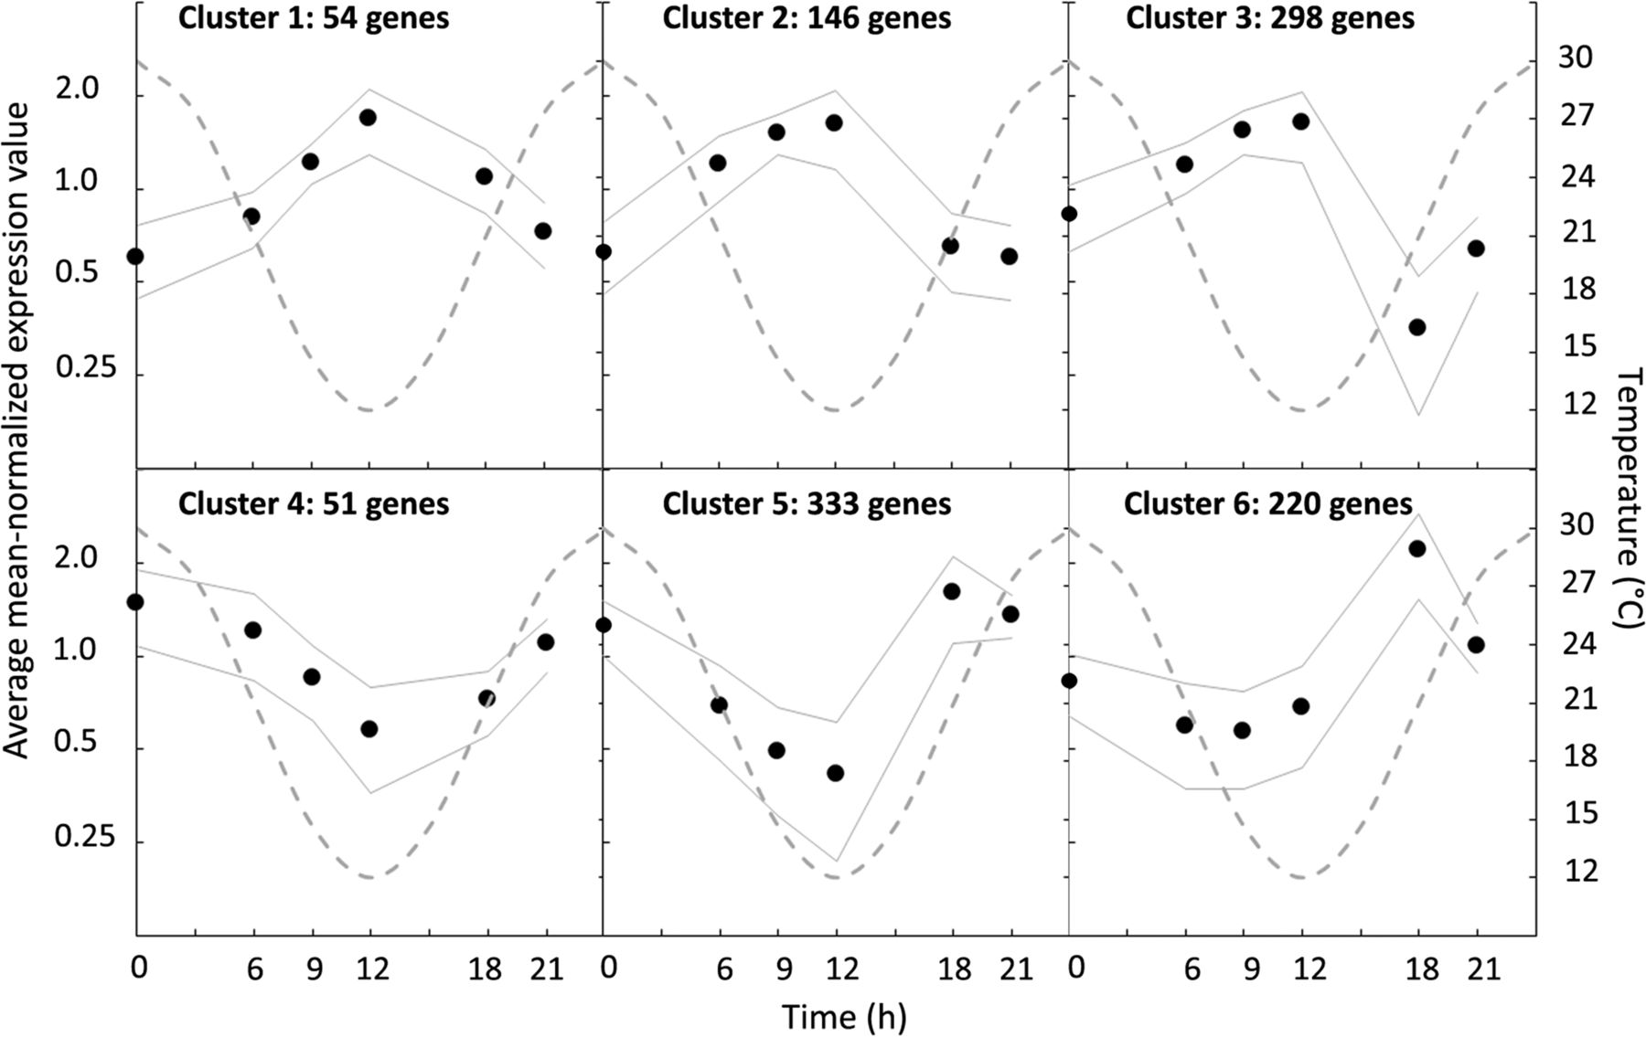
Results – Transcriptional Effects of DTC
Transcriptional Reprogramming during DTC
Figure 4
Marit Hebly et al. Appl. Environ. Microbiol. 2014;80:4433-4449

Slide 9
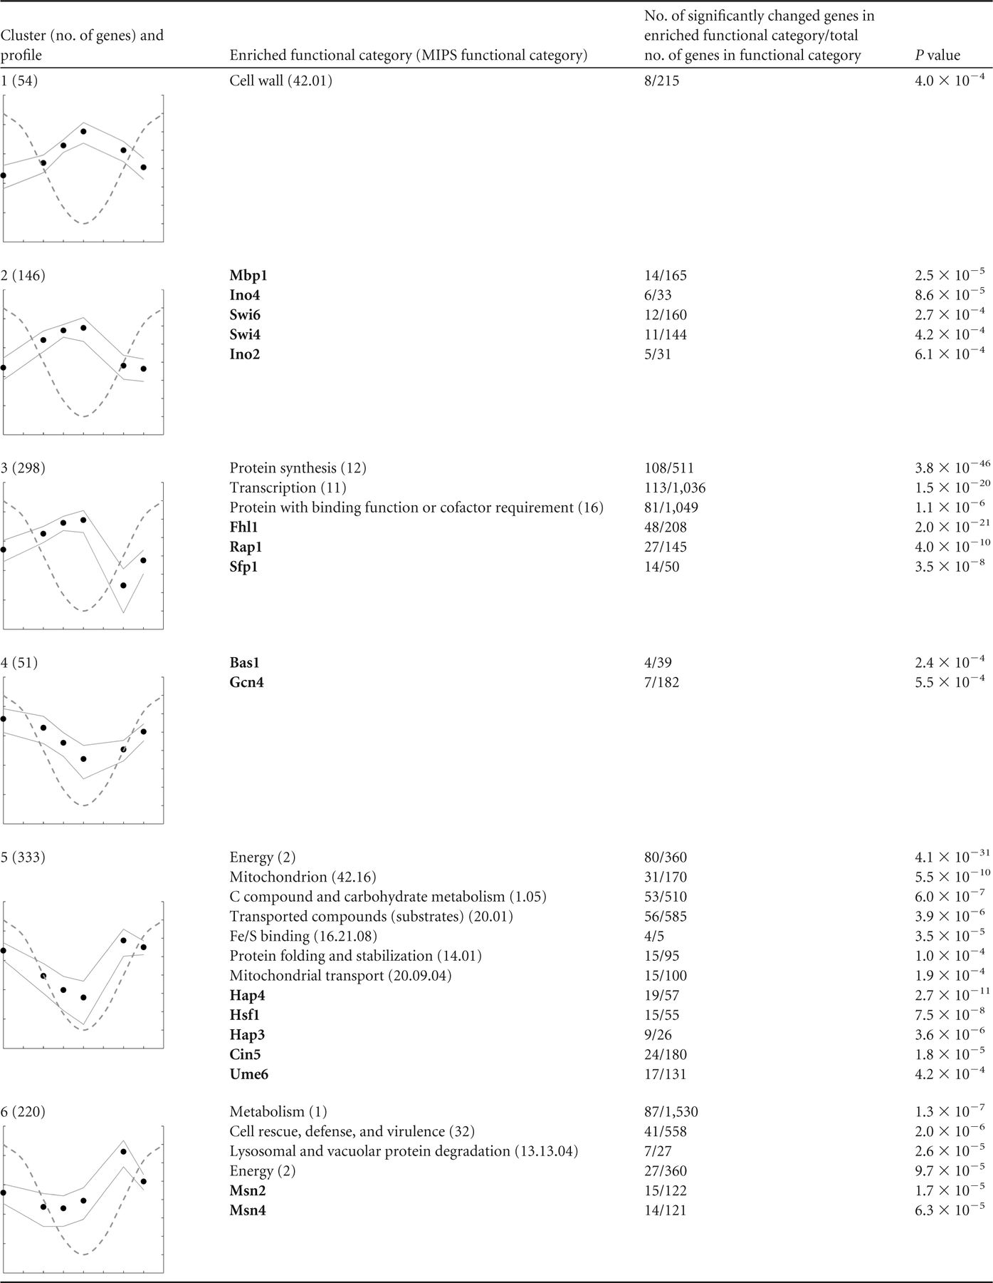
Results – Transcriptional Effects of DTC (continued)
Functional Enrichment Analysis
Table 1
Marit Hebly et al. Appl. Environ. Microbiol. 2014;80:4433-4449

Slide 10
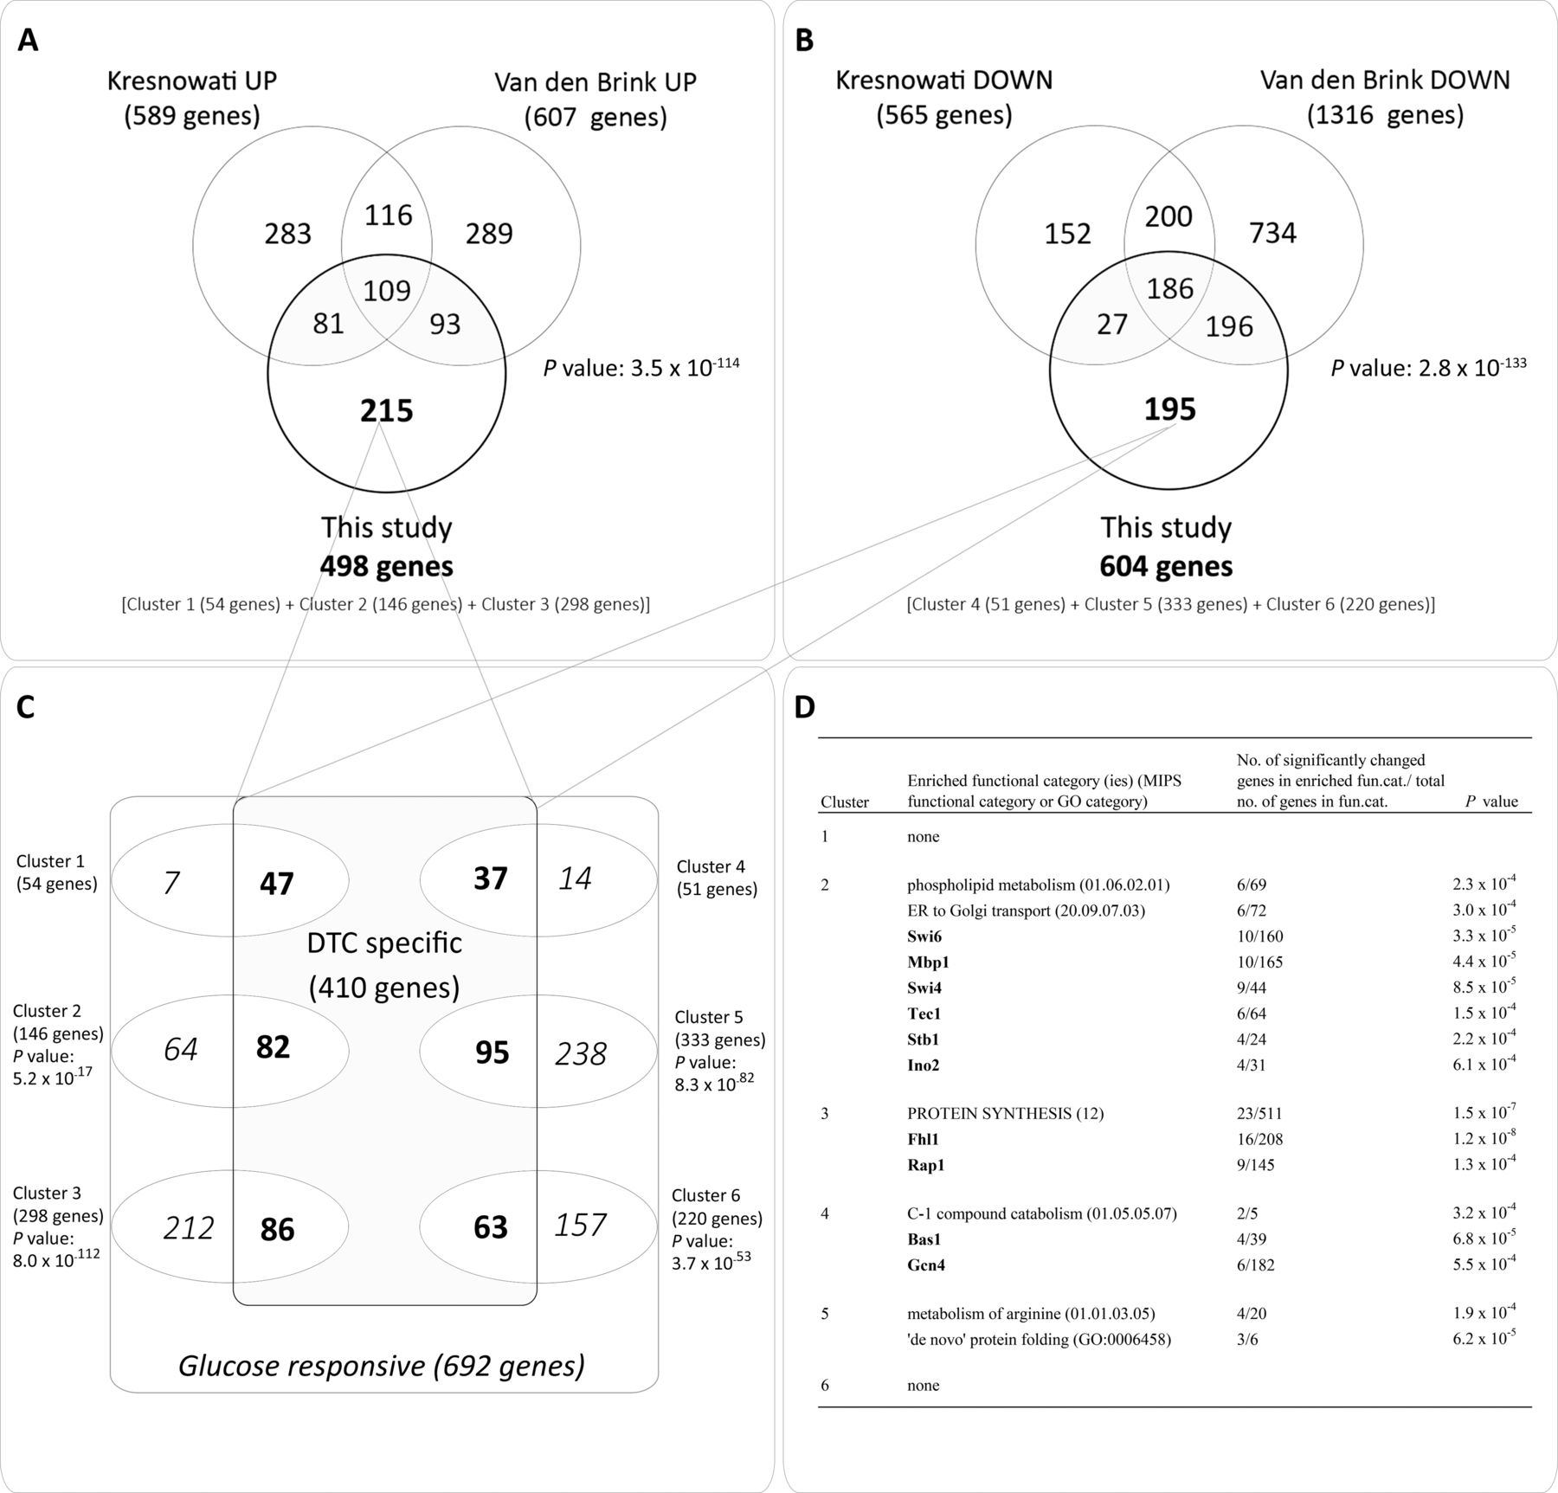
Results – Transcriptional Effects of Cyclic Glucose Concentration
Distinguishing between DTC-specific Genes and Glucose-Responsive Genes
Figure 5
Marit Hebly et al. Appl. Environ. Microbiol. 2014;80:4433-4449

Slide 11
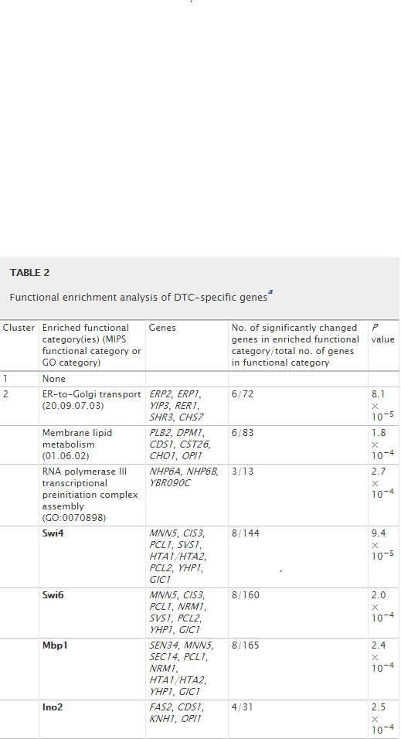
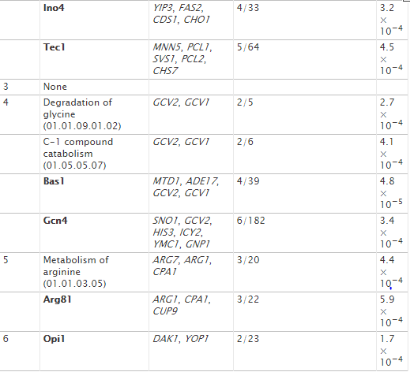
Results – Transcriptional Effects of Cyclic Glucose Concentration (continued)
Marit Hebly et al. Appl. Environ. Microbiol. 2014;80:4433-4449

Slide 12
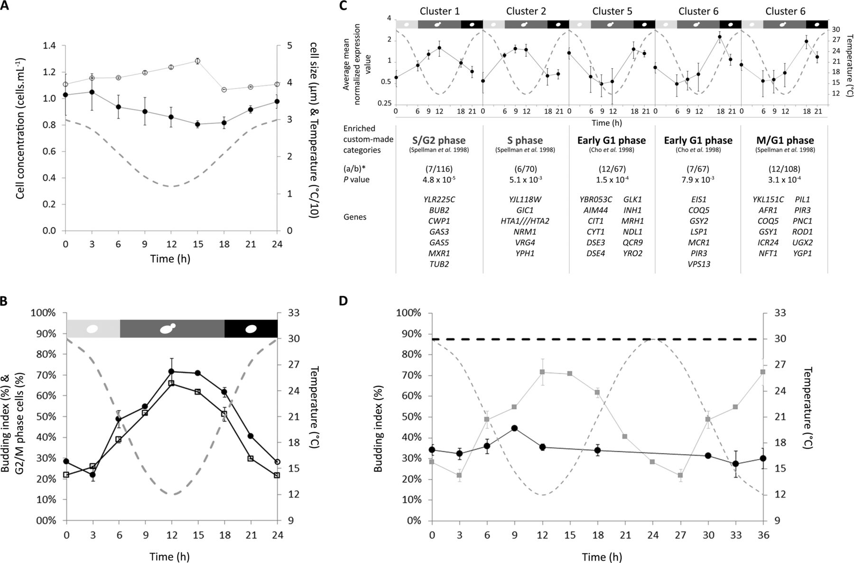
Results – Cell Cycle Distribution in DTC
Cell cycle distribution during DTC
Figure 6
Marit Hebly et al. Appl. Environ. Microbiol. 2014;80:4433-4449

Slide 13
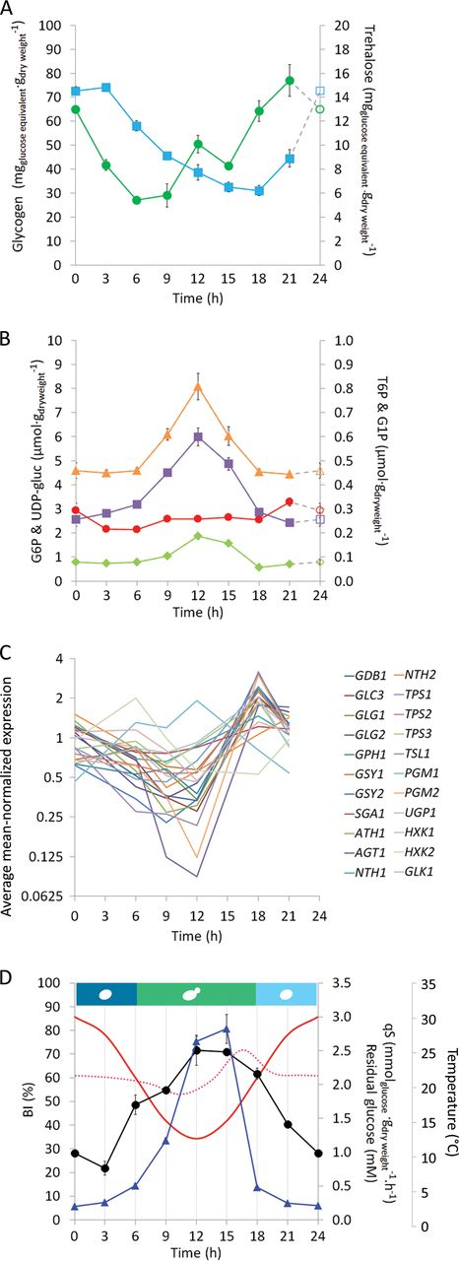
Results – Carbohydrate Storage in DTC
Carbohydrate Metabolism during DTC
Figure 7
Marit Hebly et al. Appl. Environ. Microbiol. 2014;80:4433-4449

Slide 14
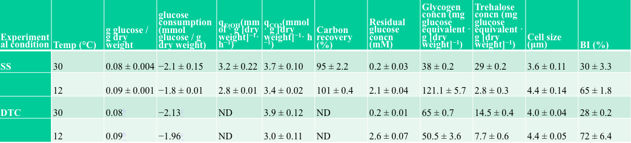
Results – Transcriptional Response in Acclimation to Cold Temperature
Physiological characteristics in steady-state and DTC conditions
Table 3

Slide 15
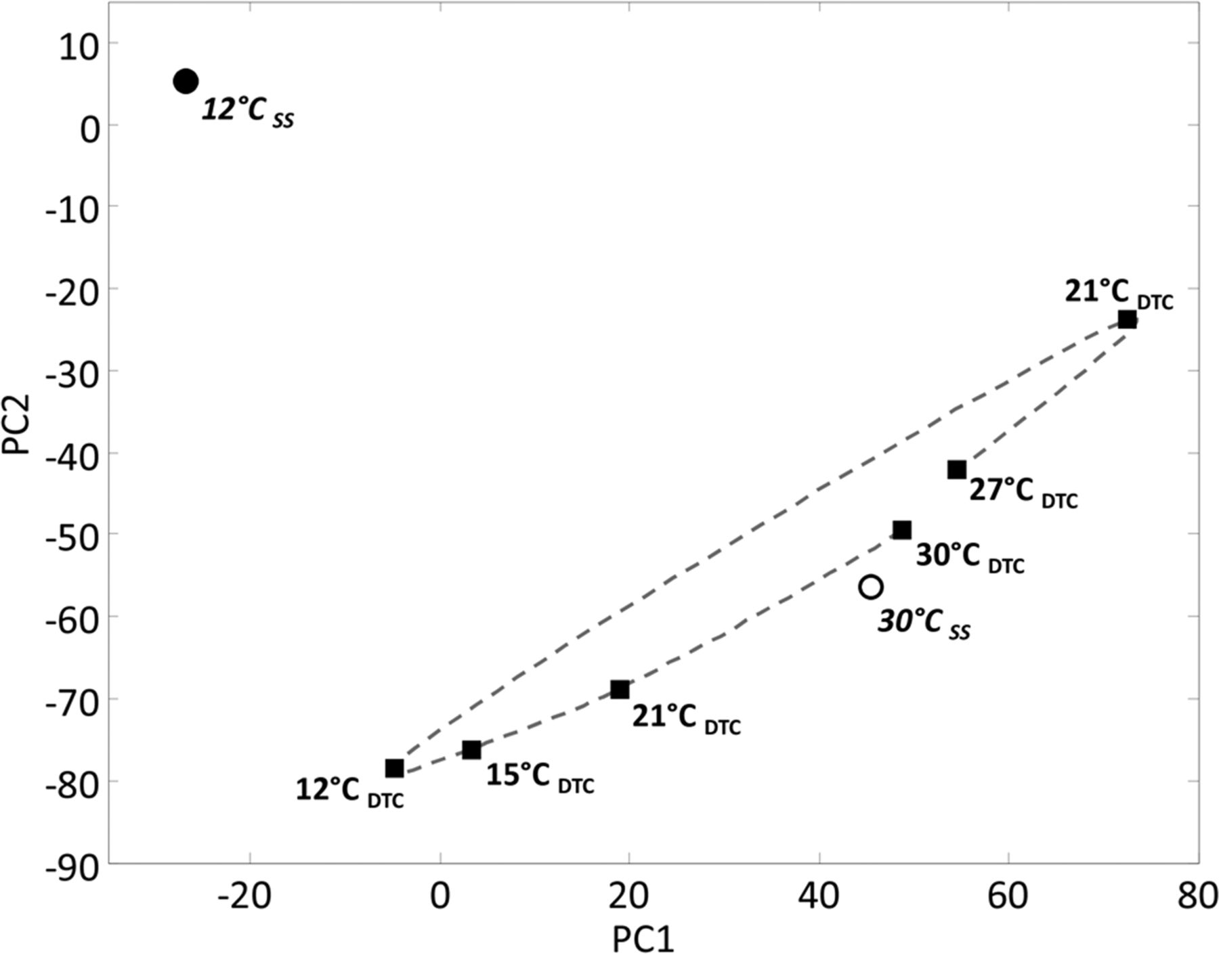
Results – Transcriptional Response in Acclimation to Cold Temperature
Principle Component Analysis in DTC and Steady-State
Figure 8
Marit Hebly et al. Appl. Environ. Microbiol. 2014;80:4433-4449

Slide 16
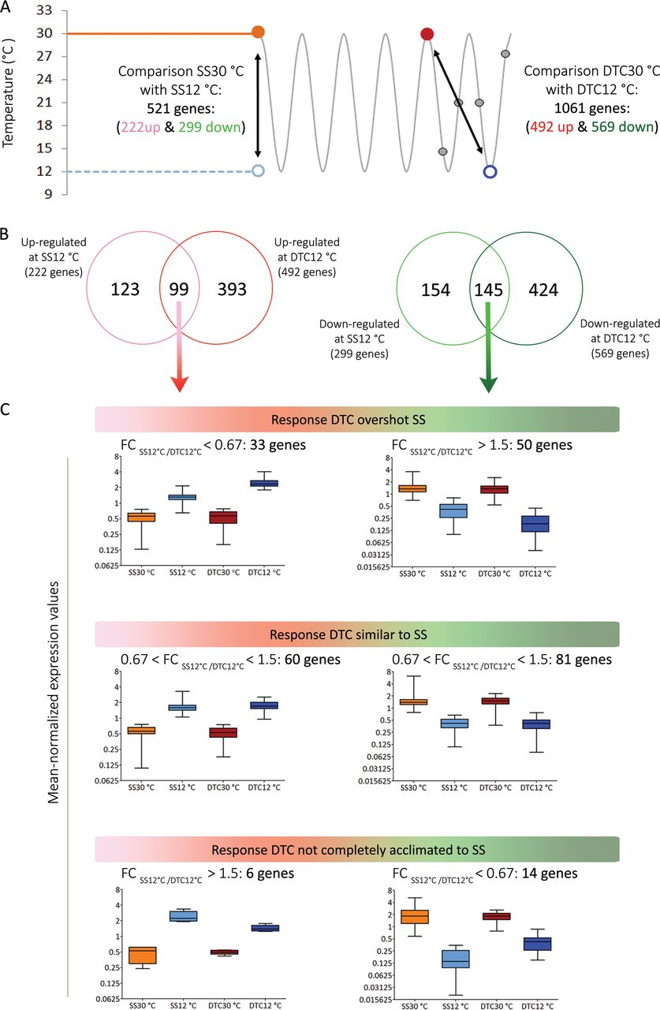
Results – Transcriptional Response in Acclimation to Cold Temperature
Comparison of Transcriptomics in Steady-State and DTC
Figure 9
Marit Hebly et al. Appl. Environ. Microbiol. 2014;80:4433-4449

Slide 17
Discussion
Growth kinetics
Rhythmic variations in glucose concentration
Fluctuations in glucose levels impact yeast transcription
μ = μ_{max} x (C_{s}) / (K_{s} + C_{s})

Slide 18
Discussion
Transcriptional Effects of DTC
Rise in temperature prompted upregulation of genes involved in phospholipid synthesis
Upregulation of Swi4/Swi6 – involved in cell membrane remodeling
Decrease in temperature prompted downregulation of genes involved in arginine synthesis and degradation
Bas1 and Gcn4 target genes were downregulated when temperature was decreased
May have regulation specific to DTC

Slide 19
Discussion
Cell cycle synchronization
Partial synchronization suggested by budding index, flow cytometry, and microarray data
At given dilution factor, average biomass doubling time was 23.1 h⁻¹
May have contributed to synchronization
Synchronization lost after removal from DTC.
Suggests lack of “entrainment”
Higher amount of cells in G₂/M phase at 12°C.
Initially appears to contradict previous literature
Suggests that relative specific growth rate correlates with cell cycle distribution, rather than absolute growth rate

Slide 20
Discussion
Carbohydrate storage
No correlation found between temperature and glycogen/trehalose concentrations in DTC
Carbohydrate mobilization occurred predominately in G₁ phase
Suggests that carbohydrate metabolism was mainly governed by cell cycle

Slide 21
Discussion
Yeast adaptation to DTC approaches acclimation
Physiology between DTC and steady-state was similar at temperature extremes
Only 10 genes were downregulated between 12°C DTC and past cold shock experiments.

Slide 22
Conclusion
Introduction: does S. cerevisiae’s response to DTC overlap with its response to steady-state conditions?
Results: transcriptional reprogramming, carbohydrate metabolism, and cell cycle variation.
Discussion: physiology is similar between DTC and steady-state, but there are some differences in transcriptome

Slide 23
Acknowledgements
Dr. Dahlquist
Dahlquist Lab Team
LMU Department of Biology

