Slide 1
Fluorescent Protein Reporters and
Fluorescence Technology
Josh Leung
James Weis
February 18th, 2010
Bio 1220, Gary Wessel

Slide 2
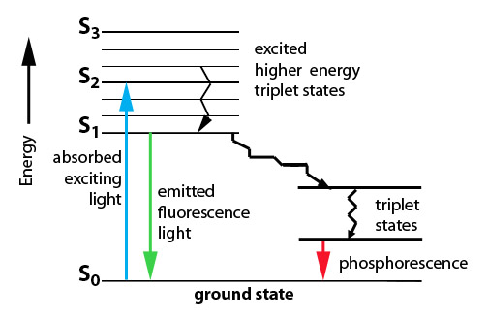
Fluorescence: How does it work?
Fluorescence vs Phosphorescence
  -Time delay – microsecond vs min
Photon absorbed → photon released
  -One photon vs two photons
GFP, other technologies mainly use fluorescence
Jablonski Diagram

Slide 3
What is Fluorescence used for?
In Biology
  Fluorescent proteins and fluorophore tagging
    cellular integrity, endocytosis, exocytosis, membrane fluidity, protein trafficking, signal transduction, enzymatic activity, genetic mapping, etc.
  Fluorescence Microscopy
  DNA Microarrays (test for gene expression)
  DNA Sequencing
  Fluorescence Recovery After Photobleaching
  Fluorescence-Activated Cell Sorting
Other uses include fluorescent lighting, flame tests, etc.

Slide 4
Advantages of Fluorescence Technology
Tagging a target molecule
  In vivo detection
  Reliable (even down to one molecule)
  High fidelity and specificity
  Identify multiple target molecules simultaneously
Development of new imaging techniques
  Also detect more types of targets

Slide 5
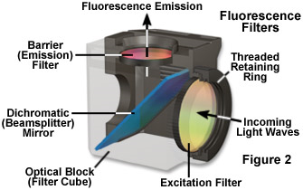
Fluorescence Microscopy
Shine light → fluorescence → detection
Separate weaker fluorescence from the excitation light using filters
Limit of detection determined by the darkness of the background (lack of noise, etc)
Camera
↑
↓
Specimen

Slide 6
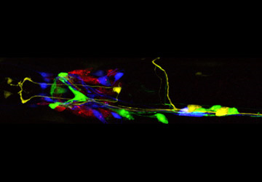
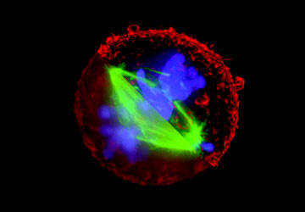
Fluorescence Microscope
C. Elegans Nervous System
Cell Division

Slide 7
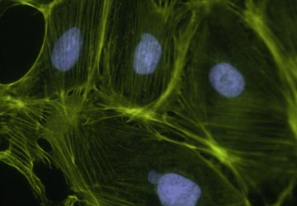
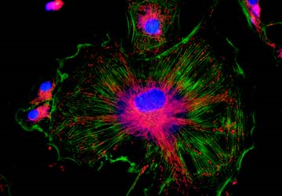
Fluorescence Microscope
Mammalian Cells
(DNA is blue, microfilaments are green)
Endothelium Cells
(Triple fluorescence staining of endothelium cells from a pulmonary artery)

Slide 8
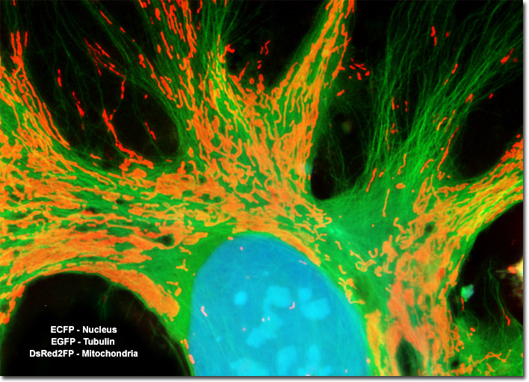
Opossum Kidney Cortex Epithelial Cells (OK Line)

Slide 9
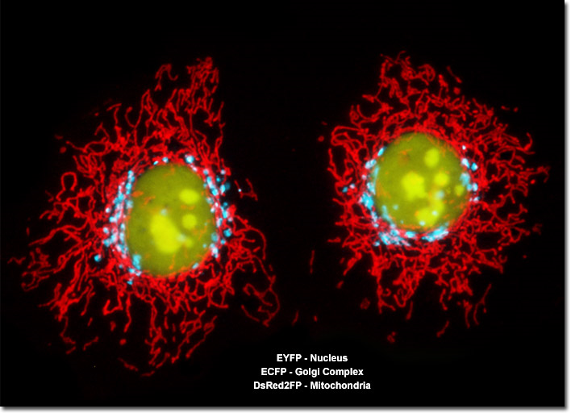
Human Cervical Adenocarcinoma Cells (HeLa Line)

Slide 10
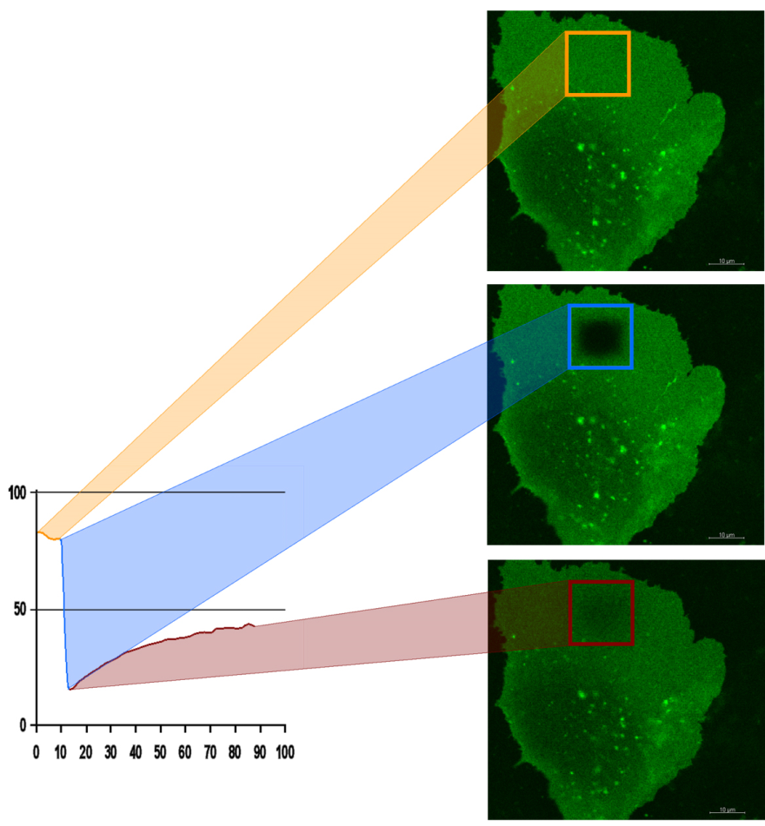
FRAP
Fluorescence recovery after photo-bleaching
Study diffusion and movement of biological molecules
  fluid mosaic model of the cell membrane
  study molecules in the cytosol, nucleus, etc
Fluorescence
Time

Slide 11
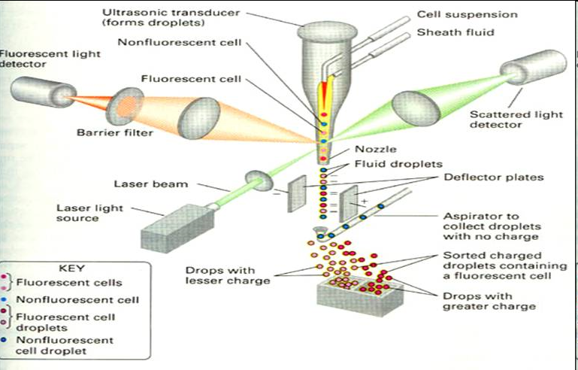
Fluorescence-Activated Cell Sorting
Rapid sorting
Sorts cells one-by-one

Slide 12
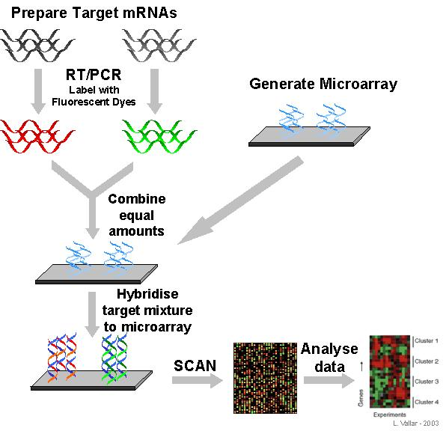
Microarrays
DNA (Gene) microarrays
  Gene expression profiling (using fluorescent labeled mRNA)
  SNP detection
Protein microarrays
  Antibody analysis
  Protein interactions

Slide 13
Reporter Genes
Attached to genes of interest
Chosen by the characteristics they confer to the organism expressing them
  Easily identified / measured
  Selectable markers
Determine whether the gene of interest is being expressed

Slide 14
Common uses of reporter genes
Gene expression assays
Promoter assays
Transformation / transfection assays
Two-hybrid screening

Slide 15
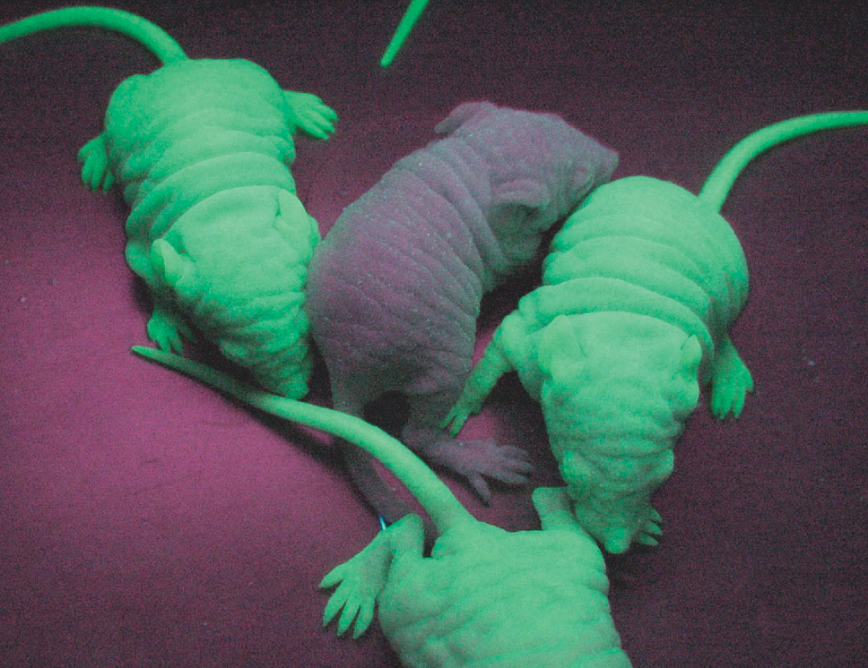
So, what makes a good reporter gene?

Slide 16
So, what makes a good reporter gene?
Genes that confer easily identifiable characteristics.
  Green Fluorescent Protein (GFP)
    Jellyfish
    Causes cells to glow green under blue light
  Red Fluorescent Protein (dsRed)
    Coral
  Luciferase
    Fireflys
    Catalyzes a reaction with luciferin, producing light

Slide 17
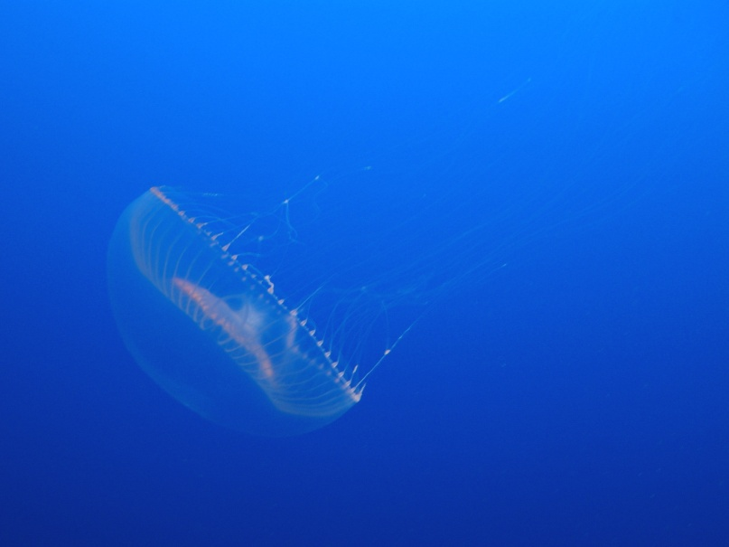
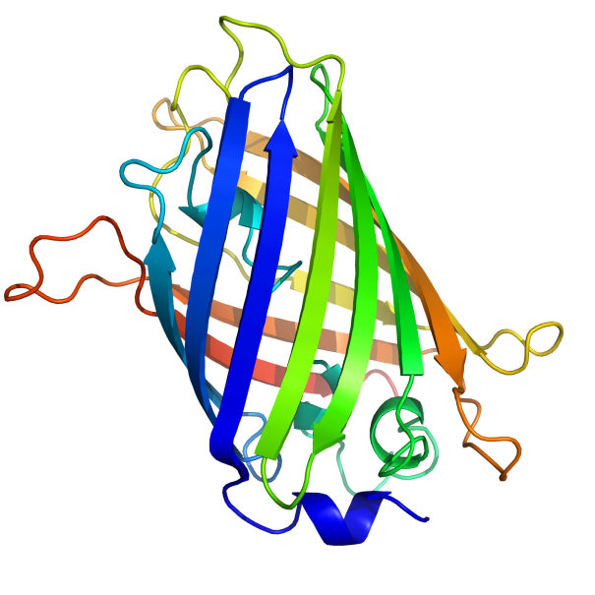
GFP
Aequorea victoria
238 amino acids
Refined from WT over the years
  1995; Mutation dramatically improving the spectral characteristics of GFP
  1995; F64L, allowing GFP use in mammalian cells
Variants
  Superfolder GFP
  Blue, Cyan, Yellow, Red, Emerald, Apple……

Slide 18
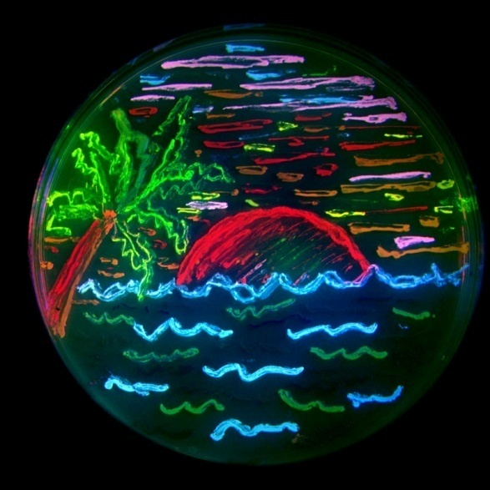
Fluorescent proteins and their uses
Fluorescent proteins derived from GFP and dsRed.
Colors:
  BFP
  mTFP1
  Emerald
  Citrine
  mOrange
  mApple
  mCherry
  mGrape

Slide 19
Florescent proteins
Fluorescence microscopy
  Florescent proteins not phototoxic, as are most florescent molecules
Determine when gene is expressed
  Exhibit morphological distinctions
  View biological processes (protein folding, transport, etc)
  Expression of a florescent protein in specific cells
    Optical detection of specific cells

Slide 20
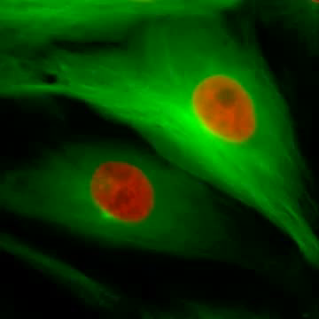
Two color male pig kidney epithelial cells undergoing mitosis
A culture of pig kidney cells
mCherry fused to human histone H2B
mEmerald fused to alpha-tubulin

Slide 21
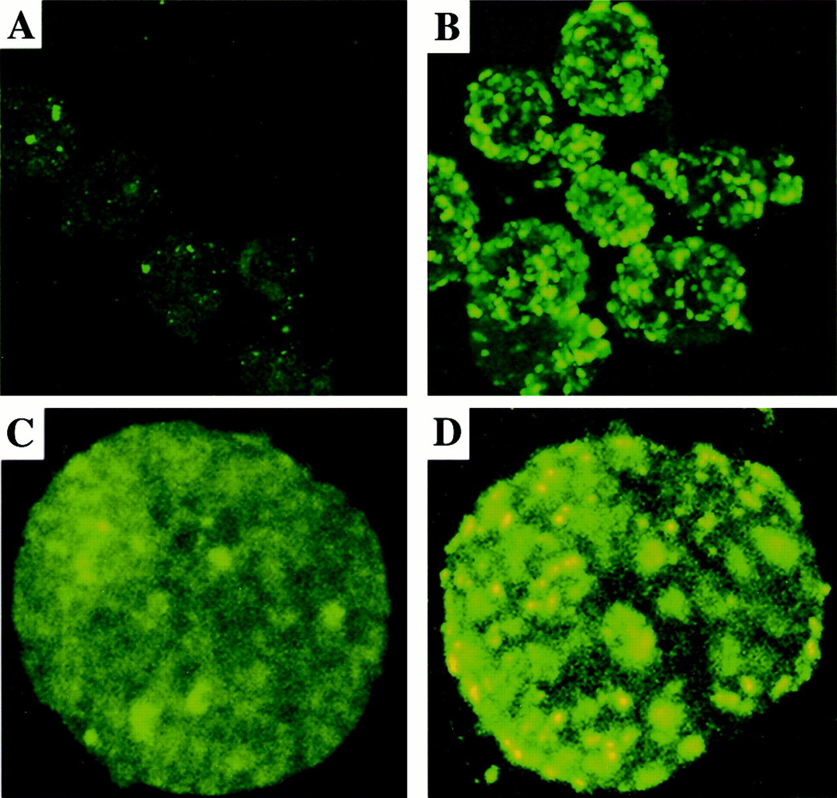
Use of GFP to identify specific cells

Slide 22
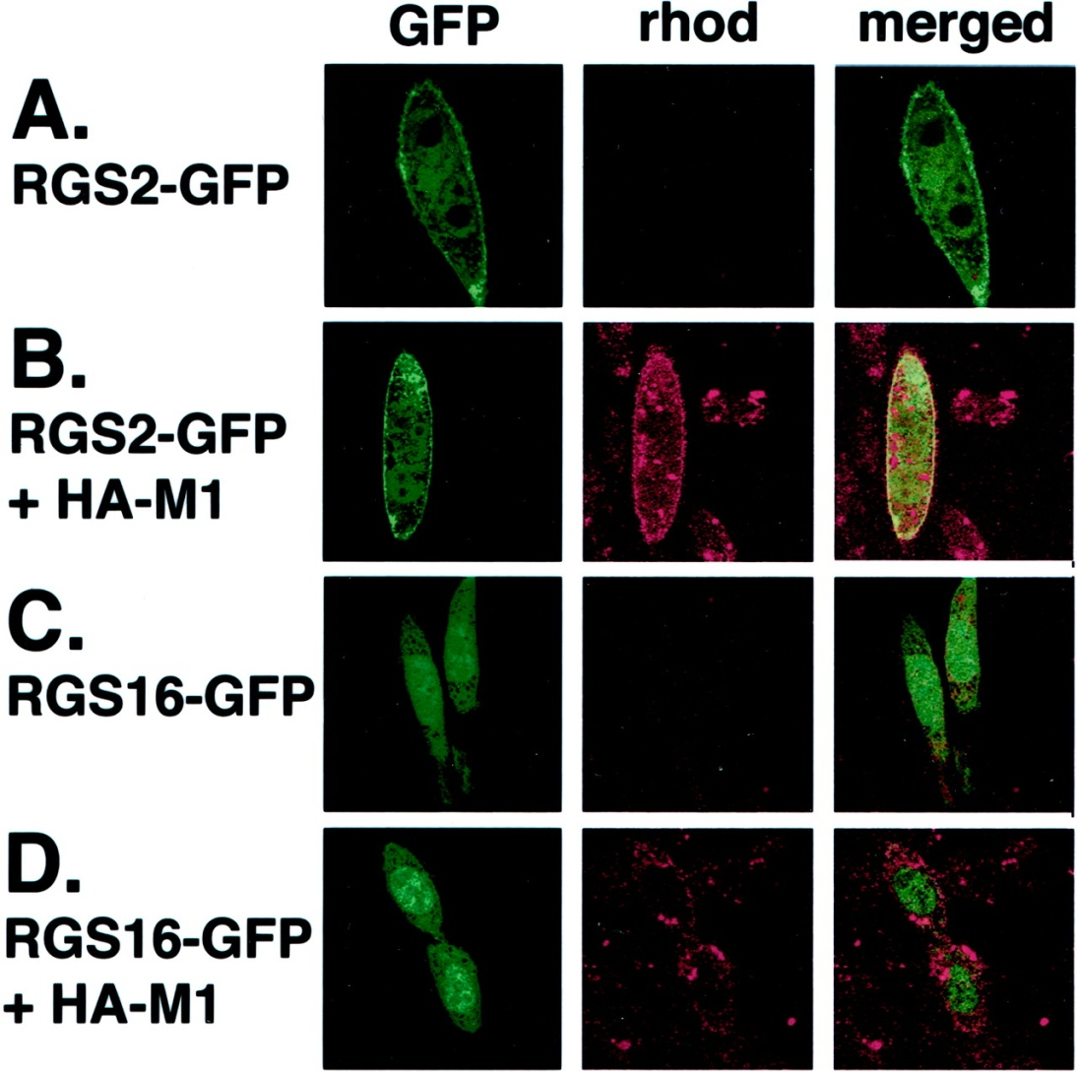
GFP to identify cellular parts

Slide 23
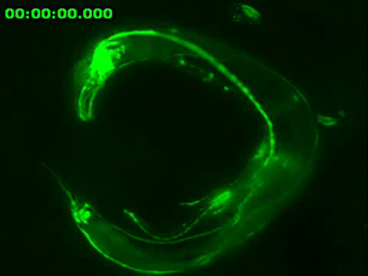
Expression of GFP to track specific cells

Slide 24
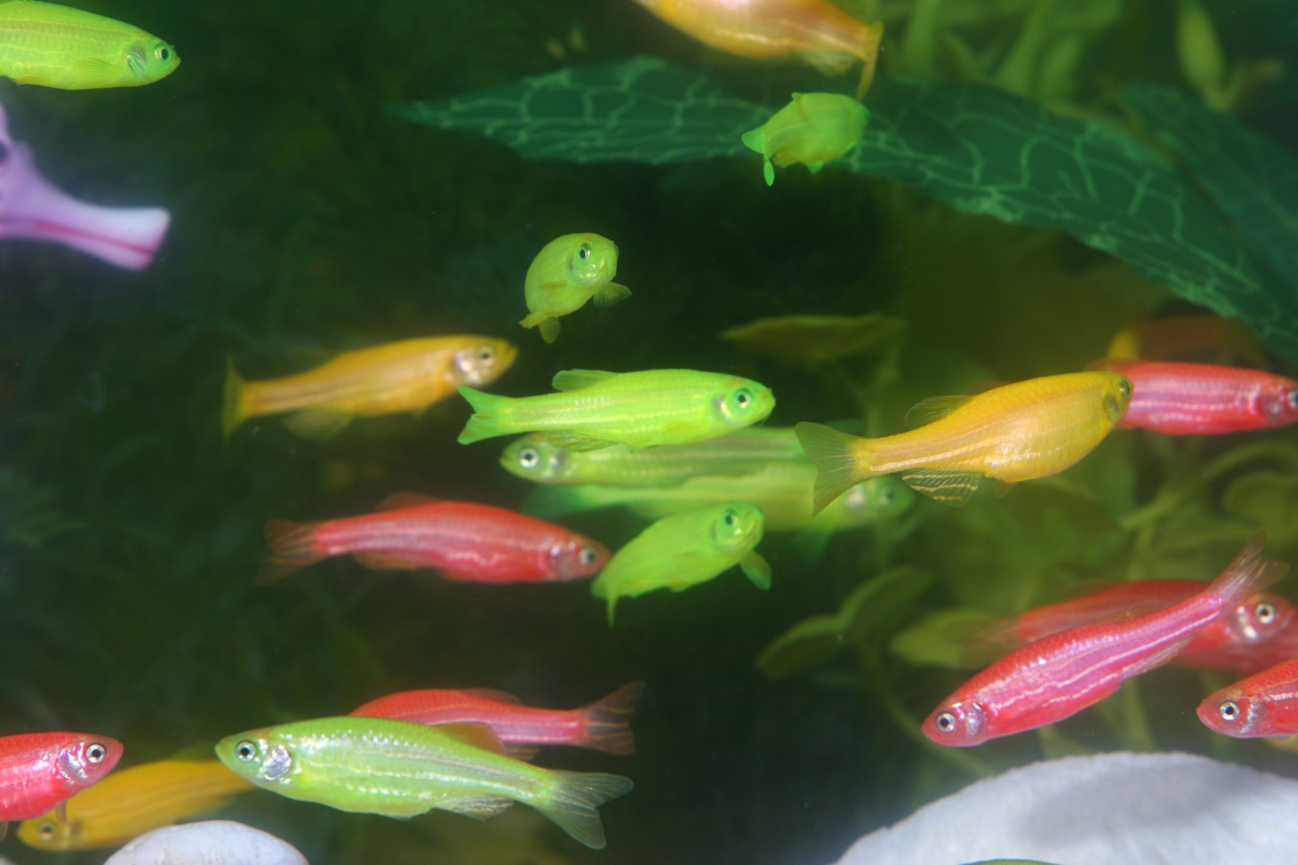
Fluorescent proteins and their uses

Slide 25
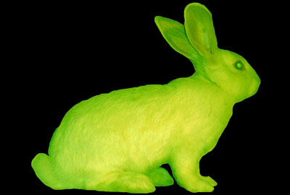
Fluorescent proteins and their uses

Slide 26
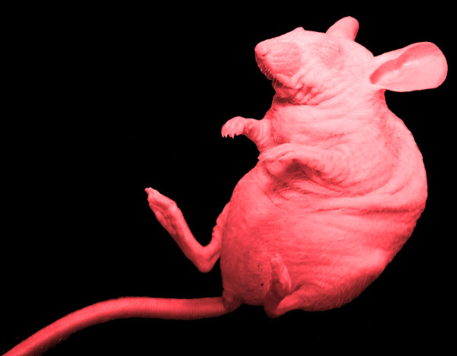
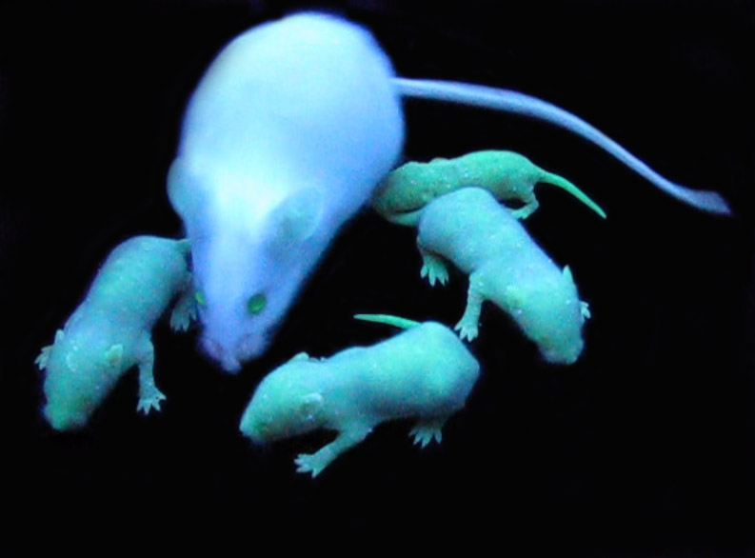
Fluorescent proteins and their uses

Slide 27
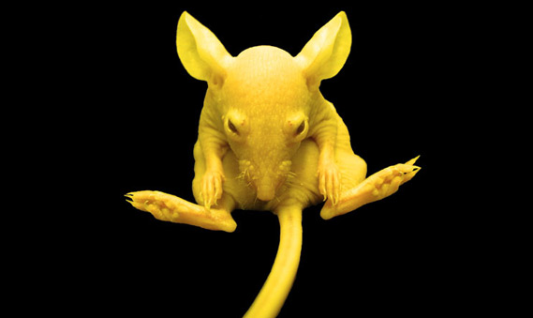
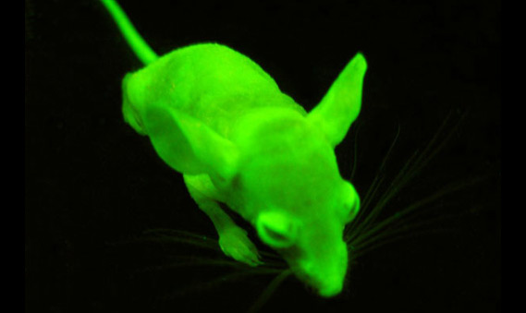
Fluorescent proteins and their uses

Slide 28
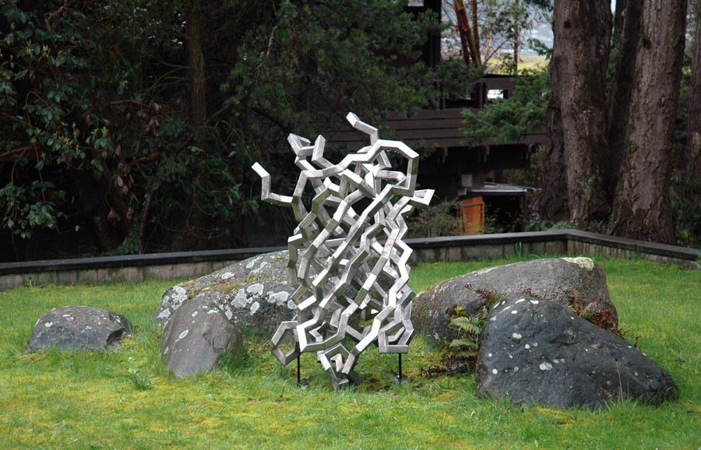
Fluorescent proteins and their uses

Slide 29
The End

