Slide 1
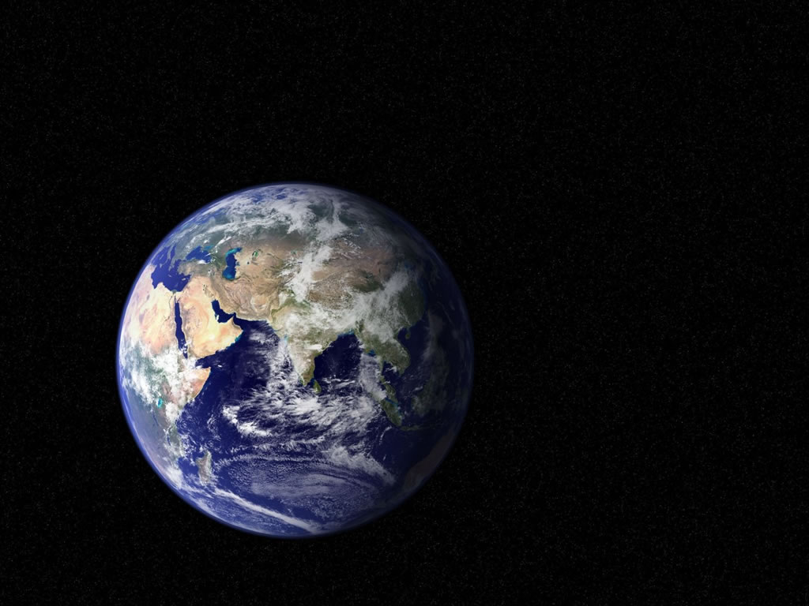
Global biological change:
The first 4.6 billion years
COSMOS
29 June 2009
Notes:
Today we are going to walk through the early history of earth,
find out the role that biology has had in shaping our earth
Later in the course we will focus more on the present day, the last century and the next century.
Today: deep history
When you look at this picture, what can you say about the planet earth?

Slide 2
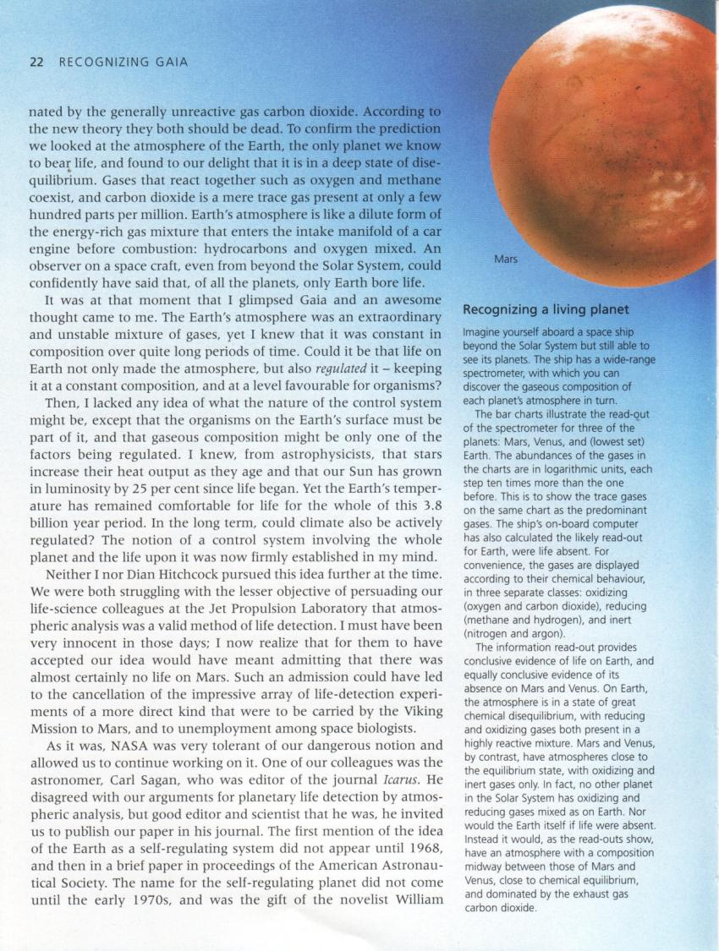
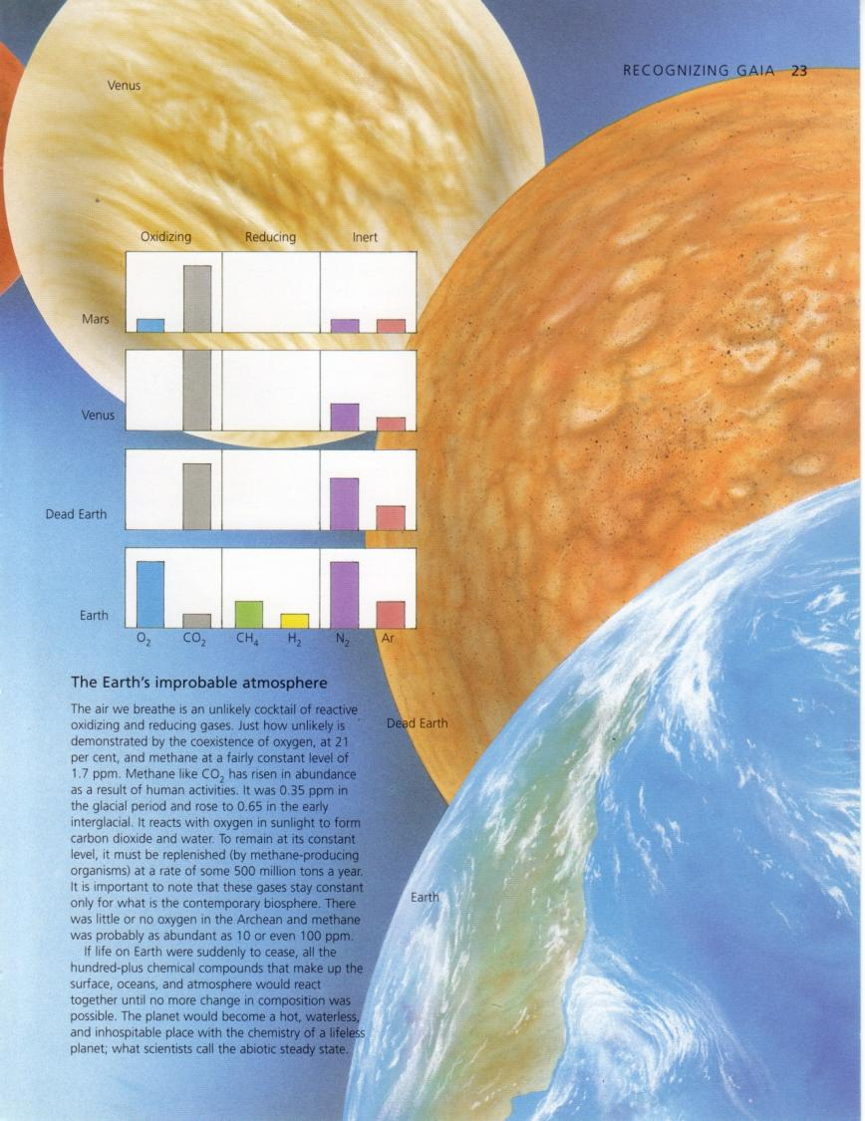
Venus
Mars
Dead Earth
Today:
What makes earth different?
How has life changed the earth?
How do human impacts compare to previous changes that the earth has experienced?
Living Earth
Story and illustrations based on:
Lovelock, J., 2000. Gaia: The practical science of planetary medicine. Oxford U Press
Notes:
What makes earth unique?
(ask for answers)
Most planets (most of the universe) is governed by chemistry and physics; biology appears very rare
Ask “How would you recognize life on another planet”?
(wait for answers)
send a probe and look for microbes
look at the entire system

Slide 3
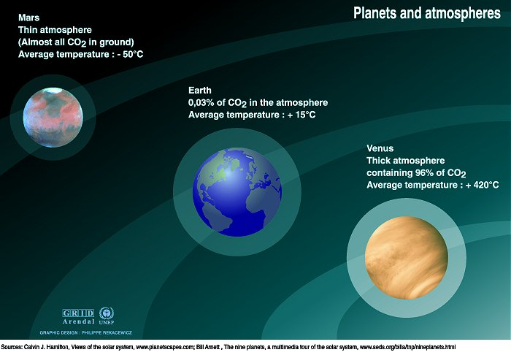
Notes:
The goldilocks hypothesis: earth is suitable for life
is it unique in the universe? Godilocks hypothesis
vs. Sagan: earth is probably fairly common
Compare it to it’s neighbors:
Mars is cold and CO2, H2O, and CH4 are often frozen, much of atm. lost
Venus has thick CO2 atmosphere and is very hot, all volatile gasses have evaporated
Earth is just right, has temp w/ liquid water

Slide 4
95%
0.25%`
2.5%
98%
2%
?
21%
0.04%
1%
78%
Notes:
Lets look more closely at the atmospheric chemistries of these planets
We have three categories, oxidizing, reducing, and inert
Recall:
Oxidizing: gives e- away
Reducing: accepts e-
Note that gasses are on a log scale – that helps to keep trace gasses visible
How to observe life:
Imagine that you are on a spaceship looking at earth
Ship has a spectrometer so you can measure atmospheric gasses in the light reflected from the surface
story of J. Lovelock at this is the question that Lovelock attempted ot JPL
Mars: has lost most of its gasses
Venus: N2 diluted b/c all gasses have been evaporated
Dead Earth: atmosphere that is intermediate between Venus and Mars
But we don’t: earth has combination of oxidizing and reducing gasses.
? For class: “What should happen in a closed system with both oxidizing and reducing gasses present?”
Life maintains this chemical gradient, by using the energy of the sun to reduce CO2 and produce oxygen
Note that earth has much lower CO2 than would be expected without life
Most C is stored in the crust, biota, and soil
Also has O2, and has methane and H2 in an oxidizing environment
To understand why, lets look at a brief history of the earth

Slide 5
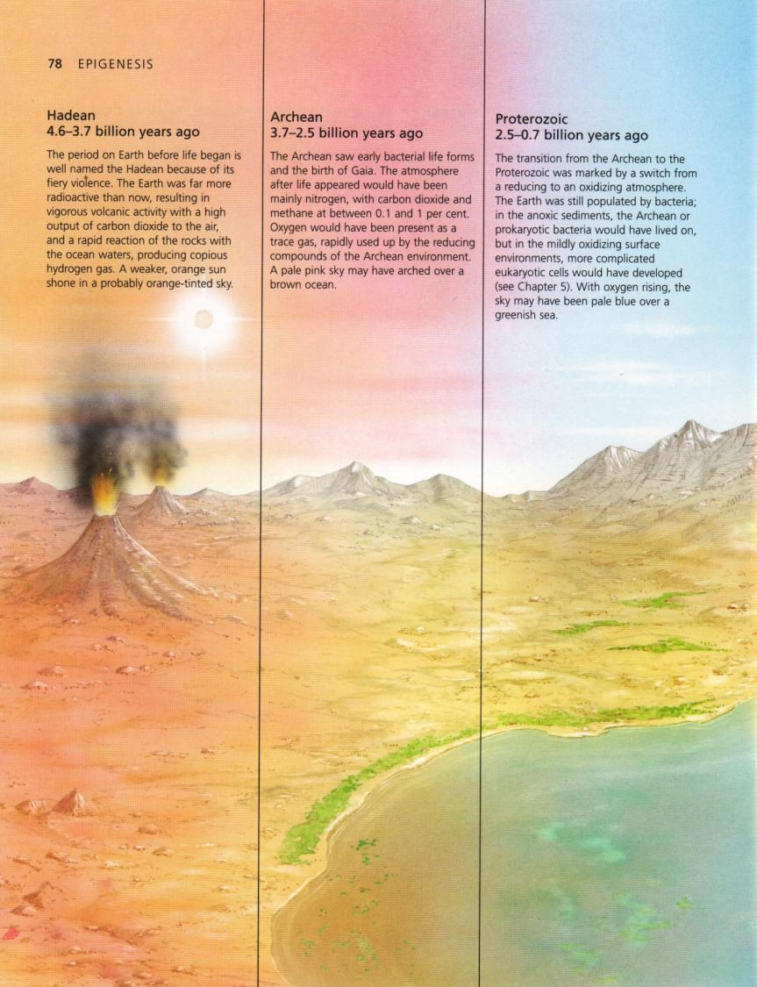
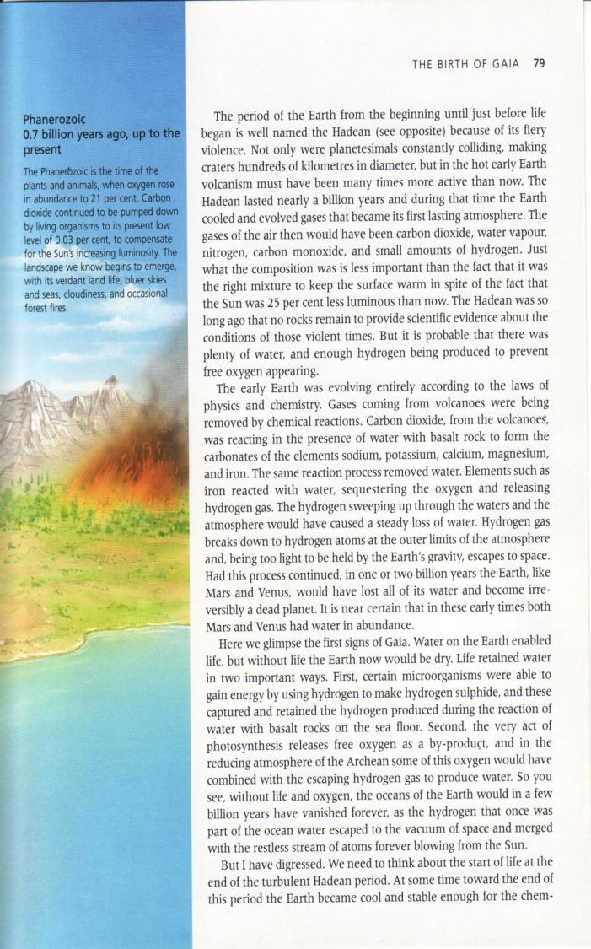
Evolution of the biosphere
Phanerozoic 0.7 bya - present
Proterozoic 2.5-0.7 bya
Archean
3.7-2.5 bya
Hadean
4.6-3.7 bya
Notes:
But why did this happen on earth?
(have student answer: life)
Hadean:
rapid chemical / physical reactions: Radioactive, Hot, high CO2 output, planet was evolving geologically
Before life, earth was a much different place, undergoing rapid transformations as planetessimals were combining, crust was stratifying, and degassing to form the atmosphere
By about 3.7 bya, started to get some permanent bodies of water, and this is where we find the first indications of life
Lets walk through the history.

Slide 6
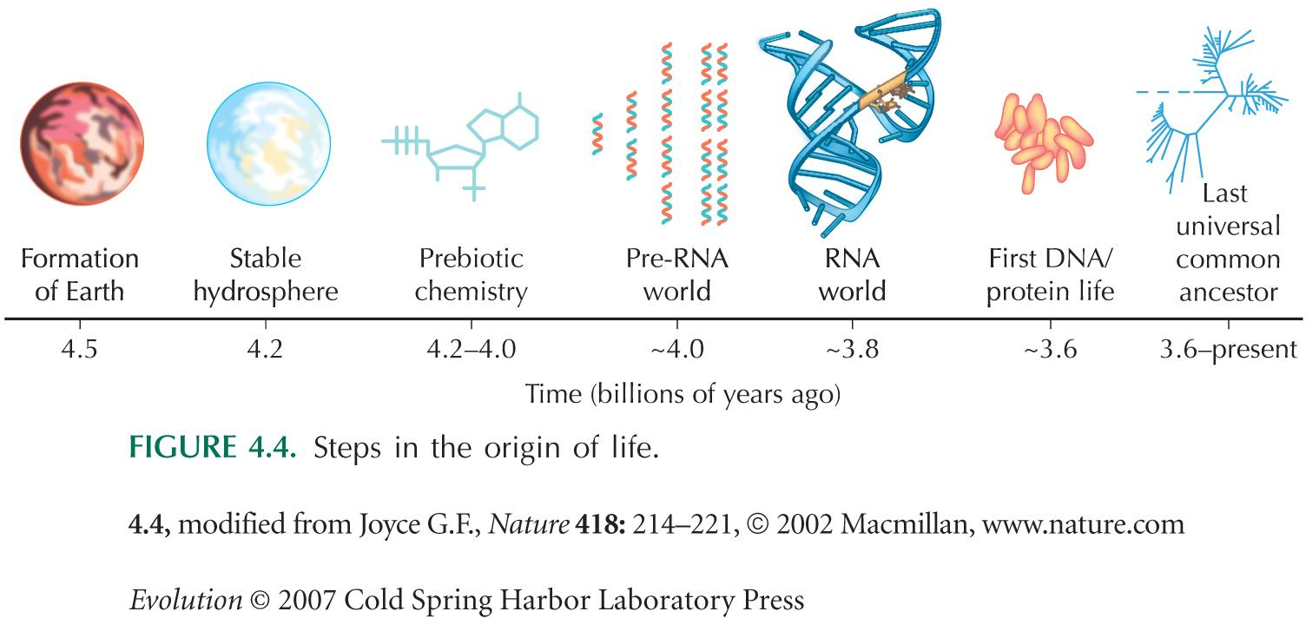
Life’s beginnings on earth
Notes:
How did life begin?
Walk through each
Last universal common ancestor brings us into the Archaen

Slide 7
A brief history of the earth
Phanerozoic 0.7 bya - present
Proterozoic 2.5-0.7 bya
Archean
3.7-2.5 bya
Hadean
4.6-3.7 bya
Notes:
Archean:
1st life forms:
bacteria, chemoautotrophs cyanobacteria,
CO2 and CH4 ~1%, O2 rapidly reacts with reducing atmosphere and ocean

Slide 8
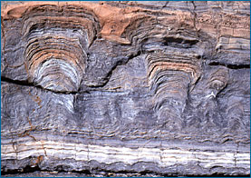
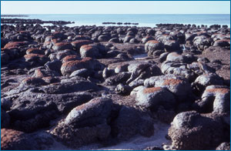
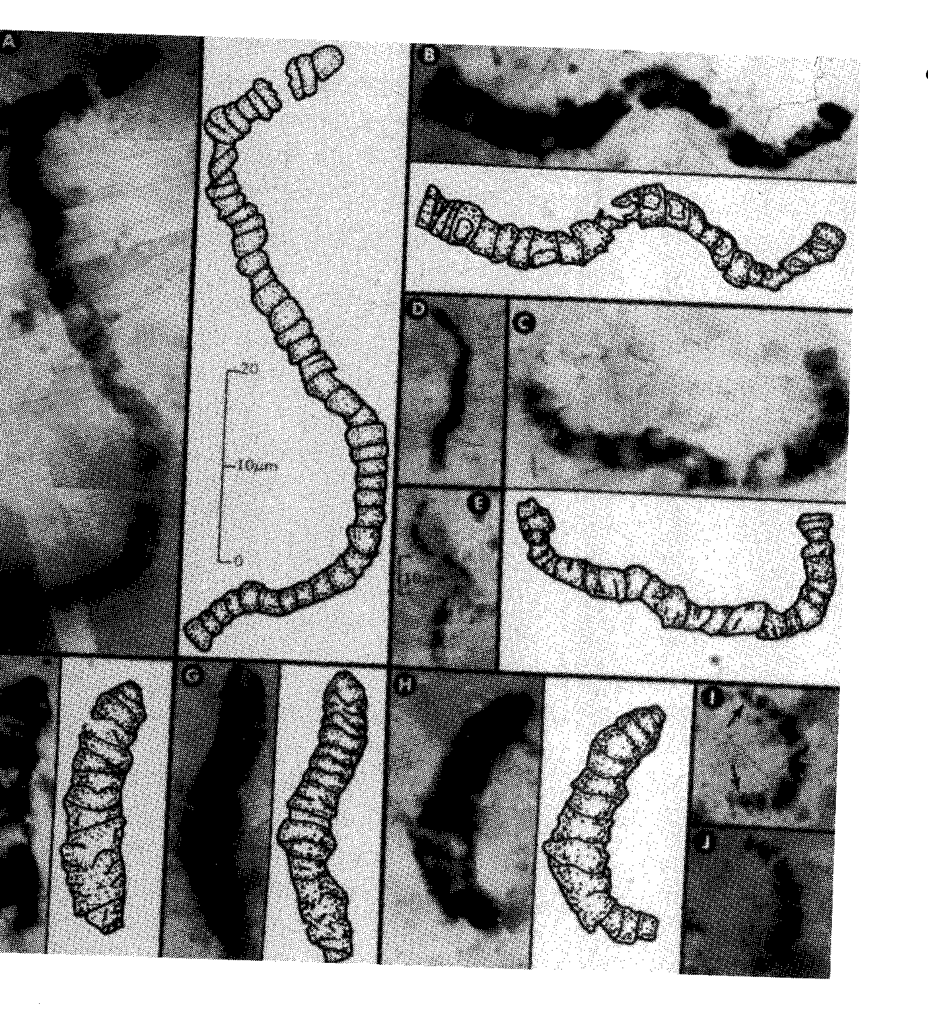
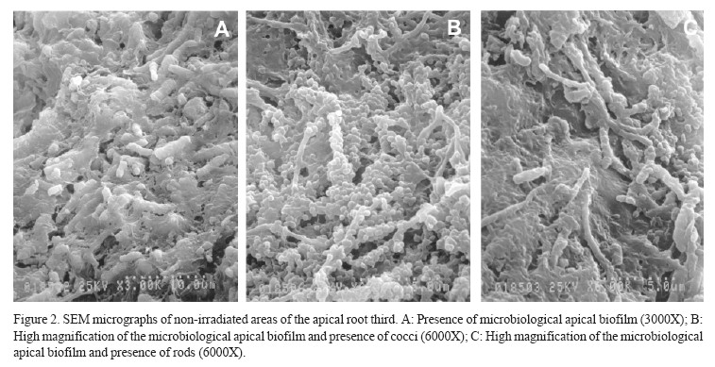
Notes:
This is a fossil stromatolite on the left, and modern stromatolites on the right
These are the earliest known ecosystems.
Note layering.
These bacteria can process oxidize and reduce a wide range of elements

Slide 9
A brief history of the earth
Phanerozoic 0.7 bya - present
Proterozoic 2.5-0.7 bya
Archean
3.7-2.5 bya
Hadean
4.6-3.7 bya
Notes:
Proterozoic:
Aerobic organisms, O2 begins to accumulate in the atmosphere
Phanerozoic:
Land plants and animals, O2 increases to 21% and stabilizes; ecosystems as we know them, blue skies & seas, forest fires,

Slide 10
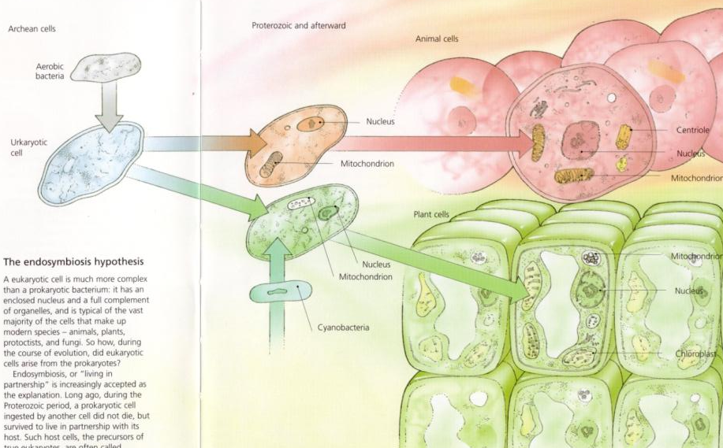
Aerobic Life
Notes:
Prokaryotes: membrane and insides
Ukaryotes: endosymbiosis, differentiated nucleus
Eukaryotes: has organelles chloroplast for photosynthesis and mitochondrion for energy production
Chloroplasts: enable cells to photosynthesize: use sunlight to produce organic matter and O2 from raw materials CO2 and H2O
Mitochondria: recombine O2 and organic matter to form CO2 and H2O plus energy

Slide 11
A brief history of the earth
Phanerozoic 0.7 bya - present
Proterozoic 2.5-0.7 bya
Archean
3.7-2.5 bya
Hadean
4.6-3.7 bya
Notes:
Proterozoic:
Aerobic organisms, O2 begins to accumulate in the atmosphere
Phanerozoic:
Land plants and animals, O2 increases to 21% and stabilizes; ecosystems as we know them, blue skies & seas, forest fires,

Slide 12
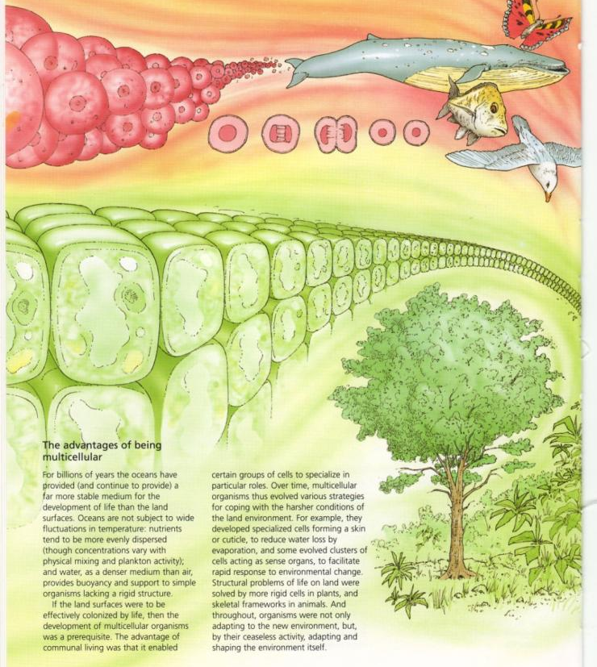
Notes:
As O2 built up, there was enough energy to make multicellular organisms
Advantages of multicellularity: why this is important
-groups of cells specialize in their roles:
skin or cuticle to reduce evaporation
sensory organs to sense environmental changes
more rigid cells allow structure to support lg bodies on land
-require lgr amts of oxygen and transport systems for O2 and nutrients
Allows life regulate temperature, water and therefore colonize land

Slide 13
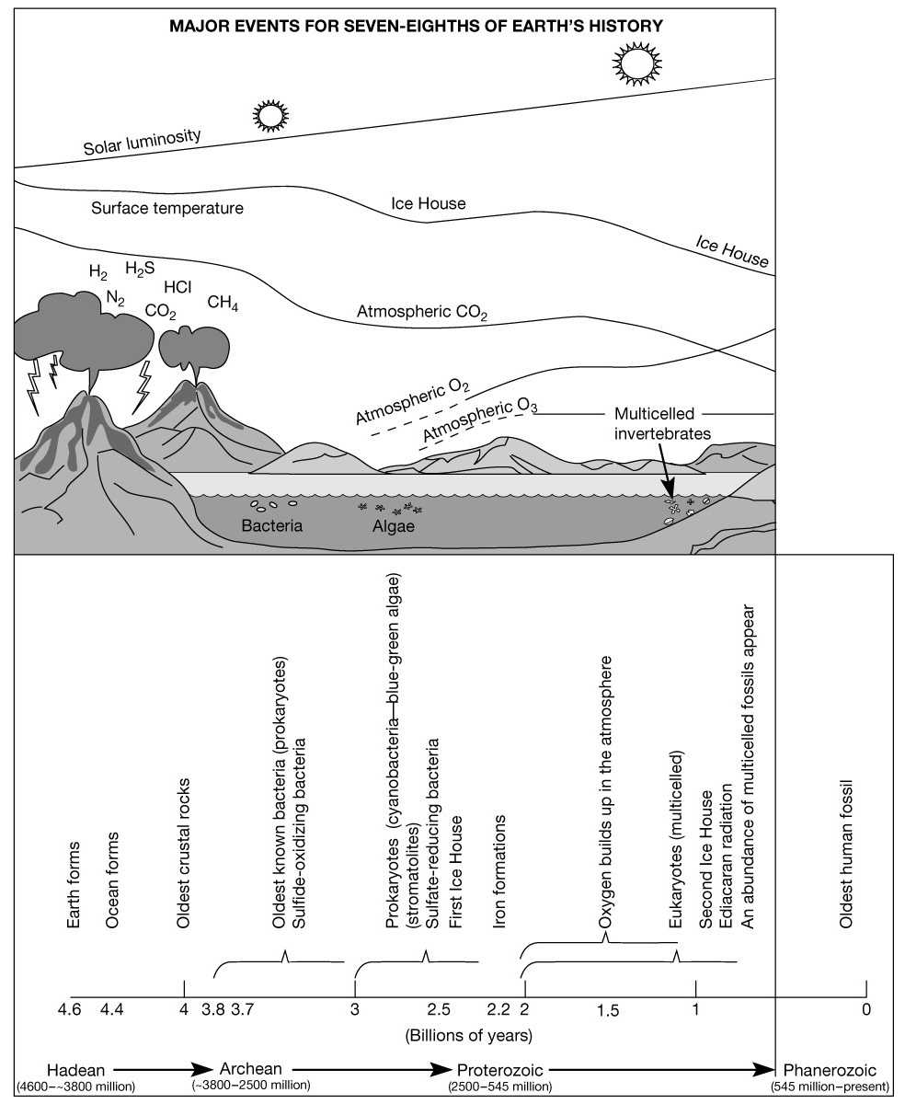
(500mya)
Notes:
The buildup of O2, and the removal of CO2 from the atmosphere had some very substantial consequences for the habitability of earth – and its ability to have multicellular organisms
Earth Forms 4.6bya
Oceans 4.4 bya
Oldest rocks ~4by
Bacteria ~3.5by – sulfate oxidizing
Prokaryotes (cyanobacteria, blue-green algae); o2 begins to accumulate in microsites around area of production
As CO2 dips, earth cools and ice appears
As 02 increases, Iron starts to rust, once all iron in rocks rusts, then O2 accumulates in atm
Then Eukaryotes evolve, then multicellularity
This brings us to ½ billion years ago, and lets quickly move through this ½ by so that we can concentrate on the impact of humans for the remainder of the cours

Slide 14
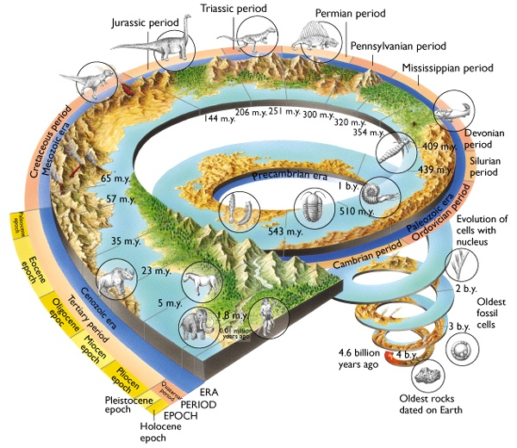
Notes:
Global biological change: most has happened in the last 500 million years
At the same time, biology has also strongly influenced the earth, including it’s habitability
Note: humans can not have near the same effect as photosynthetic organisms, although we do have power to do substantial damage

Slide 15
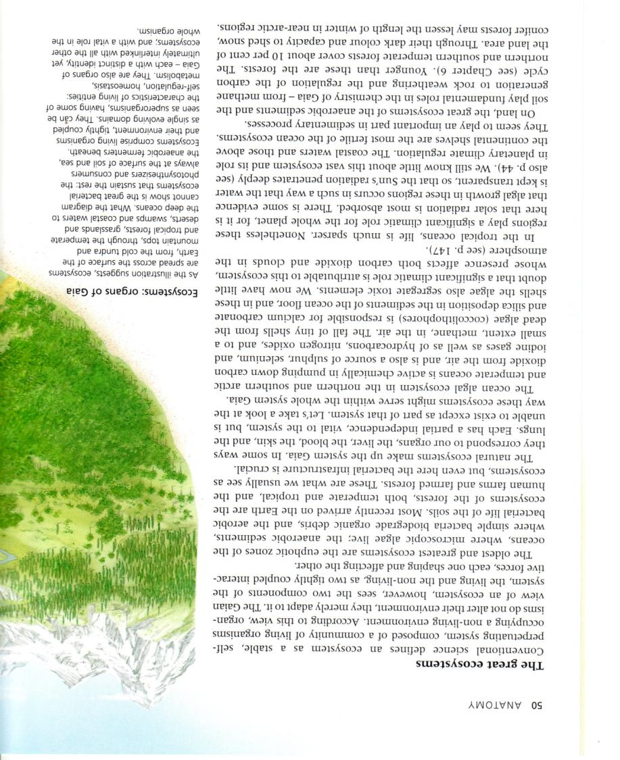
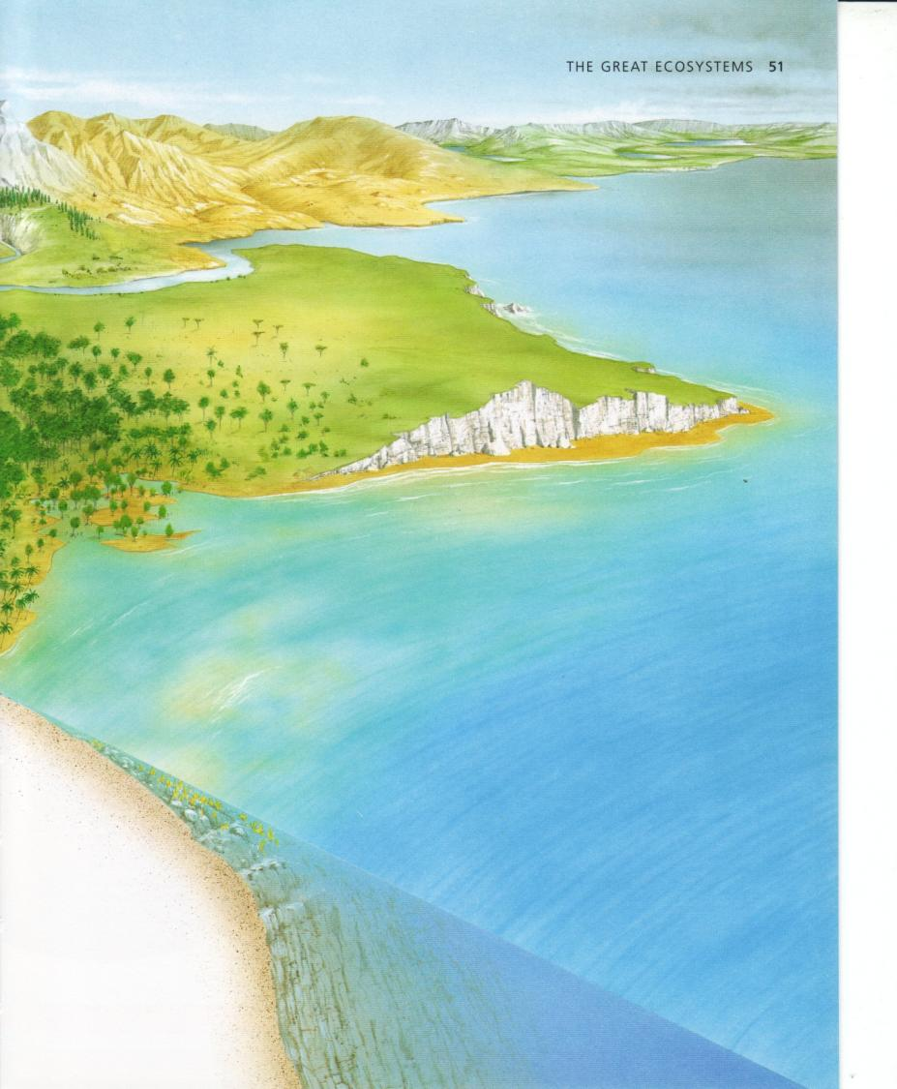
Ecosystems
Notes:
Now we are going to shift to the unit of living system that most earth system scientists use: the ecosystem.
Ecosystem: stable, self perpetuating system, composed of organisms that occupy a physical environment,
Or, alternatively: ecosystem as a tightly coupled interaction between the physical and the biological components of the system
Oldest, largest ecosystems that pump most of the O2 into the air are the euphotic zones in the ocean, also bury C atm and Ca and Si from the ocean water that gets buried, also release many gasses to the air <we will cover this in our lecture on biogeochemical cycles>
Also have savannah, temperate forests, tropical forests, wetlands

Slide 16
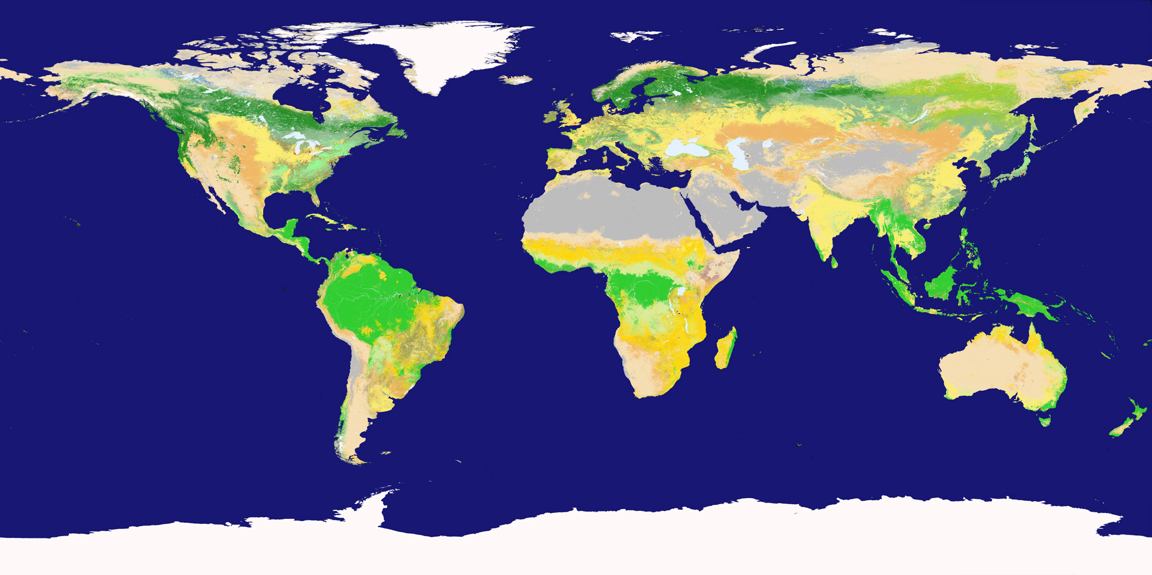
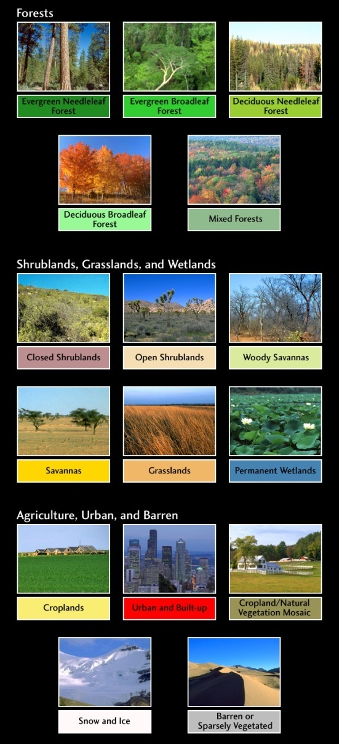
Terrestrial biomes of the world
NASA Earth Observatory: http://earthobservatory.nasa.gov
Notes:
Biomes: define biomes, walk through different biomes
Next we are going to look at the air, sea, and soil components of the earth

Slide 17
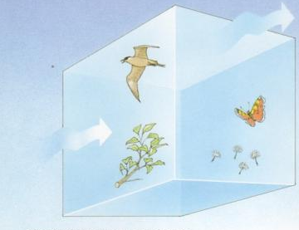
What is in a sample of Air?
Notes:
A sample of air near the sufrace
O2 21%
Coexisting with CH4 and other reactive cmpds
Low CO2, implying that this gas is actively regulated – if stuff were to burn then CO2 would increase very much (see current time CO2)
Water is distributed through the atmosphere
These gasses provide insulation
Living organisms relatively sparse – include birds and insects as well as spores and seeds and microbes that disperse through the air
Near ground, leaves extend into the atmosphere, making the surface area of gas exchange greater

Slide 18
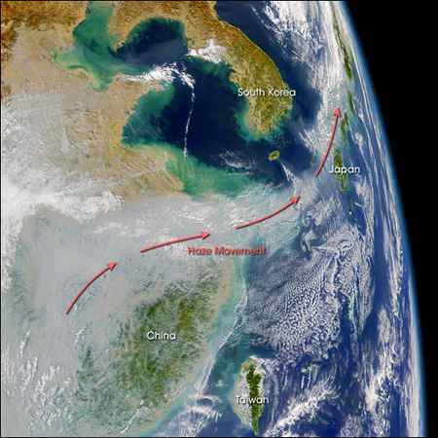

Slide 19
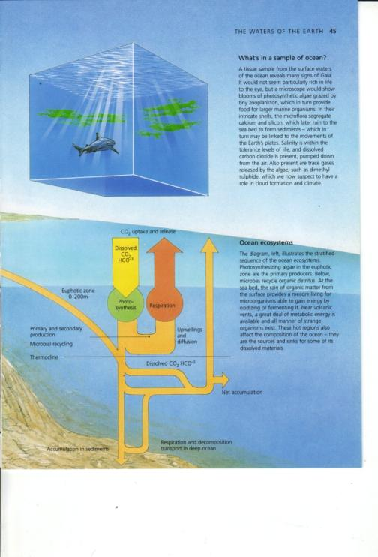
What is in a sample of Ocean?
Notes:
Water is essential to life
Most of the life is microscopic – algae, zooplankton, and bacteria in particular
Under a microscope, we would see algae being grazed by zooplankton
Algae are small chemical factories that combine si, ca, nutrients, CO2 from the surrounding area

Slide 20
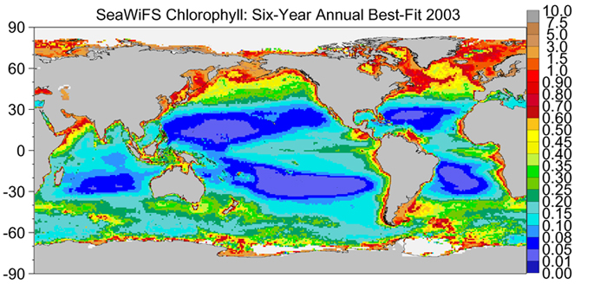
Global distribution of Chlorophyll
Notes:
Chlorophyll content
This is based on satellite imagery, because Chla reflects a particular wavelength

Slide 21
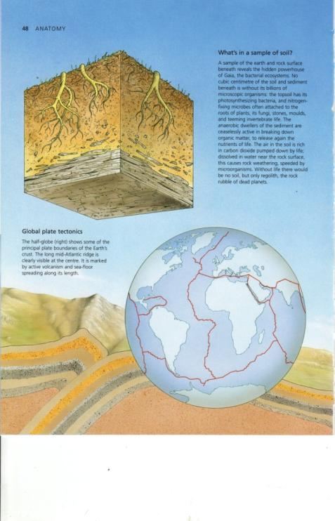
What is in a sample of Soil?
Notes:
Billions of microorganisms
Microbes attached to everything,
Most of the world’s organic matter is stored in the soil
Fungi, stones, moulds, invertibrates,
Soil air is rich in CO2, CO2 and other biotic acids help to dissolve the rocks;
Biota are responsible for developing the soil and retaining sediment

Slide 22
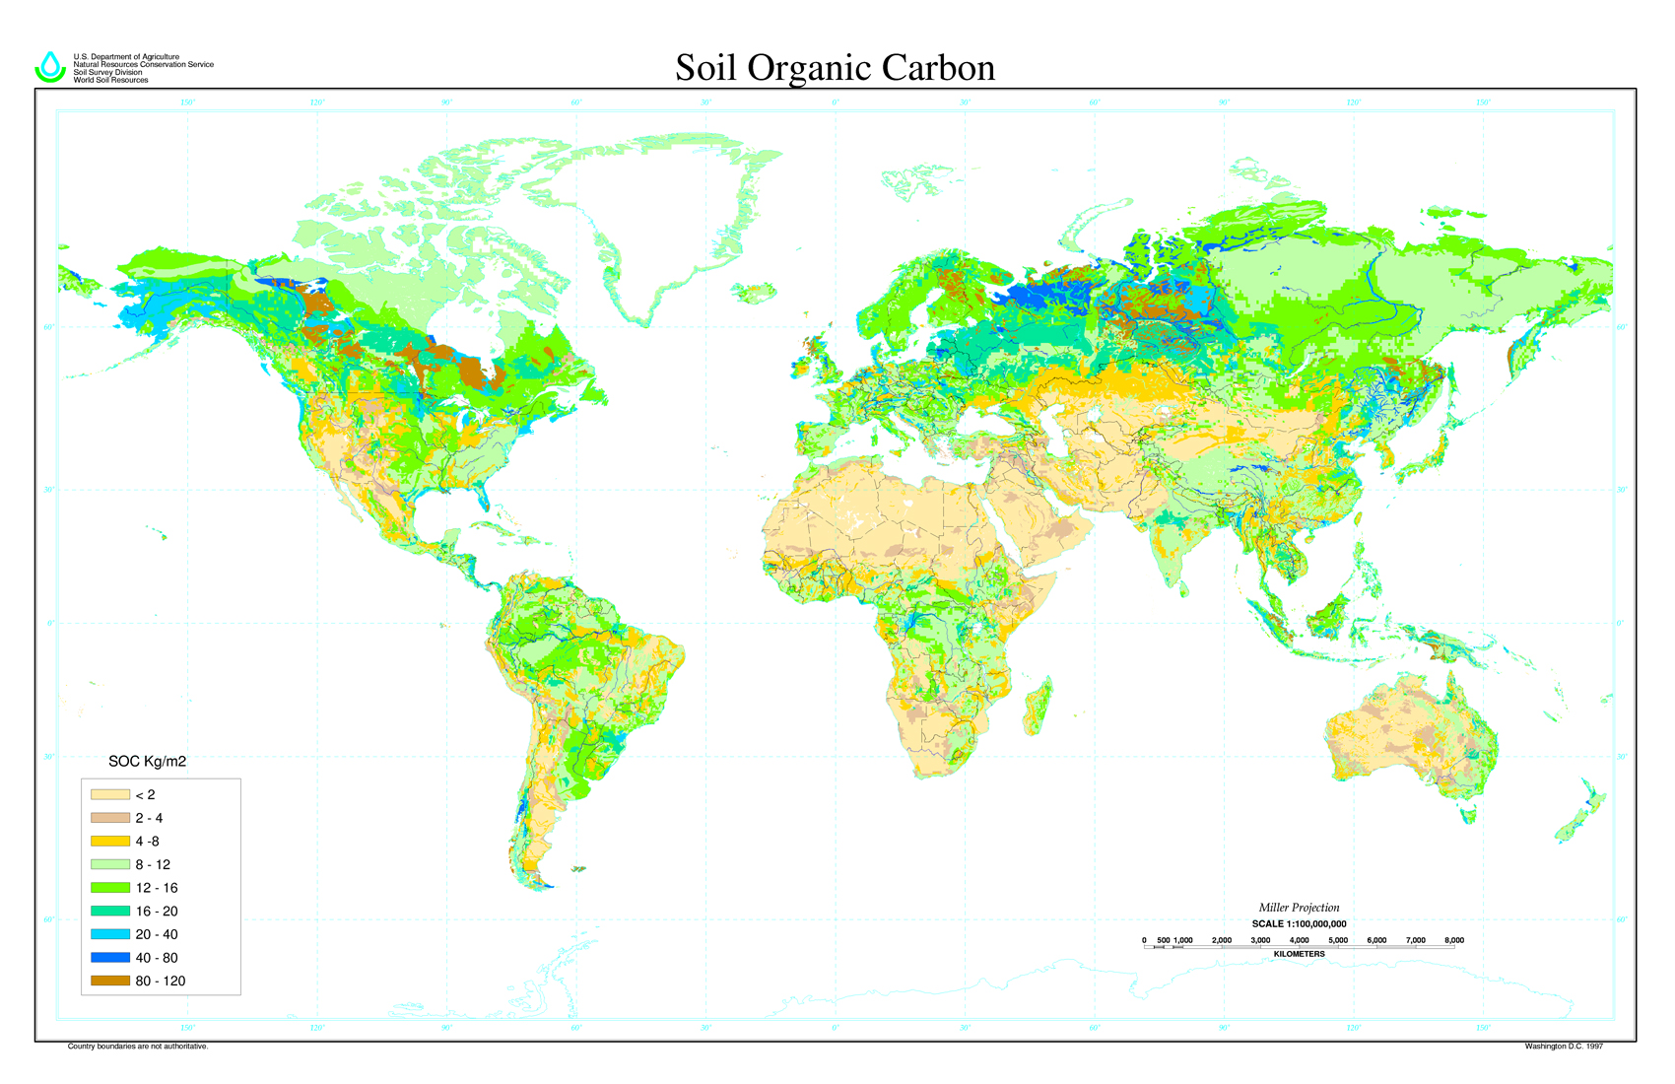

Slide 23
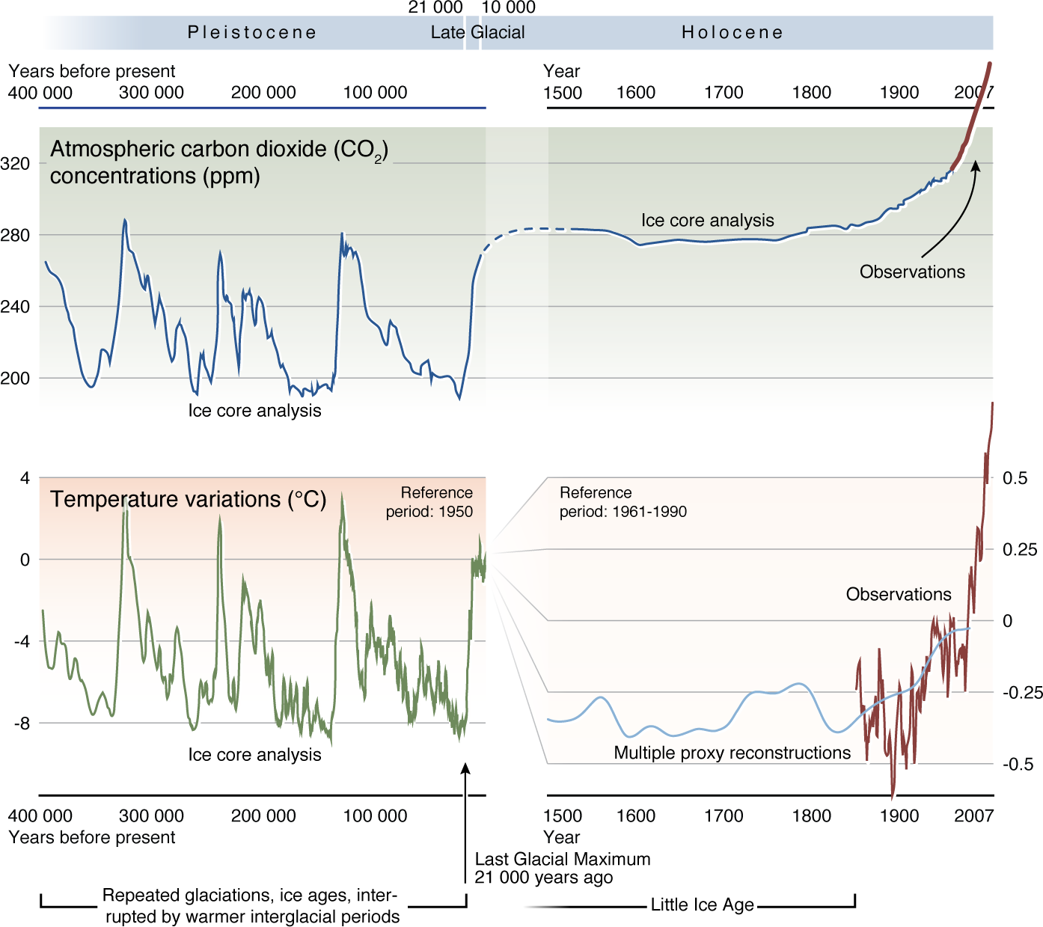
Entering the Anthropocene

Slide 24
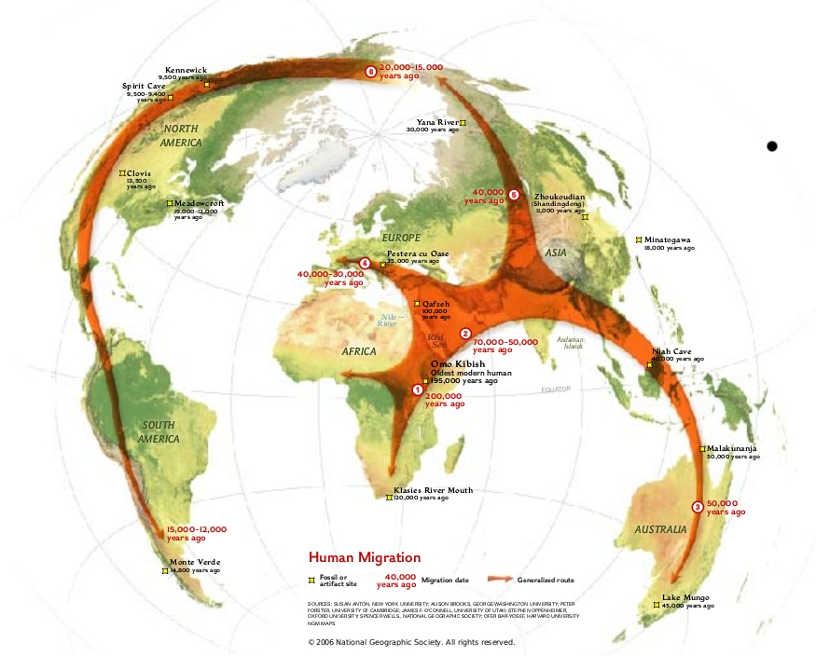
Notes:
Humans began migrating out of Africa ~50kya
At this time, the temperate regions began to open up
Increased T and rainfall (b/c atm holds more water when it is warmer) made temperate regions more habitable
Likely followed game
At end of last ice age, c. 10kya, agriculture began to develop – and we will discuss this further later in the month

Slide 25
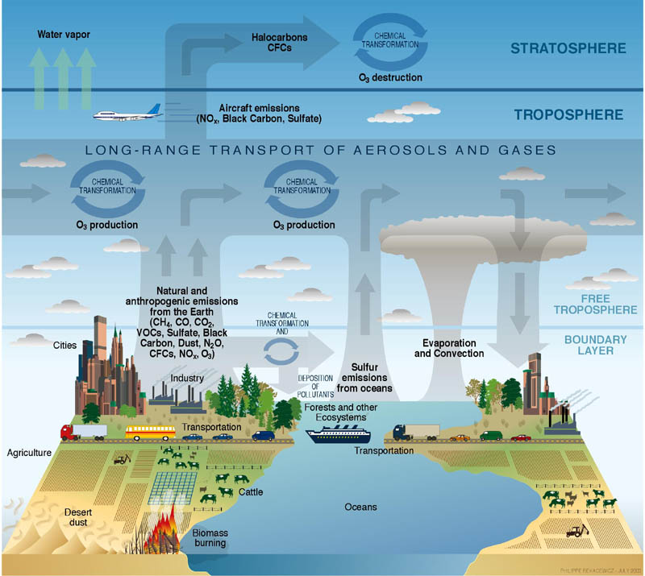
Notes:
Now we have seen how Gaia evolved over the first 4.2 billion years,
For the rest of the semester, we are going to focus on anthropogenic inputs and effects

Slide 26
Pop Quiz
How old is the earth?
In what ways does life affect the physical environment?
In what ways does the physical environment affect life?

Slide 27
Introduction to Google Docs
What are google docs?
  Software that enables online sharing and collaboration
Why?
  Facilitate group work in research
  Efficient feedback for instructor
  Record of the class work
How? (demo)
Notes:
How many people have used google documents?
The goal of using google docs in this class is to help to facilitate
1.

Slide 28
Homework for Tuesday
Create an account in Google Docs
Create a New Document
  Title “firstname lastname overview”
  Write 1 paragraph summary of today’s lecture
  Write 1 paragraph reflection of today’s lecture
  Share with me (dlebauer@gmail.com)
Use google maps to answer questions about the effect of humans on ecosystems where you live
  Google maps
  Form

Slide 29
The End

